Slide 1

US-JAPAN
US-JAPAN
Project CAD Status
R. Norris
Lawrence Berkeley National Laboratory
July, 2025
LBNL, Berkeley, CA

Slide 2
Outline
Basic Dimensions
BNL Usable Aperture
Modifications to Fit BNL Magnet
Lead Exit Modification
Coil Length Modification
Lead Mounting
Tooling Holes
Mounting in BNL Magnet

Slide 3
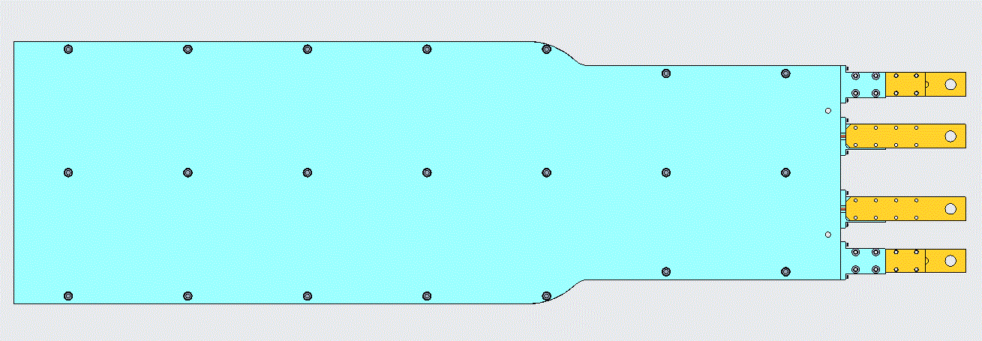
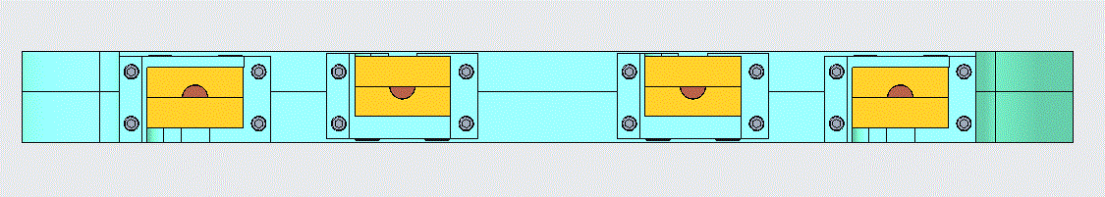
Basic Dimensions
330mm
268.8mm
1037.3mm
157.15mm
29mm

Slide 4
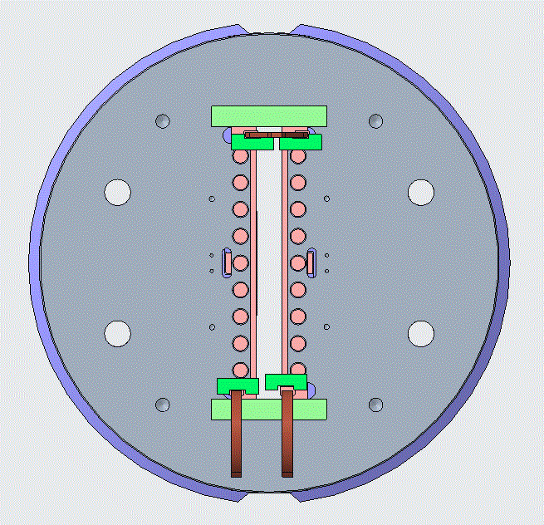
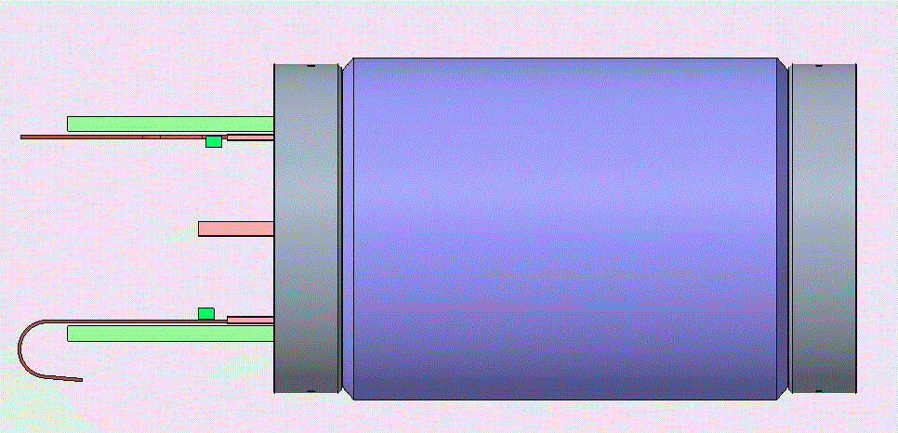
BNL Usable Aperture
Full: 335mm actual
330mm usable
Front Obstructions:
271.78mm
985.774mm
31mm actual
29mm usable

Slide 5
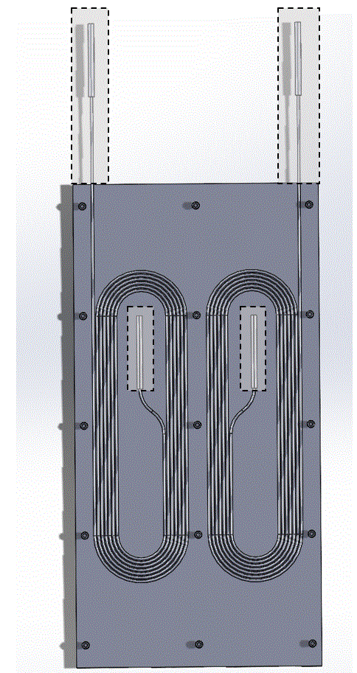
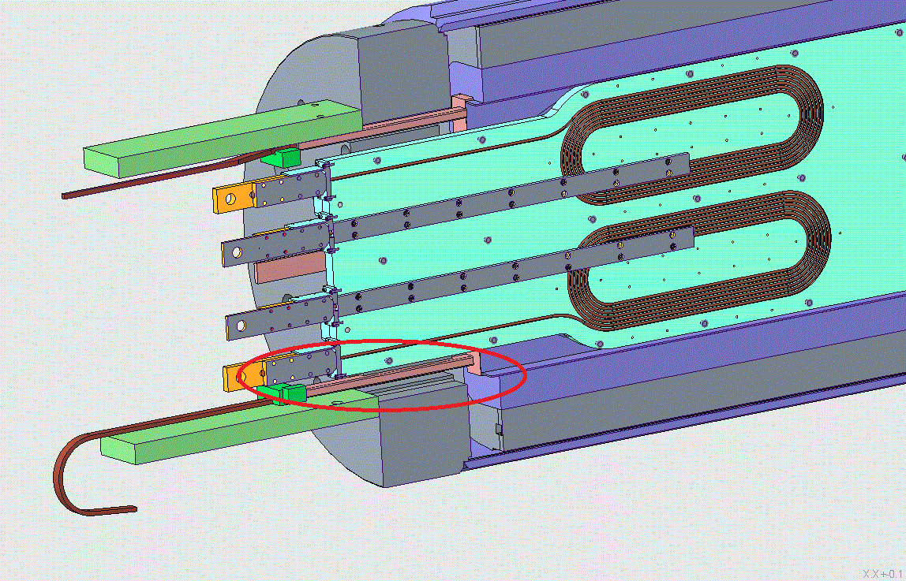
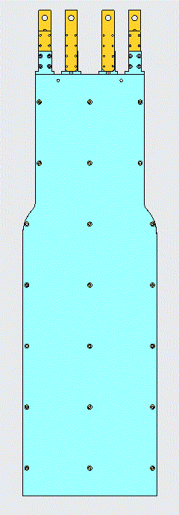
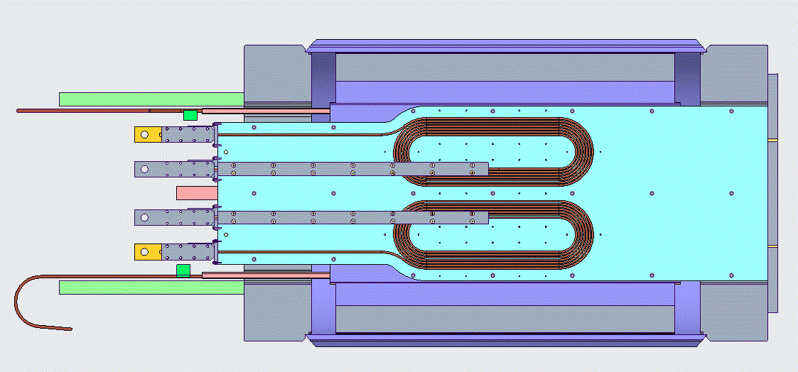
Modifications to Fit BNL Magnet
The coil mandrel assembly required several modifications to simplify mounting in the BNL magnet
The coil was lengthened to extend 50mm beyond the BNL magnet’s length, allowing for surface mounting
The front of the assembly was tapered to avoid interference with the BNL magnet leads
The assembly was modified so that the HTS coils were positioned in the center of the BNL magnet
The mandrel assemblies total thickness was taken down from 30mm to 28.575mm to fit the BNL aperture and so that readily available stock material could be used for mandrel fabrication
Original Plan
Current Design

Slide 6
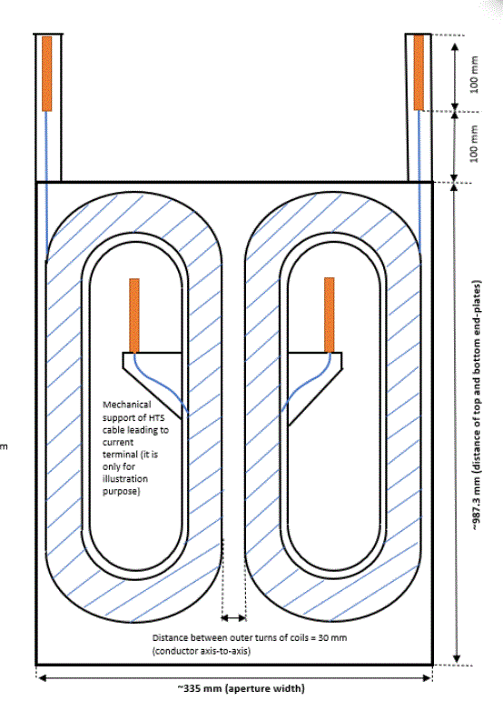
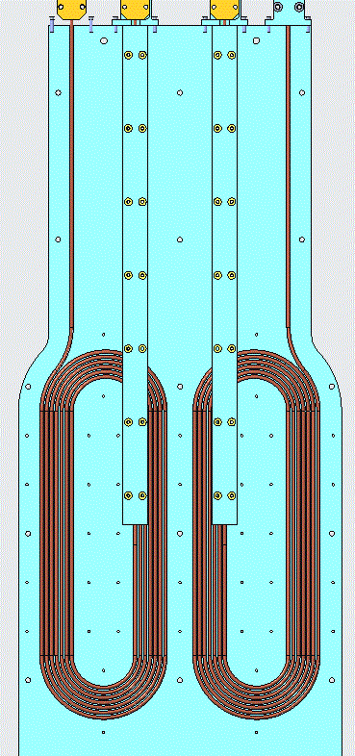
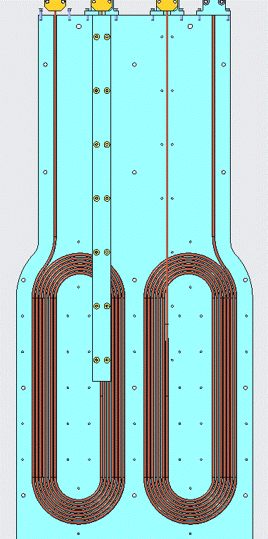
Lead Exit Modification
Original lead exit plan required internal splice blocks
To reduce complexity and mandrel thickness, leads were routed out of coil-plane and taken to the front of the mandrel
This change simplified the mandrel manufacturing, allowed the leads to all be in the same place, and eliminated the need for a complicated electrical isolation scheme
Original Plan
Current Design

Slide 7
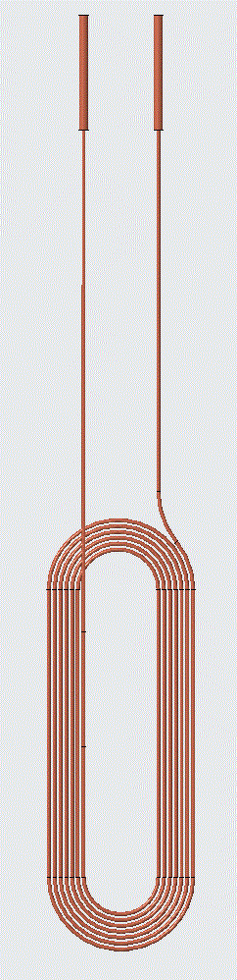
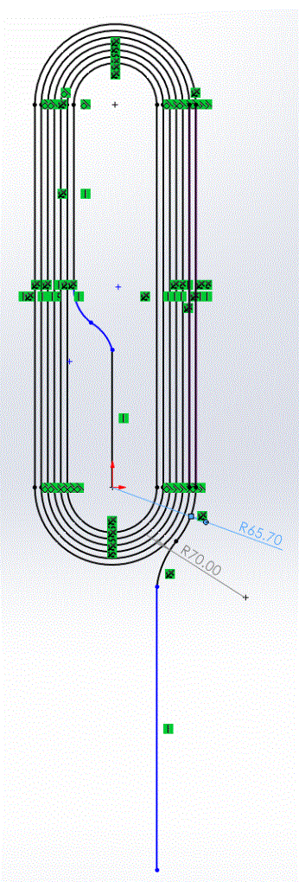
Coil Length Modification
Original coil dimensions had a 30cm straight section
The current design features the same general shape, but the straight section has been reduced to 25cm and the internal lead has been routed out of plane
Original Plan
Current Design

Slide 8
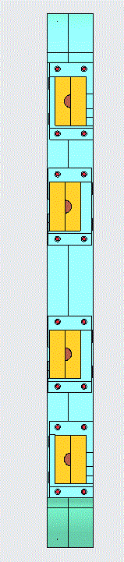
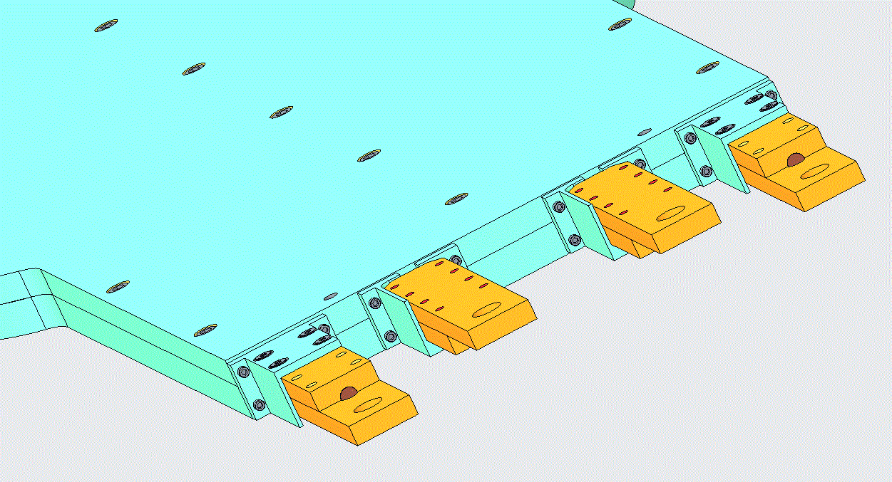
Lead Mounting
The leads are mounted and secured using the planned copper lead blocks
They are secured to the mandrel using G-10 brackets
All leads and lead mounting hardware fit within the edge-on profile to avoid interference with the BNL magnet

Slide 9
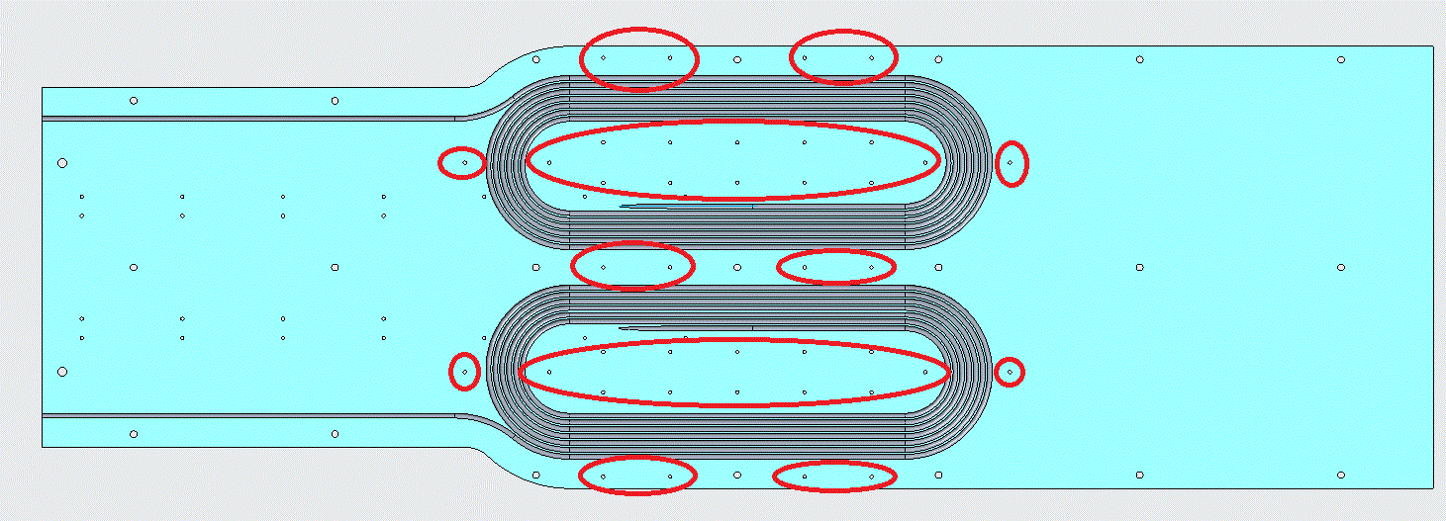
Tooling Holes
A pattern of holes were added to the lower mandrel to accommodate any tooling needed for winding

Slide 10
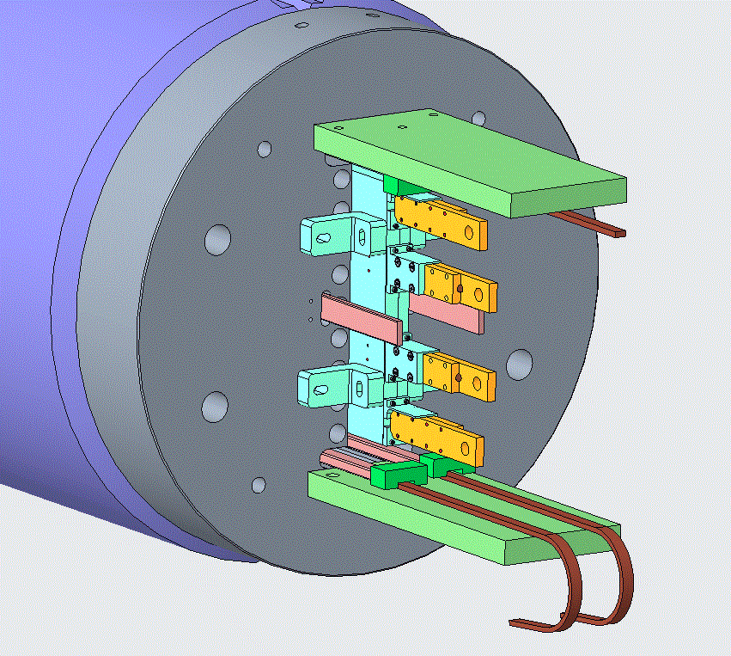
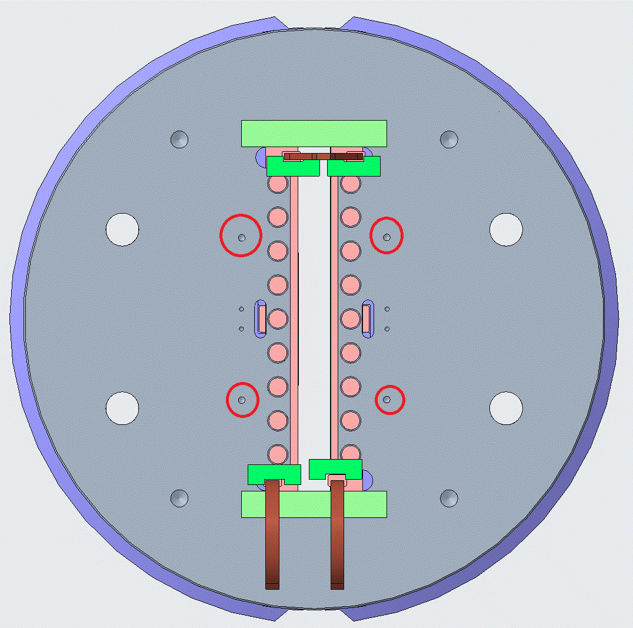
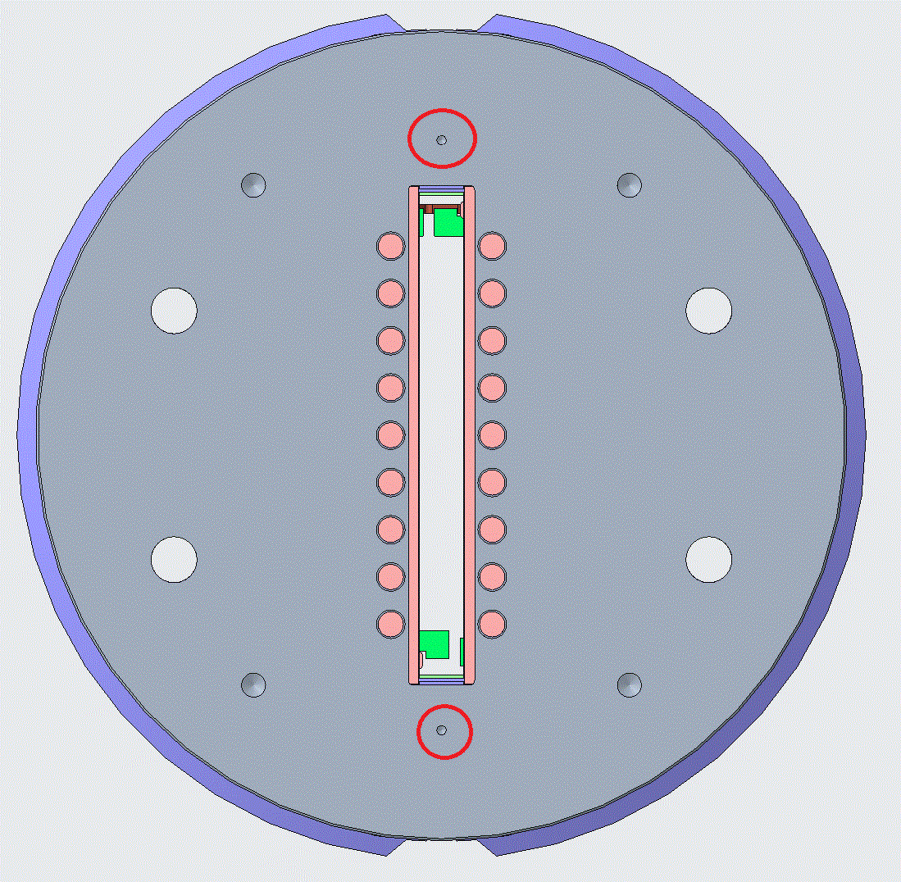
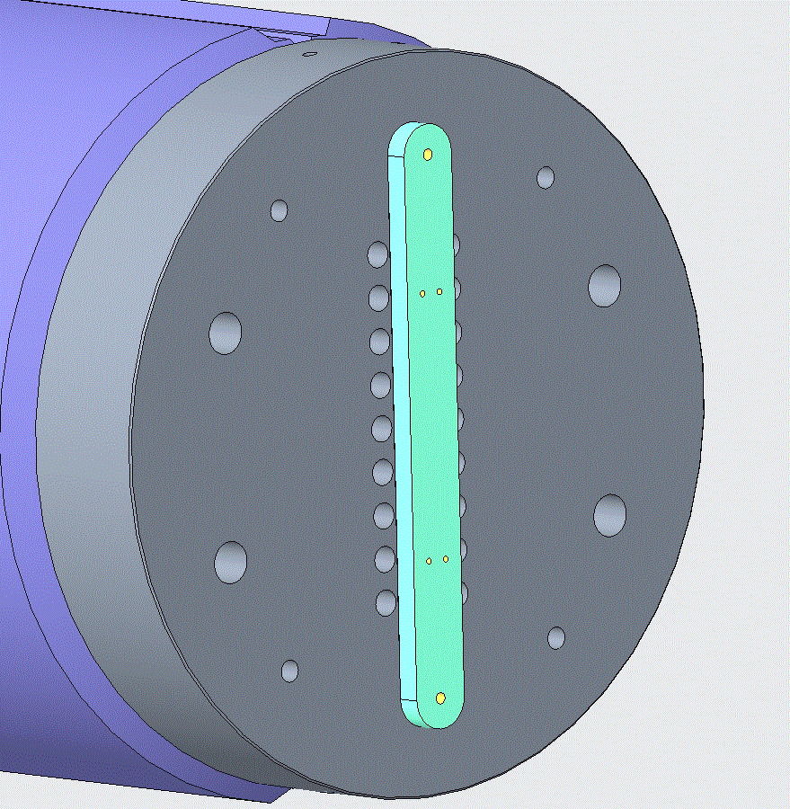
Mounting in BNL Magnet
The coil mounting scheme will use existing 5/16”-18 holes in the front and back of the magnet
All mounting parts will be made of G-10 for electrical isolation
The front mounting will be done with ¾” thick angle brackets that have slots to allow for up/down and left/right adjustability
The rear mounting is accomplished with a ¾” thick plate
The design of the mandrel and the location of the BNL leads will require insertion of the magnet from the rear

