Slide 1
MDP Area I Hybrid Magnet Meeting
P. Ferracin
August 12th, 2025

Slide 2
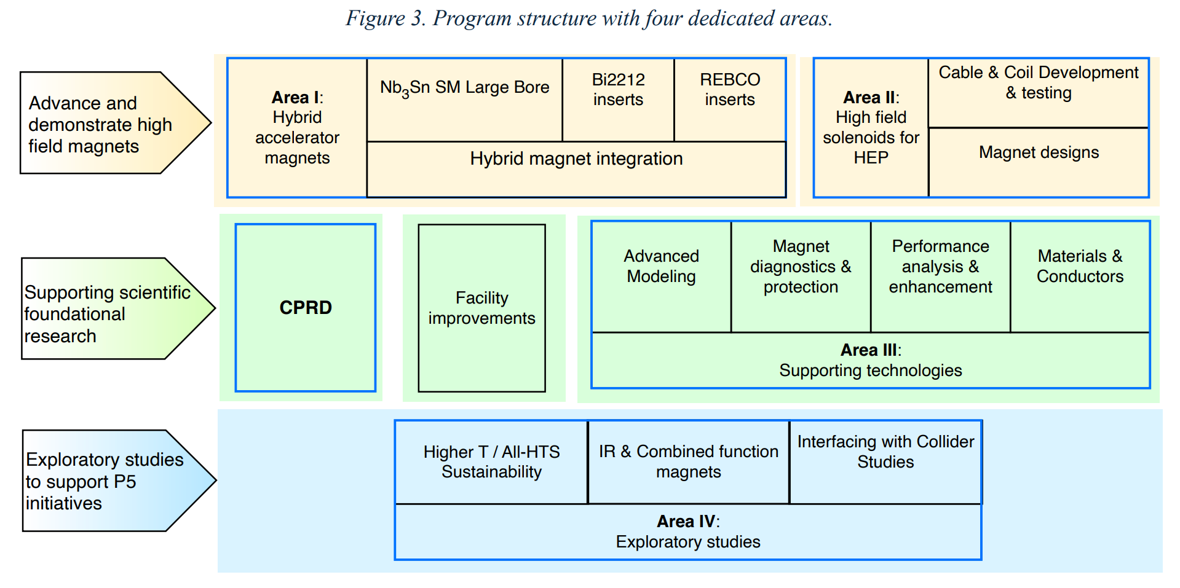
US MDP structure
From 2025 update road-map

Slide 3
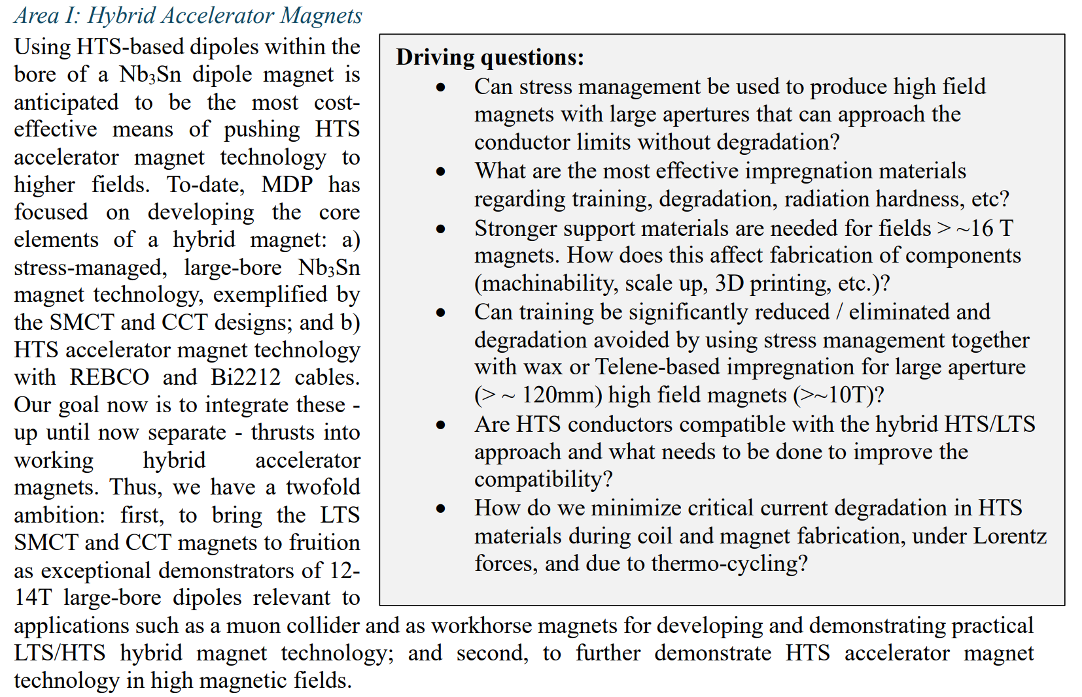
Area I description

Slide 4
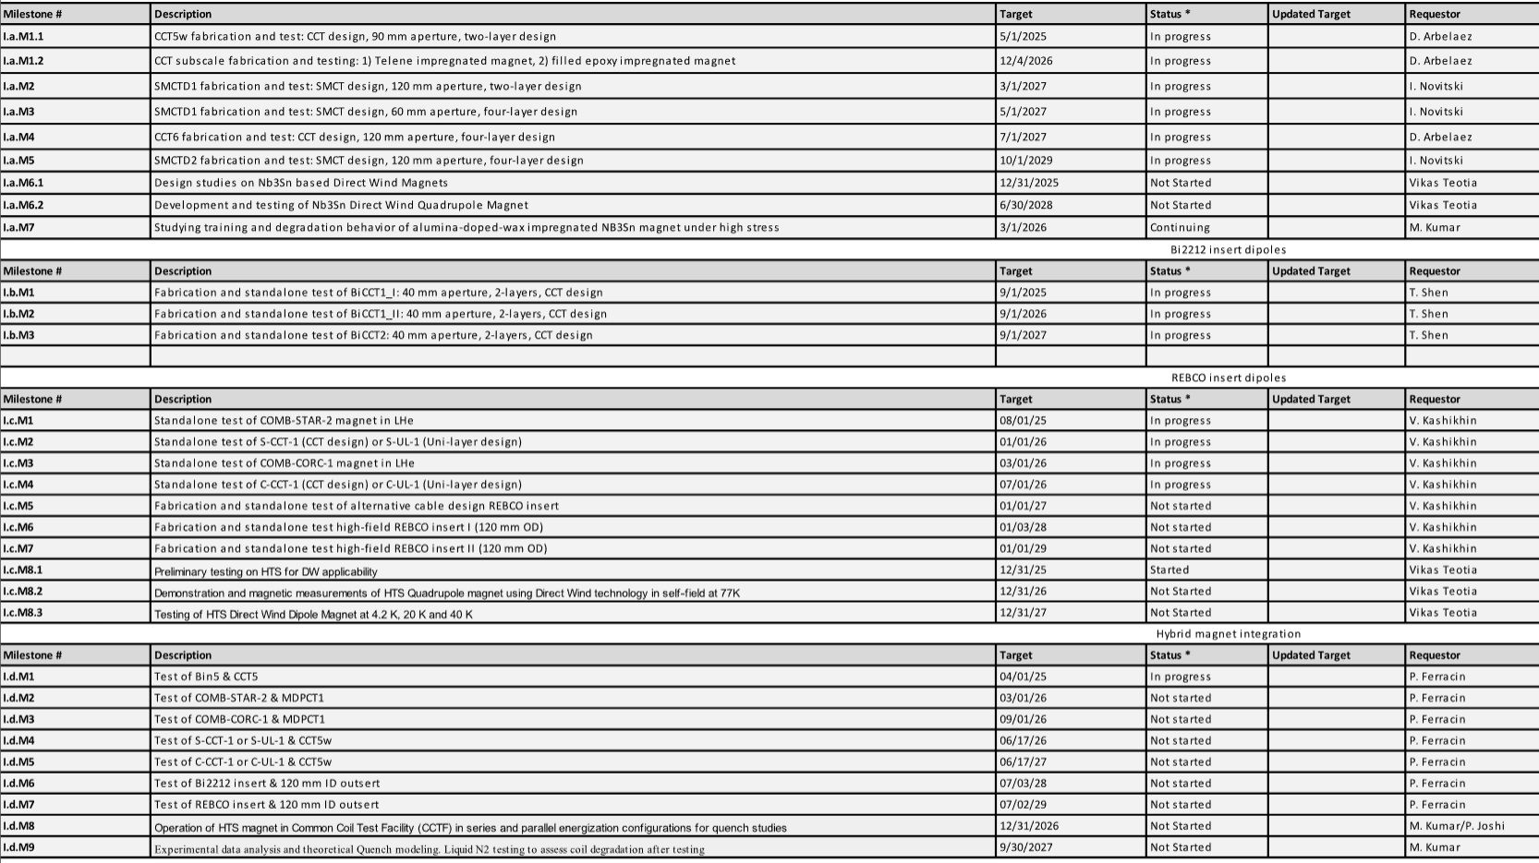
Milestones
Nb₃Sn
Bi2212
REBCO
Hybrid

Slide 5
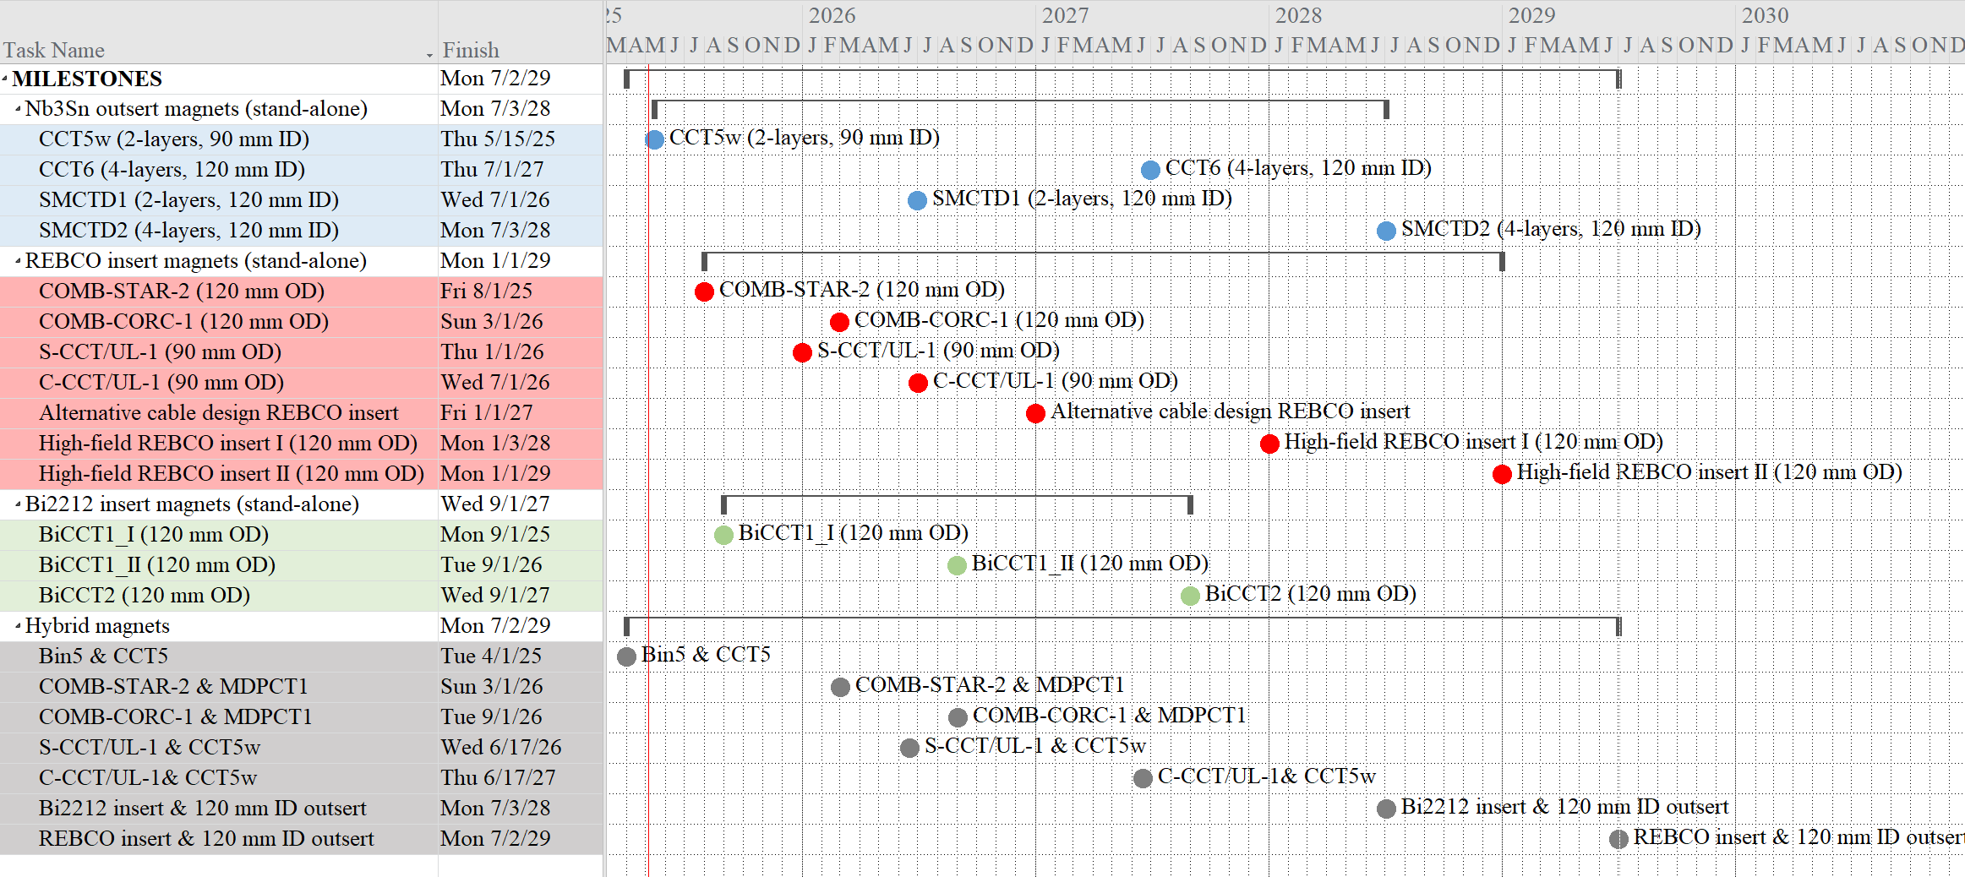
Milestones (May 2025)

Slide 6
Milestones
Nb₃Sn
Bi2212
REBCO
Hybrid

Slide 7
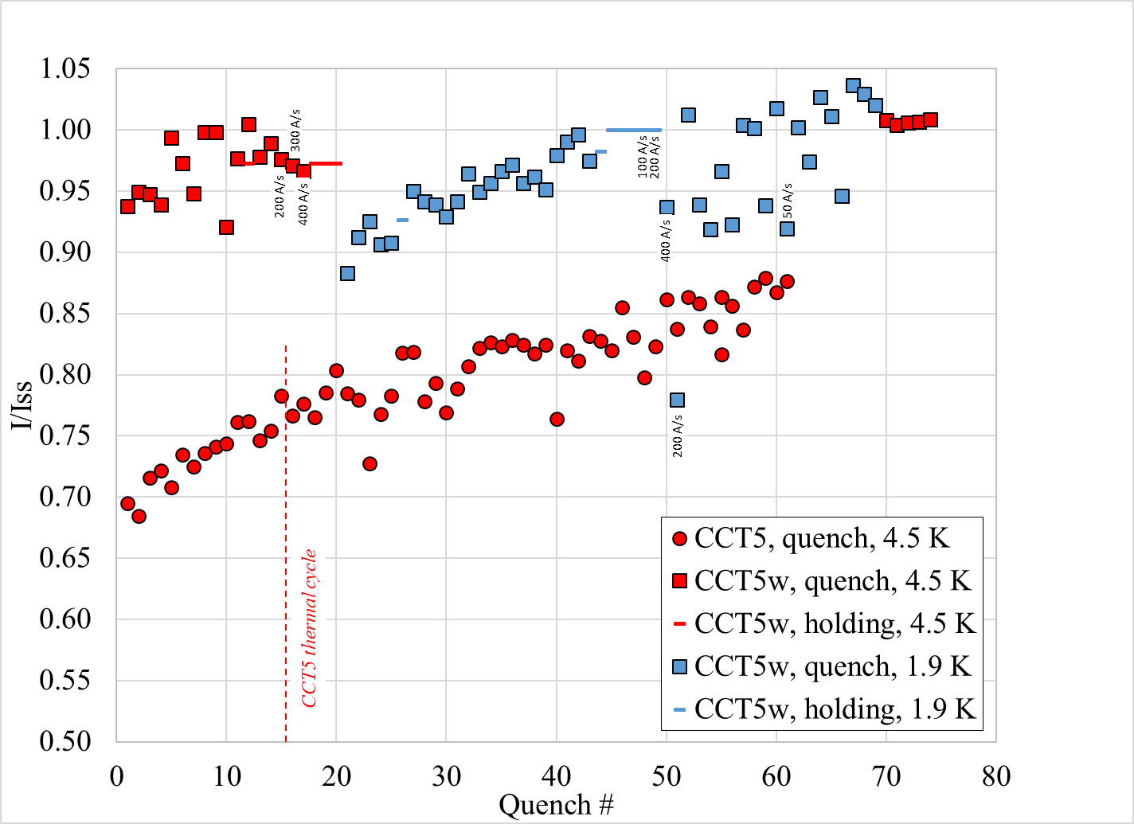
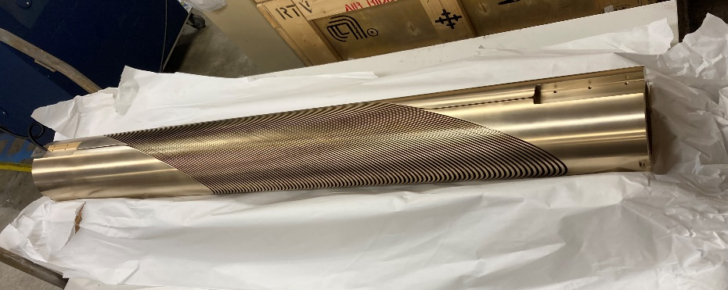
Nb₃Sn outserts
CCT5w (2-layers, 90 mm ID)
  Target date: June 2025
    Done! Test on going (thermal cycle)
CCT6 (4-layers, 120 mm ID)
  Target date: July 2027
    Layer 1 mandrel fabrication completed
      Ready to start winding
    Next step: Layer 2 mandrel fabrication

Slide 8
Nb₃Sn outserts
SMCTD1 (2-layers, 120 mm ID)
  Target date: March 2027
    Second coil mandrel fabricated
    Ultem printed part fabricated for a practice coil with Telene impregnation
      Winding in the summer 2025 and then impregnation with Telene
      Then, real coil to complete the magnet
      Thicker SS shell and end-plates under procurement for the support structure
SMCTD2 (4-layers, 120 mm ID)
  Target date: October 2029
    New cable for new inner layer coils to be fabricated
    3D coil design on going

Slide 9
Milestones
Nb₃Sn
Bi2212
REBCO
Hybrid

Slide 10
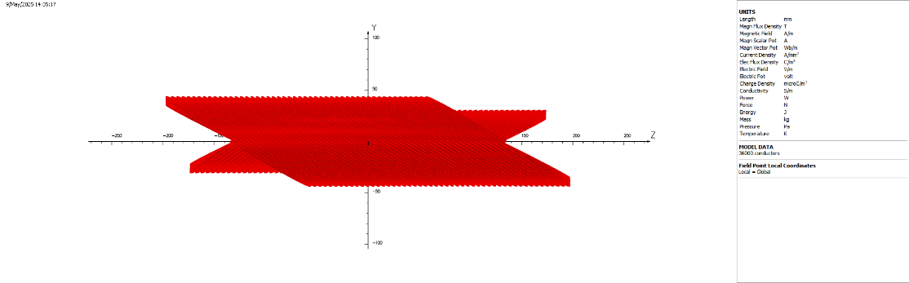
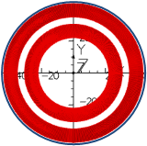
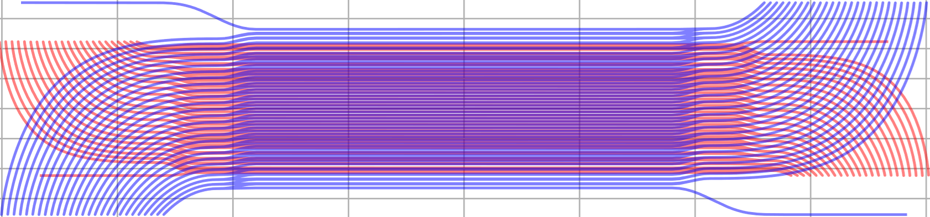
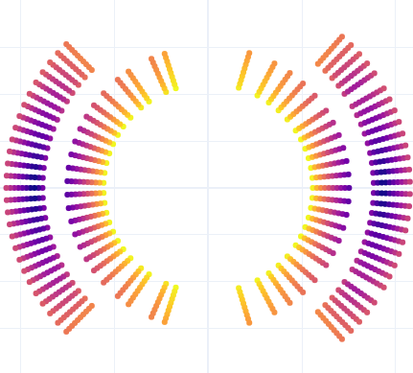
Bi2212 inserts
BiCCT1_I (120 mm OD)
  Target date: September 2025 → March 2026
    Non compatible with hybrid testing, so to be tested alone
    Renegade furnace operational
      Reaction of solenoid and ARDAP Bin5 on going/to be done
BiCCT1_II/BiUL1 (90 mm OD)
  Target date: September 2026
    Design compatible with 90 mm aperture (CCT5w) and DelTech furnace
BiCCT2/BiUL2 (120 mm OD)
  Target date: September 2027

Slide 11
Milestones
Nb₃Sn
Bi2212
REBCO
Hybrid

Slide 12
REBCO inserts
COMB-STAR-2 (120 mm OD)
  Target date: December 2025
    6 layers design
    Half of the conductor delivered
    Winding to start possibly in October
COMB-CORC-1 (120 mm OD)
  Target date: July 2026
    Conductor available

Slide 13
REBCO inserts
S-CCT/UL-1 (90 mm OD)
  Target date: January 2026 → March 2026
    All STAR wire available
C-CCT/UL-1 (90 mm OD)
  Target date: July 2026 → September 2026
    49 m cable delivered
Alternative cable design REBCO insert
  Target date: January 2027
    Rutherford-type cable (VK)
      Conductor received (SBIR)
    Stack-tape (XW, RT, LB, JLRF, GV)
      Several coil designs considered (CCT, UL, Block…)
High-field REBCO insert I (120 mm OD)
  Target date: January 2028
High-field REBCO insert II (120 mm OD)
  Target date: January 2029

Slide 14
Milestones
Nb₃Sn
Bi2212
REBCO
Hybrid

Slide 15
LTS/HTS Hybrid magnets
Bin5 & CCT5
  Target date: December 2025
COMB-STAR-2 & MDPCT1
  Target date: August 2026
    Outer layer from 15 T magnet, with insert in series
    New structure is needed
COMB-CORC-1 & MDPCT1
  Target date: February 2027
S-CCT/UL-1 & CCT5w
  Target date: June 2026 → September 2026
C-CCT/UL-1& CCT5w
  Target date: June 2027
Bi2212 insert & 120 mm ID outsert
  Target date: July 2028
REBCO insert & 120 mm ID outsert
  Target date: July 2029

Slide 16
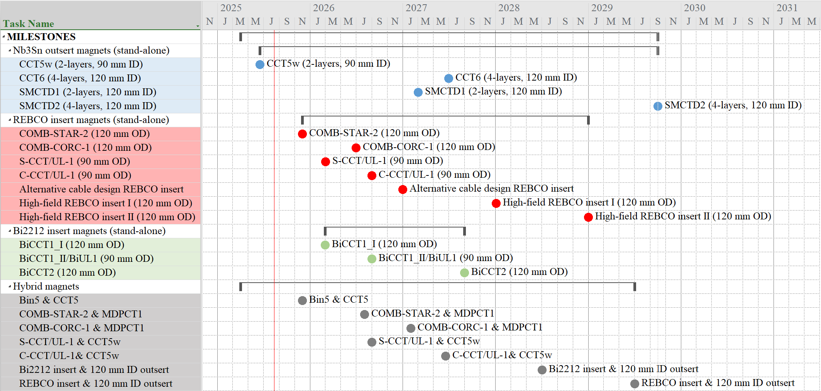
Milestones (August 2025)

Slide 17
Milestones
Nb₃Sn
Bi2212
REBCO
Hybrid

Slide 18
Other activities
CCT subscale fabrication and testing:
  Telene impregnated sub-scale magnet
    Test coil delivered to FNAL
    IL wound and react
    OL ready for reaction
  Filled epoxy impregnated magnet
    Coil to be fabricated
SMCTD1 fabrication and test
  SMCT design, 60 mm aperture, four-layer design

Slide 19
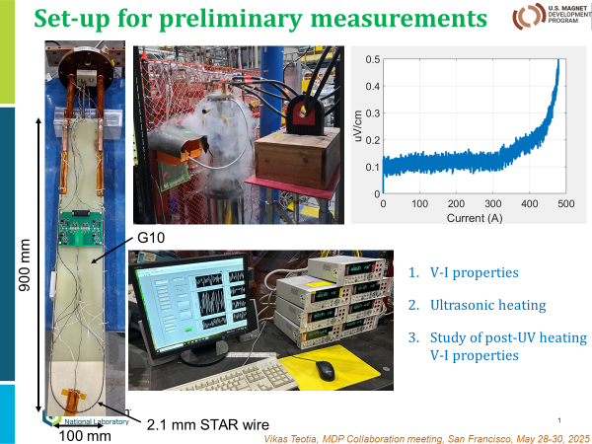
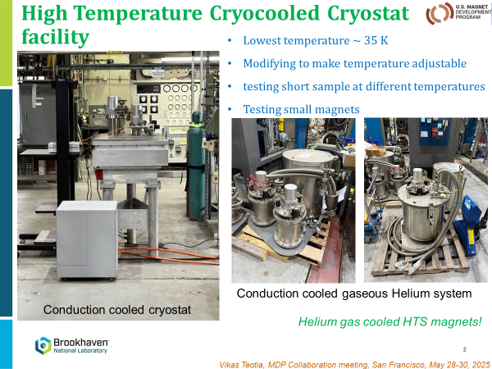
Other activities
Design studies on Nb₃Sn based Direct Wind Magnets
Development and testing of Nb₃Sn Direct Wind Quadrupole Magnet
Preliminary testing on HTS for DW applicability
Demonstration and magnetic measurements of HTS Quadrupole magnet using Direct Wind technology in self-field at 77K
Testing of HTS Direct Wind Dipole Magnet at 4.2 K, 20 K and 40 K

Slide 20
Other activities
Studying training and degradation behavior of alumina-doped-wax impregnated Nb₃Sn magnet under high stress
  Work to be started soon
Operation of HTS magnet in Common Coil Test Facility (CCTF) in series and parallel energization configurations for quench studies
  Work to be started soon
Experimental data analysis and theoretical Quench modeling. Liquid N2 testing to assess coil degradation after testing
  Work in progress

Slide 21
Appendix

