Slide 1
Upcoming DEI events.
Part of NSD's events-lists going forward.
Lambda Alliance Coffee Hour
Tuesday, December 10, 2019, 2:00, B54 Cafeteria
IDEA Brown Bag for Staff & Supervisors*
Chief Diversity, Equity & Inclusion Officer Lady Idos will lead an IDEA Brown Bag session for staff & supervisors. This is a safe place to bring questions and feedback on IDEA at the Lab and how you can help shape the conversation. No reservations are required.
Tuesday, December 17, 2019, 12:00, 50B-4205
https://lbnl.zoom.us/j/972146371
Women in Science Speaker Series
Nicola Spaldin, Professor of Materials Theory at ETH Zurich
Known for her pioneering research on multiferroics
Thursday, December 19, 2019, 10:00, 50 Auditorium

Slide 2
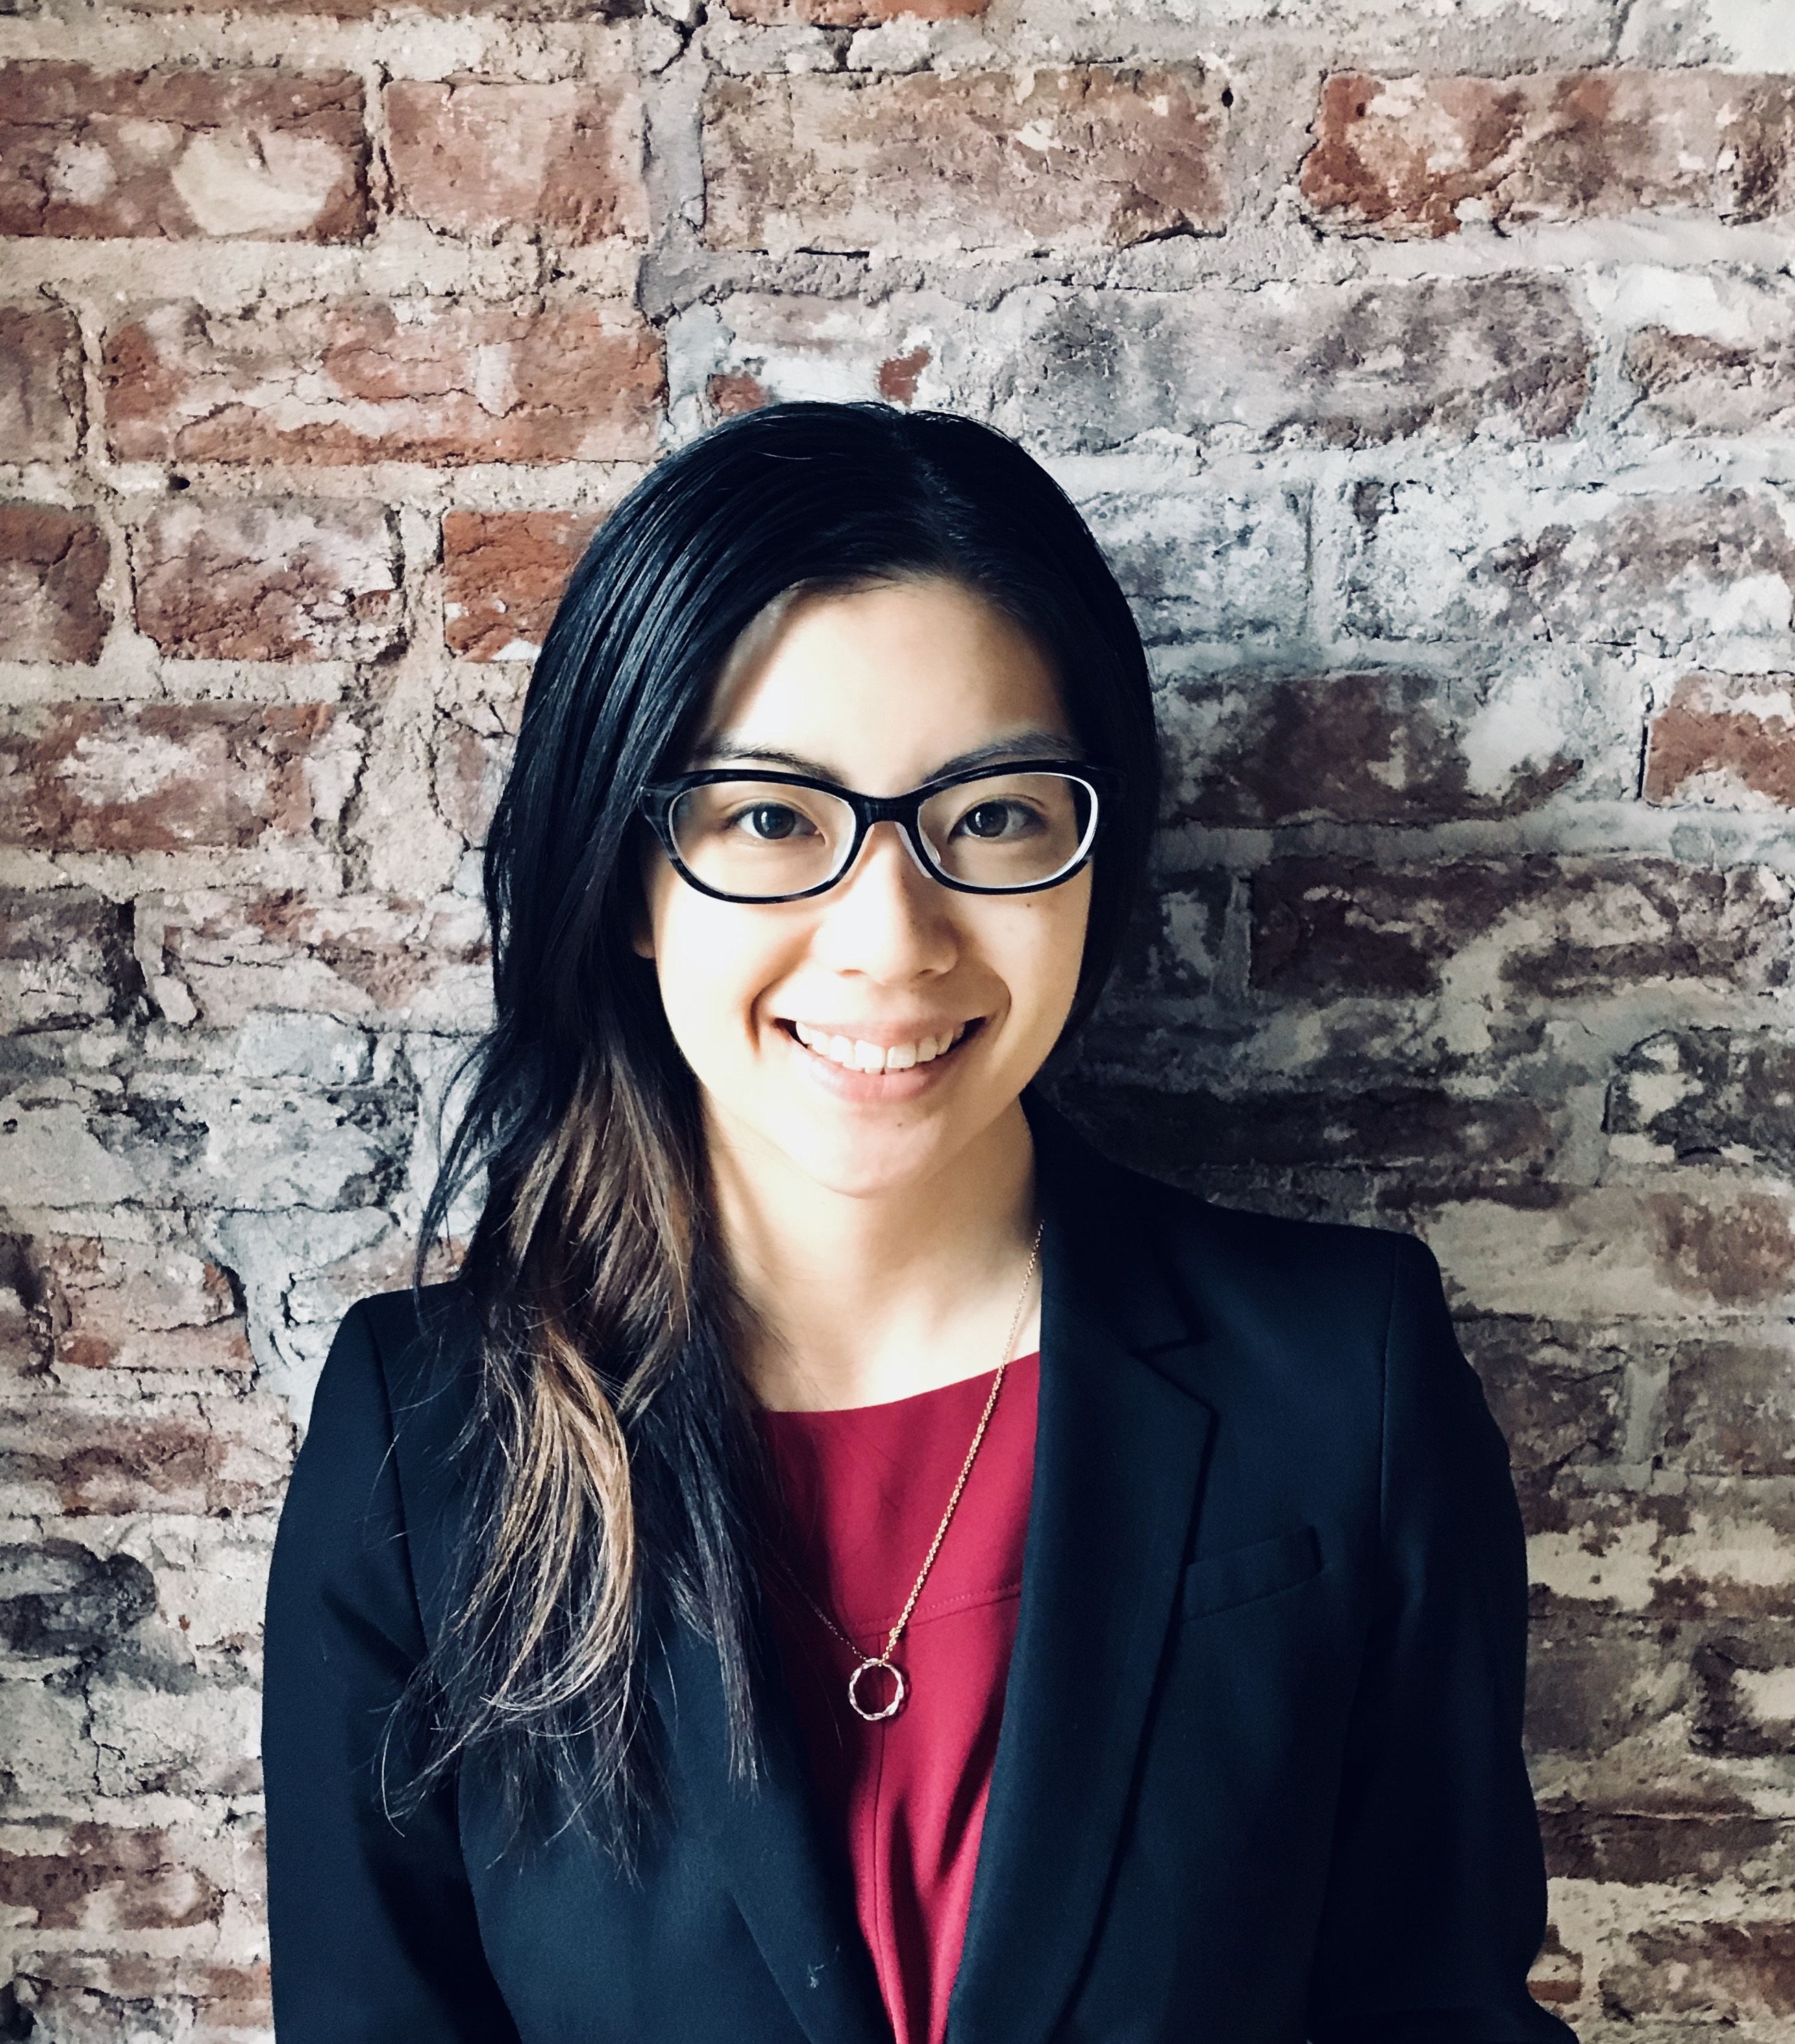
Special Thanks to Erika Suzuki!
Erika will be cycling off from the NSD DEI Council, which she has chaired since its inception.

Slide 3
Call for volunteers!
?
With Erika’s departure comes a vacancy on the NSD DEI Council, as a member or chair. If you are interested in working with the council, please contact either Tom Gallant or Ernst Sichtermann.

