Slide 1


Efficient optimization of expensive black-box simulators via marginal means, with application to neutrino detector design
Simon Mak
Department of Statistical Science
Duke University
BUQ meeting

Slide 2
Neutrino detector optimization
Ann-Kathrin’s slides

Slide 3

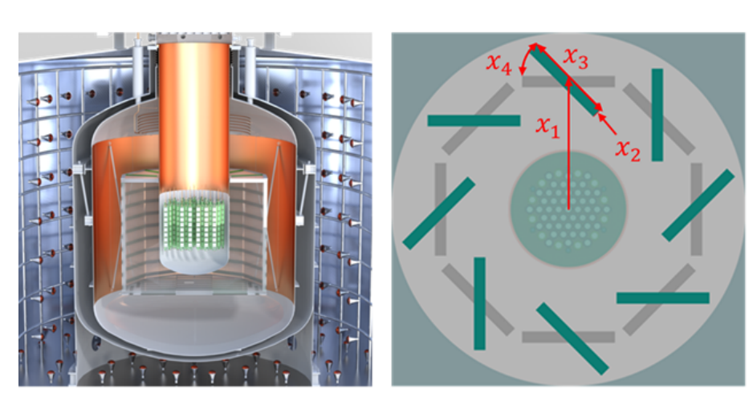
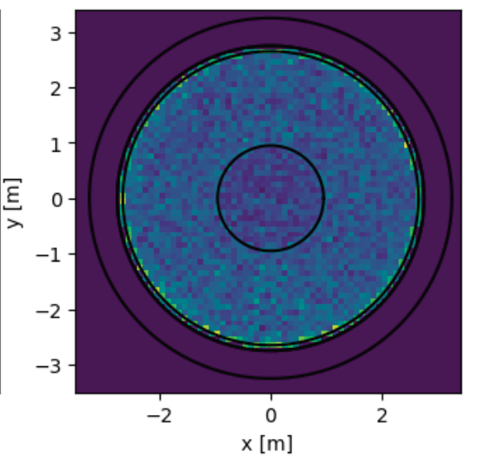
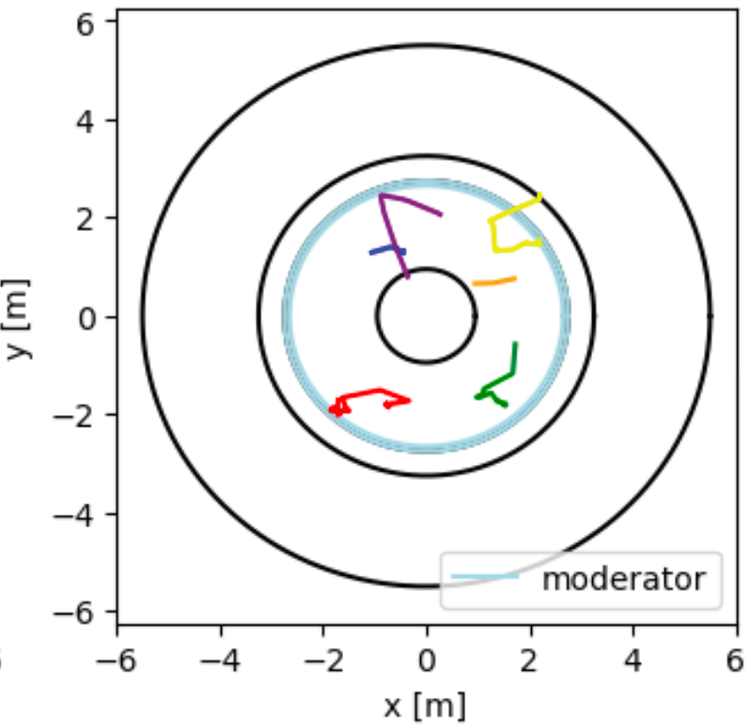
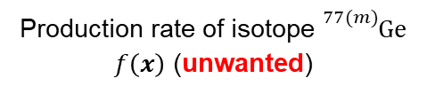

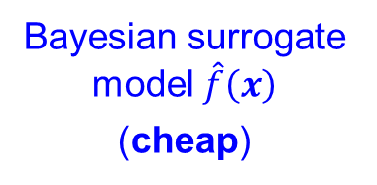

Neutrino detector optimization
Challenge: Simulation runs are highly expensive, $𝒪({10}^{2})$ CPU hours / design
Design inputs $x$
Detector simulation (expensive)
Optimization
$$x^{∗}=arg\min_{x}{f(x)}$$
Bayesian optimization
Bayesian surrogate model $\hat{f}\left(x\right)$
(cheap)
Jones et al. (1997)
Frazier et al. (2008)
Chen et al. (2024 JASA)
Liu & Mak (2025+ JCGS)
Production rate of isotope ${}_{}^{77(m)}{Ge}$ $f\left(x\right)$ (unwanted)
Ji et al. (2023 Tech, 2024 JUQ), Li et al. (2024 AISTAT, 2025 JASA, 2025 JCGS)

Slide 4
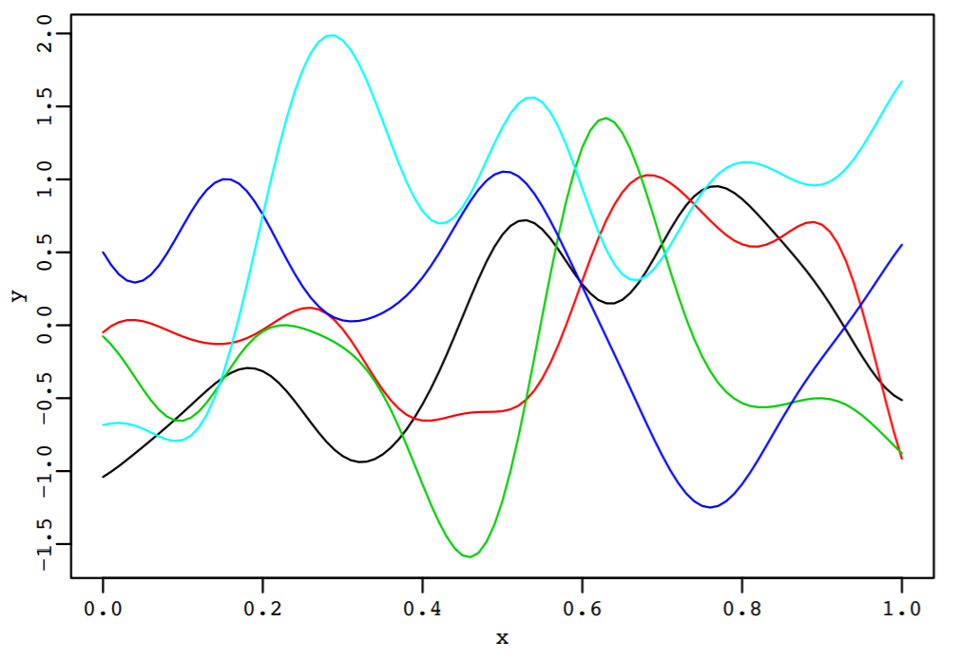
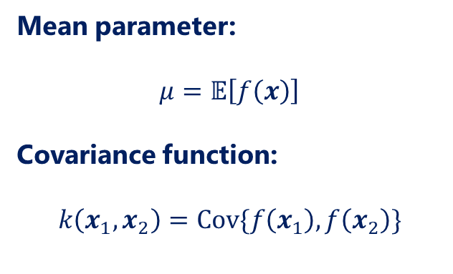

Surrogate model
Gaussian process (GP) model (Rasmussen & Williams 2006, Gramacy 2020):
  $$f\left(⋅\right)∼GP\left(μ,k\left(⋅,⋅\right)\right)$$
Mean parameter:
$$μ=𝔼\left[f\left(x\right)\right]$$
Covariance function:
$$k\left(x_{1},x_{2}\right)=Cov\{f\left(x_{1}\right),f\left(x_{2}\right)\}$$
Flexible Bayesian nonparametric model for predictive modeling

Slide 5
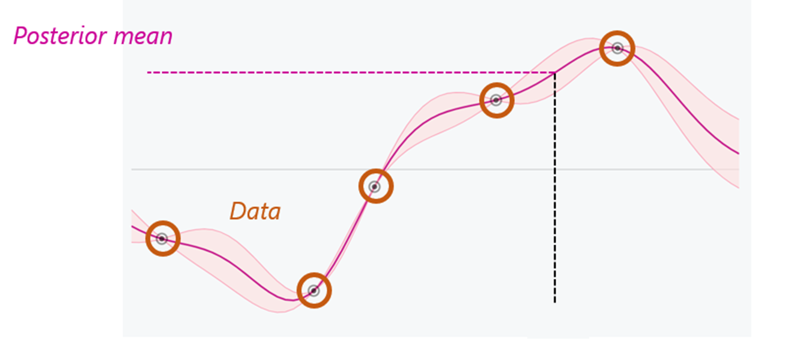




Surrogate model
$$\hat{f}\left(x_{new}\right)$$
$$f(x)$$
$$x_{new}$$
Closed-form posterior mean:
$$\hat{f}\left(x_{new}\right)=𝔼\left[f\left(x_{new}\right)|data\right]=μ+k_{new}K^{−1}(y−μ1)$$

Slide 6
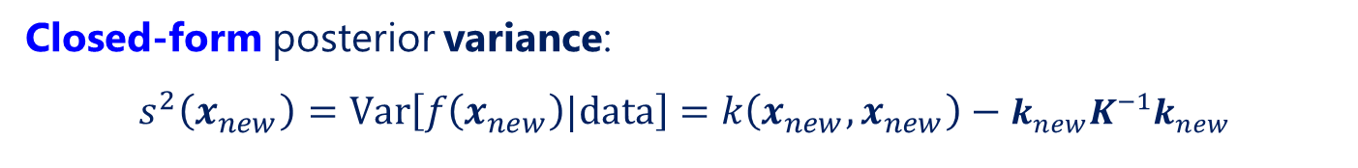

Surrogate model
$$\hat{f}\left(x_{new}\right)$$
Posterior st. dev.
$$f(x)$$
$$s\left(x_{new}\right)$$
$$x_{new}$$
Closed-form posterior variance:
$$s^{2}\left(x_{new}\right)=Var\left[f\left(x_{new}\right)|data\right]=k\left(x_{new},x_{new}\right)−k_{new}K^{−1}k_{new}$$

Slide 7
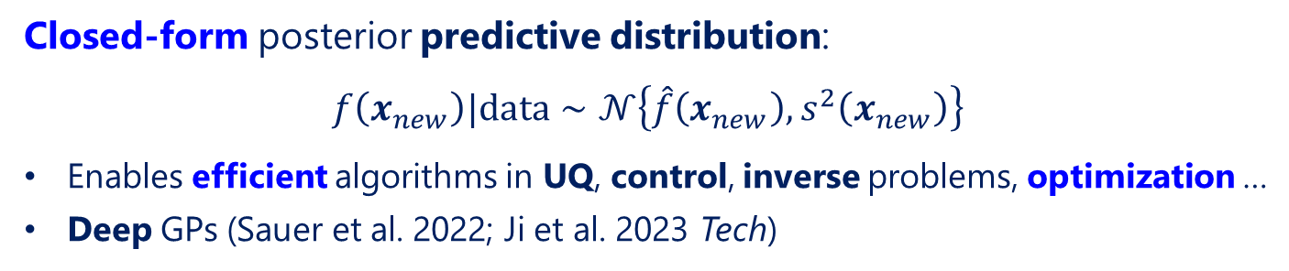
Surrogate model
$$\hat{f}\left(x_{new}\right)$$
Posterior st. dev.
$$f(x)$$
$$s\left(x_{new}\right)$$
$$x_{new}$$
Closed-form posterior predictive distribution:
$$f\left(x_{new}\right)|data∼𝒩\left\{\hat{f}\left(x_{new}\right),s^{2}\left(x_{new}\right)\right\}$$
Enables efficient algorithms in UQ, control, inverse problems, optimization …
Deep GPs (Sauer et al. 2022; Ji et al. 2023 Tech)

Slide 8
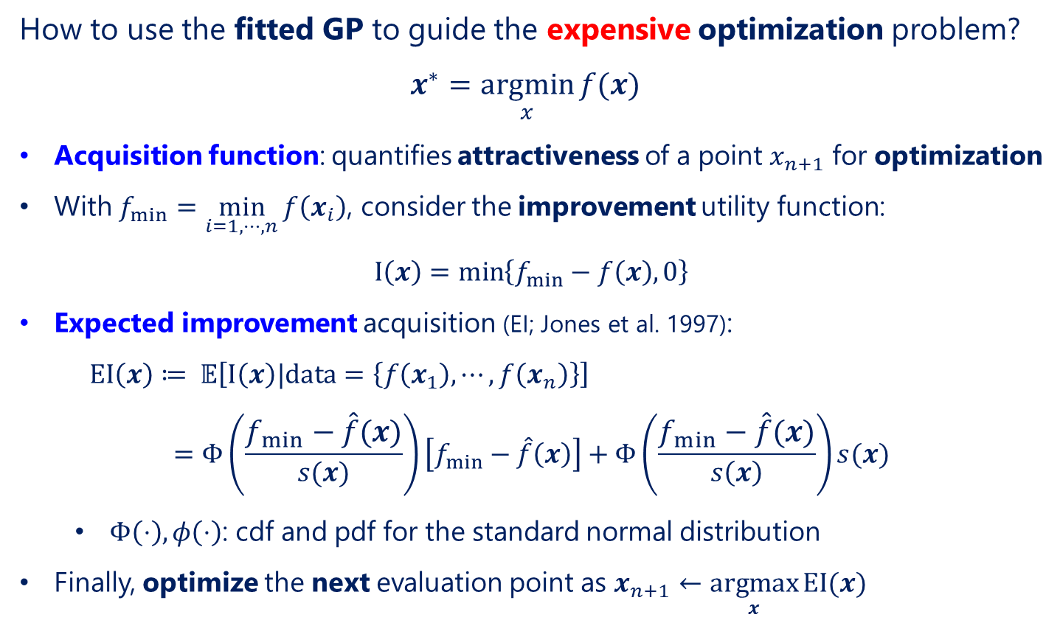
Bayesian optimization
How to use the fitted GP to guide the expensive optimization problem?
$$x^{∗}=\underset{x}{argmin}{f(x)}⁡$$
Acquisition function: quantifies attractiveness of a point $x_{n+1}$ for optimization
With $f_{min}=\min_{i=1, ⋯, n}{f\left(x_{i}\right)}$, consider the improvement utility function:
$$I\left(x\right)=\min\left\{f_{min}−f\left(x\right), 0\right\}$$
Expected improvement acquisition (EI; Jones et al. 1997):
$EI\left(x\right)≔ 𝔼\left[I\left(x\right)|data=\left\{f\left(x_{1}\right), ⋯, f\left(x_{n}\right)\right\}\right]$
$$=Φ\left(\frac{f_{min}−\hat{f}\left(x\right)}{s(x)}\right)\left[f_{min}−\hat{f}\left(x\right)\right]+Φ\left(\frac{f_{min}−\hat{f}\left(x\right)}{s\left(x\right)}\right)s(x)$$
  $Φ\left(⋅\right), φ\left(⋅\right)$: cdf and pdf for the standard normal distribution
Finally, optimize the next evaluation point as $x_{n+1}←\underset{x}{argmax}{EI(x)}$

Slide 9
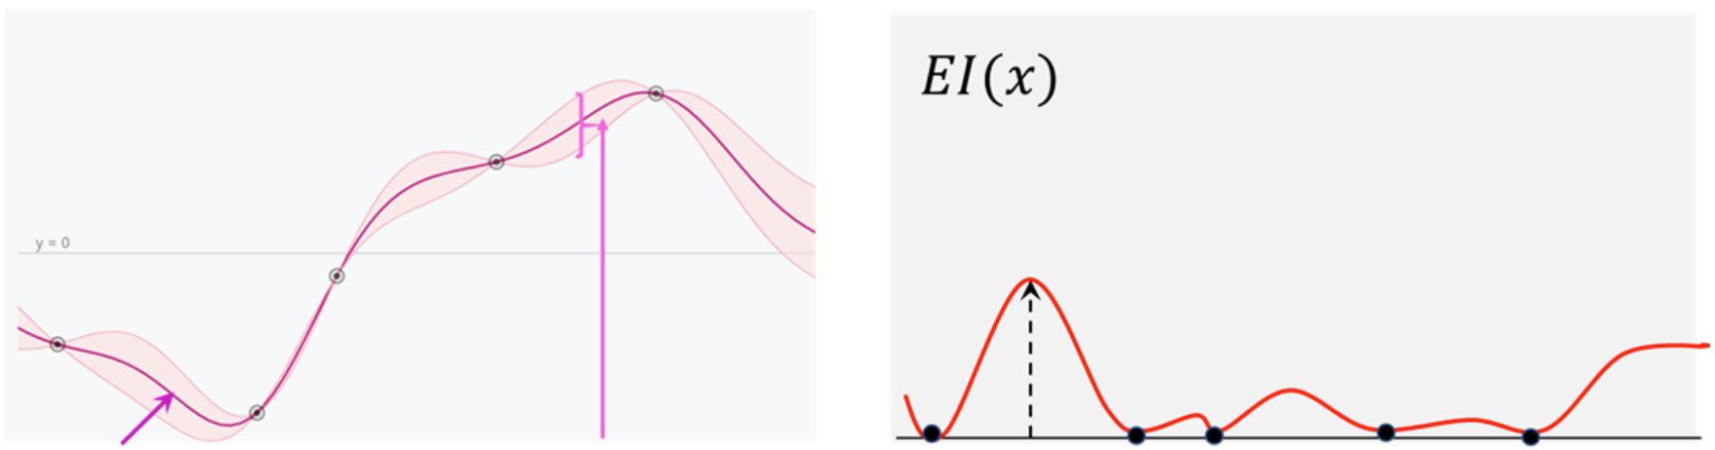

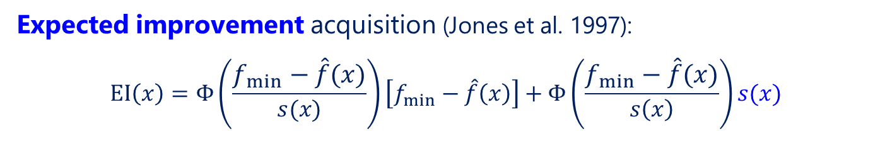

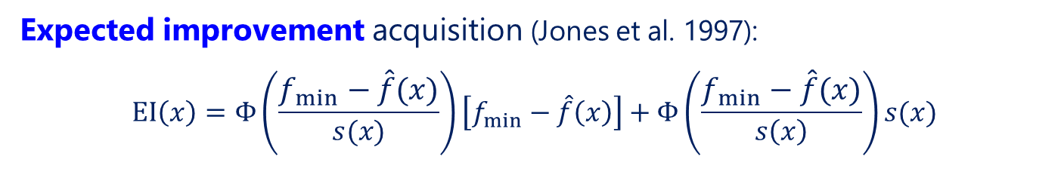
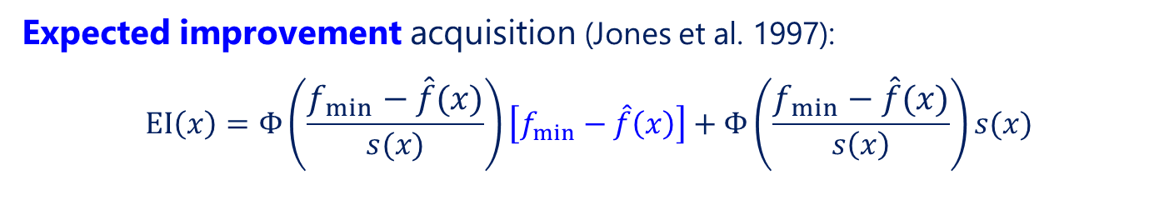

Bayesian optimization
Expected improvement acquisition (Jones et al. 1997):
$$EI\left(x\right)=Φ\left(\frac{f_{min}−\hat{f}\left(x\right)}{s(x)}\right)\left[f_{min}−\hat{f}\left(x\right)\right]+Φ\left(\frac{f_{min}−\hat{f}\left(x\right)}{s\left(x\right)}\right)s(x)$$
Expected improvement acquisition (Jones et al. 1997):
$$EI\left(x\right)=Φ\left(\frac{f_{min}−\hat{f}\left(x\right)}{s(x)}\right)\left[f_{min}−\hat{f}\left(x\right)\right]+Φ\left(\frac{f_{min}−\hat{f}\left(x\right)}{s\left(x\right)}\right)s(x)$$
Expected improvement acquisition (Jones et al. 1997):
$$EI\left(x\right)=Φ\left(\frac{f_{min}−\hat{f}\left(x\right)}{s(x)}\right)\left[f_{min}−\hat{f}\left(x\right)\right]+Φ\left(\frac{f_{min}−\hat{f}\left(x\right)}{s\left(x\right)}\right)s(x)$$
One of the most popular & widely-used acquisition functions
Closed-form acquisition:
  Easy to optimize $x_{n+1}←\underset{x}{argmax}{EI(x)}$, automatic differentiation
  Kernel parameters fitted and plugged-in for EI optimization
Interpretability:
  Exploration: favors points $x$ with large posterior uncertainty
  Exploitation: favors points $x$ with small predicted objective $\hat{f}\left(x\right)$
Exploration-exploitation trade-off fundamental in reinforcement learning (Kearns & Singh 2002)
$$f(x)$$
$$EI(x)$$

Slide 10
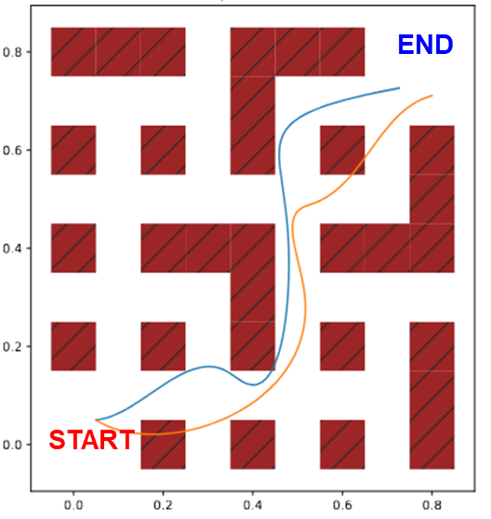
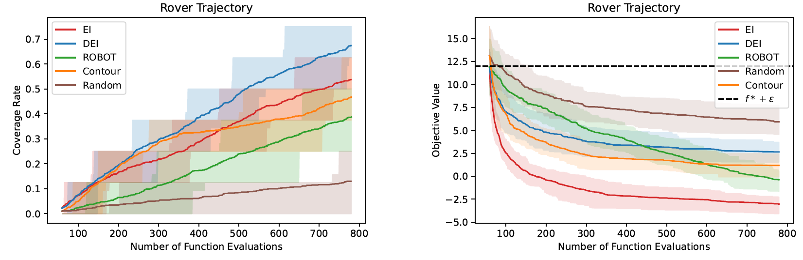
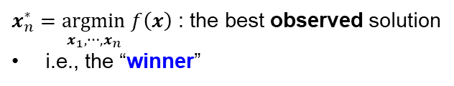

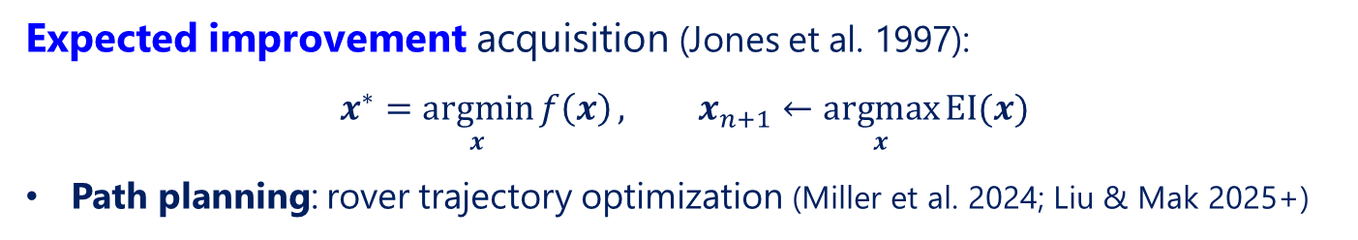
Bayesian optimization
Expected improvement acquisition (Jones et al. 1997):
$$x^{∗}=\underset{x}{argmin}{f\left(x\right)}, x_{n+1}←\underset{x}{argmax}{EI(x)}$$
Path planning: rover trajectory optimization (Miller et al. 2024; Liu & Mak 2025+)
Trajectory time $f(x_{n}^{∗})$
Obstacle
(can pass through with greatly reduced speed)
$x_{n}^{∗}=\underset{x_{1},⋯, x_{n}}{argmin} f\left(x\right)$ : the best observed solution
i.e., the “winner”

Slide 11
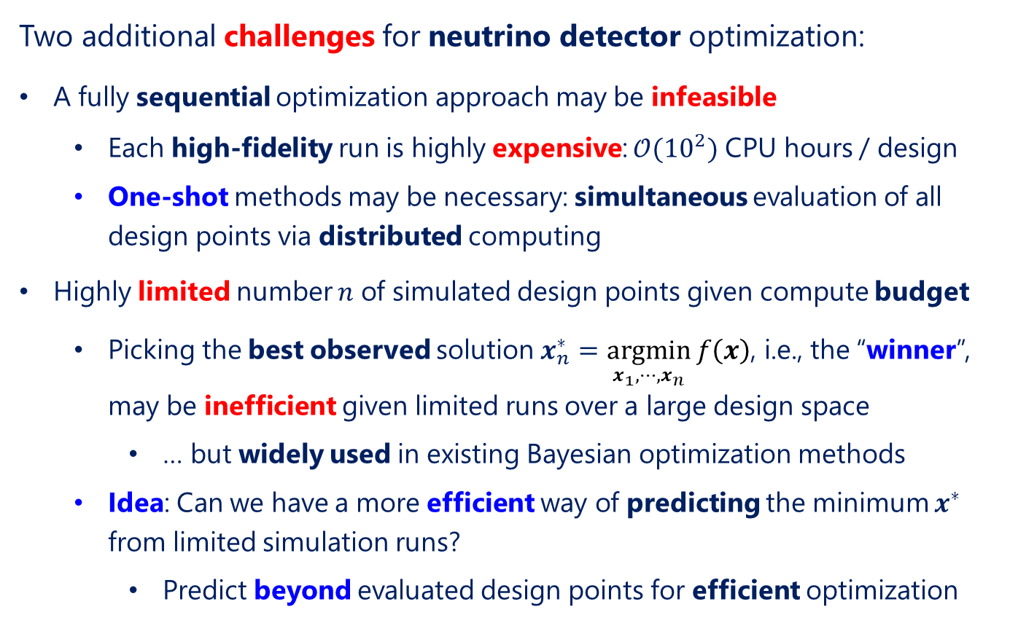
Challenges
Two additional challenges for neutrino detector optimization:
A fully sequential optimization approach may be infeasible
  Each high-fidelity run is highly expensive: $𝒪({10}^{2})$ CPU hours / design
  One-shot methods may be necessary: simultaneous evaluation of all design points via distributed computing
Highly limited number $n$ of simulated design points given compute budget
  Picking the best observed solution $x_{n}^{∗}=\underset{x_{1},⋯, x_{n}}{argmin} f\left(x\right)$, i.e., the “winner”, may be inefficient given limited runs over a large design space
    … but widely used in existing Bayesian optimization methods
  Idea: Can we have a more efficient way of predicting the minimum $x^{∗}$ from limited simulation runs?
    Predict beyond evaluated design points for efficient optimization

Slide 12
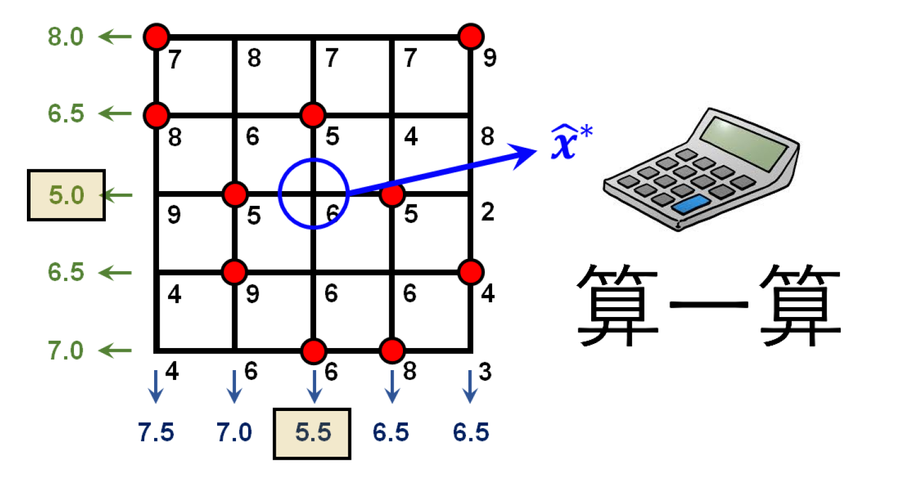
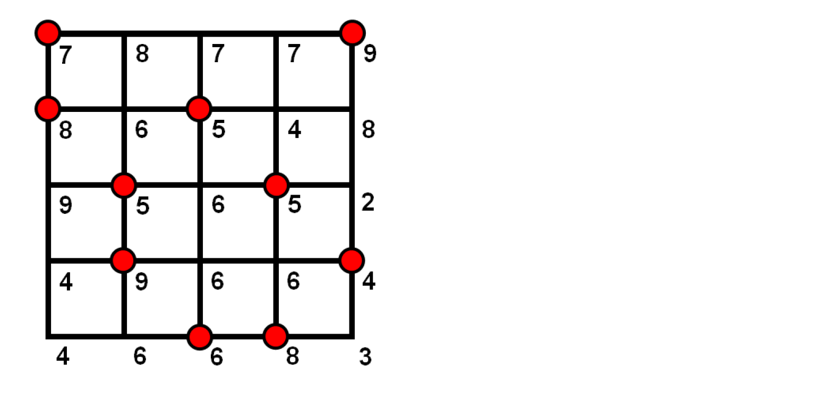
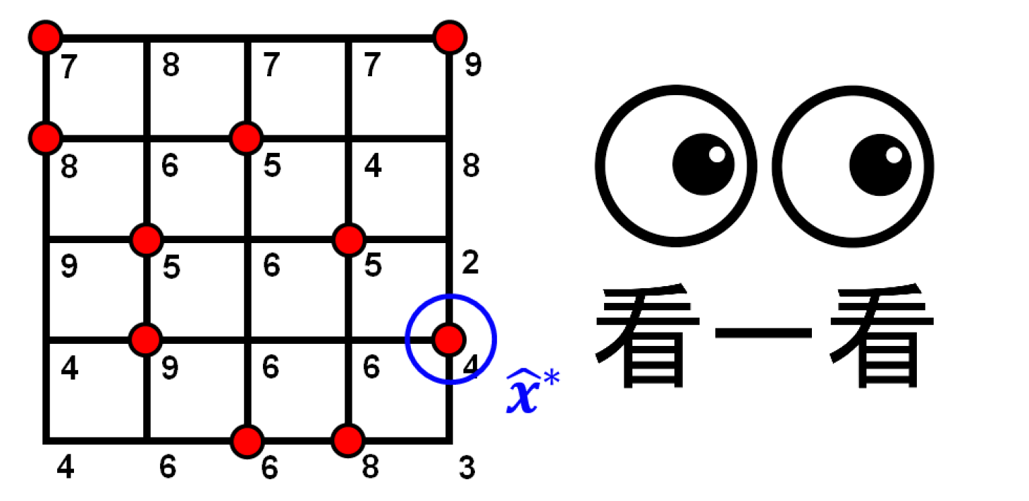

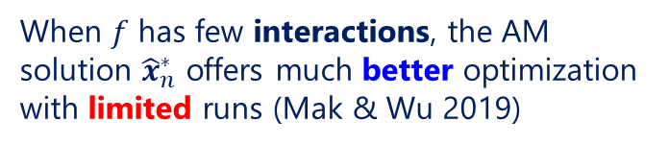





Intuition
Classical problem of parameter design optimization:
$$x^{∗}=\underset{x}{argmin}{f(x)}, x discrete$$
Taguchi (1986): analysis-of-marginal-means (AM) strategy
Wu, Mao, Ma (1990): pick-the-winner (PW) strategy
$${\hat{x}}_{n}^{∗}$$
$x_{2}$ (land plot)
Marginal means
$$x_{n}^{∗}$$
$x_{1}$ (fertilizer choice)
When $f$ has few interactions, the AM solution ${\hat{x}}_{n}^{∗}$ offers much better optimization with limited runs (Mak & Wu 2019)
Marginal means

Slide 13
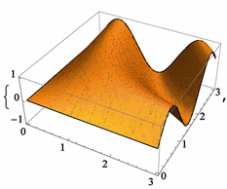
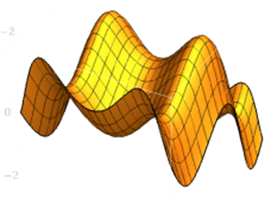


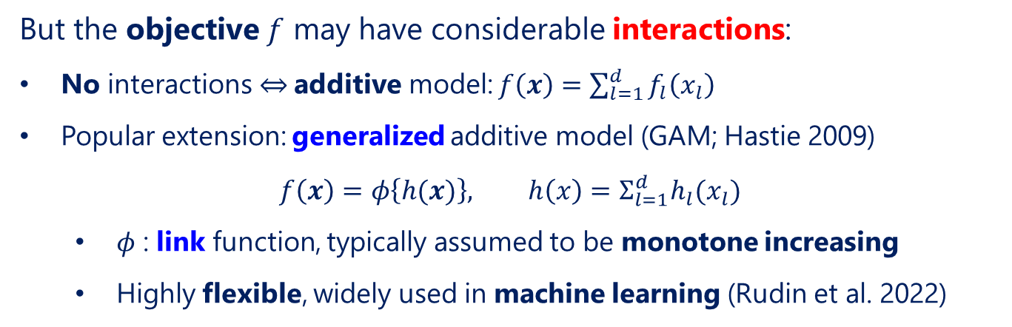

Intuition
But the objective $f$ may have considerable interactions:
No interactions $⇔$ additive model: $f\left(x\right)=\sum_{l=1}^{d}{f_{l}\left(x_{l}\right)}$
Popular extension: generalized additive model (GAM; Hastie 2009)
$$f\left(x\right)=φ\left\{h(x)\right\}, h\left(x\right)=Σ_{l=1}^{d}h_{l}(x_{l})$$
  $φ$ : link function, typically assumed to be monotone increasing
  Highly flexible, widely used in machine learning (Rudin et al. 2022)
$$f\left(x\right)$$
$$h\left(x\right)$$
Link $φ$

Slide 14


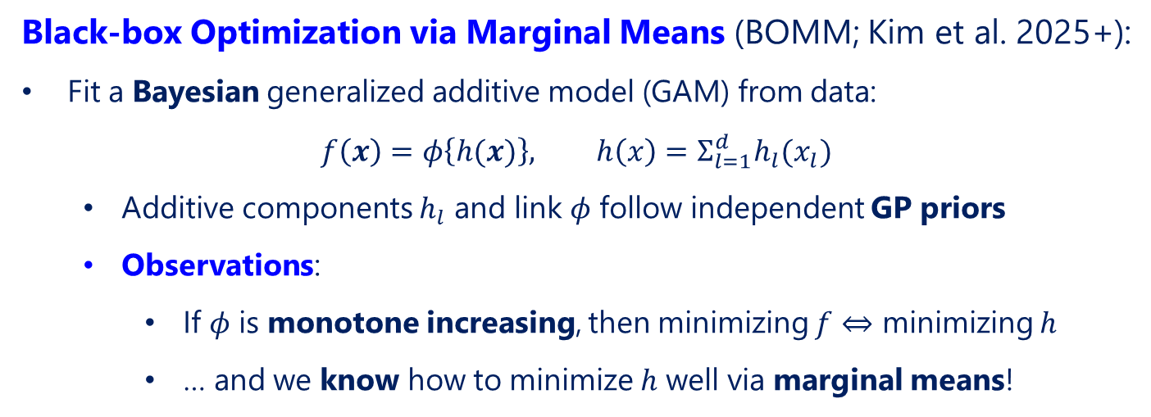

BOMM
Black-box Optimization via Marginal Means (BOMM; Kim et al. 2025+):
Fit a Bayesian generalized additive model (GAM) from data:
$$f\left(x\right)=φ\left\{h(x)\right\}, h\left(x\right)=Σ_{l=1}^{d}h_{l}(x_{l})$$
  Additive components $h_{l}$ and link $φ$ follow independent GP priors
  Observations:
    If $φ$ is monotone increasing, then minimizing $f$ $⇔$ minimizing $h$
    … and we know how to minimize $h$ well via marginal means!
$$f\left(x\right)$$
$$h\left(x\right)$$
Link $φ$

Slide 15

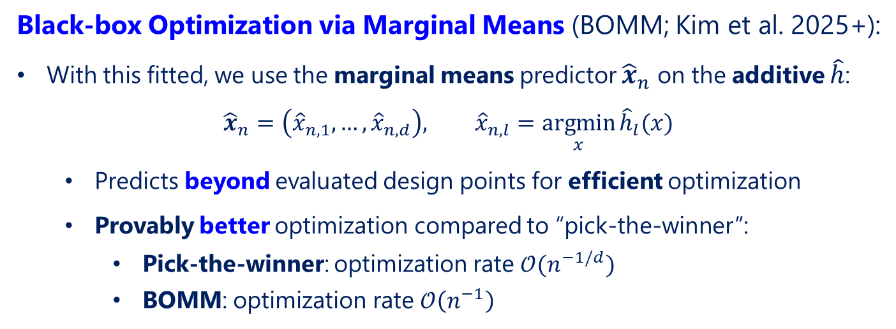
BOMM
Black-box Optimization via Marginal Means (BOMM; Kim et al. 2025+):
With this fitted, we use the marginal means predictor ${\hat{x}}_{n}$ on the additive $\hat{h}$:
$${\hat{x}}_{n}=\left({\hat{x}}_{n,1}, …,{\hat{x}}_{n,d}\right), {\hat{x}}_{n,l}=\underset{x}{argmin}{{\hat{h}}_{l}(x)}$$
  Predicts beyond evaluated design points for efficient optimization
  Provably better optimization compared to “pick-the-winner”:
    Pick-the-winner: optimization rate $𝒪(n^{−1/d})$
    BOMM: optimization rate $𝒪\left(n^{−1}\right)$
$$f\left(x\right)$$
$$h\left(x\right)$$
Link $φ$

Slide 16
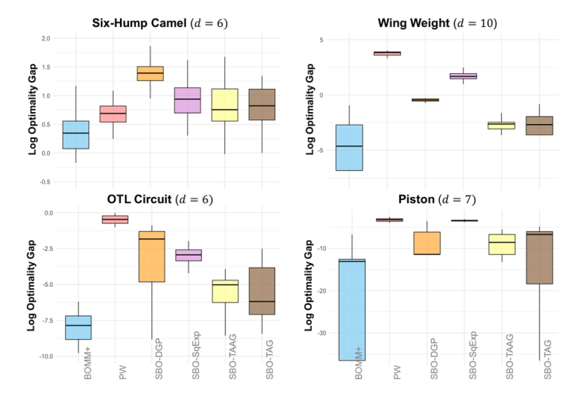
Numerical experiments
Black-box Optimization via Marginal Means (BOMM; Kim et al. 2025+):
One-shot, $n=10d$ design points (limited)

Slide 17
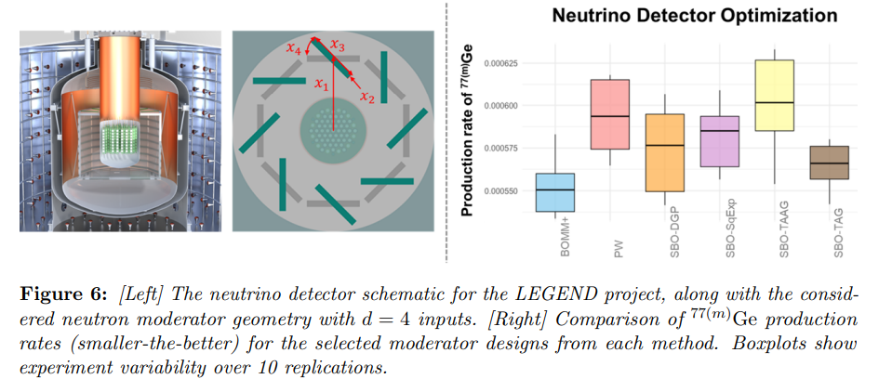
Neutrino detector optimization
Black-box Optimization via Marginal Means (BOMM; Kim et al. 2025+):
One-shot, $n=10d$ design points (limited)

Slide 18

Questions

