Slide 1

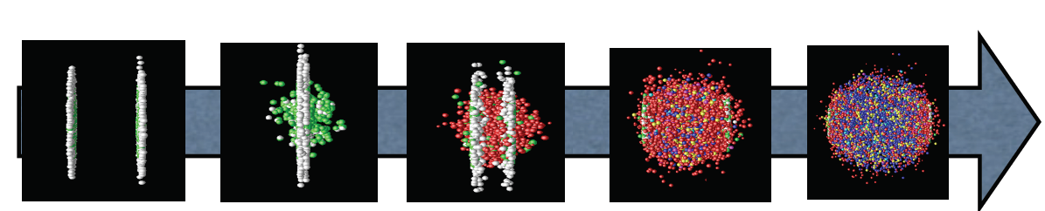
Fun with Quark Matter
Barbara Jacak, UC Berkeley & LBNL
November 4, 2019

Slide 2
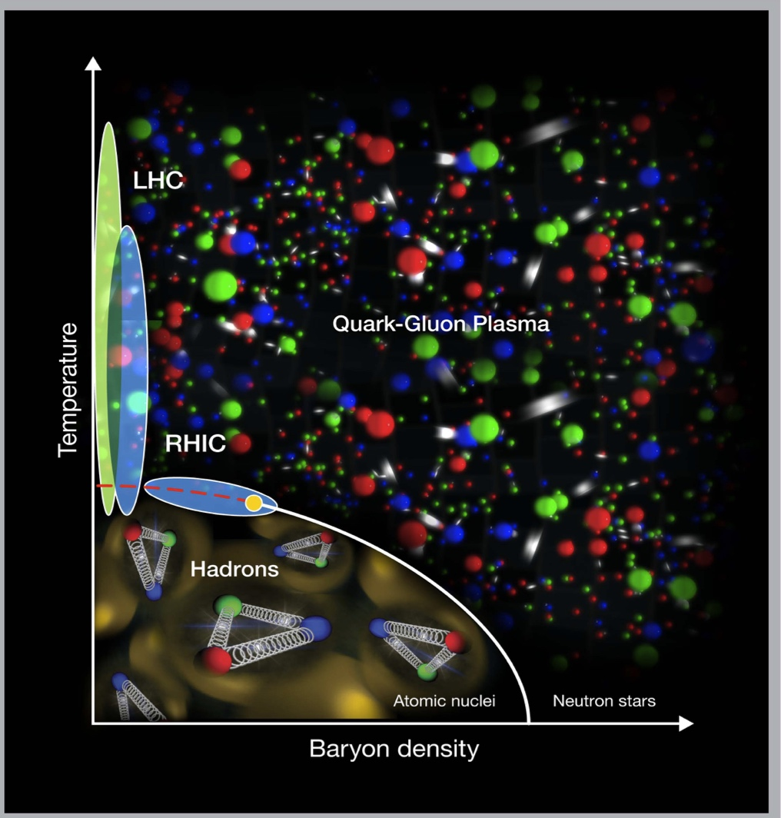
Big questions about quark gluon plasma
QGP
transport
properties?
Is there
a critical
point?
Hydrody-
namization
is fast.
How come?
QGP in small systems?

Slide 3
We know that QGP is strongly coupled
QGP flows as a nearly perfect liquid
QGP is very opaque to color-charged particles
QCD phase diagram is less well understood – an area of active work!
J/Ψ Alice 0-90%
J/Ψ Atlas 0-80%

Slide 4
NSD is exploring the questions
Beam Energy Scan at RHIC (Xin & colleagues)
Hydrodynamics in small systems
  Experiment: STAR at RHIC
Heavy quark interaction with plasma…
Parton energy loss and jet modification in QGP
  (focus of multiple RNC members)
  ((I find this topic fascinating too))
Theory of quark gluon plasma: Theory group is part of BEST and JETSCAPE collaborations (Volker, Xin-Nian, Felix & colleagues)

Slide 5
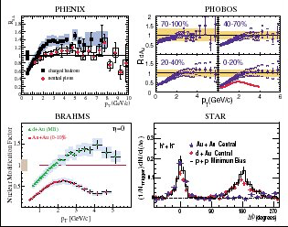
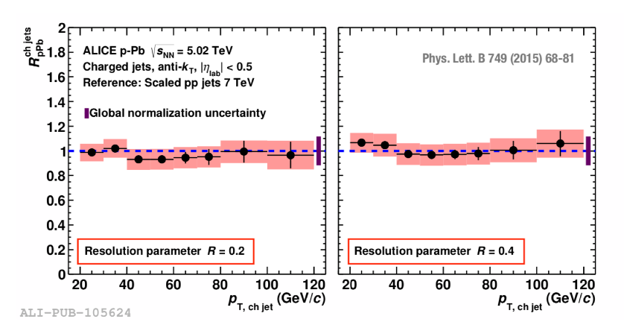
Jet quenching in small systems?
2003: no
  hadron R_{dAu}, correlations
Path length, l, is small!
  Jets “miss”, or lose very little energy
Or maybe it’s not a tiny droplet of QGP…
2015: no
  Jet R_{dAu}

Slide 6
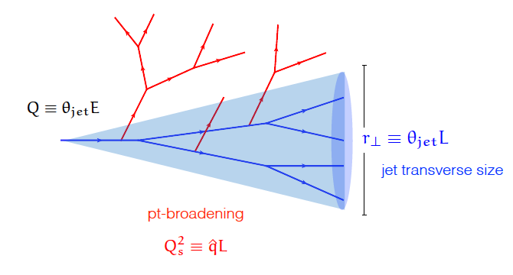
What does plasma do to quarks, gluons?
Need to better understand parton transport!
  In matter at small x in nucleon/nucleus
  In hot, dense quark gluon plasma
Need QCD transport in medium(s) & medium response
  Have a nice tool to use!
Jets:
Parton energy loss
Quark mass
dependence
Structure modifications from parton-plasma interactions
Y. Mehtar-Tani

Slide 7
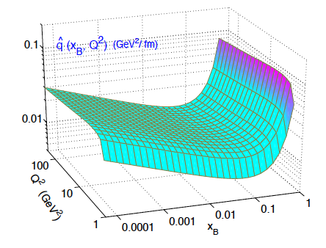
Parton energy loss
Quantify using q-hat
For a 10 GeV parton
  q = 1.9 +/- 0.7 GeV²/fm @ T=470 MeV
  1.2 +/-0.3 GeV²/fm @ T=370 MeV
    JET Collaboration PRC90, 014909 (2014)
  0.38 GeV²/fm @ 150 MeV(hot hadron gas)
  arXiv:1910.07027: Dorau, Rose, Pablos & Elfner
In cold nuclear matter
  q ~ 0.02 GeV²/fm
  arXiv:1907.11808:
  Ru, Kang, Wang,
  Xing & Zhang
<
  q= √μ²/λ λ=mean free path; μ=typical p_{T} transfer per scatter
  ~ k_{T}²/l
⌃
⌃

Slide 8
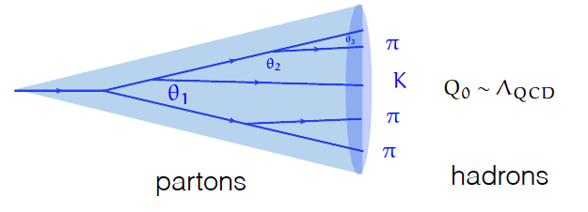
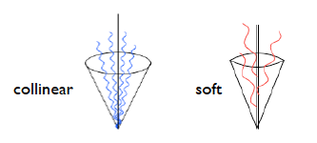
Jet: a coherent object
  q undergoes a probabilistic cascade of g emissions
  Total color charge conserved
  Successive branchings are ordered in angle
  Color coherence suppresses large-angle soft radiation by destructive interference
  color exchange w/medium!

Slide 9
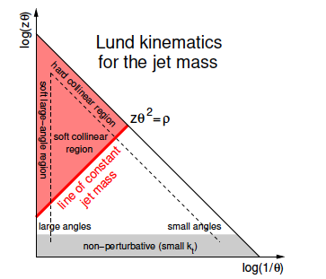
Jet structure
e.g. arXiv:1901.10342
Promising direction, relatively new
  Inspired by particle physics, but being optimized for QCD matter studies (by us!)
Fragmentation observables (particle level)
  Angular distribution within jets
  Fragmentation function
Jet shapes
  Mass, angularity, girth
Substructure
  Prong finding
  Grooming
  z_{g}, N-subjettiness
etc. (room for creativity!)

Slide 10
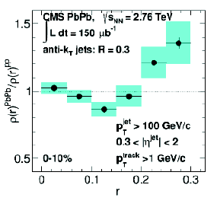
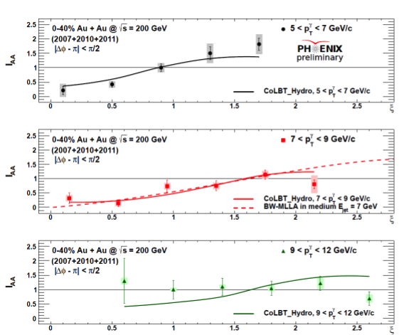
Jets get wider & “softer” in plasma
Pb+Pb/p+p:
Extra low-momentum
particles; high momenta
suppressed
Pb+Pb/
p+p:
Jets are wider in
Pb+Pb
p_{T}
PLB 730, 243 (2014)
Medium induced radiation!
Medium response!

Slide 11
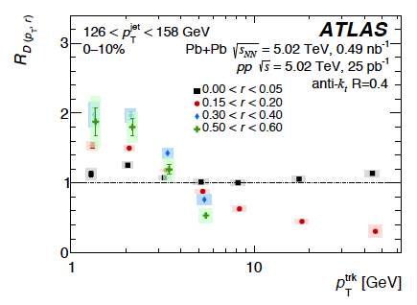
Looking differentially inside jets
arXiv: 1908.05264
See also: CMS
arXiv: 1803.00042
also measure
Fragmentation functions
q vs. g jets using γ tag
Excess soft particles at large jet radius
Narrowing of higher p_{T} particle density
Energy loss vs. medium response?
  quantify: compare theory to the differential data
  CoLBT-hydro, Hybrid, SCET_{G}

Slide 12
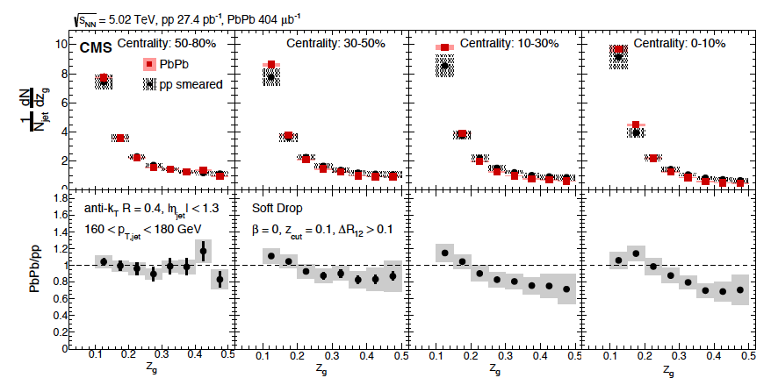
  Medium induced gluon splitting?
Groom away soft stuff, look for the 2 highest p_{T} objects
PRL 120, 142302 (2018)
Modification observed!
Experiment + Theory: data constrain E, p transport.

Slide 13
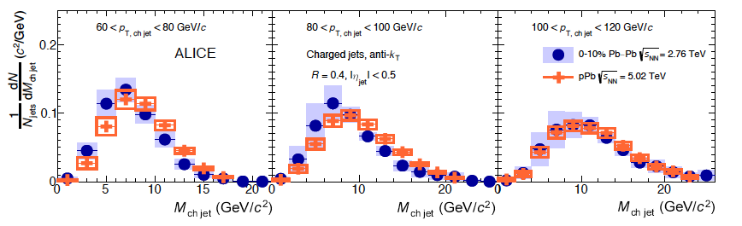
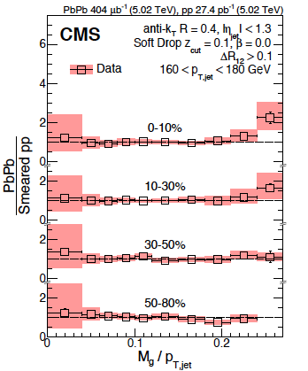
Groomed jet mass
M_{Jet} ~ zθ²
PLB 776 ,249 (2018)
Grooming allows comparison to QCD calculations (< hadronization effects)
So, is the mass modified?
Perhaps a bit for lower p_{T} jets?
But, the mass is controlled by the groomer!
arXiv: 1805.05145

Slide 14
When to groom jets, use soft-drop?
Pioneered by HEP – search for W, other hard stuff
In QGP studies soft-drop is good for:
  Isolating the first gluon splitting
  is it well enough calibrated?
  Reducing the underlying event
  are we grooming away the right particles?
In QGP soft-drop is terrible for:
  parton-plasma interactions & medium response
  …groom away the interesting soft stuff…
Proposal:
  Use a jet-grooming algorithm - “soft-keep”*
  1st step: Look at what is groomed away
  parton-plasma interaction vs. underlying event
  *e.g. collinear drop
arXiv:1907.11107

Slide 15
lower energy jets
Lower energy jets begin fragmenting sooner
  Fragmentation samples more of the medium
Will soon see results from
  ALICE
  ATLAS & CMS w/reduced jet energy threshold
  STAR
  sPHENIX

Slide 16
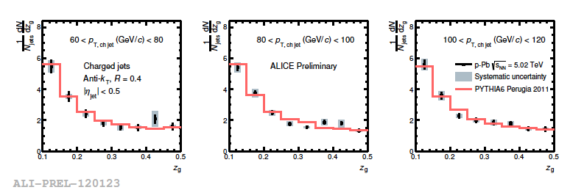
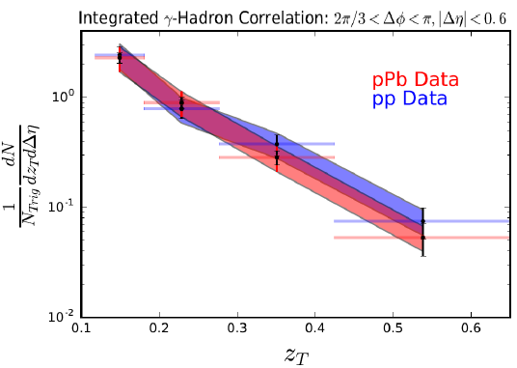
Jets in cold nuclear matter
p+Pb ~p+p, at ~20% level
Need precision for q ~ 0.02
Both on measurement and on the kinematics to understand hydro onset
⌃

Slide 17
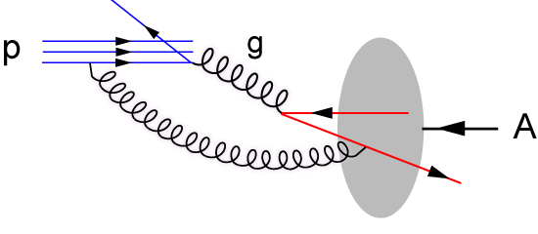
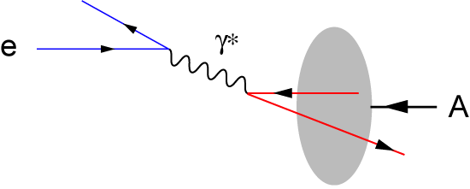
Future -> cleaner probe: Collide e + A
Hadron-Hadron
Electron beam: deep inelastic scattering
p
p/A
p/A
  Probe is a gluon
  Probe has structure!
  Dynamics of the probe mixed up with structure of the nucleus
  RHIC & LHC
  Point-like probe
  No strong interaction before hard scattering
  Control probe kinematics by measuring scattered electron
  Precision measurement
  Needs Electron-Ion Collider
Will there be hydrodynamic flow if we excite a hot spot with a point particle??!

Slide 18
We are exploring how to use jets to probe cold nuclear matter at the EIC
Stay tuned for more on this!
arXiv: 1912.05931

Slide 19
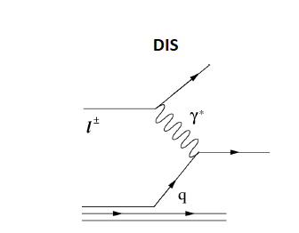
Parton-cold matter interaction: is there an equivalent of γ – jet?
Yes!
deep inelastic scattering
Scattered electron energy & angle ➔ x, Q²
Thar be jets!

Slide 20
Backup

Slide 21
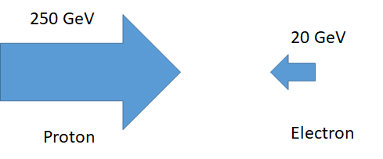
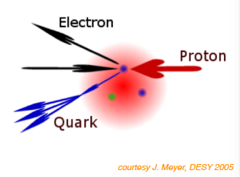
Studying the low-x region with DIS jets
Semi-Inclusive Deep Inelastic Scattering
100
Y. Song, M. Arratia
For struck quark at x ~ 10⁻³ - 10⁻²
P_{quark} ~ 100 MeV – 1 GeV
Lowest x is like fixed target!
Jet goes into electron direction

Slide 22
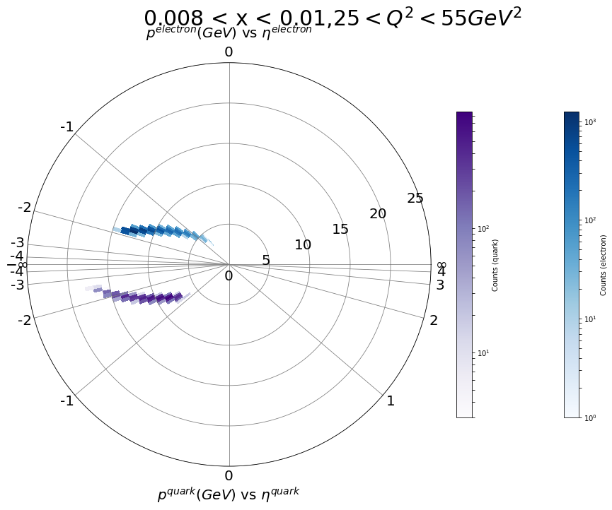
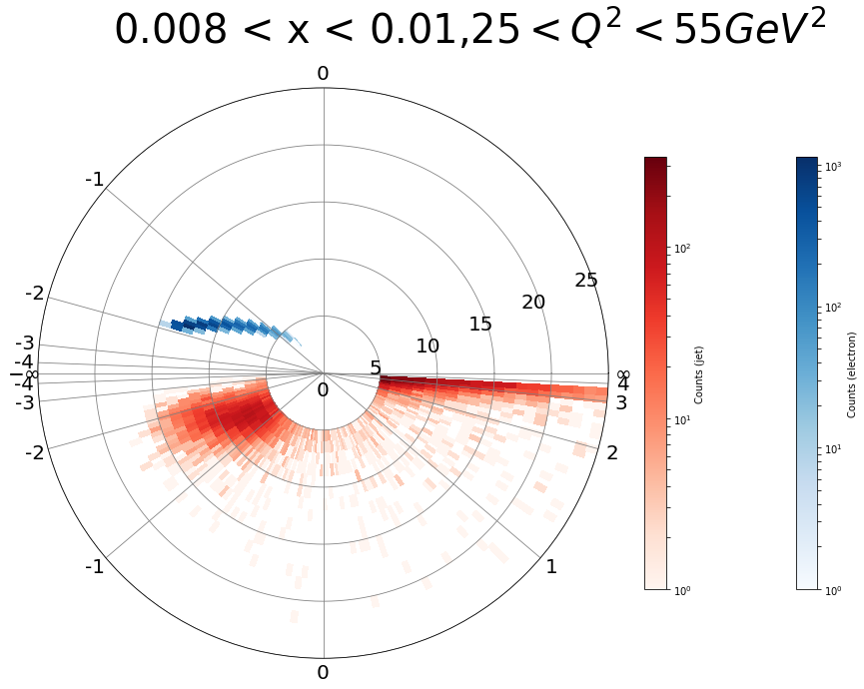
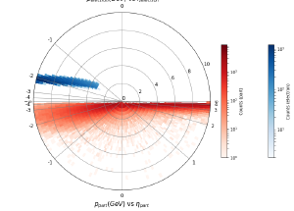
Probe CNM with tagged jet in e+A
e+p, DIS; Pythia 8. Require W² > 4 GeV²,
electron
p
η
struck parton
reconstructed jet
Youqi Song, M. Arratia
Smearing is larger for single hadrons; more so for low Q²

Slide 23
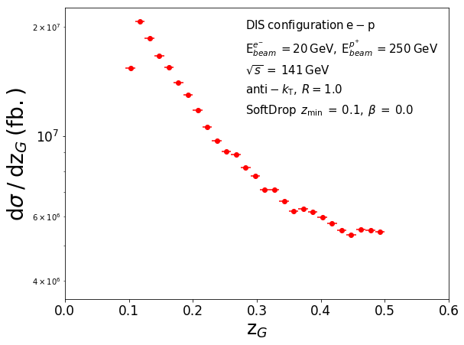
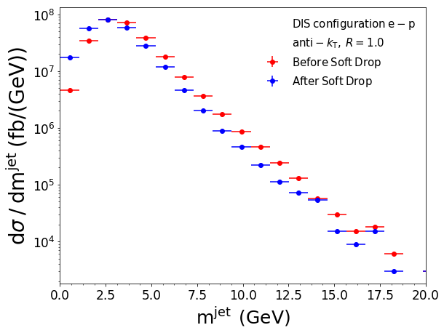
Jet substructure in clean e + p events
Miguel Arratia
Jet substructure to understand interactions with matter, hadronization, etc.

Slide 24
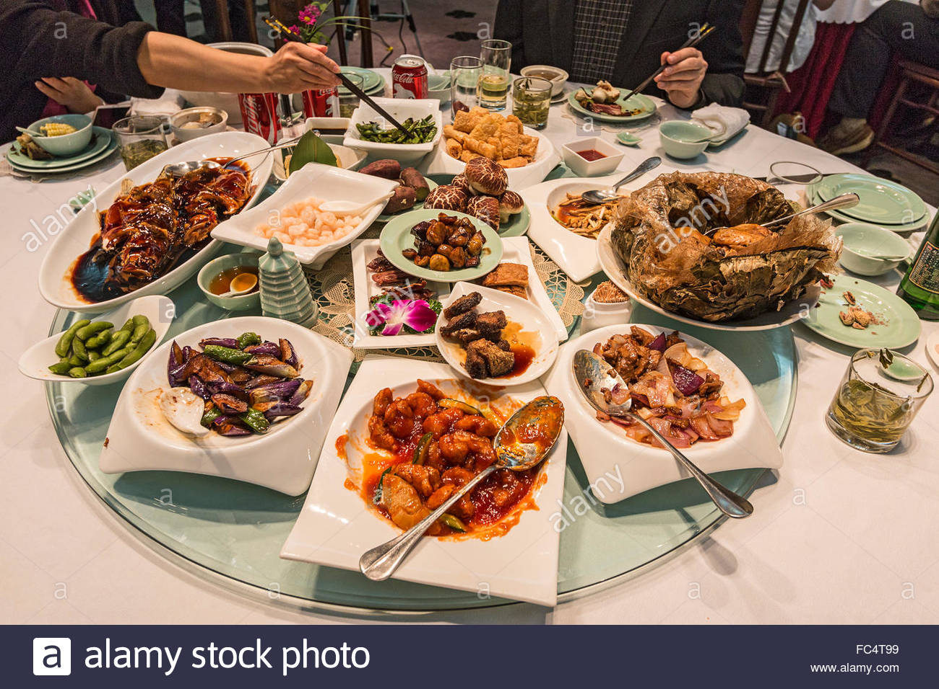
Prognosis
We have learned a lot already!
Challenges: Connect experimental observations to the phase diagram, understand mechanism of fast hydrodynamization, utilize jet substructure to quantify QCD transport in both hot & cold matter
Heavy quark, EM probes, onia, hadron dynamics, too!
This week will be a banquet of new results
Enjoy!

Slide 25
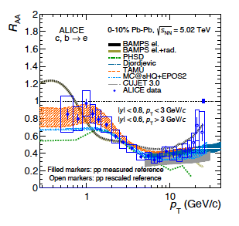
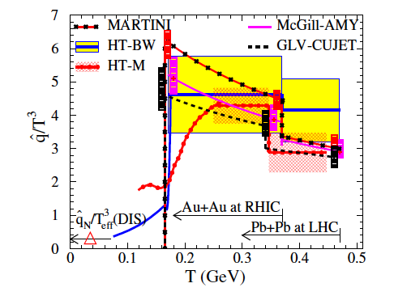
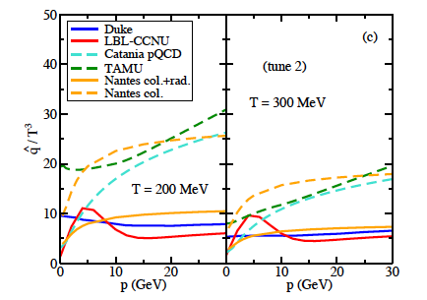
Heavy quarks
arXiv: 1910.09110
Lose energy too!
Dominated by collisions at low p_{T}
Radiation at high p_{T}
<
  q= √μ²/λ
Phys. Rev. C 90, 014909 (2014)
S. Cao, et al. arXiv:1809.07894
Light quark R_{AA} fits: JET collaboration
Heavy quark R_{AA} fits

Slide 26
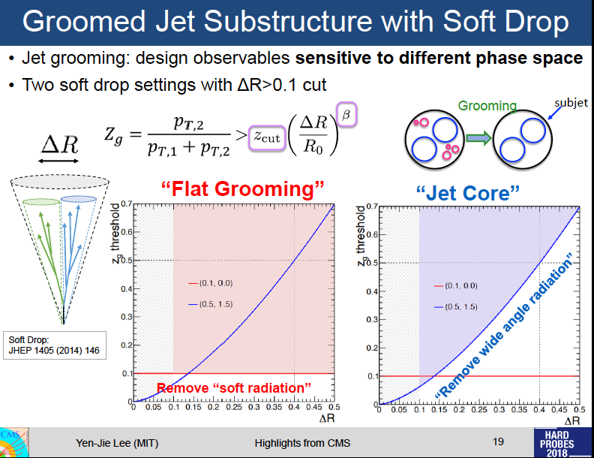
Backup

Slide 27
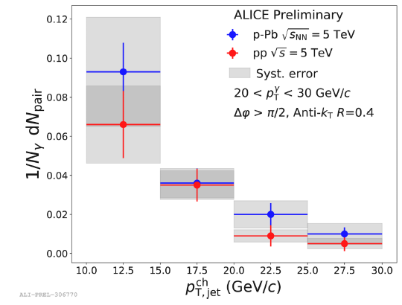
How about in cold matter?
Look at cold matter using p + nucleus collisions
Use γ-jet correlations from QCD Compton scattering
  γ energy tags the energy of the scattered parton
Jet spectra in p+Pb same as that in p+p, within ~20%

Slide 28
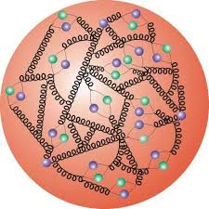
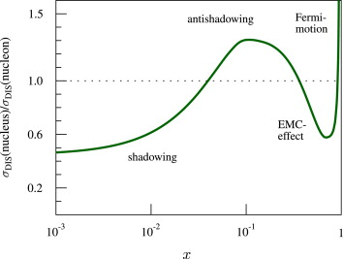
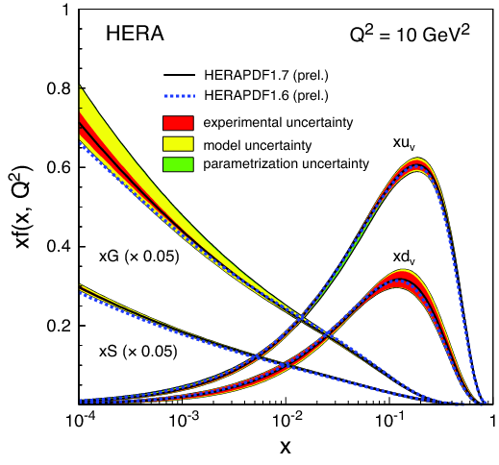
Initial state effects
3 valence quarks + gluons + sea quarks
  Gluons split into quarks + antiquarks
  Measured by scattering electrons (γ transfer)
Quark, gluon densities vs. momentum fraction they carry
  x is momentum fraction in ∞ momentum
  frame (i.e. in a proton beam)
  Q² is photon virtuality (effective mass)
    1/photon (dipole) size
For p, n inside nucleus:
  densities are different!
  q, g from different nucleons interact
  Higher parton densities –> gluon fusion
    @ higher x values than in isolated protons
      Density increases as ~ A ^{1/3}

Slide 29
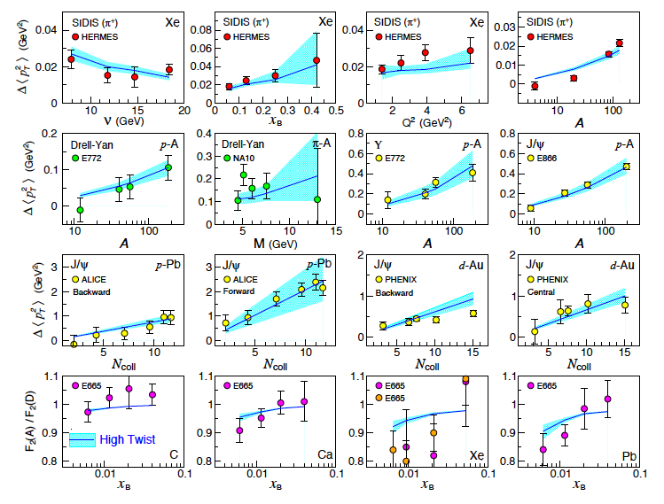
Extraction of CNM q-hat
arXiv:1907.11808

Slide 30
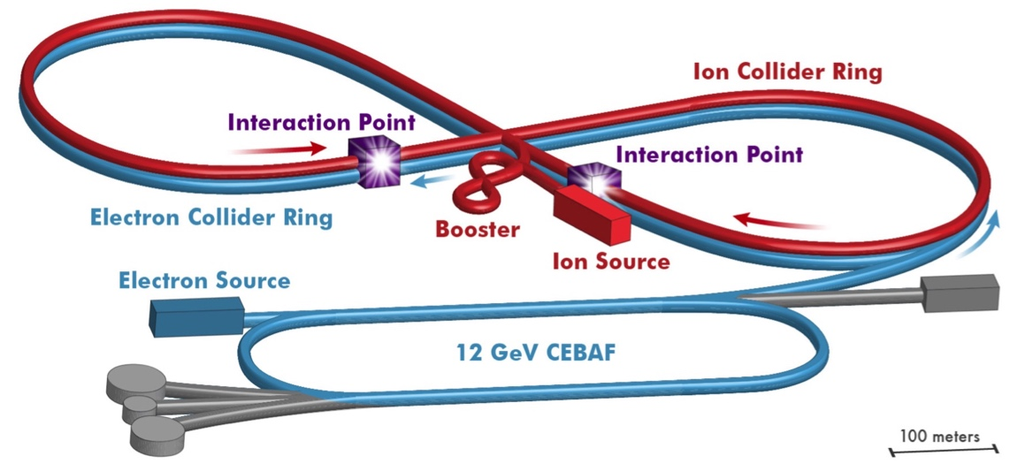
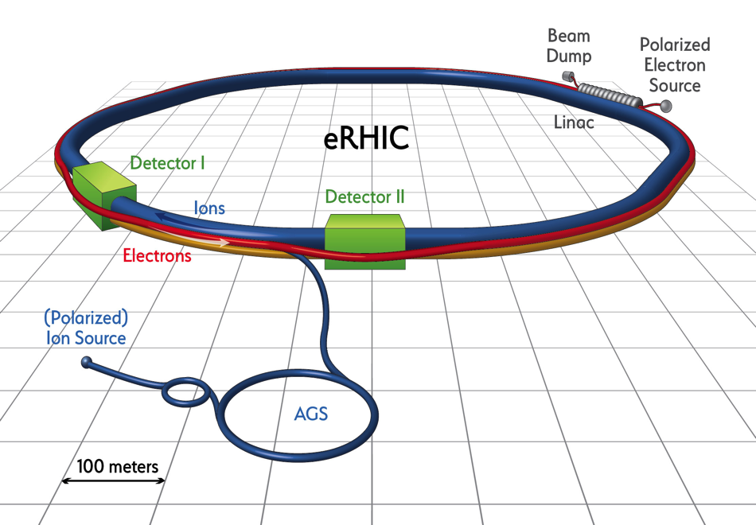
Concepts for an electron-ion collider
JLEIC at Jefferson Lab
  Add ions to electron facility
(cm Energy) √s = 20 to 65 - 140 GeV
eRHIC at Brookhaven National Lab
  Add electrons to ion facility
√s = 30 to 130 - 145 GeV

Slide 31
To look at cold nuclear matter: we tickled a nucleus with a proton
In p+A probe cold nuclear matter with a parton, not a photon.
Partons can lose energy before the hard scattering
  Photons do not
Parton can lose energy after the hard scattering
Parton experiences multiple scattering
These may be not be independent!
Many-body QCD suggests coherent interactions!
same as in parton-plasma interactions…
Goal: turn off interactions before the hard scattering!

Slide 32
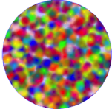
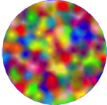
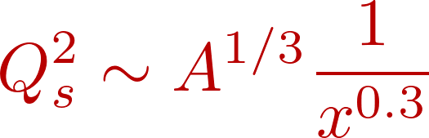
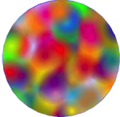
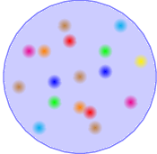
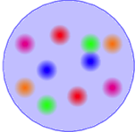

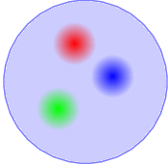

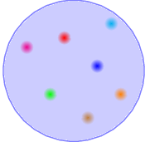
Speculation
Maybe the A+A (and p+p) collisions hit a kinematic region where the gluon density is saturated?
  Initial state starts closer to thermalized
  And/or thermalization is easier than we think
(g –> gg rate ~ gg -> g)
Saturation
Let’s measure the transport properties of cold, dense gluon matter!
Smaller gluon momentum➔
BFKL
DGLAP
Increasing probe energy ➔

Slide 33
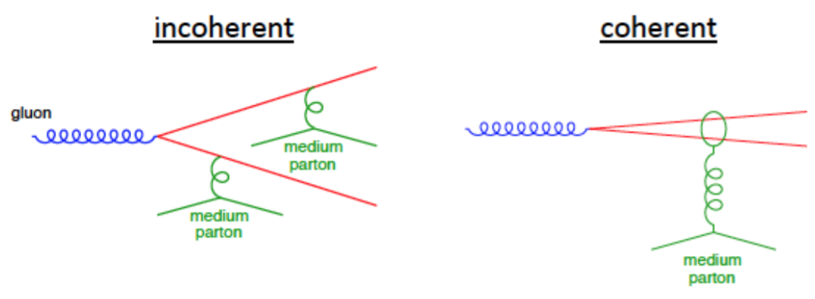
Why such fast QCD matter isotropization*?
One of the key questions for hot QCD
  But it’s very hard to measure directly!
  Depends on transport in (cold) QCD matter; parton cascade with vacuum cross sections is not fast enough
Is coherent scattering the reason?
  Parton interactions in hot, dense QCD and cold, dense QCD should be similar
Or, might the system already have many-body interactions that change the distributions from a sum of pp collisions?
* Full thermalization not required for hydrodynamics
Y. Mehtar Tani: JHEP04, 125 (2017) 2017
picture: M. Arratia

Slide 34
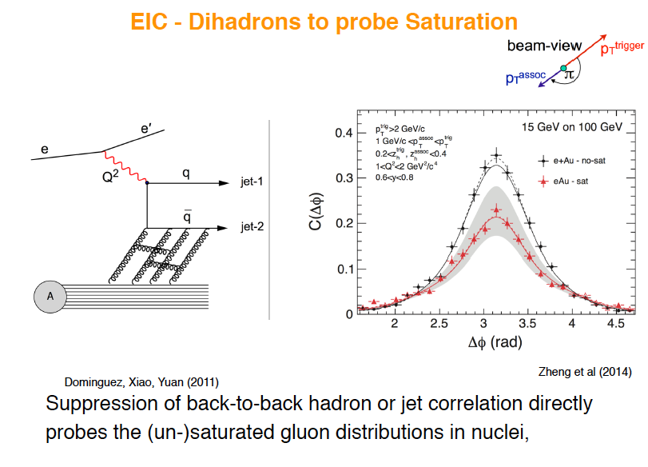
E. Sichtermann

