Slide 1
2020 Parking Permit Stickers
New parking stickers for 2020 will be available from your group admin soon. Your admin will let you know when the stickers are available for pickup.
Please bring your badge with you when you pick up your sticker.
You do not need to bring your parking hangtag with you.
Bicycle or motorcycle parking stickers: No new 2020 sticker is required at this time.
Effective January 14, 2020 Security will hand out warnings if the correct sticker is not displayed.
The 2020 sticker will be required for entry to the Lab beginning January 31.

Slide 2
NSD Property Management in 2020
Inventory Kickoff – January 6, 2020
Berkeley Lab policy mandates responsible use of all property in the custody of its employees. Property must be used in a safe manner, and adequate care must be taken to protect it from loss or damage.
Completion Targets
2/28/2020 | 80%
4/30/2020 | 90%
5/29/2020 | 95%
6/30/2020 | 100%

Slide 3
2020 Property Inventory
How can you help?
Review your property data. Ask yourself:
Is the location information correct?
Is the item still needed?
Should someone else be the custodian of the item?
Affiliates cannot be custodians, but they can be listed as users.

Slide 4
2020 Property Inventory - BigFix
Out of our inventory of 518 items this year, 445 of them are computers.
Last year, BigFix accounted for only 36 inventory resolutions.
By far, the biggest impact you can have to the inventory is to install BigFix on all of your computers.

Slide 5
BigFix Versions – go.lbl.gov/downloadbigfix
Active Management Mode
Actively managed devices will receive limited application patches, and occasional security configurations.
Passive Management Mode
In Passive Mode, BigFix is used primarily for monitoring and reporting on system status, software licensing, and asset management.
Passive Mode BigFix will not do any patching of the operating system or installed applications and will NEVER reboot the computer.

Slide 6
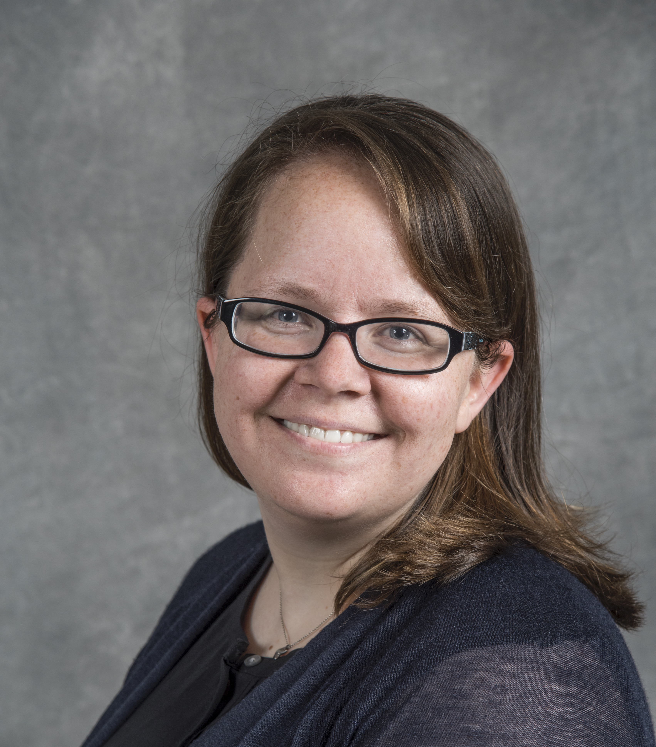
Special Thanks to Heather Crawford for joining the NSD DEI Council!

Slide 7
Special Thanks to Barbara Jacak!
Barbara will also be cycling off from the NSD DEI Council. Those wishing to volunteer should contact either Tom Gallant or Ernst Sichtermann.

