Slide 1





HEavy-Flavor TheorY for QCD Matter
Ralf Rapp
Cyclotron Institute +
Dept of Phys & Astro
Texas A&M University
College Station, TX, USA
Online Heavy-Flavor Seminar Series
Oct. 08, 2025

Slide 2
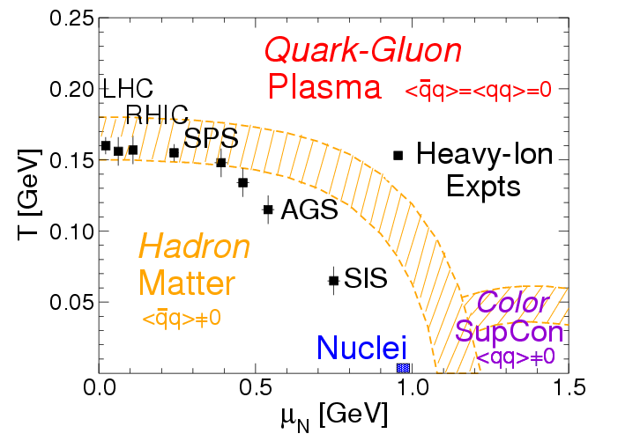
QCD Matter: Open Questions
early universe
NS mergers
neutron stars
μ_{Β}
Transport properties + their emergence from the underlying interaction
Spectral functions + degrees of freedom
Mechanisms for converting quarks + gluons into hadrons
Role of quantum effects in the strongly-coupled QGP

Slide 3
Heavy-Flavor Probes
c
D
Freeze-Out
Hadron Matter
A + A
ϒ
QGP
Develop integrated approach to heavy-quark + quarkonium transport:
Quantum-many body theory with universal in-medium interaction
constrained by thermal lattice QCD (→ spectral functions)
Transport coefficients based on same microscopic interaction
Hadronization mechanisms
State-of-the-art hydro evolution
Quantitative initial conditions based on small collision systems
Asset: large heavy-quark mass: m_{Q} >> Λ_{QCD} , T , T_{c}

Slide 4
DOE Topical Collaboration in Nuclear Theory: HEavy Flavor TheorY (HEFTY) for QCD Matter
Mukherjee
Qiu
Frawley
Vogt
Petreczky
Dong
[Rapp (PI), Petreczky + Vogt (co-spokespersons), + 9 co-PIs]
Vitev
Rapp
Hanlon
Lee
Bass

Slide 5
Outline
1.) Introduction
● QCD Matter, Heavy Quarks + HEFTY
2.) Heavy Flavor in Equilibrium Matter
● Lattice QCD + Thermodynamic T-Matrix
● Spectral Functions + Transport Coefficients
3.) Open Heavy Flavor in HICs
● Brownian Motion + Hadronization
● Charm Observables
4.) Quarkonia in HICs
● Reaction Rates + Transport Approach
● Bottomonia in Hydrodynamics
5.) Conclusions

Slide 6
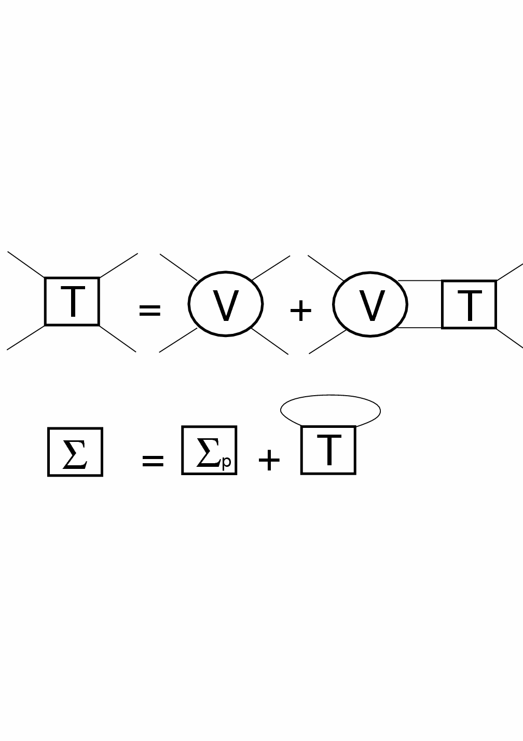
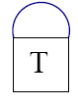
2.1 Thermodynamic T-Matrix in QGP
Scattering
equation
i=Q
j=Q,q,g
Born approximation (weak coupling): T_{ij} ≈ V_{ij}
Strong coupling → resummation: T_{ij} = V_{ij} + ∫ V_{ij} G_{i} G_{j} T_{ij}
Thermal parton propagators: G_{i} = 1 / [ω – ω_{k} –Σ_{i}(ω,k)]
Parton self-energies → self-consistency:
q ~ T << m_{Q} ⇒ q₍₄₎² = q₀² - q² ≈ -q²
⇒ 3D reduction of Bethe-Salpeter equation
In-medium potential V constrained by lattice QCD
j=q,g
Σ_{i}
=
ij
[Riek+RR ’10, Liu+RR ‘18,
Tang et al ’24 ]

Slide 7
2.2 Spin-Induced Interactions
Higher order in
1/m_{Q} expansion:
[RQM, Ebert et al ‘03]
Vector component in confining potential
Much improved hyper/fine splittings!
Significant impact on transport
coefficient: harder 3-mom dependence
[Tang+RR ‘23]

Slide 8
2.3 Wilson Line Correlators from Lattice QCD
“Quarkonium free energy at finite τ”
Static quarkonium
spectral fct:
LQCD: first cumulant
characterizes width of quarkonium
Challenge for perturbative (HTL)
calculations, even at rather large T
[Bala et al ‘22]

Slide 9
2.3.2 Wilson Line Correlators from T-Matrix
Vary input potential (+ solve self-consistent many-body problem)
to obtain:
[Tang,Mukherjee,
Petreczky+RR, EPJA60]
V(r,T)
Im T_{bb}
First microscopic description, little potential screening
Which Y states survive until which ``dissociation temperature”?

Slide 10
2.4 Complex-Pole Analysis of in-Medium T-Matrix
z = E_{R}+iE_{I}
2S
3S
1S
4S
Binding vs. Width
1S
2S
[GeV]
E_{B} = G_{Y}
E_{B}
G_{Y}
[Tang,Wu,Hanlon,Mukherjee,
Petreczky+RR, PRL135]
Bottomonium states survive deep into sQGP,
even into the continuum (after vanishing of E_{B}!)

Slide 11
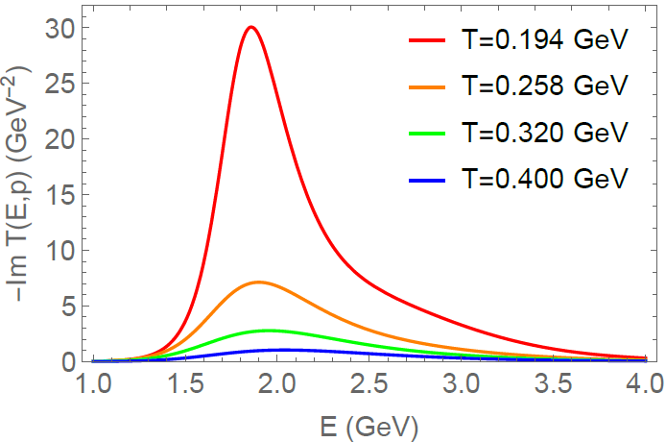
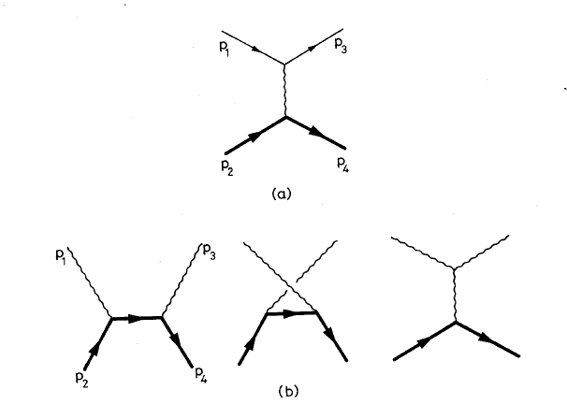
2.5 Charm-Quark Transport Coefficients
Charm-Light Quark T-Matrix
k
QGP
k'
γ_{c}(p)
- Im T_{cq} [GeV⁻²]
T_{cq}
-
cq threshold
p
p'
[Altenkort et al,
PRL132]
Broad D-mesons near T_{c}
- non-pert. interaction strength (~10x pQCD)
- broad SFs: quantum effects critical!
- τ_{c} ≈ 3 fm/c , D_{s} (2πT) ≈ 2
- natural doorway to hadronization

Slide 12
Outline
1.) Introduction
● QCD Matter, Heavy Quarks + HEFTY
2.) Heavy Flavor in Equilibrium Matter
● Lattice QCD + Thermodynamic T-Matrix
● Spectral Functions + Transport Coefficients
3.) Open Heavy Flavor in HICs
● Brownian Motion + Hadronization
● Charm Observables
4.) Quarkonia in HICs
● Reaction Rates + Transport Approach
● Bottomonia in Hydrodynamics
5.) Conclusions

Slide 13
3.1 Heavy-Flavor Transport in URHICs
0 0.5 5 10
| | | |
τ [fm/c]
D
c
initial cond.
(nPDFs, …),
pre-equil. fields
c-quark diffusion
in QGP liquid
c-quark
hadronization
D-meson
diffusion in
hadron liquid
Langevin + radiation transport (LIDO) in viscous hydro (VISHNU)
FONLL initial spectra with shadowing
T-matrix transport coeffs. + resonance recombination model (RRM)
Hadronic transport (T < T_{H} ~ 160 MeV)
[ Ke al ’18, He et al ‘20, Tang et al ‘24]

Slide 14

3.2 Heavy-Flavor Transport Equation
p² ~ m_{Q} T >> q² ~ T² ⇒ Fokker-Planck:
Q
+ C [f_{Q}]
thermalization rate diffusion coeff. radiation
(incl. LPM)
g p = ∫ d³q w_{Q}(q,p) q ~ ∫ |T_{Qj}|² (1-cosq) f ^{j}
D_{p} = ∫ d³q w_{Q}(q,p) q²
thermal relaxation time τ_{Q} = 1/γ , D_{s} = T/γ (0) m_{Q}
Quantum effects in γ, D_{p} (spectral fcts.)
⇒ Brownian particle in a liquid!
Initial conditions:
fit to pp spectra + shadowing

Slide 15


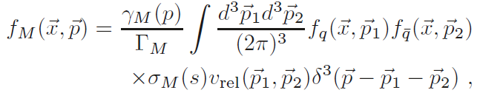
3.3 Hadronization of Heavy Quarks
Fragmentation
c → D, D*, D_{s}, Λ_{c}, …
- empirical fragmentation functions D_{c→Hc}(z)
- universal in “vacuum”: e⁺e⁻, pp collisions (large p_{T})
Coalescence/Recombination
c + q (s) → D (D_{s}), D*,… ; c + q + q (s) → Λ_{c} (Ξ_{c}), …
- depends on environment (surrounding anti-/quarks)
- test hadronization through “charm hadro-chemistry”
- Resonance Recombination Model
σ_{Μ} (s) v_{rel} ~ |T_{Qi} |² : resonant heavy-light amplitude
[Hwa et al ‘03,
Fries et al ‘03,
Greco et al ’03]
[Ravagli+RR ’07]

Slide 16
3.4 D-Meson Data at the LHC
Semicentral Central Pb-Pb
Previously
[ALICE ‘21]
near T_{c}: 1.5 ≤ D_{s}(2πT) ≤ 4.5
[Krishna, Fu et al ’25]
“Flow bump” in R_{AA} + large v₂
⇒ strong coupling near T_{c}
Scattering rate ~ 1 GeV ⇒ liquid!
Remnants of confining force!
Now: D_{s} (2πT) ≤ 2

Slide 17
Outline
1.) Introduction
● QCD Matter, Heavy Quarks + HEFTY
2.) Heavy Flavor in Equilibrium Matter
● Lattice QCD + Thermodynamic T-Matrix
● Spectral Functions + Transport Coefficients
3.) Open Heavy Flavor in HICs
● Brownian Motion + Hadronization
● Charm Observables
4.) Quarkonia in HICs
● Reaction Rates + Transport Approach
● Bottomonia in Hydrodynamics
5.) Conclusions

Slide 18
4.1 Quarkonium Transport in URHICs
0 0.5 5 10
| | | |
fireball time
τ [fm/c]
c
-
c
production +
evolution of
cc wave pack.
c-quark
diffusion
in QGP
~ T_{melt}:
ψ can
form
QGP
kinetics
c+c ↔ ψ
~ T_{pc}:
c and c
hadronize
-
-
hadronic
kinetics
-
t_{form}~1fm/c t_{c}^{eq} ~3fm/c t_{y}^{eq} ~ 1/ G_{y}
[Satz et al, Capella et al, Spieles et al, PBM et al, Thews et al, Grandchamp et al, Ko et al, Zhuang et al, Zhao et al,
Chaudhuri, Gossiaux et al, Young et al, Ferreiro et al, Strickland et al, Brambilla et al, …]

Slide 19
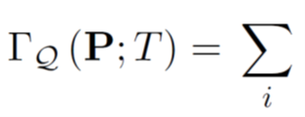
4.2 Quarkonium Reaction Rates in sQGP
Σ_{Q}
Im T_{QQ} ⇔ Im S_{Q}
Σ_{Q}
d⁴p'r_{Q}' d⁴q r_{i} f_{i} d⁴q' r_{i}'(1-f_{i}')
Integrations over (broad) in-medium spectral functions r_{Q,i}
Structure effects: interference factor 1-exp(ik⋅r) ensures G_{Q} (r→0) → 0
[Wu et al, JHEP07]

Slide 20
4.3 Bottomonium Reaction Rates in sQGP
Importance of binding energy + structure effects for break up
Numerically large (up to GeV for excited states)
[Wu et al ’25]

Slide 21
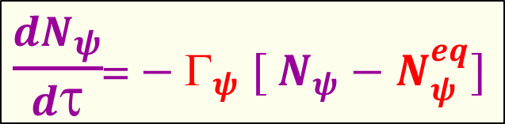
4.4 Kinetic Approach in Hydrodynamics
-
Β
→
←
Inelastic reactions:
Y + p b + b + p
-
ϒ
Β
[Grandchamp+RR ’01-’04, Wu+RR ’24…]
Detailed
balance:
b
-
b
ϒ
Transport coefficients:
- Equilibrium limit N_{Y}^{eq}(m_{Y} ,T, N_{cc}) + reaction rate G_{y}(p, T, E_{B}, r)
Implementation into viscous hydro [KSU]
- Trajectories for primordial suppression
Extension of regeneration to
non-uniform medium

Slide 22
4.5 Bottomonium Transport in Pb+Pb at the LHC
[Wu et al ’25]
Fair predictions (no tuning), problems at higher p_{T}?

Slide 23
4.6 Bottomonium Transport in p+Pb at the LHC
[Thapa, Vogt, et al ’25]
Interplay of CNM effects, large suppression + regeneration?!

Slide 24
5.) Summary
Comprehensive collaborative approach to heavy flavor in medium:
- Lattice-informed quantum-many body theory
- Reliable calculations of nonperturbative transport coefficients
- Transport in AA in state-of-the-art hydrodynamics
- Open HF hadronization with modern recombination model
- Quantum transport for quarkonia to be elaborated
- Small systems: initial conditions for AA + applications to EIC
Highlights thus far:
- New lattice results on quarkonia + HQ diffusion
- Quarkonia survive deep into the QGP (complex-pole analysis)
- Remnants of confining force provide strong coupling in QGP, large widths
+ doorway to hadronization toward T_{pc}
- HQ diffusion coefficient from phenomenology: D_{s} (2πT) ≤ 2

Slide 25
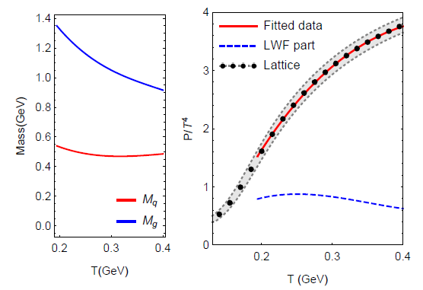
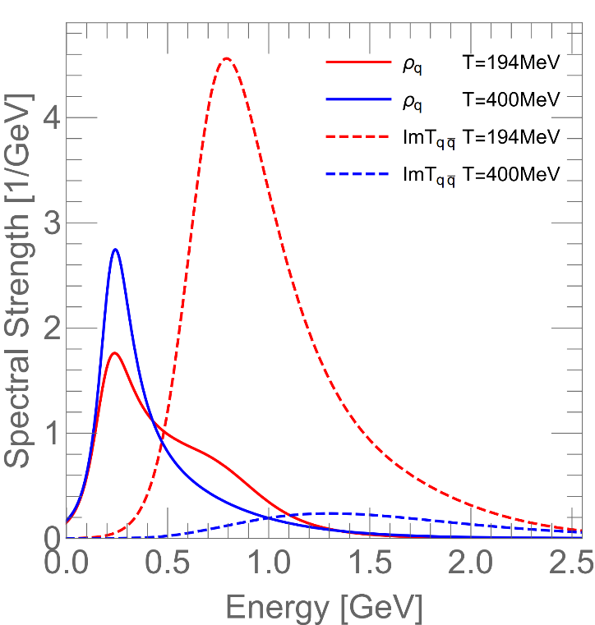
4.3 QGP Equation of State + Degrees of Freedom
Input Masses Pressure Quark + “Meson” Spectral Fcts
Confining force near T_{pc} : - soft partons melt
- broad hadronic resonances emerge

Slide 26
5.3 LQCD Constraint II: Extended Operators
[Tang,Mukherjee,Petreczky+RR, in prep]
[Larsen et al ‘20]
Quarkonium spectral fct:
Effective mass
Slightly less potential screening

Slide 27
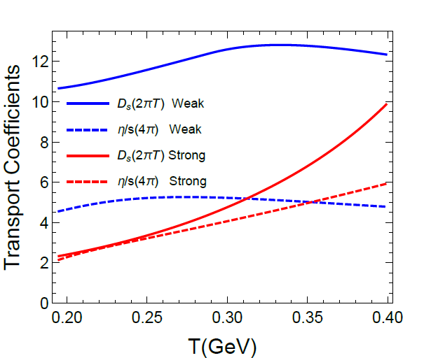
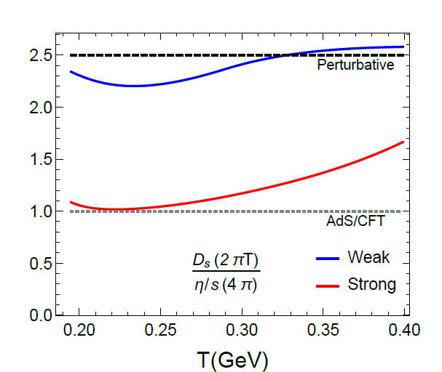
4.4 Transport Coefficients + Strong-Coupling Limit
Shear Viscosity and Heavy-Quark Diffusion
Strongly coupled: (2πT) D_{s} ~ (4π) η/s
Perturbative: (2πT) D_{s} ~ 5/2 (4π) η/s
Transition as T increases

Slide 28
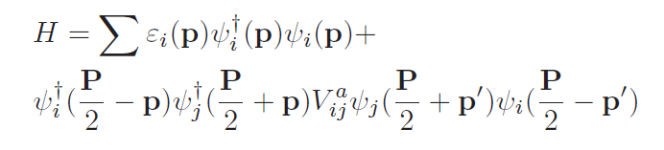
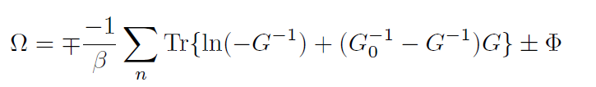



4.2 QGP Equation of State + Spectral Functions
In-Medium
Hamiltonian
Thermodynamic
Potential (pressure)
Selfconsistent SFs
Lutttinger-Ward
Functional
G = G₀ + G₀S G
S = GT
T = V + VGGT
n,n
Full off-shell resummed Luttinger-Ward functional (!)
→ accounts for dynamically emerging hadronic resonances
Fit “bare” quark + gluon masses

Slide 29
3.4 Susceptibilities
μ_{B} dependence of bare masses + potential
fit b_{m}=0.1, b_{s}(T) to
predict charm susceptibilities
Susceptibilities compatible with heavy-light resonances above T_{pc}
Genuine prediction of negative χ^{uc}
[Liu+RR ‘22]

Slide 30
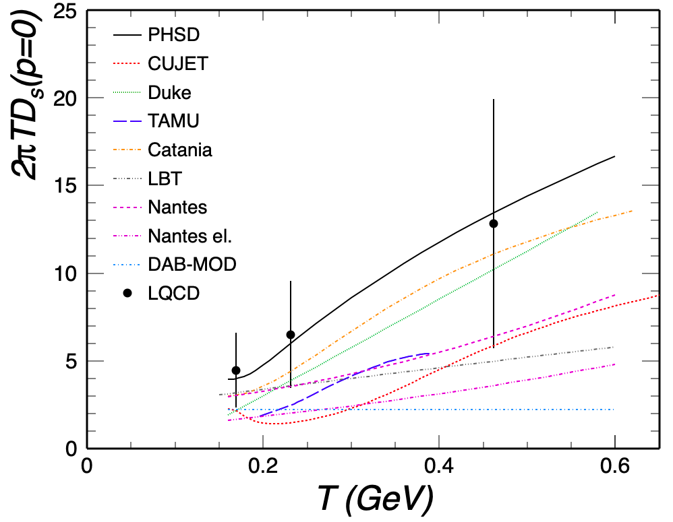
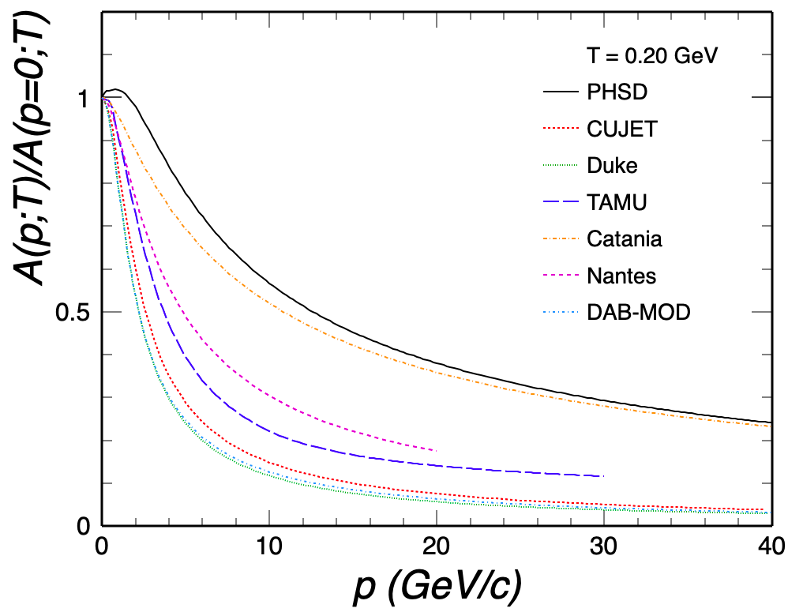
2.6 Temperature vs Momentum Dependence
[ECT* HF workshop ’21, RR et al]
correlation: large D_{s} ↔ weak p-dependence
need control over momentum dependence

Slide 31
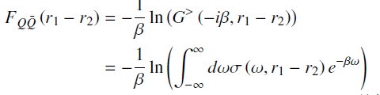


2.2 Potential Extraction from Lattice Data
Free energy ≠ potential: F_{QQ} = U_{QQ} – T S_{QQ}
Microscopic many-body approach:
−
QQ spectral function
Use trial potential
Self-consistently calculate self-energies to fit lattice-QCD data for F_{QQ}
Weak coupling (small Σ_{I}): F → V

Slide 32
3.4 Charmonia - Open-HF Coupling II: Elliptic Flow
QGP charm-quark diffusion + RRM
Recombination reaches out to p_{T} ~ 8 GeV [He,Wu+RR ’22]

Slide 33


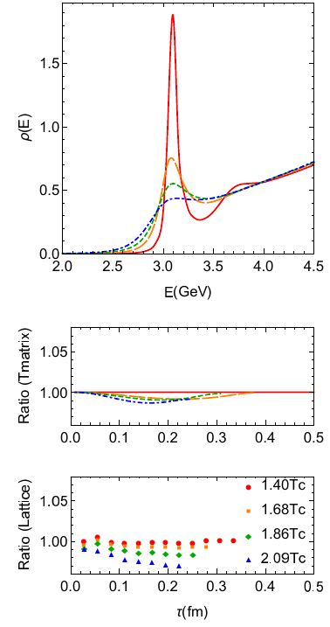
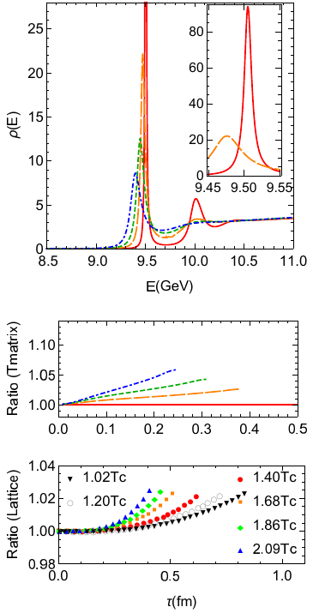
2.3 Lattice Constraints II: Euclidean Correlators
Charmonium Bottomonium
[Liu et al ’18]
[Aarts et al ’18]
J/y melts near T~ 320 MeV
ϒ(1S) survives until T > 500 MeV

Slide 34

3.) Hamiltonian Approach to QGP
In-Medium Hamiltonian with ``bare” 2-body interactions
- effective light-parton masses
Interaction: Cornell potential with relativistic corrections
- as used in heavy-quark sector
Implement into Brueckner / Luttinger-Ward-Baym approach

Slide 35
3.3.3 Heavy-Flavor Spectral Functions
Charm-Light Quark T-Matrix Charm + Bottom Quark SFs
Broad D-meson resonances emerge near T_{pc}
Despite large widths, G_{Q} ~ 0.6GeV << w_{Q}
⇒ c + b quarks remain reasonable quasiparticles!

Slide 36
4.5 In-Medium Quarkonium Binding Energies

Slide 37
4.4 Two Main Observables in Heavy-Ion Collisions
Modification of transverse-momentum (p_{T}) spectra in AA collisions
relative to pp collisions:
R_{AA} (p_{T}) ≡ (dN/dp_{T} )_{AA} / ( N_{coll} dN/dp_{T} )_{pp}
Angular distribution of the particle spectra
v₂: “elliptic flow” coefficient
→ reflects coupling strength of
heavy quark to medium expansion
Q

Slide 38
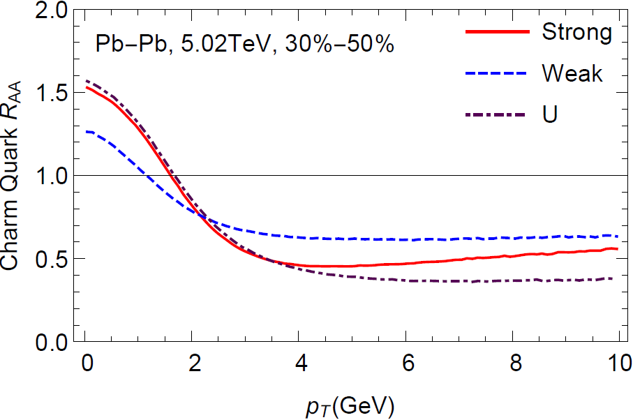
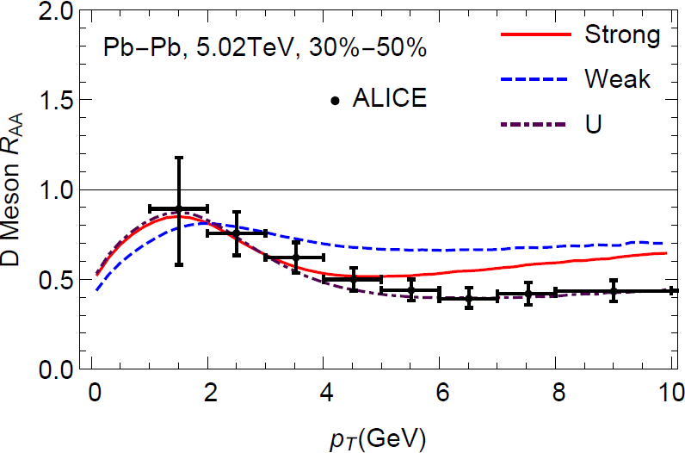
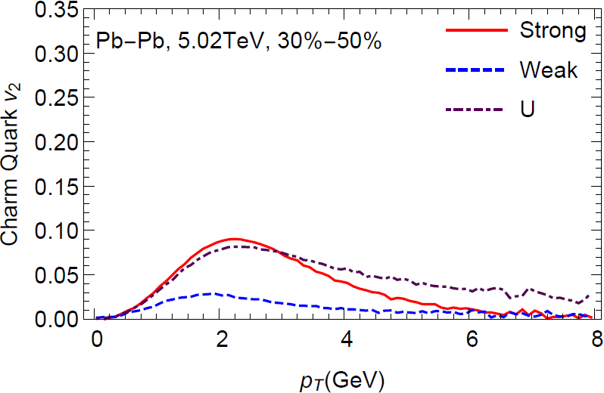
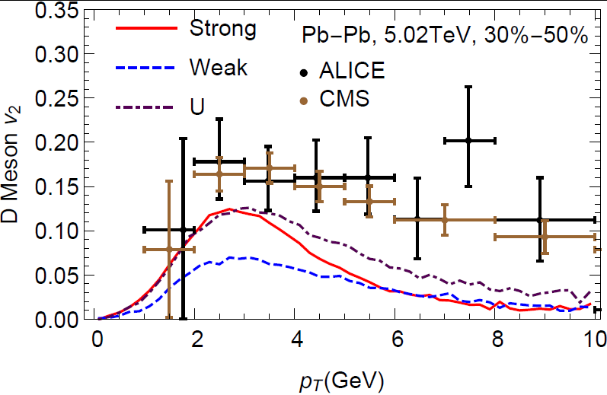
4.5 Sensitivity to Heavy-Quark Potential
Charm Quark D Meson
Strongly-coupled potential gives max. low-p_{T} c-quark v₂
Weakly-coupled potential (~ free energy) insufficient
[Liu,He+RR ‘19]

Slide 39

2.6 Charm Hadro-Chemistry
-
D meson with strange quark: D_{s}= (cs)
[ALICE ‘21]
Strange quarks in
QGP enhance D_{s}
via recombination
[He,Fries+RR ‘13]
Charm Baryon-to-Meson Ratio: Λ_{c} / D⁰
Recombination + flow
effect on Λ_{c}

Slide 40
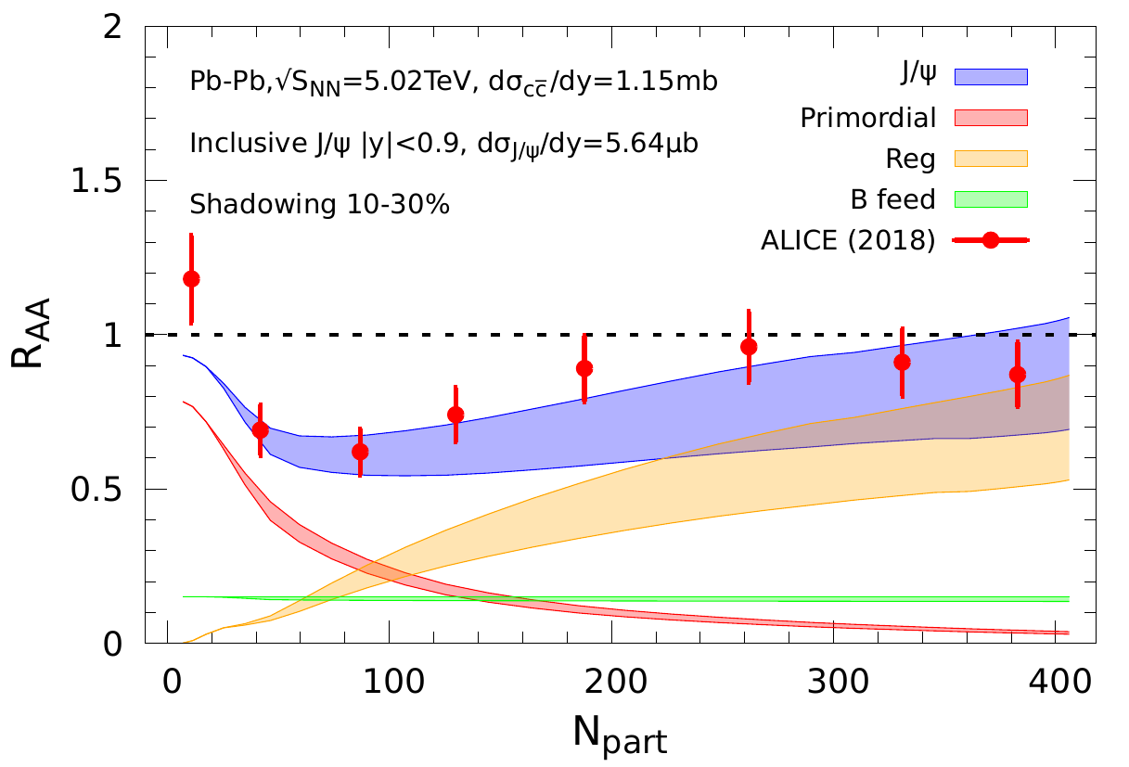
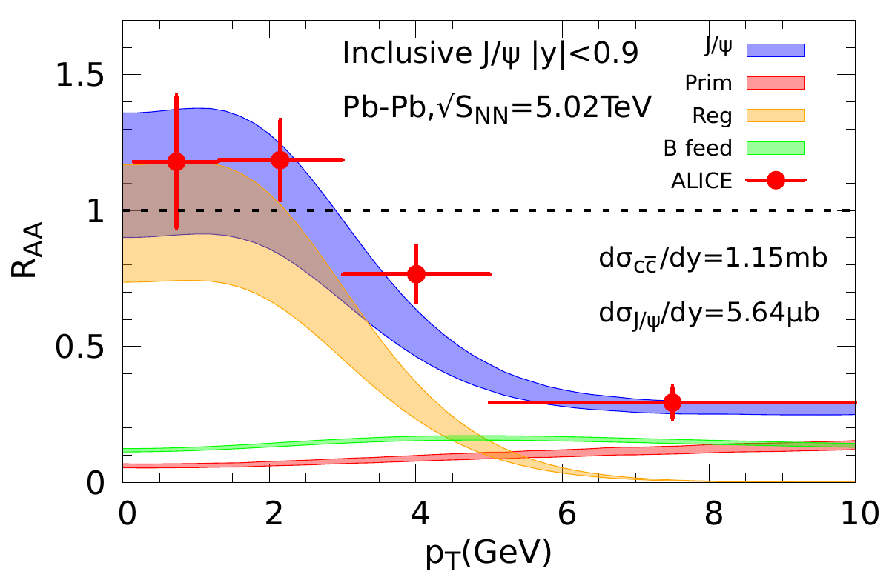
3.4 Charmonium Transport: LHC
Centrality p_{T} Dependence
Mid-
Rapidity
Forward
Rapidity
substantial regeneration, concentrated at low p_{T}

Slide 41
3.5 Interplay of Transport Coefficients: Charmonia
Phenomenological constraints on Γ_{ψ} from d/p-A:
J/ψ suppressed in QGP, ψ(2S) in hadronic matter
Transport in AA:
J/ψ / ψ(2S) near equilibrium in QGP / hadronic phase
→ “Sequential Regeneration” [Du+RR ’15]
[Wu+RR ‘24]

Slide 42
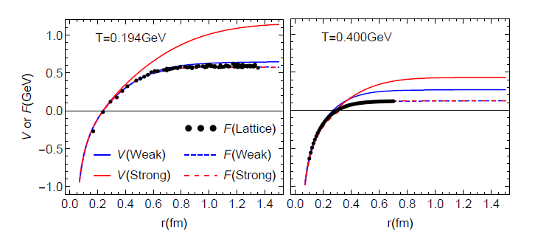
2.2.2 In-Medium Potential from Lattice Data
Two types of solutions:
weakly coupled scenario (WCS) vs. strongly coupled scenario (SCS)
WCS: potential close to free energy F, Γ_{Q} = 2Σ_{I} ~ 0.1 GeV
SCS: remnants of confining force well above T_{c}, Γ_{Q} ~ 0.6 GeV

Slide 43
1.5 Strongly Coupled QGP
⇔ Quantum liquid with transport coefficients
near conjectured lower bounds
Microscopic calculation of transport coefficients should
obey quantum-lower bounds
Description of bulk medium through which heavy quarks
propagate should encode strong-coupling properties
→ transport coefficients: (4π)η/s, D_{s}(2πT), σ_{el}/T
Large scattering rates → large collisional widths
→ broad spectral functions → off-shell (quantum) effects
Q
QGP
Q

