Slide 1
TODAY
Next Meeting: 28th of January 2020

Slide 2
Upcoming events
HIT
January 21, Tuesday, 3:00pm
Shujie Li (Univ. of New Hampshire)
INPA
Arnaud De Mattia – IRFU, CEA, Université Paris-Saclay
January 17 @ 12:00 pm - 1:00 pm
Bldg. 50A, room 5132.
Nuclear Theory
Xiandong Ji
Wed, 15. Jan, 1pm, Swiatecki (Theory) Lounge @ B70
RPM
Marjon Moulai (MIT) “Unstable Sterile Neutrinos in IceCube and Beyond
January 14 @ 4:00 pm - 5:00 pm, 50A-5132 (Sessler Conference Room)
Daniel Joseph Antrim (UCI) “It Takes Two to Lambda: A New Dilepton Channel for the Search for Higgs Boson Pairs and a Pair of New Small Wheels for the Upgrade of the ATLAS Detector at CERN”
January 16 @ 4:00 pm - 5:00 pm, INPA Common Room (50-5026), 50-5026
Reserved - January 23 @ 4:00 pm - 5:00 pm, 50A-5132
UCB Nuclear Engineering
Compact accelerators and photon sources using laser-driven plasma acceleration
January 27 @ 4:00 pm - 5:00 pm
3105 Etcheverry Hall
UCB Physics
QUANTUM SUPREMACY USING A PROGRAMMABLE SUPERCONDUCTING PROCESSOR
John Martinis, UC Santa Barbara and Google
Monday, January 27, 2020 - 4:15pm
Location: 1 LeConte

Slide 3
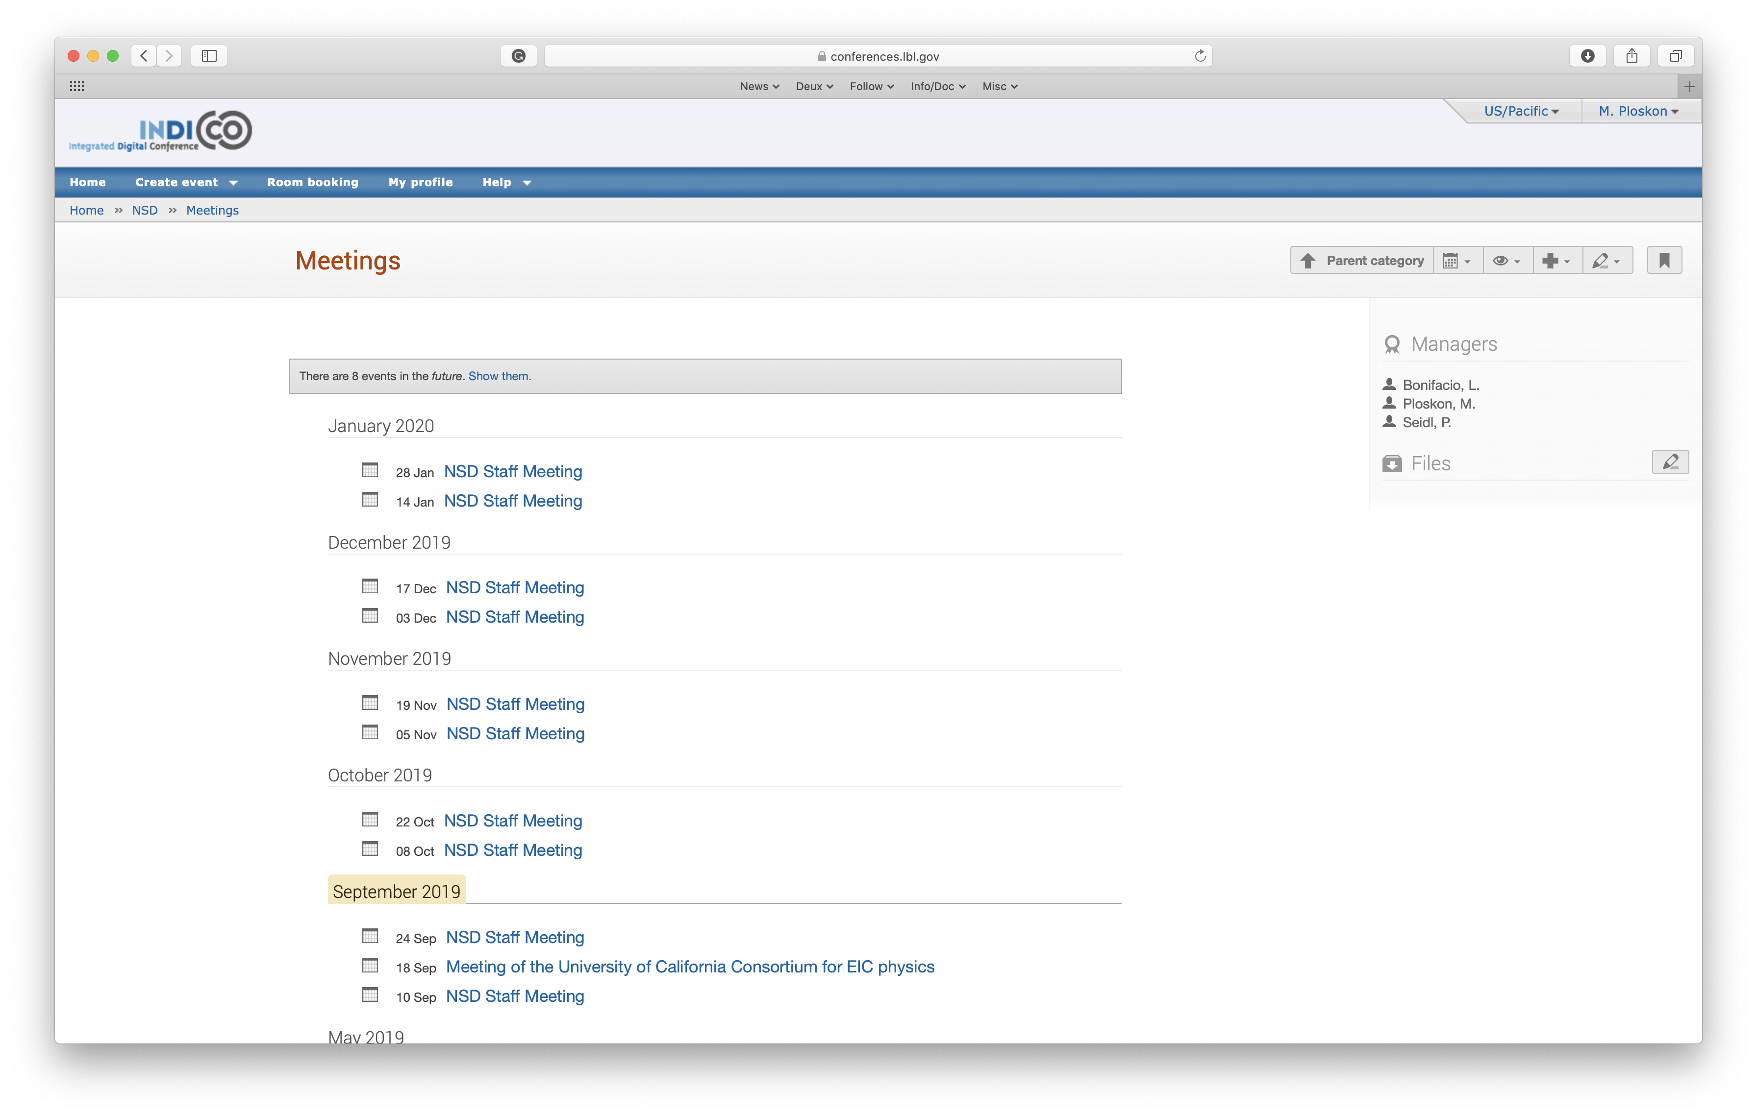
Next Meeting: 28th of January
https://conferences.lbl.gov/category/73/
Volunteers/suggestions welcome!

