Slide 1
C3 update
MDP bi-weekly meeting
X. Wang, 10 September 2025

Slide 2
Topics for today
Tests we have so far, especially the second test in June
See Yufan’s talk at MT-29
First look at the short-sample limit at 4.2 K
What’s next

Slide 3
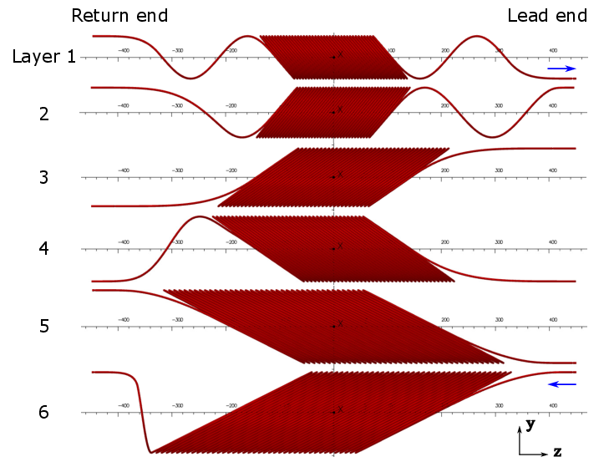
Magnet design was driven by the 30 mm minimum bend radius of the CORC® wire as of 2018
ID 65 mm, OD 160 mm, 900 mm long
Today’s CORC® wire can be bent to 20 mm radius

Slide 4
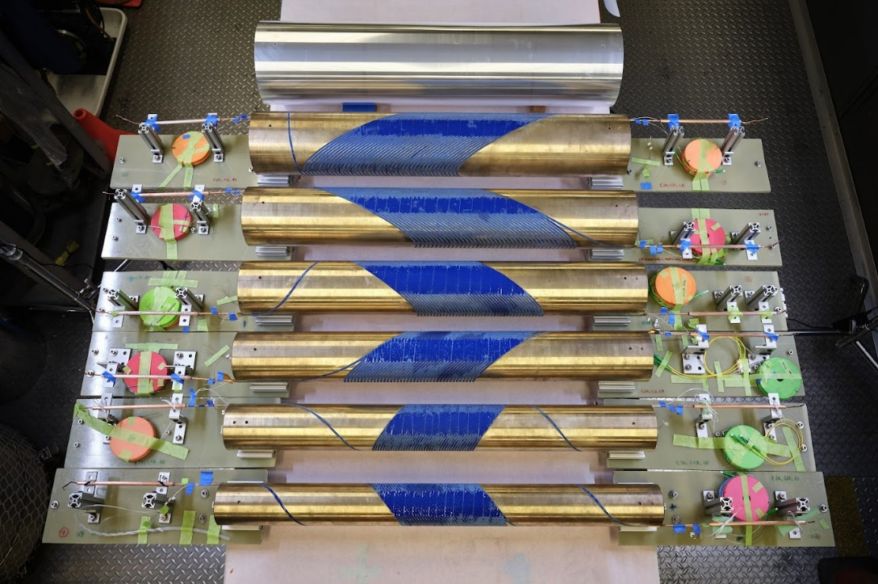
Coils and shell before assembly, November 2024
A. Saravanan designed the mandrels
R. Norris designed the shell
Co-wound two optic fibers with the CORC® wire in each layer
Image courtesy of A. Lin

Slide 5
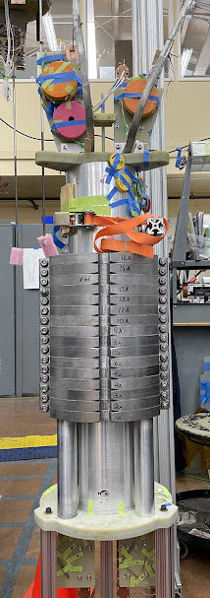
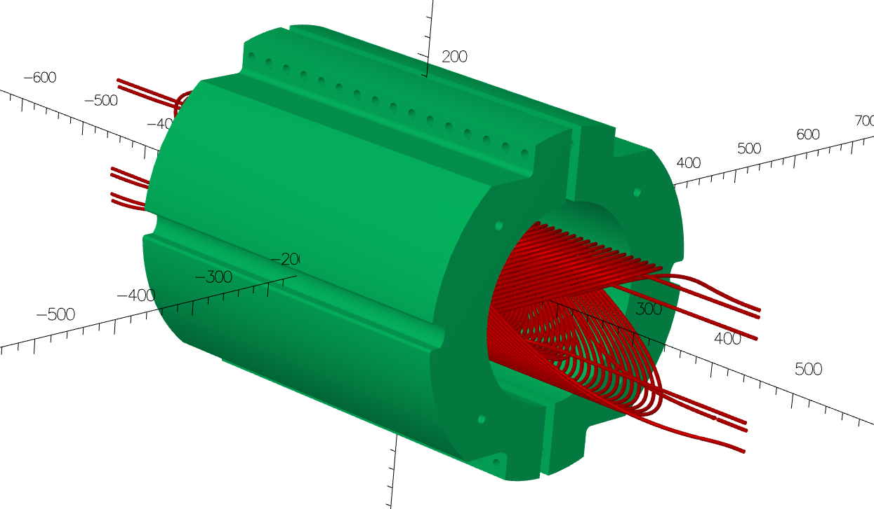
C3 has an iron yoke outside the aluminum shell
Designed by L. Brouwer, R. Norris and D. Arbelaez, following Nb₃Sn CCT5
25.4 mm thick laminations, 76.2 mm radial thickness, covering 406 mm magnet length
Increased the TF by 30%, from 0.72 to 0.93 T/kA

Slide 6
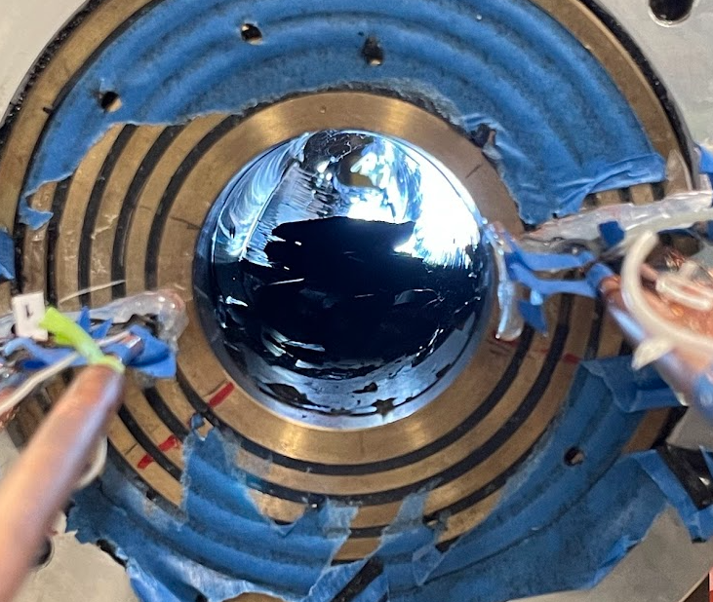
The unplanned Stycast in the aperture limited the scope of the first test
Stycast leaked into the aperture and filled ~ 40% of the volume
Not trivial to quickly remove it
Impact on magnet/conductor unknown
Live with the Stycast in the first test
Assess the magnet performance without pushing
Install a Hall probe in the aperture to verify the dipole field

Slide 7
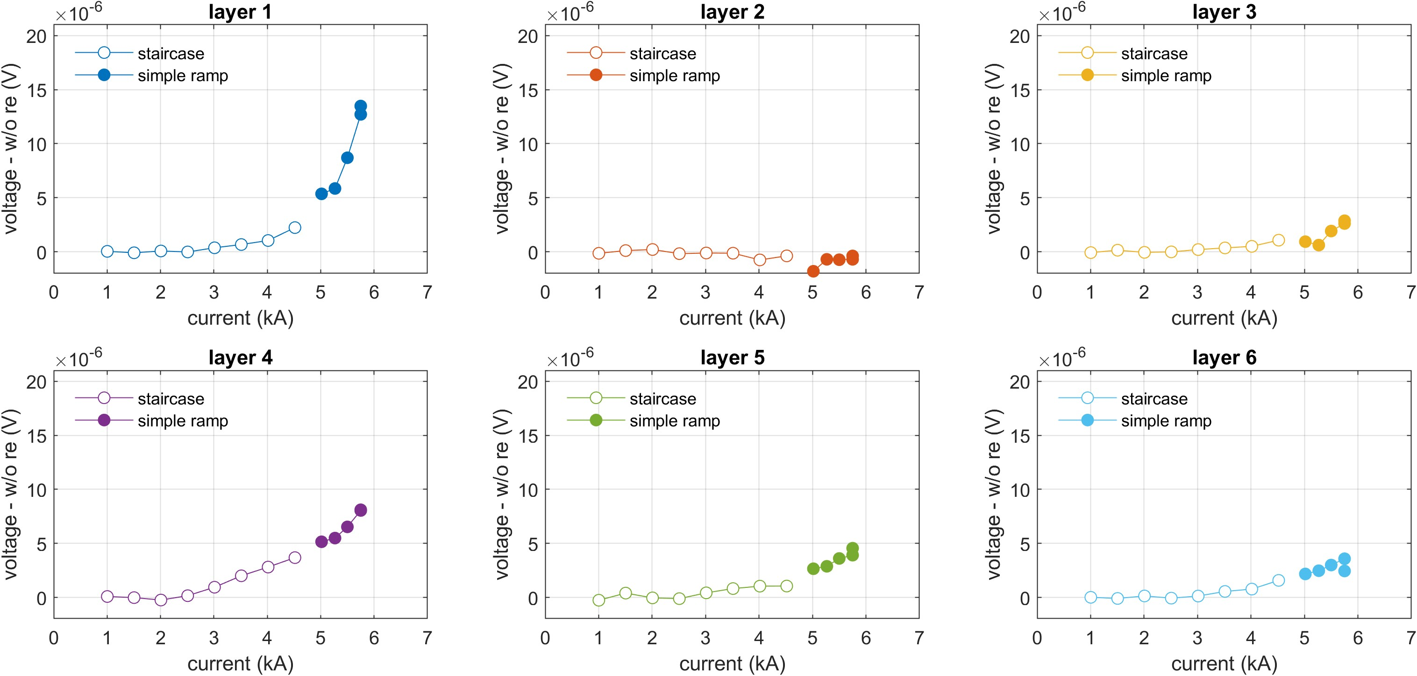
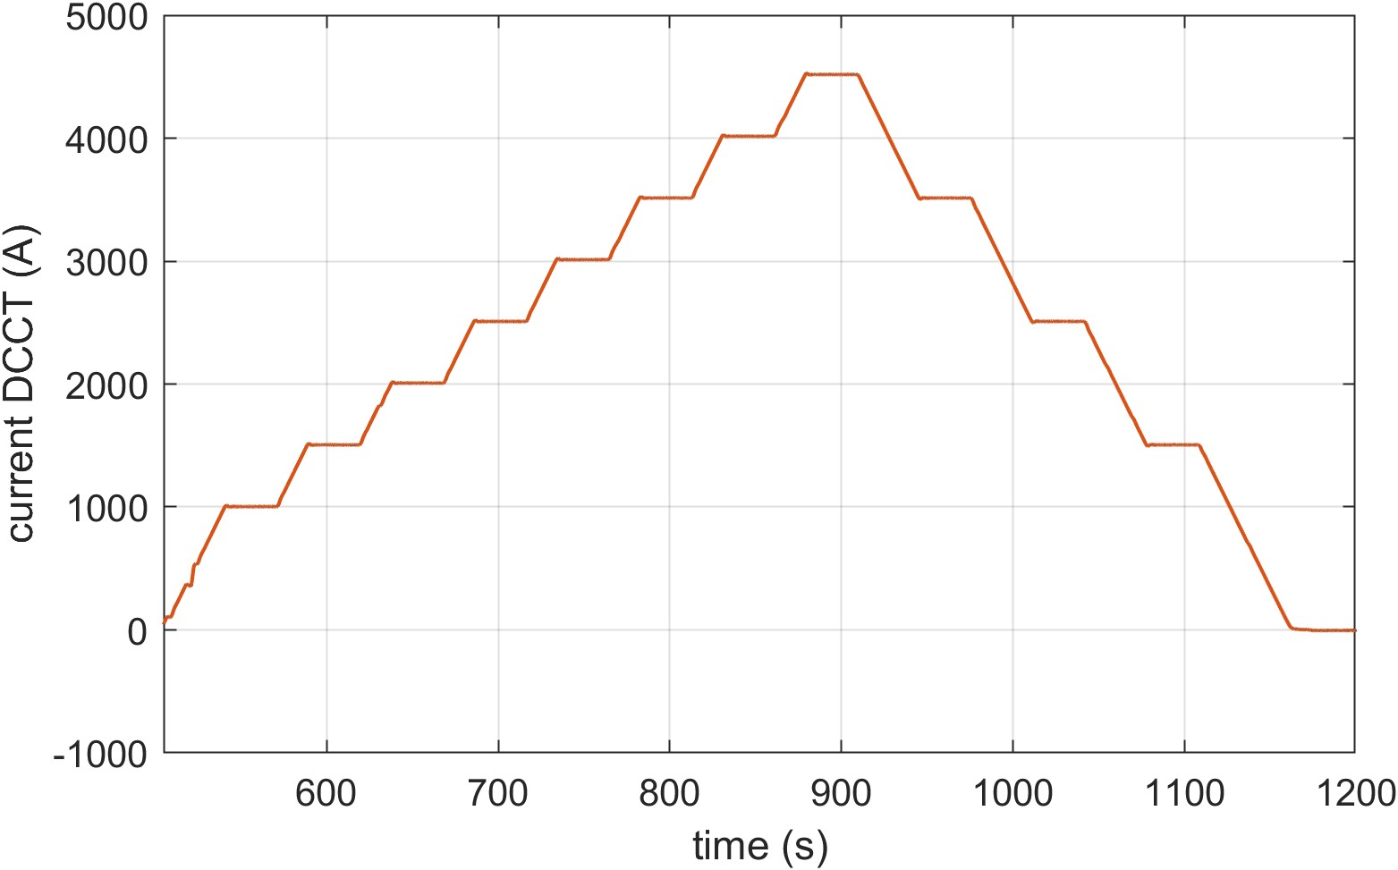
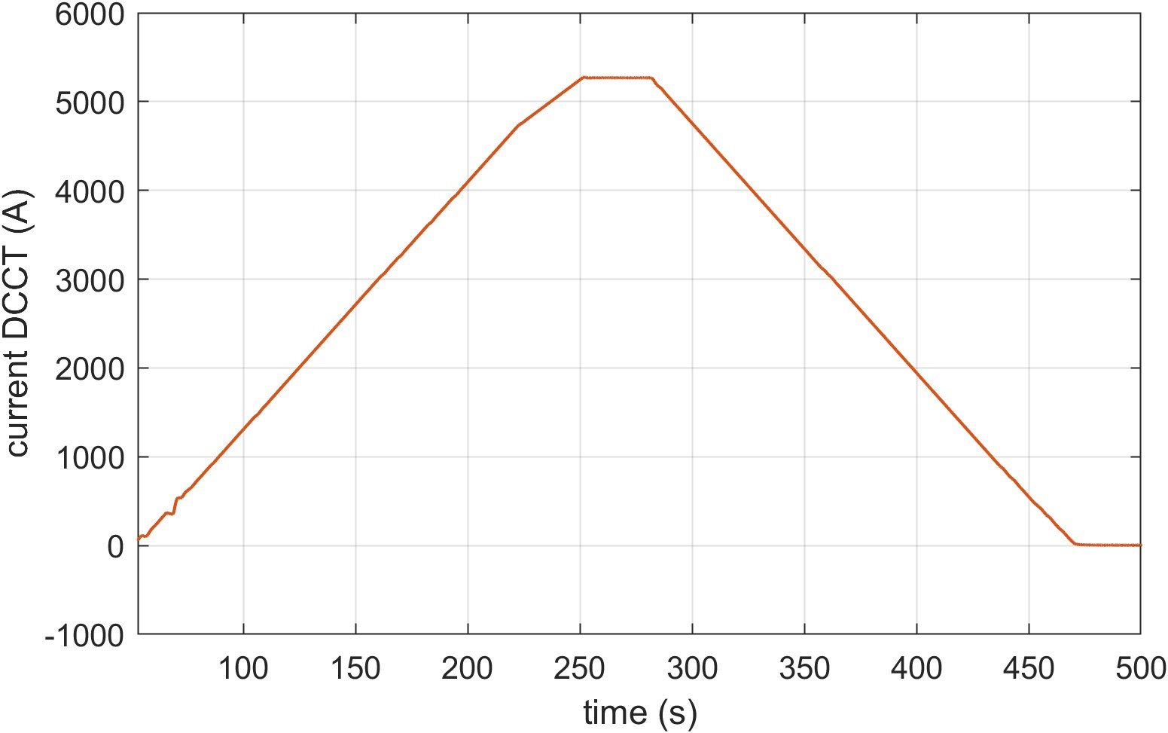
The magnet showed a reasonable performance
We stopped at 5.75 kA with Layer 1 voltage peaked at 14 µV
Y. Yan
staircase ramping
simple ramping

Slide 8
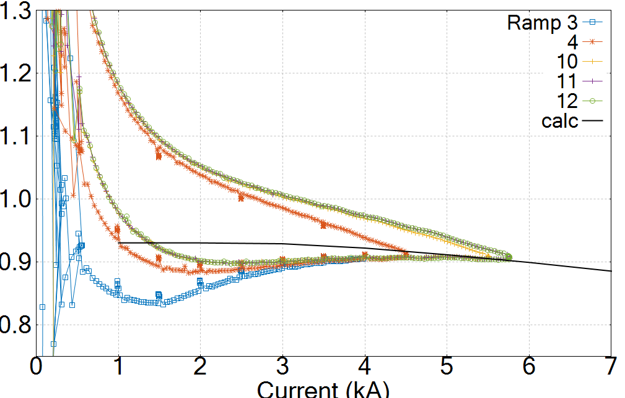
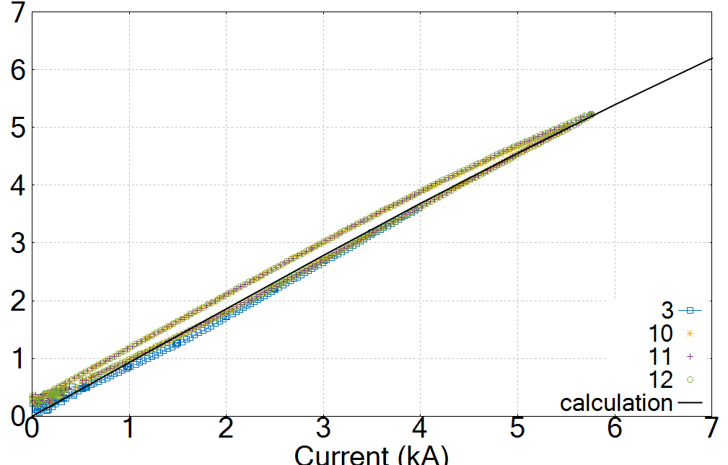
Generated a dipole field of 5.2 T, agreeing with the calculation
First 4.2 K test, March 2025
Iron contributed 1.1 T,
21% of the total field
4.2 K
Dipole TF (T/kA)
Dipole field (T)
5.2 T
4.2 K
Measured using a Hall probe
Calculation by Y. Yan and L. Brouwer

Slide 9
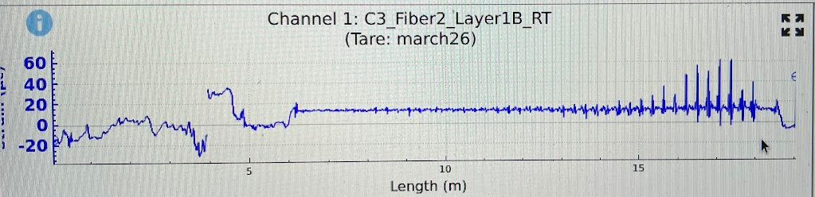
Removing the Stycast was stressful
Fiber in Layer 1 picked up the strain as we started – conductor was strained
3/27/2025
Peak strain increased by 200 µε as we got desperate and cut harder
Would it degrade the conductor and magnet performance ?

Slide 10
Questions for the second test
Did removing Stycast in the aperture degrade the magnet?
What’s the field quality?
Measure with a rotating probe developed by J. DiMarco
Can we push for a higher magnet voltage and dipole field?
Notes:
What’s the short-sample prediction?
Measure the I_{c} (B) of the wires at 77 and 4.2 K

Slide 11
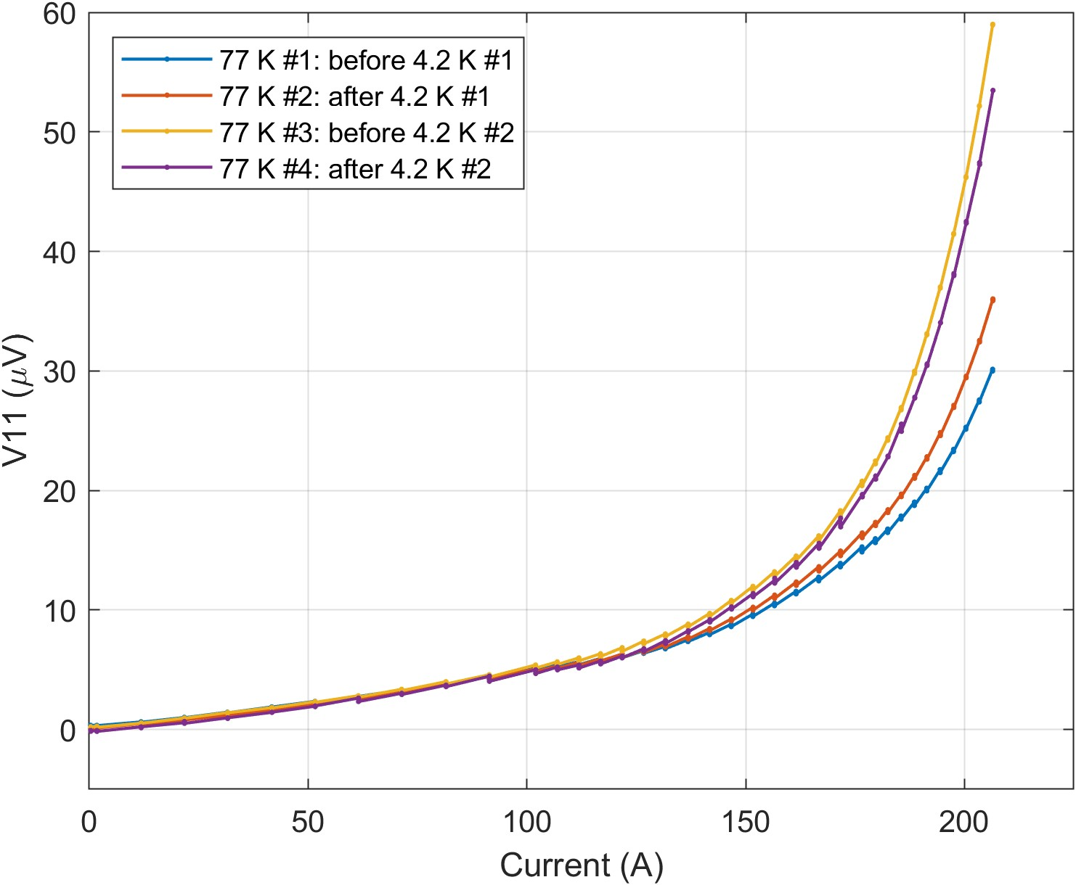
77 K data showed a I_{c} degradation after removing the Stycast
after removing Stycast
before removing Stycast
Y. Yan

Slide 12
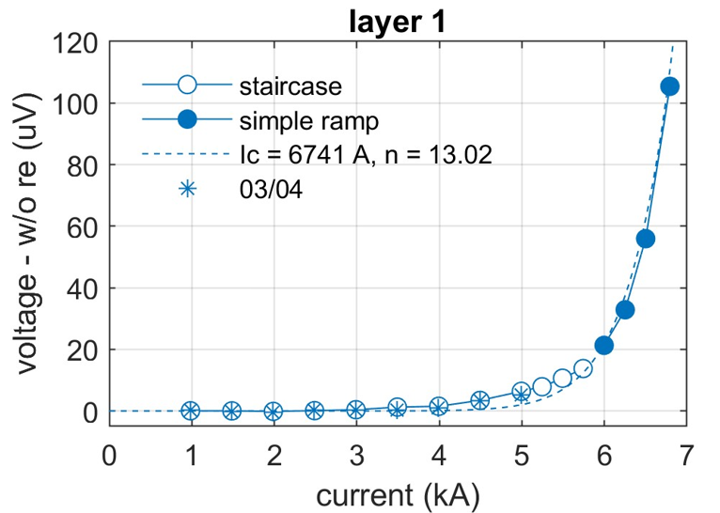
The degradation, however, was less obvious at 4.2 K
Y. Yan

Slide 13
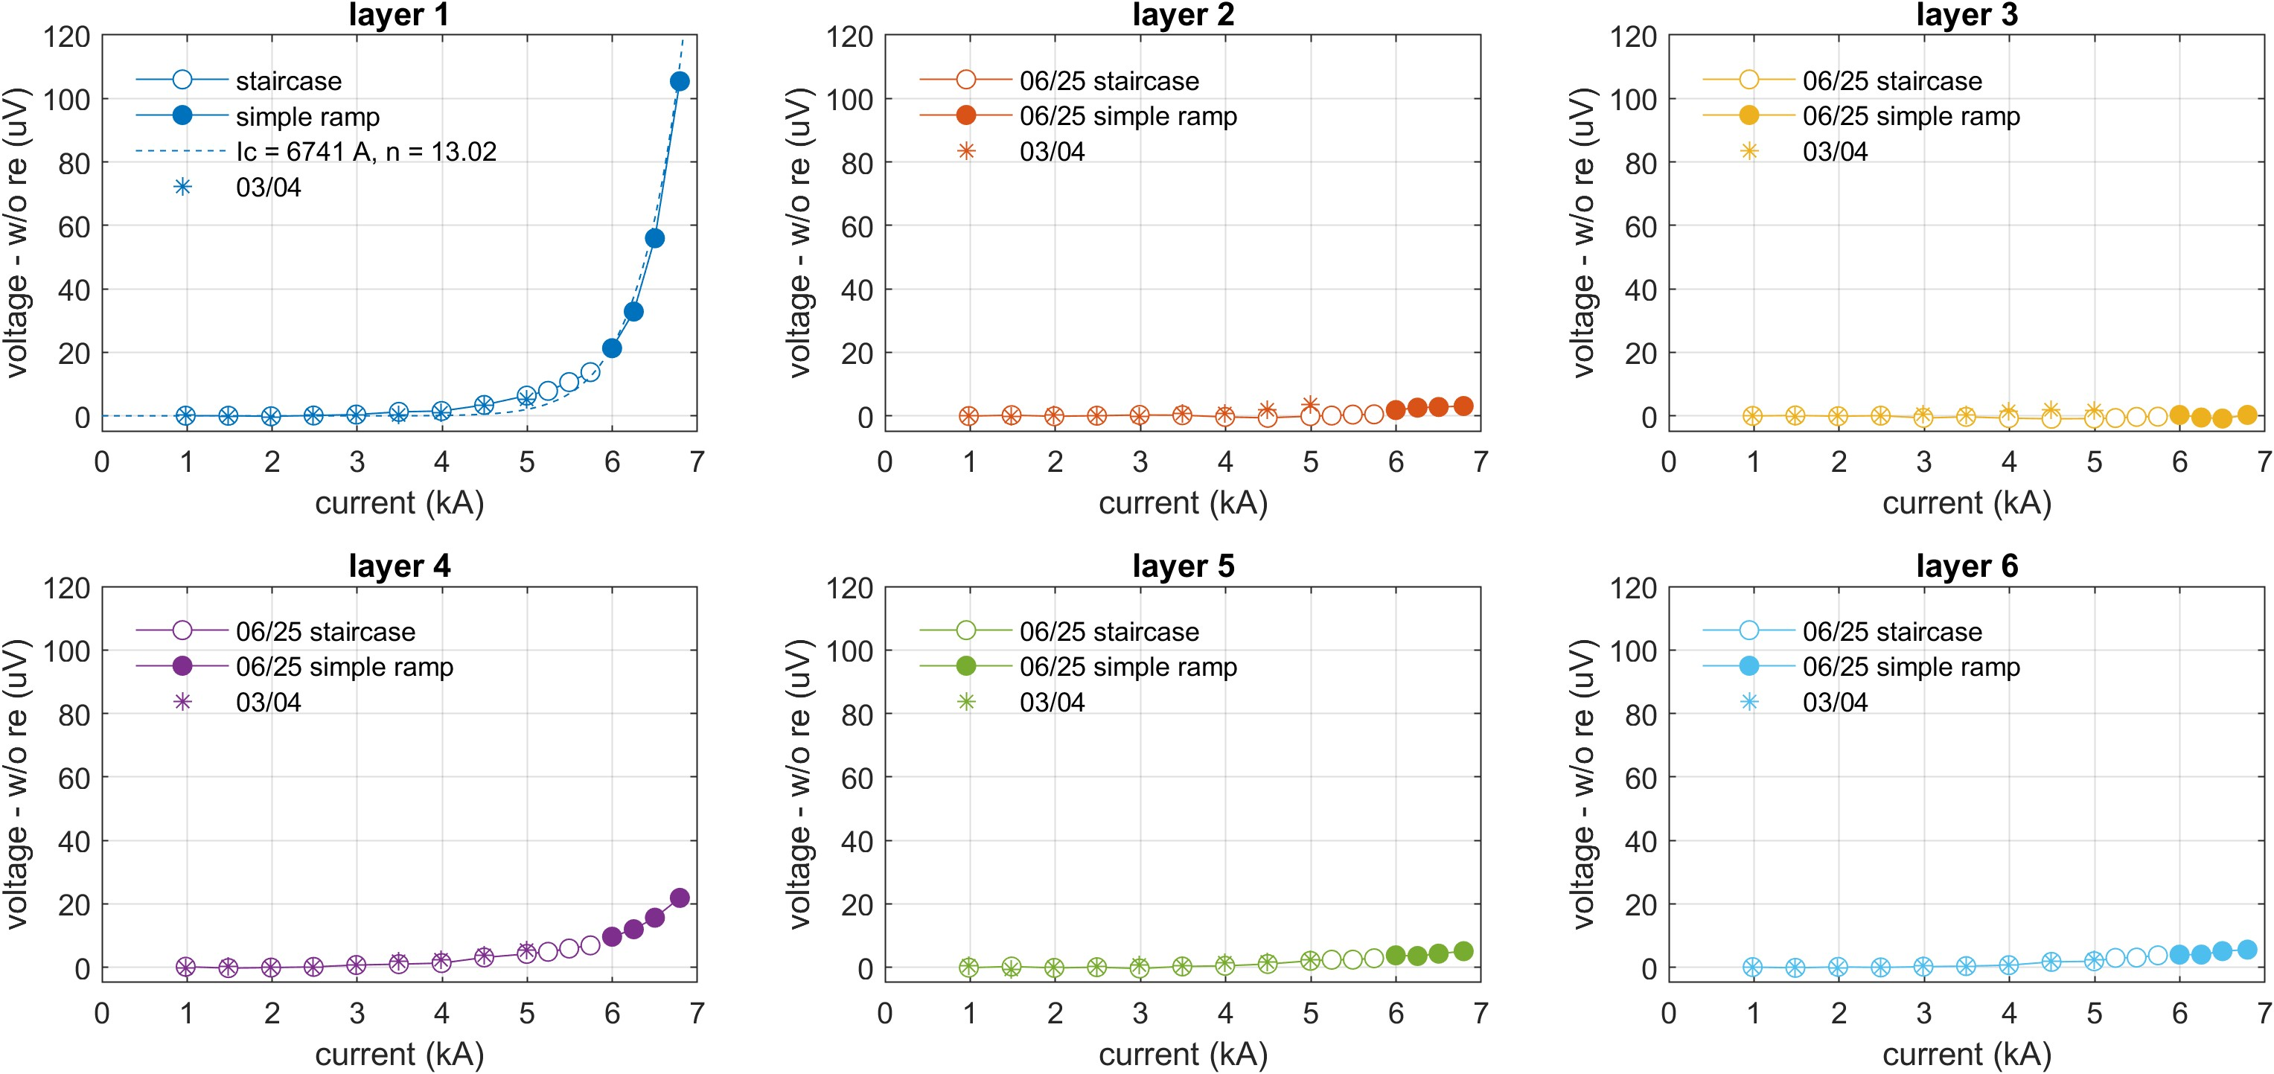
We stopped at 105 µV across Layer 1, reaching 6.75 kA at 4.2 K
06/25/2025: peak current 6.75 kA, I_{c} = 6741 A at V_{c} = 100 µV, n = 13
Layer 1 initial voltage increase started at ~3 kA
Slow voltage rise also observed in Layer 4
Y. Yan

Slide 14
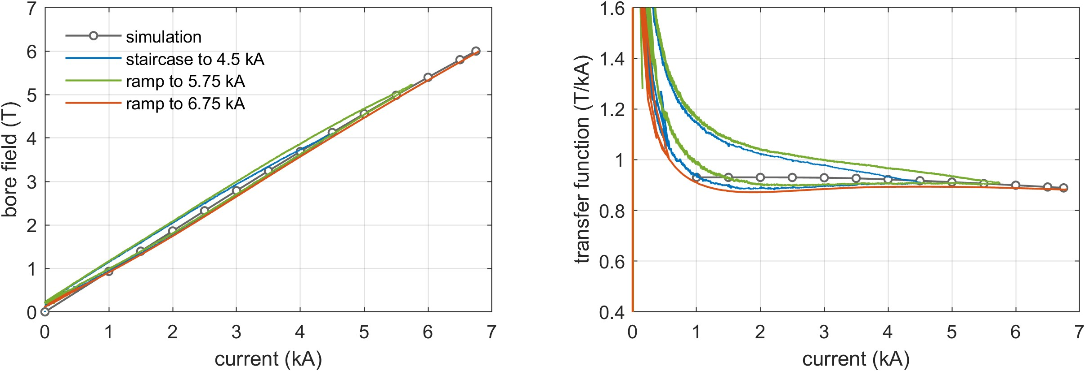
The dipole field reached 5.99 T at 6.75 kA
5.99 T
4.2 K
4.2 K
Peak I x B force on the conductor ~ 42 kN/m
Iron contribution ~ 1.1 T, 19% of the total field
Calculation by L. Brouwer and Y. Yan

Slide 15
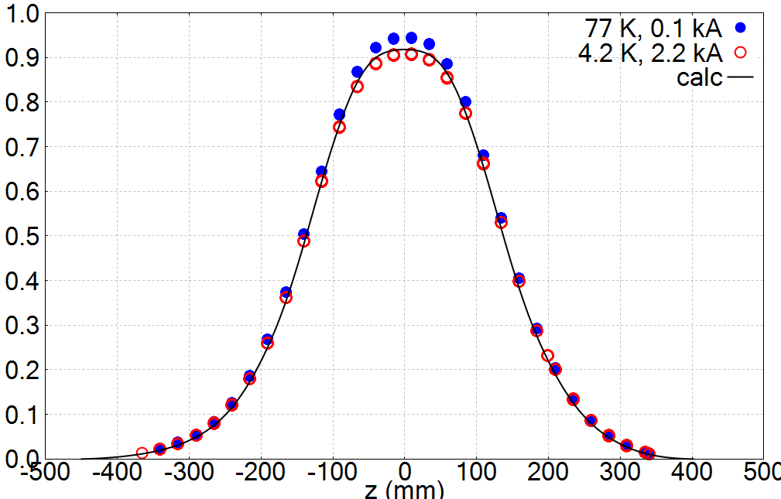
Field profile roughly matches that from simulation (w/o magnetization)
B1 TF (T/kA)
Rotating coil developed by J. DiMarco; Measurement system by B. Ghiorso and R. de Leon.

Slide 16
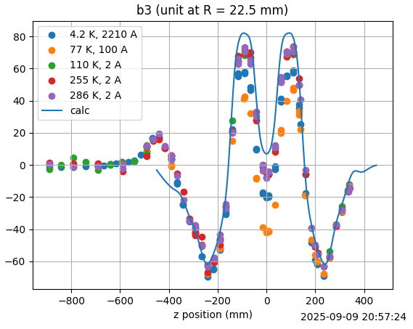
Stronger persistent-current effect at 77 K than at 4.2 K in the normal sextupole, b₃
Different from C2
-11 units at 4.2 K
-33 units at 77 K

Slide 17
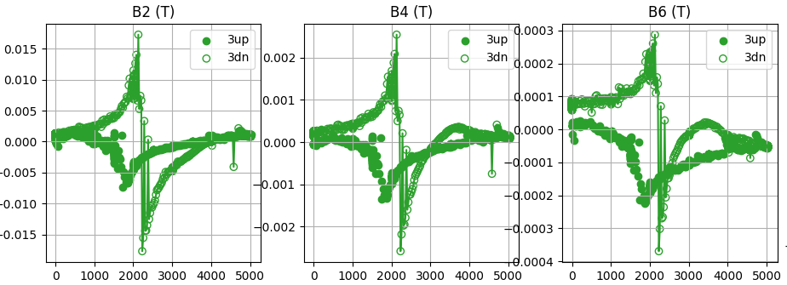
One of the mysteries in the measured multipoles
The trajectory of the multipoles reversed during the down ramp around 2 kA
Current (A)

Slide 18
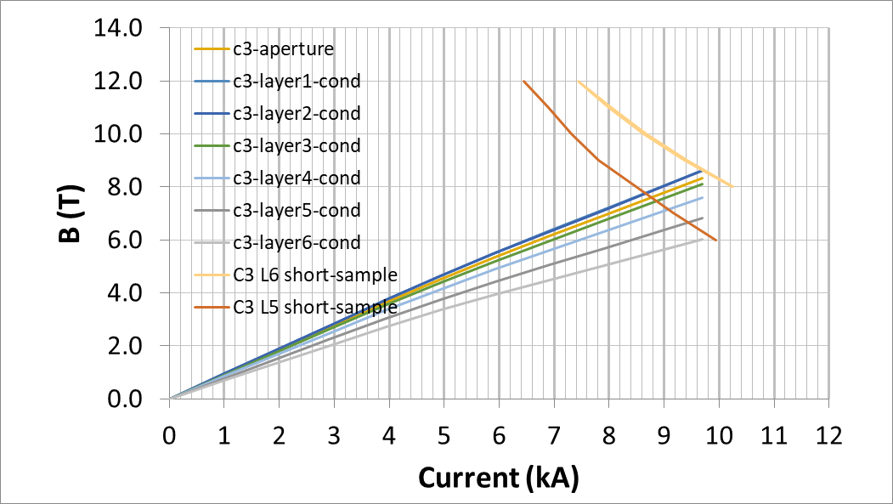
Short-sample dipole field for C3 is at least 8 T at 4.2 K
Measured I_{c}(B, 4.2 K) for Layers 5 and 6
Expect better performance for the inner-layer conductors
ACT will measure the short samples for the other layers

Slide 19
Two conclusions
Layers 1 and 4 likely degraded before the test
Measure the short-sample performance at 77 K to confirm
Search for causes of degradation → learn and share lessons → fewer bugs next time
Can reach 10 T dipole field using today’s CORC® wire based on the HM tapes
Verify that the conductor will be mechanically sound
Search for $

Slide 20
Next – what can we learn from a third test?
Is the magnet still sound?
Effect of previous test and thermal cycles
Complete the field-quality study
Maxim: Design cycles to verify if the reverse of the multipole was due to the magnetization effect?
Will repeated current cycling degrade the performance?
Effect of stress cycles
Can we identify the weak point in the winding?
Holding current at high current for a longer period and see if the fiber picks the temperature rise
What’s the current limit?
Push to a higher current without or with thermal runaway
Maxim: try the MOSFET to shift the current in Layer 1

Slide 21
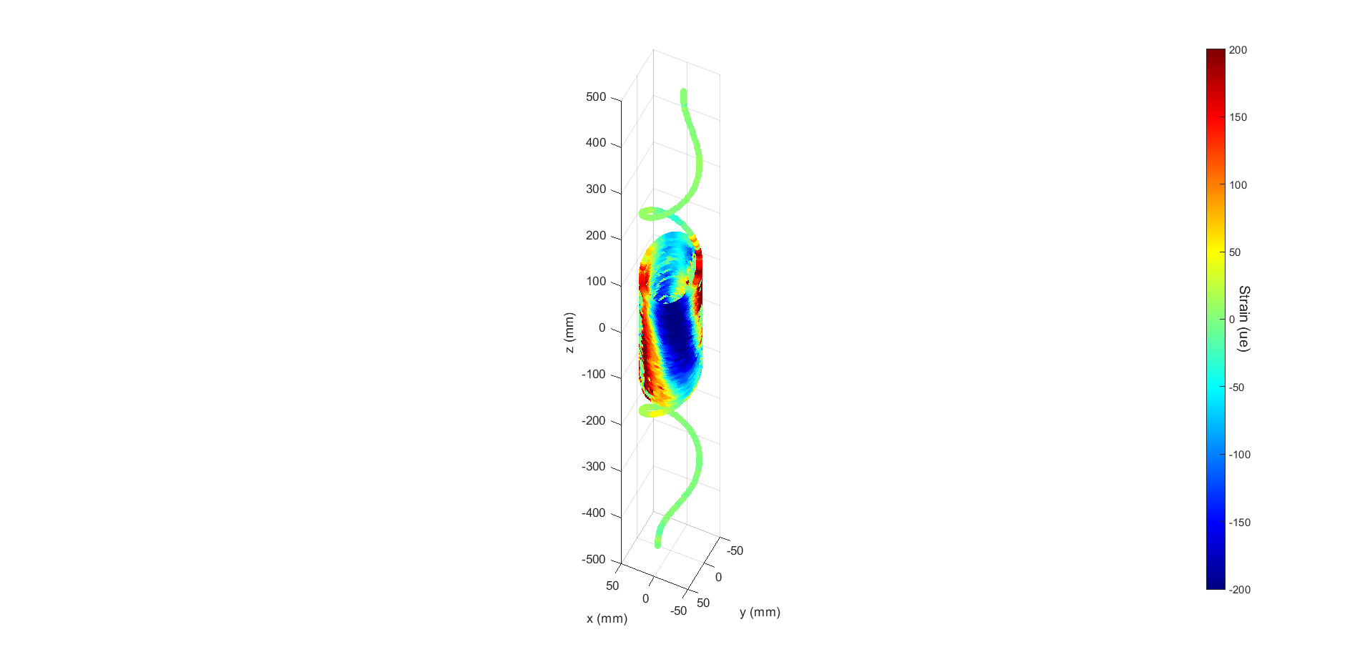
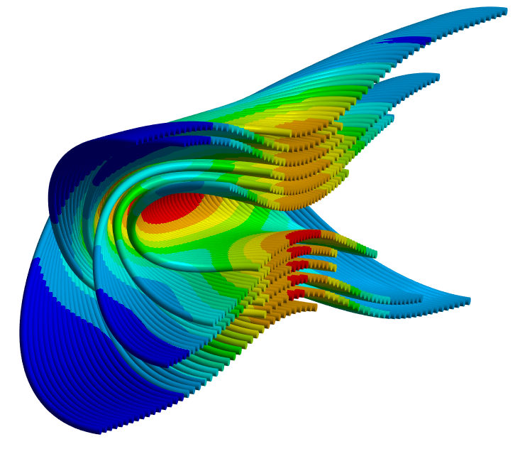
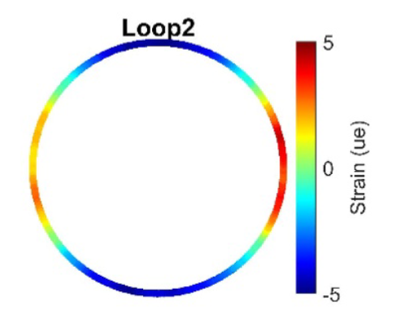
Next - dig into the fiber data and validate finite-element modeling
Measurement by L. Luo
Calculation by G. Vallone
[Luo et al., Wed-Af-Po.08-07]
[Vallone et al., Fri-Mo-Or2-03]
Midplane
Pole
Midplane

Slide 22
We can learn a lot from C3
Data mining just started – hope the funding will be back soon
Keep making better magnets and learn

Slide 23
Questions / comments
Lance: does the model consider the location of individual tapes?
No, the model considers the CORC wire as a cylinder carrying uniform current density across the entire cross section of the wire.
George: the data at the center of the magnet at cold includes both magnetization and geometric effect
Steve: can we tell if the degradation occurred before the coil fabrication?
It’s a good point. We can’t yet.
Ramesh: can we have the leads outside the cryostat to test individual layers?
Yes, it is a good idea. Vadim did that for the COMB magnet
Vadim: Layer 1 is expected to see the highest field so the voltage rise in this layer is expected.
Yes. However, Layer 2 has almost identical peak field as Layer 1 but it didn’t generate significant voltage. However, we cannot rule out Layer 1 wire was degraded before coil winding, as Steve mentioned.

Slide 24
Questions / comments
Maxim:
The reverse of the multipole can be a result of the change of the magnetization in the conductor.
The MOSFET switch will be available soon. May use it to bypass the current in Layer 1.
David:
Can we push the current to the current-sharing regime and check the magnet performance?
Dima:
Slide 16. Field quality experiment: How close to Ic value was the bias current at 77K and at 4.2K?
About uniformity. Do you have TapeStar data for Ic(77K, x)? Does nonuniformity suggest layers 1 and 4th layer having problems?
There may be more that I missed

