Slide 1

Collaboration for large scale demonstration of Telene – step 1
G. Ambrosio, A. Kikuchi, S. Krave, D. Turrioni
FNAL, April 14, 2025

Slide 2
Goal and Steps
Demonstration of Telene for large scale superconducting magnet applications.
Final step: fabrication of accelerator quality coils up to 3.8 m for large aperture magnets (up to 135 mm).
Intermediate steps:
  cable-stacks to demonstrate good quality impregnation, and make samples for measurements of mechanical and electrical properties;
  1-m coils to demonstrate good quality impregnation, and make samples for measurements of mechanical and electrical properties:
Results to be compared with similar samples impregnated with CTD-101k to be used as benchmark

Slide 3
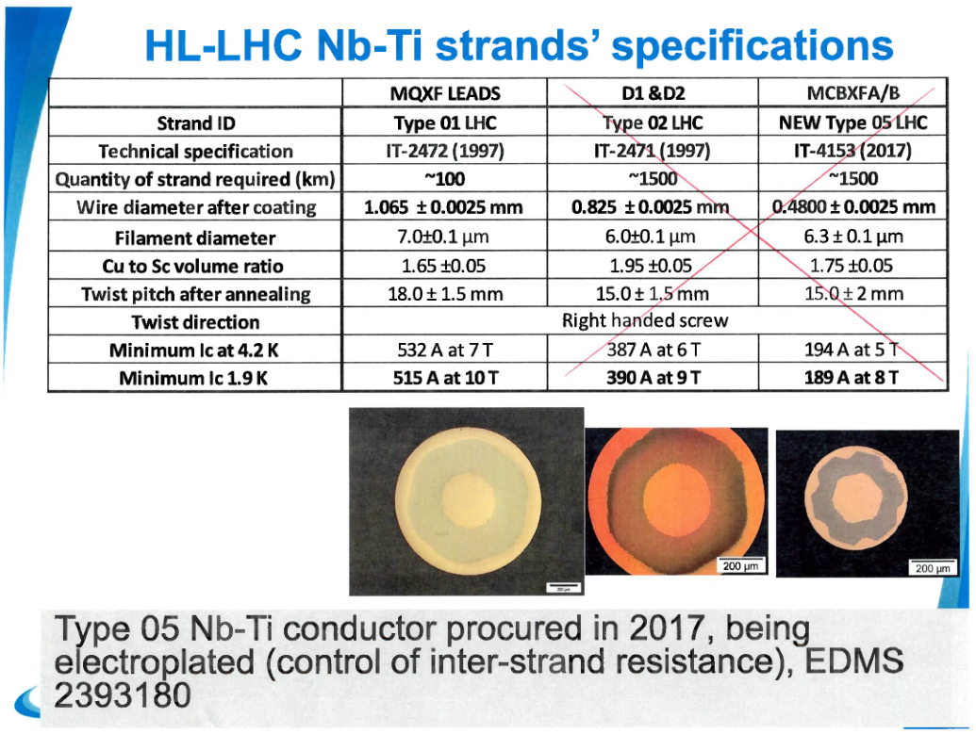
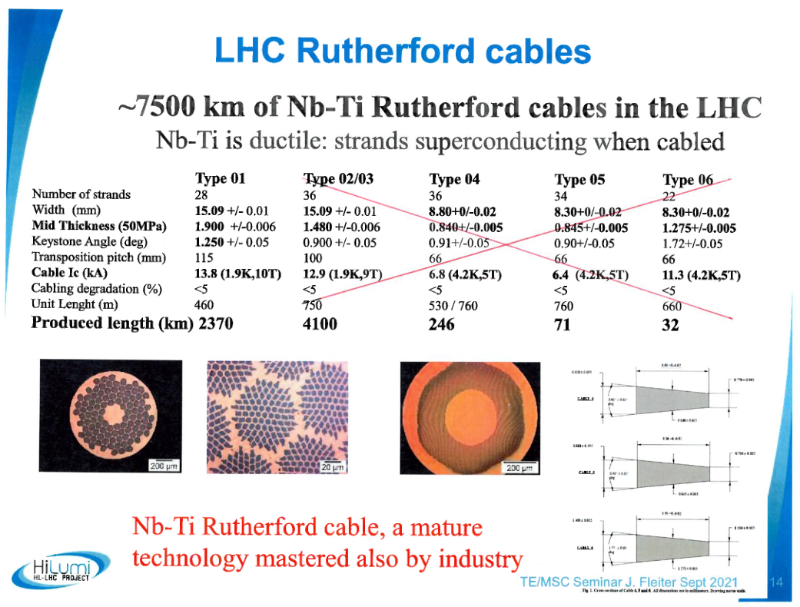
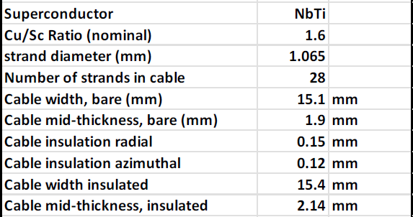
Cable dimensions
EIC IR quadrupole cable dimensions

Slide 4
Insulation compatible with impregnation
S2-glass tape:
  Thickness ~ 75 um
  10-20% overlap at joint allowing small build up
Polyimide tape with adhesive:
  Adhesive to be cured in curing press
  Thickness 25 um
  Width (TBD) smaller than S2-glass tape
  Wound on S2-glass tape center
    gaps for Telene/epoxy flow

Slide 5
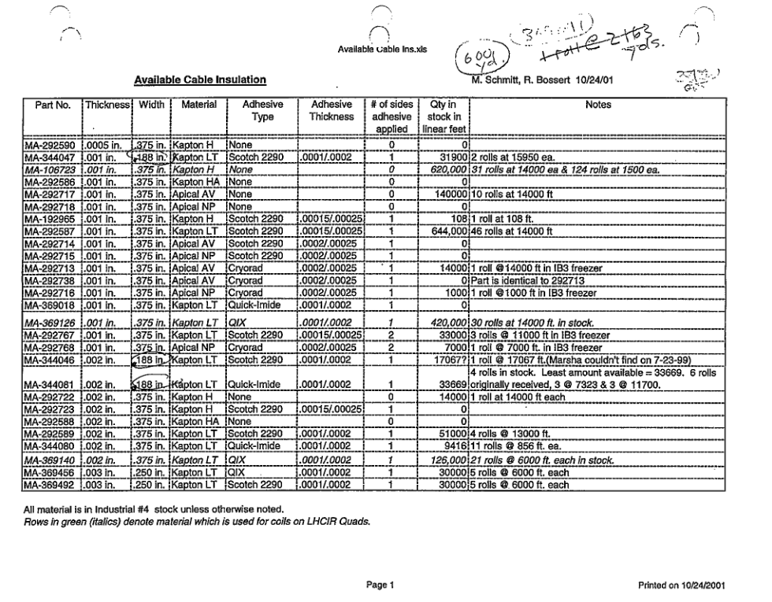
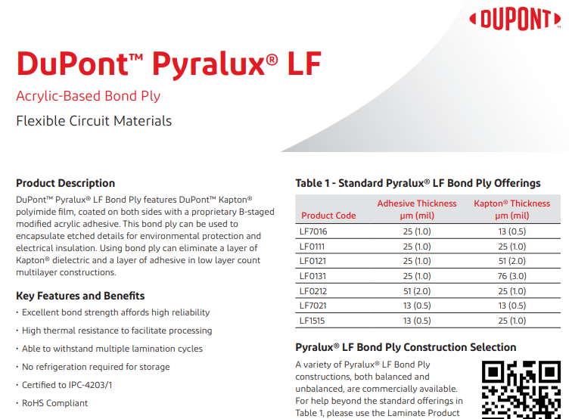

B Stage Tape Procurement
We are working through finding a vendor for B stage Polyimide as we had a rather old stock of it from the SSC/Tevatron.
  Previously used wither a modified polyimide or epoxy
Current products similar to this tape are coverlay or bondply for flexible circuits (with polyimide or acrylic adhesive)
  Possibly available from dupont in 250’ lengths
  May need custom B staging with 3rd party vendor

Slide 6
Plans for cable stacks
Make cable stacks exploring insulation and impregnation options:
  Benchmark: S2-glass sleeve (used for HQ) impregnated with Telene/CTD-101k
  S2-glass+kapton insulation impregnated with Telene/CTD-101k
  Roles: NIMS will provide Telene; Fermilab will make the cable stacks
Measure structural properties at RT and 77K:
  Elastic modulus at RT to 75MPa (can be measured at Fermilab)
  Elastic modulus at 77 K (can be measured at Fermilab)
  Thermal contraction RT-77K (can it be measured at NIMS? Looking for possible vendor)
  Shear strength at RT and 77K (ASTM D2344) (can be measured at Fermilab with SBS test )

Slide 7
EIC Stack Layout
4.29 mm shim
21.45 mm Outer
25.27 mm
2 x 8.58 mm 4-stack
3.82 mm shim
2x 250 mm

Slide 8
EIC
4.93 mm
4.93 mm
EIC
4.29 mm shim
21.45 mm Outer
25.27 mm
2 x 8.58 mm 4-stack
15.4 mm
25.27 mm

Slide 9
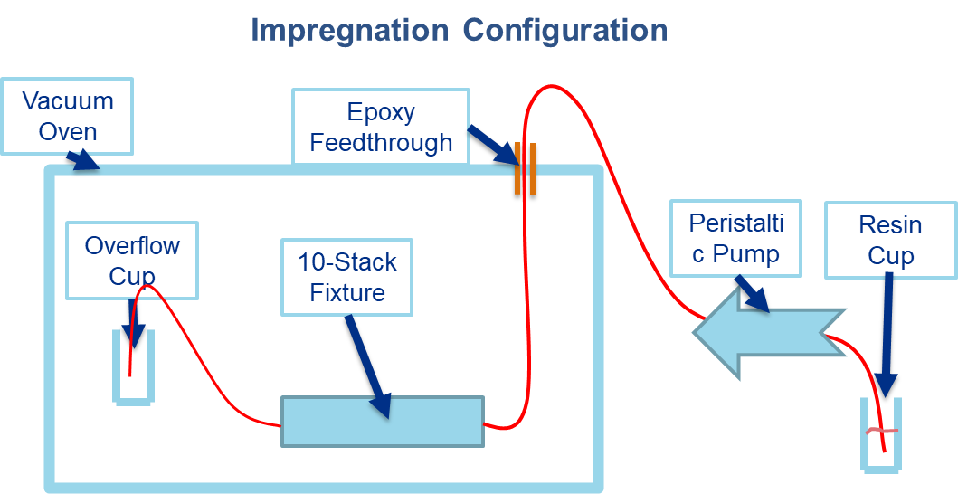
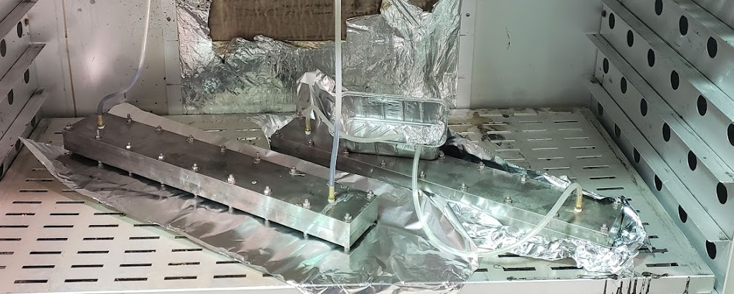
Impregnation procedure
Evacuate oven to -20 in Hg (250 Torr)
  250 times higher than we do with epoxy
  Transfer resin to coil as usual
  Cure in oven

Slide 10
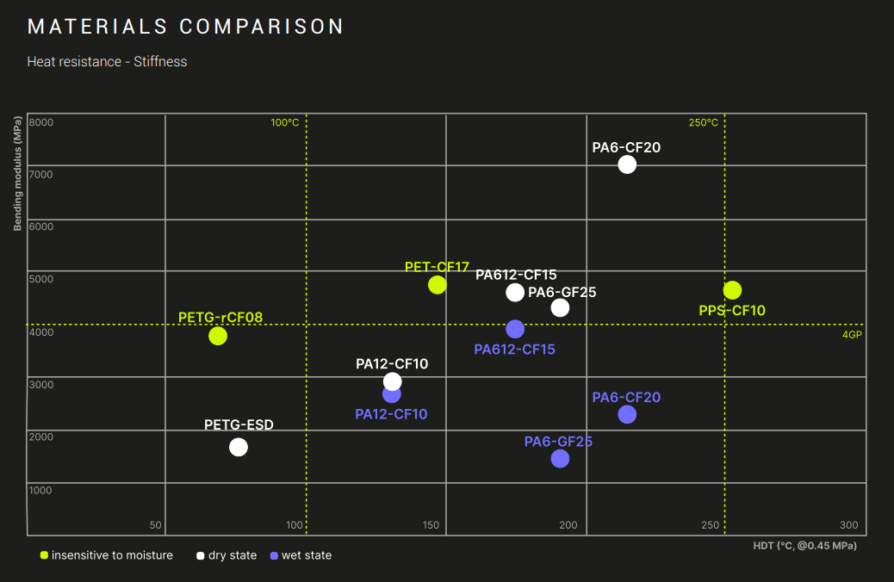
Shim Material
Since we have a high temp printer, I plan on exercising it
Shims are planned be printed from PPS-CF10 and wrapped with Teflon tape.
  Backup machined aluminum

Slide 11
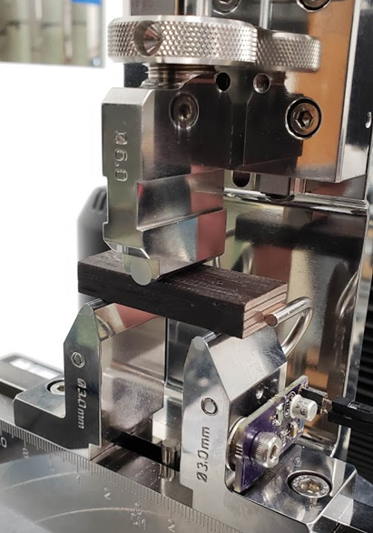
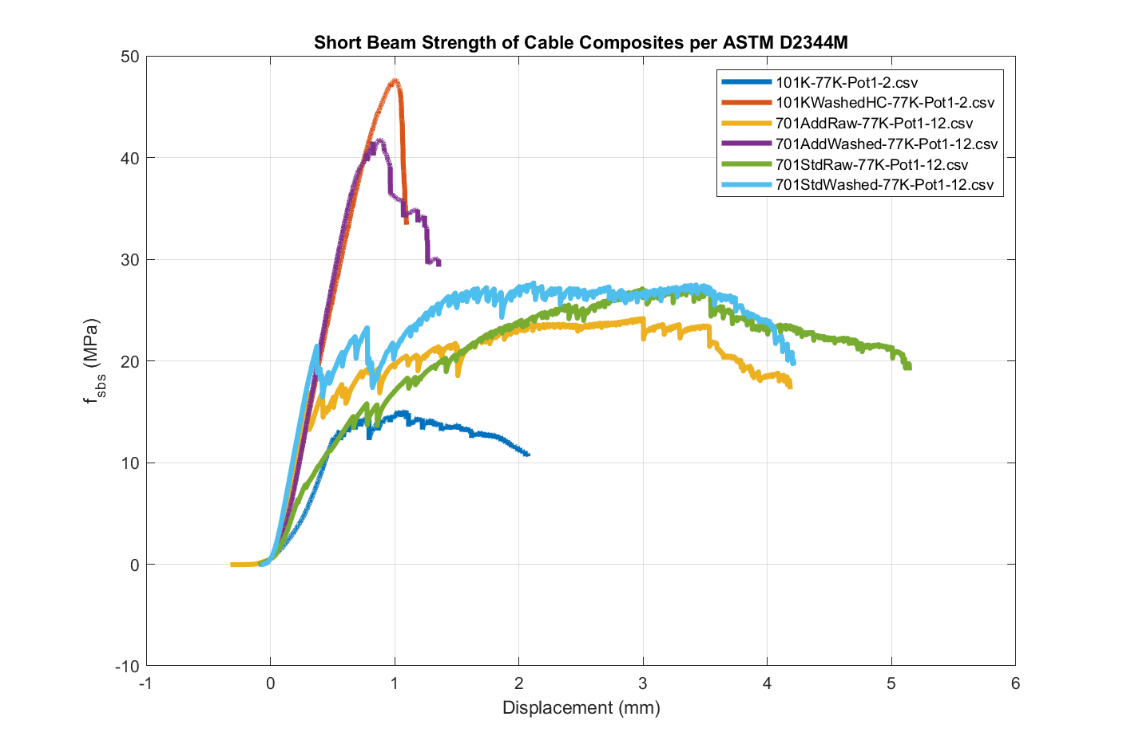
Sample testing
Samples will be labeled with unified naming system.
All test data will be stored in Excel document
Relevant data will be plotted against existing tests
Publish results (or at least write report)

Slide 12
Estimates
Estimates based on having tech(s) available
Estimate of time for 4 stack measurements for EIC | This is an estimate to prepare samples of 1 type of insulation. A column of additional types is shown which would be added for each general scheme.
S. Krave, 13 March 2025
nSamples | 5
 | Labor Hours (1st Stack) |  | Additional Types (ea) |  | Total Stacks
 | Eng | Tech | Eng | Tech | Eng | Tech | Notes
Sample Planning (insulation layout etc) | 4 | 2 | 2 | 2 | 12 | 10
Impregnation Procedure and Safety | 8 |  |  |  | 8 | 0
Cable Section and Insulation | 1 | 4 |  | 4 | 1 | 20
Shim Fabrication |  | 8 |  |  | 0 | 8 | Fabricate shims to size for stacka s desired
Sample Fixture Prep (clean, Zyvax) | 1 | 6 |  | 6 | 1 | 30 | Zyvax for Telene
Assemble fixture |  | 2 |  | 2 | 0 | 10
Pot sample | 2 | 4 | 2 | 4 | 10 | 20
Section and prepare samples |  | 8 |  | 4 | 0 | 24 | For 4-stack
Fixture cleanup |  | 2 |  | 2 | 0 | 10
Sample Testing RT | 4 | 4 | 2 | 4 | 12 | 20
Sample Testing LN2 | 4 | 4 | 2 | 4 | 12 | 20
Analysis and Report generation | 8 |  |  |  | 8 | 0
Totals |  |  |  |  | 64 | 172
Contingency (25%) |  |  |  |  | 16 | 43
Revised Total |  |  |  |  | 80 | 215
M&S
Shim Material | $200
Impregnation tube and Fittings | $400
Telene | ???
LN2 | $200

Slide 13
Moving forward

