Slide 1
Ergo During COVID-19

Slide 2
COVID-19 has prompted a new Expedited Telework Agreement
Components of the Agreement that pertain to our Ergonomics Program:
1. If employee(s) will be working from home for 30 days or less and have not had a home office ergo evaluation:
A formal HR Telecommuting Agreement is not required.
Employee has reviewed Tips for Employees Working from Home and will comply with recommendations provided by EHS Ergonomics Program.
2. If agreement is extended beyond 30 days or if employee has any issues that might impact ergonomic comfort and safety, an ergo eval should be requested at ergoeval.lbl.gov.
3. If at any time and/or for any reason while an employee is telecommuting an issue arises this should prompt employees to contact ergo@lbl.gov.
NOTE: No in-person ergo evaluations will be conducted. All ergo evaluations will be done via Zoom, Google Chat, Facetime, phone etc.

Slide 3
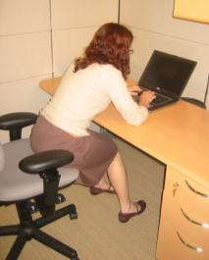
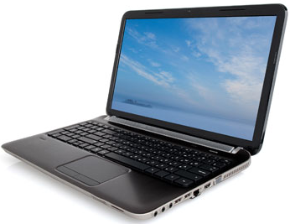
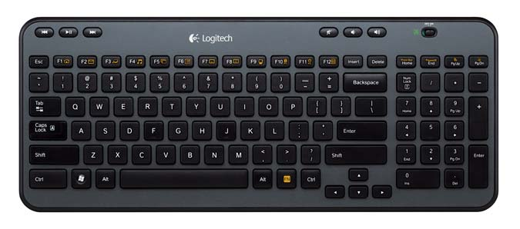
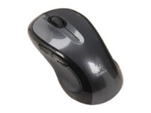
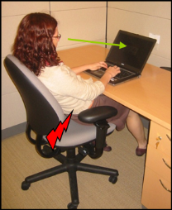
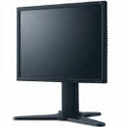
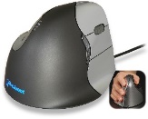
There is NO SAFE ERGONOMIC way to work directly on a laptop
Laptop Riser
Desktop Monitor

Slide 4
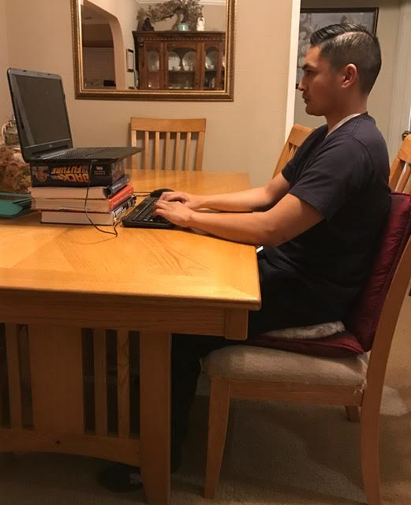
Equipment/ set up considerations….
You are encouraged to bring your keyboard, mouse, and monitor from your office or utilize books to prop up laptop if a monitor is not available.
If a good ergo chair is not available utilize pillows or cushions for added support.
If foot support is needed use a cushion on the floor, box, and/or books.
Employees cannot take chairs, tables, desks and/or printers home from the lab.

Slide 5
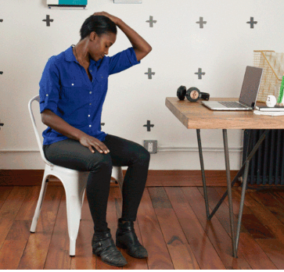
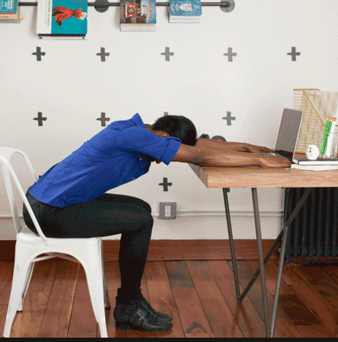
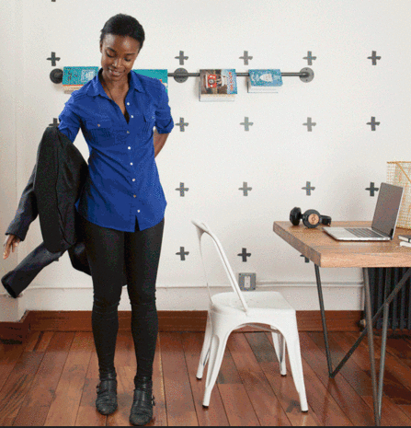
You should move at least every hour
Install RSI Guard and following break reminder cues
Found at: software.lbl.gov -IT Supported Downloads
ERGO RESOURCES
https://ergo.lbl.gov/home/covid-19-resources-from-the-ergo-team
VIRTUAL SESSION: ergo@home w/Melanie Alexandre
https://lbnl.zoom.us/j/274779526

