Slide 1
Recent and Upcoming Developments in Fermilab Test Facilities
10/22/2025
Vlad Nikolic

Slide 2
Agenda
Today
Test Facility Overview
HFVMTF → MAGNES Test Facility
Test Stand 3
Development of New VMTF DAQ System (Presented by Peter Thompson)

Slide 3
Test Facility Overview at FNAL – IB1
01

Slide 4
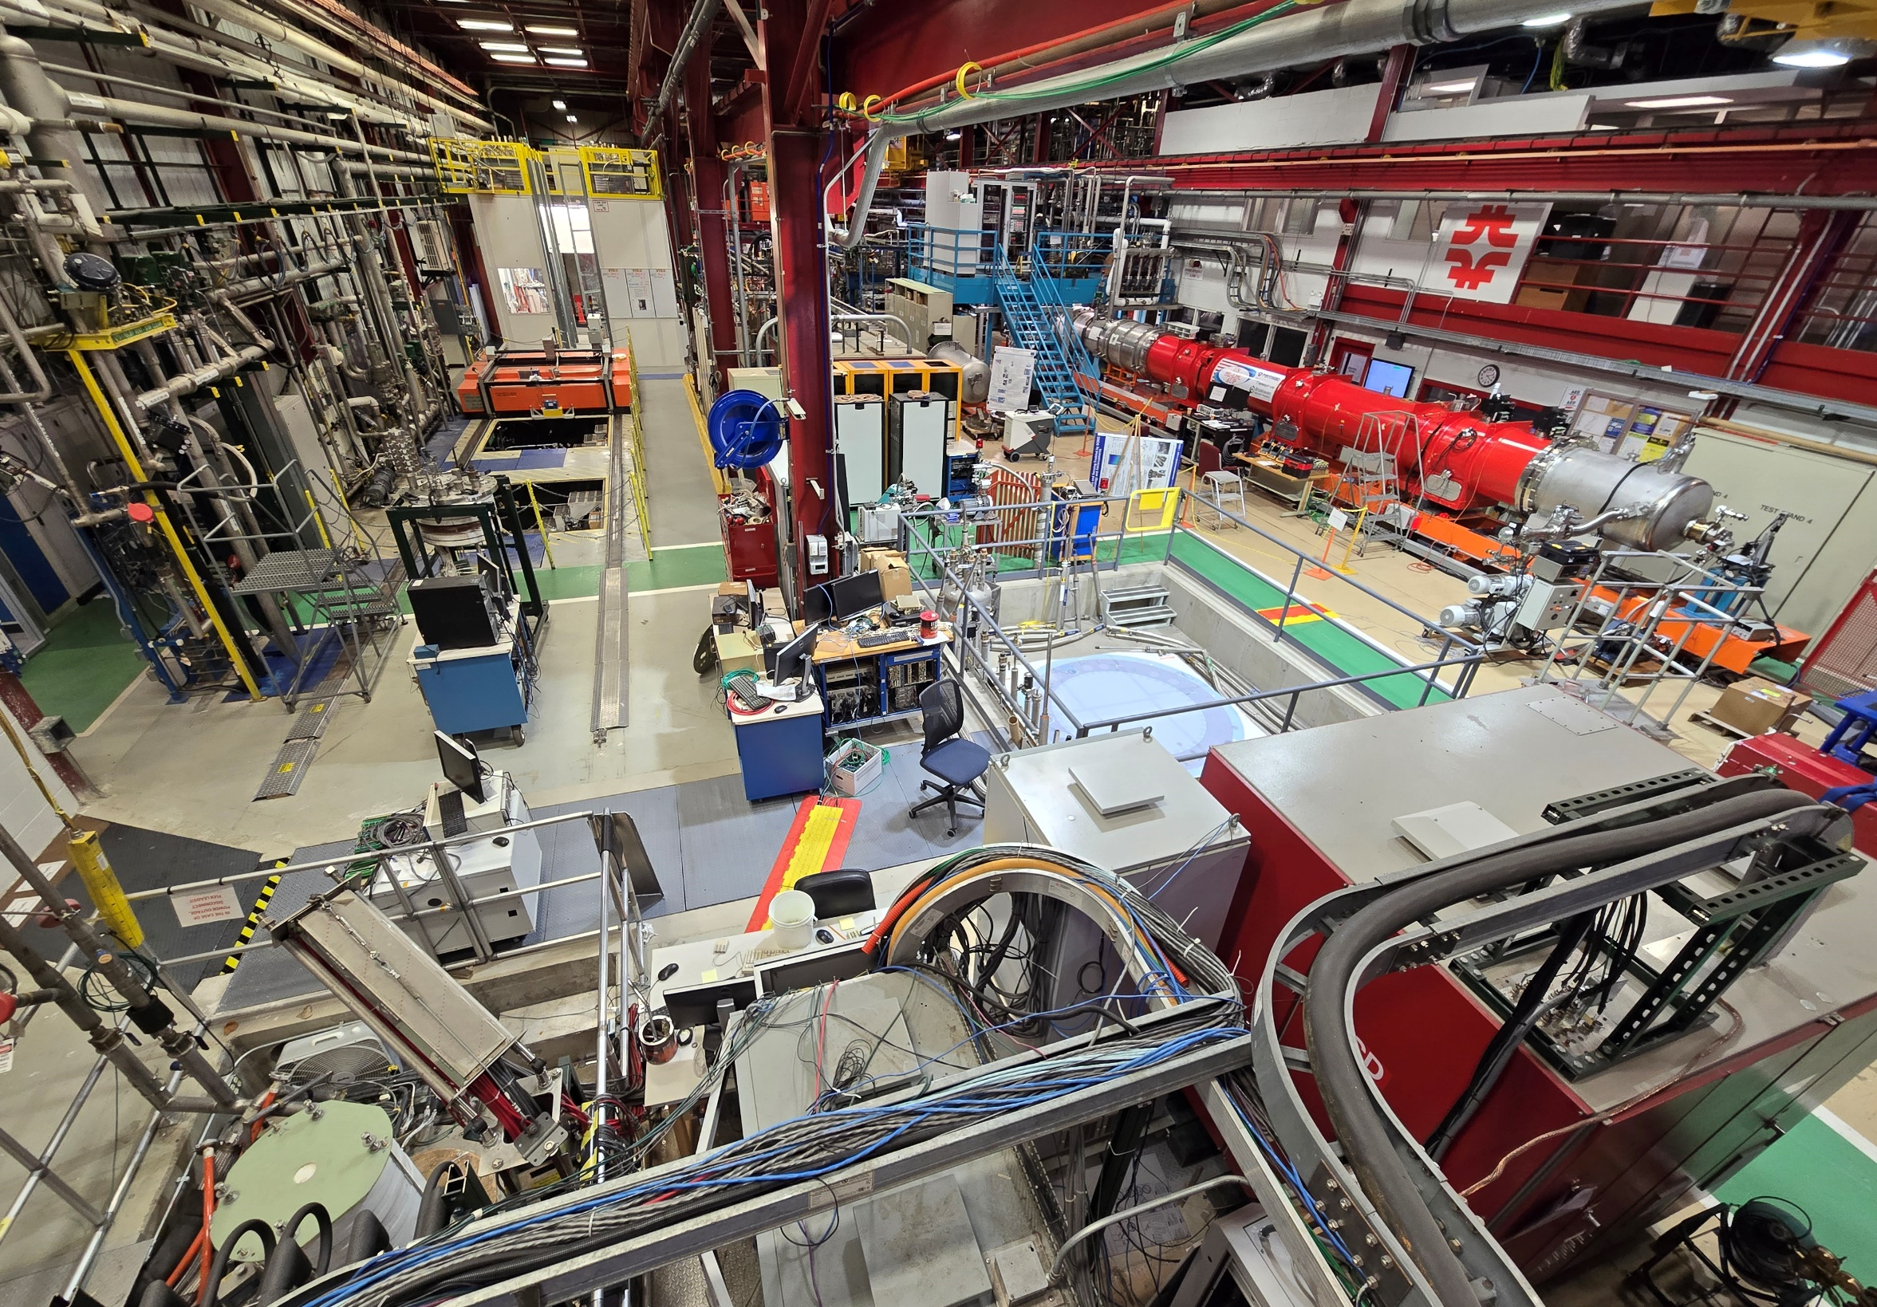
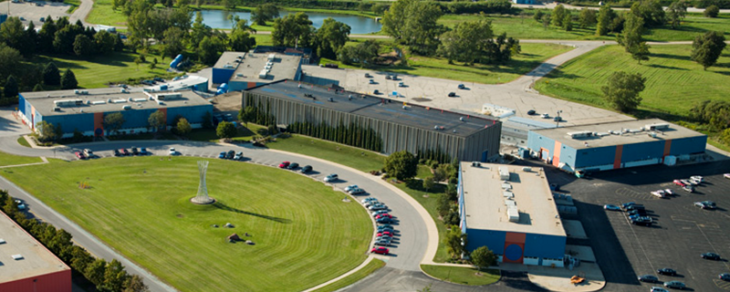
Test Facility Overview at FNAL – IB1
Vertical Magnet Test Facility (VMTF): 4 m deep, 0.65 m diameter up to 30kA
High Field Vertical Magnet Test Facility (HFVMTF): 3m deep, 1.3m diameter up to 24kA
Stand 3: 1 m deep, 0.5 m diameter up to 10 kA
Stand 4: Interface for horizontal cryostat up to 18kA
CoCoLoCo: conduction cooled low-cost facility
VCTF-3 cryostats : 4 m deep, 0.7 m diameter (used for cavity testing)
Stand 3
Stand 4
HFVMTFMAGNES
VCTF
IB1
Industrial Complex
CoCoLoCo
VMTF
Lifting and Handling tools in IB1:
Two 25-top cranes (synced mode 50T)
Two 10-ton cranes

Slide 5
MAGNES Test Facility
02

Slide 6
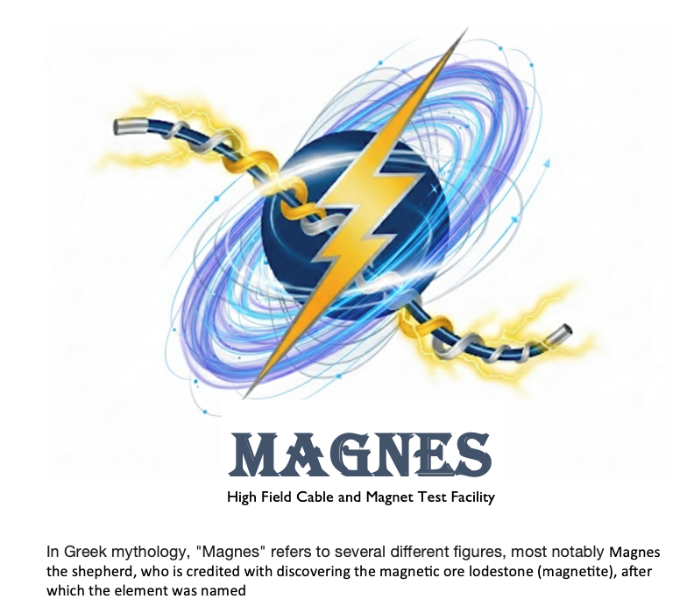
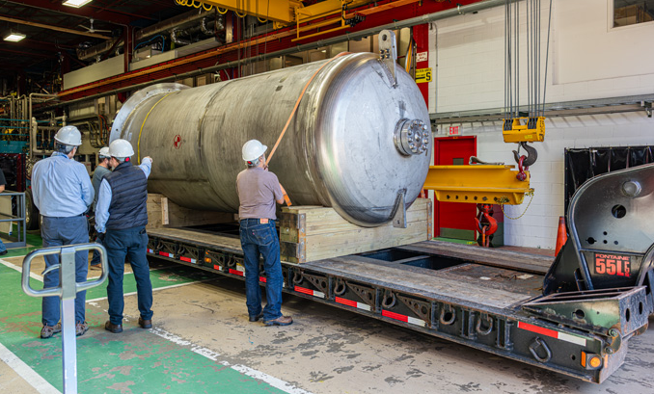
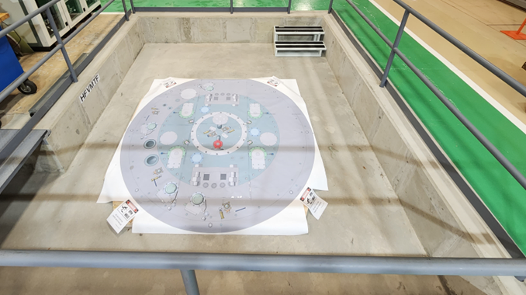
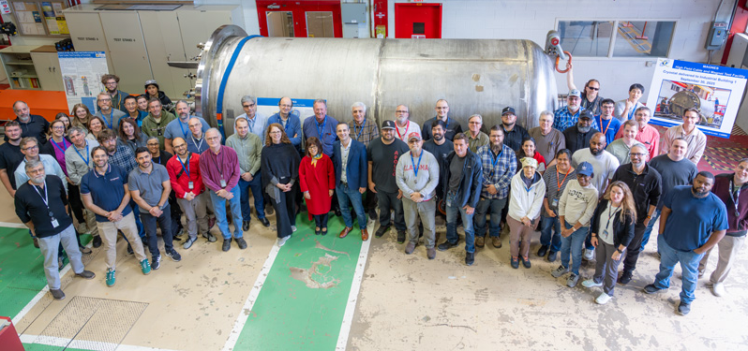
MAGNES Test Facility
Note name change: HFVMTF → MAGNES Test Facility
Large dual-bath vessel equipped with a lambda plate that separates the 4.5 K normal liquid helium from the pressurized superfluid helium at 1.9 K and 1.3 bar.
Two sets of PSs; Min 20 V @ 24 kA , Min 20 V @ 16 kA
Production/Operational grade QP
Cryostat Arrival at Fermilab – September 30, 2025
  Currently undergoing acceptance testing
  Leak checks and pressure tests are in progress
Installation in the pit planned for the end of October 2025
Top Plate and Lambda Plate nearing completion
  All components have been manufactured, and assembly has started
  Expected delivery by the end of November 2025
Cryogenic Integration
  Piping connection between the cryostat and existing cryogenic facility is expected to start in January 2025

Slide 7
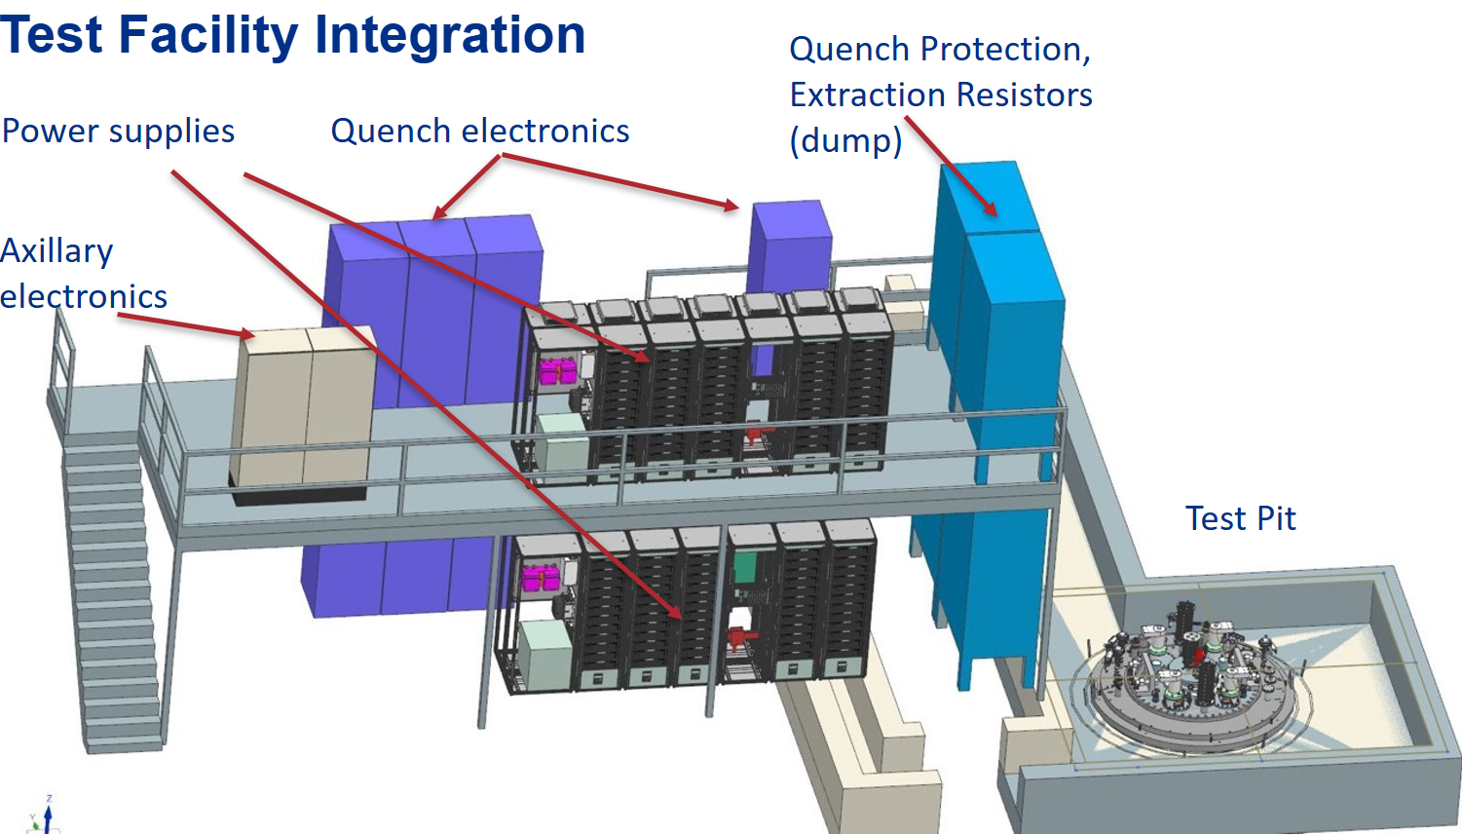
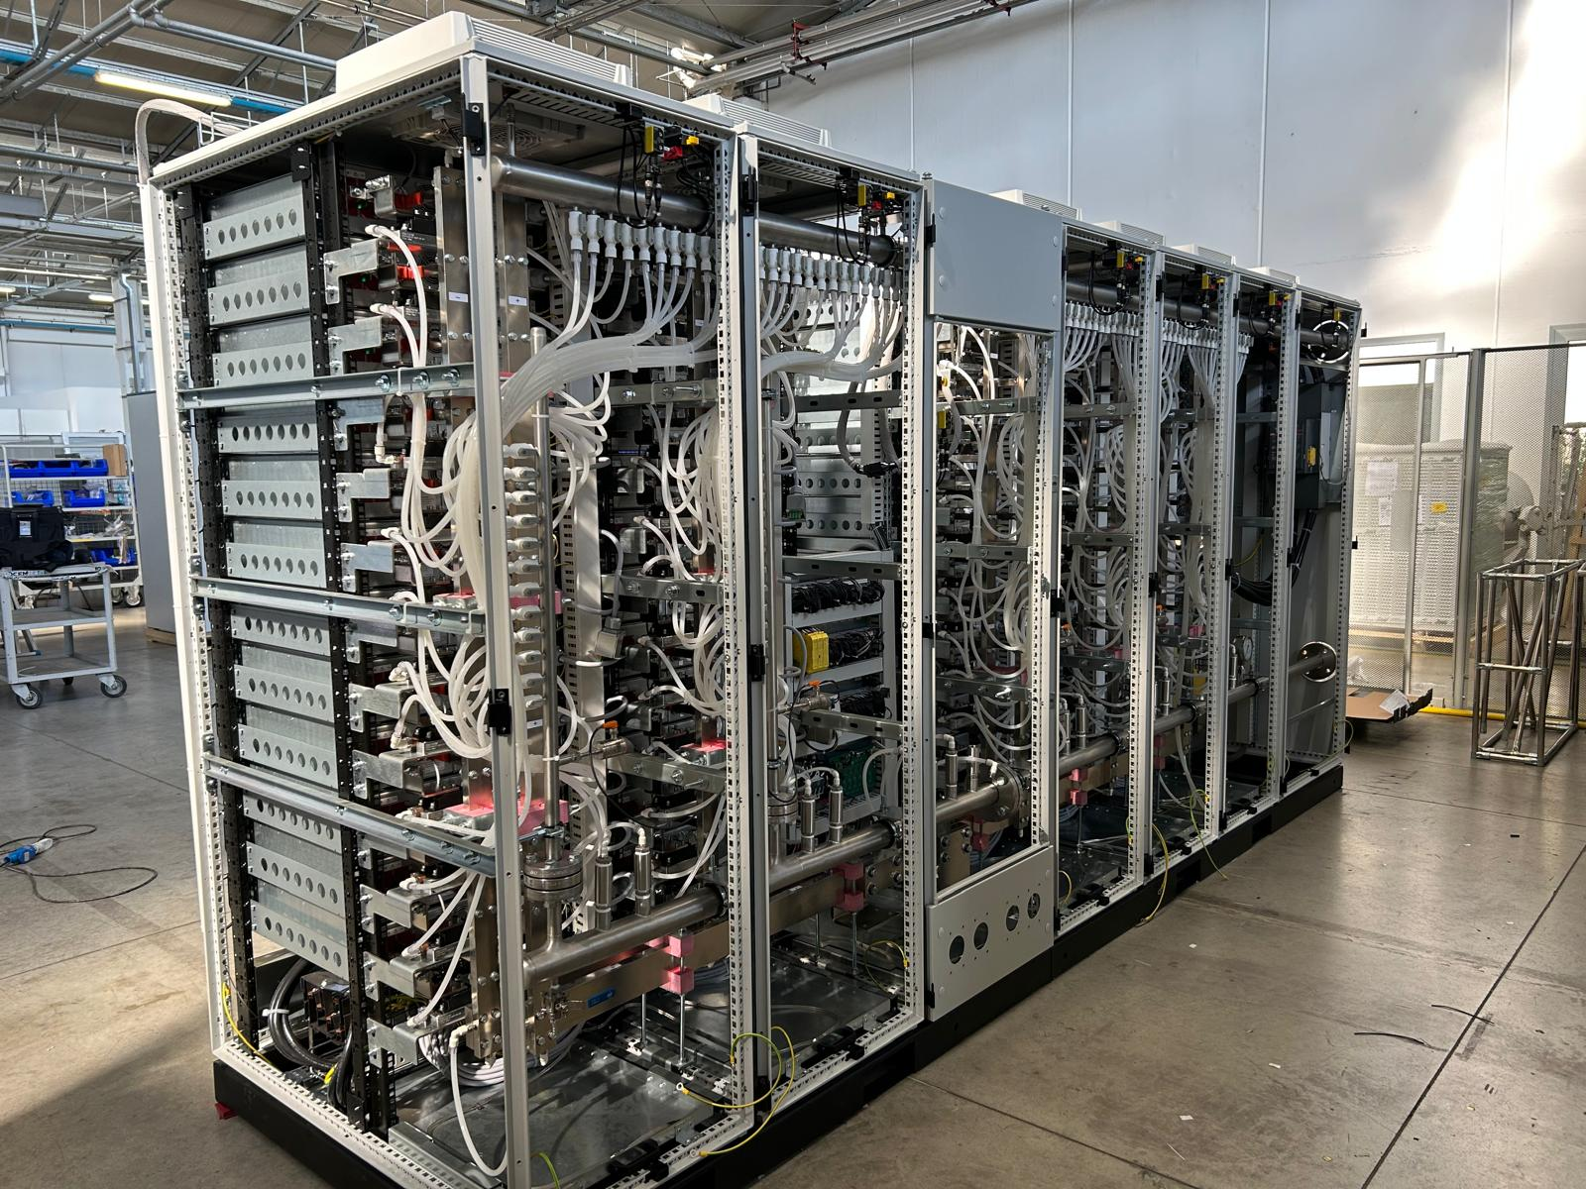
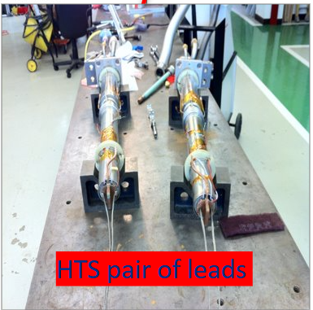
MAGNES Test Facility
Mezzanine procurement in progress
  Installation of the mezzanine is planned for mid-2026.
Power supplies are undergoing FAT
  Expected delivery to FNAL by the end of 2025
Quench Protection System in the production phase
Dump Switch and Resistor Desing nearing completion
  IGBT components testing in progress
  Components order soon to be sent to procurement
AD/DC distribution system in the design phase
HTS leads refurbishment currently underway

Slide 8
Test Stand 3 Test Facility
03

Slide 9
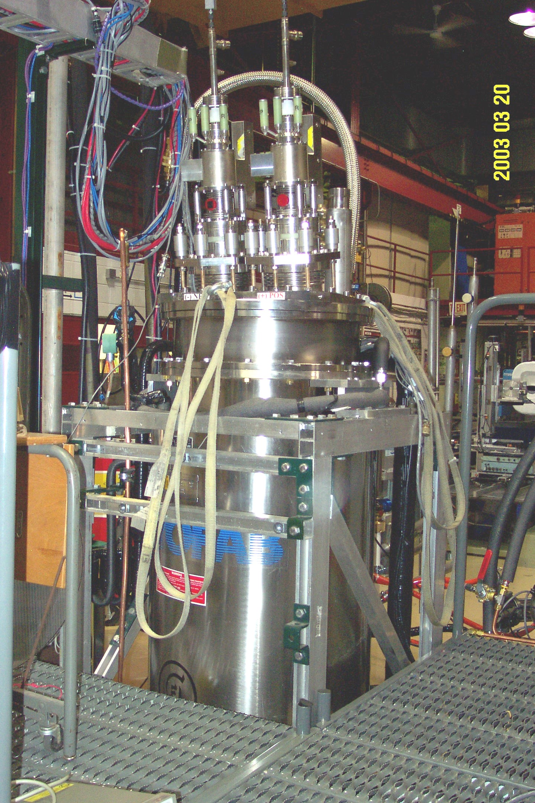
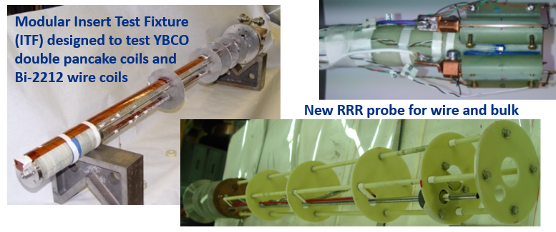
TEST STAND 3 Test Facility
Background:
Test dewar was last used in 2020 for superconducting leads testing
Goal:
To operate as an easily configurable test dewar to support various R&D projects
Examples of potential R&D projects to test:
New Hall probe system to measure shielding of bulk MgB₂ tubes

Slide 10
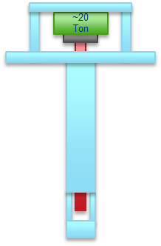
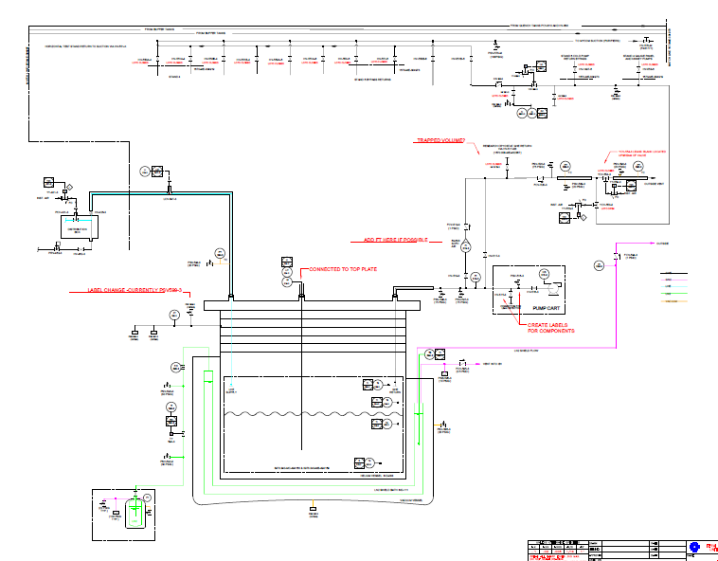
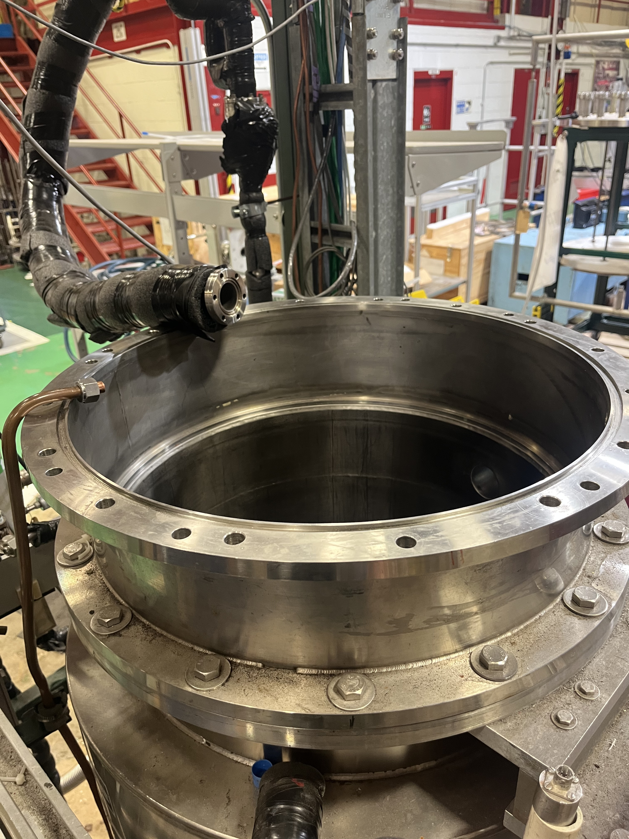
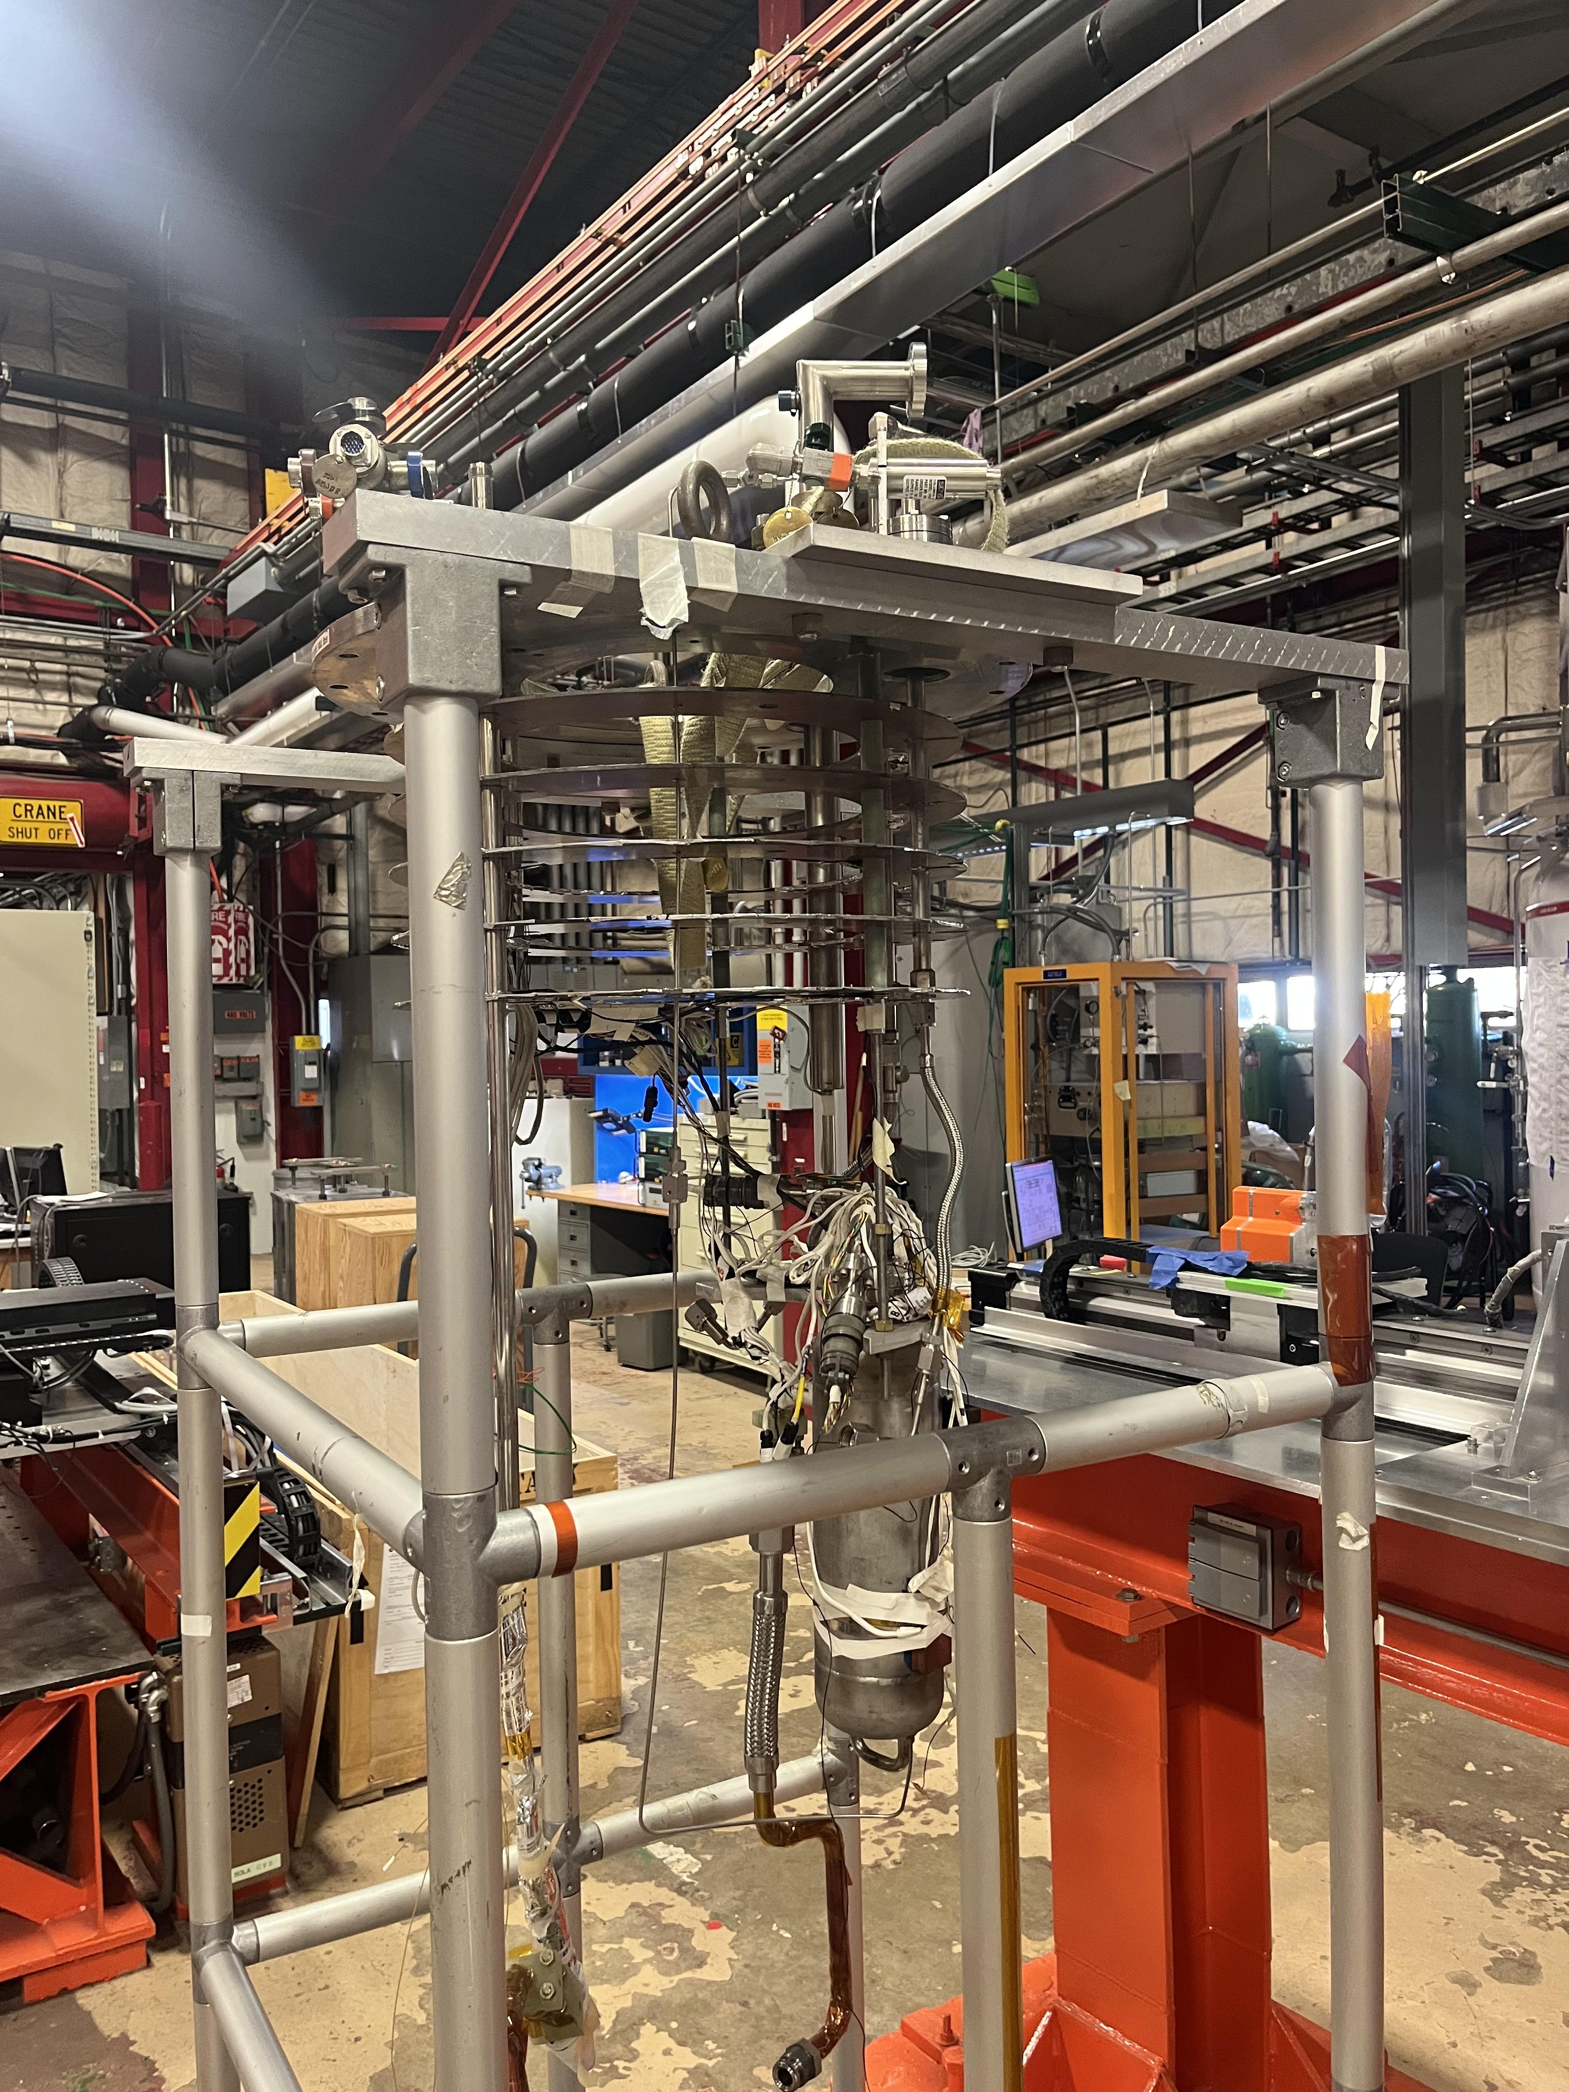
TEST STAND 3 Test Facility
Updates:
Project 1: Develop and test a cryogenic-capable load system – stack and cables testing
157 mm diameter probe designed to deliver up to 20 tons of load and 10 kA current to a sample (under design)
Progress:
Preparing for a cryogenic readiness test
New extension to accommodate system length
Testing existing instrumentation
Updating documentation

Slide 11
Development of New VMTF DAQ System (Presented by Peter Thompson)
04

Slide 13
Backup Slides

Slide 14
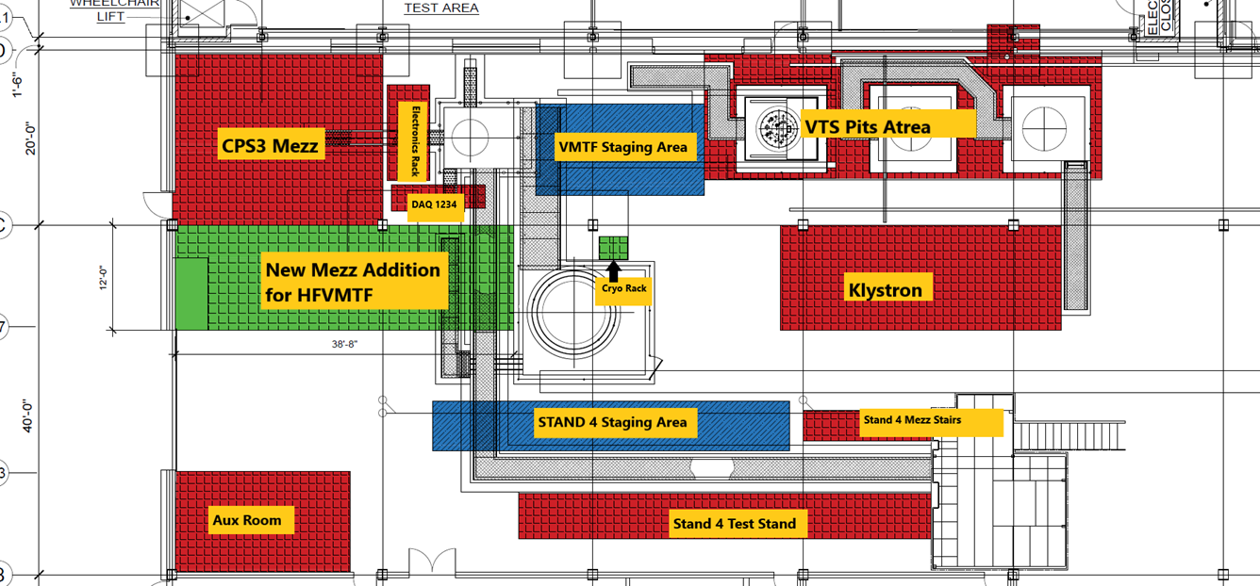
MAGNES

Slide 15
MAGNES
Parameter | Value
Background Dipole Field | 15 T
Minimum Operational Temperature | 1.9 K
Maximum Magnet Diameter | 1.3 m
Maximum Magnet Length | 3.0 m
Maximum Stored Energy | 20 MJ
Maximum Weight | 20 t
Test Sample Temperature | 4.5-50.0 K
Maximum Test Sample Current (direct) | 16 kA
Maximum Test Sample Current (transformer) | 100 kA

Slide 16
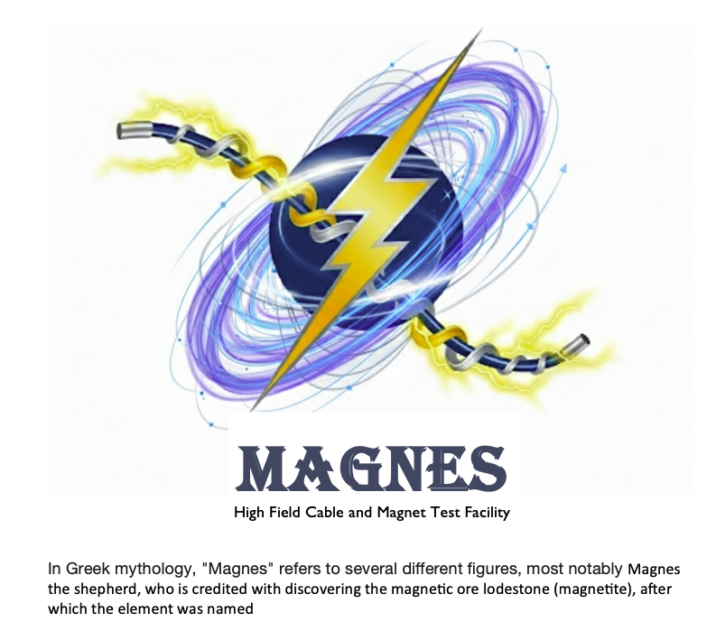
MAGNES

