Slide 1
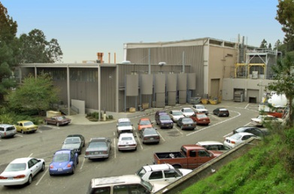
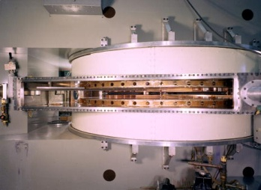
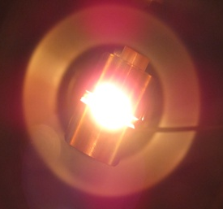
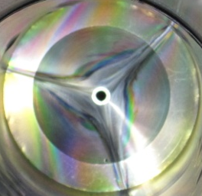
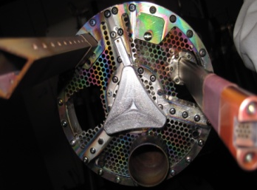
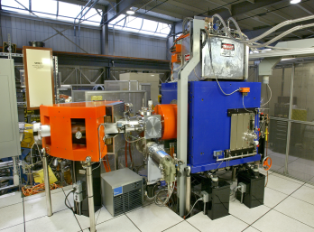
Bremsstrahlung Measurements from the ECR Ion Source VENUS
Janilee Benitez
Lawrence Berkeley National Lab
April 7, 2020

Slide 2
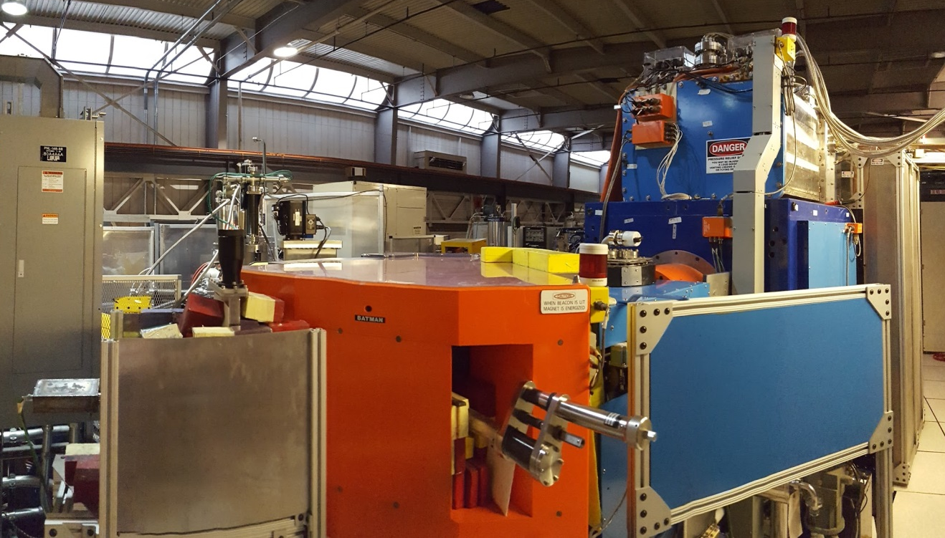
Outline
ECR Ion Source Basics
Why Bremsstrahlung Measurements?
Setup & Analysis
Results
Summary
Janilee Benitez NSD Talk April 7, 2020

Slide 3
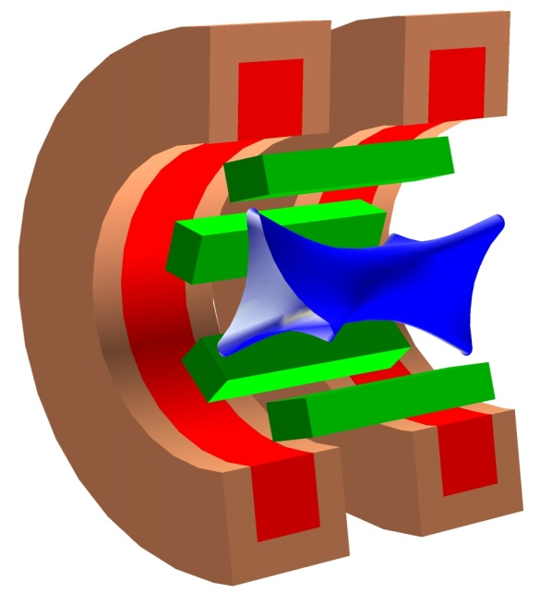
ECR Ion Source Physics
ECR: Electron Cyclotron Resonance
e-
Key Ingredients
1
gas
+
1
2a
radial field
B_{ECR}
gas
+
3
Plasma
2b
axial field
5
µ-waves
+
2a
3
µ-waves
Ion
beam
=
+
Sextupole Magnets
(radial confinement field)
4
High Voltage
4
2b
Solenoid Magnets
(axial confinement field)
5
Ion beam
High Voltage
Janilee Benitez NSD Talk April 7, 2020

Slide 4

so
Standard Model for ECR ion sources
ECRs have been designed and built according to
Frequency Scaling:
Confinement Criteria:
LBL ECRs Generation | ω_{μ-wave} | B_{ECR} | ¹⁶O⁶⁺ (eμA)
1st (1980s) | 6.4 GHz | 0.2 T | 80
2nd (1990s) | 14 GHz | 0.5 T | 800
3rd (2000s) | 28 GHz | 1.0 T | 4,000
4th | 56 GHz | 2.0 T | 10,000
B_{EXT}
B_{INJ}
$$Bmin\sim 0.5−0.8BECR$$
B_{ECR}
4th generation ECR in design stages at 88” cyclotron
B_{MIN}
Z
Janilee Benitez NSD Talk April 7, 2020

Slide 5




Electron Heating
Electrons absorb energy near the resonance zone
Simulations show more electron heating with shallower gradient (high B_{min}/B_{ECR}).
Believed that shallow gradient means electrons spend more time near resonance and absorb more energy
ECR’s have been built according to:
Frequency Scaling
Confinement Criterion
Generation | ω_{μ-wave} | Max Inj. B-field | ¹⁶O⁶⁺ (eμA)
1st | 6.4 GHz | 0.4 T
2nd | 14 GHz | 1.7 T
3rd | 28 GHz | 4.0 T
B_{INJ}
B_{EXT}
B_{ECR}
shallow gradient
$$Bconf≥2B_{ECR}$$
$$Bmin\sim 0.8BECR$$
steep gradient
$$Binj>Bext$$
$$Bext<\min{Brad}$$
B_{MIN}
Z
Janilee Benitez NSD Talk April 7, 2020

Slide 6
Electron Energy Distribution
Ionization potential: how much energy electrons must have to ionize atoms
¹⁹⁷Au⁵⁹⁺ Ionization Potential~ 5.9keV
Optimum ionization cross section is ~5 x Ionization Potential
e-
e-
Janilee Benitez NSD Talk April 7, 2020

Slide 7
Electron Energy Distribution
Evidence that ECR plasma has 2+ Maxwellian velocity distributions
Relate the experimental distribution (bremsstrahlung spectrum) to the Maxwellian distribution by describing the plasma spectral temperature T_{s}
Cold
E~10s eV
Counts/s
T_{s}=-1/slope
n (E)
Warm
10s eV <E < 5 keV
Hot
E > 5 keV
E
Studying T_{s} produced by hot electrons
E
Janilee Benitez NSD Talk April 7, 2020

Slide 8

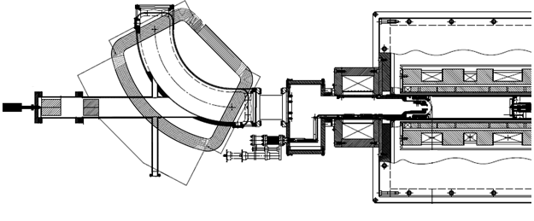
Setup for Bremsstrahlung Measurements
10 mm extraction hole
Batman Analyzing Magnet
Plasma chamber
15.5 mm puller hole
XR-100-CdTe Detector
Janilee Benitez NSD Talk April 7, 2020

Slide 9
Extras
Bremsstrahlung Measurements Analysis
Calibration Applied
Spectra corrected for detector efficiency
Natural log of data taken in energy range of interest.
Linear fit applied. T_{s}=-1/slope
Janilee Benitez NSD Talk April 7, 2020

Slide 10
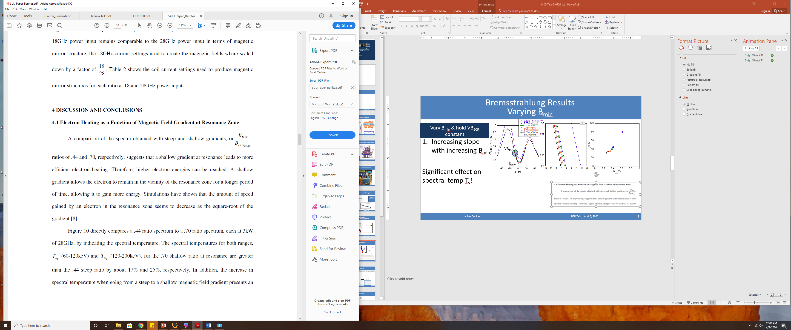
Extras
Previous Bremsstrahlung Measurements
Prior simulations had shown more electron heating with shallower gradient.
Previous measurements focused on comparing gradient at the resonance by changing B_{min}/B_{ECR}
Shallow gradient
Steep gradient
Several ECR groups replicated results where T_{s} ↑ with B_{min}/B_{ECR}
Janilee Benitez NSD Talk April 7, 2020
10

Slide 11
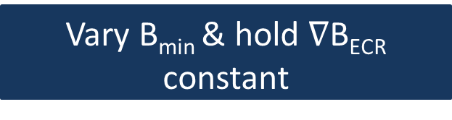
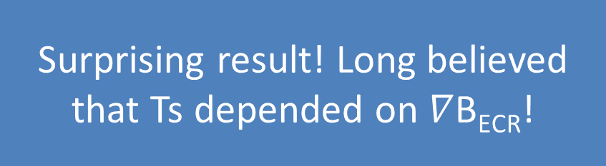

Extras
Bremsstrahlung Results
Varying B_{min}
Vary B_{min} & hold $∇$B_{ECR} constant
Increasing slope with increasing B_{min}
Significant effect on spectral temp T_{s}!
$∇$B_{ECR}
B_{min}
Surprising result! Long believed that Ts depended on $∇$B_{ECR}!
Janilee Benitez NSD Talk April 7, 2020

Slide 12
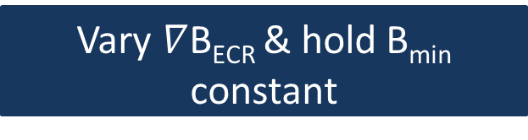
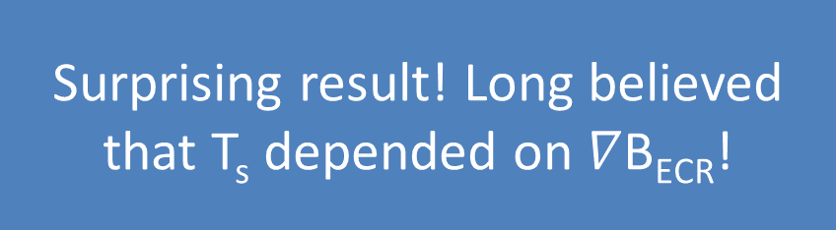
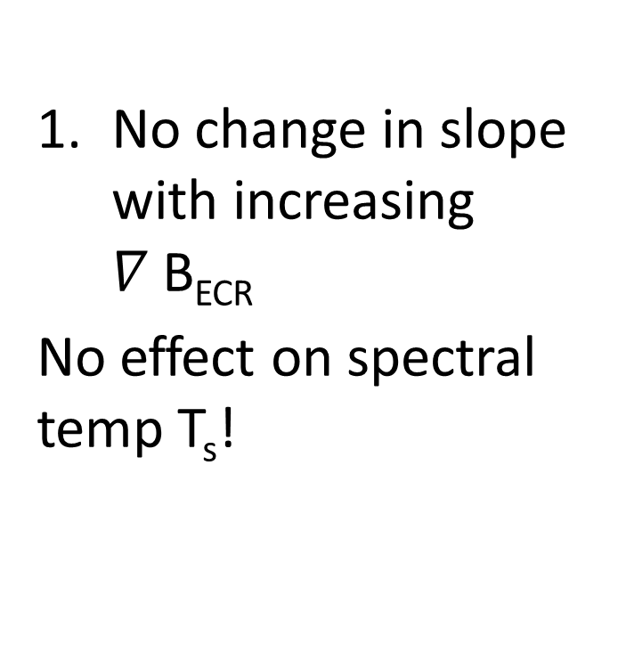

Extras
Bremsstrahlung Results
Varying $∇$B_{ECR}
Vary $∇$B_{ECR} & hold B_{min} constant
No change in slope with increasing $∇$B_{ECR}
No effect on spectral temp T_{s}!
Surprising result! Long believed that T_{s} depended on $∇$B_{ECR}!
Janilee Benitez NSD Talk April 7, 2020

Slide 13
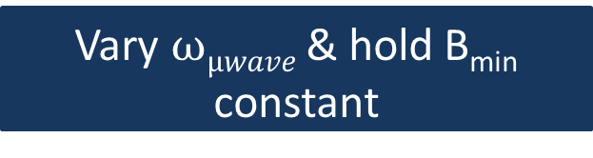
Bremsstrahlung Results
Varying Heating Frequency
Vary $ωµwave$& hold B_{min} constant
No change in slope with increasing different heating frequency
No effect on spectral temp T_{s}!
Frequency (GHz) | Injection Gradient at B_{ECR} (T/m) | Extraction Gradient at B_{ECR} (T/m) | Ts (keV)
14 | -4.67 | 4.22 | 48.8
18 | -7.71 | 6.54 | 43.8
28 | -12.75 | 10.00 | 44.4
Janilee Benitez NSD Talk April 7, 2020

Slide 14
Bremsstrahlung Results
Summarizing Data
VENUS Only
Janilee Benitez NSD Talk April 7, 2020

Slide 15
Bremsstrahlung Results
Summarizing Data
VENUS Only
Janilee Benitez NSD Talk April 7, 2020

Slide 16
Bremsstrahlung Results
Summarizing Data
VENUS & AECR-U
& ECR
& SUSI
T_{s} is linearly dependent on B_{min} not VB_{ECR}
#
Janilee Benitez NSD Talk April 7, 2020

Slide 17
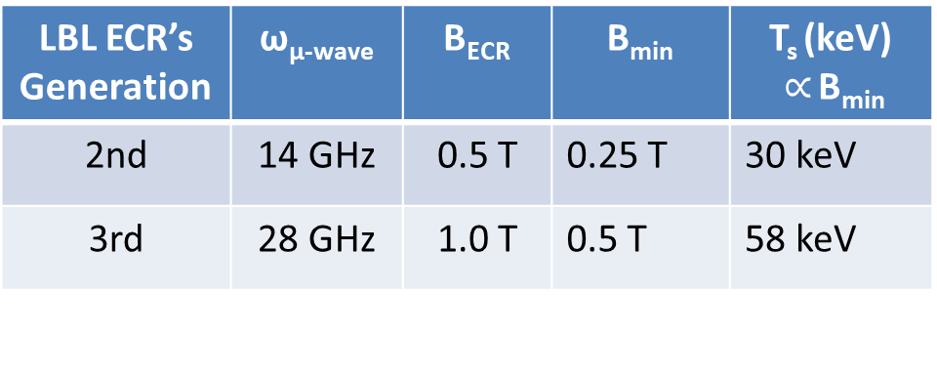
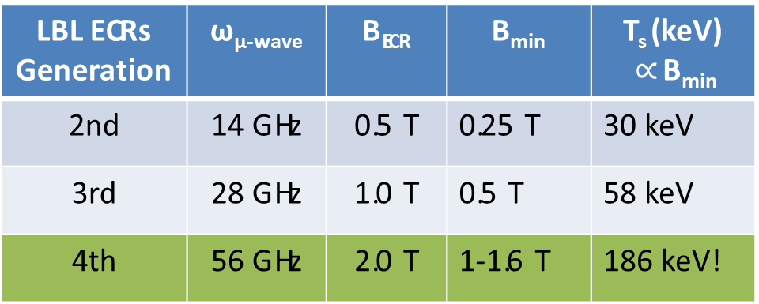
Implications for Next Generation
4th generation ECR:
Want hot electrons to create high charge states
Engineering issues: plasma chamber damage and heat deposit into cryostat/magnets
LBL ECR’s Generation | ω_{μ-wave} | B_{ECR} | B_{min} | T_{s} (keV) $∝$ B_{min}
2nd | 14 GHz | 0.5 T | 0.25 T | 30 keV
3rd | 28 GHz | 1.0 T | 0.5 T | 58 keV
4th | 56 GHz | 2.0 T | 1-1.6 T | 186 keV!
LBL ECRs Generation | ω_{μ-wave} | B_{ECR} | B_{min} | T_{s} (keV) $∝$ B_{min}
2nd | 14 GHz | 0.5 T | 0.25 T | 30 keV
3rd | 28 GHz | 1.0 T | 0.5 T | 58 keV
4th | 56 GHz | 2.0 T | 1-1.6 T | 186 keV!
Janilee Benitez NSD Talk April 7, 2020

Slide 18
Summary
T_{s} increases with increasing B_{min} (true for ECR’s min-B configuration)
Production of high charge state ions requires high density of hot electrons. How can we produce more for this purpose?
Implications for 4th generation (high frequency, higher Bmin)
Janilee Benitez NSD Talk April 7, 2020

