Slide 1
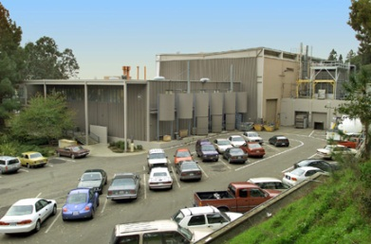
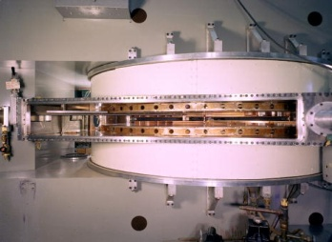
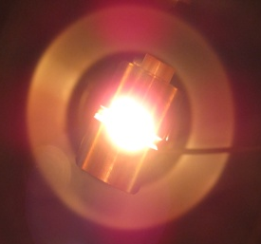
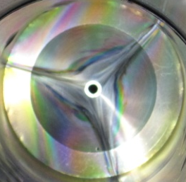
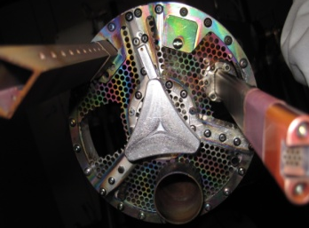
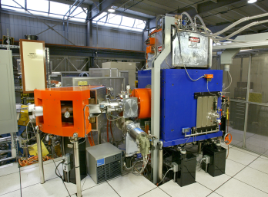
88-Inch Cyclotron Updates
Janilee Benitez
November 4, 2025

Slide 2

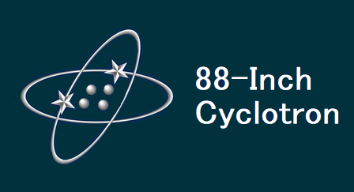



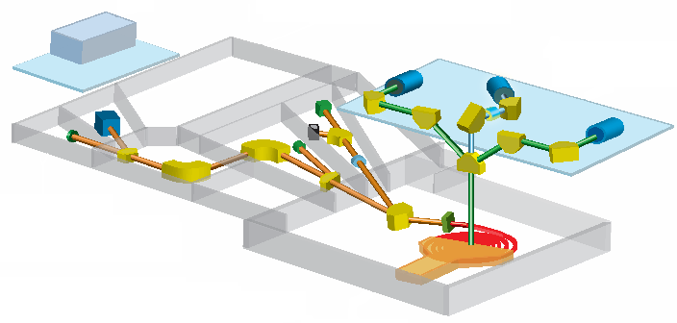

Layout
88-Inch Layout
The 88-Inch Cyclotron is fed by three ECR ion sources: ECR, AECR-U, and VENUS
Where’s my beam!
ECR
VENUS
Cave 4B Heavy Ion Facility
AECR-U
Cave 4A Light Ion Facility
beamtime:
I. radiation effects testing (~50%)
II. basic science (SHE search, neutrons) (~50%)
Cyclotron
2
2
2
NSD Meeting - Nov 4, 2025 Janilee Benitez

Slide 3
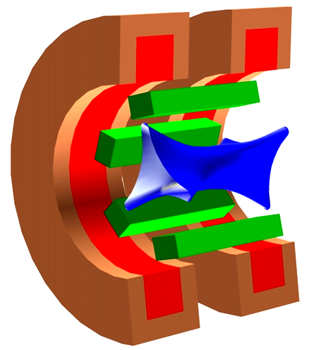

Work at the ECRs*
*Electron Cyclotron Resonance
plasma
confining magnetic fields
ion beam
RF heating

Slide 4
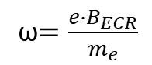
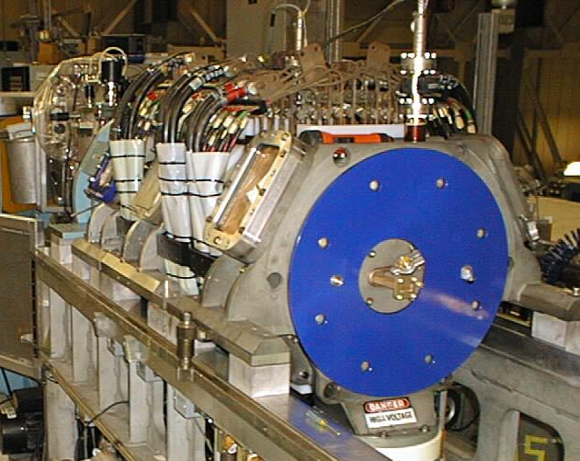
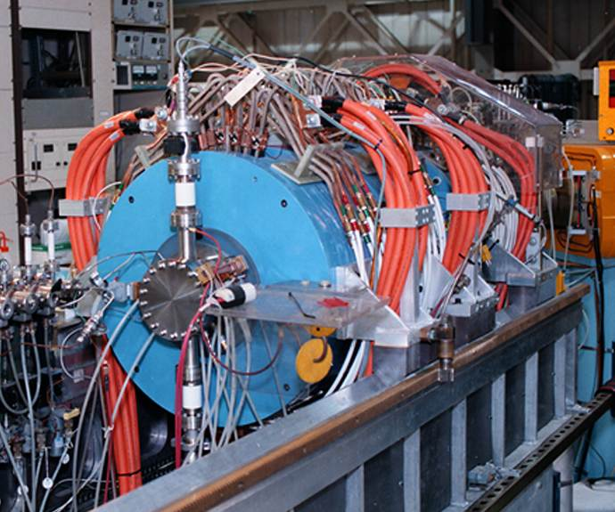
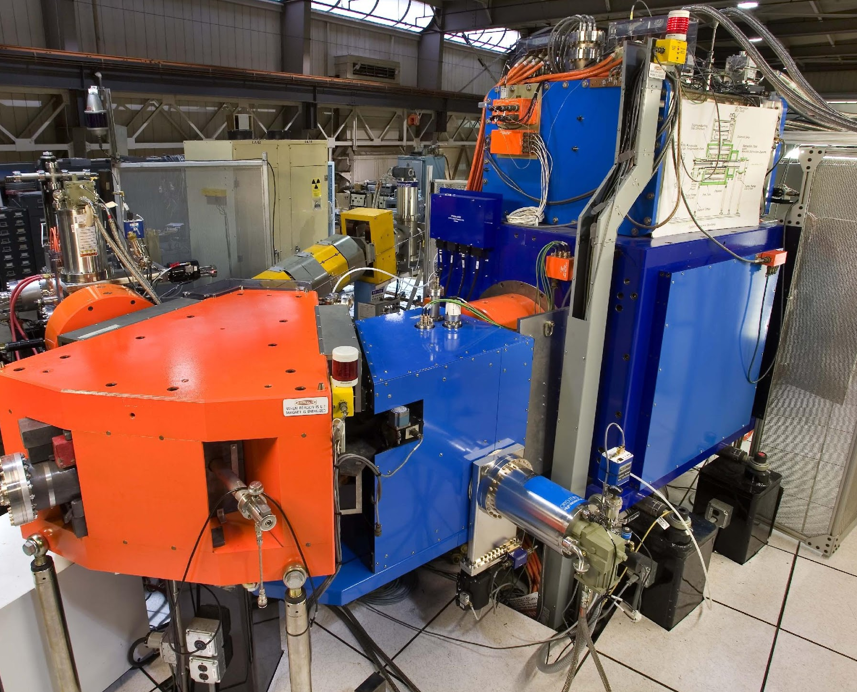
ECRs at the 88”
1st Generation ECR
1983
Max B-Field: 0.4T
Frequencies: 6.4GHz
Max Power: 0.6kW
2nd Generation AECR-U
1996
Max B-Field: 1.7T
Frequencies: 10, 14GHz
Max Power: 2.6kW
3rd Generation VENUS
2004
Max B-Field: 4.0T
Frequencies: 18, 28GHz
Max Power: 12kW
Beam Intensity ∝ ω²
4
4
4
NSD Meeting - Nov 4, 2025 Janilee Benitez

Slide 5
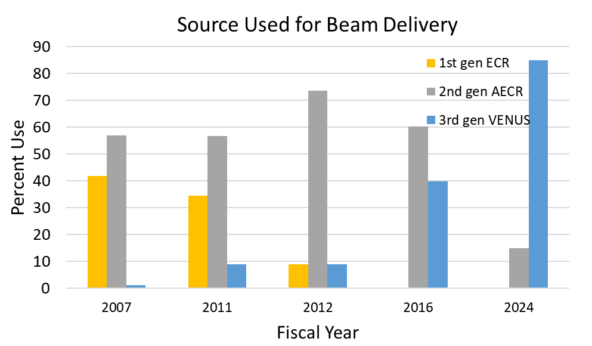
ECR Source Usage at the 88-Inch
E ∝ Q²
E=energy
Q=ion charge state
5
5
5
NSD Meeting - Nov 4, 2025 Janilee Benitez

Slide 6

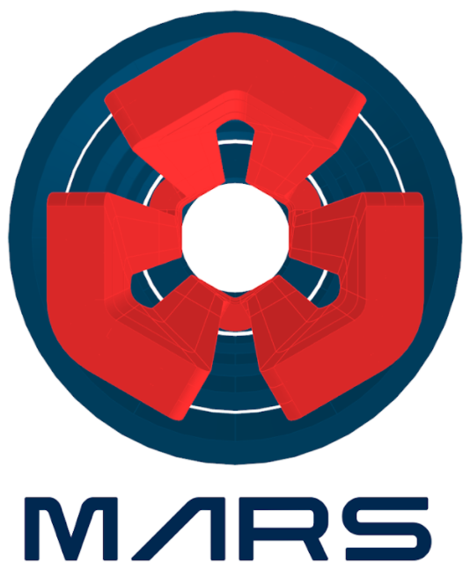
ECRs at the 88-Inch
1st Generation ECR
1983
Max B-Field: 0.4T
Frequencies: 6.4GHz
Max Power: 0.6kW
2nd Generation AECR-U
1996
Max B-Field: 1.7T
Frequencies: 10, 14GHz
Max Power: 2.6kW
3rd Generation VENUS
2004, 2008 for operations
Max B-Field: 4.0T
Frequencies: 18, 28GHz
Max Power: 12kW
4th Generation MARS-D
Max B-Field ~ 6T
Max Frequency: 45GHz
Beam Intensity ∝ ω²
6
6
6
6
6
NSD Meeting - Nov 4, 2025 Janilee Benitez

Slide 7
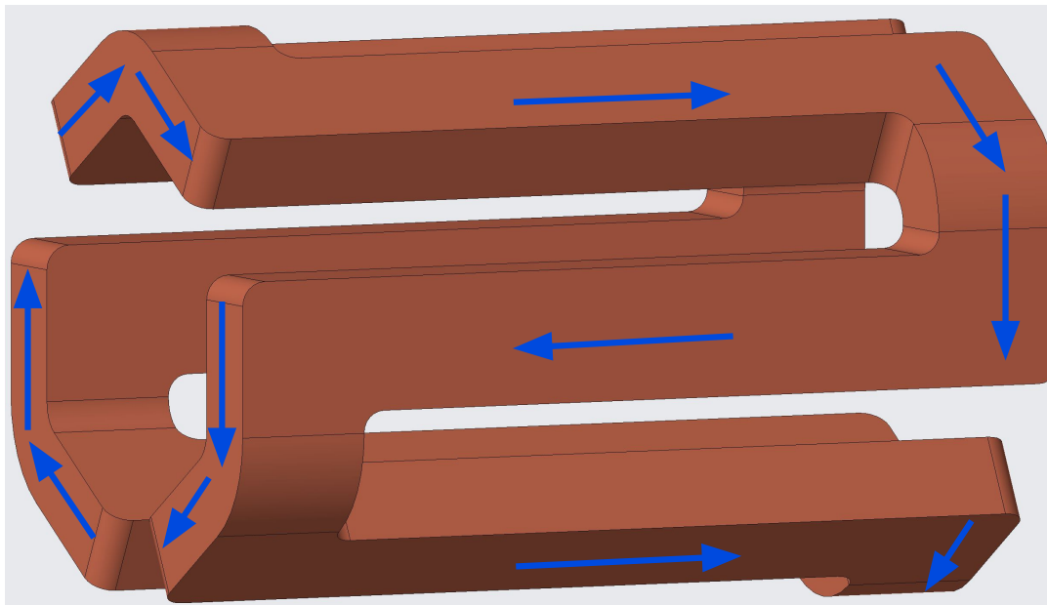
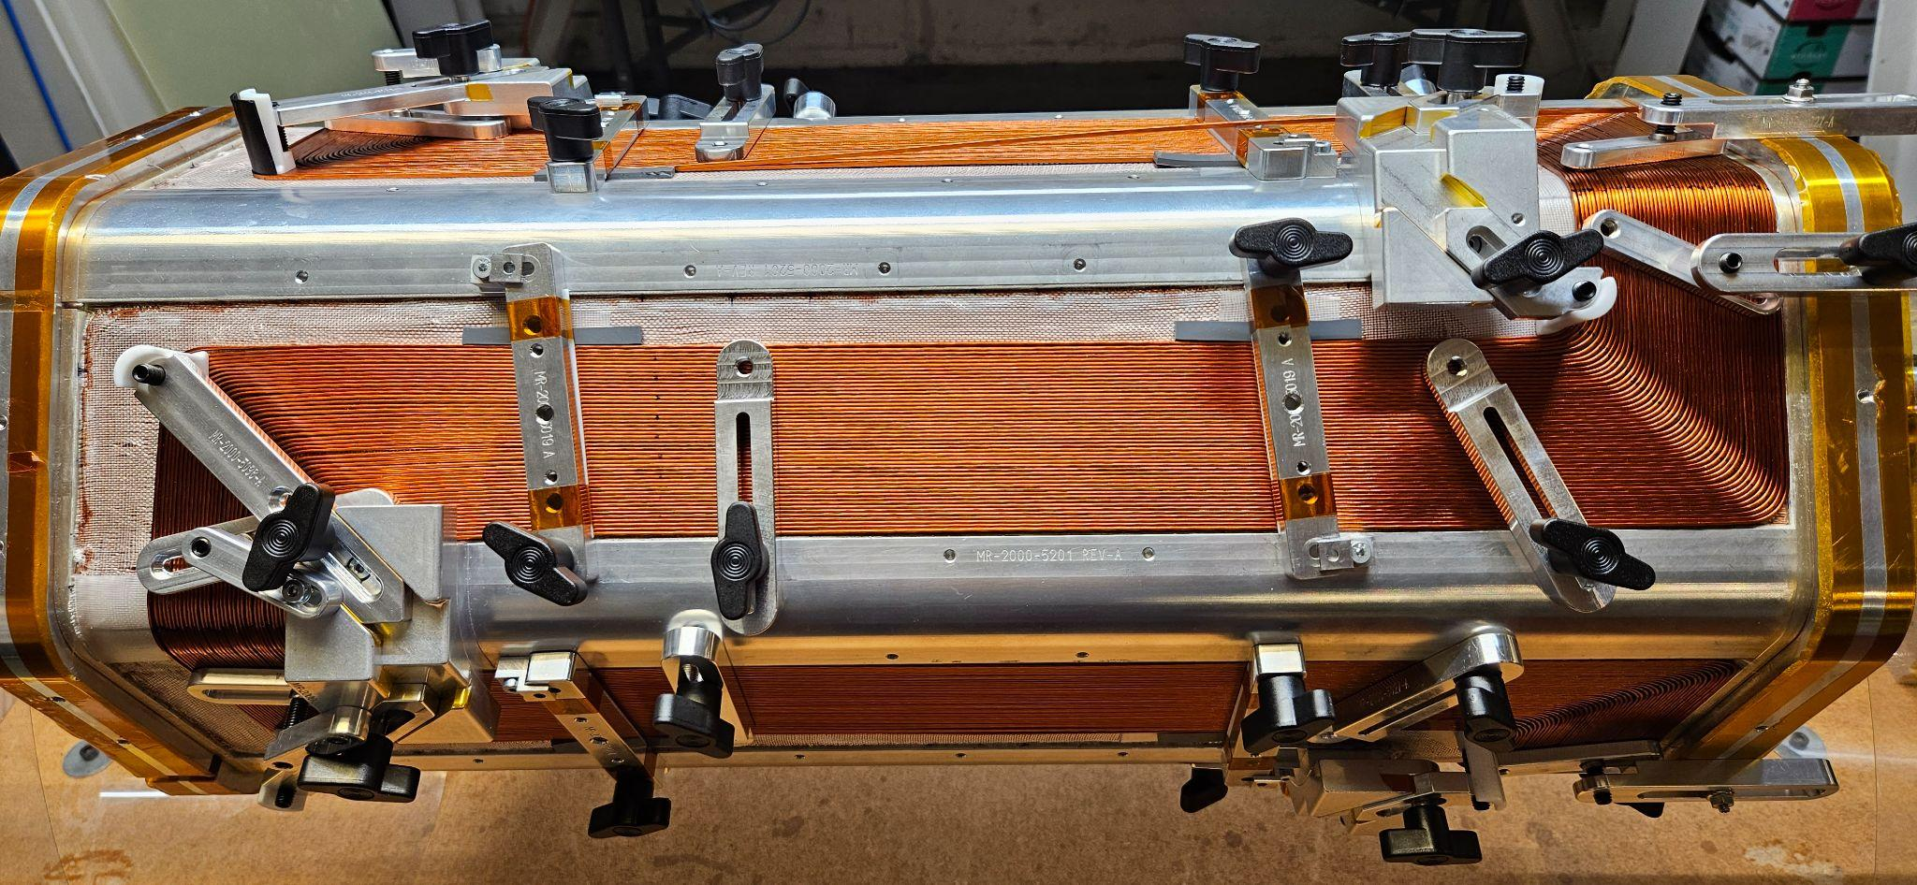
MARS
DOE funded: 1. winding of coldmass (sextupole + solenoids)
2. cryostat design
Largest risks for 4th Generation MARS
MARS-D R&D Project
1.1 Project Management
1.2 Project Design Documentation
1.4 Magnet Coldmass Design & Fabrication
1.6 Cryostat & Magnet in Cryostat Procurement
1.8 Ion Source Design & Fabrication
1.10 Beamline System Design & Fabrication
1.12 RF System Design & Integration
1.14 PLC System Design & Fabrication
1.16 Installation and Commission Prep.
1.17 MARS ECR Ion Source Installation
1.19 Test & Commission Final System
closed-loop-coil
Sextupole (Closed-loop -coil)
Solenoids
Assembly
Test
Design
Fabrication
✔
~summer 2026
~summer 2026
7
NSD Meeting - Nov 4, 2025 Janilee Benitez

Slide 8
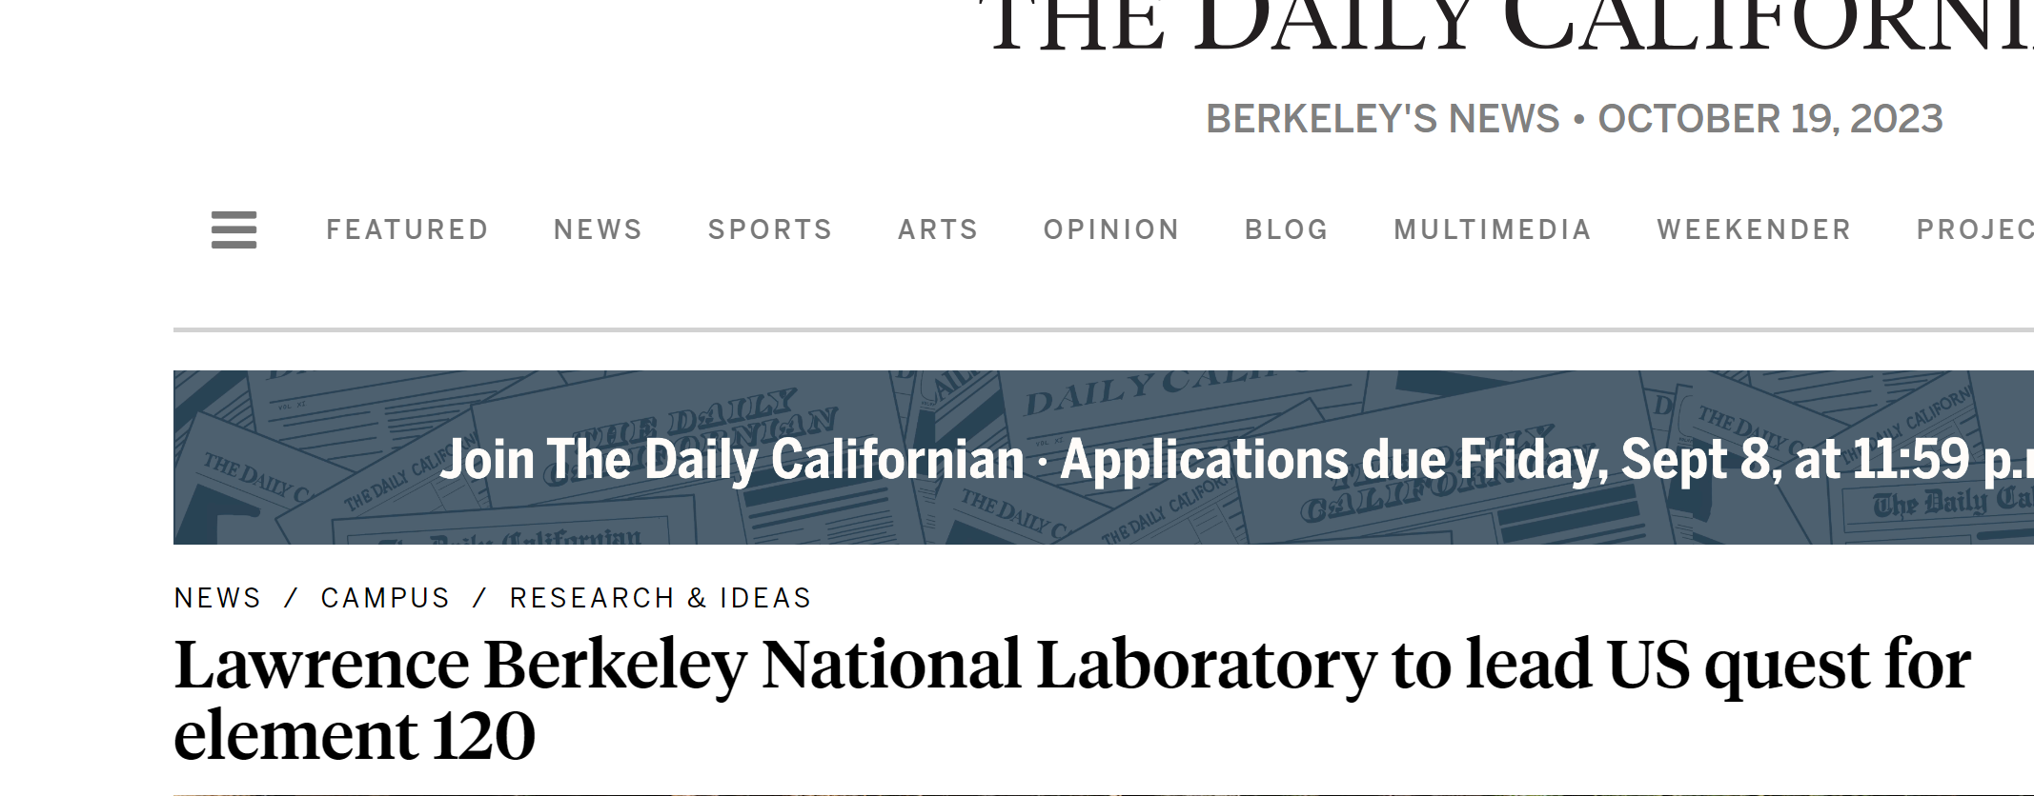
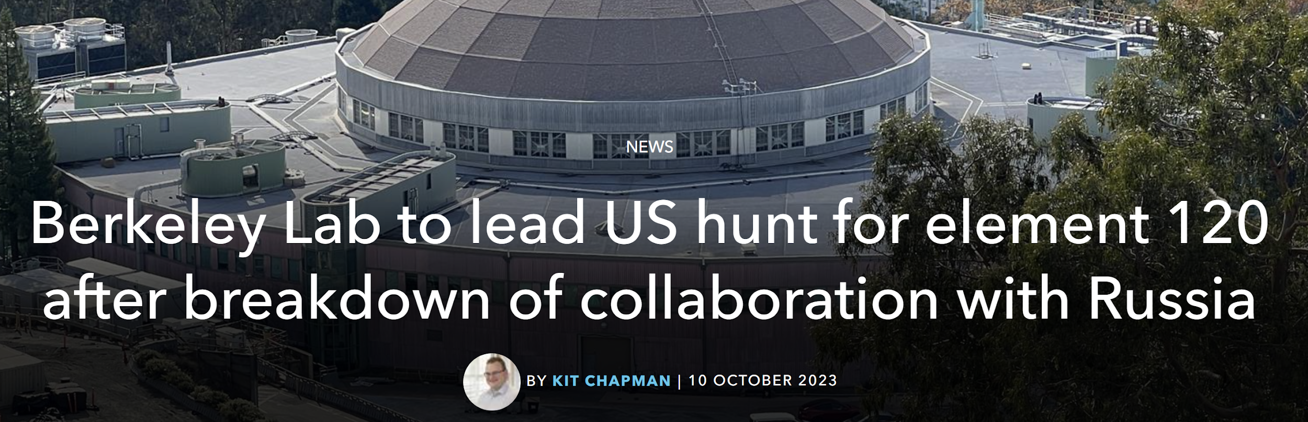
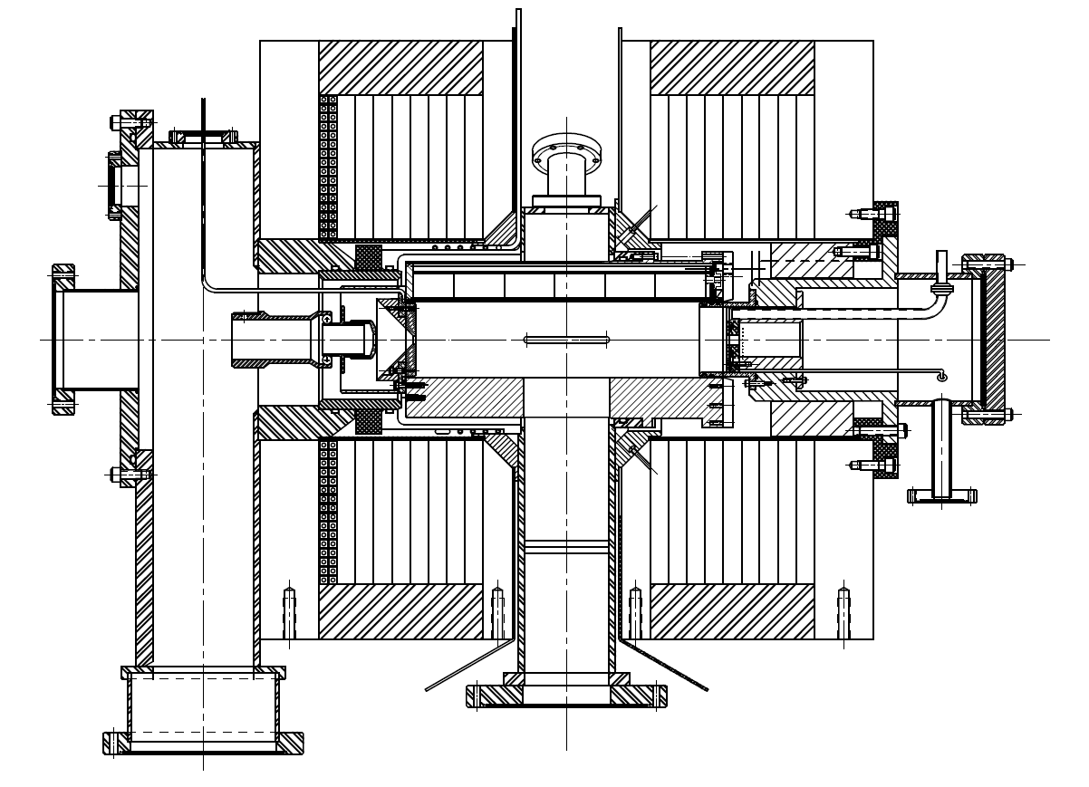

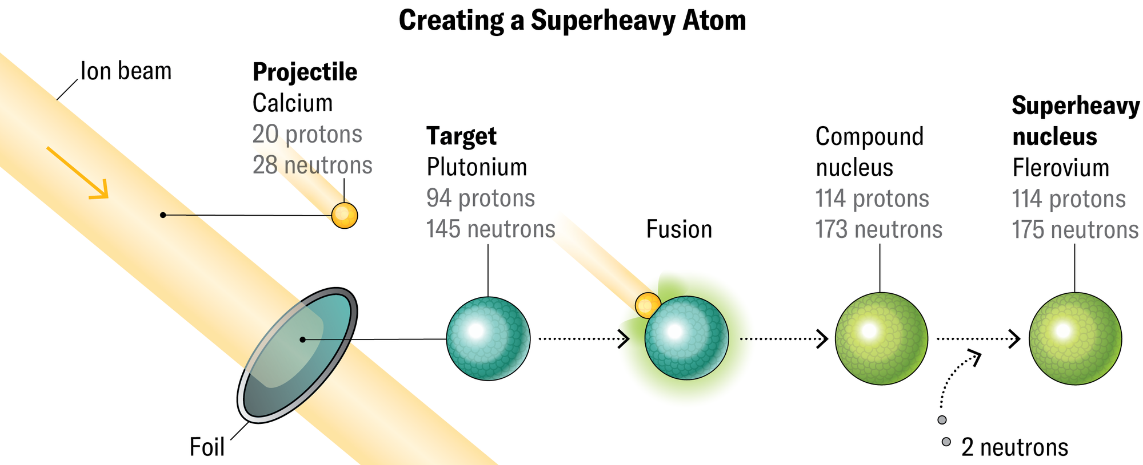

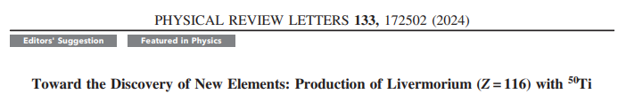


The Role of ECRs in SHE Synthesis
ECR
Adapted from Source: https://www.scientificamerican.com/article/superheavy-elements-are-breaking-the-periodic-table/
8
NSD Meeting - Nov 4, 2025 Janilee Benitez

Slide 9
Summary of SHE Production
Element |  | Facility | Source | Beam | Target | Year
104 | Rutherfordium (Rf) | JINR, LBNL | PIG | ²²Ne, ¹²C | ²⁴²Pu, ²⁴⁹Cf | 1964
105 | Dubnium (Db) | JINR, LBNL | PIG | ²²Ne, ¹⁵N | ²⁴³Am, ²⁴⁹Cf | 1968
106 | Seaborgium (Sg) | LBNL ,JINR | PIG | ¹⁸O (⁵⁴Cr) | ²⁴⁹Cf (Pb) | 1974
107 | Bohrium (Bh) | GSI | PIG | ⁵⁴Cr | ²⁰⁹Bi | 1981
108 | Hassium (Hs) | GSI | PIG | ⁵⁸Fe | ²⁰⁸Pb | 1984
109 | Meitnerium (Mt) | GSI | PIG | ⁵⁸Fe | ²⁰⁹Bi | 1982
110 | Darmstadtium (Ds) | GSI | CAPRICE ECR | ⁶²Ni | ²⁰⁸Pb | 1994
111 | Roentgenium (Rg) | GSI | CAPRICE ECR | ⁶⁴Ni | ²⁰⁹Bi | 1994
112 | Copernicium (Cn) | GSI | CAPRICE ECR | ⁷⁰Zn | ²⁰⁸Pb | 1996
113 | Nihonium (Nh) | Riken | 18 GHz ECRIS | ⁷⁰Zn | ²⁰⁹Bi | 2004
114 | Flerovium (Fl) | JINR | ECR4M | ⁴⁸Ca | ²⁴⁴Pu | 1999
115 | Moscovium (Mc) | JINR | ECR4M | ⁴⁸Ca | ²⁴³Am | 2004
116 | Livermorium (Lv) | JINR | ECR4M | ⁴⁸Ca | ²⁴⁸Cm | 2001
117 | Tennessine (117) | JINR | ECR4M | ⁴⁸Ca | ²⁴⁹Bk | 2010
118 | Oganesson (118) | JINR | ECR4M | ⁴⁸Ca | ²⁴⁹Cf | 2006
119 |  |  | AN ECR
120 |  |  | AN ECR
Electron Cyclotron Resonance Ion Sources
(ECRs)
9
9
9
NSD Meeting - Nov 4, 2025 Janilee Benitez

Slide 10

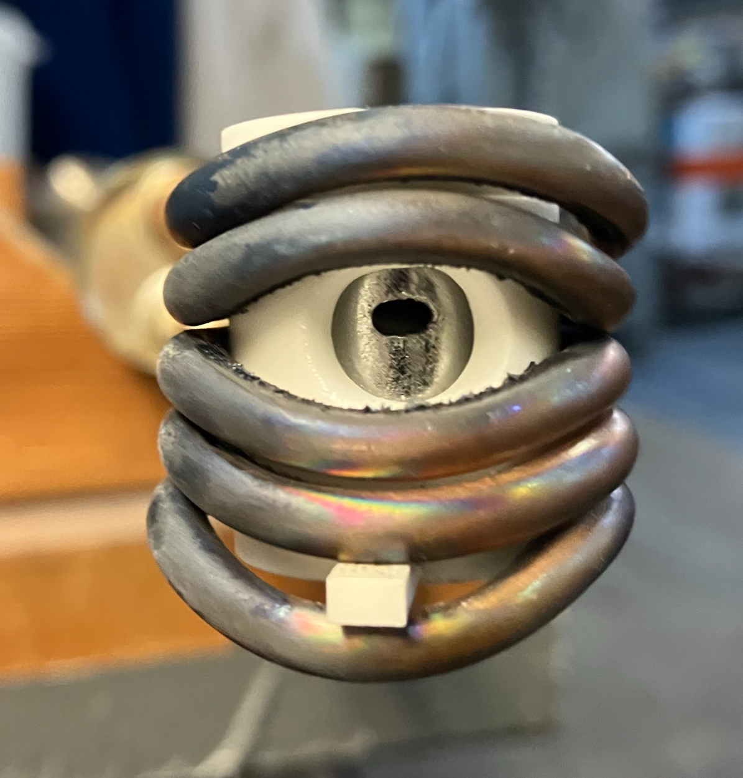
⁵⁰Ti Production for SHE Searches
LBL BGS group will search for element 120 via:
3+ years developing beam
Continued Development of Inductive Oven (Damon Todd)
Delivered 23.5 µA on target!
Courtesy of Damon Todd
Facility | ECR | Method | Production at source To-Date
JINR | DECRIS-PM (14 GHz) | MIVOC | ⁴⁸Ti¹⁰⁺ ⁴⁸Ti⁷⁺ ~30 uA/115 uA
GSI | CAPRICE (14.5 GHz) | High Temperature Oven | ⁵⁰Ti⁸⁺ 90 uA
LBL 88-Inch Cyclotron | VENUS (28 GHz) | Inductive Oven | ⁵⁰Ti¹²⁺ 200 uA
RIKEN
IMP CAFE2
10
10
10
NSD Meeting - Nov 4, 2025 Janilee Benitez

Slide 11
Cyclotron Upgrades

Slide 12
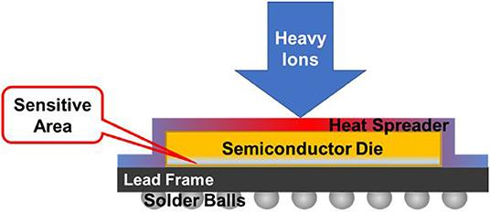
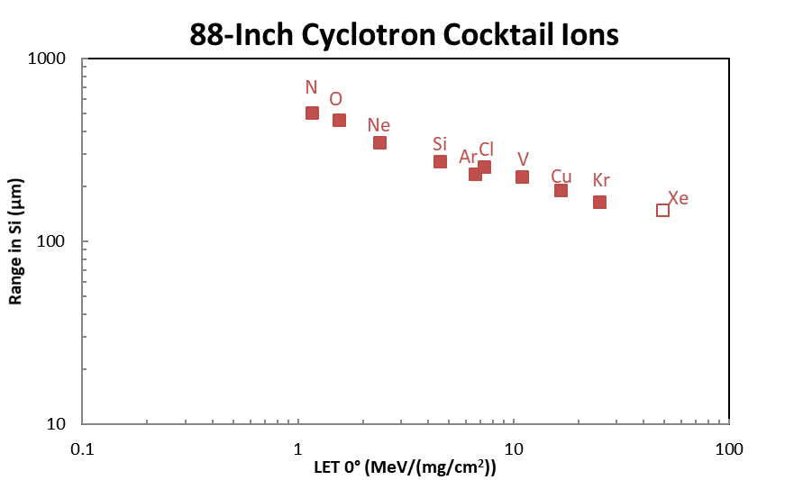
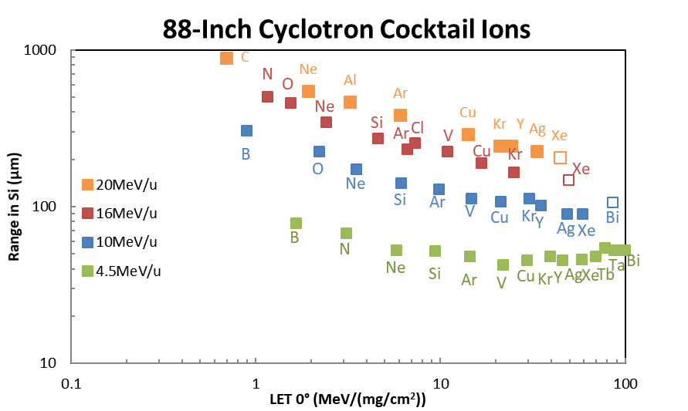
Layout
Upgrades for Cocktail Delivery
Test Resource and Management Center (TRMC, DOD) funded upgrades
Goal: Improve production, transmission, and reliability of the 20 MeV/u cocktail
Why the need for 20 MeV/u cocktail?
layers on chips are increasing in thickness
increasing beam energy allows for deeper penetration into parts
Xe⁴⁶⁺
Xe⁴³⁺
Success Criteria:
Cyclotron vacuum < 1.0x10⁻⁶ Torr
2. Delivery of ¹²⁴Xe⁴⁶⁺ with a minimum current of 20 epA
12
12
12
NSD Meeting - Nov 4, 2025 Janilee Benitez

Slide 13


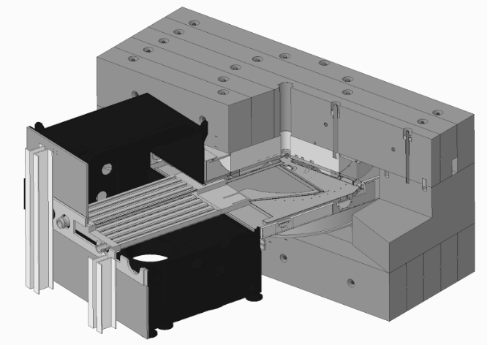
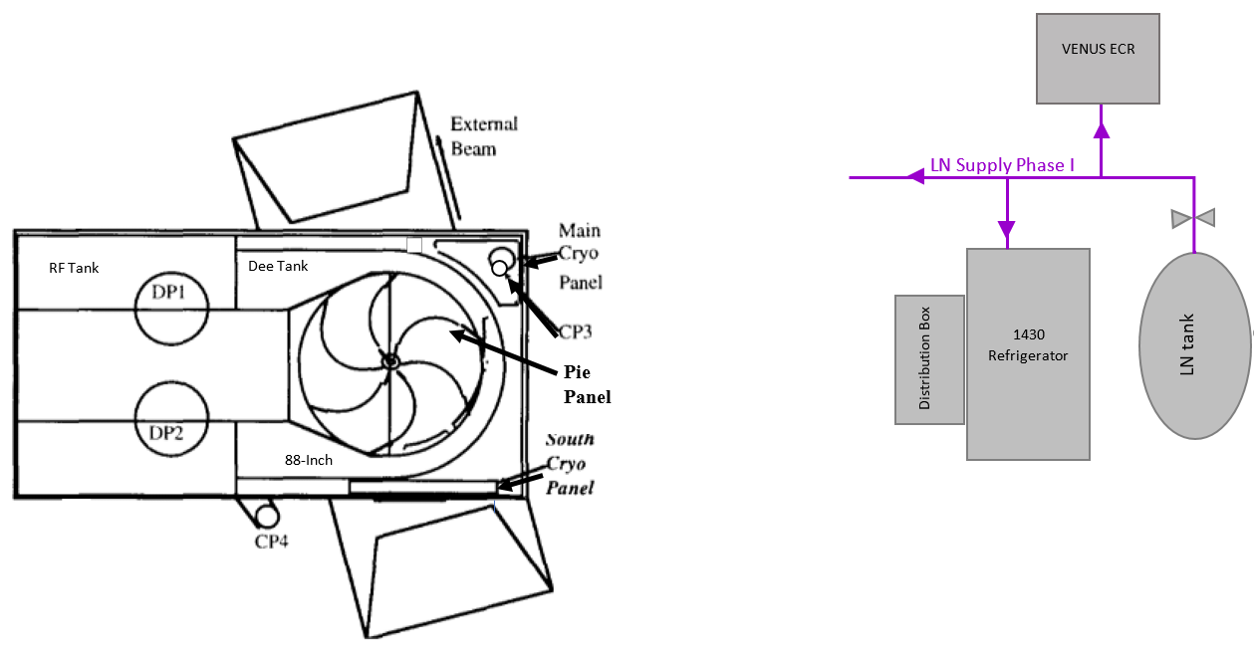
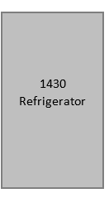
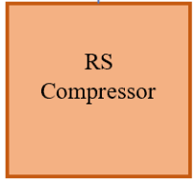
Layout
Overall Picture of Upgrades
Reliability
M41
Beam Production
M42
Transmission
Combo of improvements, reached KPPs
✓ <1.0 x 10⁻⁶ Torr
✓ > 20 pA Xe⁴⁶⁺
Improvements affect several components
Know how to achieve reliably
Achieve reliably
13
13
13
NSD Meeting - Nov 4, 2025 Janilee Benitez

Slide 14
Layout
TRMC Project Activities
Improved vacuum system (necessary to transport the high charge state ion beams in the 20 MeV/u cocktail)
2. Spare He compressor (for use with LR1430 refrigerator)
3. Beamline power supply (replace a failed PS)
4. LN Line replacement (upgrade the LN delivery system to the cyclotron cryopanels and diffusion pumps)
5. Additional 18 GHz RF System (to generate required high charge state ion beams)
6. Improved VENUS Plasma Chamber (to run at higher power and improve reliability)
✔
✔
✔
✔
✔
14
14
14
NSD Meeting - Nov 4, 2025 Janilee Benitez

Slide 15
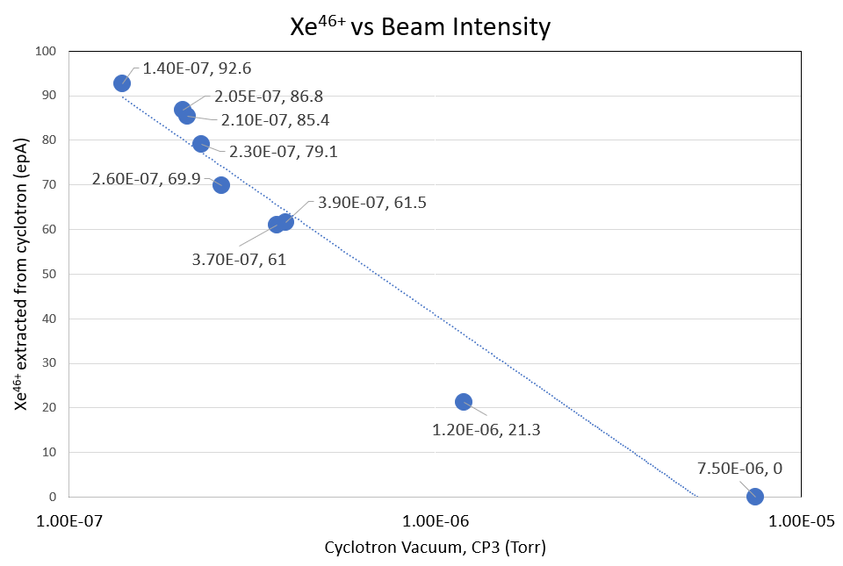

Cyclotron Vacuum is Important
Xe⁴⁶⁺ 92 pA (from 10 epA)
Au⁵³⁺ 100 pA (from 10 epA)
Combo of improvements, reached KPPs
✓ <1.0x10⁻⁶ Torr
✓ > 20 epA Xe⁴⁶⁺
15
15
15
NSD Meeting - Nov 4, 2025 Janilee Benitez

Slide 16
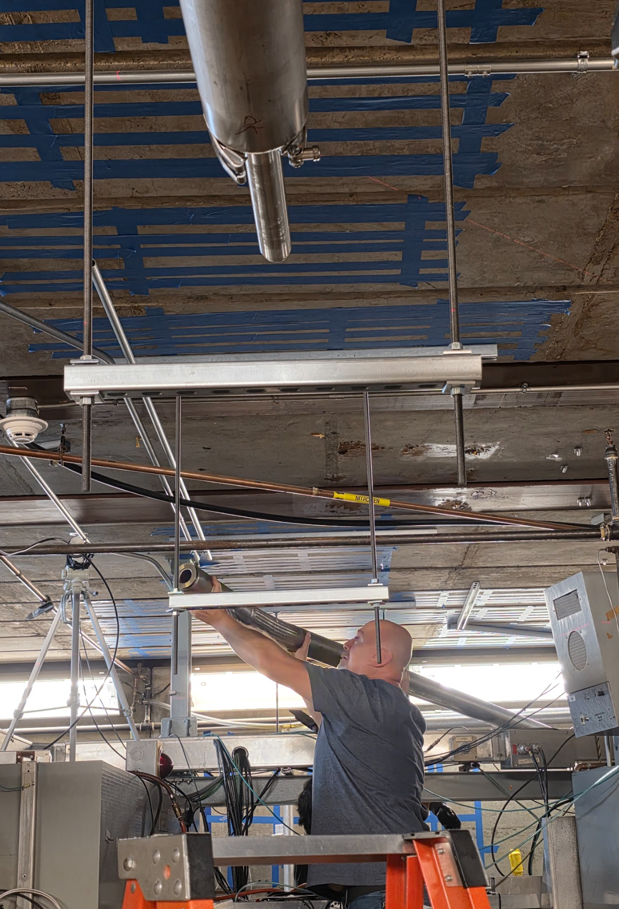
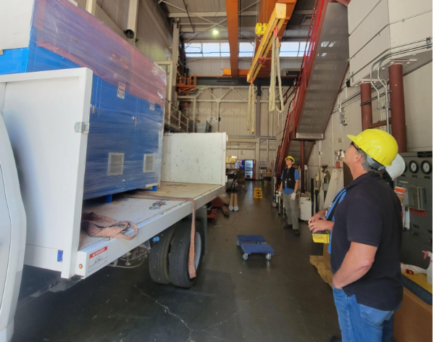
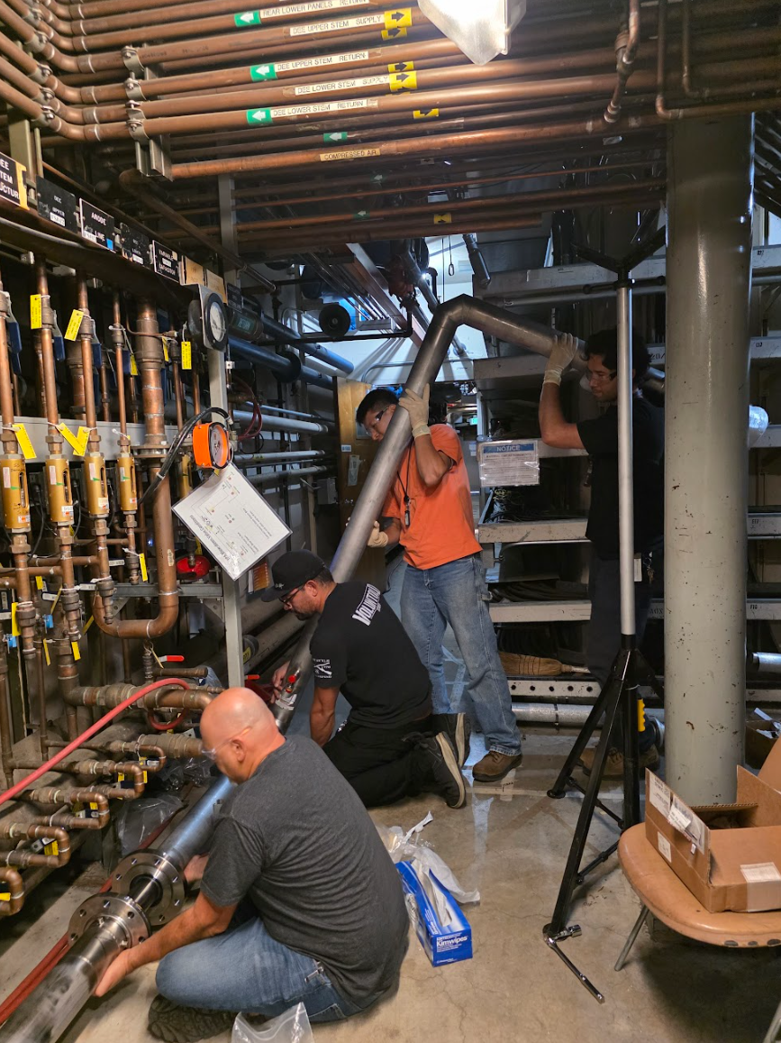
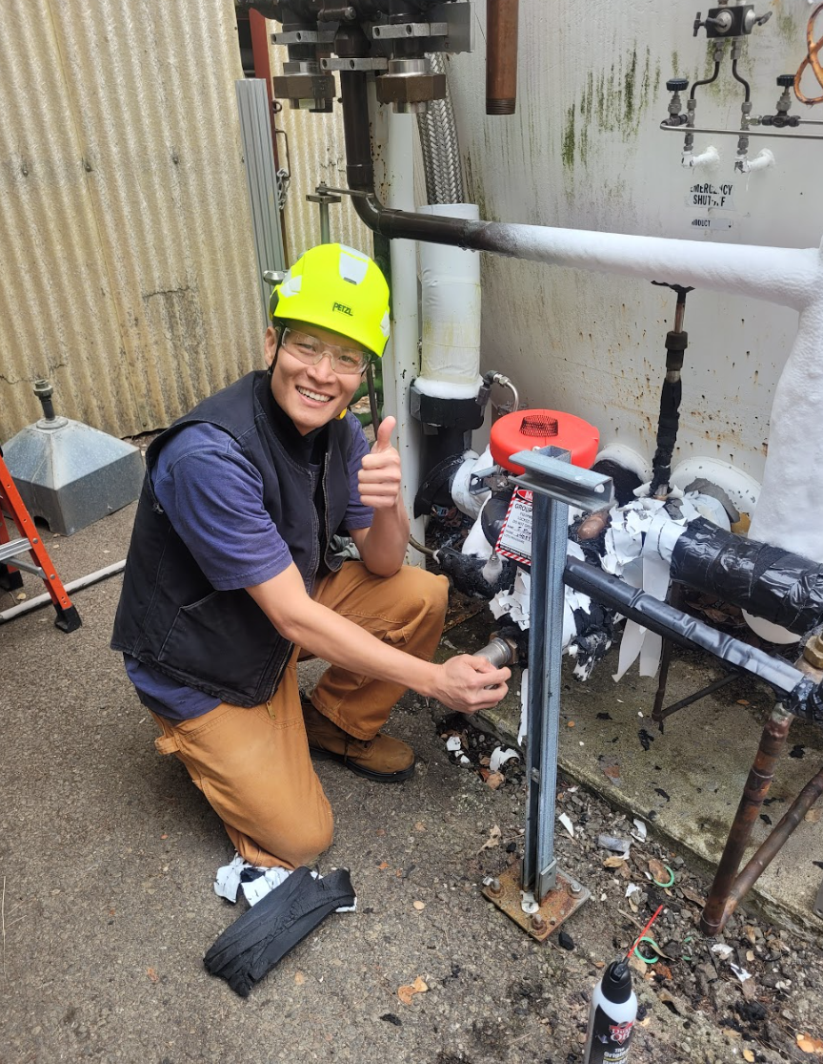
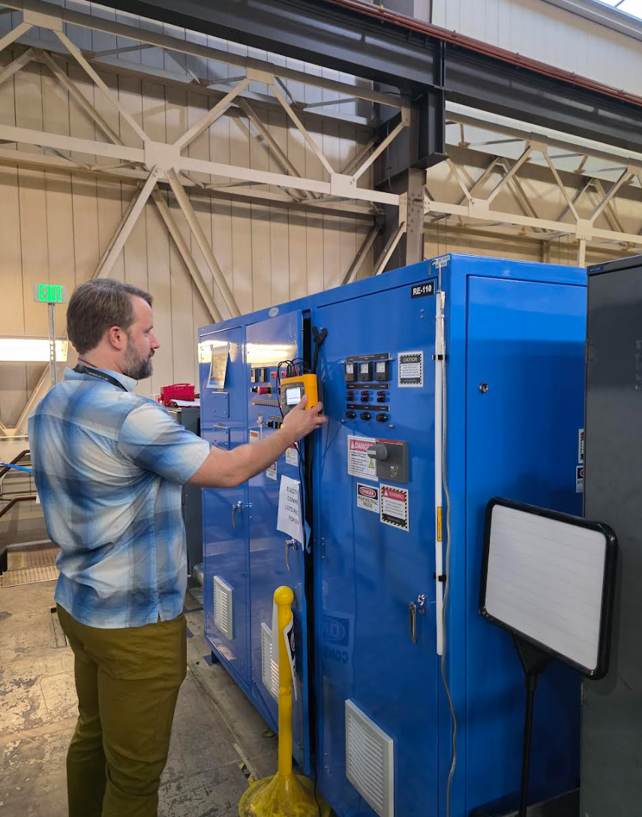
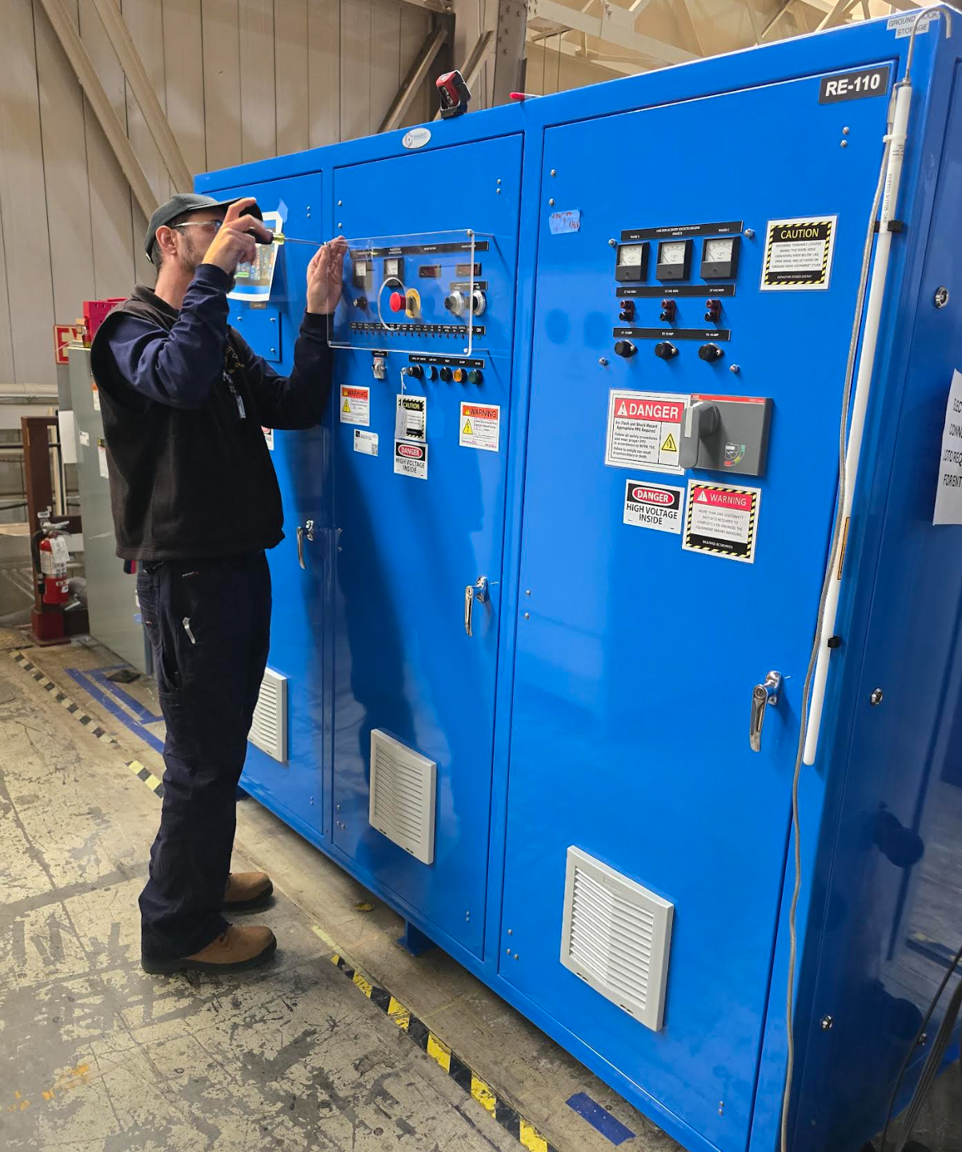
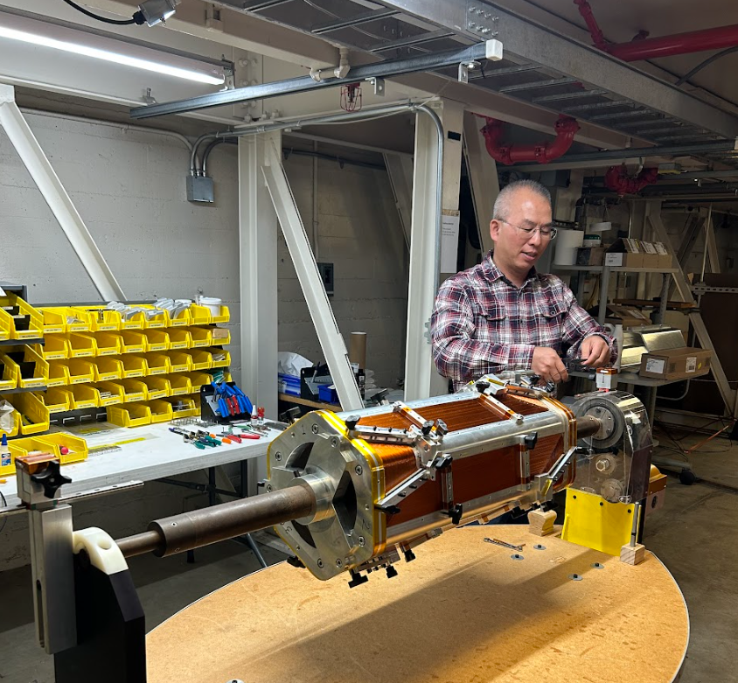
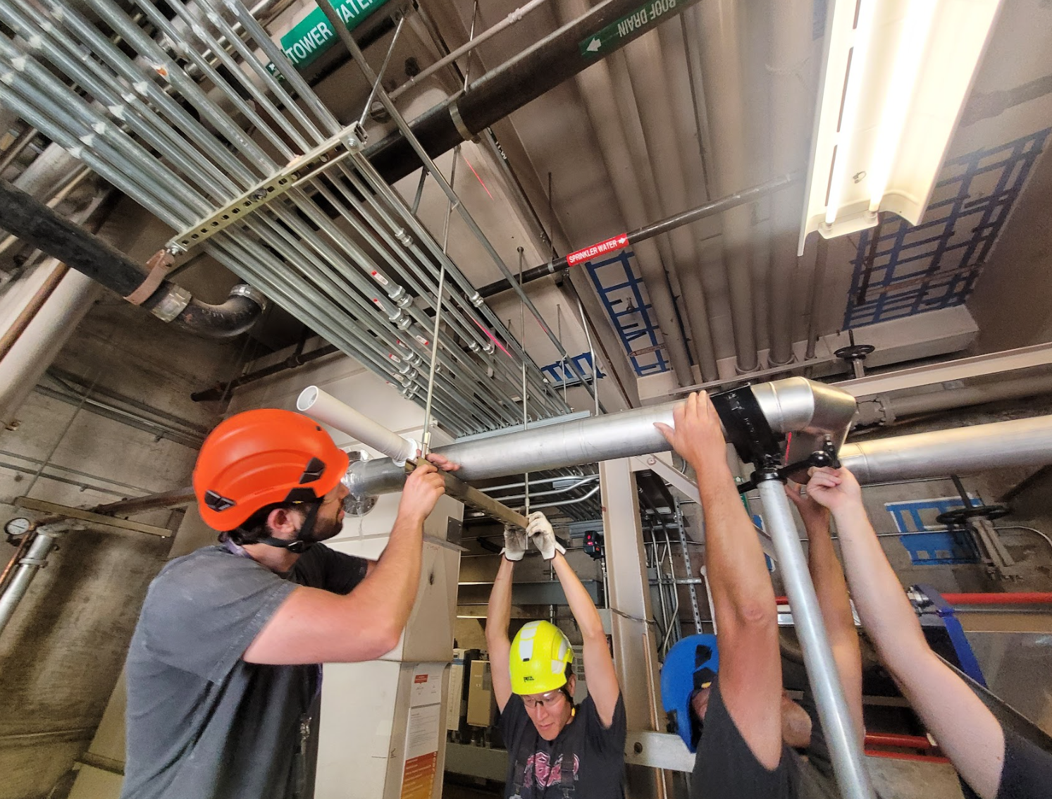
Working around the 88-Inch
LN Vacuum Jacket Phase I Install
LN Vacuum Jacket Phase II Install
LN Vacuum Jacket Phase II Install
M41/M42 Delivery
M41/M42 PS Install
MARS Winding
LN Vacuum Jacket Phase I Install
16
M41/M42 PS Install
16
16

Slide 17
Current Outlook for FY26
Estimated 4,578 hours
DOE NP: 2,187 hours
BASE: 2,391 hours
TRMC: 441 hours
NASA: 441 hours
Work For Others: 509 hours
Blue Origin: 600 hours
Alter Technologies: 400 hours
New for FY26
FY25 Q3, Q4 saw an up time of 99% and 98%
17
17
17
NSD Meeting - Nov 4, 2025 Janilee Benitez

Slide 18
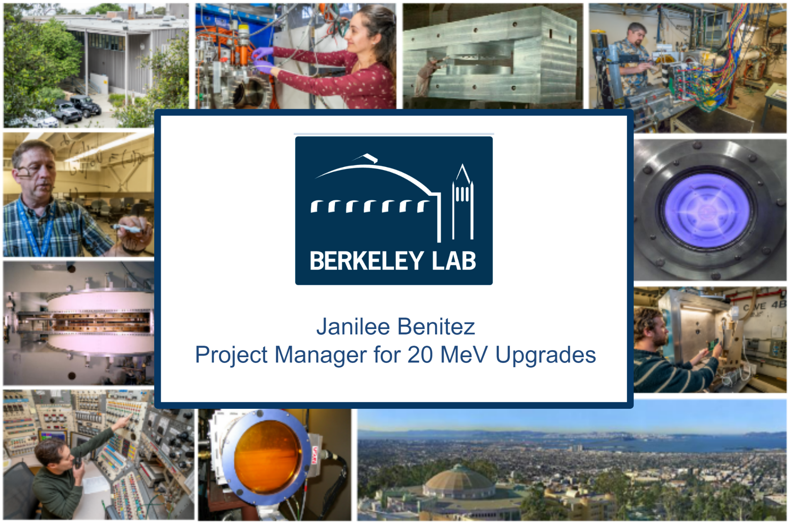
Tite
Thank You
Any Questions?

