Slide 1
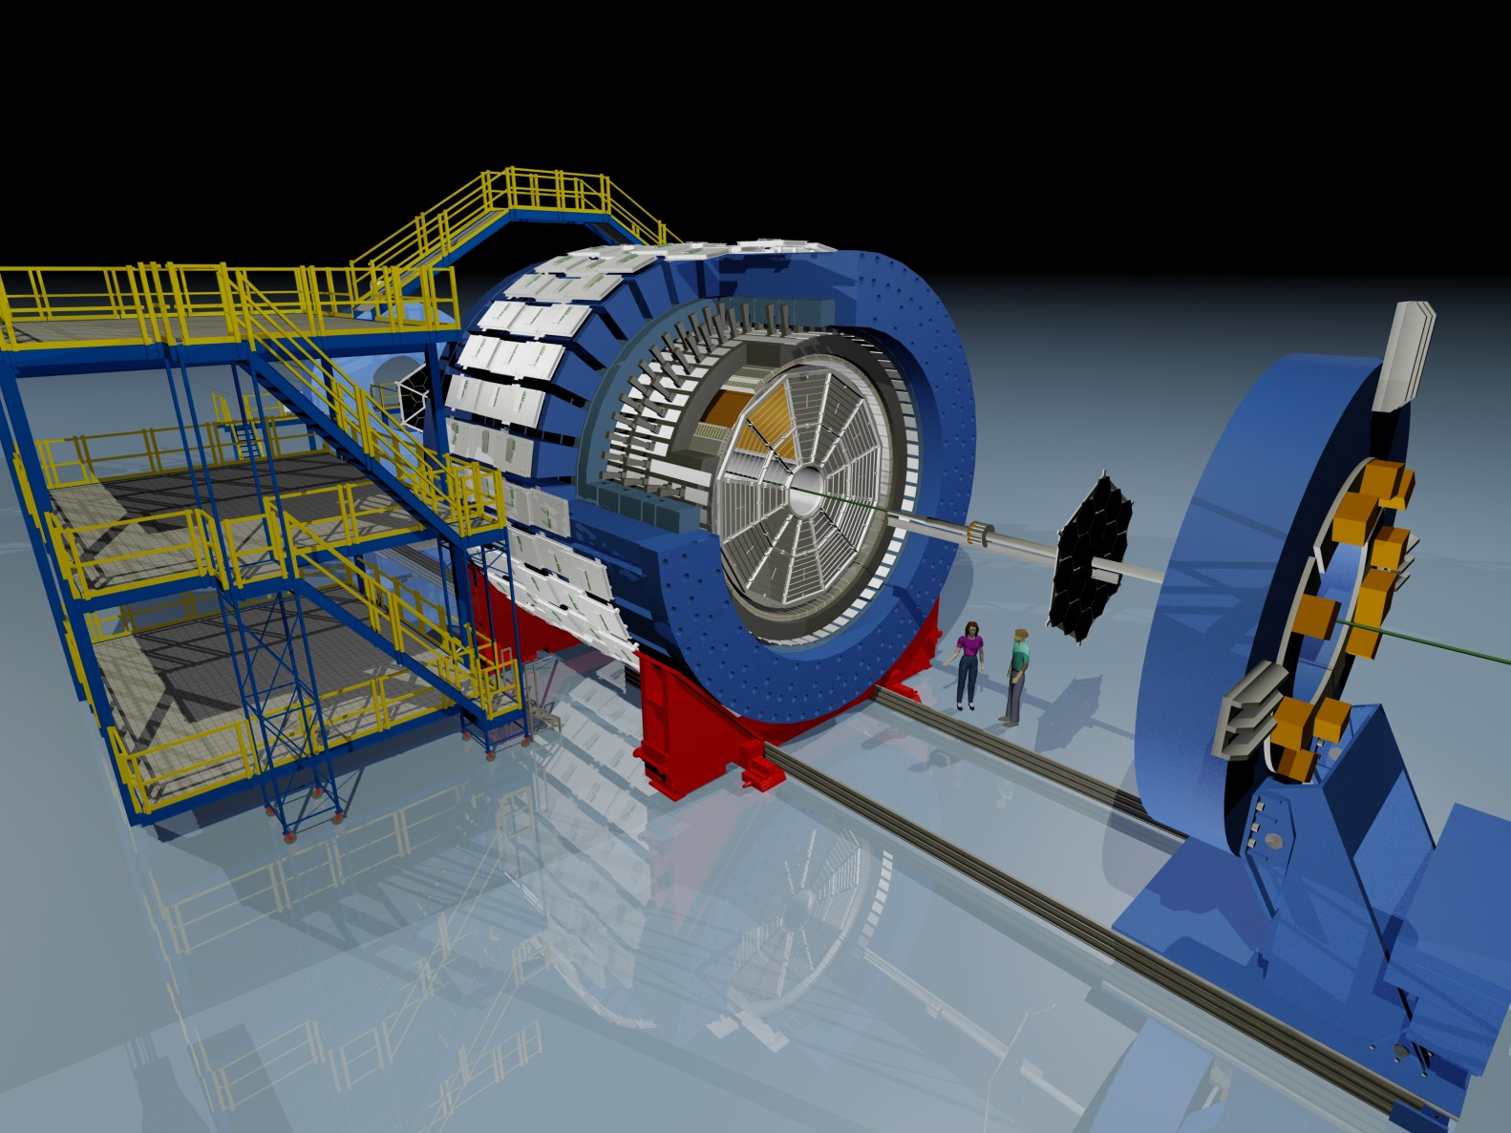
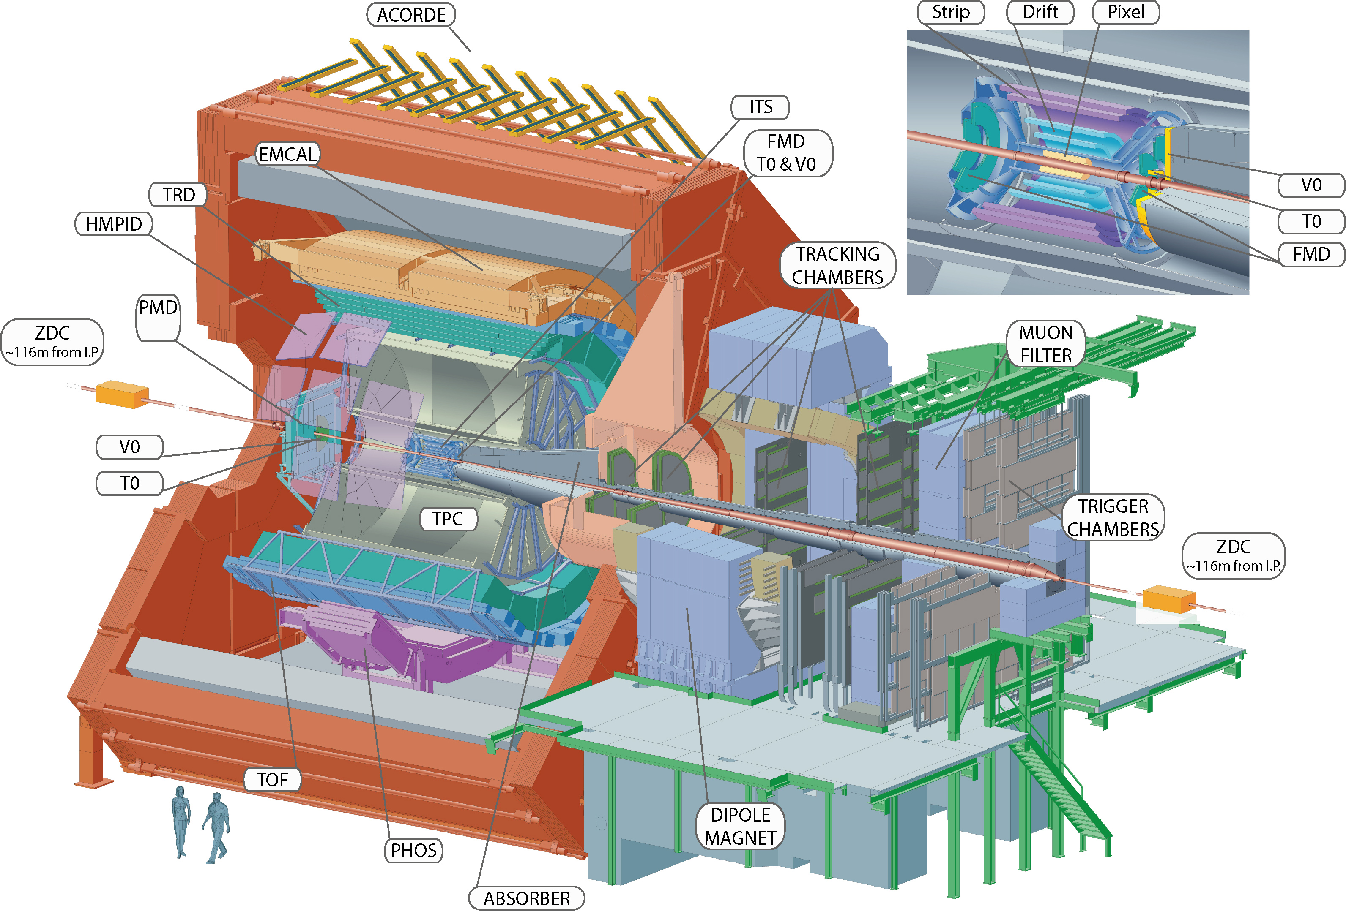
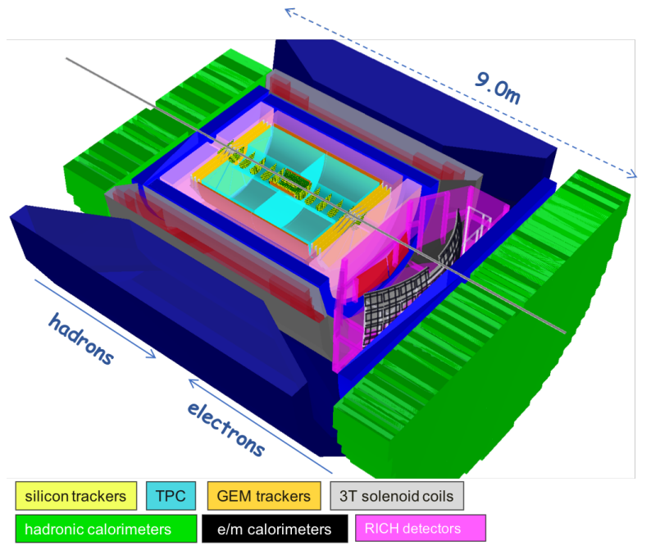
Monolithic Active Pixel Sensors (MAPS) in Heavy Ion Collider Experiments
STAR – MAPS Gen. 1
ALICE – MAPS Gen. 2
EIC Detector – MAPS Gen. 3?

Slide 2
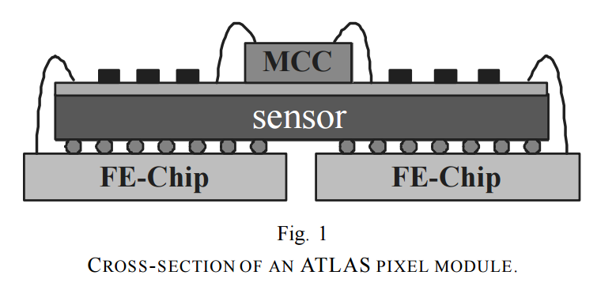
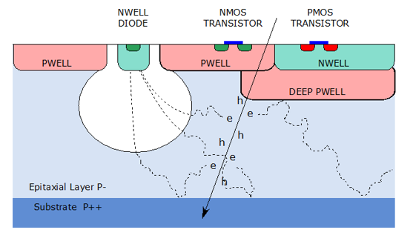
What are MAPS sensors?
Charged particle tracking detectors at large experiments rely on silicon pixel sensors to provide high resolution hit points for tracking and vertex determination.
Standard planar hybrid pixels
Monolithic Active Pixel Sensors
Signal generated in depleted detector silicon.
Signals processed by front end chips bump bonded to detector silicon.
Typical sensor Si thickness ~ 250 µm.
Pixel size typical 50 µm x 400 µm (dependent on bump bonding capability).
Radiation tolerance ~50 Mrad.
Radiation length (per layer) ~2.5% (includes support structure and cooling).
Larger capacitance at sensing node
Detector and processing integrated into one silicon wafer in commercial CMOS process.
Signal generated in epitaxial layer and collected primarily by thermal diffusion.
Signals processed in circuitry integrated into matrix and on sensor.
Can be thinned to < 50 µm.
Pixel size as small as 10 µm x 10 µm.
Radiation tolerance ~3 Mrad.
Radiation length (per layer) ~0.3%
Very small capacitance in sensing node (few fF)

Slide 3
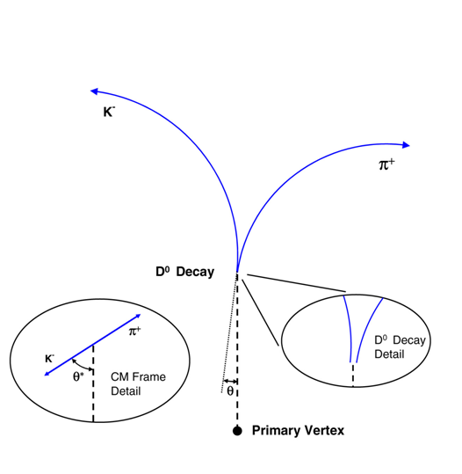
Vertexing requirements for charged particle tracking in HI collisions
Ultra precise charged particle tracking for locating secondary vertices at low momentum (≤ 1 GeV/c)
Direct Topological reconstruction of Charm
  Detect charm decays with small cτ, including D⁰ → K + π
Need good single point resolution
Need low radiation length – we are in the low momentum pointing resolution regime where multiple coulomb scattering is a strong limitation.
  Low mass, low z support structures
  Sensors thinned to 50 µm
  Aluminum conductor FPCs
Low power budget so cooling doesn’t impose additional radiation length issues and less power supply conductor.
Relatively fast readout to limit event pileup.
In the D⁰ example the cτ is 123 µm, to do the physics at STAR we need ~50 µm DCA pointing resolution for 750 MeV/c kaons.
The physics goals for STAR and ALICE vertex detectors are the essentially the same but in different collision energy regimes
Method: Resolve displaced vertices (60-150 microns)
Notes:
Heavy flavor as a probe of the QGP. 60um for lambda c

Slide 4
MAPS in Heavy Ion Colliders
The characteristics of MAPS sensors are very well suited to the collision event structure and moderate luminosity environment that is characteristic of heavy ion colliders.
STAR at RHIC
ALICE at LHC
Very similar detector configurations for tracking:
TPC is main tracking detector in a solenoidal 0.5T magnetic field.
Silicon vertex detector layers close to the beam pipe in the field cage of the TPC for high resolution vertex tracking.
Central collisions (impact parameter 80-100%) give thousands of charged particles per collision but typically do not occur every beam crossing.
1st Generation
RHIC luminosity 8 x 10²⁷ cm⁻²s⁻¹
TPC readout is ~1 kHz
Sensor integration time is ~186 us
Average pixel occupancy in silicon is ~ 0.01%
2nd Generation
LHC luminosity (post LS2) 9 x 10²⁹ cm⁻²s⁻¹
TPC readout is ~50 kHz (new GEM foil gain stage)
Sensor integration time is ~10 us
Average pixel occupancy in silicon is ~ 0.01%
Notes:
Ion back flow

Slide 5
STAR PXL detector
First large scale MAPS vertex detector at a collider.
In order to meet all of the criteria explained before, needed to pioneer advanced techniques, primarily to limit the radiation length:
    Thinning to 50 µm and demonstrating that this didn’t affect sensor performance.
    Very low mass and low z carbon structures.
    Air cooling at room temperatures.
Included an advanced mechanical design to install an already mapped detector that did not change position or distort due to airflow or temperature change.
Overall detector system design and construction at LBNL.
https://www.sciencedirect.com/science/article/pii/S0168900218303206?via%3Dihub

Slide 6
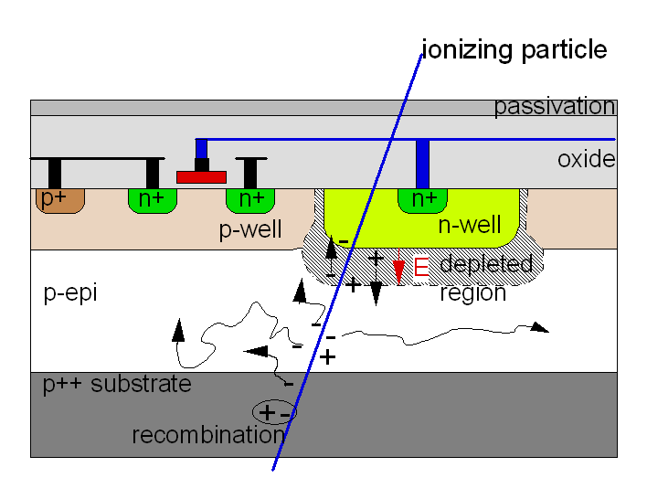
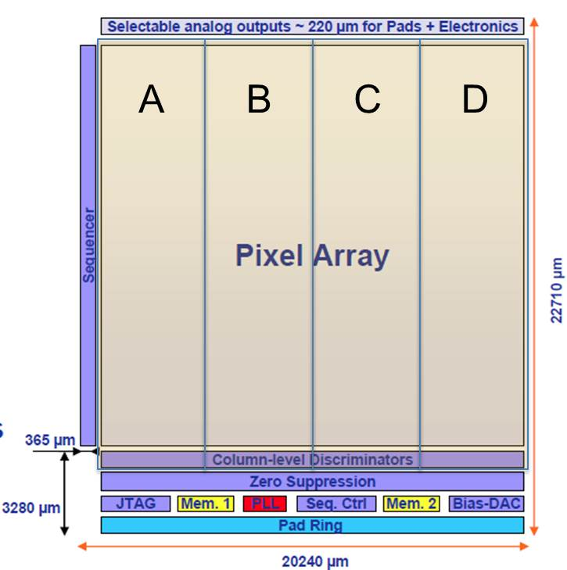
PXL MAPS sensor
Ultimate-2: third revision sensor developed for PXL by the PICSEL group of IPHC, Strasbourg
AMS OPTO 0.35μm process
Binary readout of hit pixels
  4 sub-arrays to help with process variation
High resistivity p-epi layer (800 ohm-cm)
  Reduced charge collection time
  Improved radiation hardness
S/N ~ 30
MIP Signal ~ 1000 e-
Rolling-shutter type readout
  A row is selected
  For each column, a pixel is connected to discriminator
  Discriminator detects possible hit
  Move to next row
185.6 μs integration time
~170 mW/cm² power dissipation
Pixel matrix
  20.7 µm x 20.7 µm pixels
  928 rows x 960 columns = ~1M pixel
  In-pixel amplifier
  In- pixel Correlated Double Sampling (CDS)
Digital section
  End-of-column discriminators
  Integrated zero suppression (up to 9 hits/row)
  Ping-pong memory for frame readout (~1500 w)
  2 LVDS data outputs @ 160 MHz

Slide 7
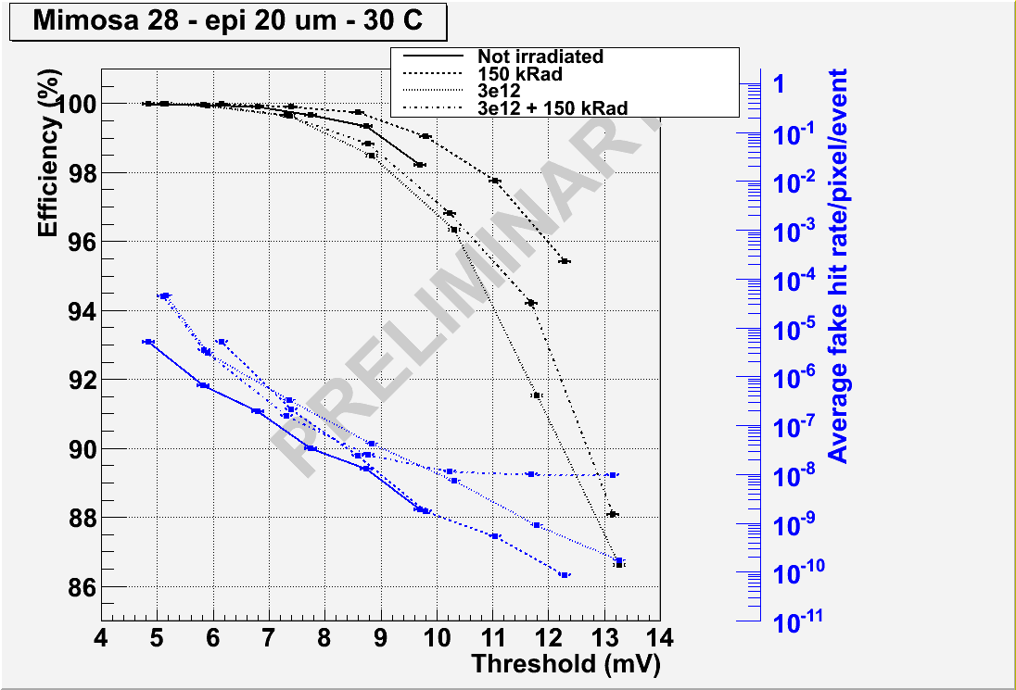
Ultimate 1 sensor efficiency vs. fake hit rate
Tested for STAR Operating conditions
Developed and tested by IPHC
Marc Winter
CMOS Group
IPHC, Strasbourg, France

Slide 8
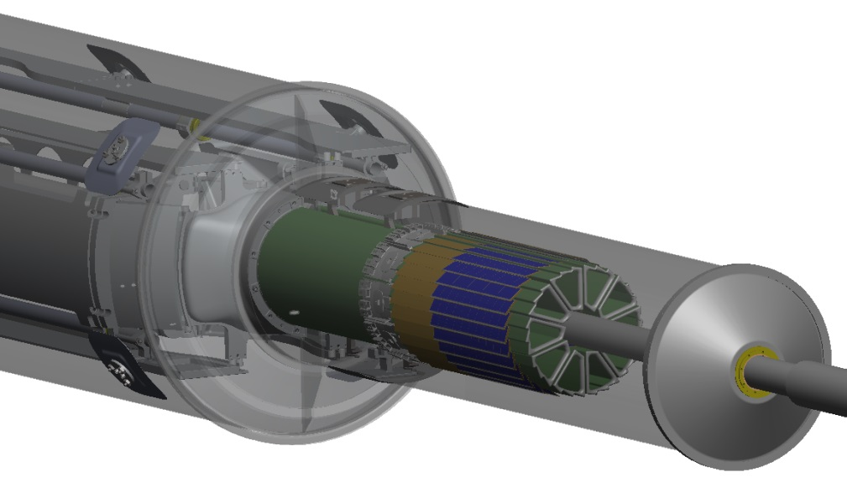
PXL Detector Design
Insertion from one side
2 layers
10 sectors total (in 2 halves)
4 ladders/sector
Ladder with 10 MAPS sensors (~ 2×2 cm each)
carbon fiber composite sector tubes (~ 200 µm thick)
RDO Buffers / Drivers
MAPS
Aluminum conductor Ladder Flex Cable
2-layer kapton flex cable with Al traces
20 cm

Slide 9
PXL Design Parameters
DCA Pointing resolution | (10 ⊕ 24 GeV/p⋅c) μm
Layers | Layer 1 at 2.8 cm radius Layer 2 at 8 cm radius
Pixel size | 20.7 μm X 20.7 μm
Hit resolution | 3.7 μm (6 μm geometric)
Position stability | 5 μm rms
Material budget first layer | X/X₀ = 0.39% (Al conductor cable)
Number of pixels | 356 M
Integration time (affects pileup) | 185.6 μs
Radiation environment | 20 to 90 kRad / year 2*10¹¹ to 10¹² 1MeV n eq/cm²
Rapid detector replacement | < 1 day
356 M pixels on ~0.16 m² of Silicon
Air cooling
Sensors thinned to 50 µm

Slide 10
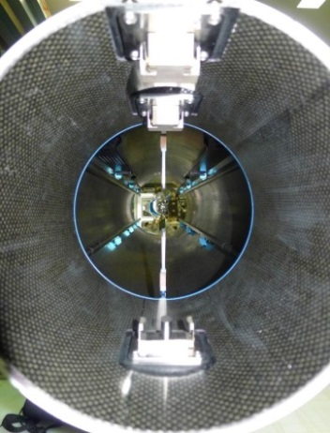
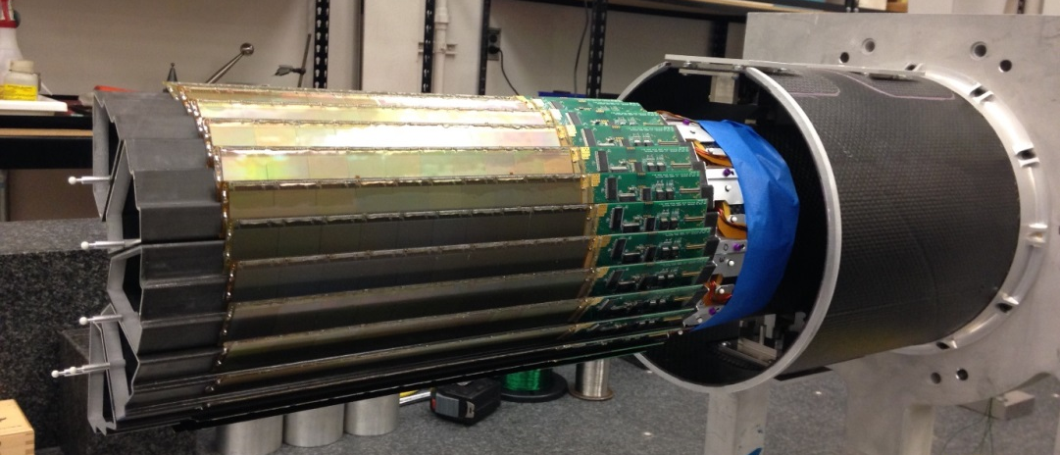
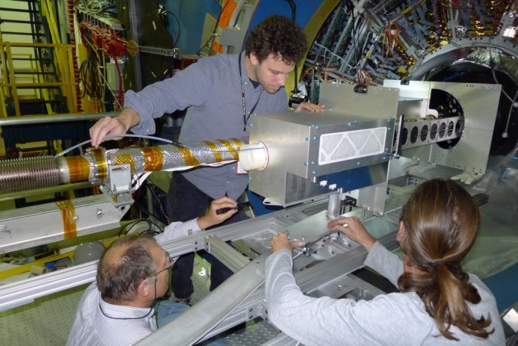
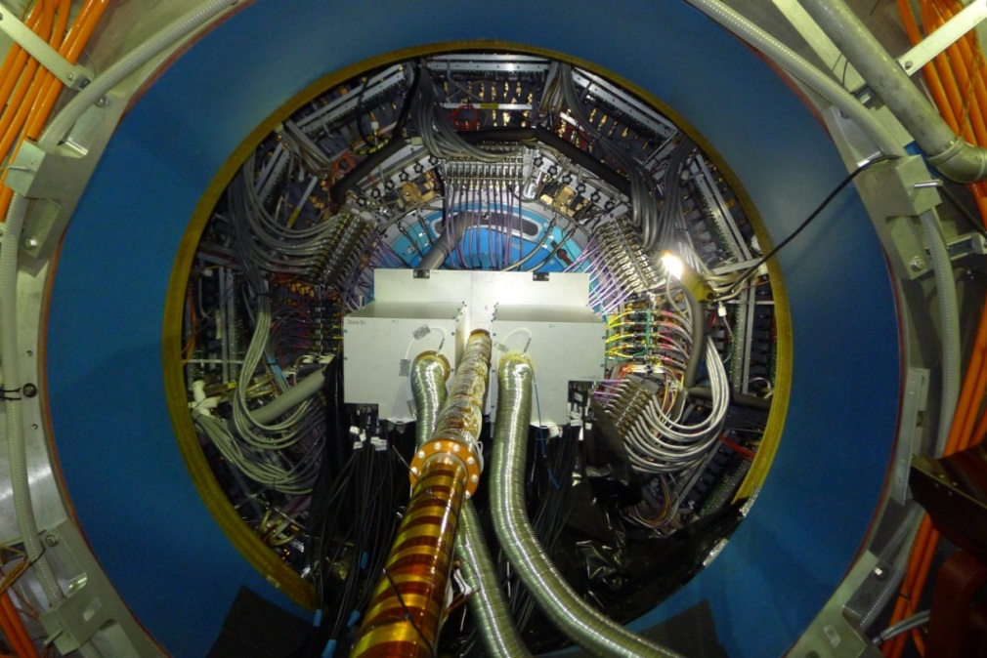
PXL Installation in STAR
  Kinematic mounts
Novel insertion approach
  Inserted along rails and locked into a kinematic mount inside the support structure
  duplicate, truncated PXL support tube with kinematic mounts
  Insertion in STAR
  PXL inserted and cabled in STAR
https://www.sciencedirect.com/science/article/pii/S0168900218303206?via%3Dihub

Slide 11
PXL timeline
HFT proposal submitted to DOE
DOE “mission need” (CD-0) DOE R&D $
2003
2004
2005
2006
2007
2008
2009
Analog Sensor R&D
digital binary R&D with IPHC
Mechanics R&D
DOE tech selection CDR (CD-1) pro $
DOE tech selection TDR (CD-2/3) con $
2010
2011
2012
2013
2014
2015
2016
Physics run
Physics run
Physics run
Engineering run
Sensor refine and fab
R&D + Prototype construction
Construction and rework
The HFT was removed from STAR after the completion of run 16 and put into storage.

Slide 12
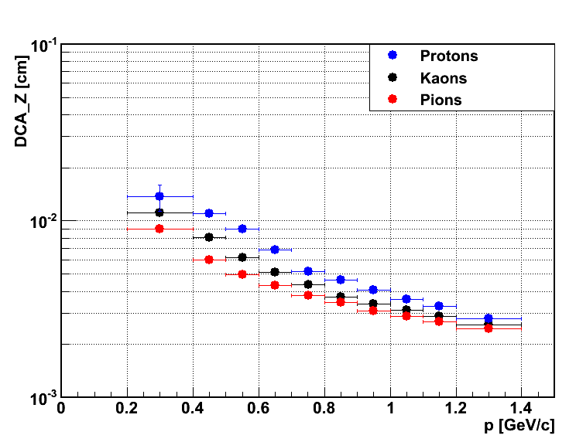
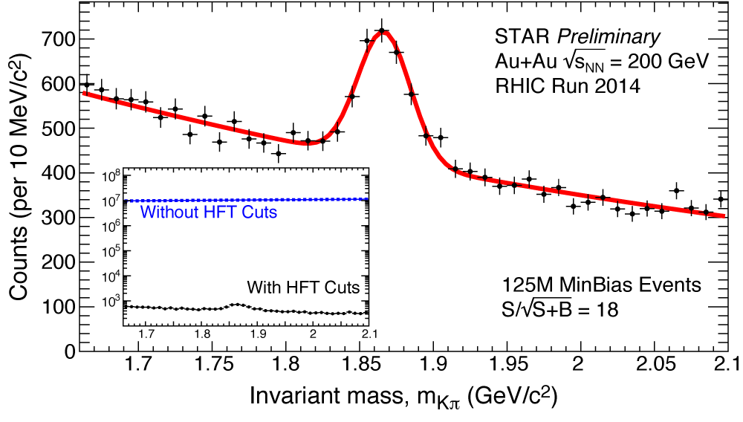
HFT Performance from 2014 data
DCA pointing resolution
  Design requirement exceeded: 46 µm for 750 MeV/c Kaons for the 2 sectors equipped with aluminum cables on inner layer
  ~ 30 µm for p > 1 GeV/c
  From 2015: all sectors equipped with aluminum cables on the inner layer
Physics of D-meson productions
  High significance signal
  Nuclear modification factor R_{AA}
  Collective flow v₂
First Λ_{c}⁺ signal observed in HI collisions (PRL LL16224)! cτ ∼ 60 μm
46 µm
D⁰ → K π production in
√s_{NN} = 200GeV Au+Au collisions
(partial event sample)

Slide 13
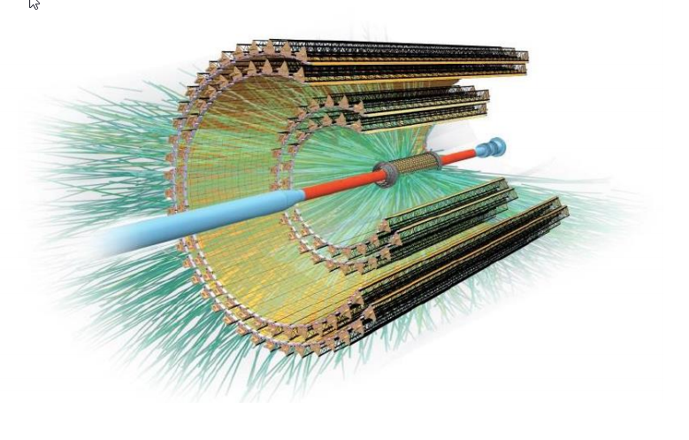
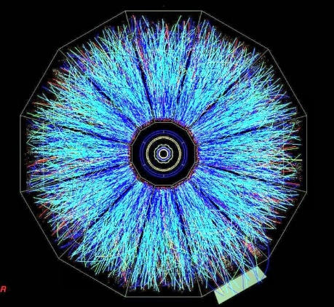
ALICE Inner Tracking System (ITS) Upgrade – next generation MAPS detector
 | STAR PXL | ALICE ITS
Silicon area | 0.16 m² | 10 m²
# pixels | 356 M | 12.5 G
# layers | 2 | 7
Integration time | 186 µs | 10-20 µs
Trigger rate | ~1 kHz | ~100 kHz (p-p)
X/X₀ inner layer | ~0.4 % | ~0.3 %
RDO speed | 160 MHz | 1.2 GHz

Slide 14
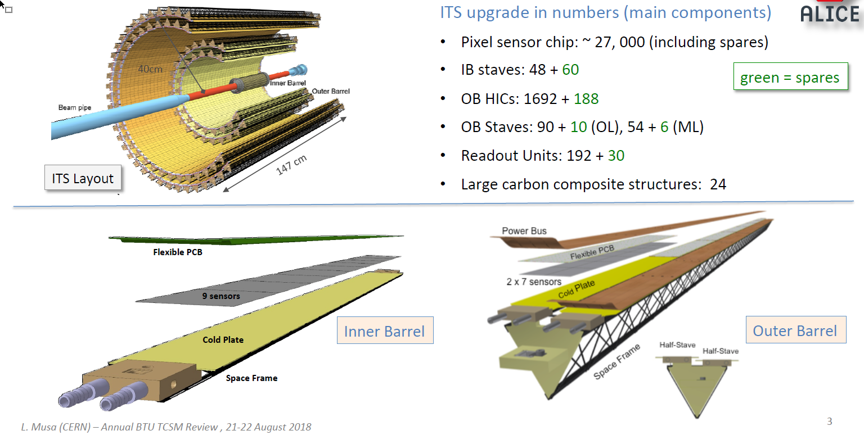
ALICE ITS Upgrade – next generation MAPS detector
ITS Upgrade in numbers:
IB staves: 48 r (mm) = 23, 31, 39
ML staves: 54 r (mm) = 194, 247
OL staves: 90 r (mm) = 353, 405
Readout Units: 192
Large carbon composite structures: 24
12.5G pixels
10 m² of silicon
(PXL was 0.16 m²)

Slide 15
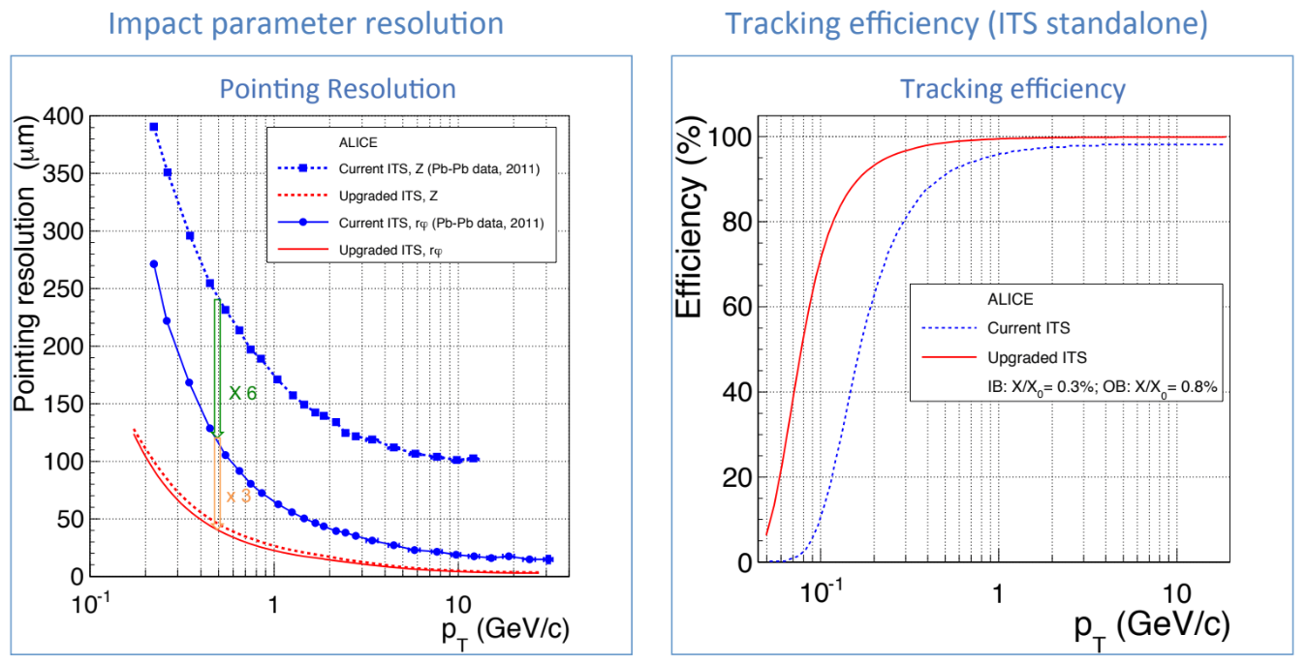
Upgraded ITS Performance
All layers are MAPS sensors
~40 µm at p_{T} = 500 MeV/c

Slide 16
ALPIDE – next generation MAPS sensor
CMOS Pixel Sensor using 0.18μm CMOS Imaging Process (TowerJazz)
Signal Chain
N_{A} ~ 10¹⁶
N_{A} ~ 10¹³
N_{A} ~ 10¹⁸
N_{A} ~ 10¹³
pixel capacitance ≈5 fF (@ V_{bb} = -3 V)
Qin (MIP) ~ 1300 e- => ~40mV
N_{A} ~ 10¹⁸
27 um x 29um pixels in a 512 x 1024 array
High-resistivity (> 1kΩ cm) p-type epitaxial layer (25mm) on p-type substrate.
Small n-well diode (2 um diameter), ~100 times smaller than pixel => low capacitance (~fF)
Reverse bias voltage (-6V < V_{BB} < 0V) to substrate (contact from the top) to increase depletion zone around NWELL collection diode.
Deep PWELL shields NWELL of PMOS transistors => full CMOS circuitry within active area.
Triggered readout mode - Sensor and front-end continuously active: upon particle hit front-end forms a pulse with ~1-2ms peaking time
30mm
15mm
L. Musa
Notes:
6 metal layers

Slide 17
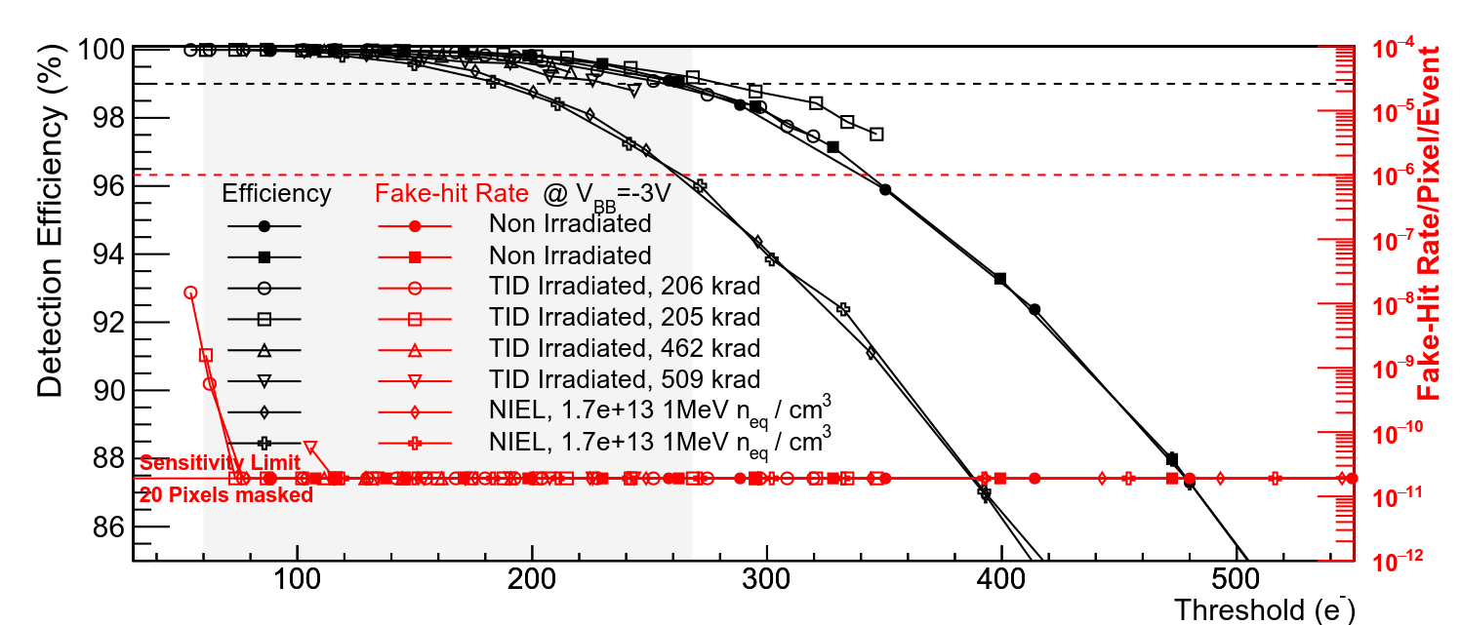
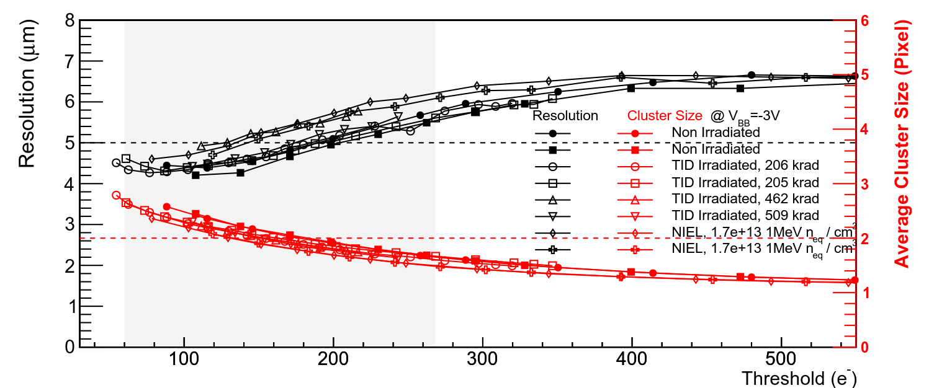
ALPIDE Measured Performance
99%
6 GeV/c π
Large operational margin with only 10 masked pixels (0.002%), fake-hit rate < 10⁻¹⁰ pixel/event
Non irradiated and TID/NIEL chips similar performance
10x lifetime NIEL
Non irradiated
Nucl. Phys. A 967 (2017) 900-903
Nucl. Phys. A 967 (2017) 900-903
6 GeV/c π
pointing resolution = (5 ⊕ 22GeV/p⋅c) μm
5 μm resolution @ 200 e⁻ threshold
Chip-to-chip negligible fluctuations
L. Musa – EIROforum,Topical Workshop, CERN, May 2018

Slide 18
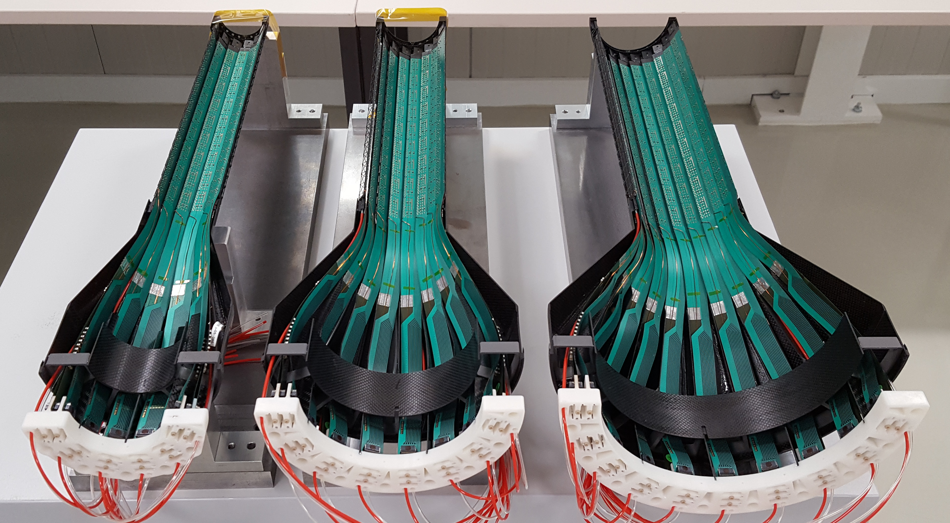
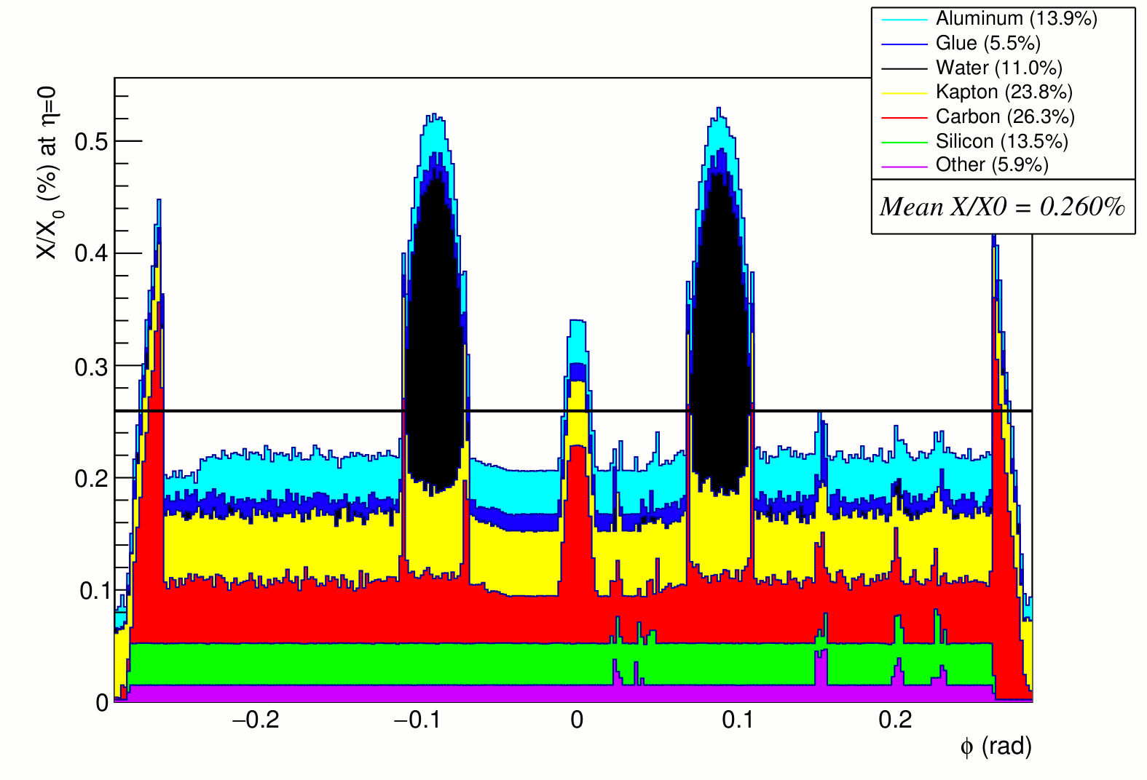
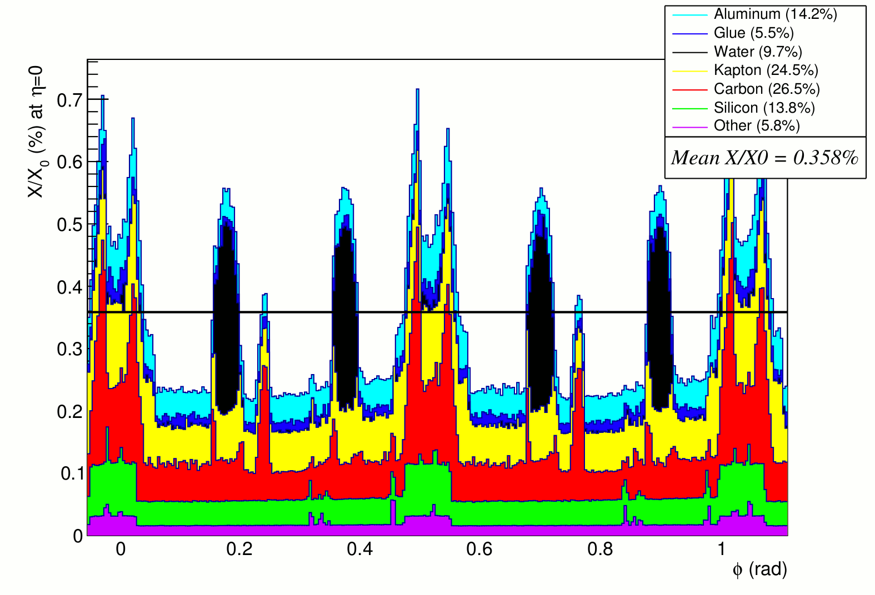
Assembled Inner Half-Barrel
Single stave, perpendicular tracks
Tilted staves with overlap, inclined tracks
Half-layer 0
Half-Layer 1
Half-Layer 2
L. Musa

Slide 19
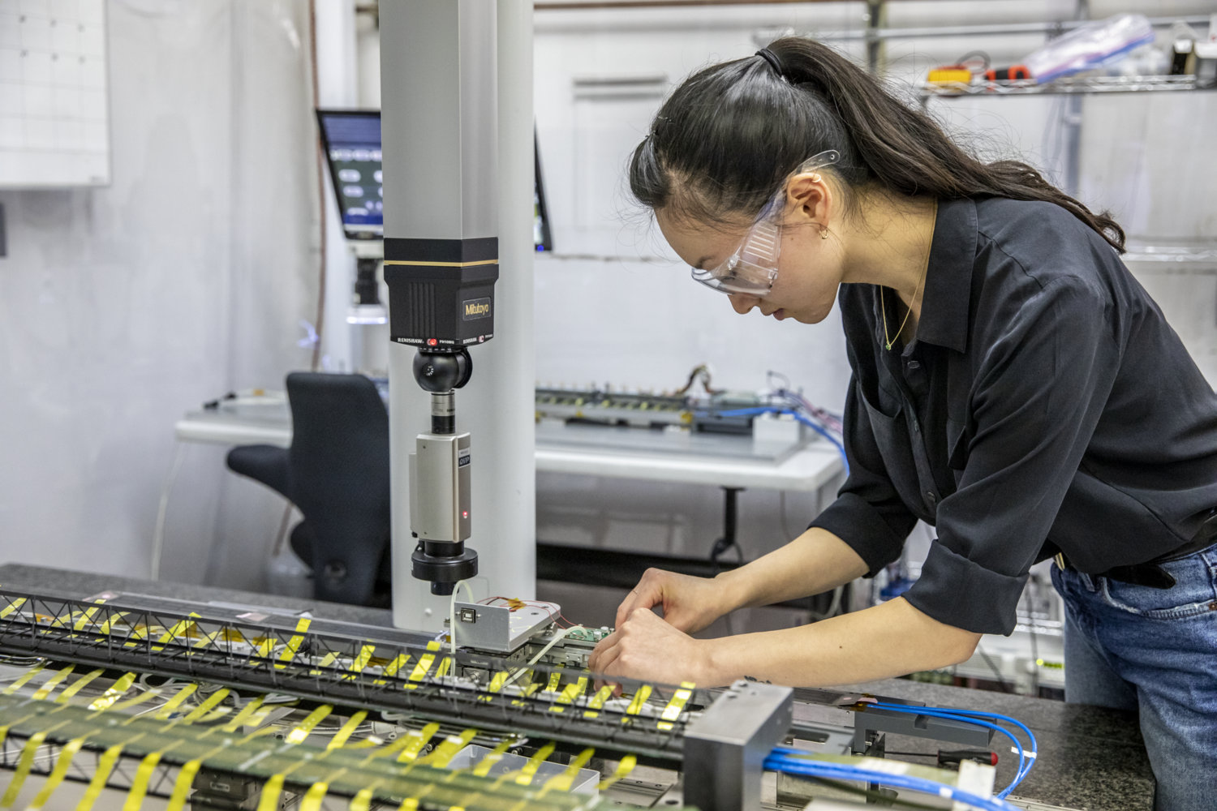
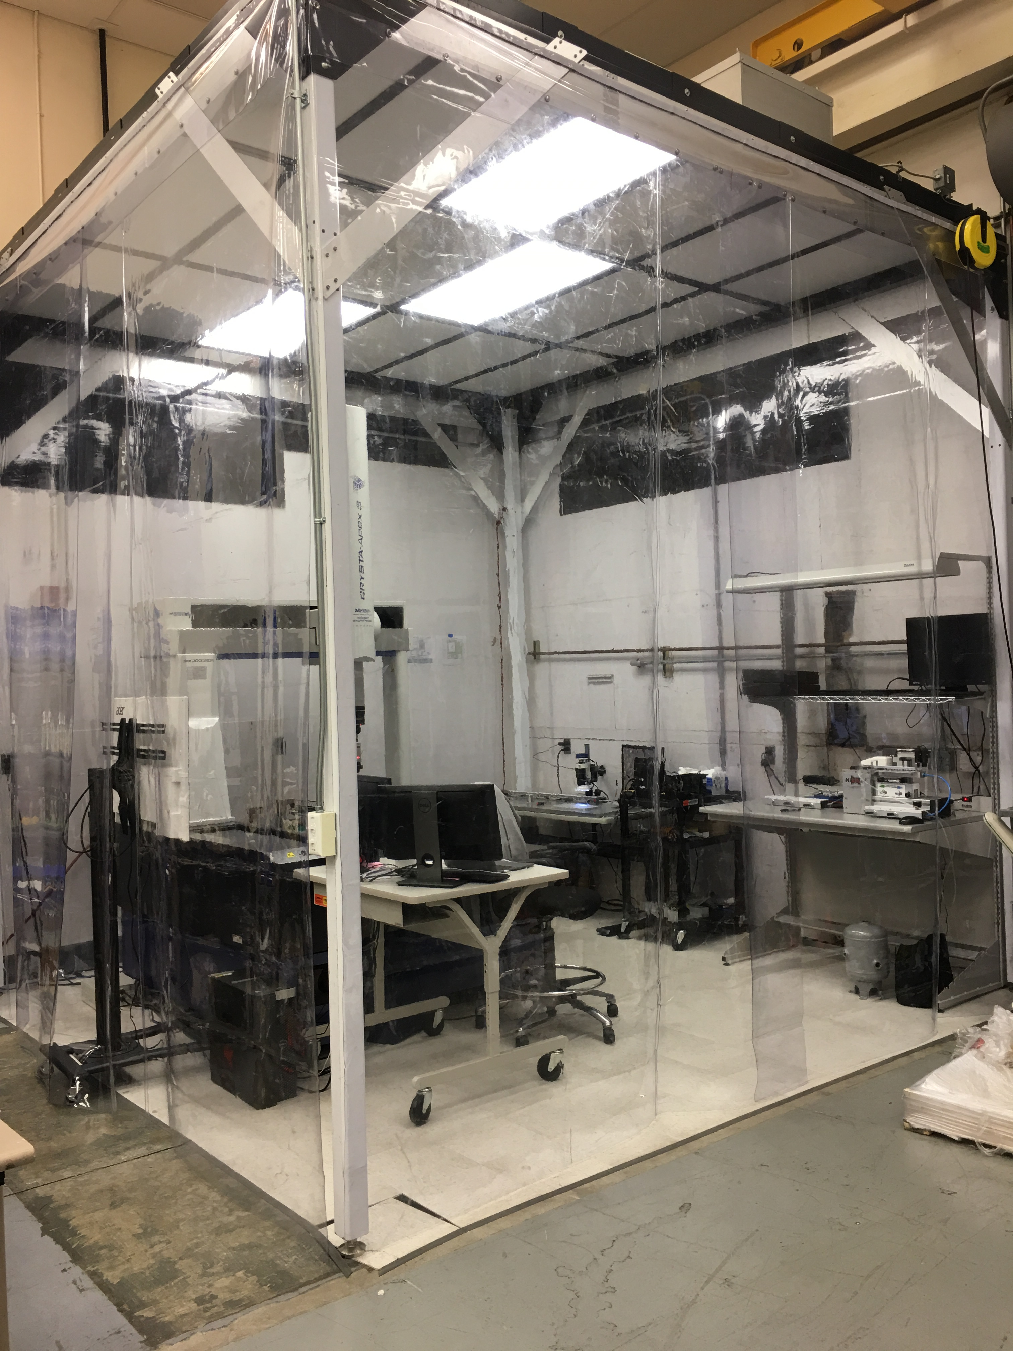
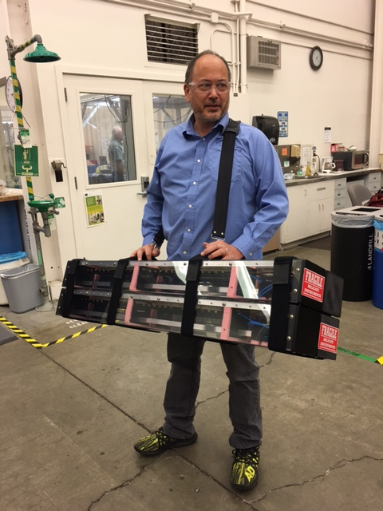
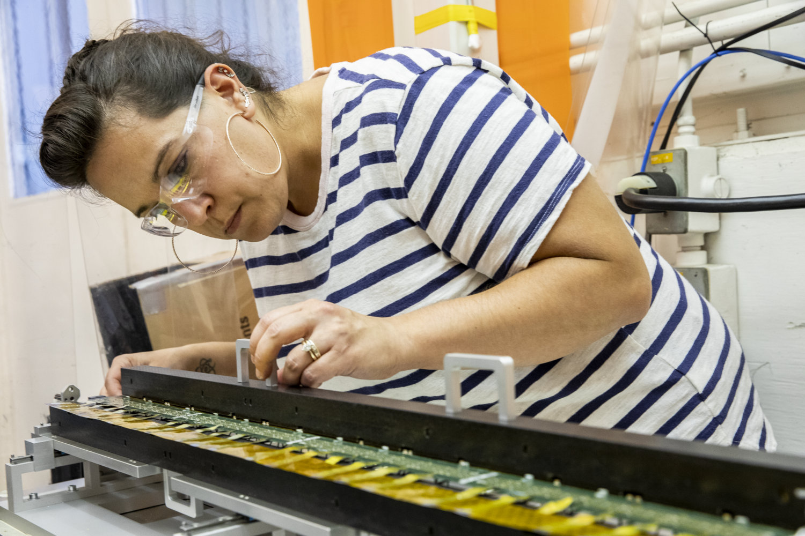
Middle Layers Assembly at LBNL
Clean Tent Bldg. 77
Middle layer stave assembly
Transportation to CERN
Power bus folding and stave testing

Slide 20
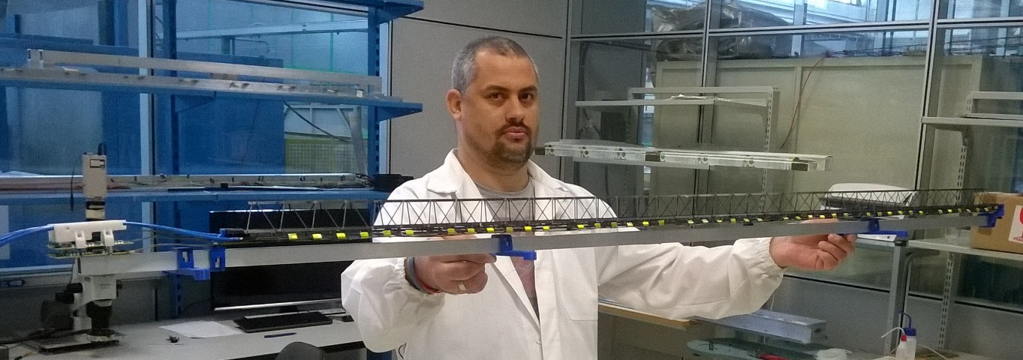
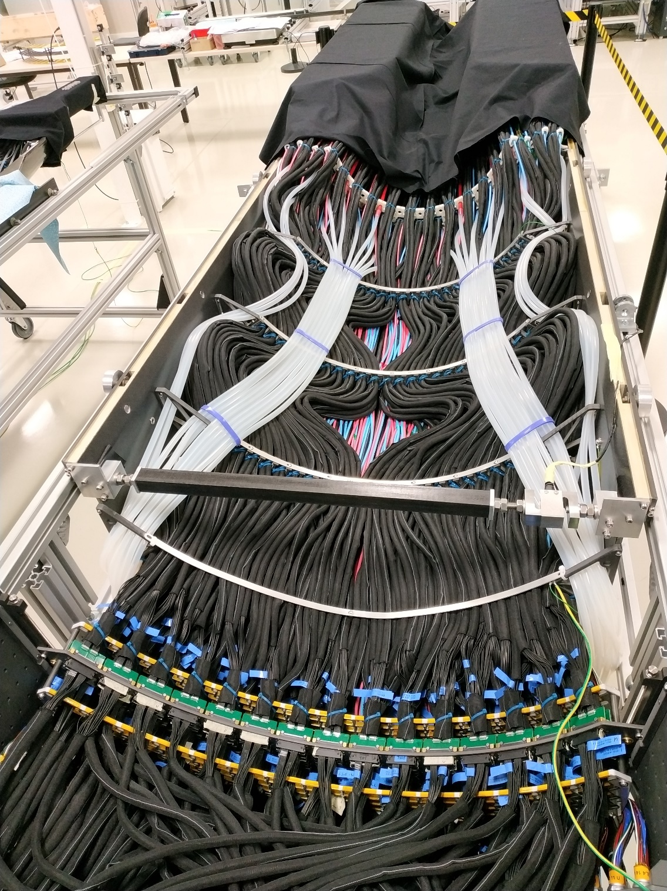
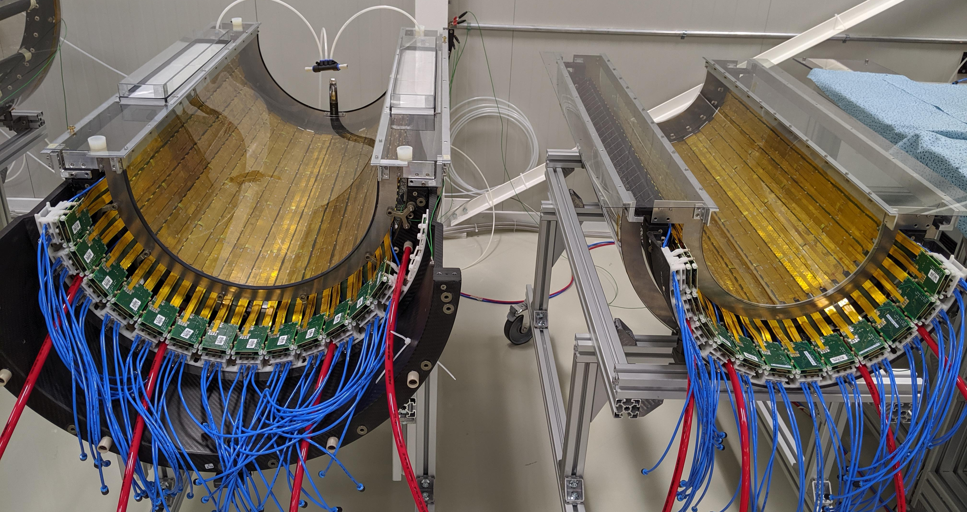
Assembled Outer Half Barrel
102 Million pixel, average noise uniform ~ 5e
L. Musa – EIROforum,Topical Workshop, CERN, May 2018

Slide 21
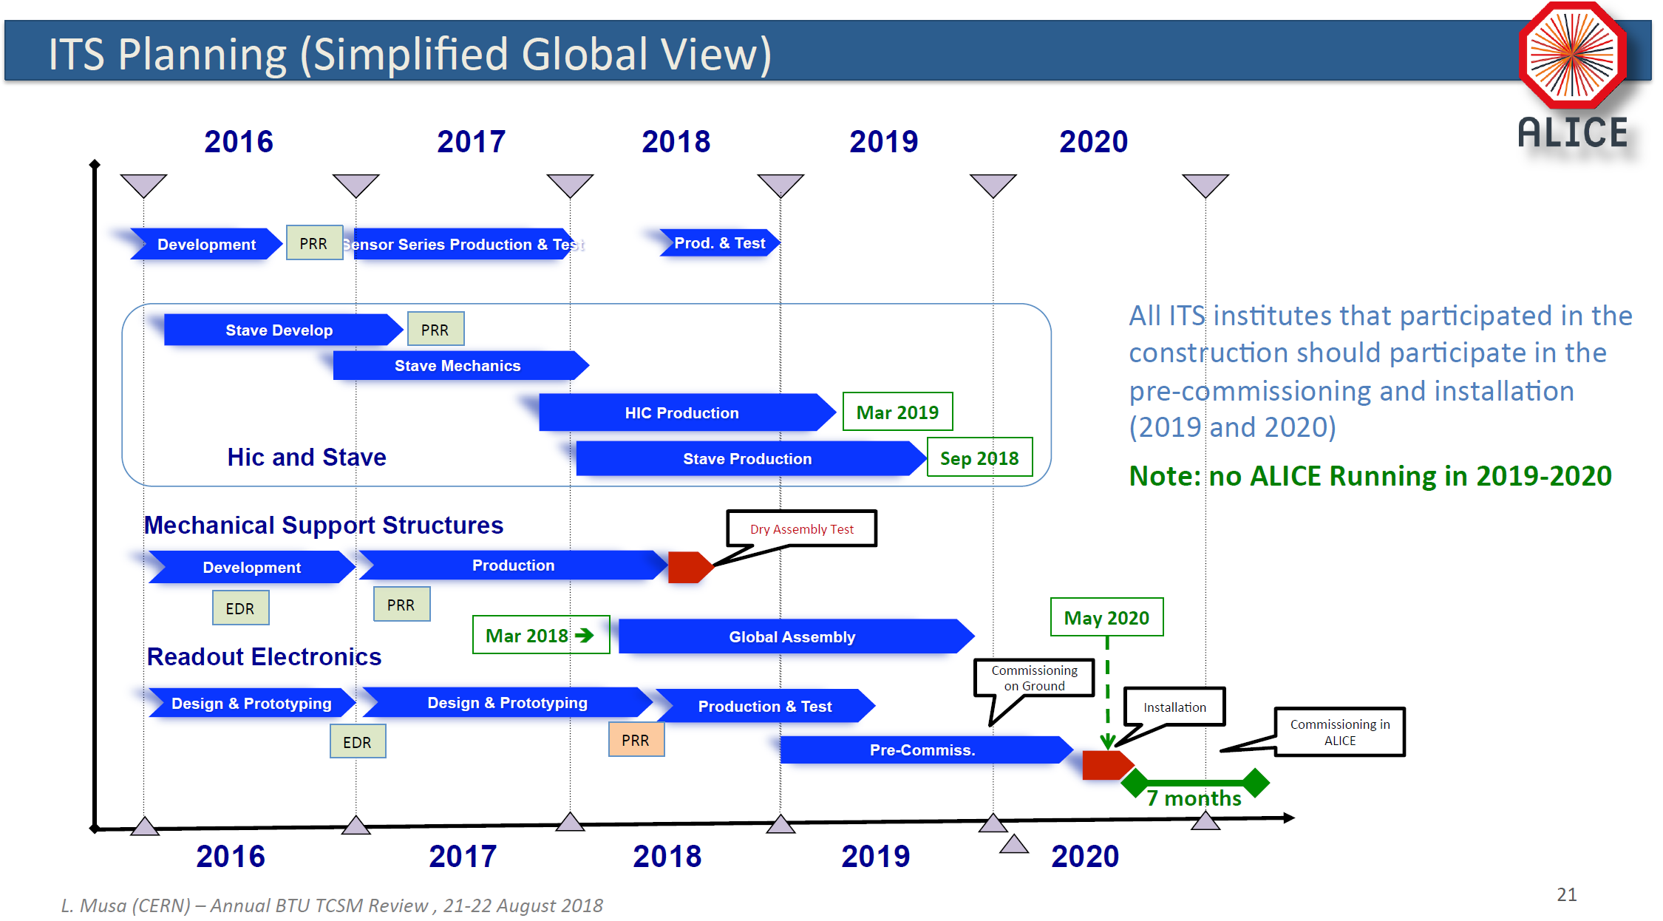
ITS Upgrade Schedule
schedule
Covid-19

Slide 22
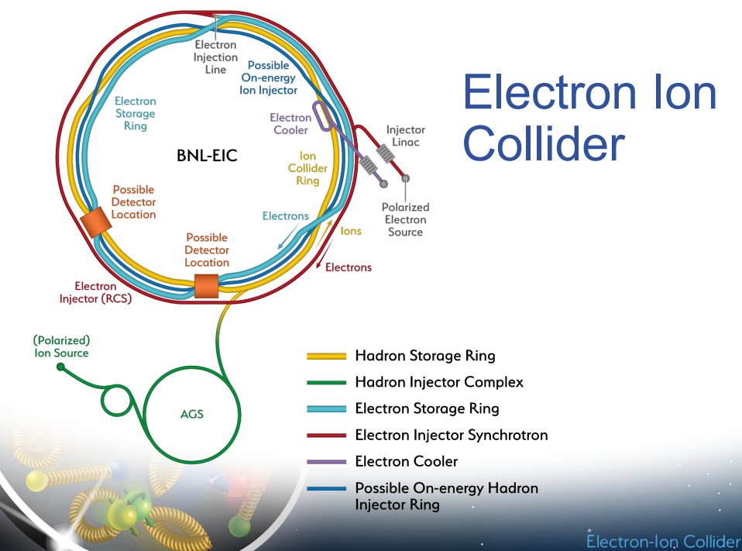
EIC Detector Path
Jim Yeck – 3/19/2020
The Electron Ion Collider has received CD-0 from DOE (December 2019) and has a site chosen (BNL).
It is projected to come online in the 2030 timeframe.
The instrumentation aspects of the EIC are interesting and challenging in the tracking domain arising from the asymmetric collision environment and physics of interest.
The tracking acceptance is very large with 4 ≤ │eta│.
The desired tracking momentum reach is as low as 100 MeV/c. – (low radiation length)
Momentum resolution of 1-2% - (small pixel size)
However:
The occupancy and radiation tolerance requirements are modest (less than ALICE ITS)
These requirements fit MAPS very well with very low radiation length, moderate radiation tolerance and small pixel size.

Slide 23
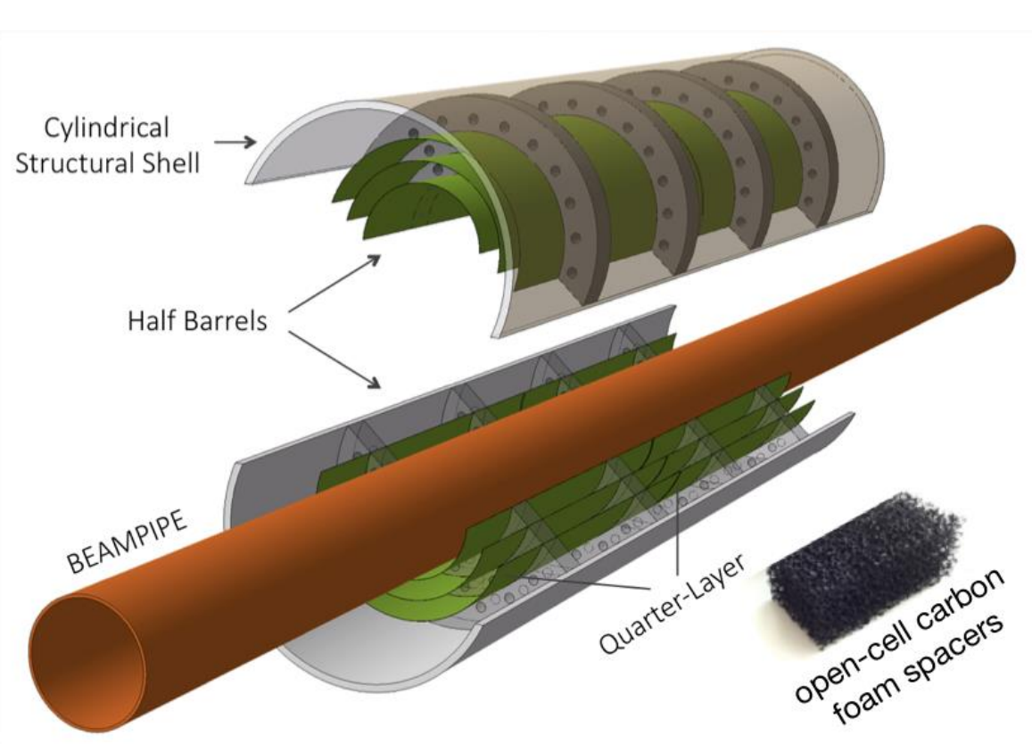
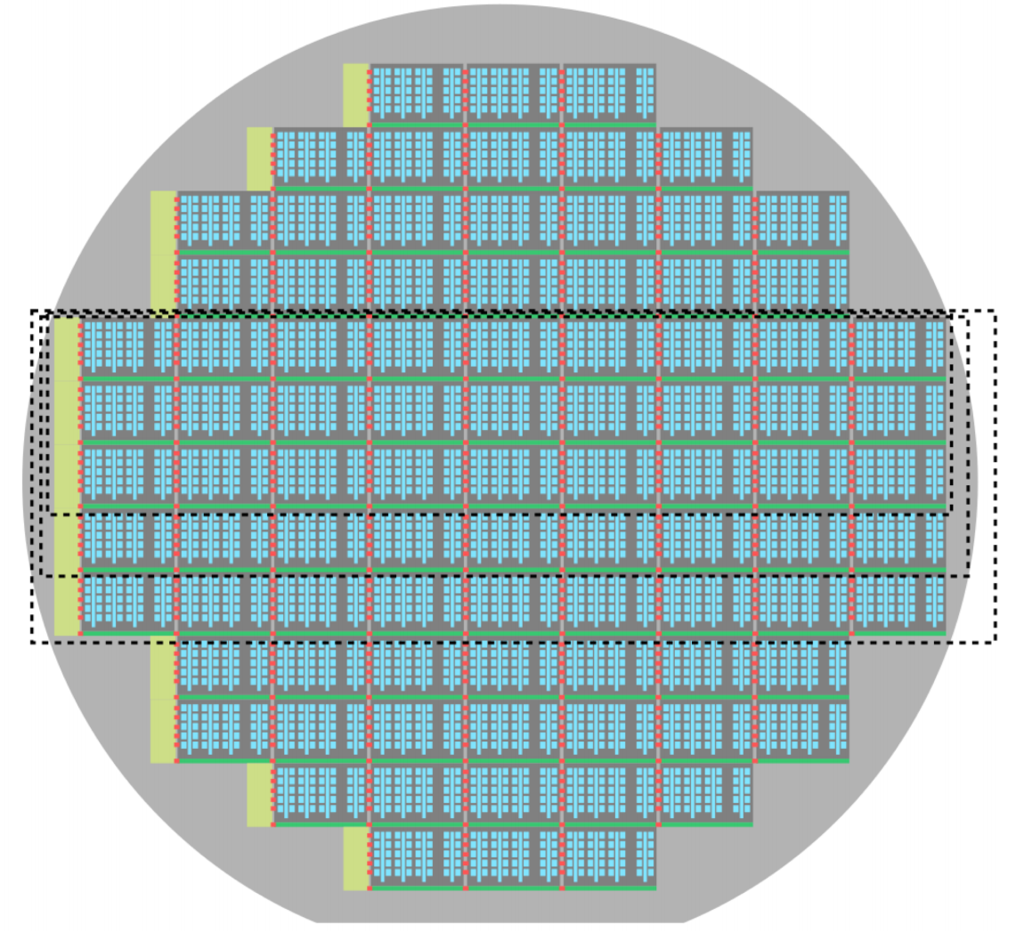
EIC Detector Path
The requirements for an EIC tracking sensor exceed those of existing MAPS…
Fortunately CERN is embarking on a new MAPS development for installation in the ALICE ITS during LS3 that has very significant overlap with EIC sensor requirements.
The most relevant efforts in this Letter of Intent (endorsed by the LHCC in September 2019) include:
Silicon R&D for next generation MAPS sensor (with significant improvements)
coupled with
R&D into extremely low X/X0 cylindrical vertex detection with “bent” silicon
“bent” silicon
Detector
concept
Each layer half barrel is a single stitched sensor
“stitched” silicon
X/X0 ~ 0.05%

Slide 24
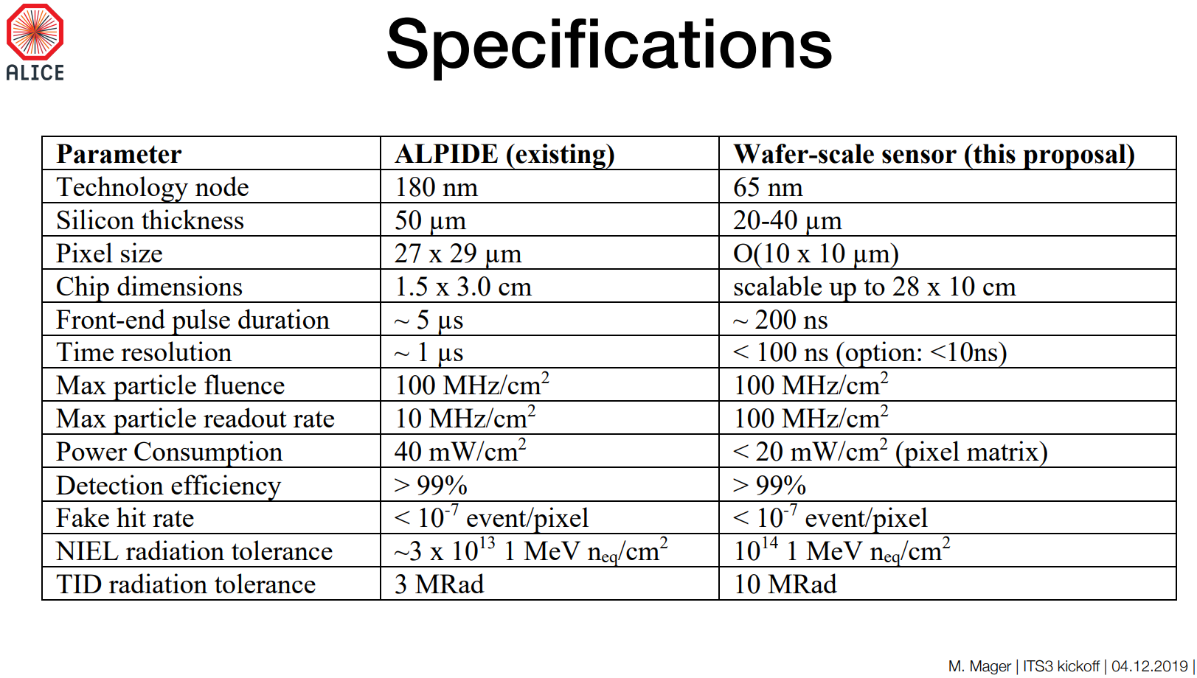
EIC Detector Path
We have formed a EIC silicon sensor consortium which has joined the ITS3 effort with the goal of developing a sensor for use at EIC. There is strong synergy with both the goals and schedule for the sensor development for both experiments.

Slide 25
Summary
The characteristics of MAPS sensors are an excellent fit for the heavy ion collider environment.
The STAR PXL detector based on the IPHC designed Ultimate 2 sensor met the performance requirements and delivered the physics that it was designed for.
The ALICE ITS upgrade based on the CERN designed next generation ALPIDE sensor is in the middle of construction and should be installed during LS2 at the LHC.
The EIC should start construction soon and there is a path for using the 3rd generation MAPS for tracking in this challenging environment.

Slide 26
backup

Slide 27
Why use MAPS sensors?
The attributes of MAPS sensors fit the requirements for tracking in HI collisions very well
CMOS technology
  pixel size – As low as 10µm x 10µm
    low occupancy for high multiplicity events
    Gives very good single point resolution (even better with clustering)
  Allows the use of digital binary hit address output while maintaining single point resolution (simplified design)
Radiation length (minimize MCS)
  Sensors can be thinned to 50µm or less
  less mass and less support structure
  Low power dissipation 40-170 mW/cm² means less powering and cooling infrastructure
Efficiency and fake hit rate
  typical efficiencies are >99.9% for a wide range of thresholds
  fake hit rates are typically 10⁻⁶ or better.
Cost and complexity
  simple single sensor from a commercial foundry. No bump bonding or complex technologies, already processed binary data output.

Slide 28
MAPS in Heavy Ion Colliders
In this talk I will describe the use of MAPS sensors in two experiments (STAR Heavy Flavor Tracker and ALICE Inner Tracking System Upgrade).
These two experiments comprise the first and second generation of MAPS sensors used for charged particle tracking at colliders.
It is not a coincidence that these experiments are both heavy ion collision experiments. The characteristics of MAPS sensors are very well suited to the collision event structure and moderate luminosity environment that is characteristic of heavy ion colliders.
Central collisions (impact parameter 80-100%) give thousands of charged particles per collision but typically do not occur every beam crossing.
The average pixel occupancy per sensor integration time is of order 0.01% for minimum bias data.
The goal of these detectors is to enable precision tracking in the low momentum regime in high multiplicity events.

Slide 29
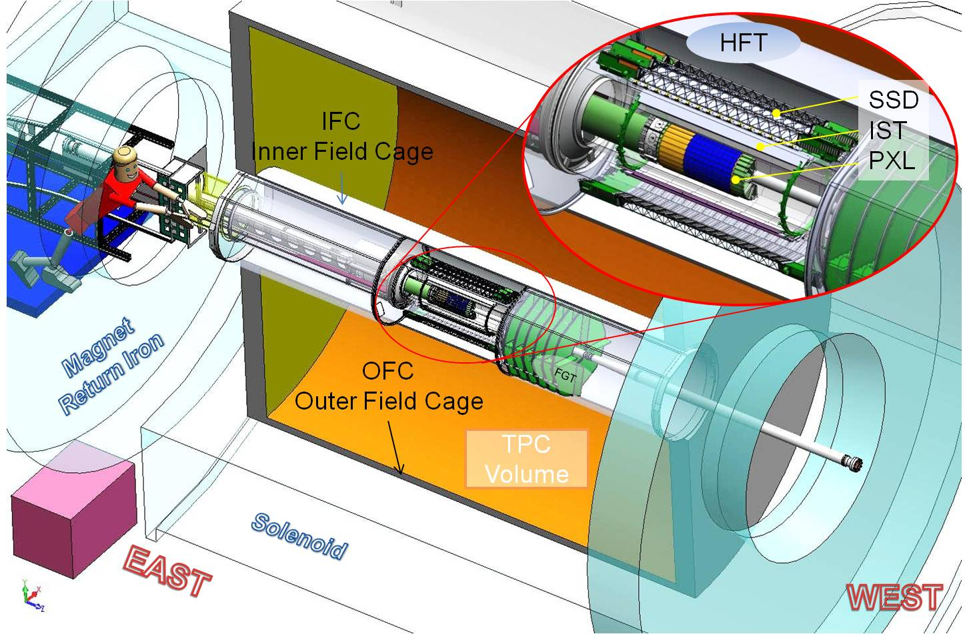
PXL in STAR Inner Detector Upgrades
TPC – Time Projection Chamber
(main tracking detector in STAR)
HFT – Heavy Flavor Tracker
SSD – Silicon Strip Detector
  r = 22 cm
IST – Inner Silicon Tracker
  r = 14 cm
PXL – Pixel Detector
  r = 2.5, 8 cm
We track inward from the TPC with graded resolution:
~1mm
~300µm
~250µm
<30µm
vertex
TPC
SSD
IST
PXL
Notes:
Ist is a silicon pad detector upgrade is several detectors, focus is on the pixle detectors. Other detectors connect tpc tracks with the pxl detector – don’t go into pointing

Slide 30
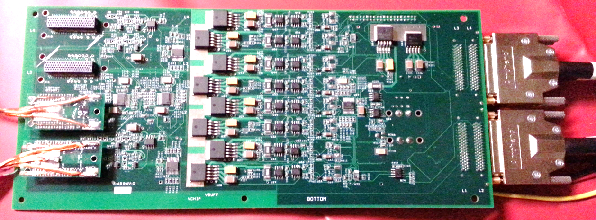
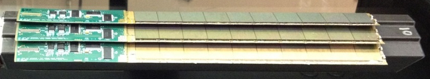
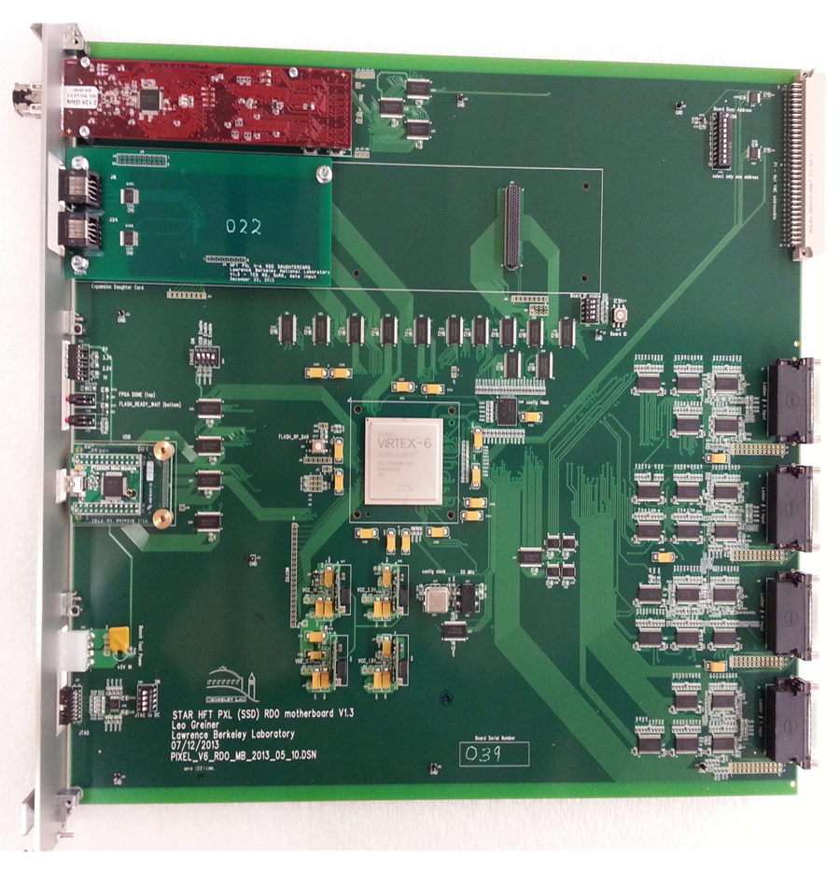
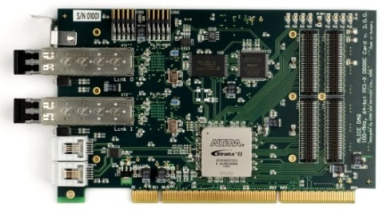
Sector Readout Electronics Chain
2 m
(42 AWG TP)
11 m (VHDCI)
Clk, config, data
Clock, config, data, power
Mass Termination Board - signal buffering - latch-up protected power
PXL Sector
RDO board
w/ Xilinx Virtex-6 FPGA
100 m (fiber optic)
PXL built events
DAQ PC with fiber link to RDO board
Highly parallel system
  4 ladders per sector
  1 Mass Termination Board (MTB) per sector
  1 sector per RDO board
  10 RDO boards in the PXL system
Trigger,
Slow control,
Configuration,
etc.
Existing STAR
infrastructure

Slide 31

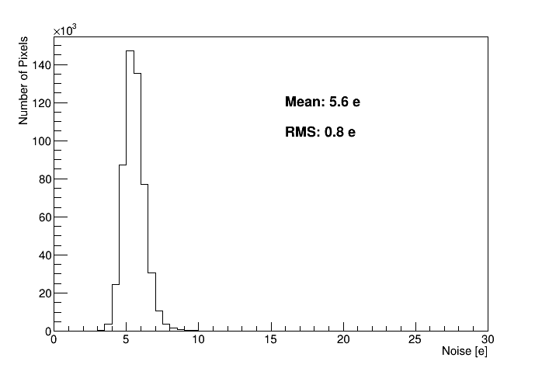
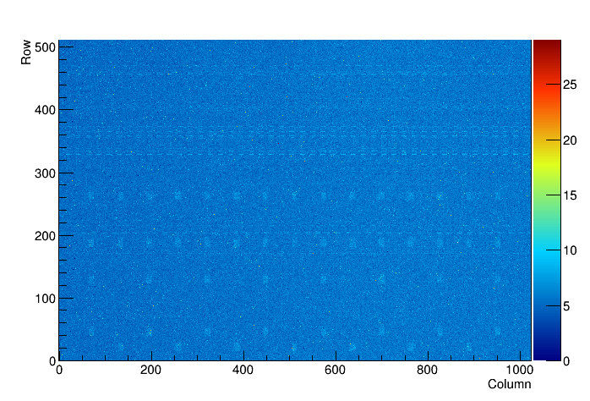
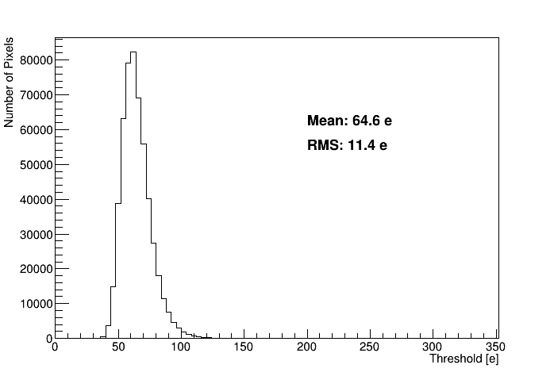
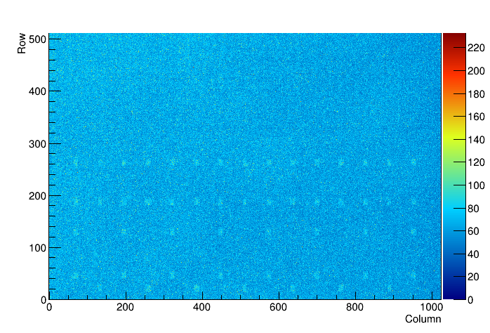
ALICE CMOS Pixel Sensor
Thresholds and Noise
Noise Map
S-curve scan using internal charge injection circuit
keep comparator threshold fixed
inject varying charges
extract threshold and noise from error-function fit
noise in electrons
Noise
Thresholds MAP
thresholds in electrons
Thresholds
L. Musa – EIROforum,Topical Workshop, CERN, May 2018

Slide 32
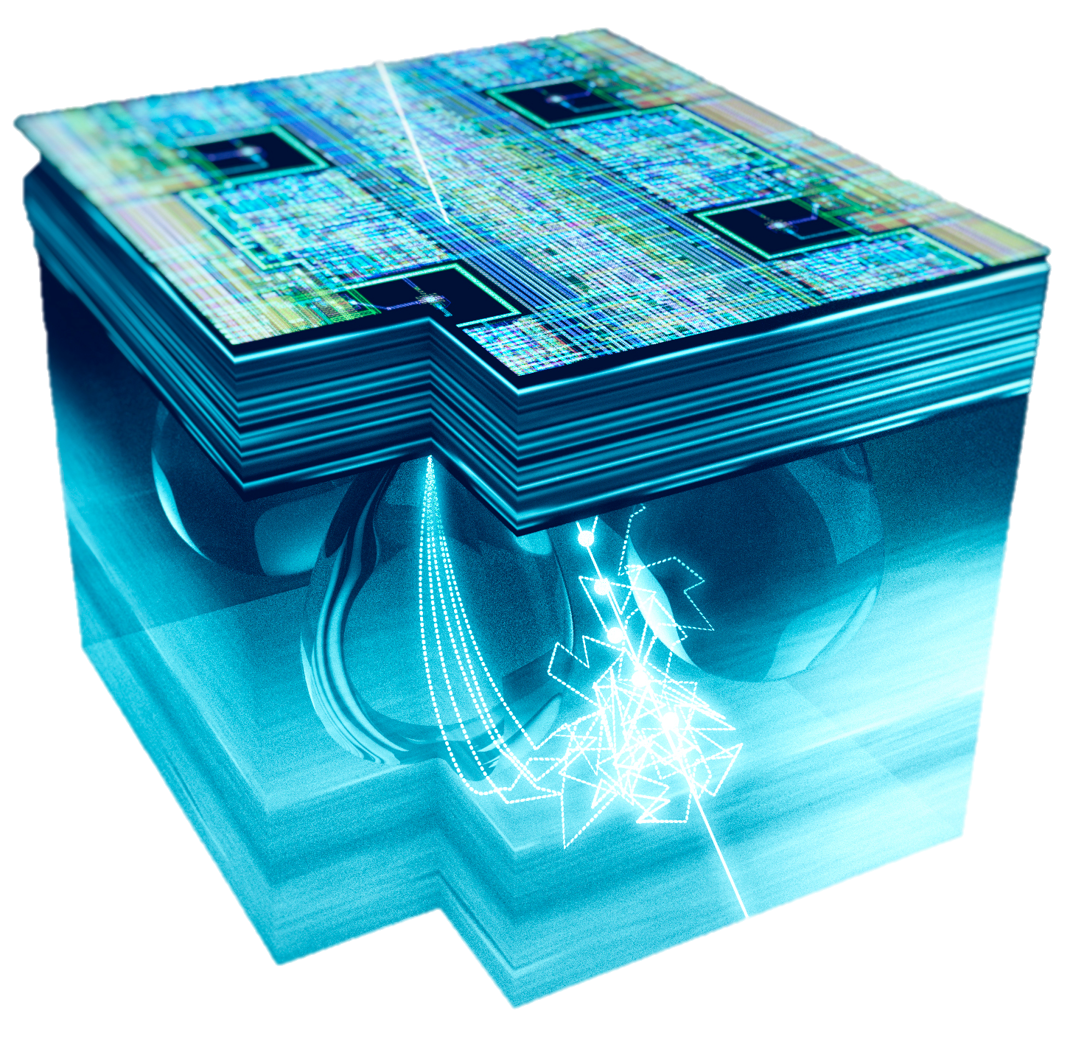
ALPIDE – next generation MAPS sensor (see WS talk later)
CMOS Pixel Sensor using 0.18μm CMOS Imaging Process (TowerJazz)
collection electrode
28 μm
0.3 pJ / bit
N_{A} ~ 10¹⁶
2 x 2 pixel
volume
Artistic view of a SEM picture of ALPIDE cross section
N_{A} ~ 10¹³
N_{A} ~ 10¹³
C_{in} ≈ 5 fF
N_{A} ~ 10¹⁸
N_{A} ~ 10¹⁸
pixel capacitance ≈5 fF (@ V_{bb} = -3 V)
Q_{in} (MIP) ≈ 1300 e a V ≈ 40mV
High-resistivity (> 1kΩ cm) p-type epitaxial layer (25μm) on p-type substrate
Small n-well diode (2 μm diameter), ~100 times smaller than pixel => low capacitance (~fF)
Reverse bias voltage (-6V < V_{BB} < 0V) to substrate (contact from the top) to increase depletion zone around NWELL collection diode
Deep PWELL shields NWELL of PMOS transistors
30mm
15mm
➔ full CMOS circuitry within active area
L. Musa
Notes:
6 metal layers

Slide 33
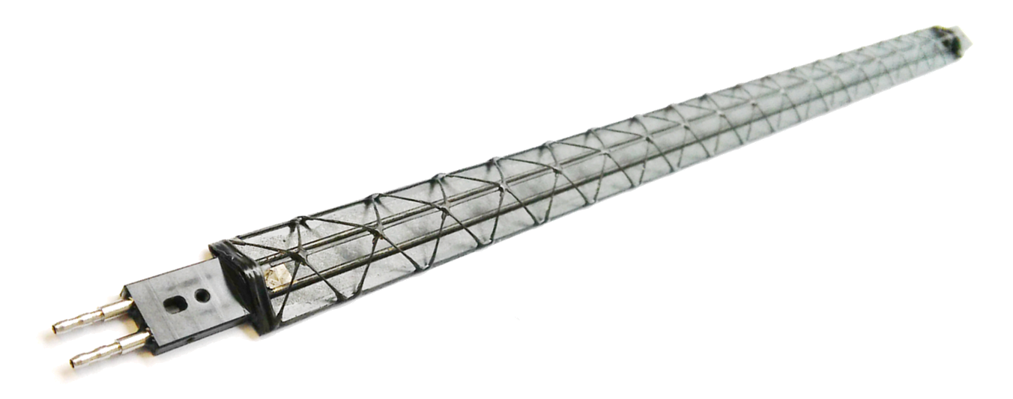
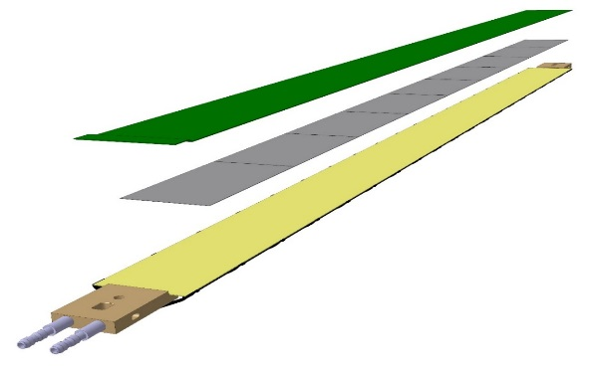
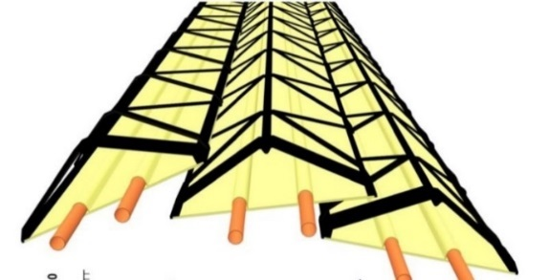


Inner Barrel Stave
Flexible PCB
Connector
9 sensors
Space Frame
L 290 mm, 1.7 gr weight
Cold Plate
Connector
Fitting
Material budget
Hybrid Integrated Circuit
Single stave, perpendicular tracks
Tilted staves with overlap, inclined tracks
L. Musa – EIROforum,Topical Workshop, CERN, May 2018
33

Slide 34
ALPIDE Triggered architecture
Front-end acts as delay line
Sensor and front-end continuously active: upon particle hit front-end forms a pulse with ~1-2μs peaking time
Threshold is applied to form binary pulse and hit latched into memory
L. Musa – EIROforum,Topical Workshop, CERN, May 2018

Slide 35
Outline for this presentation
Why MAPS are a good choice for charged particle tracking in STAR and ALICE and upcoming EIC.
The STAR PXL detector and Ultimate 2 MAPS sensor.
  Full description of detector performance.
  Timeline and overall MAPS assessment.
The ALICE ITS upgrade and ALPIDE MAPS sensor.
  Status of detector production and performance of ALPIDE and staves.
EIC Detector – toward next generation of MAPS
Summary.

