Slide 1
Some response comments for the USMDP ETAC Half-yearly review, October 31, 2025
David C. Larbalestier
Applied Superconductivity Center,
National High Magnetic Field Laboratory
Florida State University
REBCO work is supported by the U.S. Department of Energy, Office of Science, Office of Fusion Energy Sciences. Work at NHMFL is supported by US DOE OHEP under Grants DE-SC0010421 and DE-SC0024610, by NSF under Award DMR-2128556, and by the State of Florida. Work at LBNL is supported by US DOE, Office of Science under contract No. DE-AC02-05CH11231. In addition to ARDAP support, work at Bruker OST LLC and Engi-Mat Co. has additionally benefited from the support of SBIR-STTR grants from the U.S. Department of Energy, Office of Science.
Bi-2212 work is supported by the U.S. Department of Energy, Office of Science, Office of High Energy Physics under the framework of the U.S. Magnet Development Program, and the Accelerator R&D and Production Office.

Slide 2
Themes of the ASC approach to making HTS materials suitable for high field magnets beyond those possible with HTS
Our MagLab Driver is to make the highest fields possible so as to serve the users (this is all highly relevant to solenoids for Muon Colliders – and the conductor and model coils useful for dipole magnets for colliders too)
  We have to understand the J_{c} of available HTS conductors, REBCO and Bi-2212
  We must understand the conductor strain tolerance and the degradations generated by excessive strain
  We must devise test beds that can verify our conductor understanding and the models that are used to design our magnets
  Effective postmortems can close the loop between models and practice and reveal “unknown” and especially “unknown unknowns”
None of this is easy, not least because of the cost of HTS and the high level of effort needed to deconstruct the whole “Design-build-test-postmortem-next model” test cycle

Slide 3
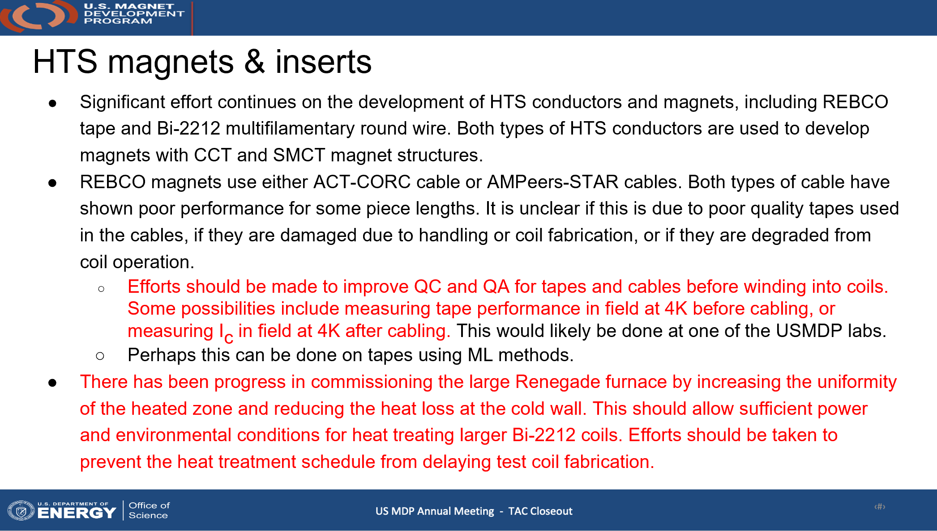
Summary Comments from the TAC in May 2025
A benefit of the ASC-MagLab effort is that we probe much higher field uses, thus much higher stress use than dipoles in self field are presently capable of
It may be that damage to CORC and STAR is presently occurring more in winding than in use – needs to be understood
Especially for REBCO we have put great effort into making torque magnetometry routine so that the whole Ic(θ,B,T) characteristic is available.
We are also expanding our continuous in-field evaluation tool to allow tests at variable T and B (so far up to 15 T at 4.2 K)
Understanding and recommissioning the 1 m long Renegade and the smaller Deltech has been a major effort this year with much progress

Slide 4
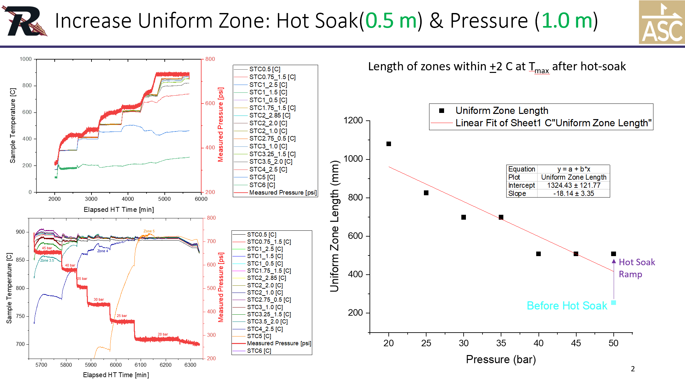
Update on OPHT furnaces
Dan Davis and team have been working continuously understand and augment the new 1 m long furnace
Now ready for 1 m long at 20 bar or 50 cm at 50 bar
LBL coils (38 cm BIN CCT) are 2nd in line (at their request) after an imminent Oxford Instruments coil
Deltech has also been rebuilt with Kanthal windings replacing original SiC heaters that often failed

Slide 5
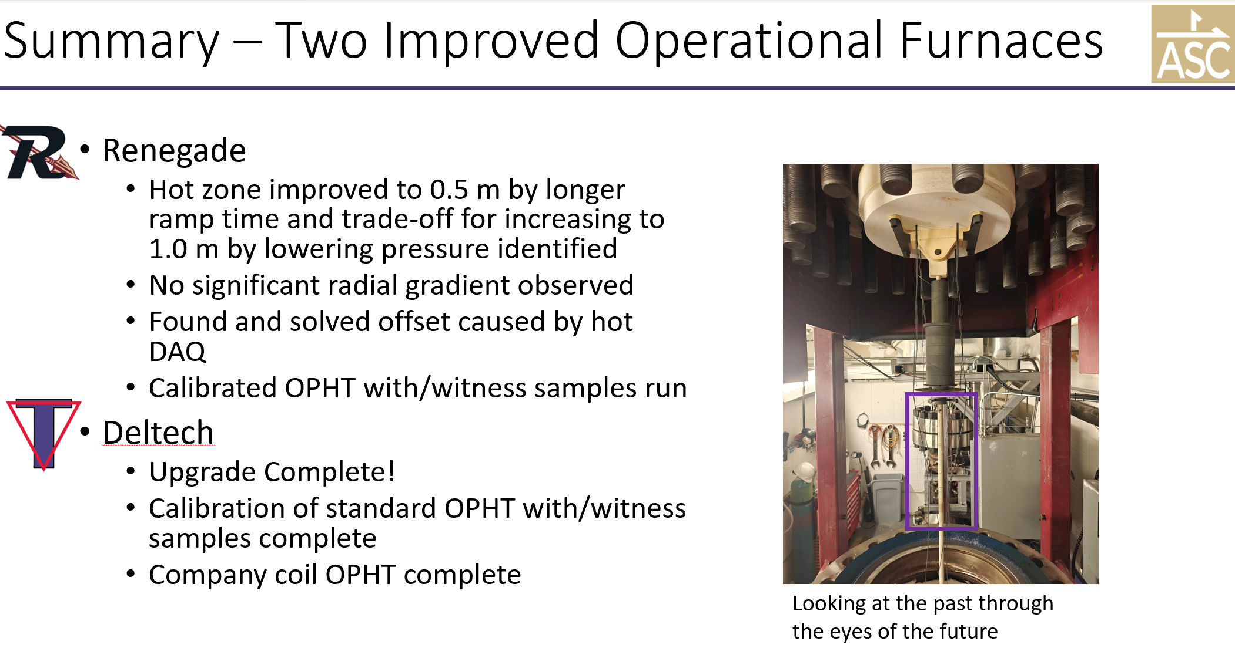

Slide 6
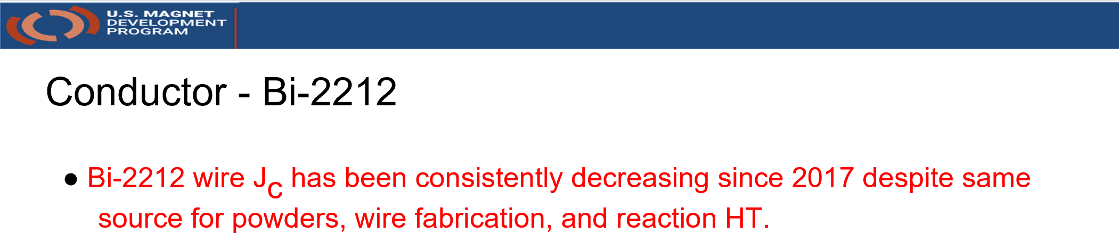
Concerns about Bi-2212 I_{c}/J_{c}/J_{E} reproducibility
Actually, there has been a slow Jc decline in the plateau HT suitable for coils
ARDAP decided to support a joint LBL-ASC (PIs Tengming Shen and Dan Davis) program that would contract with the powder (EngiMat) and wire supplier (BOST) to make multiple billets which in principle could understand critical manufacturing choices and arrest this decline
In parallel, we have pursued a deep analysis of filament quality, possible impurity effects in wire manufacture and others without yet seeing a breakthrough
Jiang et al., IEEE Trans. Appl. Supercond. DOI: 10.1109/TASC.2023.3236870

Slide 7
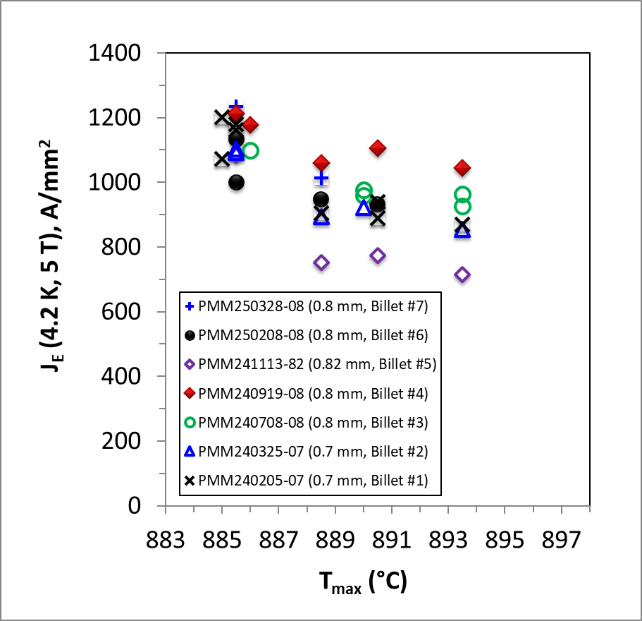
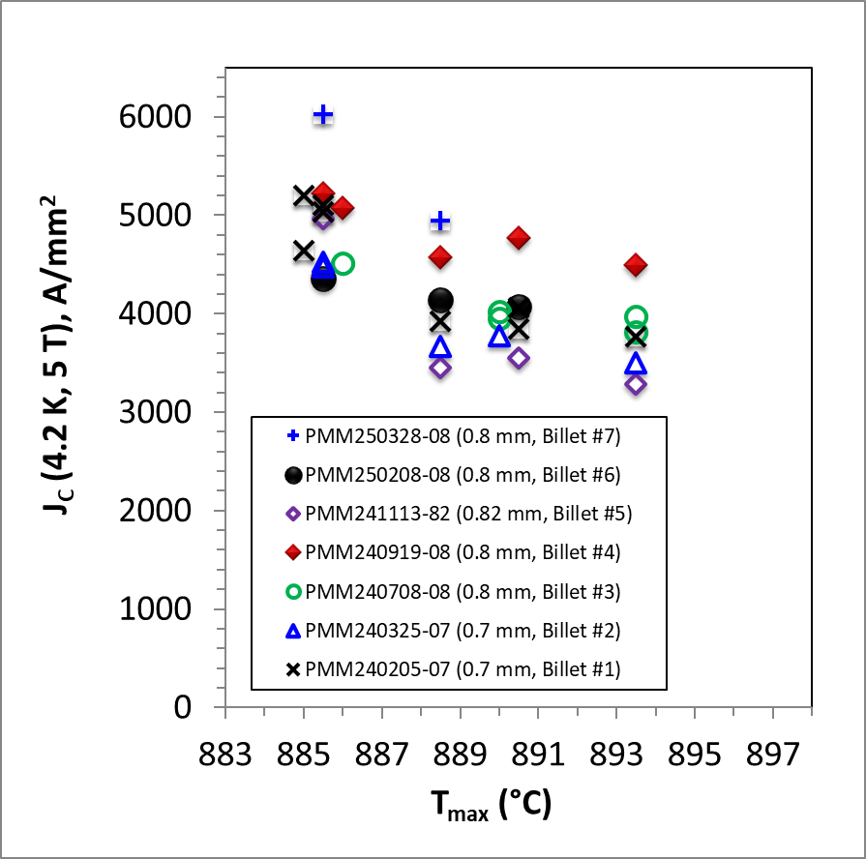
J_{E} and J_{C} of 7 ARDAP wires:
Billet #4 shows good plateau J_{E} (~ 1100 A/mm²) but billet #5 only 750 A/mm²
All wires were made by BOST with EngiMat powder to nominally the same specs
J_{E}(4.2 K, 5 T)
J_{C}(4.2 K, 5 T)
7

Slide 8
Brief Summary – my personal view, not necessarily a consensus
There are variables at both EngiMat and BOST that neither ARDAP nor our prior work has succeeded in uncovering
We have worked to encourage second source wire (KisWire KAT, Korea) and powder manufacturers (NavaFlex – like EngiMat now have a phase 2 SBIR)
These Jc variations are much smaller than in production REBCO tapes but because the Bi-2212 fill factor is only ~20%, Bi-2212 users are reluctant to give up the 20-30% Jc lost since 2018
Addressing these issues is a major focus of ongoing efforts by our university program (Hellstrom, Jiang, Kametani and Larbalestier), MDP efforts (PI Pong) and the industrial partners at EngiMat, NavaFlex, BOST, KAT and SMS (Alex Otto)

Slide 9
REBCO Drivers
REBCO is the first choice for user magnets at the MagLab but its performance in user magnets has been variable. As the research arm of the MagLab effort, we wanted to develop a thorough understanding of the conductor and to test our understanding in a high-field, high stress affordable-scale magnet: Little Big Coil led by Jeseok Bang
We developed torque magnetometry so that we could accurately know the full angular Ic(Θ,B,T) properties of the conductor and properly gauge how close we could drive our coils towards short sample: led by Jan Jaroszynski (DC Fields) and Aixia Xu
To understand the conductor better we have made multiple purchases of SST, FFJ, SuperPower, Fujikura conductors to understand how stable their behavior is – and we are working closely (under joint ARPA-E support) with start up High Temperature Superconductors Inc of Santa Barbara CA who are establishing a US-based, US owned Coated Conductor manufacturing facility

Slide 10
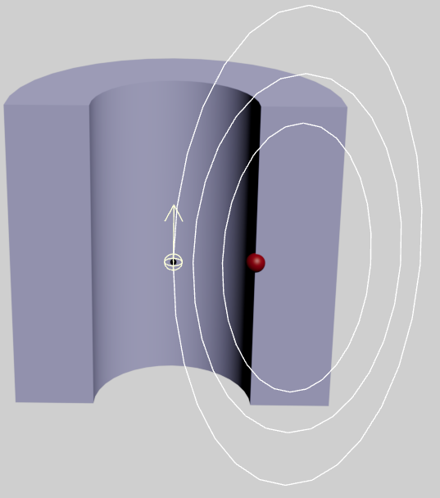
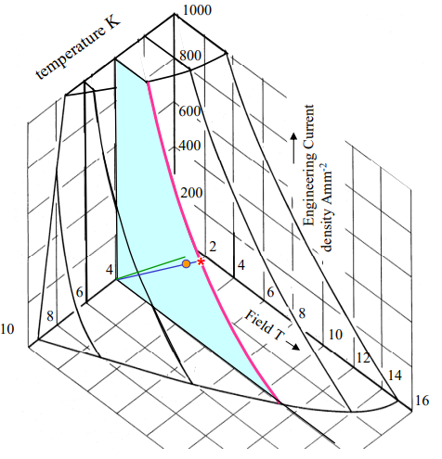
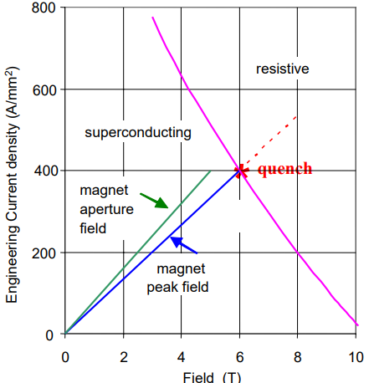
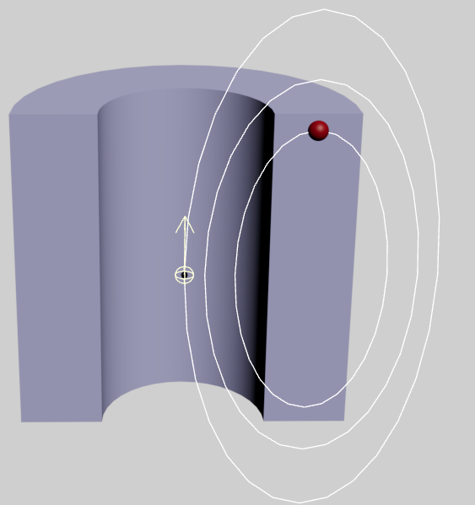
LTS vs. REBCO magnet design are far from being the same!
Isotropic Case
H_{oo}
H_{pf} ~1.05 H_{oo} (very well-known relation, e.g. Nb₃Sn)
H_{oo}
H_{or}
Martin Wilson, Superconducting magnets for accelerators, CAS Zakopane, Oct. 2006
Very uncertain J_{c}(H, θ) calculation
REBCO
H_{c} where I_{c}(H, T, θ)
is minimum

Slide 11
Key points (Aixia Xu talk at HiTAT CERN workshop last week)
The large I_{c} anisotropy of REBCO (5-7) greatly complicates REBCO magnet design
  Uncertainty (and variability of IBAD offset angle – 3-5 degrees) add extra uncertainty
Lift factors based on 77 K self field Ic are of very limited value
  Critical angles in solenoids are generally 15-20° off the ab-planes so
In spite of huge scaleup and investments in CC production, there is still substantial measured variability in multiple deliveries of SuperPower (MOCVD), FFJ (PLD) and SST(PLD) tapes that we have characterized
Here we illustrate these points by extensive torque magnetometry and SEM/TEM on recent SST tapes
Similar variation seen in recently purchased SP and FFJ tapes too

Slide 12
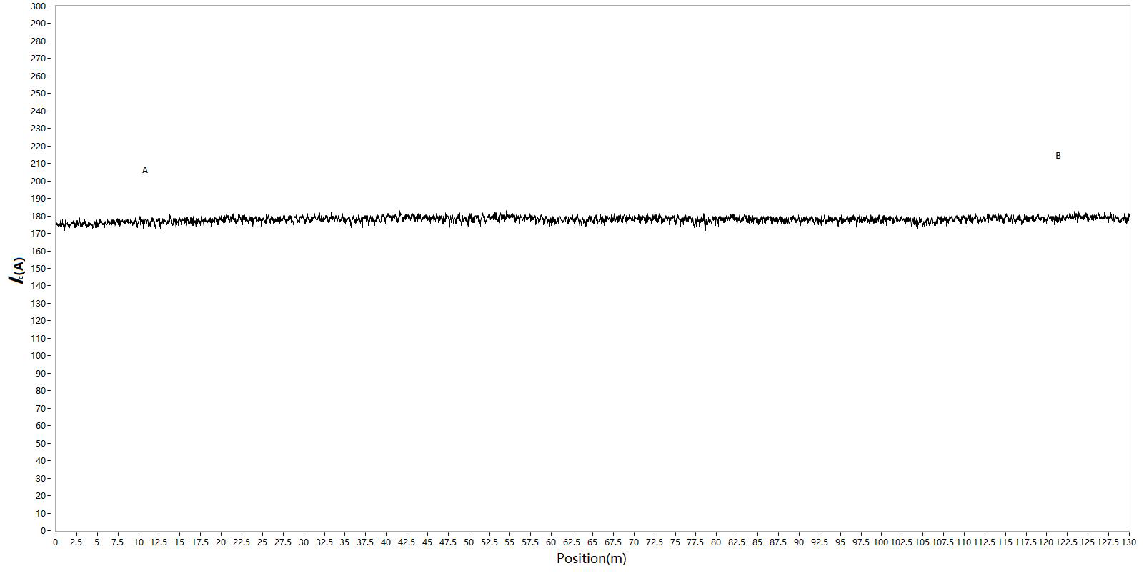
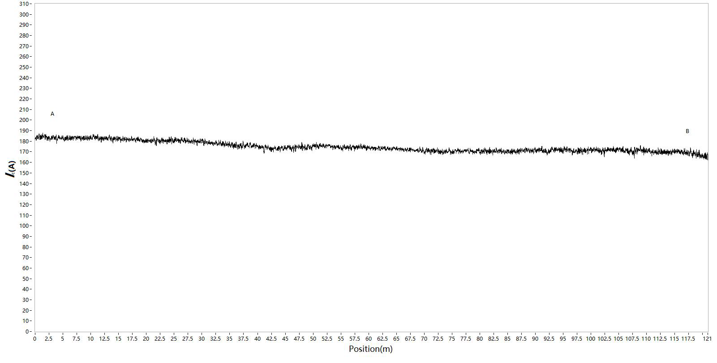

7 spools delivered in January from December 2024/January 2025 production
7 spools delivered in January from December 2024/January 2025 production
Tape | Ic(77 K, sf) (A) |  |  |  |  | Piece length (m)
 | Spec | Inspection data
 |  | Average | S.D. (%) | Max. | Min.
ST2501-204 | 160 | 190 | 2 | 200 | 178 | 121
ST2501-218 | 160 | 178 | 0.8 | 182 | 171 | 130
ST2501-84 | 160 | 174 | 2.8 | 187 | 162 | 121
ST2501-115 | 160 | 206 | 2.7 | 222 | 184 | 156
ST2501-143 | 160 | 185 | 1.2 | 193 | 175 | 117
ST2412-1329 | 160 | 185 | 1.5 | 197 | 173 | 108
ST2412-1362 | 160 | 188 | 1.7 | 199 | 176 | 111
Lengthwise Ic(77 K, sf) by MCorderTM calibrated by transport measurement
All 7 tapes exhibit Ic >160 A through the length
Ic(77 K, sf) varies among spools, along conductor length within individual spool as well
Clearly Ic(77 K, sf) variation level varies from spool to spool
ST2501-218
Almost drop-out free
ST2501-84

Slide 13
The variation becomes larger at low T and high field, ~50% at 20 K/15 T
G-L like angular dependence signals that weak uncorrelated pinning is now very important
The strong correlated pinning plays a key role around the ab-plane
J_{c}(20 K, 15T, H//ab) varies from -24% to 28%
The variation distributes more randomly

Slide 14
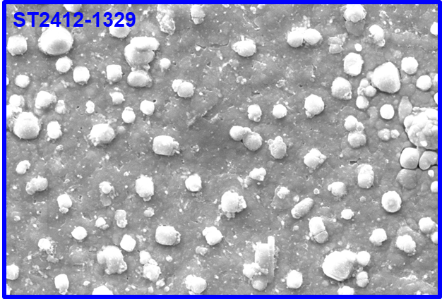
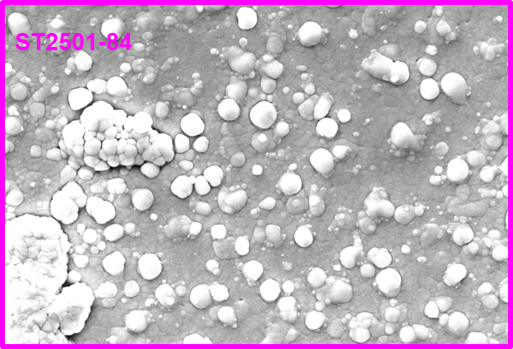
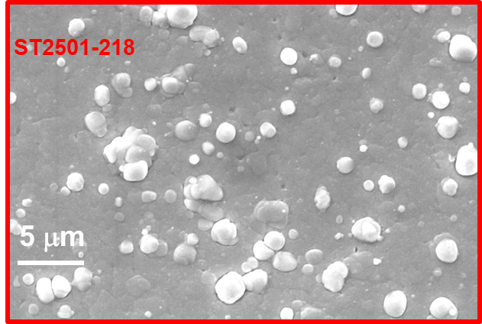
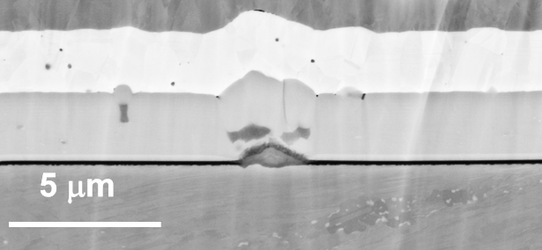
The variation becomes ~50% at 20 K/15 T – not easily overlooked!
Microstructure gives some clues to the observed J_{c} variations and suggests both vortex pinning and connectivity variations
~20%
These particles nucleated on second phase particles inside REBCO layer
~28%
~9.38%

Slide 15
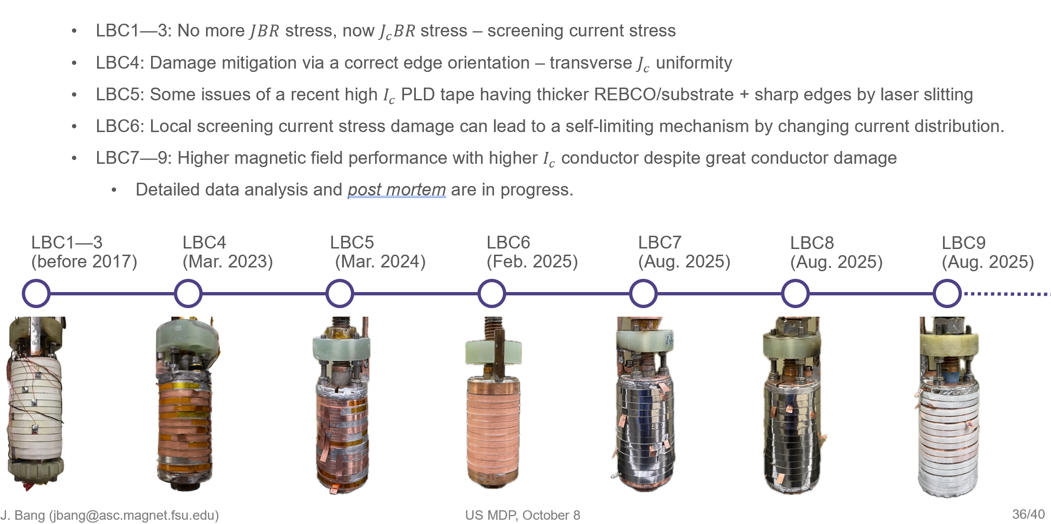
Little Big Coil is our Design-Build-Test-Postmortem platform: Jeseok Bang lead

Slide 16
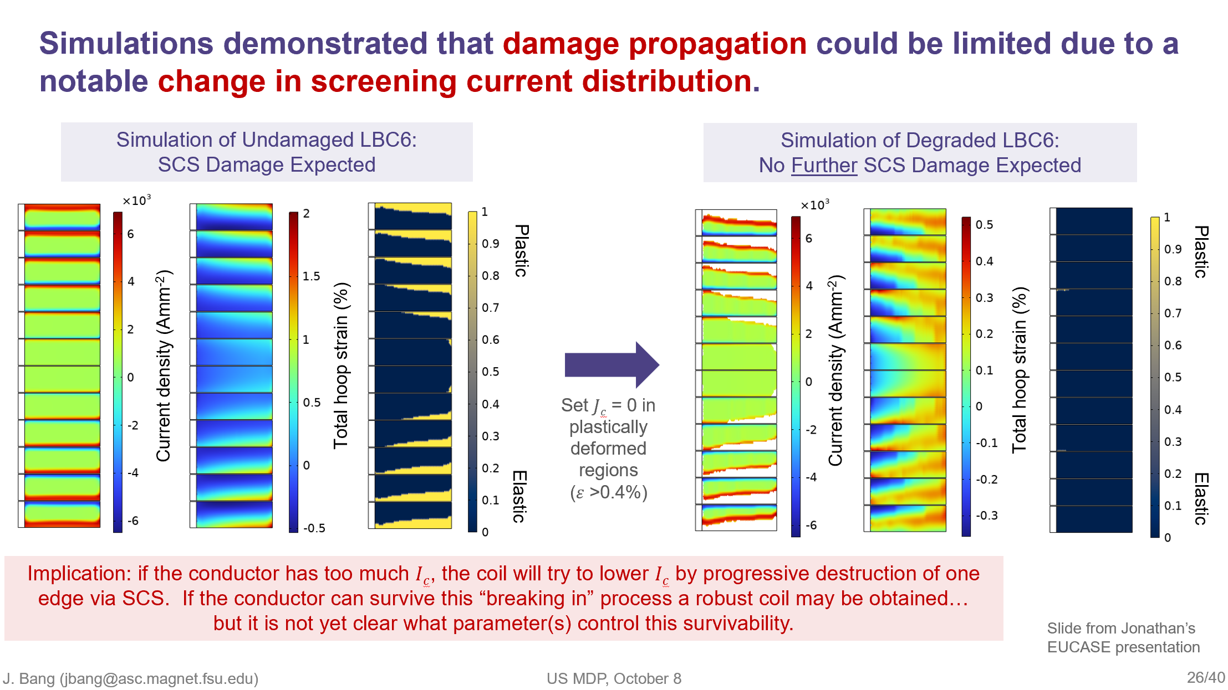
Extensive simulation and postmortem comparison is showing up many interesting features – LBC6 survived 6 quenches without degradation, in spite of significant conductor damage – damage may have helped!

Slide 17
Summary points
We believe a strong high field solenoid program is an important component of an HTS dipole program
Both Bi-2212 and REBCO conductors need better understanding
  Bi-2212 suffers from a small supply chain for which DOE-OHEP support has been absolutely pivotal
  REBCO CC has a robust supply chain but is very variable – close comparison of coil to conductor performance requires detailed knowledge of Jc(Θ,B.T), σ−ε curve and perhaps transverse Jc variations due to its impact on screening current stress
Both technologies have demonstrated world leading performance in recent solenoids tested in the 40 mm cold bore, 31 T Bitter magnet
  Bi-2212 coil achieved 34.1 T at a _{E} of 464 A/mm2 and a JBr hoop stress of over 250 MPa
  REBCO Little Bic Coils hit two new world record DC field marks last month (LBC8 46.7 T with a SuperPower HM and LBC9 48.7 T with Faraday Factory tape) – both survived quench and are now undergoing postmortem

