Slide 1
Some response comments for the USMDP ETAC Half-yearly review, October 31, 2025
David C. Larbalestier
Applied Superconductivity Center,
National High Magnetic Field Laboratory
Florida State University
REBCO work is supported by the U.S. Department of Energy, Office of Science, Office of Fusion Energy Sciences. Work at NHMFL is supported by US DOE OHEP under Grants DE-SC0010421 and DE-SC0024610, by NSF under Award DMR-2128556, and by the State of Florida. Work at LBNL is supported by US DOE, Office of Science under contract No. DE-AC02-05CH11231. In addition to ARDAP support, work at Bruker OST LLC and Engi-Mat Co. has additionally benefited from the support of SBIR-STTR grants from the U.S. Department of Energy, Office of Science.
Bi-2212 work is supported by the U.S. Department of Energy, Office of Science, Office of High Energy Physics under the framework of the U.S. Magnet Development Program, and the Accelerator R&D and Production Office.

Slide 2
Themes of the ASC approach to making HTS materials suitable for high field magnets beyond those possible with LTS
Our MagLab Driver is to make the highest fields possible so as to serve the users (this is all highly relevant to solenoids for Muon Colliders – and the conductor and model coils useful for dipole magnets for colliders too)
We have to understand what limits the J_{c} of available HTS conductors, REBCO and Bi-2212
We must understand the conductor strain tolerance and the degradations generated by excessive strain
We must devise test beds that can verify our conductor understanding and the models that are used to design our magnets
Effective postmortems can close the loop between models and practice and reveal “unknown” and especially “unknown unknowns”
None of this is easy, not least because of the high cost of HTS and the high level of effort needed to deconstruct the whole “Design-build-test-postmortem-next model” test cycle

Slide 3
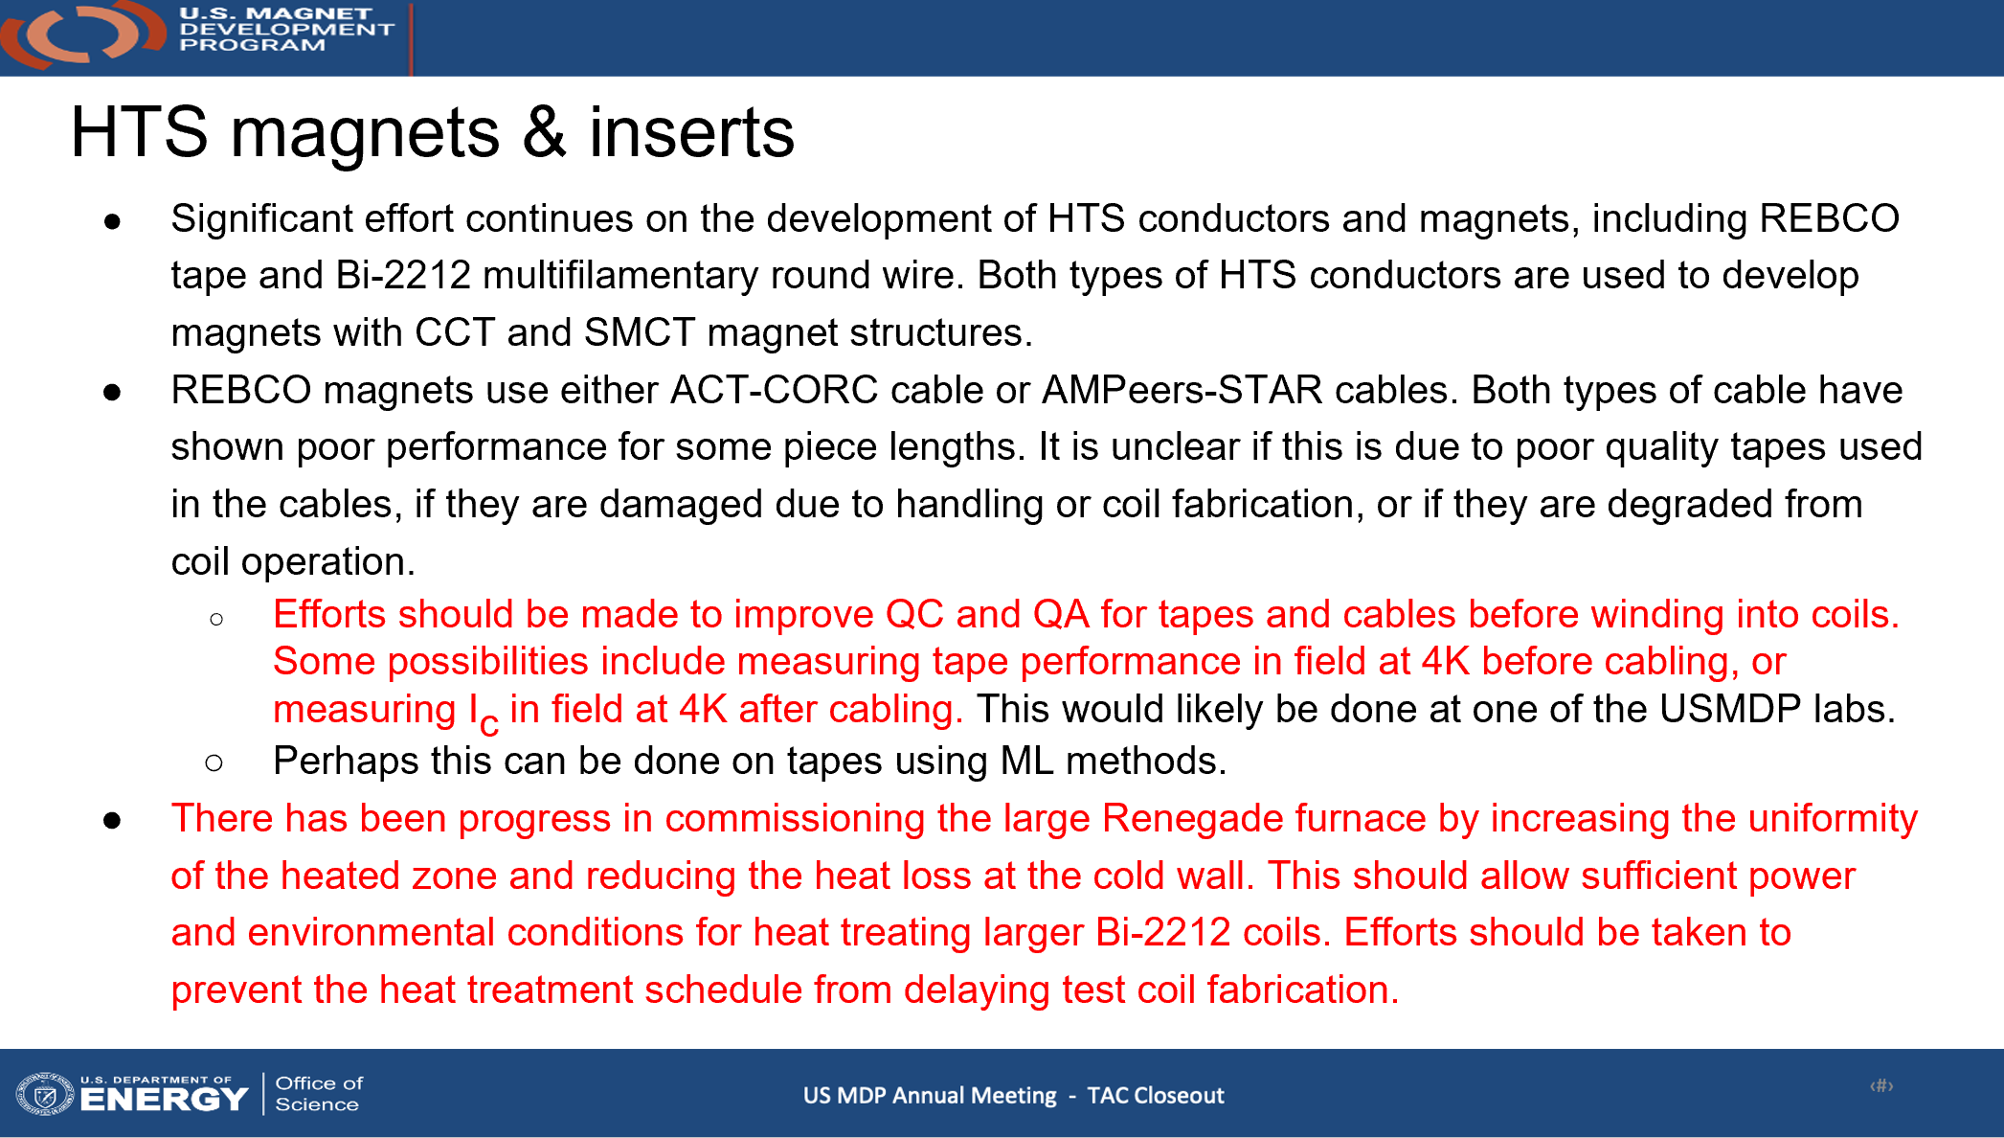
Summary Comments from the TAC in May 2025
A benefit of the ASC-MagLab effort is that we probe much higher field uses, thus much higher stress use than dipoles in self field are presently capable of
It may be that damage to CORC and STAR is presently occurring more in winding than in use – needs to be understood
Especially for REBCO we have put great effort into making torque magnetometry routine so that the whole Ic(θ,B,T) characteristic is available.
We are also expanding our continuous in-field evaluation tool to allow tests at variable T and B (so far up to 15 T at 4.2 K)
Understanding and recommissioning the 1 m long Renegade and the smaller Deltech has been a major effort this year with much progress

Slide 4
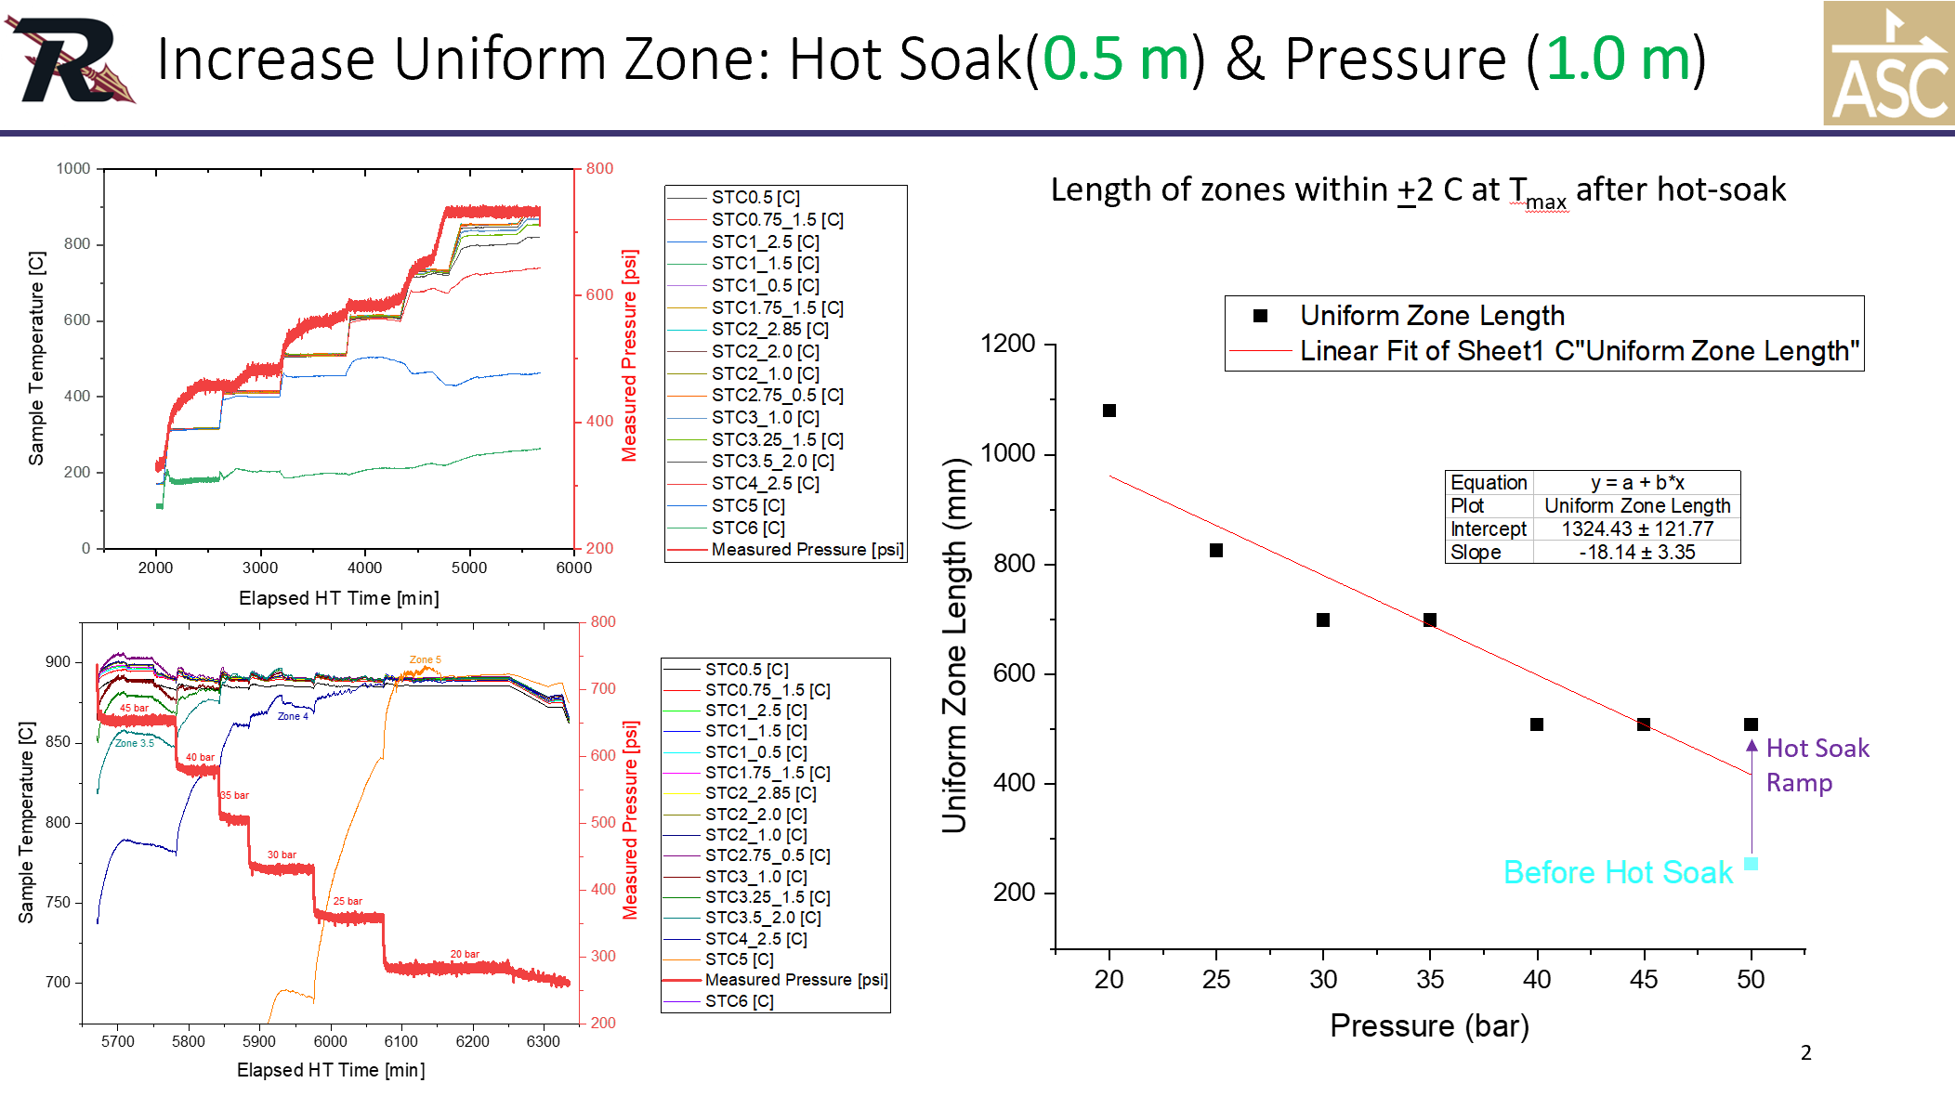
Update on OPHT furnaces
Dan Davis and team have been working continuously understand and augment the new 1 m long furnace
Now ready for 1 m long at 20 bar or 50 cm at 50 bar
LBL coils (38 cm BIN CCT) are 2nd in line (at their request) after an imminent ASC high field prototype coil
Deltech has also been rebuilt with Kanthal windings replacing original SiC heaters that often failed
Hot soak allows 50 bar and 0,5 m length while and 1 m unifomtiy occurs at 25 bar – convective prcesses still being probed

Slide 5
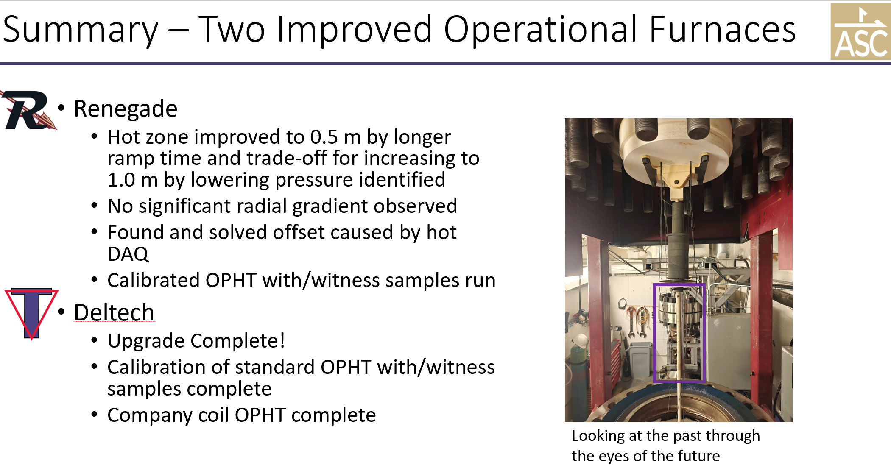

Slide 6
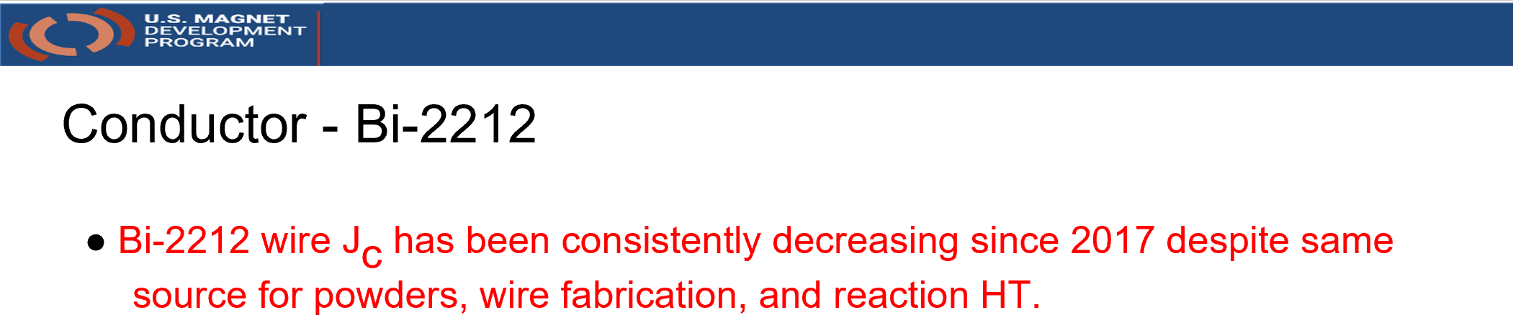
Concerns about Bi-2212 I_{c}/J_{c}/J_{E} reproducibility
Actually, there was a loss in Jc about 2019 but not a continuous decrease
ARDAP decided to support a joint LBL-ASC (PIs Tengming Shen and Dan Davis) program that would contract with the powder (EngiMat) and wire supplier (BOST) to make multiple billets which in principle could understand critical manufacturing choices and arrest this decline
In parallel, we have pursued a deep analysis of filament quality, possible impurity effects in wire manufacture and others without yet seeing a breakthrough
Jiang et al., IEEE Trans. Appl. Supercond. DOI: 10.1109/TASC.2023.3236870

Slide 7
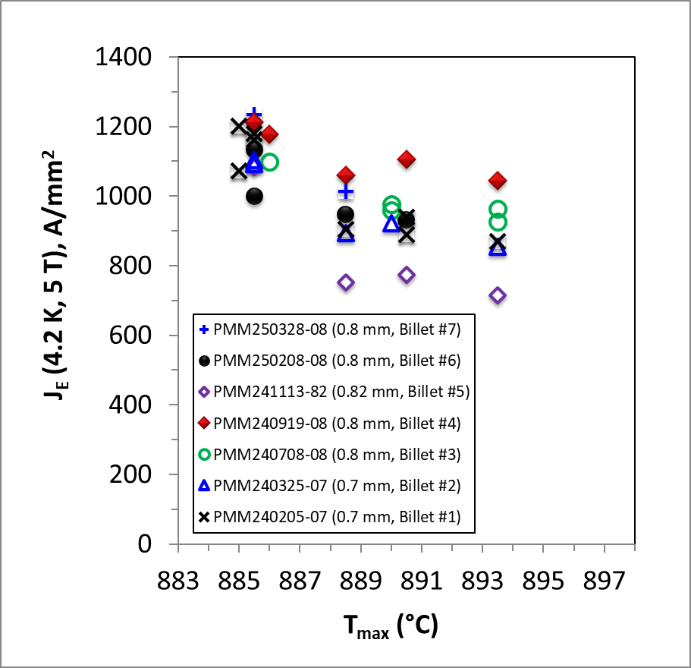
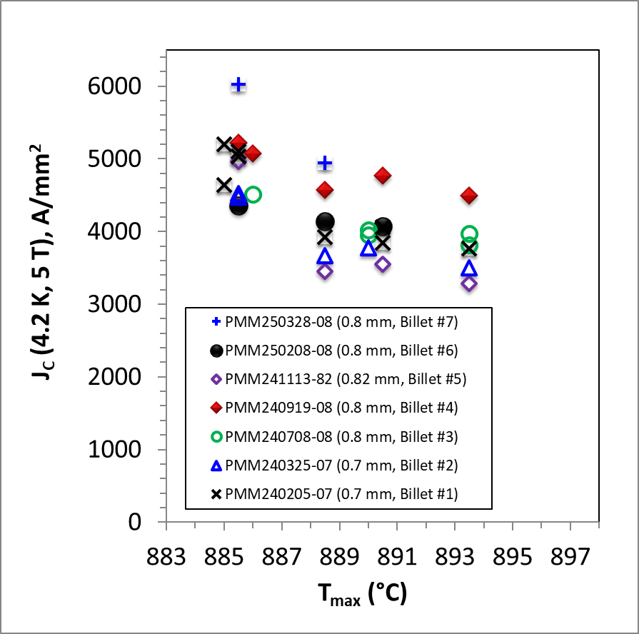
J_{E} and J_{C} of 7 ARDAP wires (2023-2025): Billet #4 shows good plateau J_{E} (~ 1100 A/mm²) but billets are quite variable
All wires were made by BOST with EngiMat powder to nominally the same specs
J_{E}(4.2 K, 5 T)
J_{C}(4.2 K, 5 T)
Fill factor variation is responsible for part of this variation – Jc is a fairer comparison
7

Slide 8
Brief Summary
There are variables at both EngiMat and BOST that ARDAP has not yet been able to define -
We have worked to encourage second source wire (KisWire KAT, Korea) and powder manufacturers (NavaFlex – like EngiMat now have a phase 2 SBIR)
These Jc variations are much smaller than in production REBCO tapes but because the Bi-2212 fill factor is only ~20%, Bi-2212 users are reluctant to give up the 20-30% Jc lost since 2018
Addressing these issues is a major focus of ongoing efforts in our university program (Hellstrom, Jiang, Kametani and Larbalestier), MDP efforts (PI Pong) and the industrial partners at EngiMat, NavaFlex, BOST, KAT and SMS (Alex Otto)

Slide 9
REBCO Drivers
REBCO is the first choice for user magnets at the MagLab (and perhaps for Muon Colliders and certainly for fusion) but its performance in user magnets has been variable. As the research arm of the MagLab effort, we are developing a thorough understanding of the conductor and testing our understanding in a high-field, high stress affordable-scale magnet: Little Big Coil led by Jeseok Bang
We developed torque magnetometry so that we could accurately know the full angular Ic(Θ,B,T) properties of the conductor and properly gauge how close we could drive our coils towards short sample: led by Jan Jaroszynski (DC Fields) and Aixia Xu
To understand the conductor better we have made multiple purchases of SST, FFJ, SuperPower, Fujikura conductors to understand how stable their behavior is – and we are working closely (under joint ARPA-E support) with start up High Temperature Superconductors Inc of Santa Barbara CA who are establishing a US-based, US owned Coated Conductor manufacturing facility

Slide 10
Key points (Aixia Xu talk at HiTAT CERN workshop last week)
The large I_{c} anisotropy of REBCO (5-7) greatly complicates REBCO magnet design
Uncertainty (and variability of IBAD offset angle – 3-5 degrees) add extra uncertainty
Lift factors based on 77 K self field Ic are of very limited value
Critical angles in solenoids are generally 15-20° off the ab-planes so
In spite of huge scaleup and investments in CC production, there is still substantial measured variability in multiple deliveries of SuperPower (MOCVD), FFJ (PLD) and SST(PLD) tapes that we have characterized
Here we illustrate these points by extensive torque magnetometry and SEM/TEM on recent SST tapes
Similar variation seen in recently purchased SP and FFJ tapes too

Slide 11
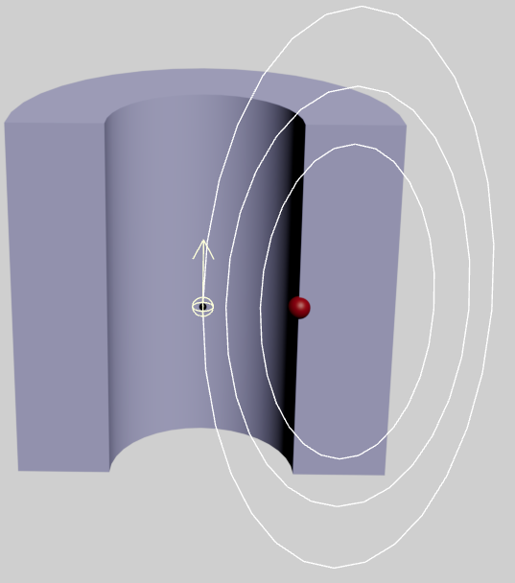
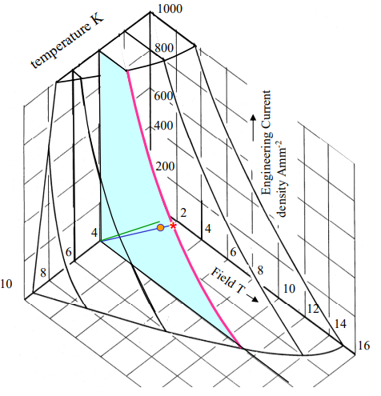
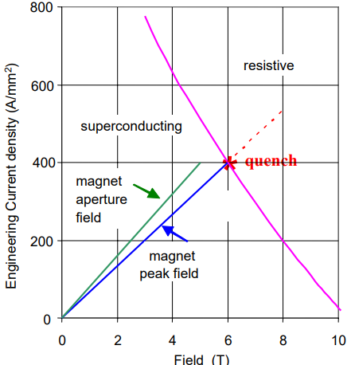
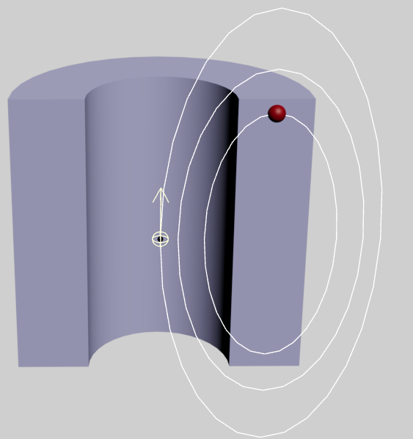
LTS vs. REBCO magnet design are far from being the same!
Isotropic Case
H_{oo}
H_{pf} ~1.05 H_{oo} (very well-known relation, e.g. Nb₃Sn)
H_{oo}
H_{or}
Martin Wilson, Superconducting magnets for accelerators, CAS Zakopane, Oct. 2006
Very uncertain J_{c}(H, θ) calculation
REBCO
H_{c} where I_{c}(H, T, θ)
is minimum

Slide 12
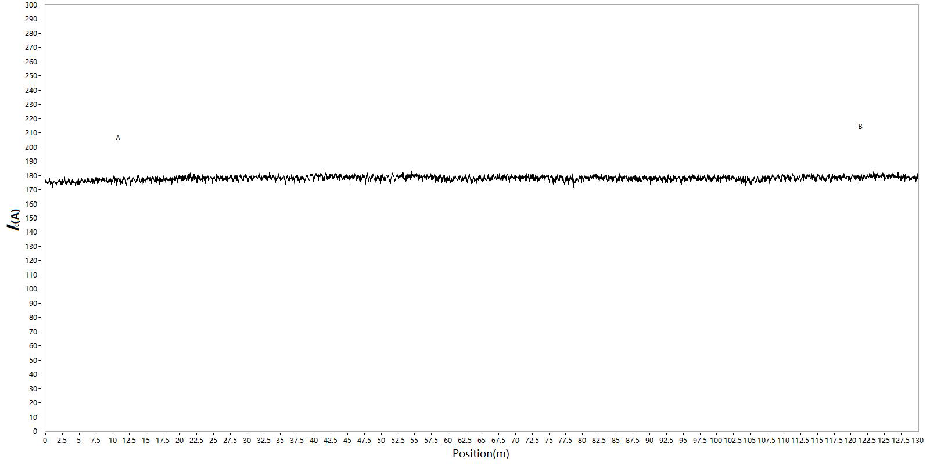
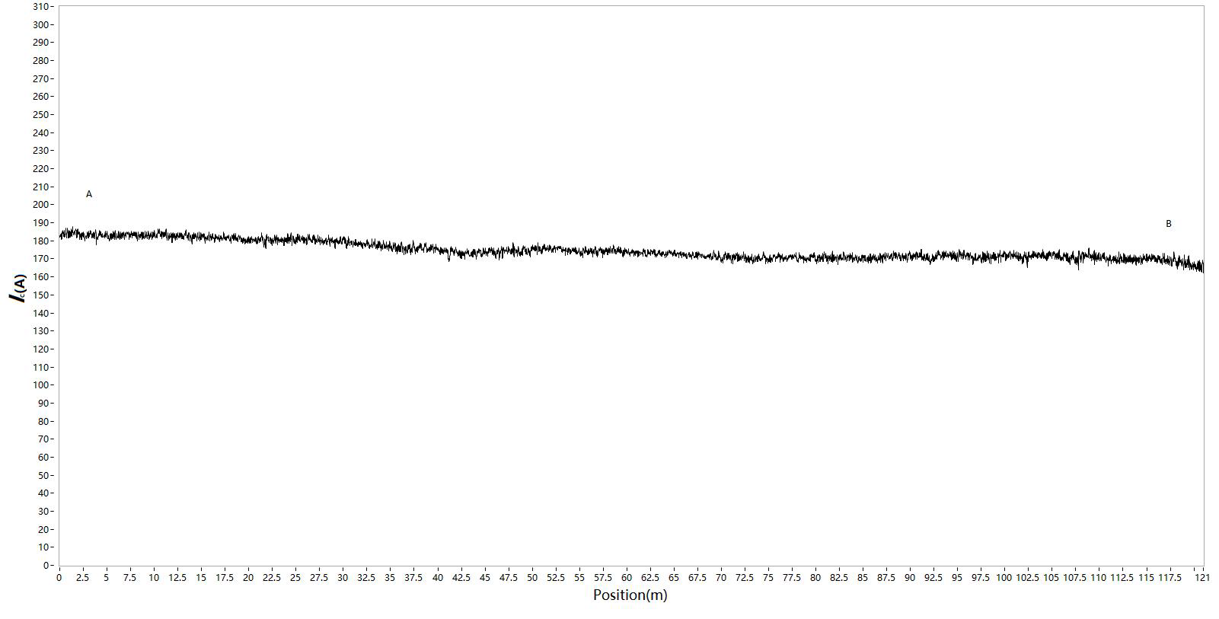

7 spools delivered in January from December 2024/January 2025 production
7 spools delivered in January from December 2024/January 2025 production
Tape | Ic(77 K, sf) (A) |  |  |  |  | Piece length (m)
 | Spec | Inspection data
 |  | Average | S.D. (%) | Max. | Min.
ST2501-204 | 160 | 190 | 2 | 200 | 178 | 121
ST2501-218 | 160 | 178 | 0.8 | 182 | 171 | 130
ST2501-84 | 160 | 174 | 2.8 | 187 | 162 | 121
ST2501-115 | 160 | 206 | 2.7 | 222 | 184 | 156
ST2501-143 | 160 | 185 | 1.2 | 193 | 175 | 117
ST2412-1329 | 160 | 185 | 1.5 | 197 | 173 | 108
ST2412-1362 | 160 | 188 | 1.7 | 199 | 176 | 111
Lengthwise Ic(77 K, sf) by MCorderTM calibrated by transport measurement
All 7 tapes exhibit Ic >160 A through the length
Ic(77 K, sf) varies among spools, along conductor length within individual spool as well
Clearly Ic(77 K, sf) variation level varies from spool to spool
ST2501-218
Almost drop-out free
ST2501-84

Slide 13
The small 77 K variation becomes much larger at low T and high field, ~50% at 20 K/15 T
G-L like angular dependence signals that weak uncorrelated pinning is now very important
The strong correlated pinning plays a key role around the ab-plane
J_{c}(20 K, 15T, H//ab) varies from -24% to 28%
The variation distributes more randomly

Slide 14
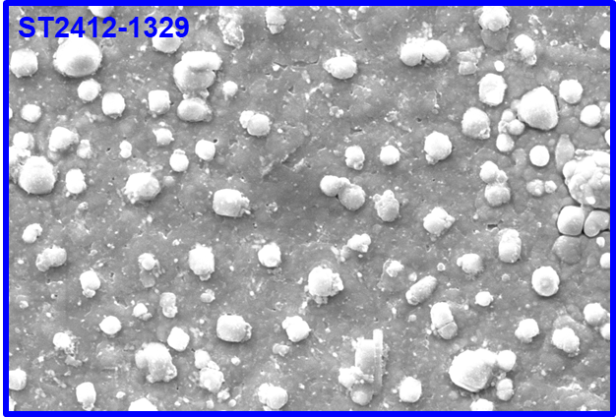
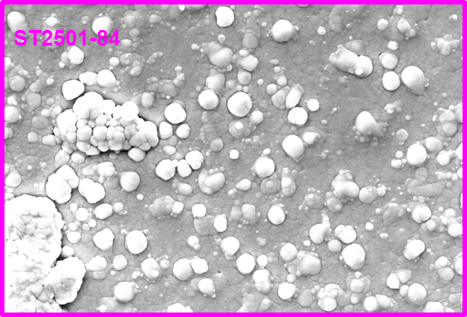
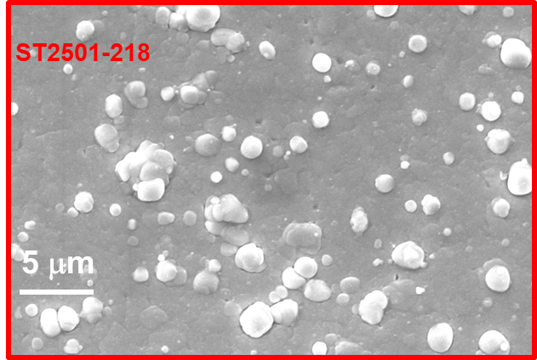
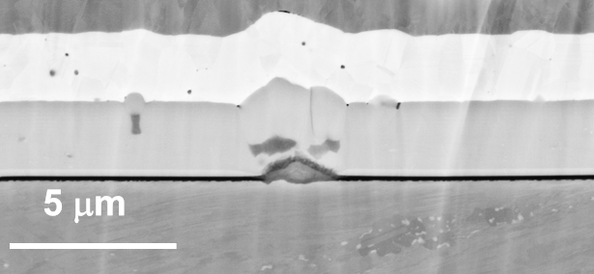
The variation becomes ~50% at 20 K/15 T – not easily overlooked!
Microstructure gives some clues to the observed J_{c} variations and suggests both vortex pinning and connectivity variations
Apparently the ab-plane offset can vary too
~20%
These particles nucleated on second phase particles inside REBCO layer
~28%
~9.38%

Slide 15
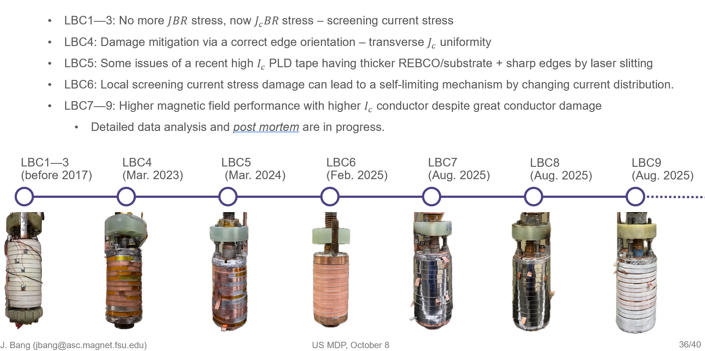
Little Big Coil is our Design-Build-Test-Postmortem platform: Jeseok Bang lead
42.7 T, quenched safely 5 times at same field
45.5 T
41.0 T
46.0 T
48.7 T

Slide 16
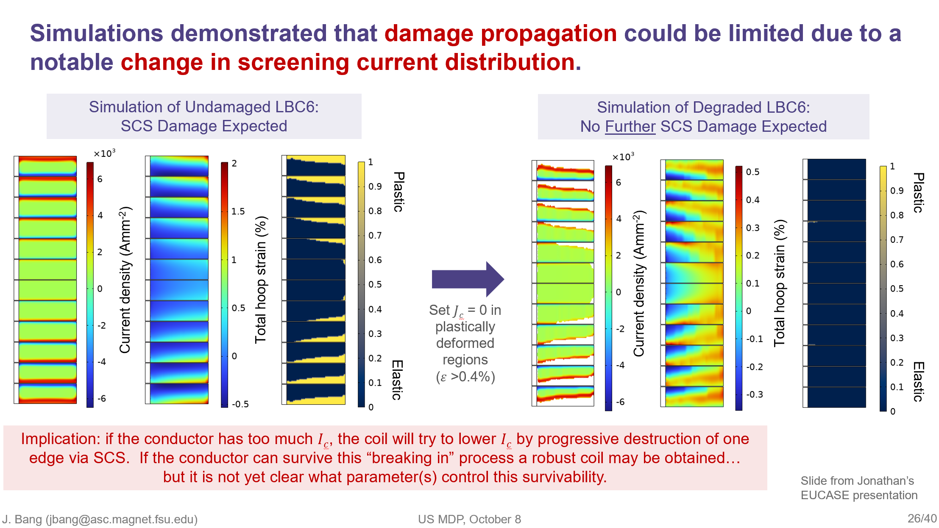
Extensive simulation and postmortem comparison is showing up many interesting features – LBC6 survived 6 quenches without degradation, in spite of significant conductor damage – damage may have helped!

Slide 17
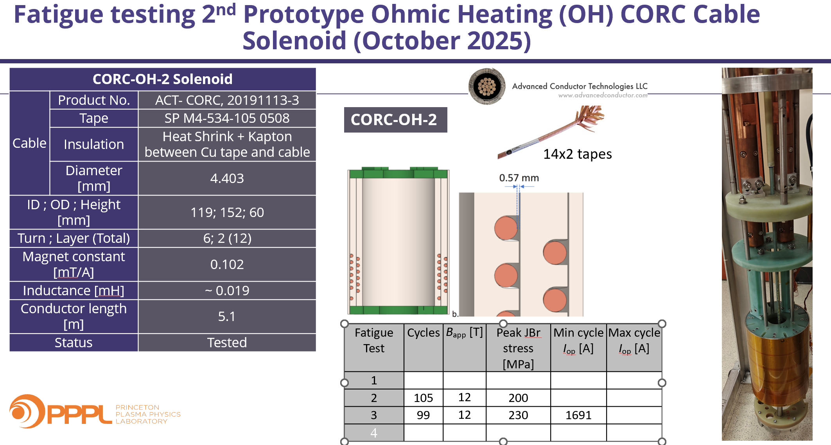
Very recent tests of a 5 m long CORC restrained in a stainless steel backing plate

Slide 18
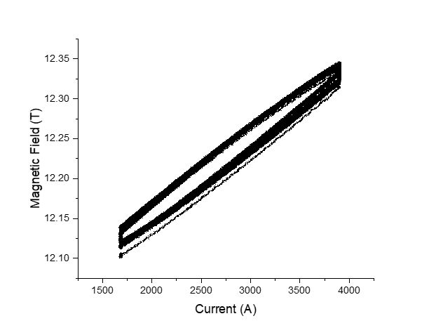
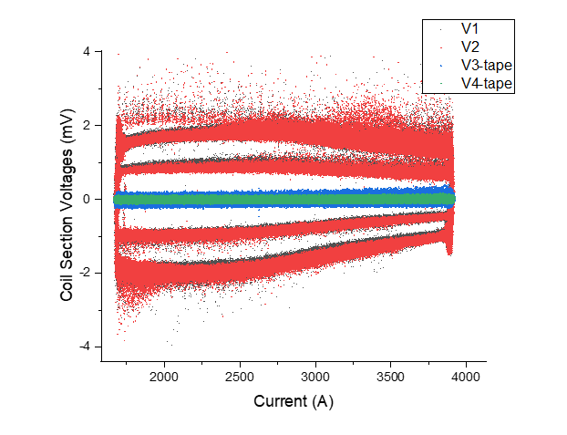
99 cycles to 230 MPa, no significant change
400 A/s
800 A/s
800 A/s, 2 s hold, 1691 A (100 MPa) – 3900 A (230 MPa)
Field Hysteresis
800 A/s
400 A/s
V1, V2
V3-tape, V4-tape

Slide 19
Summary points
We believe a strong high field solenoid program is an important component of an HTS dipole and Muon Collider program
Both Bi-2212 and REBCO conductors need better understanding
Bi-2212 suffers from a small supply chain for which DOE-OHEP support has been absolutely pivotal
REBCO CC has a robust supply chain but is very variable – close comparison of coil to conductor performance requires detailed knowledge of Jc(Θ,B.T), σ−ε curve, and Ic(ε) behavior and perhaps transverse Jc variations due to its impact on screening current stress
Both technologies have demonstrated world leading performance in recent solenoids tested in the 40 mm cold bore, 31 T Bitter magnet
Bi-2212 coil achieved 34.1 T at J_{E} of 464 A/mm2 and a JBr hoop stress of over 250 MPa
REBCO Little Bic Coils hit two new world record DC field marks last month (LBC8 46.7 T with a SuperPower HM and LBC9 48.7 T with Faraday Factory tape) – both survived quench and are now undergoing postmortem
Fatigue testing of CORC coils up to 230 MPa (JBr) has not yet found issues – Screening current stresses are undoubtedly much higher and damage may appear in postmortem – but maximum current so far has been to less than 50% Ic (for B ∥ c-axis)

Slide 20
Additional Comments by Lance Cooley
A 40 T project perspective on which Lance is co-PI

Slide 21
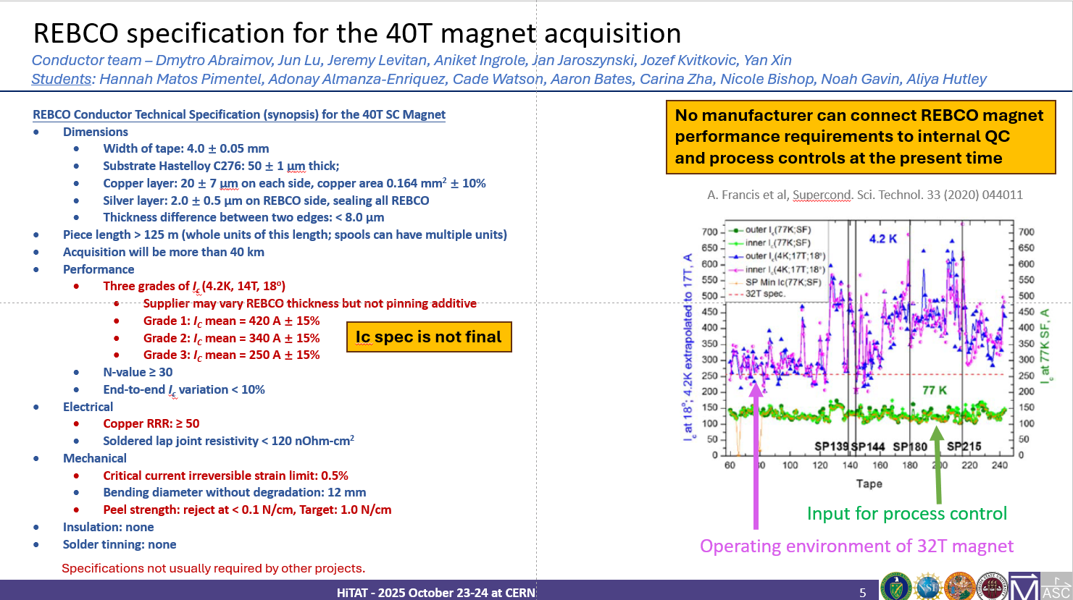
QC of REBCO conductor
Manufacturers do not measure at 4.2 K and high field.
“Lift factor” is not reliable.
Conductor QC is largely derived from MagLab’s conductor characterizations for projects like 32T and 40T

Slide 22
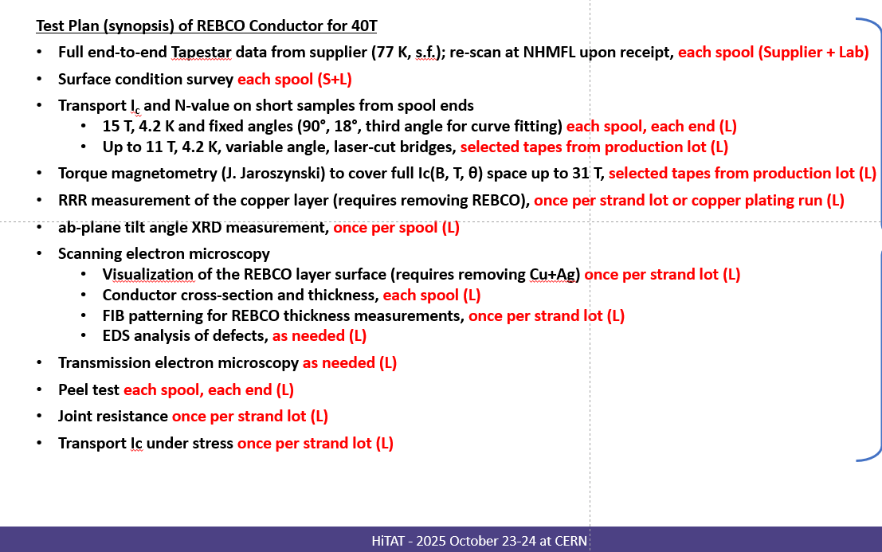
QC of REBCO conductor
Ic at three field angles (usually 90°, 18°, and 8° or 23°) at 15 T, 4.2 K to get a fitting curve
Also tests of copper quality, but to a much lesser degree of standaridization

Slide 23
QC of cables for MDP
ACT relies upon Dima Abraimov for high-field conductor characterizations
Presumably Ampeers QC is done at Houston
Not for distribution
2023-era, 2 mm wide Shanghai SC conductor like that delivered in MDP CORC cables.
Ic variation within run < 6%
Ic variation run-to-run ~15%
(both are comparable to other suppliers)
Run 1
Run 2

Slide 24
What’s missing from the QC portfolio?
Specifications and standard measurements of surface roughness end-to-end
Roughness may have caused one CORC to degrade under bending when another identical CORC did not degrade
Laser-mic measurements of dimensions end-to-end
Specifications and tests of the copper that are tied to understanding of what material is being delivered from the plating lines
RRR, Cu resistivity, and contact resistance vary
Peel strength and location of delamination (at buffer side = REBCO bottom, or at silver = REBCO top)
Multiple MDP labs capable of getting the same answer for the same measurements on exchanged samples

