Slide 1
Update to the MDP Technical Advisory Committee
Soren Prestemon
For the MDP Collaboration
10/30/2025

Slide 2
Outline
Reminder of our updated roadmap and priorities
Major developments since the 2025 Collaboration Meeting
CCT5w test results
C3 test results
Next milestones for the program
Budget considerations and priorities
Community engagement

Slide 3
Our program has been reviewed and revised to align with P5 recommendations
Central focus: develop and test high field magnets for HEP
Improve integration for hybrid magnets
Investigate HEP-motivated solenoid designs
Support magnets with critical materials, expertise & dev. of new enabling technologies
Strengthen linkage between technologies and magnets
Forward looking – what is enabled by our advances, and what is achievable for colliders
Align with, and support, collider design efforts

Slide 4
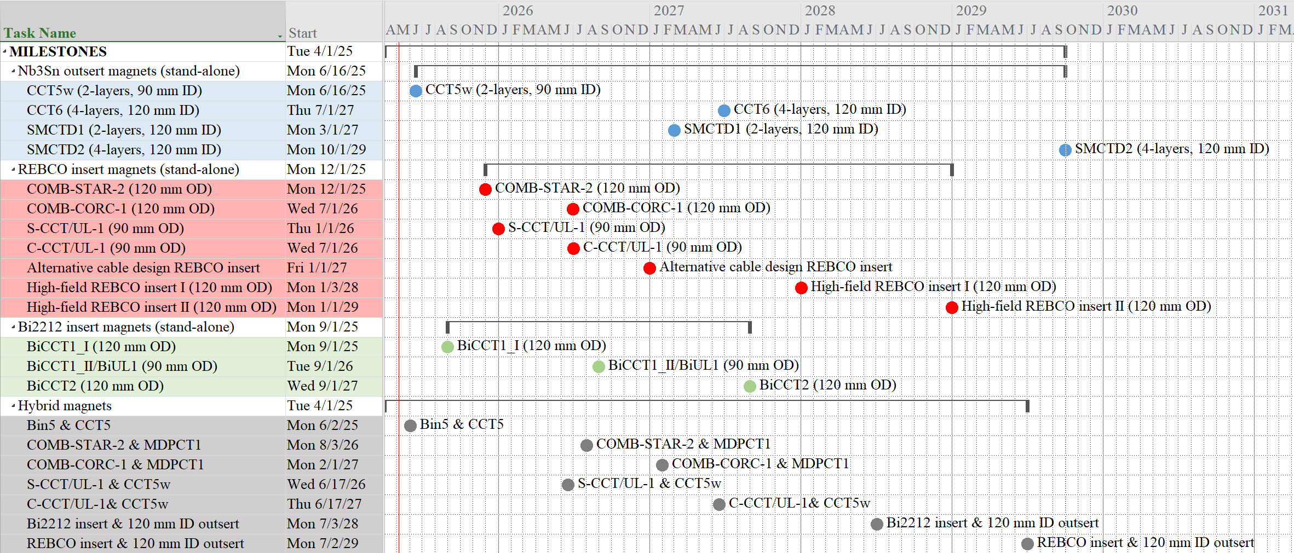
Reliable high-field large bore Nb3Sn dipoles are critical components for MDP Serve as proof-of-concept for Muon Collider, and workhorse for hybrid testing

Slide 5
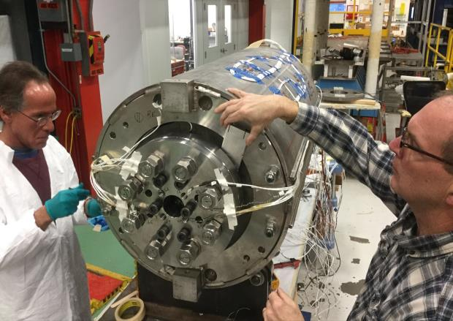
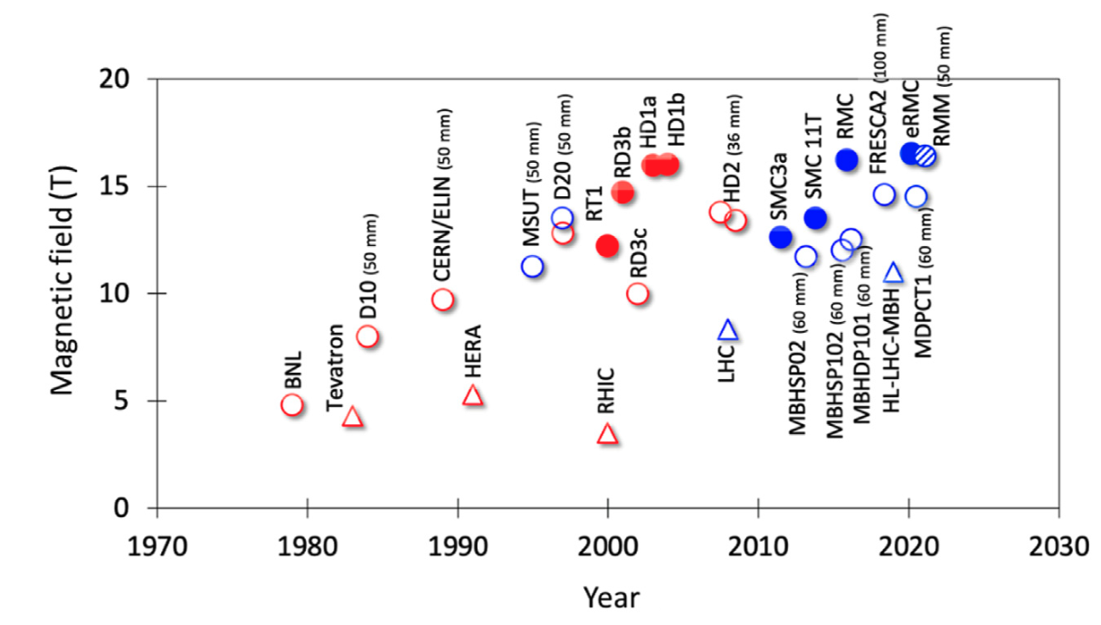
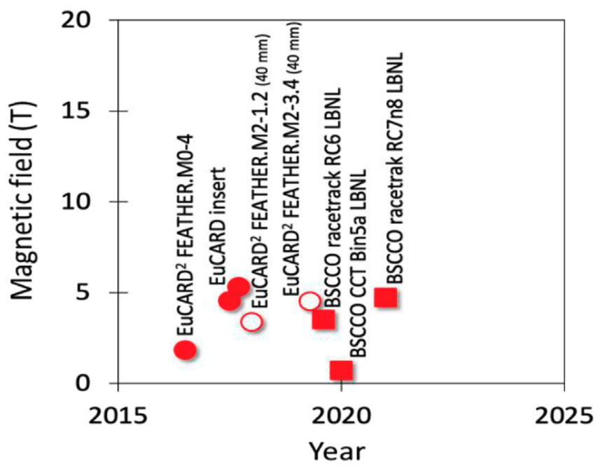
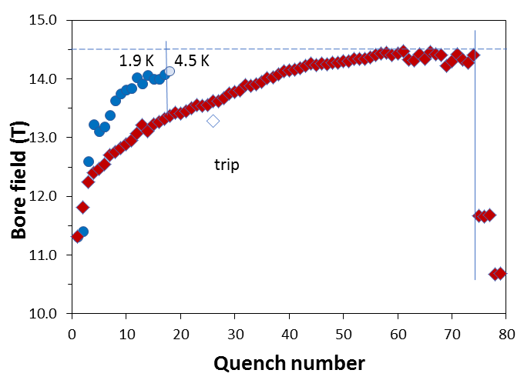
A key early MDP result was the 14.5T “MDPCT1” dipole
FNAL 14.5T “MDPCT1”
Bottura, Prestemon, Rossi, & Zlobin, Front. Phys., 12 October 2022
MDP Perspective:
[I]: Highest priority issue: degradation mechanisms; design mitigation
[II]: Second priority: Initial quench current and memory after thermal cycle
[III]: Third priority: Training rate
II
III
I

Slide 6
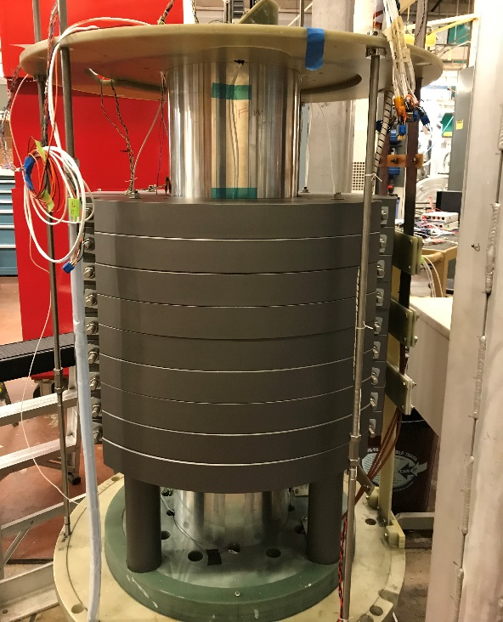
A Number Of Technology Issues Were Addressed With CCT 2-layer Magnet Series
 | CCT3 | CCT4 | CCT5
Bore size [mm] | 90 | 90 | 90
Groove design | constant width | 1.25 mm gap at pole | 1.65 mm gap at pole
Conductor | RRP 54/61 Ta doped | RRP 54/61 Ta doped | RRP 108/127 Ti doped
HT Temp [C] | 650 | 660 | 675
Potting configuration | full magnet | full magnet | individual layers
Epoxy | CTD-101K | CTD-101K | FSU Mix 61
Layer-to-layer interface | bonded | mold released | bend and shim process
Field quality
Conductor damage/stability
Cost and scalability
Training
CCT4 addressed issues with conductor damage during heat treatment in CCT3
CCT5 was tailored towards improving training performance of CCT4

Slide 7
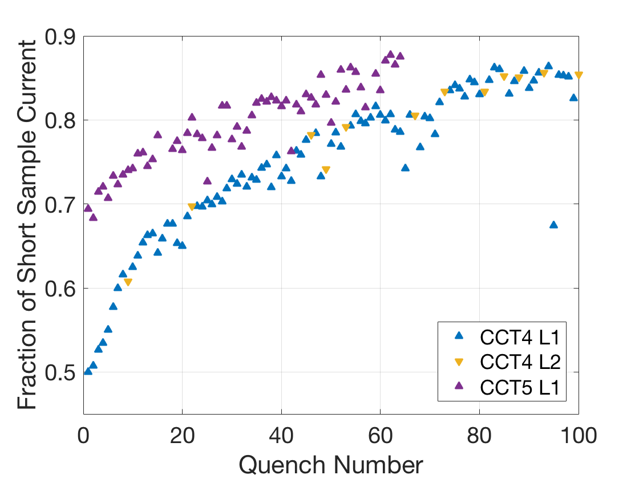
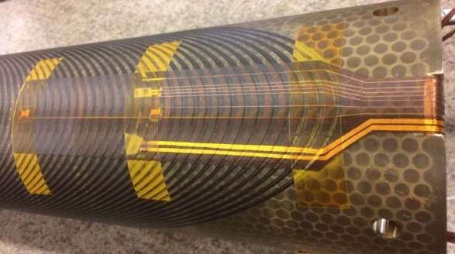
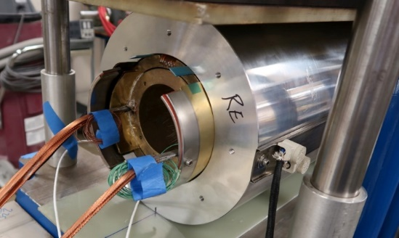
CCT5 Showed Improved Training but Long Training Still Remained
CCT4
Coils and shell impregnated together
CTD101K epoxy
CCT5
Bend-and-Shim assembly of individually impregnated coils
Mix61 epoxy from FSU
Quench Current Relative to SSL
Training rate after “fast” segment is similar for CCT4/5
Individually Potted Coil
Bend and Shim Assembly
Initial “fast” training eliminated in CCT5

Slide 8
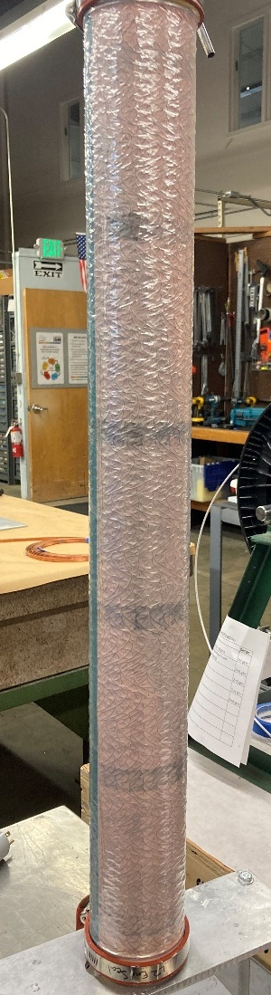
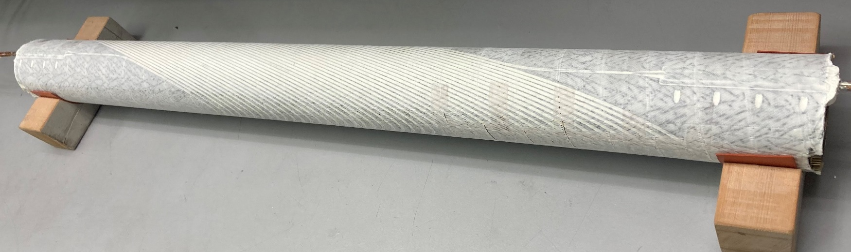
Motivation for use of Al₂O₃ Filled Wax
Filled wax can provide low shear strength properties of wax (desired for minimal training) but with improved bulk modulus for improved stress distribution to conductor
Better CTE match can also be obtained by using fillers
Filled wax impregnation process was developed for subscale CCT coils
Follow filled wax recipe developed by A. Brem et. al.¹
Modified plain wax impregnation process by substituting peel ply and flow media that is permeable to particles
1. A. Brem et al., IEEE Transactions on Applied Superconductivity, vol. 34, no. 5, pp. 1-5, Aug. 2024, Art no. 7700105, doi: 10.1109/TASC.2023.3338588.
CCT Subscale 7 Coil

Slide 9
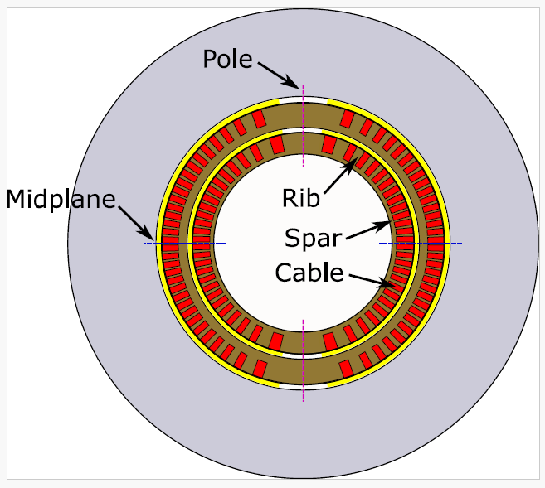
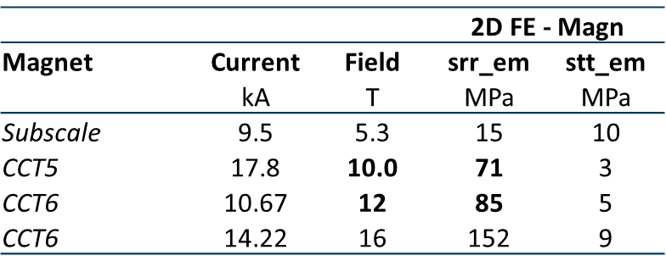
Filled Wax Impregnation Beyond Subscale Models (CCT5W)
Under conditions where there is no bonding to the ribs in CCT, the edge of the cable sees higher normal stress
CCT5W, wax impregnated CCT5 @10T 90 mm bore (CCT5-W), has been fabricated as a stepping-stone towards CCT6
Average radial stress of CCT5 at 10 T is representative of CCT6 at ~12 T. Subscale stresses are significantly lower.
If CCT5-W is successful, can consider to impregnate CCT6 with filled wax
CCT5W follows same general approach as for CCT5, with only following modifications:
Coil impregnation with filled wax
Larger shim angle between layers
Stress on Turn from Lorentz Force
Plain Wax SUB
CCT5W
CCT6
Filled Wax SUB
Analysis performed by: G. Vallone and M. Juchno

Slide 10
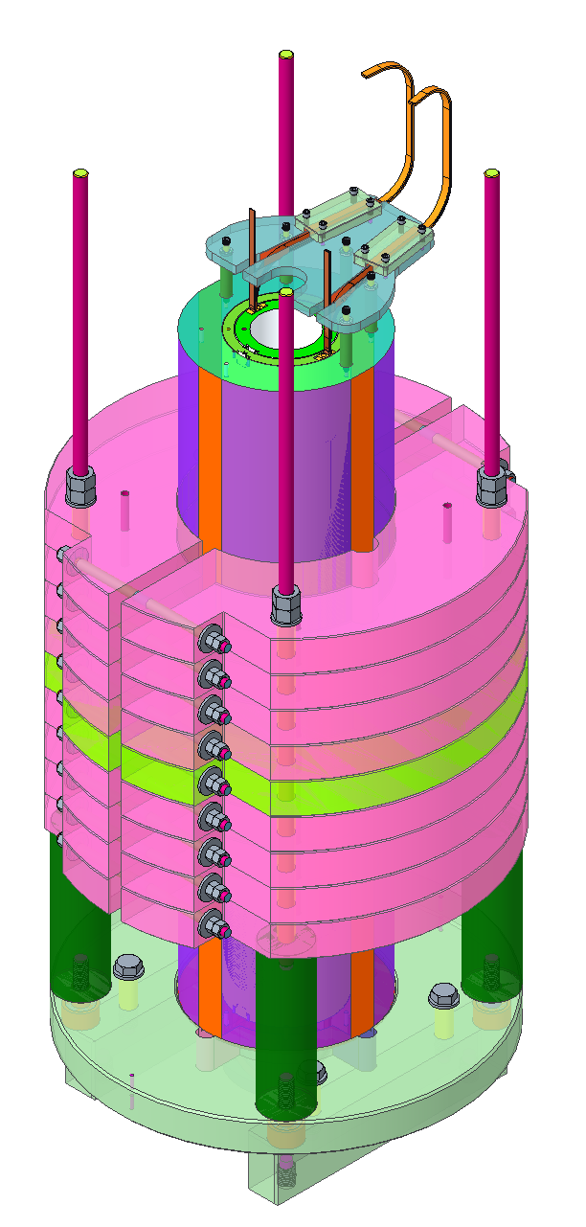
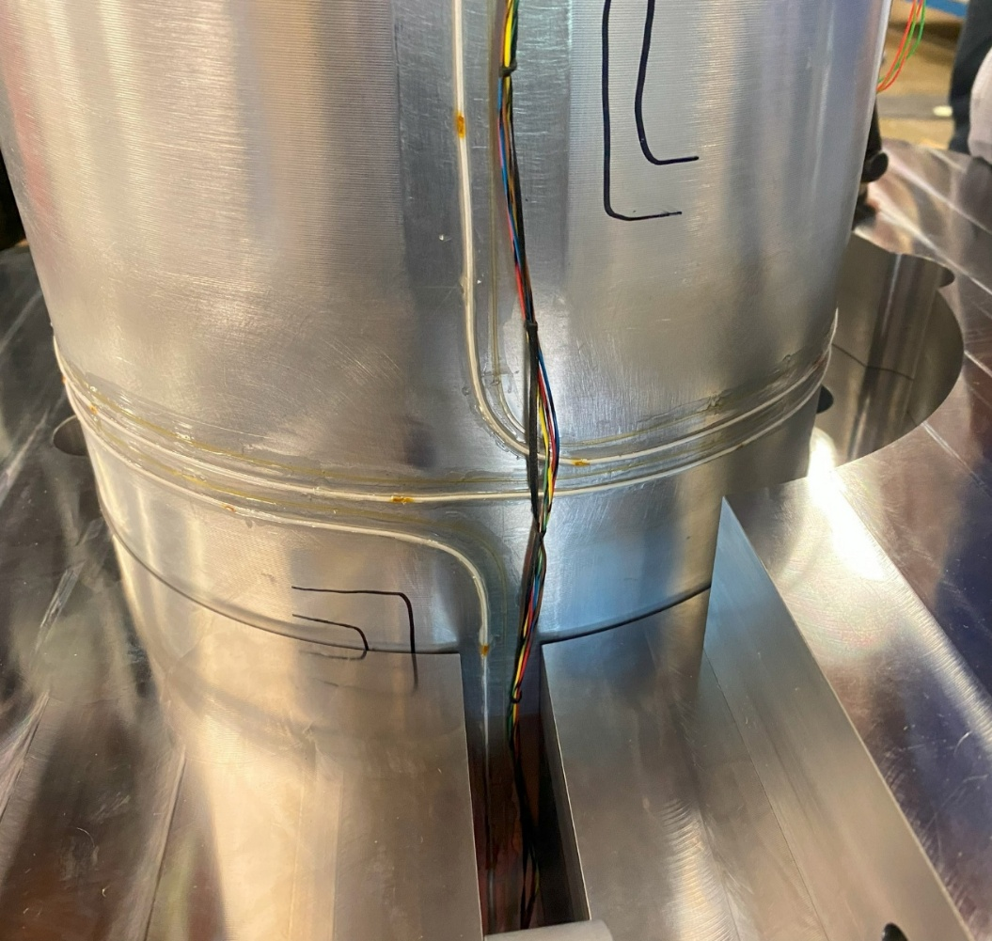
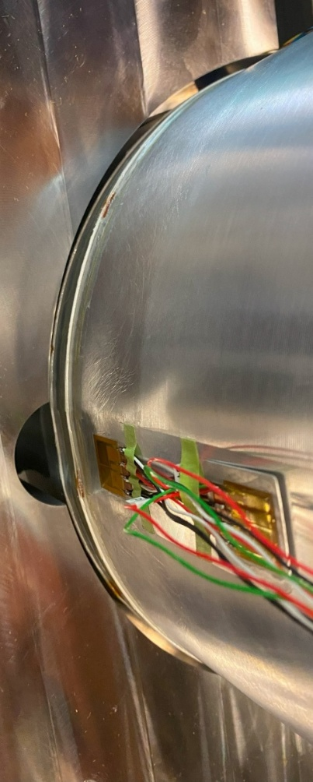
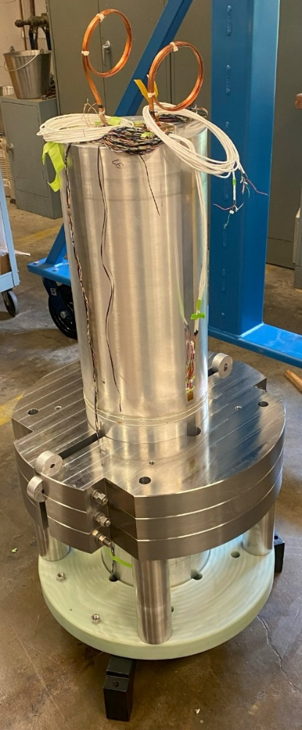
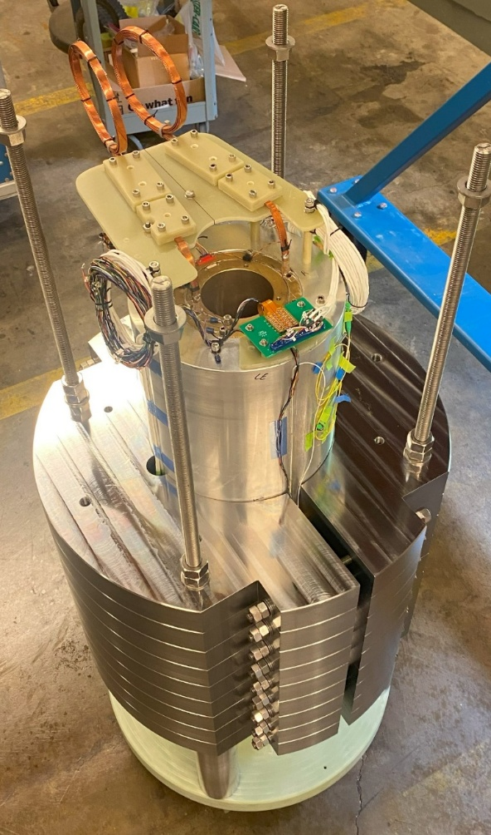
Shell Instrumentation and Yoke Assembly
Shell was instrumented with strain gages, optical fibers, and RF sensor
External yoke was assembled by stacking laminations
Suspension rods
Splice box
Iron yoke laminations
Central laminations have radial clearance due to installed instrumentation
Vertical assembly
Strain Gage Stations

Slide 11
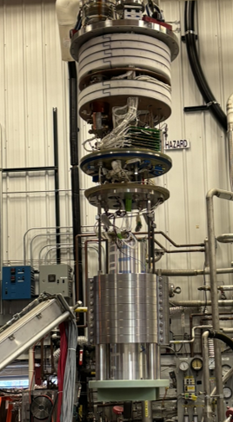
Magnet Test at Fermilab
The magnet was tested at Fermilab – Effort led by M. Baldini and S. Stoynev
Additional instrumentation incorporated at Fermilab
Acoustic sensors
Warm bore flex quench antennas
Rotating coil for magnetic measurements (to be performed after thermal cycle)
Current clamp (Rogowski coil)
Magnet protection
30 mΩ dump resistor
Detection time is 1 – 2 ms (includes applied delay to ensure that quenching segment can be identified) and switching time is ~ 1ms
Maximum hot spot temperature based on adiabatic calculation is approximately 150 K
Initial testing performed at 4.5 K followed by 1.9 K testing

Slide 12
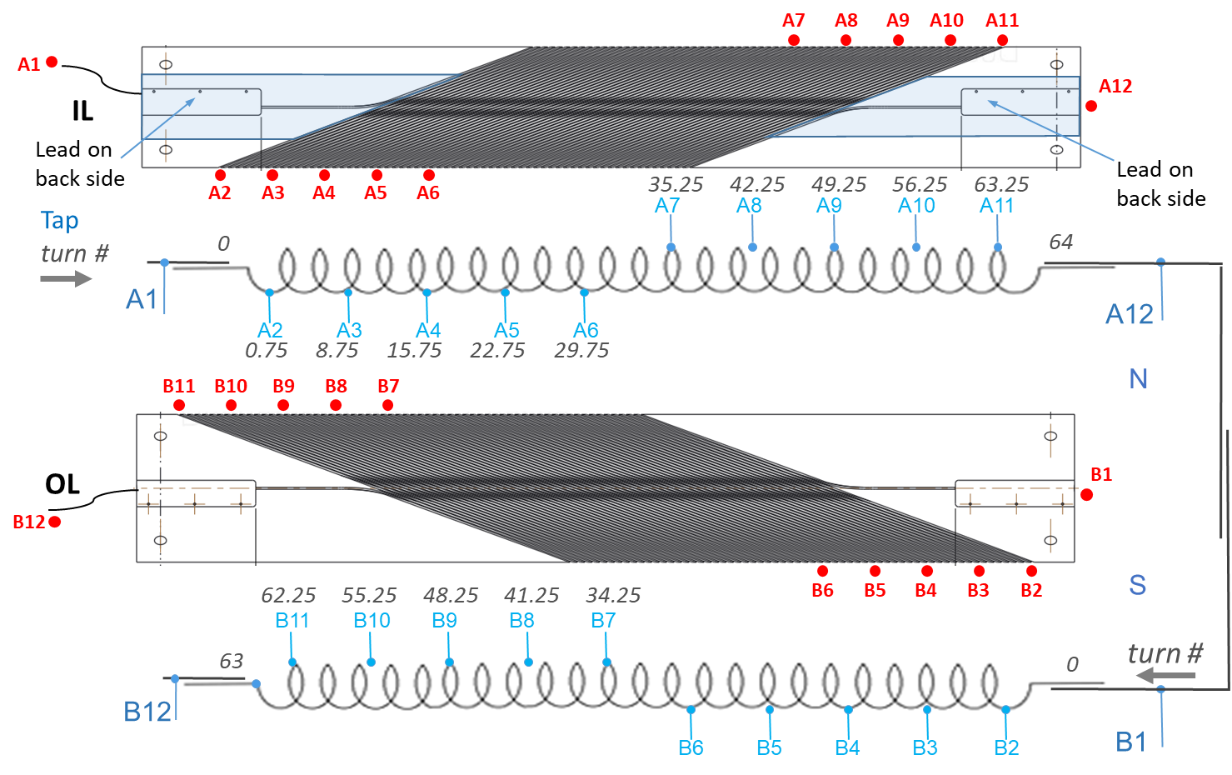
Voltage Tap Layout
11 voltage tap segments in each coil (most segments contain 7 – 8 turns, end segments contain lead area and first turn)

Slide 13
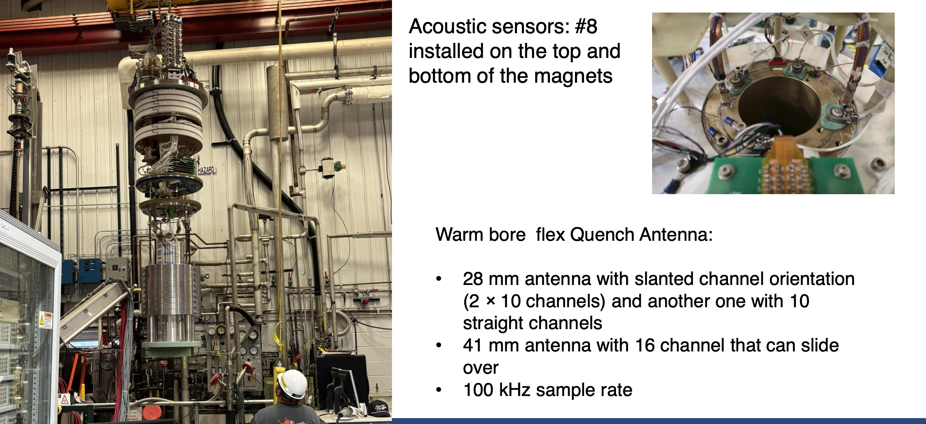
Additional instrumentation provided by FNAL

Slide 14
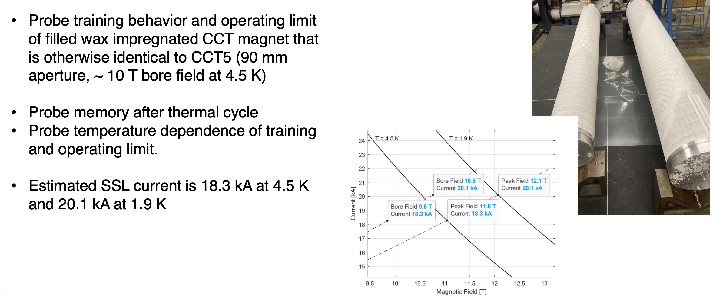
Goals of the magnet test

Slide 15
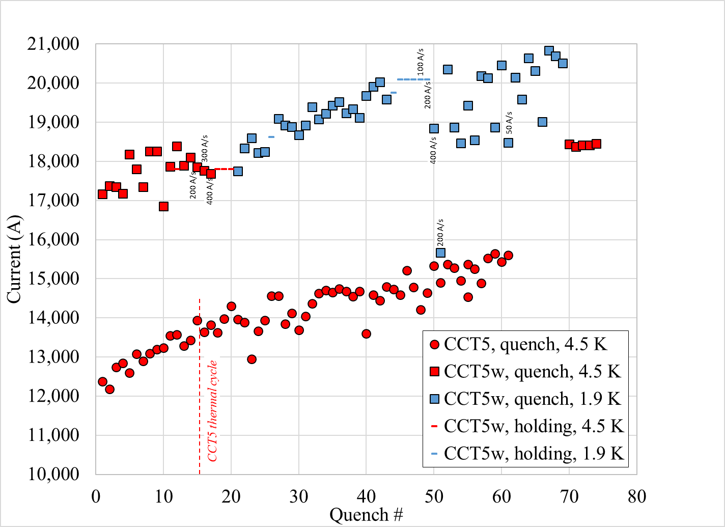
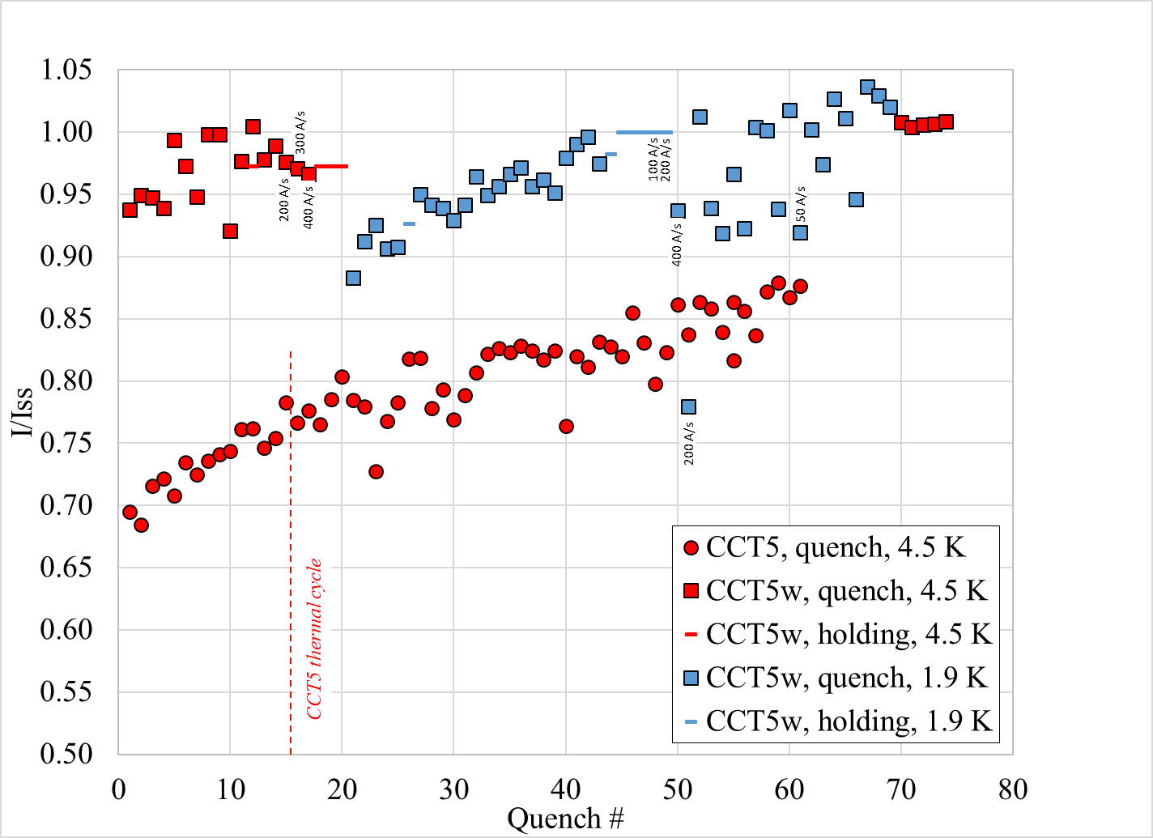
Training Results: Comparison between CCT5 and CCT5-W
Quench Current
Normalized Quench Current
90% of SSL

Slide 16
Training Result Observations
Maximum Current / Field Reached
4.5 K: 18.4 kA corresponding to bore field of 9.9 T*, peak field of 11.1 T, and 101% of predicted short-sample limit
1.9 K: 20.8 kA corresponding to bore field of 11.1 T*, peak field of 12.4 T, and 103% of predicted short-sample limit
Initial test at 4.5 K
Training starts at 94% of SSL
Training is not monotonic (some detraining observed)
Demonstrated multiple ramping and holding cycles at 97% of predicted SSL
No strong ramp rate dependence observed
Test at 1.9 K
Training starts at 88% of SSL
Training is not monotonic but constrained to a tight band at first
Demonstrated multiple ramping and holding cycles at 100% of predicted SSL
Large detraining seen during high ramp rate quenches
Training is more erratic after this point in the test
Quench location (based on voltage tap segment) varies throughout 1.9 K testing
Outer layer quenches seen during 1.9 K testing with 20 A/s ramp rate at high current but no longer seen after ramp rate was reduced to 5 A/s (it’s possible that eddy currents in shell could have led to increased outer layer temperature)
* Field values based on calculation, magnetic measurement to be performed after thermal cycle

Slide 17
Training Result Observations (Cont.)
Testing at 4.5 K after 1.9 K test
Stable plateau observed over 5 quenches at 18.4 kA
Quench locations are constrained to two segments that contain the high field region of the magnet (segments containing first and last turn)
General observations
No degradation has been observed during first phase of testing, will perform thermal cycle next
The filled wax magnet, CCT5-W, trains but starts at significantly higher fraction of short sample when compared to the epoxy impregnated version, CCT5
Maximum current per strand achieved is 990 A using MQXF strand (i.e. current is close to 2.5 x operating current for MQXF magnets)

Slide 18
Temperature Dependence

Slide 19
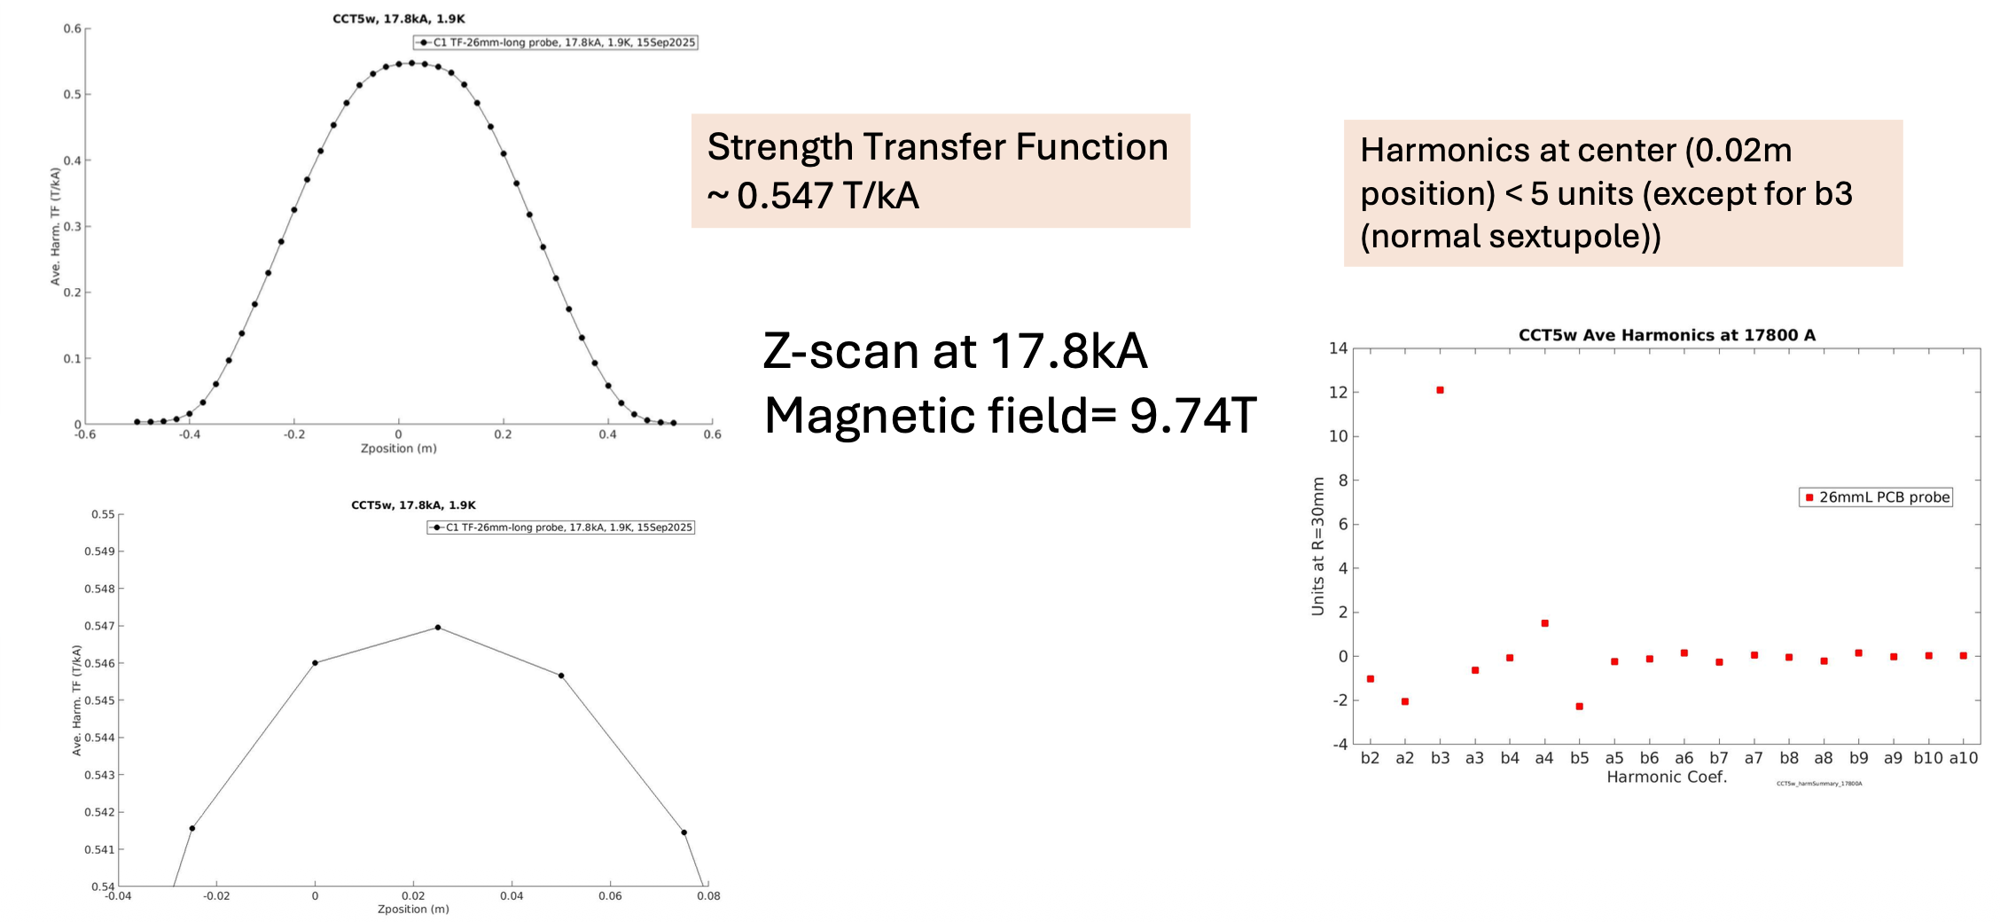
Magnetic measurements @ 1.9K (J. DiMarco)

Slide 20
Magnetization effects during a classic accelerator ramp cycle

Slide 21
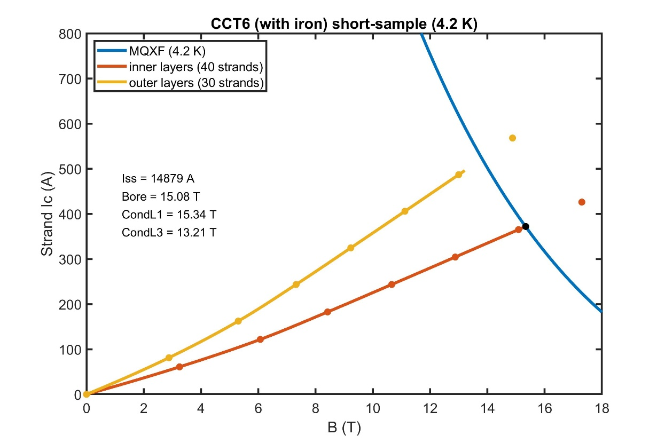
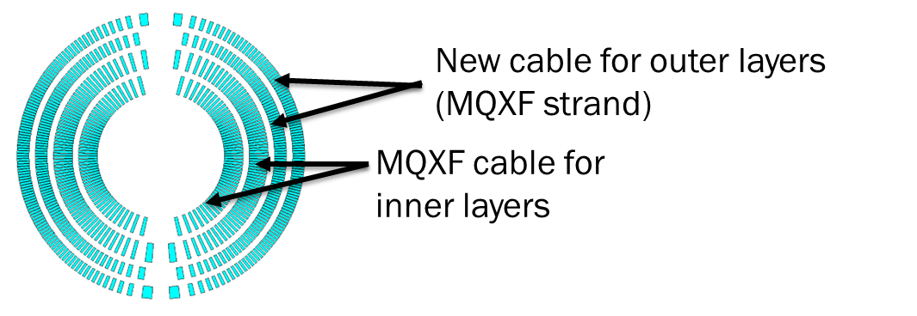
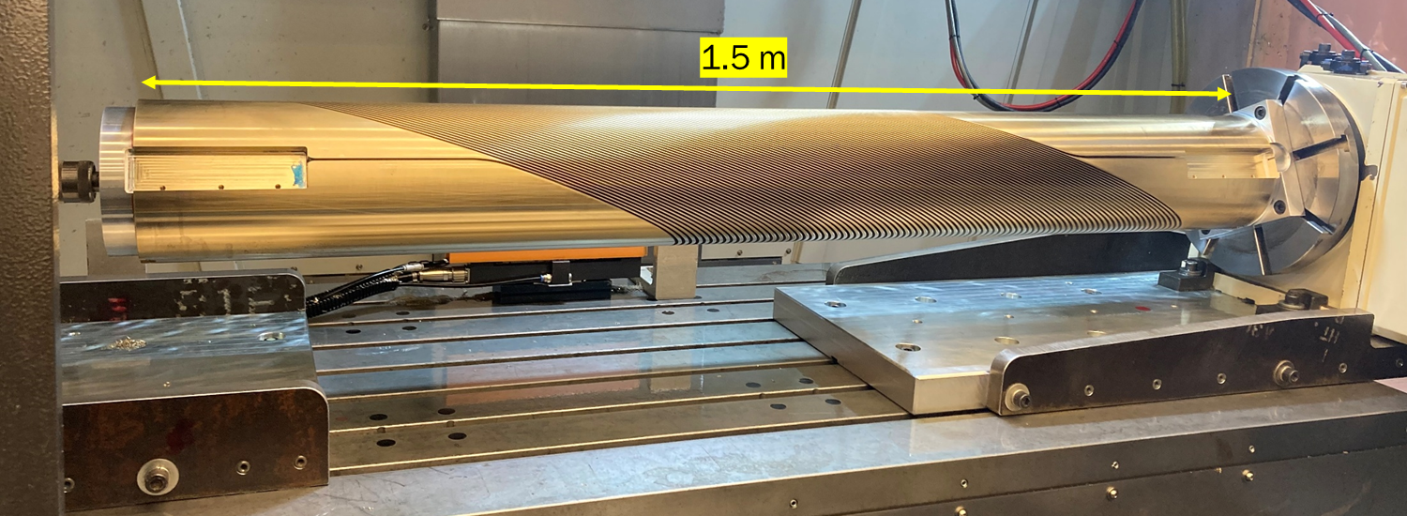
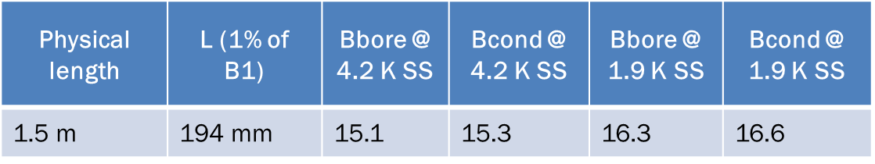
Next Steps in US MDP Nb₃Sn CCT Program
Fabrication of CCT6, 4-layer Nb₃Sn dipole with 120 mm and short sample bore field of ~15 T at 4.5 K (expected mid 2027)
First layer mandrel has been machined after several winding / reaction / impregnation tests on short mandrels
Currently working on optimization of mechanical structure

Slide 22
A major deliverable from the 2020 roadmap was C3, a REBCO CORC-based CCT dipole – enabled development of technology to support these milestones

Slide 23
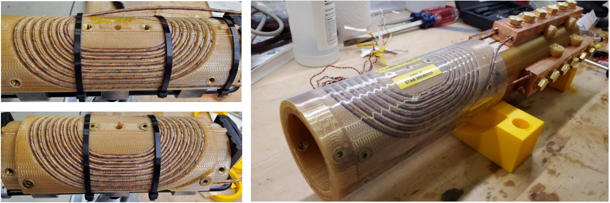
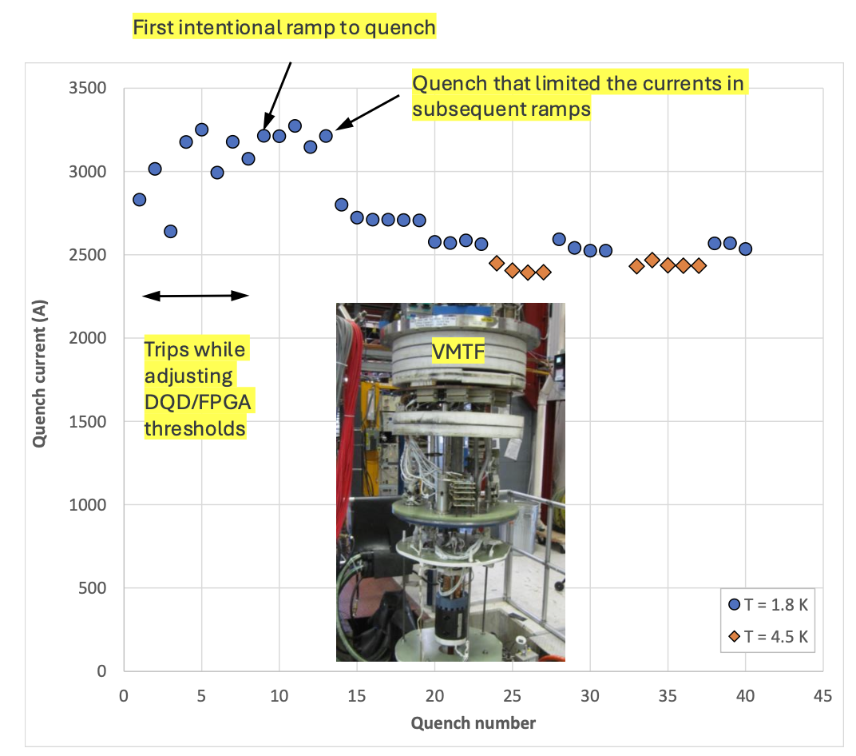
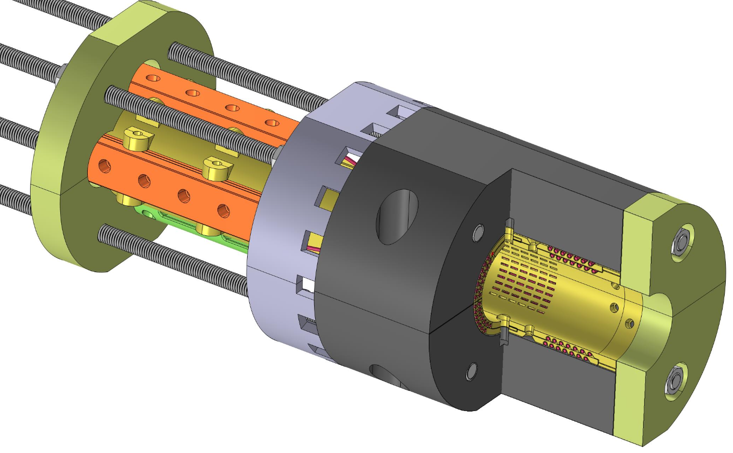
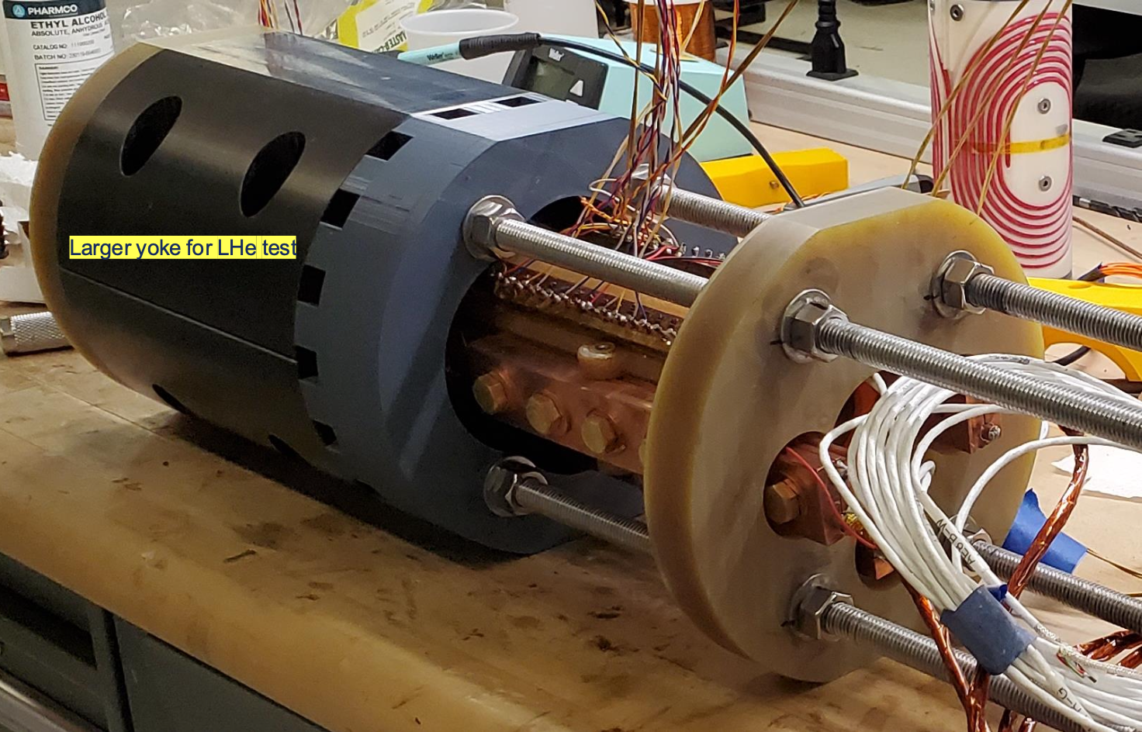
Development of REBCO magnet technology - COMB-STAR-1
Vadim Kashikhin
COMB processes developed
Degradation observed on one half
95% IC retention on the other half

Slide 24
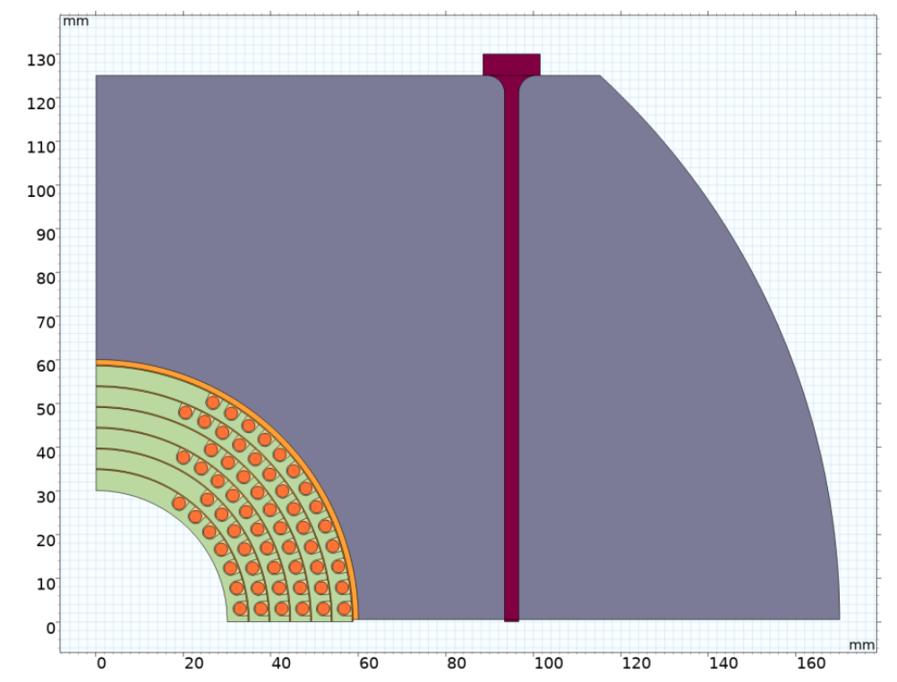
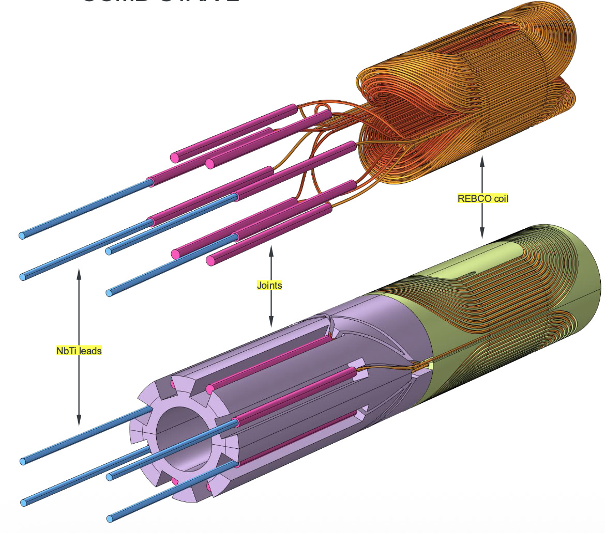
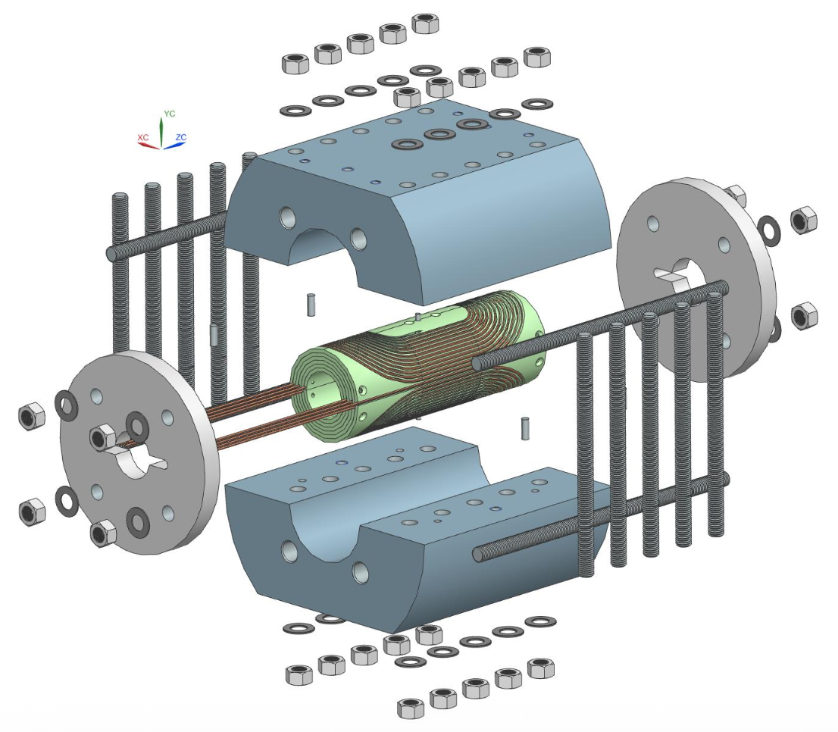
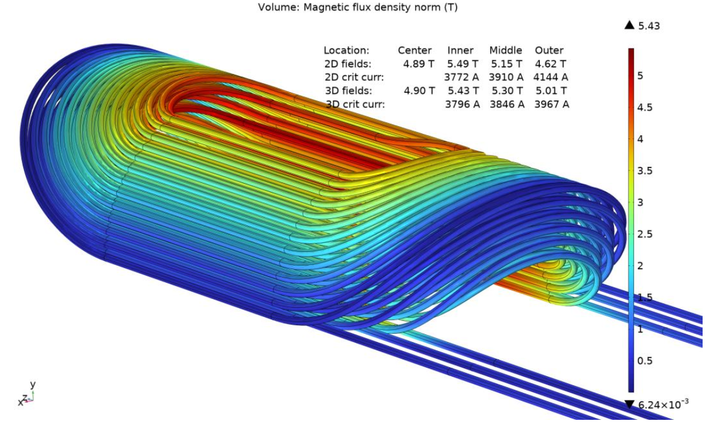
Next COMB-STAR-2 magnet designed to achieve 4.9T

Slide 25
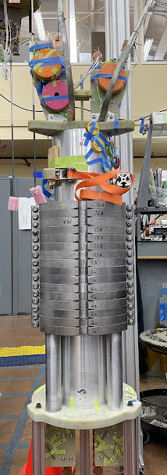
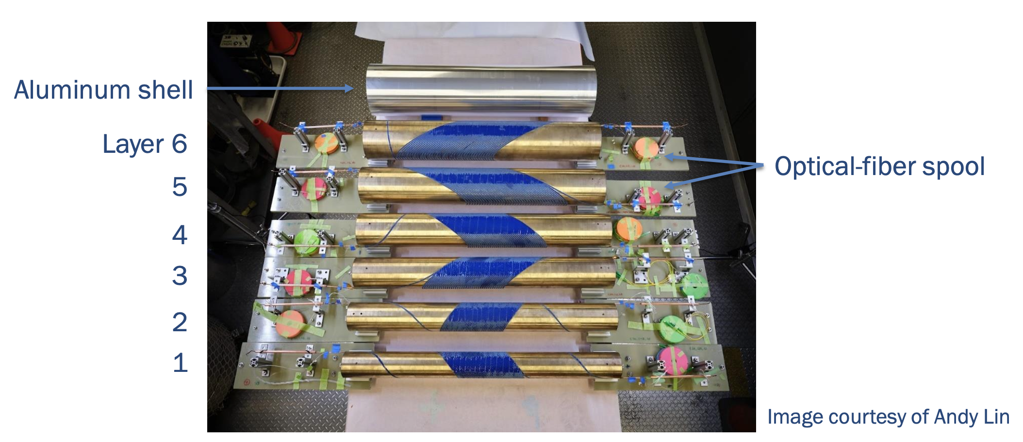
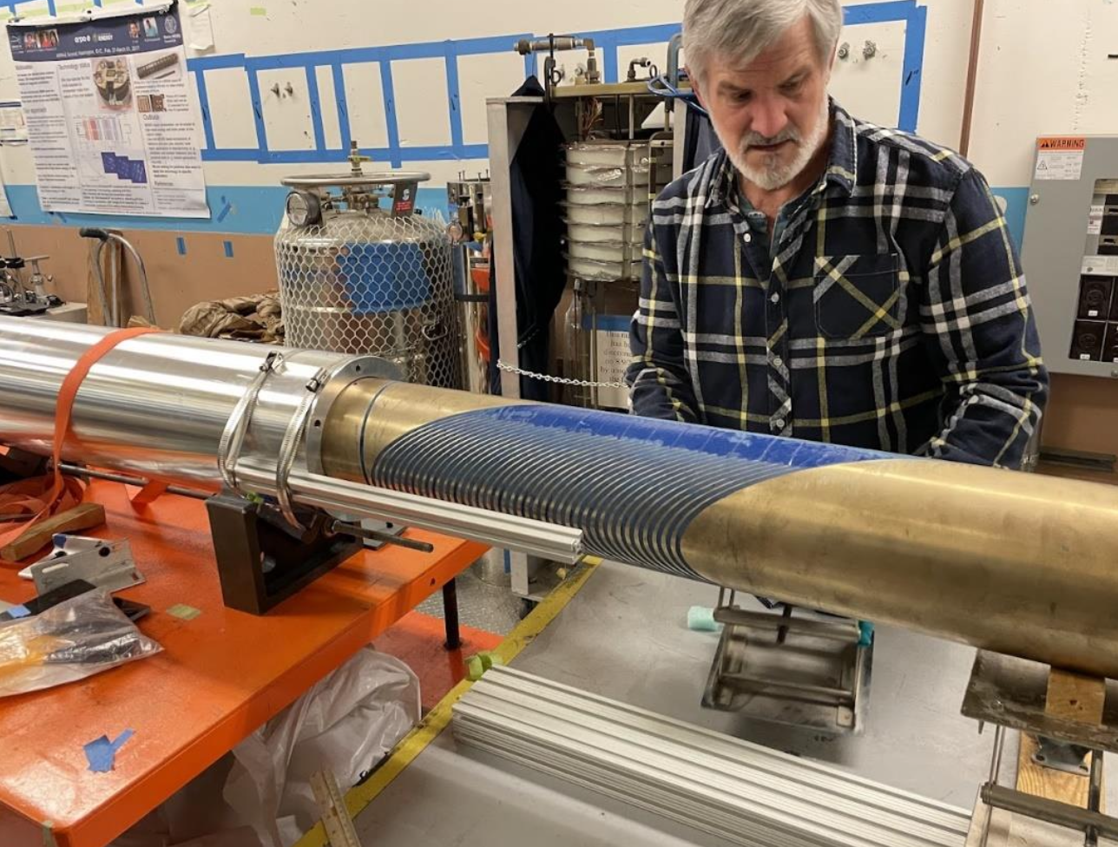
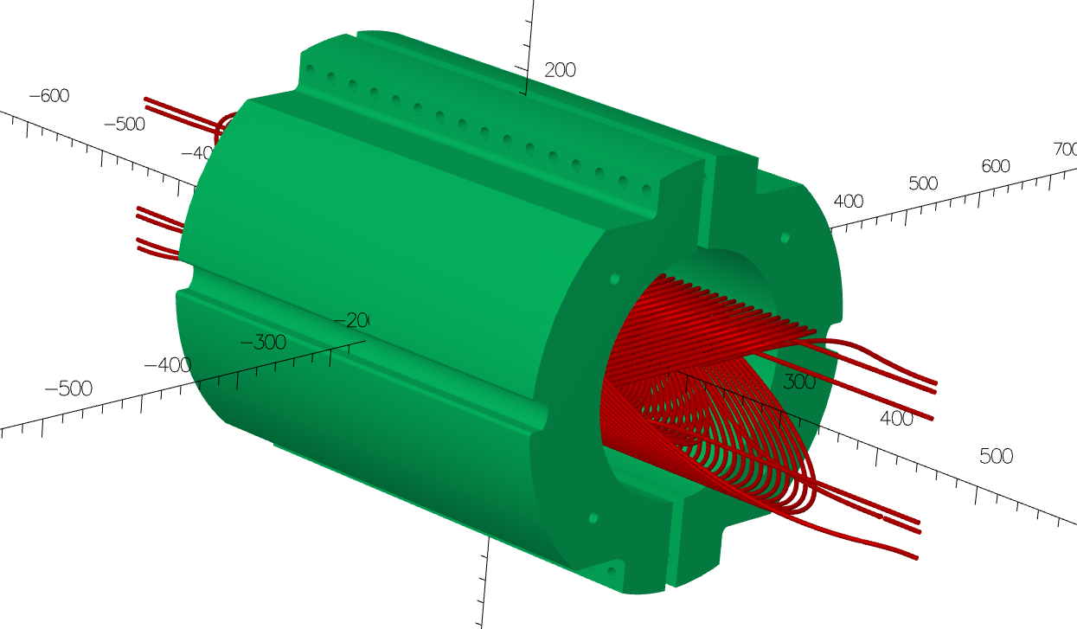
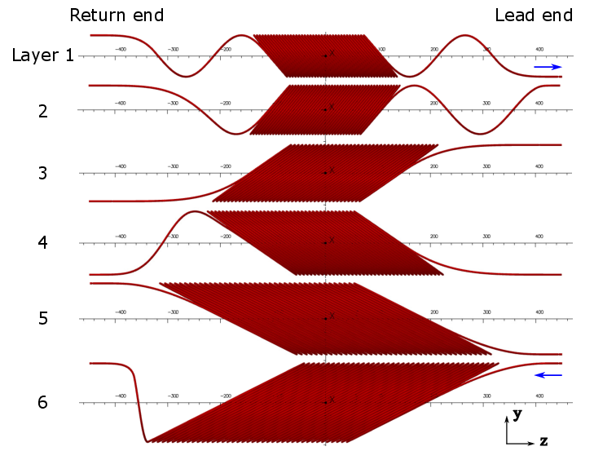
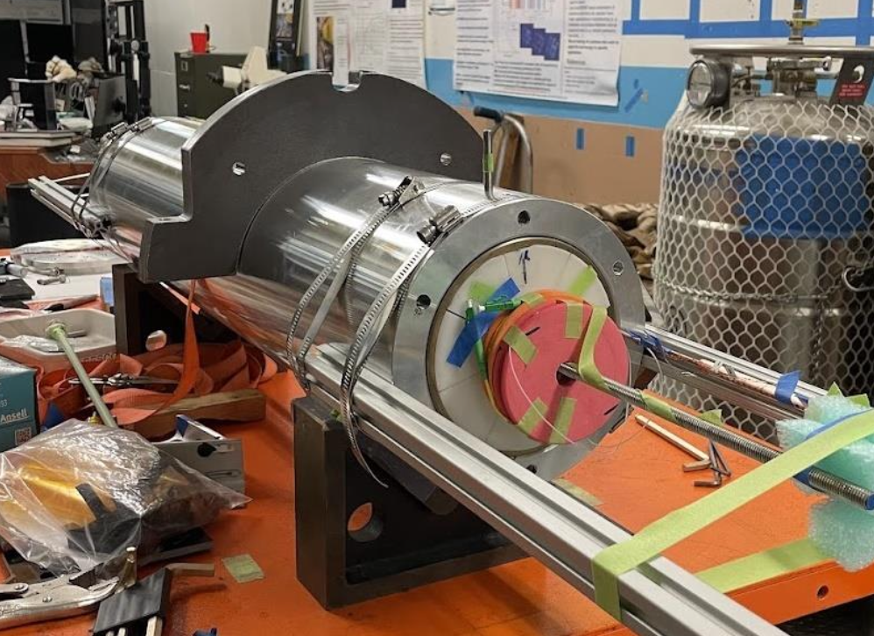
C3 is a 6-layer, 65mm ID CCT magnet using CORC conductor
Xiaorong Wang
145 m of CORC® wires in six pieces, maximum piece length 35 m
Specified the minimum tape Ic for HM tapes

Slide 26
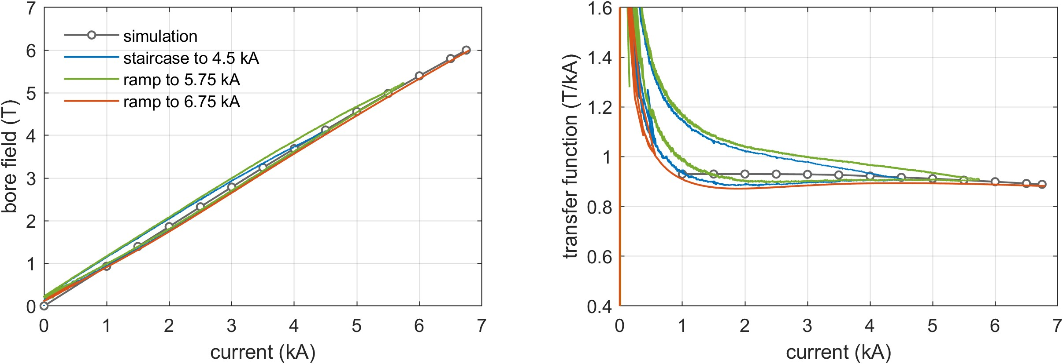
The dipole field reached 5.99 T at 6.75 kA
5.99 T
4.2 K
4.2 K
Calculation by L. Brouwer and Y. Yan
Peak I x B force on the conductor ~ 42 kN/m
Iron contribution ~ 1.1 T, 19% of the total field

Slide 27
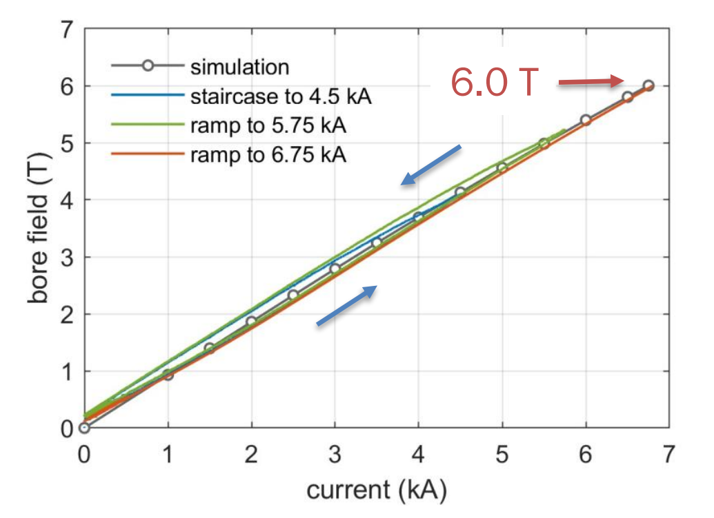
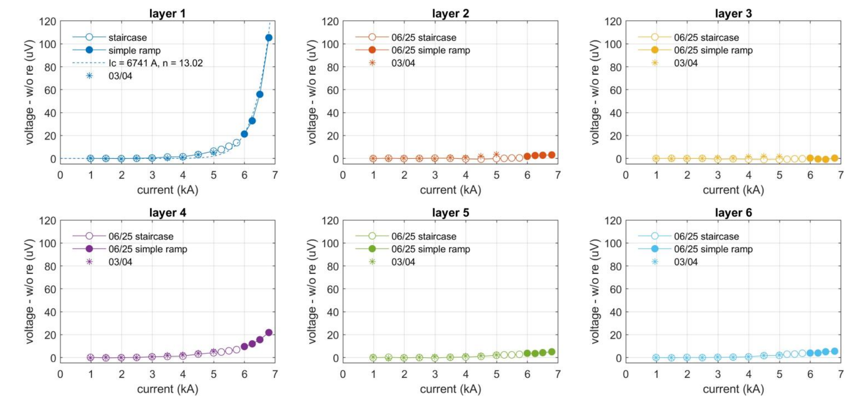
Achieved 6 T in 65 mm aperture
Voltage rise observed in layer 1 (and less in layer 4), likely degraded during fabrication
But no thermal run-away (“quench”)
Ramping stopped at 6.75 kA → 6 T

Slide 28
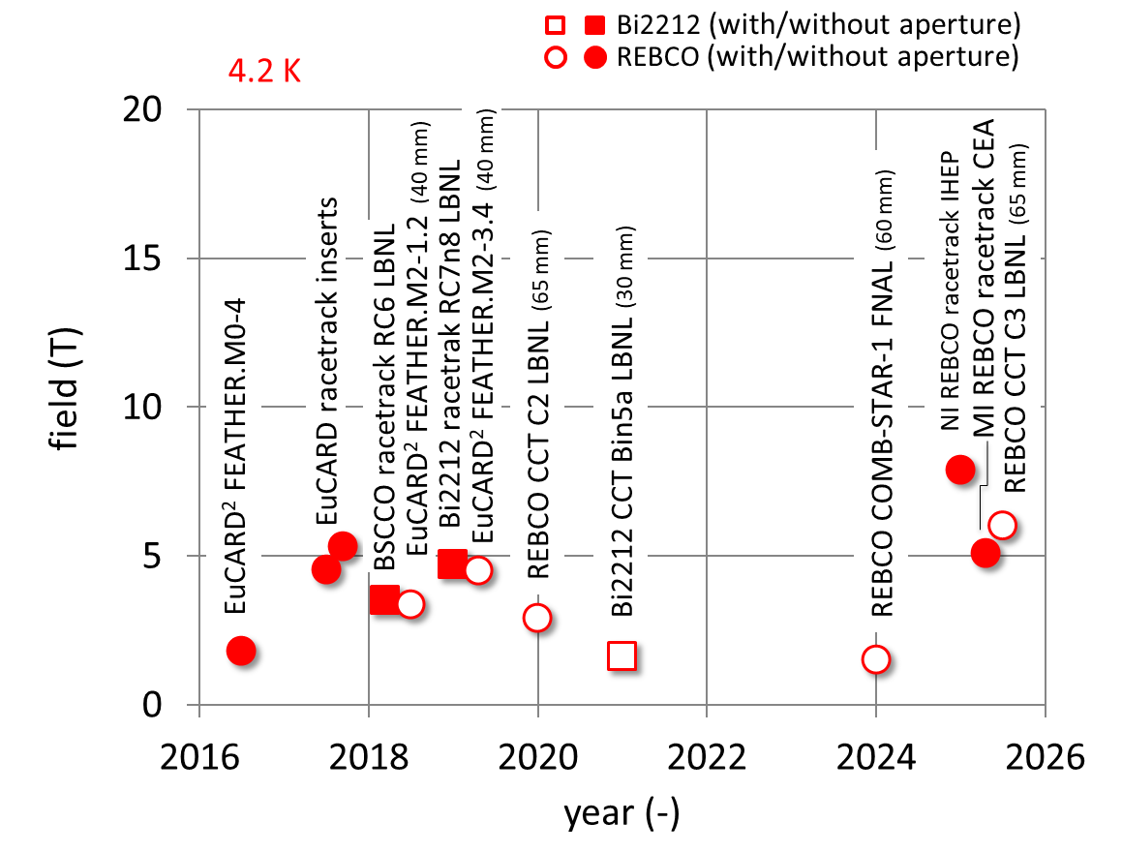
Record field for HTS magnets with aperture

Slide 29
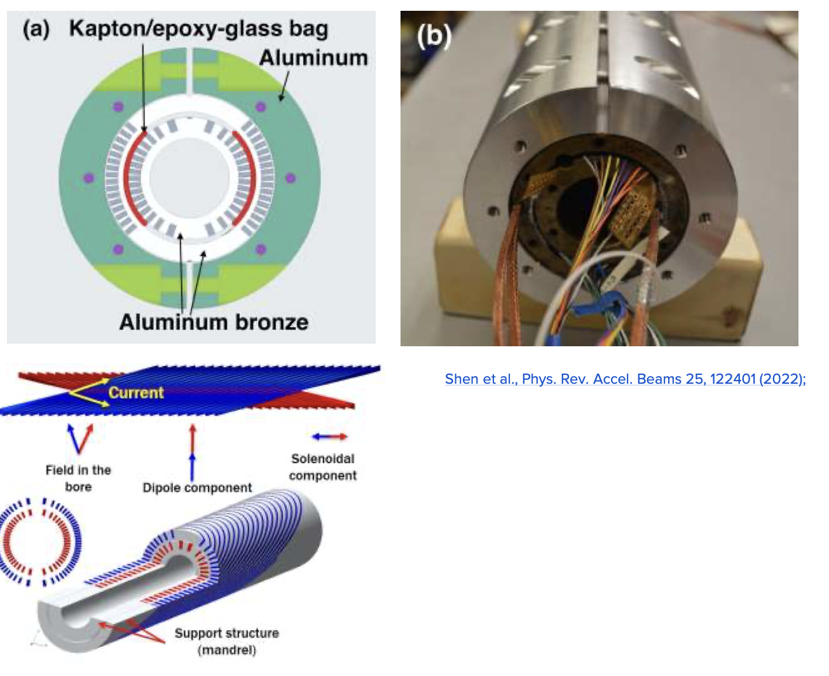
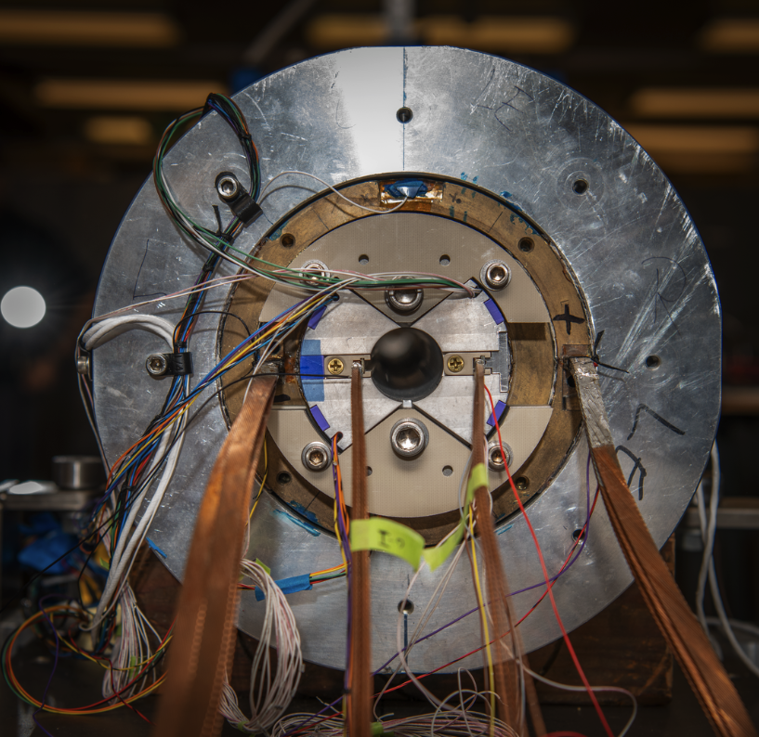
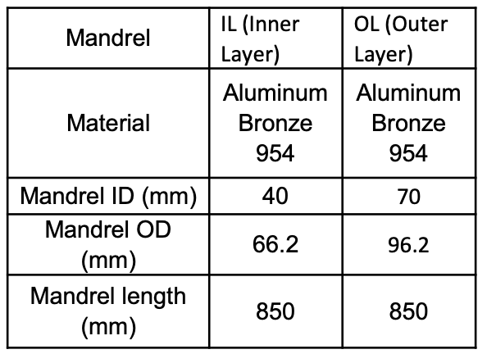
Hybrid testing will allow “rapid” exploration of HTS at high field
First hybrid magnet at LBNL will incorporate Bi2212 C1 in the CCT5 Nb3Sn dipole – ready for testing

Slide 30
Budget considerations and priorities
GARD is under stress – budget reductions in 2025-2026, likely in 2027
Our focus is on:
Prioritizing key results that can impact HEP strategy
Demonstrating relevance of our work to existing and potential projects
Maintaining expertise and facilities
Leverage synergistic opportunities

Slide 31
Community engagement
Despite tight budgets (including travel), we have been actively engaged in the international community since the Collaboration Meeting
Enabling the discovery of QCD Axion Dark Matter at the GUT scale, May 7-9, LBNL
US-Japan Symposium 2025, May 12-14, Sapporo, Japan
IMCC and MuCol annual meeting, May 12-16, Hamburg, Germany
FCC Week, May 19-23, Vienna, Austria
16th International Heavy Ion Conference, HIAT2025, East Lansing, MI
Open Symposium on the European strategy for Particle Physics, Venice, Italy
MT29, July 1-6, Boston, MA
US Muon Collider Accelerator School & 2nd Annual USMCC, Aug 3-8, FNAL
2025 North American Particle Accelerator Conference (NAPAC 25), Aug. 10-15, Sacramento
ICIS 2025 (International conference on Ion Sources), Oxford, UK
International Workshop on Fixed Field Alternating gradient accelerators, London, UK
17th European Conference on Applied Superconductivity / EuCAS 2025, Porto, Portugal
2nd High Temperature superconductors for Accelerator Technology (HiTAT) Workshop, Oct. 23-24, CERN (remote)

Slide 32
Backup

Slide 33


Early Development of Nb3Sn CCT Magnets was Carried out on ~10T, 90 mm aperture, 2 layer dipoles
Magnets designed with short sample limit at 4.5 K at ~ 10 T
Magnets have a 90 mm clear bore
Initial focus was on technology development
Efficient Mandrel Machining and optimization of groove geometry (critical to accommodate relative length change between cable and mandrel)
Winding Methods
Lead splicing
Instrumentation
Coil / Magnet impregnation
Assembly
Three magnets in this series were fabricated CCT3/4/5

Slide 34








Stress-managed CCT magnets towards progressively higher field
MDP program has focused on developing CCT magnet technology and pushing towards higher field and larger apertures
Design and prototyping in progress
Target: 12-14 T in 120 mm aperture
D. Arbelaez, IEEE Trans. Appl. Supercond., Vol. 32, No. 6, Sep. 2022, 4003207.
L. Brouwer, IEEE Trans. Appl. Supercond., Vol. 32, No. 6, Sep. 2022, 4001805.
Subscale Magnet Program
CCT 5
Tested in 2019
Trained to 8.5 T in 90 mm aperture (9.8 T predicted SSL)
Inform decisions on design and impregnation choices with strong focus on training reduction

Slide 35



Description of Subscale CCT Program
In 2019, sub-scale CCT magnets program launched
Fast turn-around for training and material studies
5.4 T in 50 mm aperture, 711 mm length
High current density + optimized design → training representative of larger 10 T magnets
Sub-scales test history
Sub2-5: similar training performance as CC5
Sub6 and Sub7: outstanding results training-free with wax and nearly training-free with filled wax
Parameter | Value
Bore Diameter [mm] | 50
Outer Diameter [mm] | 133
Length [mm] | 711
Strand type | RRP 132/169
Strand diameter [mm] | 0.6
Cable width [mm] | 4.0
Cable thickness [mm] | 1.1
Number of strands | 11
Short sample current [kA] | 9.1 / 9.5 *
Short sample bore field [T] | 5.2 / 5.4 *
Short sample peak field [T] | 6.4 / 6.6 *
* Earlier magnets used conductor with slightly lower SSL
Sub2: Mix-61
Sub3: Mix-61 thick spar
Sub4: CTD 701x
Sub5: Wax IL/Mix-61 OL
Sub6: Wax
Sub7: Filled Wax

Slide 36





Design Overview and Parameters
Magnet Parameters
2-Layer CCT
21 strand cable (MQXF strand)
Bore diameter: 90 mm
Aluminum Shell
External yoke
Magnet length: 1 m
Magnet cable parameters
CCT5W Layout
Yoke Iron laminations
Layer 1
Load Line*
Layer 2
Magnet main dimensions
Aluminum shell
Yoke rods
Transverse rods
*SSL based on extracted strand witness samples measured at 4.2 K

Slide 37







Shim Angle Analysis
CCT5-W FE model
FE model developed to determine required shim angle
Objective is to ensure that the shim covers any areas where cable has outward radial motion
Contact between cable and channel is modeled as non-bonded
Shim angle of α = 2x76° was selected
Radial Motion during Powering
Layer 1
With shim lines
Layer 2
With shim lines
Smartshim
$$α$$
FE model by G. Vallone

Slide 38


CCT5W Mandrel Machining and Winding
Mandrels machined using a 3-axis operation at LBNL main machine shop
Groove and splice feature machining time is approximately 1 week

Slide 39


CCT5W Coil Winding
Coils are wound by hand with light tension (applied by hand)
Voltage tap flags are inserted after making small cuts in the glass braid
Voltage tap flags

Slide 40




CCT5W Coil Reaction
Coils are wrapped in perforated stainless-steel sheets for reaction
Additional space in pole region accommodates differences between cable and mandrel thermal expansion
Voltage tap trace connections and splicing operations are performed after heat treatment

Slide 41




CCT5W Coil Impregnation
Individual coil impregnation performed as with CCT5
New (more porous) peel ply and flow media used for impregnation with fillers
Impregnation Layers
Mandrel
Glass Tape Wrap
Peel Ply
Flow Media
Vacuum Bag / Shrink Tape
New peel ply
New flow media

Slide 42




CCT5W Coil Assembly
Epoxy-filled Kapton bladders (smartshims) create the interface between layers 1 and 2 and layer 2 and the aluminum shell
Inter-layer quench antennas are included between layers 1 and 2 (developed by R. Teyber and designed for CCT5W by E. Buron)

Slide 43

Stronger persistent-current effect at 77 K than at 4.2 K in the normal sextupole, b₃
Different from C2
-11 units at 4.2 K
-33 units at 77 K

Slide 44


Detailed fiberoptic strain data was gathered throughout the tests
Strain measured via distributed optical fiber sensing
Lots of data to analyze!
L. Luo, https://doi.org/10.1088/1361-6668/adba98
Midplane
Pole
Midplane

