Slide 1
Muon Collider Strategy and Coordination
S. Gourlay/M. Palmer
TAC
October 31, 2025

Slide 2
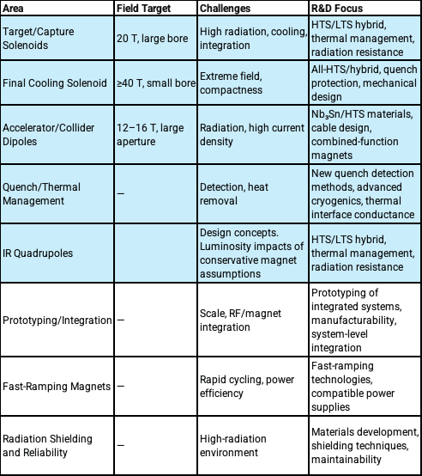
Muon Collider Magnet challenges and overlap with MDP
These areas highlight the significant technical challenges and the innovative approaches required to support the development of a muon collider, focusing on both the high-performance demands of the magnets and the integration into the broader collider system.

Slide 3
Exploit synergies
International Muon Collider Collaboration
Rapidly growing private fusion development
  Possible funding opportunities
  Our program should be complementary to private development
Strong coupling to high-field user magnet program at MagLab
For guidance
  US Muon Collider Collaboration
  National Lab Accelerator Study Group for the Muon Collider
    Possible LDRD funding?

Slide 4

National Lab Accelerator Study Group for a Muon Collider
Study Group Membership composed of representatives of DOE National Labs with Accelerator Facilities
Argonne: Philippe Piot, ppiot@anl.gov
Berkeley: Jean-Luc Vay JLVay@lbl.gov
Brookhaven: Steve Peggs, peggs@bnl.gov
Fermi: Steve Gourlay (Chair), sgourlay@fnal.gov
JLab: Robert Rimmer, rarimmer@jlab.org
Los Alamos: Steve Russel, srussell@lanl.gov
Oak Ridge: Fulvia Pilat, pilatfc@ornl.gov
SLAC: Emilio Nanni, nanni@slac.stanford.edu
Scientific Secretary: Diktys Stratakis, USMCC, diktys@fnal.gov
S. Gourlay
October 27, 2025

Slide 5
Charge to the National Lab Accelerator Study Group for a Muon Collider
Charge to the National Lab Accelerator Study Group for a Muon Collider
The purpose of this study group is to:
Identify the key accelerator challenges that must be addressed to enable the realization of a 10 TeV Muon Collider;
Evaluate the R&D steps, including demonstrations, simulation and software tools, and facility capabilities required to address these challenges;
Provide a technically-informed, bounded estimate of the time required to complete each major R&D category, recognizing that these estimates will inform — but not constitute — a full collider development plan; and
Assess the capabilities and roles of U.S. national laboratories in contributing to these critical areas.

Slide 6
Charge to the National Lab Accelerator Study Group for a Muon Collider
The study should build on existing U.S. and International Muon Collider Collaboration (IMCC) R&D planning documents, critically evaluating them to identify areas of alignment, overlap, and gaps that require further attention. This includes technical gaps, infrastructure needs, and coordination challenges.
The group is not tasked with developing a full collider concept or roadmap, but rather with clarifying and prioritizing the foundational technical work needed over the next decade. The resulting estimates and findings should serve as inputs for a coordinated, evolving timeline for muon collider R&D.
Strong emphasis should be placed on coordination across U.S. national labs, as well as alignment with international efforts, to ensure that the U.S. program is both complementary and high impact in the global context.
The study group is expected to deliver a written report by July 1, 2026.

Slide 7
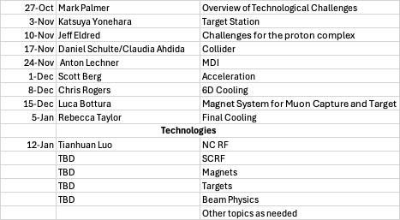
Seminar Series
Preliminary Presentation Schedule
Monday’s at 11:00 Central time
Jointly organized with USMCC
Talks will be recorded unless otherwise requested
Posted on Indico
AI Summary

Slide 8
Next Meeting
The second meeting of this series will take place at 11am Central time on Monday Nov 3rd and will be dedicated to the Target/Capture system design challenges and R&D.
https://indico.muoncollider.us/event/2/
Join Zoom Meeting
https://fnal.zoom.us/j/98844855305?pwd=ptQTvWa7EQytkA2oaorVp22blVPkfq.1&jst=2
Meeting ID: 988 4485 5305
Passcode: 483977

