Slide 1

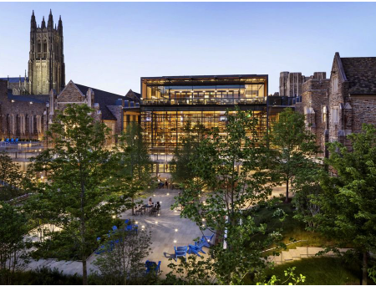
Respecting the boundaries: Space-filling designs for surrogate modeling with boundary information
Simon Mak
Duke University
Joint work with Yen-Chun Liu (Duke), Hendrik Roch and Chun Shen (Wayne State)

Slide 2
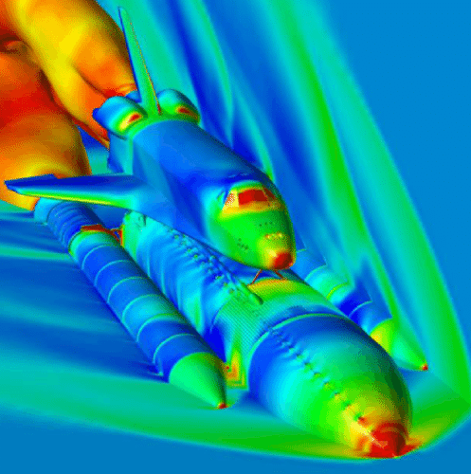
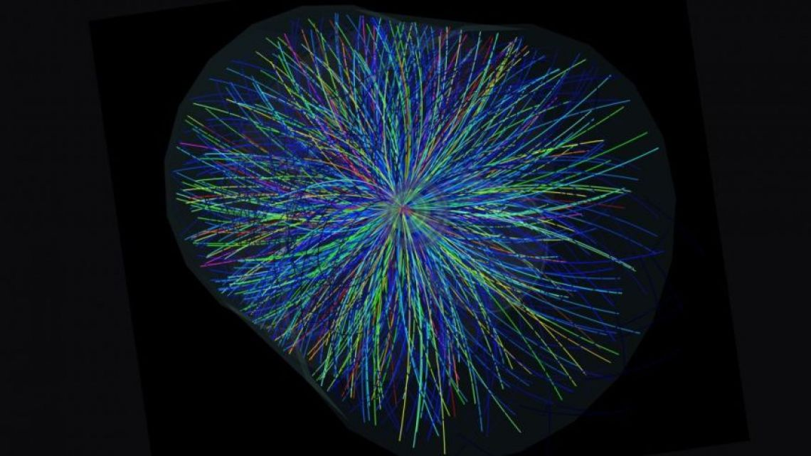
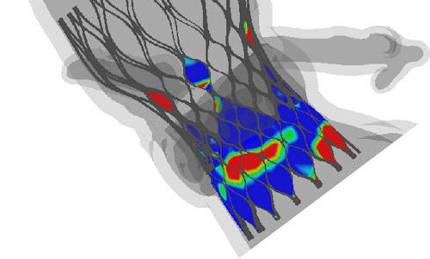
Computer experiments
Complex phenomena can be virtually simulated via computer code
Rocket propulsion
Mak et al. (2018), Yeh et al. (2018), Chang et al. (2019, 2021), Zhang et al. (2022)
High-energy physics
Everett et al. (2021), Liyanage et al. (2022), Ji et al. (2023a,b), Li et al. (2024, 2025)
Aortic valves
Chen et al., (2020, 2021)
Computer experiments widely used as proxies for physical experiments (expensive, unethical, or impossible!)
However, the more complex the phenomena, the more time-consuming the simulations!

Slide 3
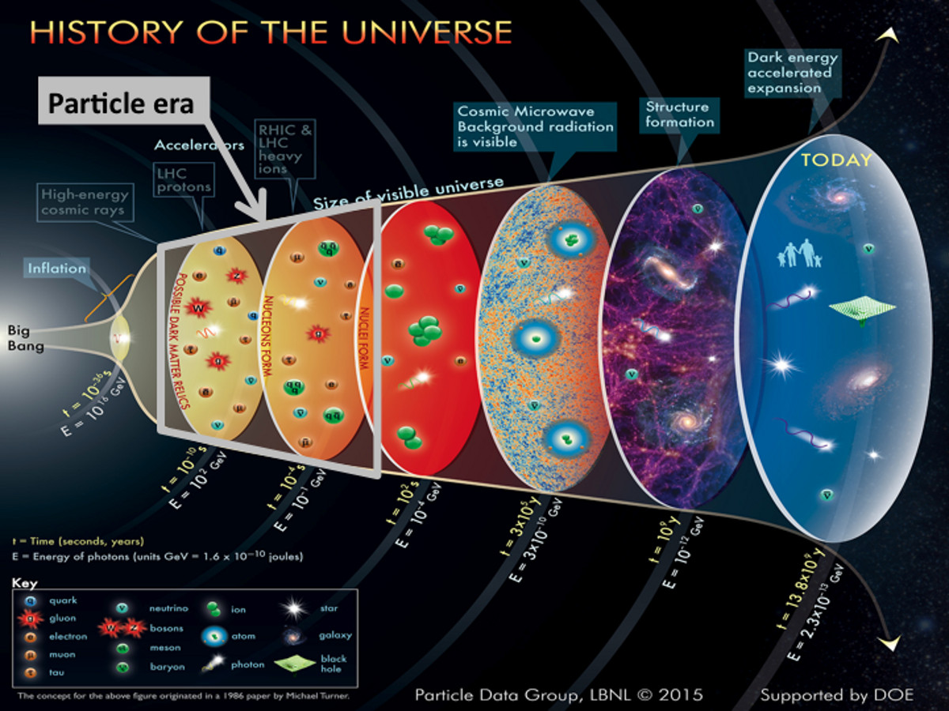



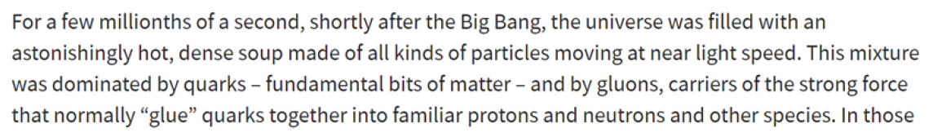
Quark-gluon plasma
Quark-gluon plasma (QGP) in universe formation:

Slide 4
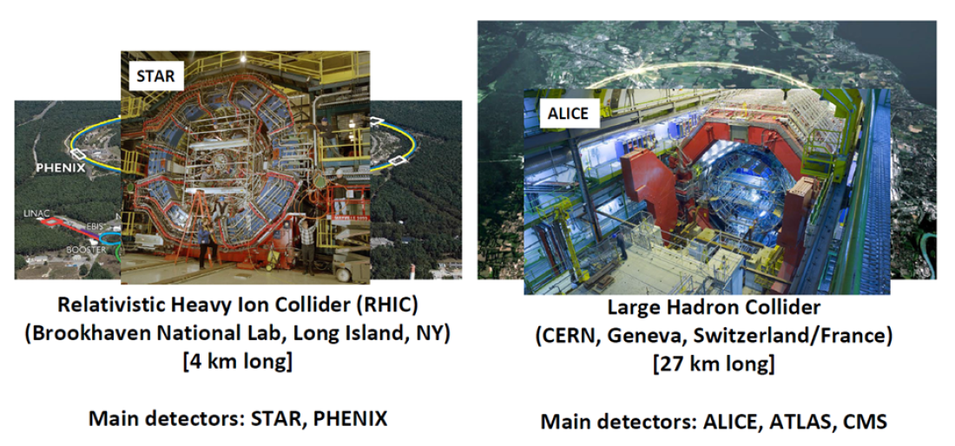


Particle collider experiments
Parameters $x$
Parameter calibration
Particle collider simulator
QGP observable $f\left(x\right)$
Experimental data

Slide 5
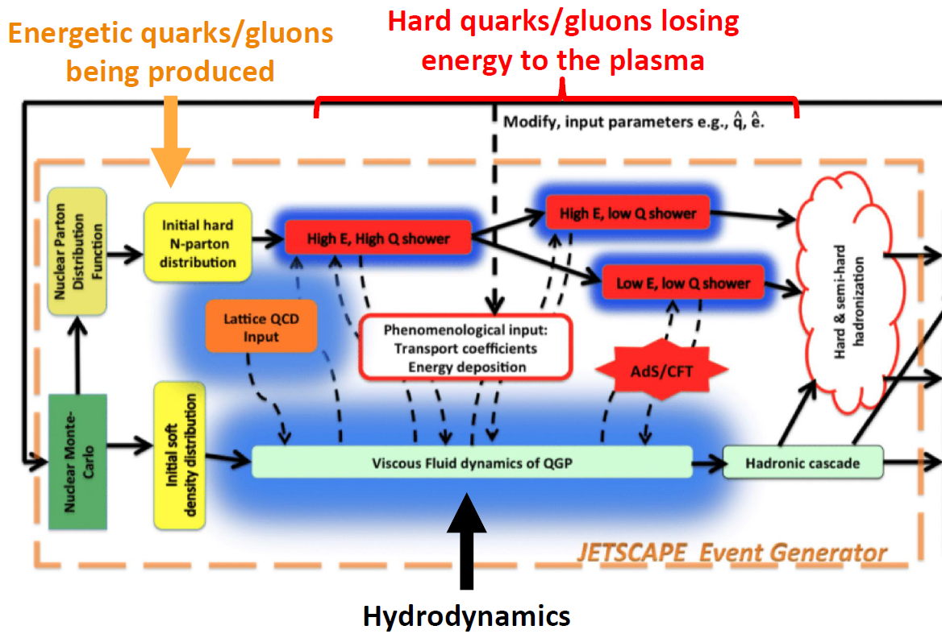


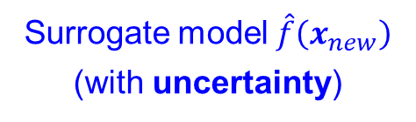
Particle collider experiments
Parameters $x$
Particle collision simulator:
Key bottlenecks:
Expensive: $𝒪({10}^{4})$ CPU hours / simulation run
High-dimensional parameter space (~20-dim.)
Many simulations of $f\left(x\right)$ needed for parameter calibration in this high-dim. space
Enter Bayesian surrogate modeling
Particle collider simulator
Surrogate model $\hat{f}\left(x_{new}\right)$
(with uncertainty)
Computationally expensive (${10}^{4}$ CPU hours / evaluation)!
QGP observable $f\left(x\right)$
Ji et al. (2024 JUQ), Tang et al. (2024 JUQ), Chen et al. (2024 JASA), Li et al. (2025 JASA, 2025 JCGS)

Slide 6
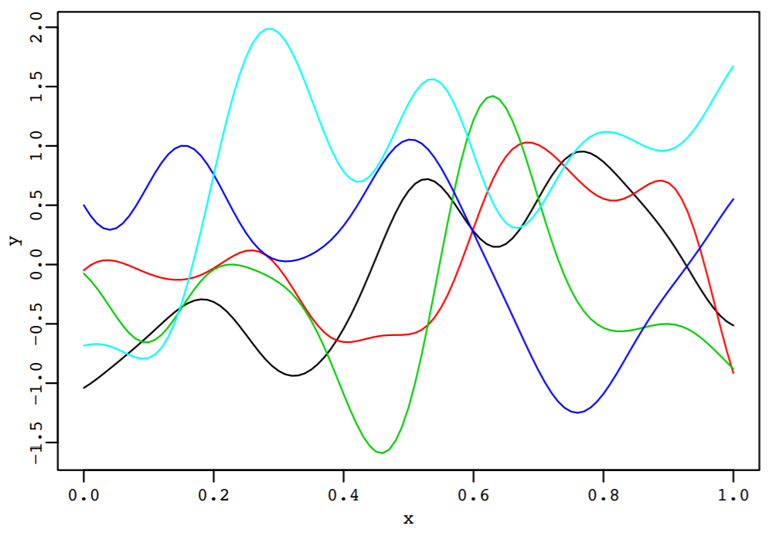
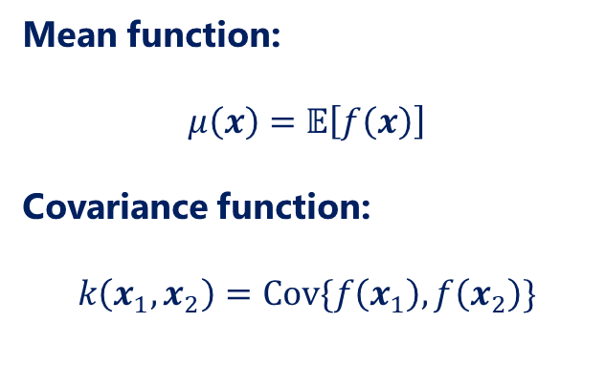
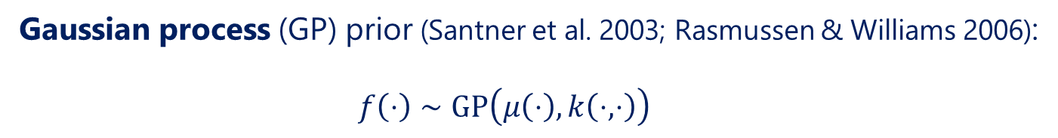
Gaussian processes
Gaussian process (GP) prior (Santner et al. 2003; Rasmussen & Williams 2006):
  $$f\left(⋅\right)∼GP\left(μ\left(⋅\right),k\left(⋅,⋅\right)\right)$$
Mean function:
$$μ\left(x\right)=𝔼\left[f\left(x\right)\right]$$
Covariance function:
$$k\left(x_{1},x_{2}\right)=Cov\{f\left(x_{1}\right),f\left(x_{2}\right)\}$$
Flexible Bayesian nonparametric model for predictive modeling

Slide 7
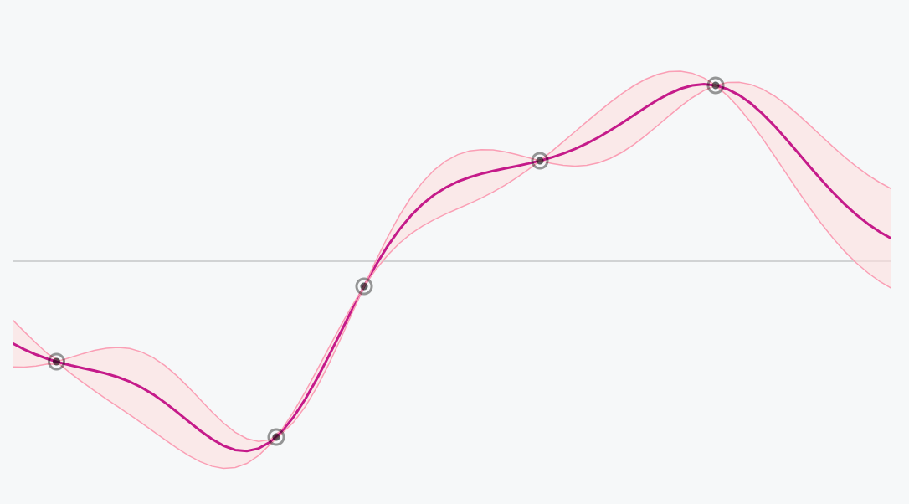
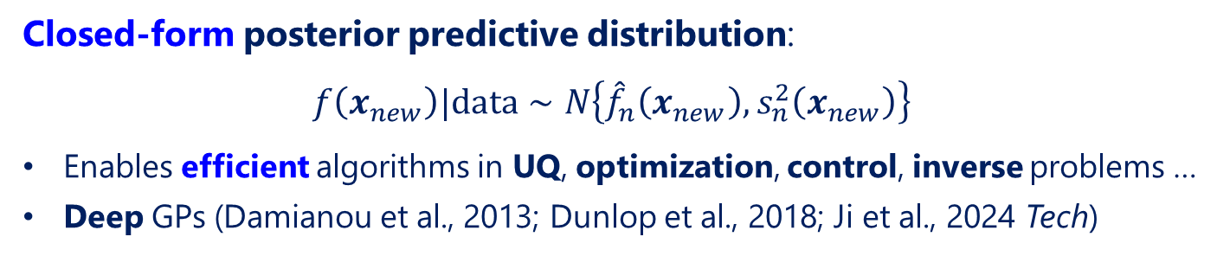



Gaussian processes
Prediction
$$\hat{f_{n}}(x_{new})$$
Data
Uncertainty
$$s_{n}\left(x_{new}\right)$$
Input
$$x_{new}$$
Closed-form posterior predictive distribution:
$$f\left(x_{new}\right)|data∼N\left\{{\hat{f}}_{n}\left(x_{new}\right),s_{n}^{2}\left(x_{new}\right)\right\}$$
Enables efficient algorithms in UQ, optimization, control, inverse problems …
Deep GPs (Damianou et al., 2013; Dunlop et al., 2018; Ji et al., 2024 Tech)

Slide 8
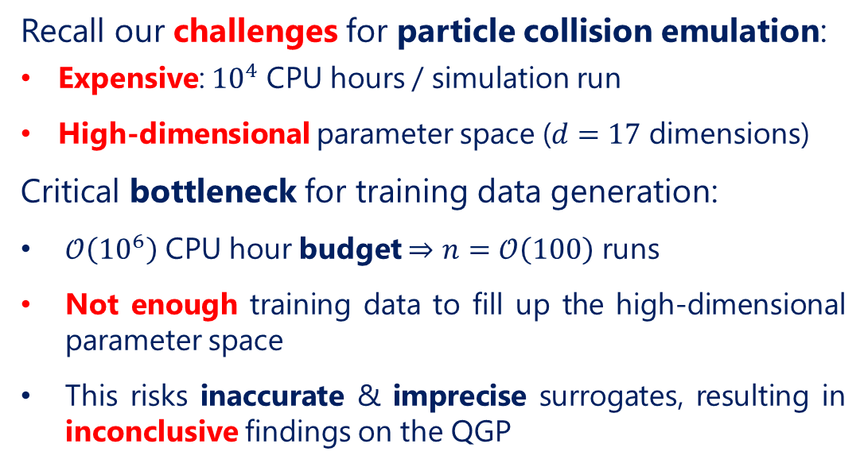


Challenges
Parameters $x$
Recall our challenges for particle collision emulation:
Expensive: ${10}^{4}$ CPU hours / simulation run
High-dimensional parameter space ($d=17$ dimensions)
Critical bottleneck for training data generation:
$𝒪\left({10}^{6}\right)$ CPU hour budget $⇒$ $n=𝒪\left(100\right)$ runs
Not enough training data to fill up the high-dimensional parameter space
This risks inaccurate & imprecise surrogates, resulting in inconclusive findings on the QGP
Particle collider simulator
QGP observable $f\left(x\right)$

Slide 9
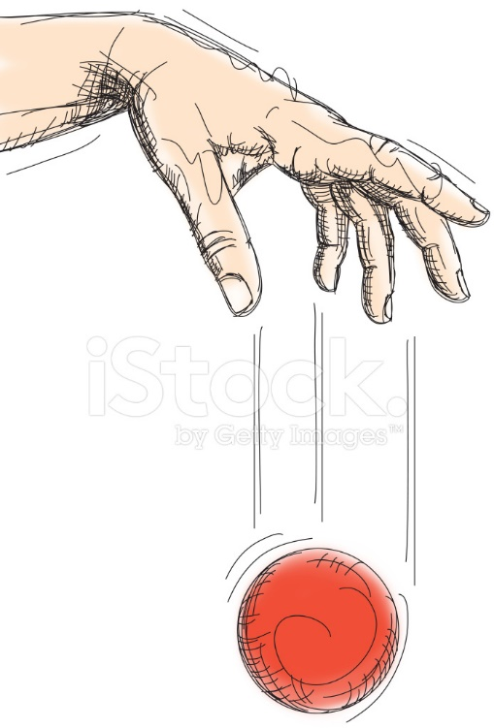
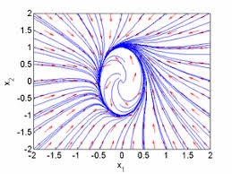
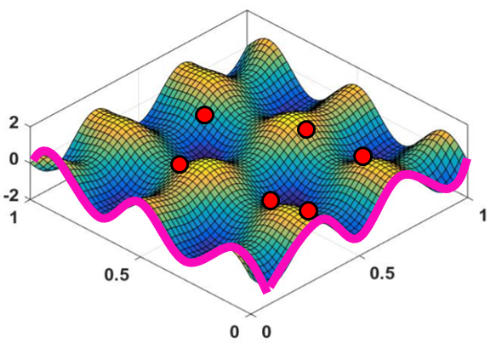

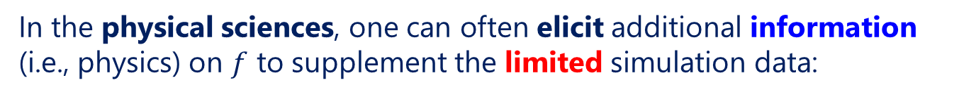


A saving grace
In the physical sciences, one can often elicit additional information (i.e., physics) on $f$ to supplement the limited simulation data:
Mechanistic equations:
  Wheeler et al. (2014), Raissi et al. (2019), etc.
Monotonicity and shape constraints:
  Golchi et al. (2015), Wang & Berger (2016), Maatouk & Bay (2017), Kim & Mak (2025+), etc.
Boundary information:
  Tan (2018), Ding et al. (2019), Vernon et al. (2019), Jackson & Vernon (2023), Dalton et al. (2024), Ding et al. (2025+), etc.
$$f(x)$$
$$x_{2}$$
$$x_{1}$$
Incorporating such information for surrogate modeling allows for improved predictions and interpretable scientific decision-making

Slide 10
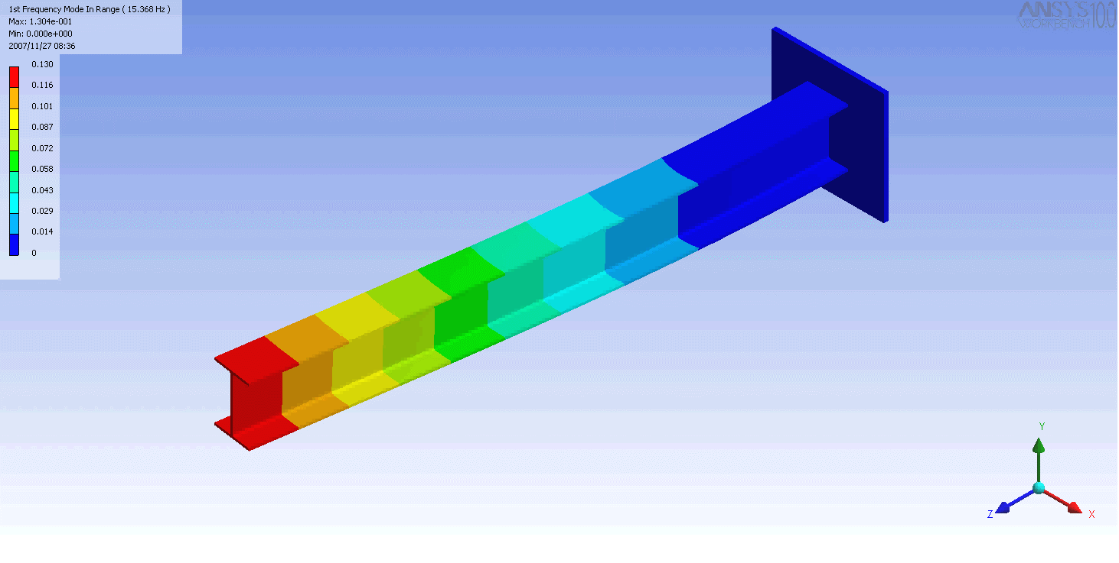
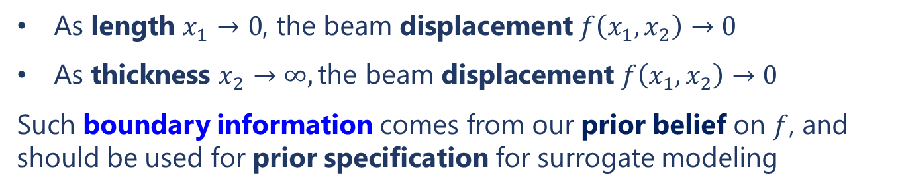



Boundaries as prior information
Consider the bending of a beam under a fixed external force
$$x_{2}$$
$$x_{1}$$
$$f(x_{1},x_{2})$$
As length $x_{1}→0$, the beam displacement $f\left(x_{1},x_{2}\right)→0$
As thickness $x_{2}→∞,\text{the} \text{beam} \text{displacement} f\left(x_{1},x_{2}\right)→0$
Such boundary information comes from our prior belief on $f$, and should be used for prior specification for surrogate modeling

Slide 11
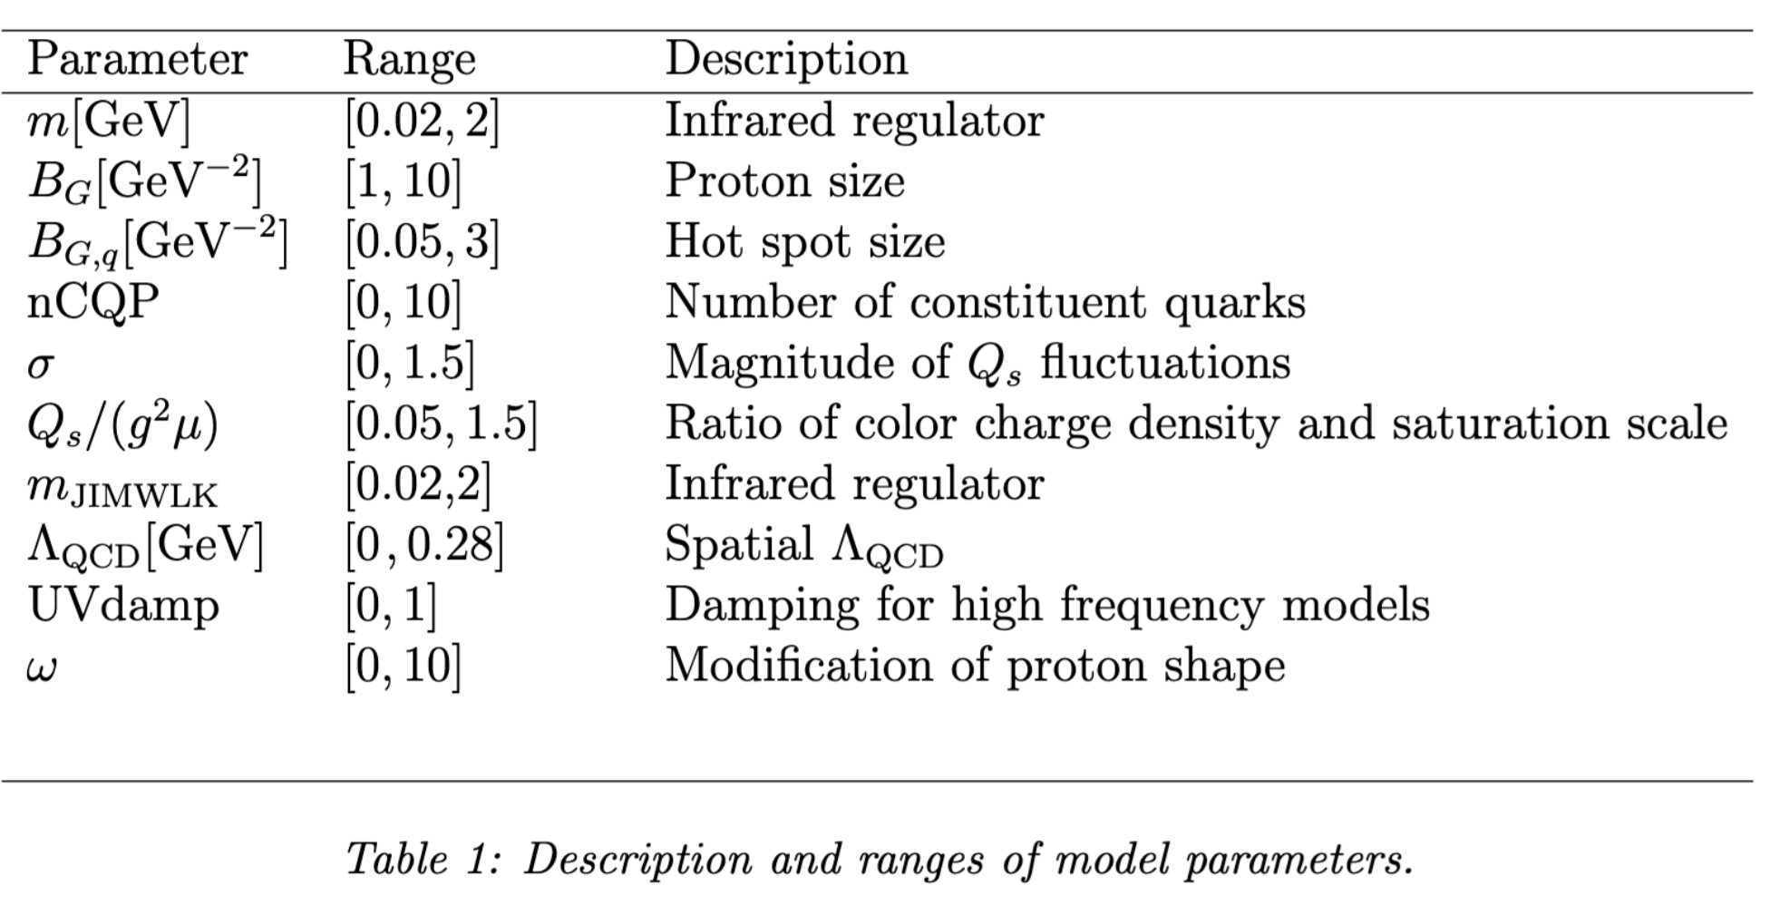
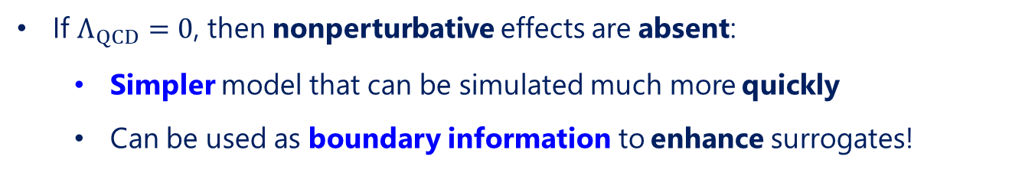


Boundaries as prior information
Our application: emulating particle collisions
$$⋯$$
$Λ_{QCD}$: threshold below which nonperturbative effects become important
If $Λ_{QCD}=0$, then nonperturbative effects are absent:
  Simpler model that can be simulated much more quickly
  Can be used as boundary information to enhance surrogates!

Slide 12
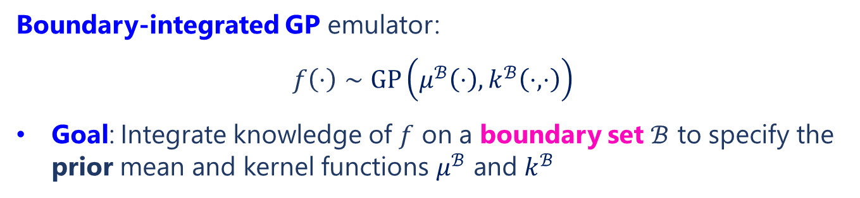
Boundary information
Boundary-integrated GP emulator:
$$f\left(⋅\right)∼GP\left(μ^{ℬ}\left(⋅\right),k^{ℬ}\left(⋅,⋅\right)\right)$$
Goal: Integrate knowledge of $f$ on a boundary set $ℬ$ to specify the prior mean and kernel functions $μ^{ℬ}$ and $k^{ℬ}$
+ Training data
Known boundaries

Slide 13
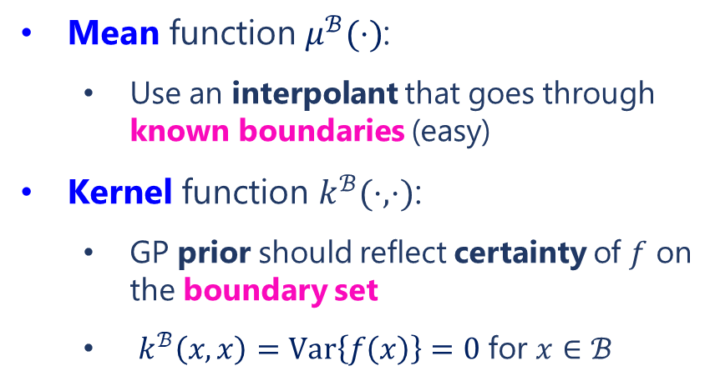
Boundary information
Boundary-integrated GP emulator:
$$f\left(⋅\right)∼GP\left(μ^{ℬ}\left(⋅\right),k^{ℬ}\left(⋅,⋅\right)\right)$$
Goal: Integrate knowledge of $f$ on a boundary set $ℬ$ to specify the prior mean and kernel functions $μ^{ℬ}$ and $k^{ℬ}$
Mean function $μ^{ℬ}(⋅)$:
  Use an interpolant that goes through known boundaries (easy)
Kernel function $k^{ℬ}(⋅,⋅)$:
  GP prior should reflect certainty of $f$ on the boundary set
  $k^{ℬ}\left(x,x\right)=Var\left\{f\left(x\right)\right\}=0$ for $x∈ℬ$

Slide 14
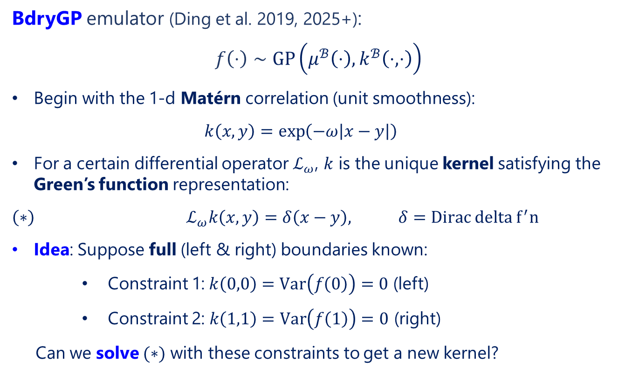
BdryGP
BdryGP emulator (Ding et al. 2019, 2025+):
$$f\left(⋅\right)∼GP\left(μ^{ℬ}\left(⋅\right),k^{ℬ}\left(⋅,⋅\right)\right)$$
Begin with the 1-d Matérn correlation (unit smoothness):
  $$k\left(x,y\right)=\exp\left(−ω\left|x−y\right|\right)$$
For a certain differential operator $ℒ_{ω}$, $k$ is the unique kernel satisfying the Green’s function representation:
$$\left(∗\right) ℒ_{ω}k\left(x,y\right)=δ\left(x−y\right), δ=Dirac delta f^{′}n$$
Idea: Suppose full (left & right) boundaries known:
    Constraint 1: $k\left(0,0\right)=Var\left(f\left(0\right)\right)=0$ (left)
    Constraint 2: $k\left(1,1\right)=Var\left(f\left(1\right)\right)=0$ (right)
Can we solve $(∗)$ with these constraints to get a new kernel?

Slide 15
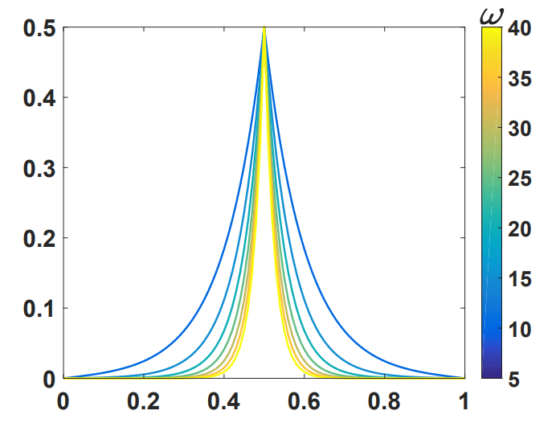


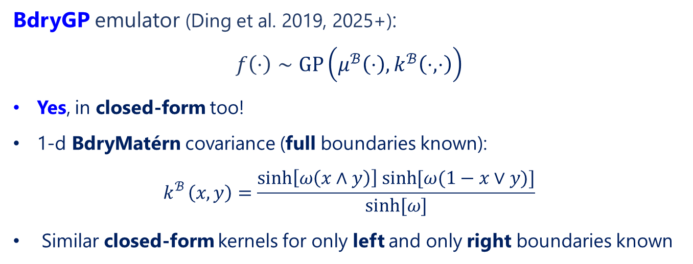
BdryGP
BdryGP emulator (Ding et al. 2019, 2025+):
$$f\left(⋅\right)∼GP\left(μ^{ℬ}\left(⋅\right),k^{ℬ}\left(⋅,⋅\right)\right)$$
Yes, in closed-form too!
1-d BdryMatérn covariance (full boundaries known):
$$k_{}^{ℬ}\left(x,y\right)=\frac{sinh\left[ω\left(x∧y\right)\right] sinh[ω(1−x∨y)]}{sinh[ω]}$$
Similar closed-form kernels for only left and only right boundaries known
$$k_{}^{ℬ}\left(x,x\right)=Var\left\{f(x)\right\}$$
$$x$$

Slide 16
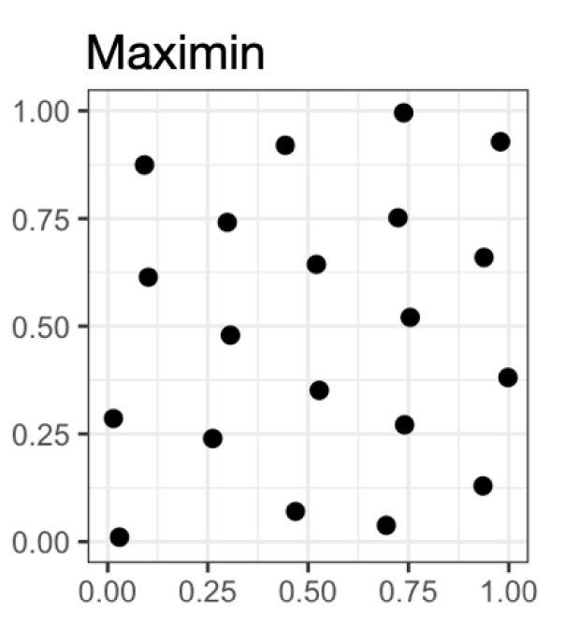



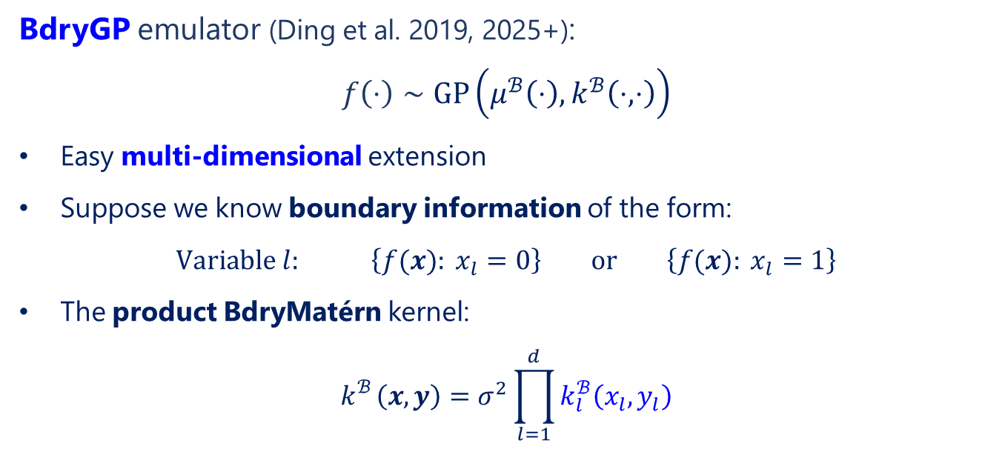

BdryGP
BdryGP emulator (Ding et al. 2019, 2025+):
$$f\left(⋅\right)∼GP\left(μ^{ℬ}\left(⋅\right),k^{ℬ}\left(⋅,⋅\right)\right)$$
Easy multi-dimensional extension
Suppose we know boundary information of the form:
$$Variable l: \left\{f(x): x_{l}=0\right\} or \left\{f(x): x_{l}=1\right\}$$
The product BdryMatérn kernel:
$$k_{}^{ℬ}\left(x,y\right)=σ^{2}\prod_{l=1}^{d}{k_{l}^{ℬ}\left(x_{l},y_{l}\right)}$$
$$x_{1}=0$$
$$k_{1}^{ℬ}$$
$$x_{2}=0$$
$$k_{2}^{ℬ}$$

Slide 17
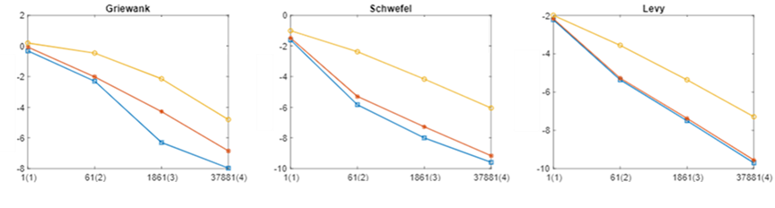

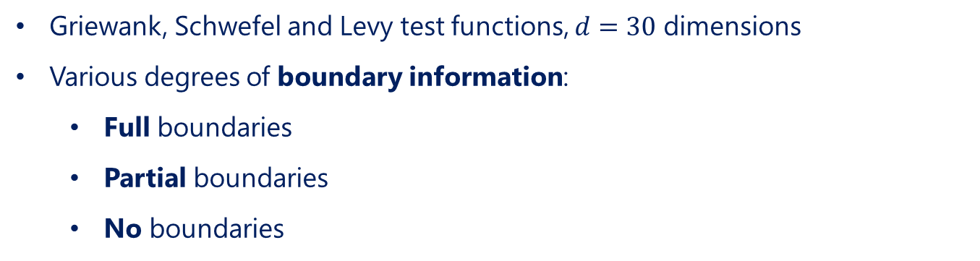

BdryGP
BdryGP emulator (Ding et al. 2019, 2025+):
$$f\left(⋅\right)∼GP\left(μ^{ℬ}\left(⋅\right),k^{ℬ}\left(⋅,⋅\right)\right)$$
Griewank, Schwefel and Levy test functions, $d=30$ dimensions
Various degrees of boundary information:
  Full boundaries
  Partial boundaries
  No boundaries
Griewank
Schwefel
Levy
Log-RMSE
Log-RMSE
Log-RMSE
Sample size
Sample size
Sample size
All models are trained on the same dataset
Considerably better predictions with boundary information incorporated

Slide 18
Experimental design
A careful experimental design that respects known boundaries can further enhance emulator performance:
Model-based designs (Sacks et al. 1989, Currin et al. 1991, etc.):
  Targets an optimality criterion derived from a fully-specified GP model with fixed parameters, i.e., length-scales
  Limitation: GP length-scales are typically unknown prior to data, and its misspecification for design can lead to poor robustness
Space-filling designs (Joseph et al. 2016):
  Model-robust: depends on only distances between design points
  Latin hypercube designs (McKay et al. 1979, etc.)
  Maximin designs (Johnson et al. 1990, Morris & Mitchell 1995, etc.)
  Minimax designs (Johnson et al. 1990, Mak & Joseph 2018, etc.)
  MaxPro designs (Joseph et al. 2015, 2019)

Slide 19

Experimental design
  $$𝒟_{n}^{∗}=argmax_{𝒟 }\min_{x,x^{′}∈𝒟} {\left|\left|x−x^{′}\right|\right|}_{2}$$
$n=20$-point maximin design:
Known boundaries
Suboptimal design points
Standard space-filling designs are suboptimal for boundary-integrated GPs
  Experimental design should respect known boundary information

Slide 20

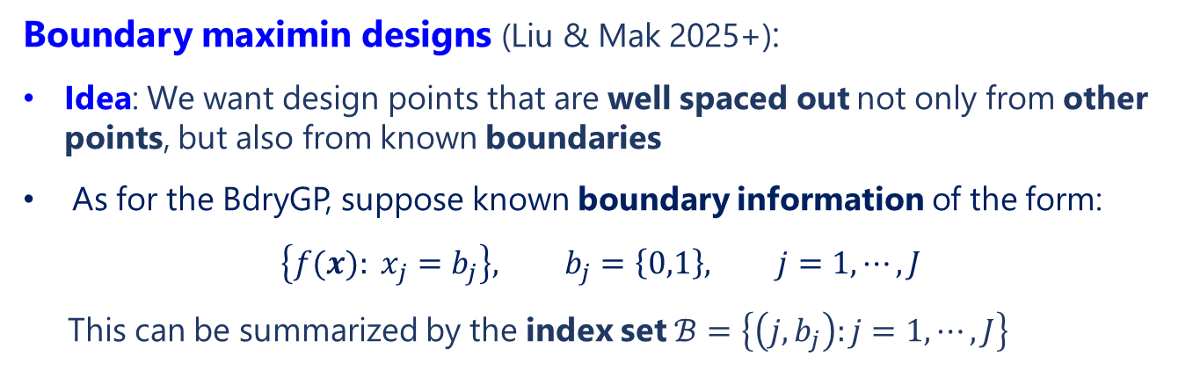
Boundary maximin designs
Boundary maximin designs (Liu & Mak 2025+):
Idea: We want design points that are well spaced out not only from other points, but also from known boundaries
As for the BdryGP, suppose known boundary information of the form:
$$\left\{f(x): x_{j}=b_{j}\right\}, b_{j}=\left\{0,1\right\}, j=1, ⋯, J$$
This can be summarized by the index set $ℬ=\left\{\left(j,b_{j}\right):j=1, ⋯, J\right\}$
Known boundaries
Here, $ℬ=\left\{\left(1,0\right),\left(1,1\right),\left(2,0\right),(2,1)\right\}$

Slide 21

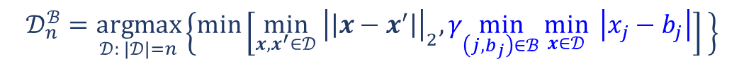
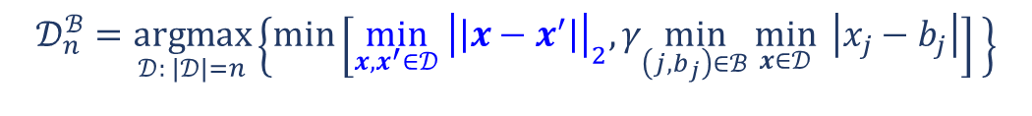
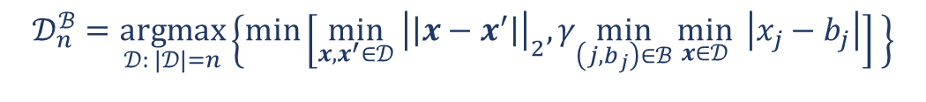
Boundary maximin designs
Boundary maximin designs (Liu & Mak 2025+):
Define the new boundary maximin design as:
  No two design points should be too close together
  No point should be too close to a known boundary
Parameter $γ$ controls the trade-off between design space-fillingness and its distance from known boundaries
  Smaller $γ$ $⇒$ greater emphasis on distance from boundaries
These designs can be optimized via standard design algorithms:
  Exchange-type algorithms (Federov 1972, etc.)
$$𝒟_{n}^{ℬ}=\underset{𝒟: |𝒟|=n}{argmax}\left\{\min\left[\min_{x,x^{′}∈𝒟} {\left|\left|x−x^{′}\right|\right|}_{2},γ\min_{\left(j,b_{j}\right)∈ℬ}\min_{x∈𝒟}{ \left|x_{j}−b_{j}\right|}\right] \right\}$$
$$𝒟_{n}^{ℬ}=\underset{𝒟: |𝒟|=n}{argmax}\left\{\min\left[\min_{x,x^{′}∈𝒟} {\left|\left|x−x^{′}\right|\right|}_{2},γ\min_{\left(j,b_{j}\right)∈ℬ}\min_{x∈𝒟}{ \left|x_{j}−b_{j}\right|}\right] \right\}$$
$$𝒟_{n}^{ℬ}=\underset{𝒟: |𝒟|=n}{argmax}\left\{\min\left[\min_{x,x^{′}∈𝒟} {\left|\left|x−x^{′}\right|\right|}_{2},γ\min_{\left(j,b_{j}\right)∈ℬ}\min_{x∈𝒟}{ \left|x_{j}−b_{j}\right|}\right] \right\}$$

Slide 22
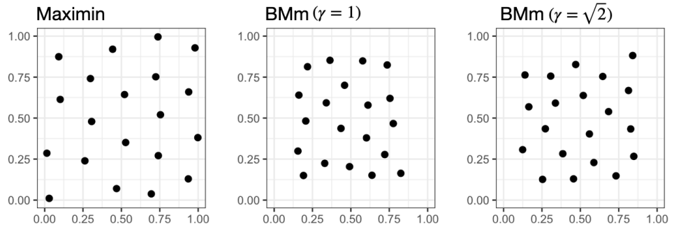
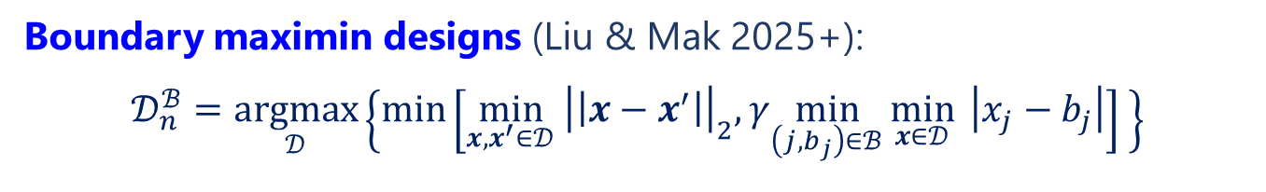
Boundary maximin designs
Boundary maximin designs (Liu & Mak 2025+):
$$𝒟_{n}^{ℬ}=\underset{𝒟}{argmax}\left\{\min\left[\min_{x,x^{′}∈𝒟} {\left|\left|x−x^{′}\right|\right|}_{2},γ\min_{\left(j,b_{j}\right)∈ℬ}\min_{x∈𝒟}{ \left|x_{j}−b_{j}\right|}\right] \right\}$$
Known boundaries
Decreasing $γ$: greater emphasis on boundaries

Slide 23
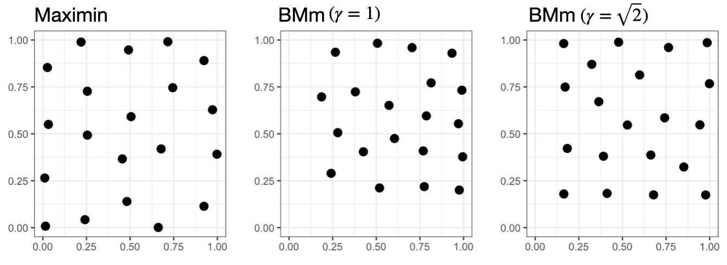
Boundary maximin designs
Boundary maximin designs (Liu & Mak 2025+):
$$𝒟_{n}^{ℬ}=\underset{𝒟}{argmax}\left\{\min\left[\min_{x,x^{′}∈𝒟} {\left|\left|x−x^{′}\right|\right|}_{2},γ\min_{\left(j,b_{j}\right)∈ℬ}\min_{x∈𝒟}{ \left|x_{j}−b_{j}\right|}\right] \right\}$$
Known boundaries
Decreasing $γ$: greater emphasis on boundaries

Slide 24
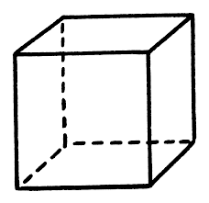


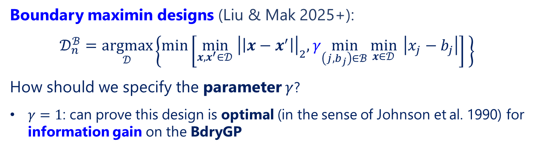
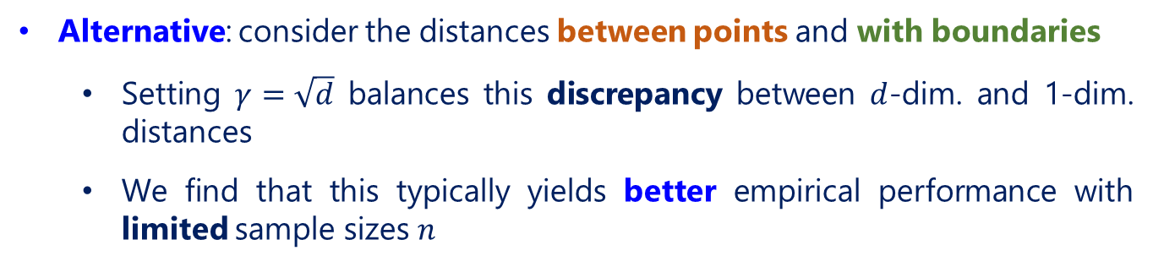
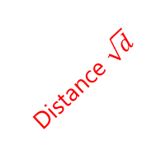
Specifying $γ$
Boundary maximin designs (Liu & Mak 2025+):
$$𝒟_{n}^{ℬ}=\underset{𝒟}{argmax}\left\{\min\left[\min_{x,x^{′}∈𝒟} {\left|\left|x−x^{′}\right|\right|}_{2},γ\min_{\left(j,b_{j}\right)∈ℬ}\min_{x∈𝒟}{ \left|x_{j}−b_{j}\right|}\right] \right\}$$
How should we specify the parameter $γ$?
$γ=1$: can prove this design is optimal (in the sense of Johnson et al. 1990) for information gain on the BdryGP
Alternative: consider the distances between points and with boundaries
  Setting $γ=\sqrt{d}$ balances this discrepancy between $d$-dim. and 1-dim. distances
  We find that this typically yields better empirical performance with limited sample sizes $n$
Distance $\sqrt{d}$
Distances between points (in $d$ dimensions)
Distances with boundaries (in 1 dimension)
Distance 1

Slide 25
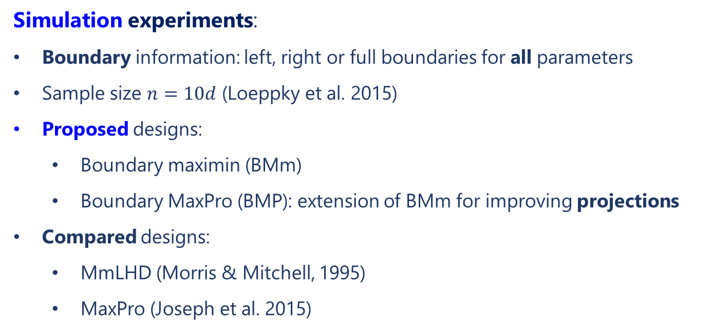
Numerical experiments
Simulation experiments:
Boundary information: left, right or full boundaries for all parameters
Sample size $n=10d$ (Loeppky et al. 2015)
Proposed designs:
  Boundary maximin (BMm)
  Boundary MaxPro (BMP): extension of BMm for improving projections
Compared designs:
  MmLHD (Morris & Mitchell, 1995)
  MaxPro (Joseph et al. 2015)

Slide 26
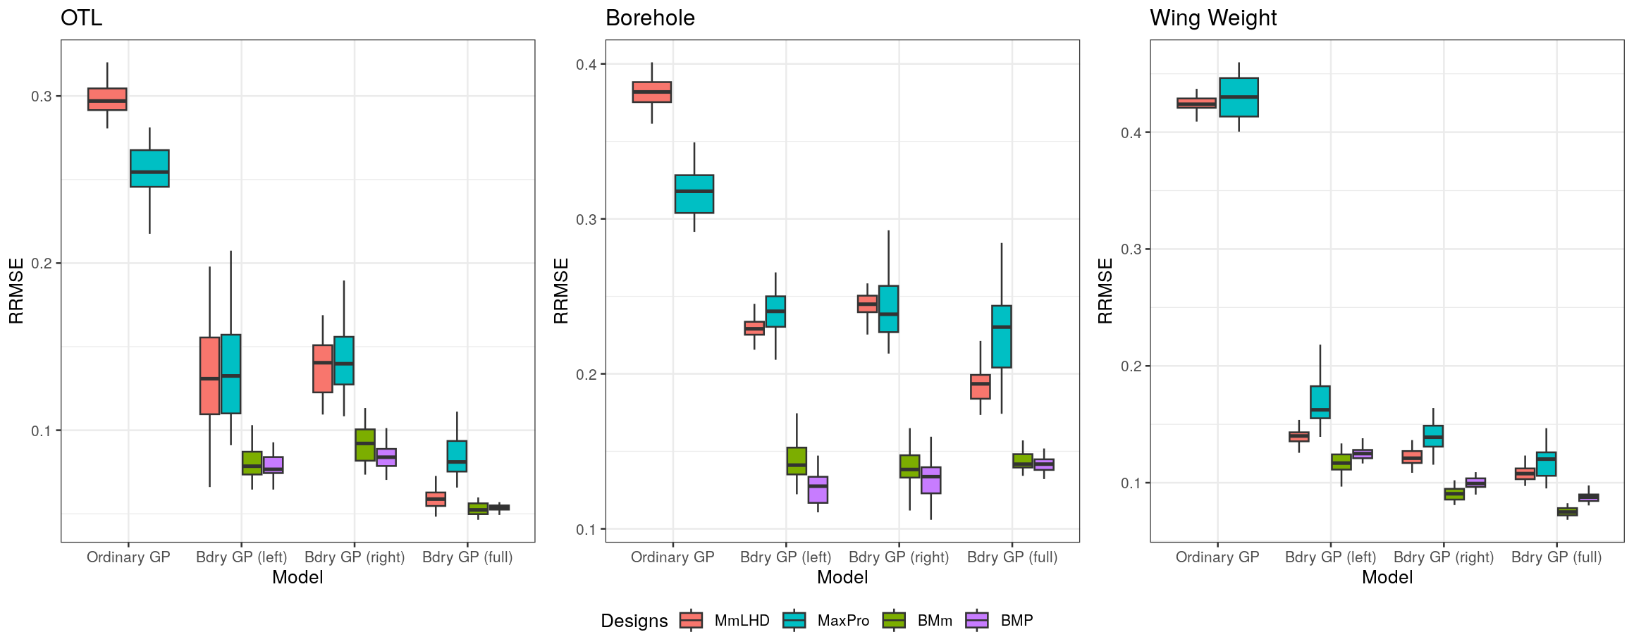

Numerical experiments
Borehole function ($d=8$)
Existing designs,
existing GP (no bdry)
Existing designs, BdryGP
Proposed designs, BdryGP

Slide 27
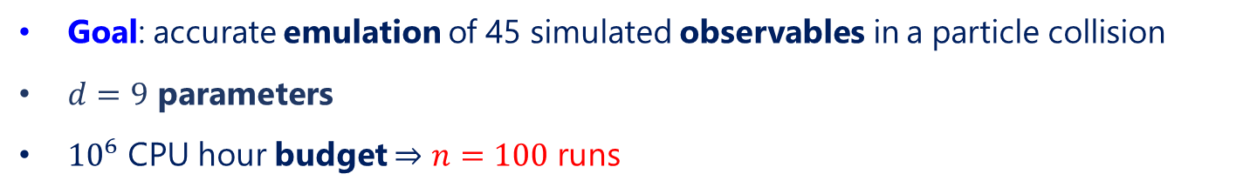
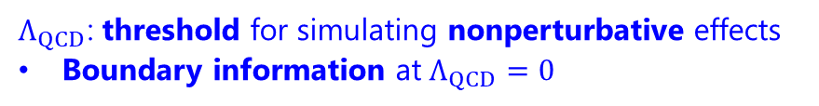
Emulating particle collisions
$Λ_{QCD}$: threshold for simulating nonperturbative effects
Boundary information at $Λ_{QCD}=0$
Goal: accurate emulation of 45 simulated observables in a particle collision
$d=9$ parameters
${10}^{6}$ CPU hour budget $⇒$ $n=100$ runs

Slide 28
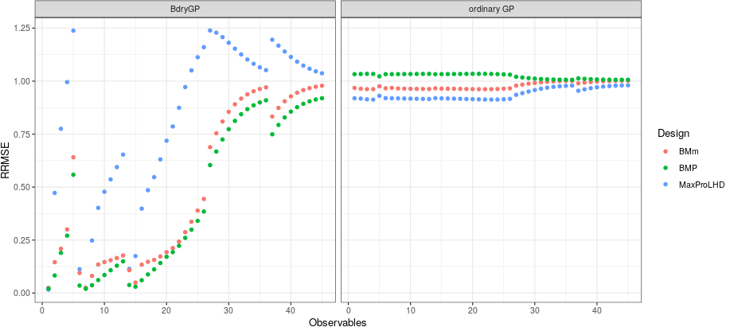
Emulating particle collisions
Our designs
State-of-the-art
A careful experimental design can considerably amplify the benefits of boundary-integrated surrogates!

Slide 29

Questions

