Slide 1
NSD DEI Activities A year in review
Tom Gallant, Chair, NSD DEI Council

Slide 2
Membership changes
Departing Members:
Erika Suzuki, Inaugural Chair
Barbara Jacak
New Members:
Heather Crawford
Mark Bandstra
Current Members
Tom Gallant, Chair
Ernst Sichtermann
Heather Crawford
Mark Bandstra

Slide 3
NSD Staff Meeting DEI Topics
April 30, 2019 – Luminary Card Program
May 14, 2019 – Hearing Resources
Sept. 10, 2019 – 50 Ways to Fight Bias
Oct. 22, 2019 – Inclusive Meetings
Nov. 19, 2019 – Library Services – LGBTQIA Section – Michael Golden
Dec. 3, 2019 – DEI Calendar Included in NSD Staff Meeting Events List
Dec. 17, 2019 – NSD DEI Council Updates
Jan. 14, 2020 – Searches, Bias, and Tools
Jan. 28, 2020 – Nuclear Science Day and Division Outreach
Feb. 11, 2020 – Mental Health Initiative at LBNL
Feb. 25, 2020 – Employee Resource Group Overview
March 10, 2020 – Leanin.org 50 Ways to Fight Bias Cards
March 24, 2020 – Early Career Employee Resource Group
April 7, 2020 – Reducing Social Isolation
April 21, 2020 – Inclusive Meeting Best Practices
May 5, 2020 – Bias in Performance Reviews

Slide 4
Call for DEI Topics
The DEI Council would like to ensure that topics you want discussed are covered. If you have a topic you would like the DEI committee to consider covering, please reach out to any of the members.
Mark Bandstra: MSBandstra@lbl.gov
Heather Crawford: HLCrawford@lbl.gov
Tom Gallant: TGGallant@lbl.gov
Enrst Sichtermann: EPSichtermann@lbl.gov

Slide 5
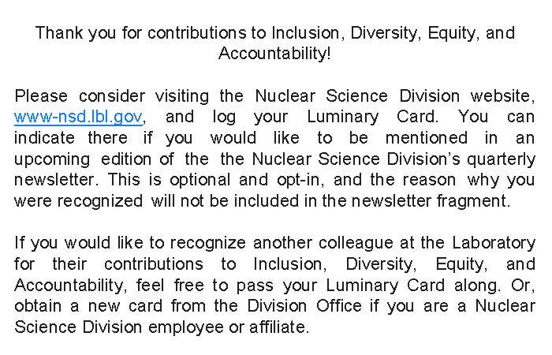
Luminary Card Program – Update
The Luminary Cards are going virtual. To accommodate the Shelter-in-Place, the DEI council has made a PDF version of the Luminary Card available. The virtual cards are available on the Nuclear Science Division website. The premise is the same; send a card to someone to recognize a positive action in support of Inclusion, Diversity, Equity, and Accountability or the work climate in the Division or at the Laboratory.

Slide 6
Luminary Card Program (Cont.)
The virtual cards include a page of instructions to the recipient. All links in the virtual card are clickable. One of the links will take you to a form to log your card. You can indicate your willingness to include your name as a recipient in the NSD Newsletter. The reason for receiving the card will not be included in the newsletter as shown below.
The physical cards will continue to be available in the Division Office.

