Slide 1
Status of Recent Quench Antenna applications at Fermilab for CCT5w and HTS tape
19Nov 2025
Presented by J. DiMarco
work in progress…

Slide 2
CCT5w ‘TAN coil’ QA test

Slide 3
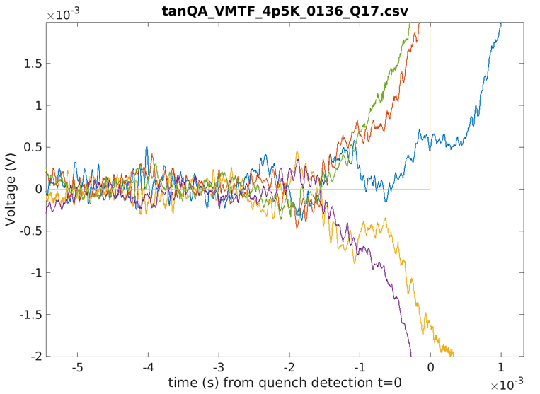
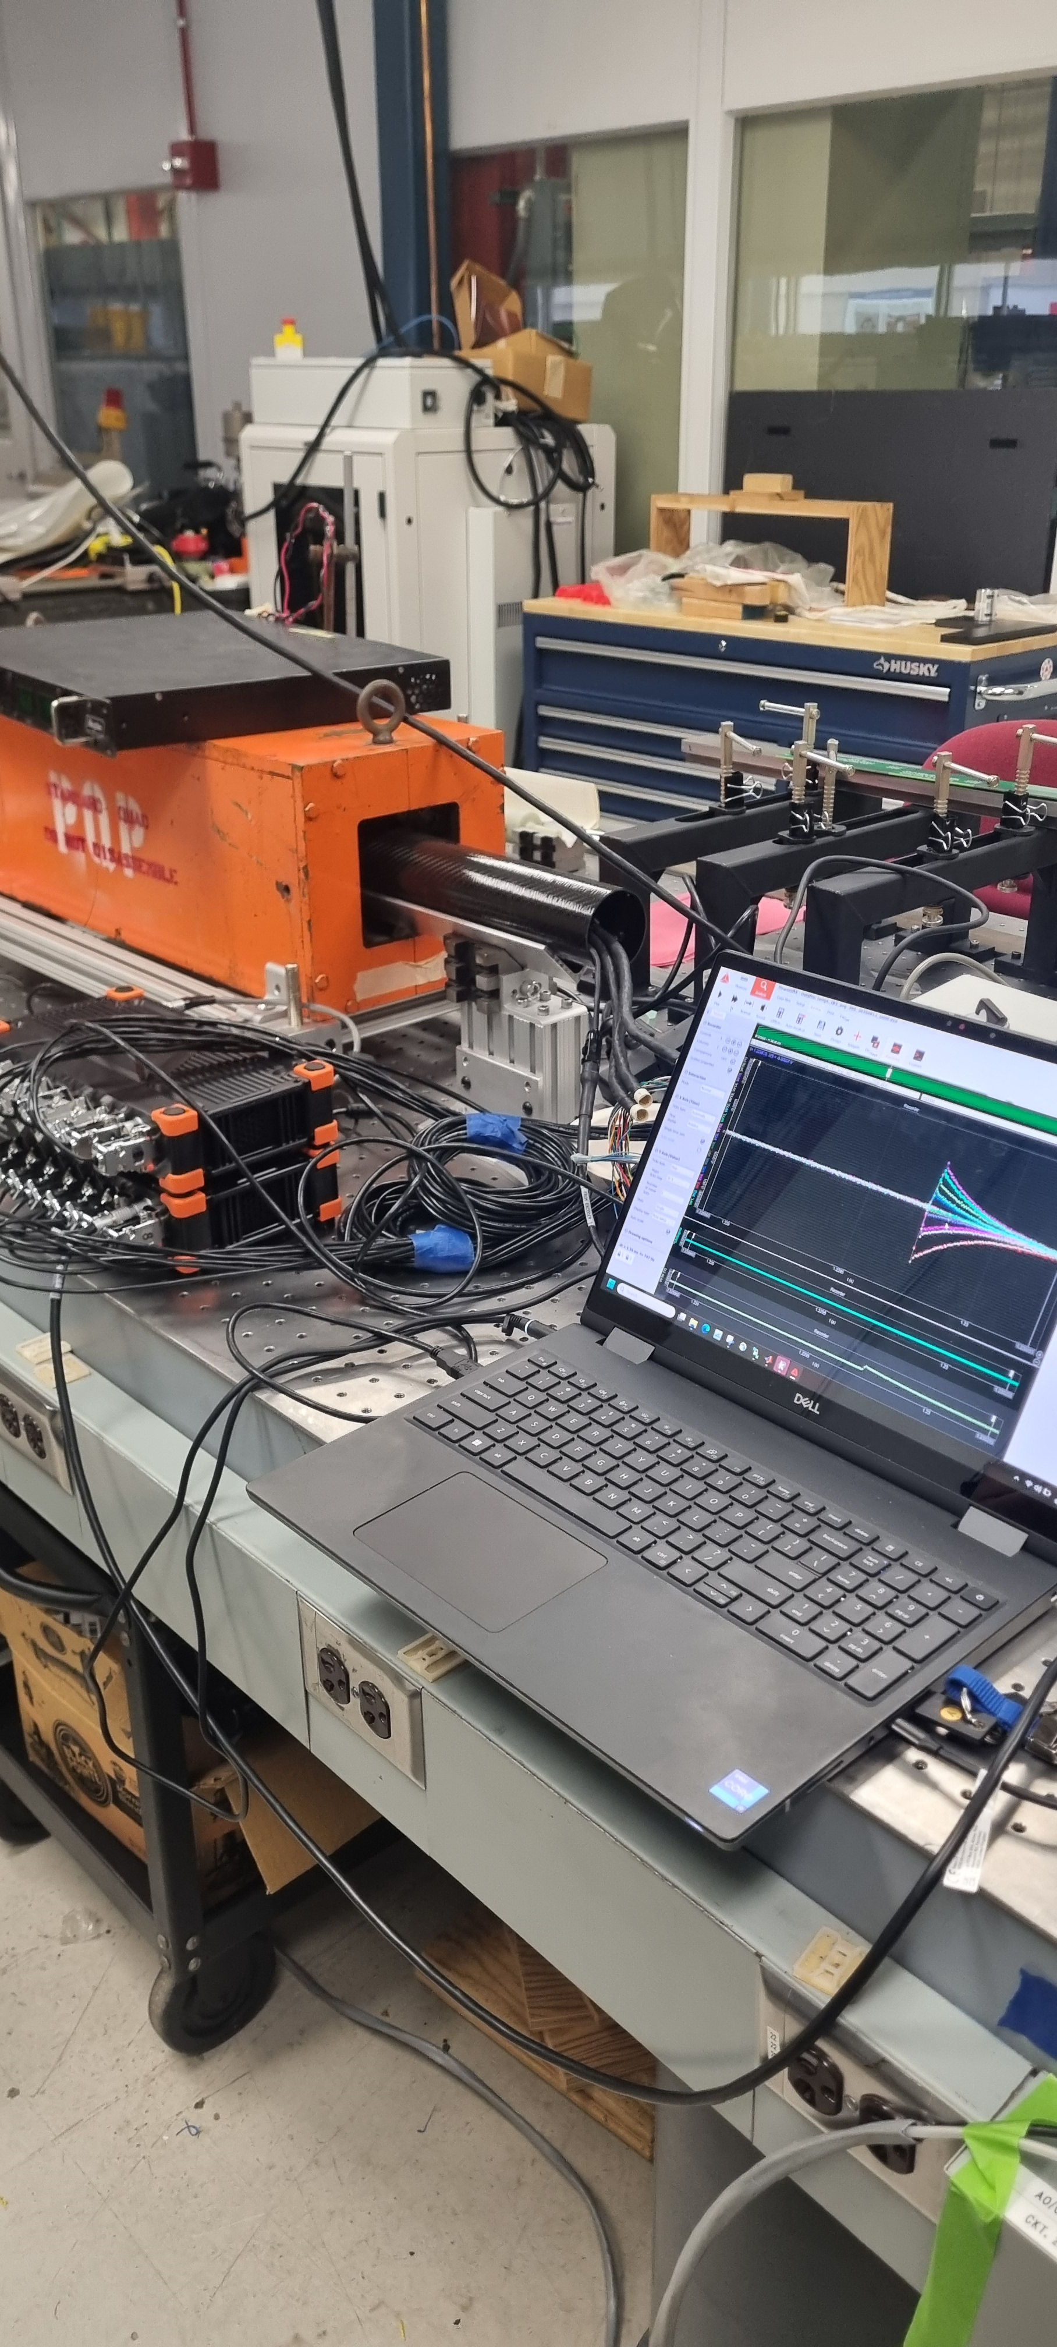
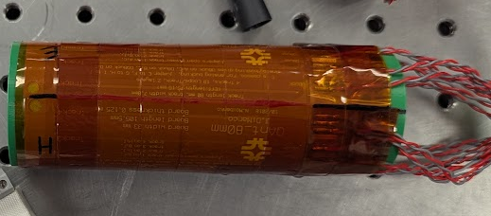
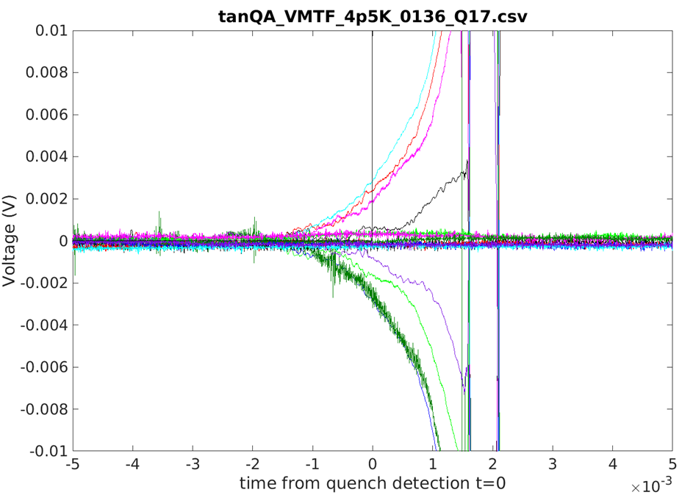
Three types of quench antennas were used:
Inter-layer QA
Warm-bore slant QA with 28mm dia.
Tangential warm-bore QA array with 42 mm dia.
Data taken typically for entire ramp, all tests
Signals with
60 Hz filtering
Quench trigger
24-bit, 200 kHz sampling daq
Second warm bore QA
16 tangential loops around 41mm diameter cylinder; 2-layer pcb, 36 turns total

Slide 4
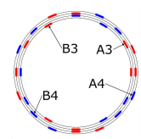
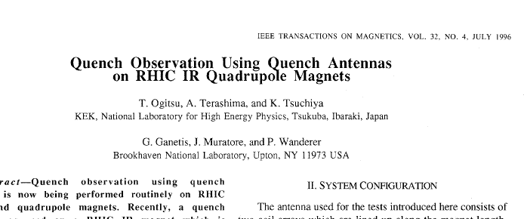


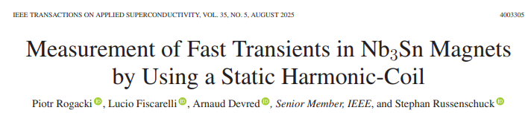
Harmonic multipole sensitive QA have been used to localize quenches radially and azimuthally
- The thought here was to use an array of tangential windings to do the same type of analysis
TAN probe array can give measurement of all low order harmonics (below Nyquist order) – in principle can measure and use any pairs of consecutive harmonics to do this

Slide 5
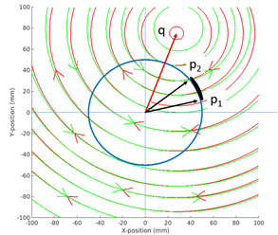
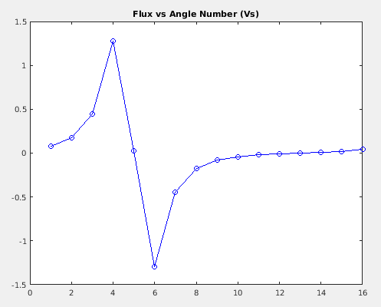
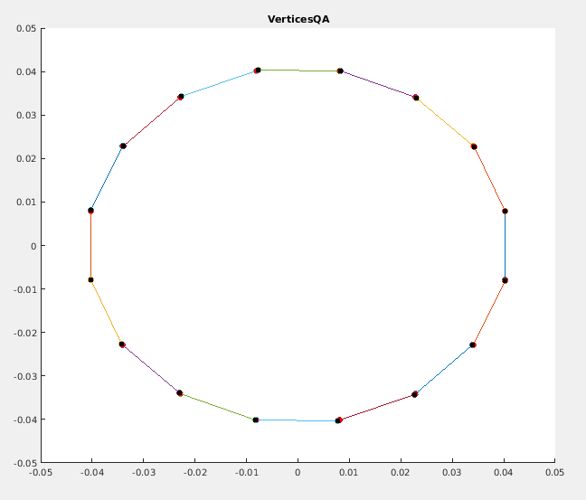
Field from Line Current doublet
Simulated flux in vertices
The TAN analysis works well with the simulated data in determining the location of the quench source
16 vertex QA layout

Slide 6
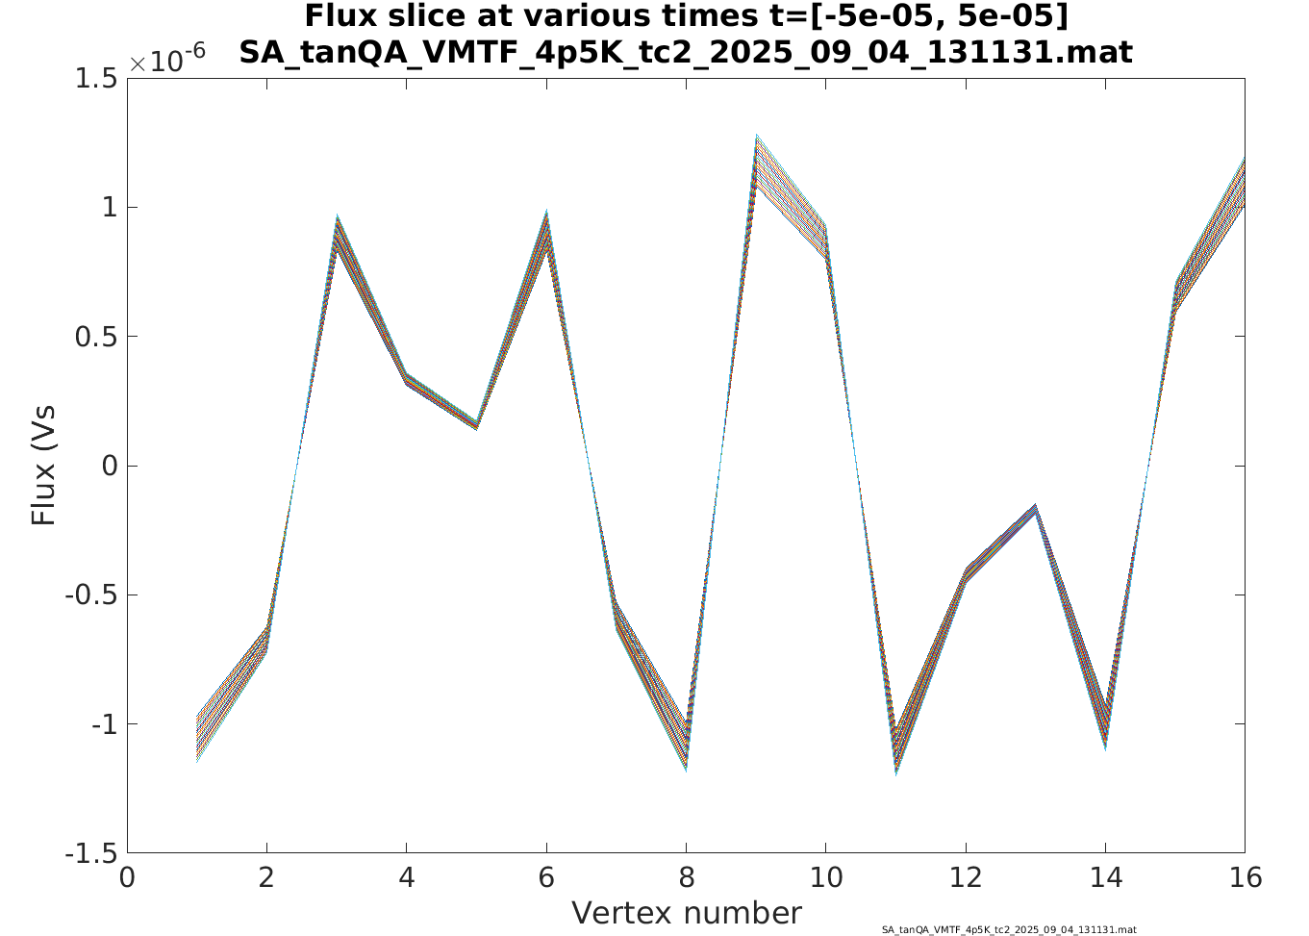
Measured Flux
Note that symmetric, and not really indicating that part of the coil is closer to the source.

Slide 7
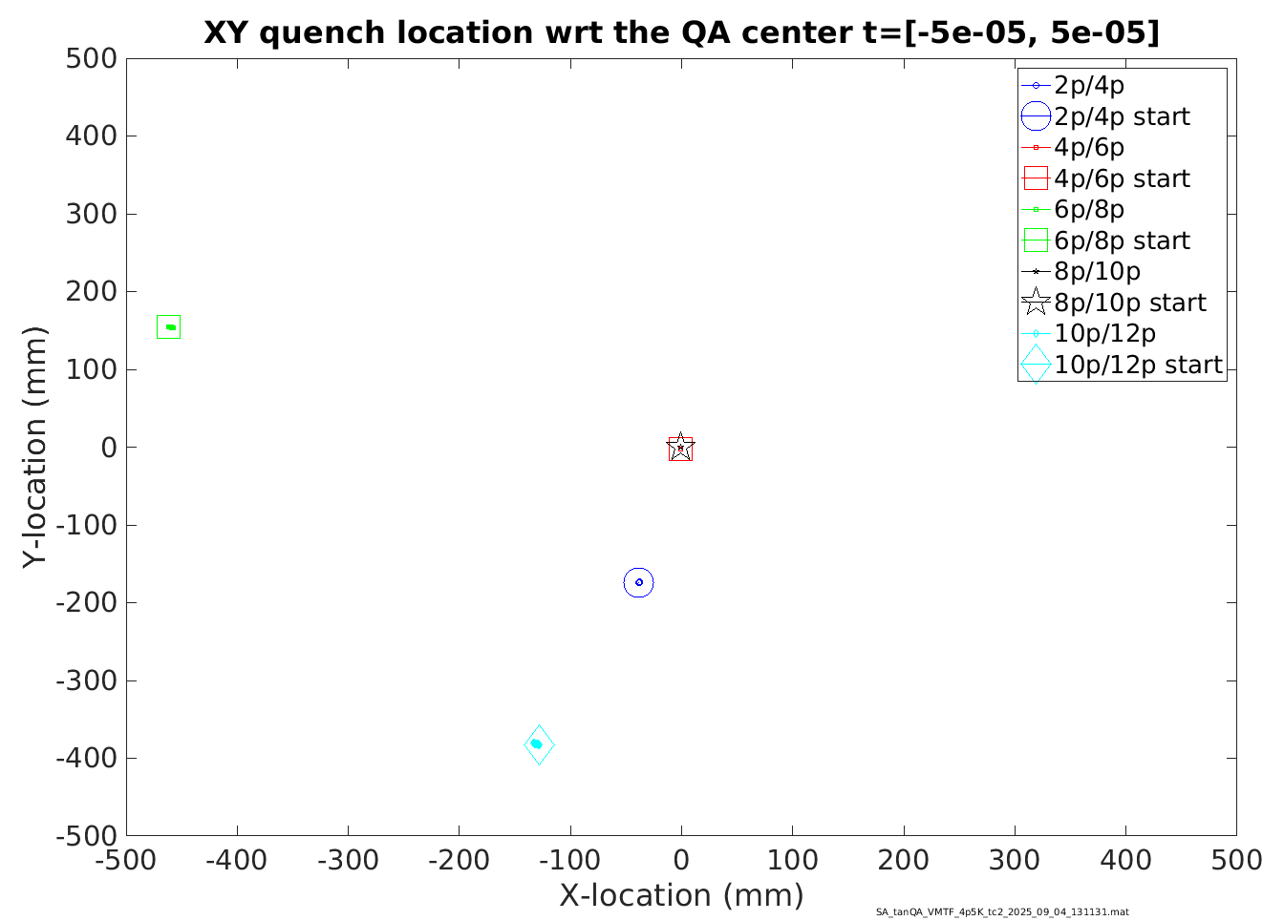
Analysis does not work!
(Not valid results, not consistent among harmonic pairs…)
Still working on this -
Could be that CCT cable geometry requires a somewhat different analysis (?) …

Slide 8
HTS REBCO QA test

Slide 9
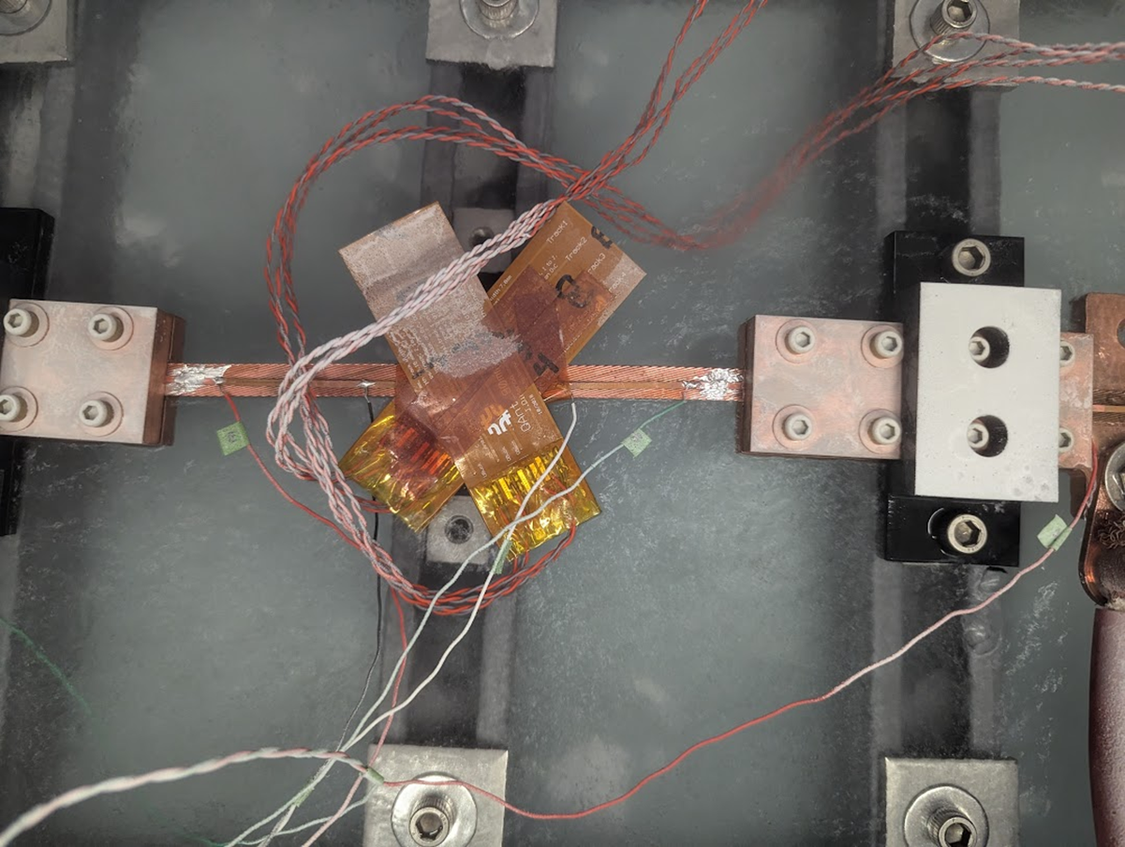
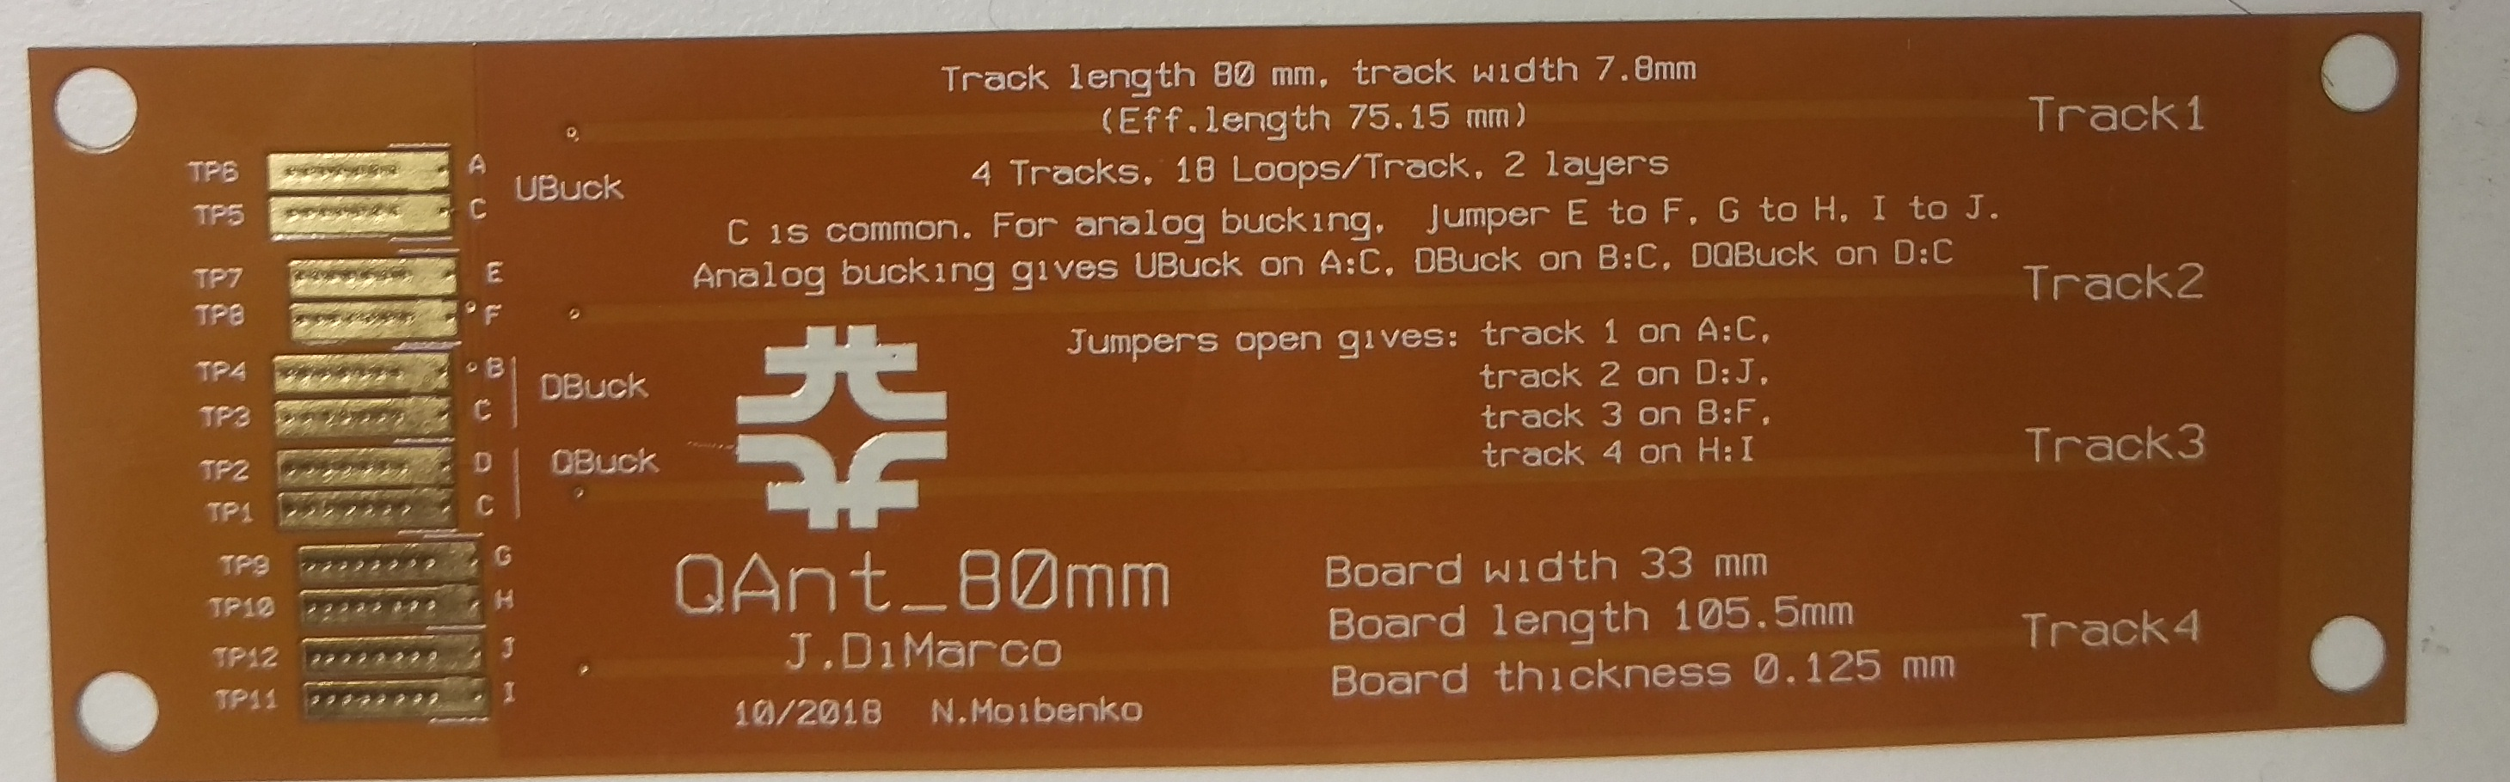
Voltage taps
REBCO tape
36 loop (18 front/back), ~4mm average loop width, 80mm length
LN2 bath

Slide 10
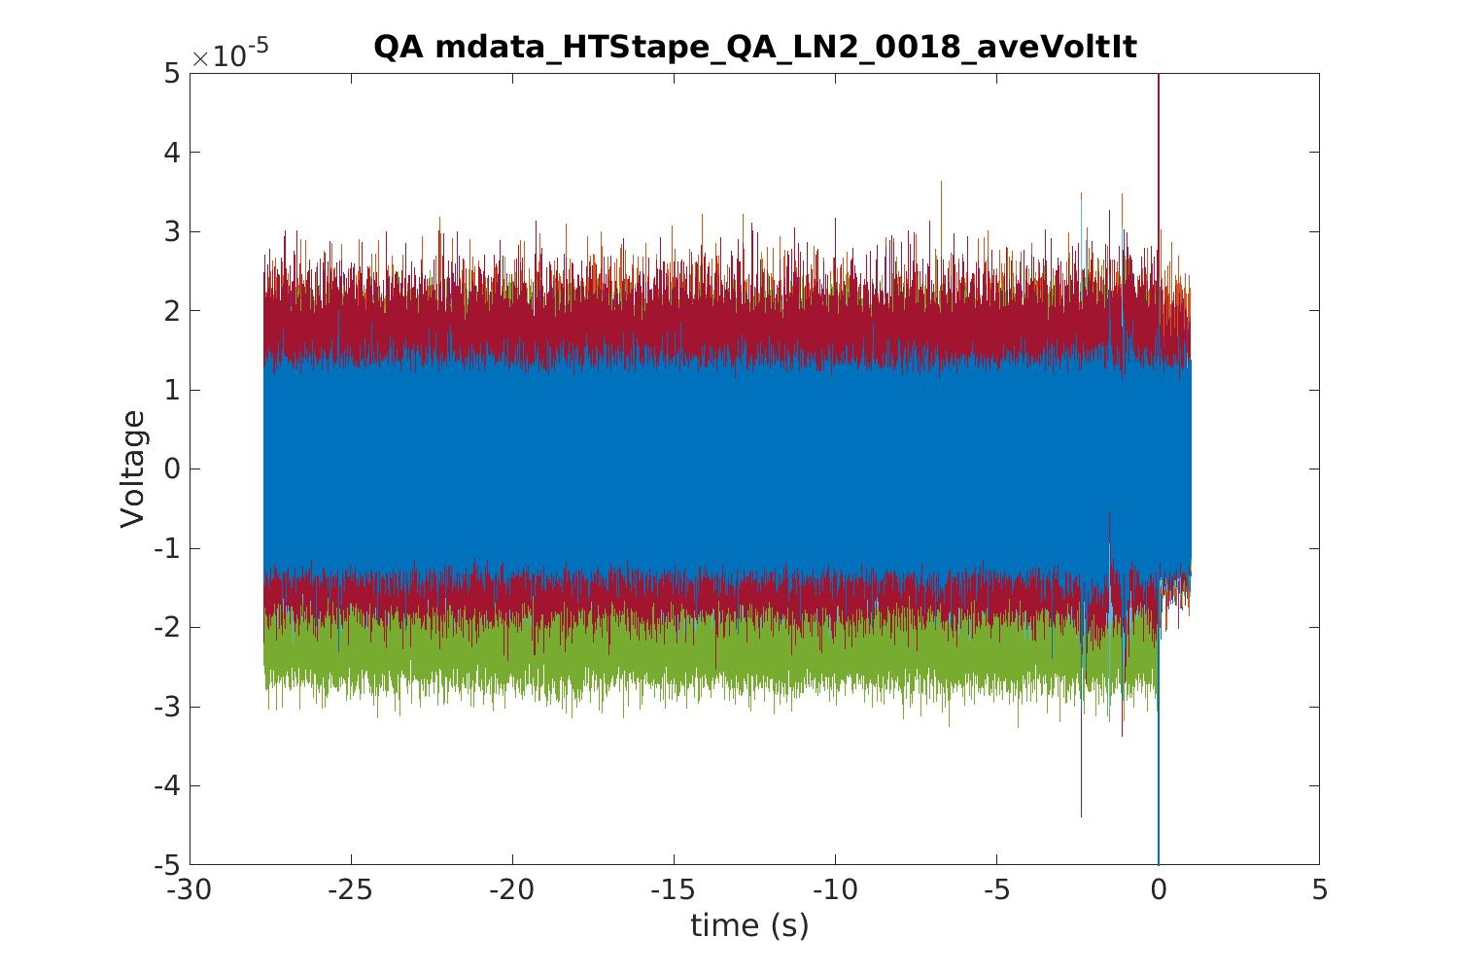
Clear activity here

Slide 11
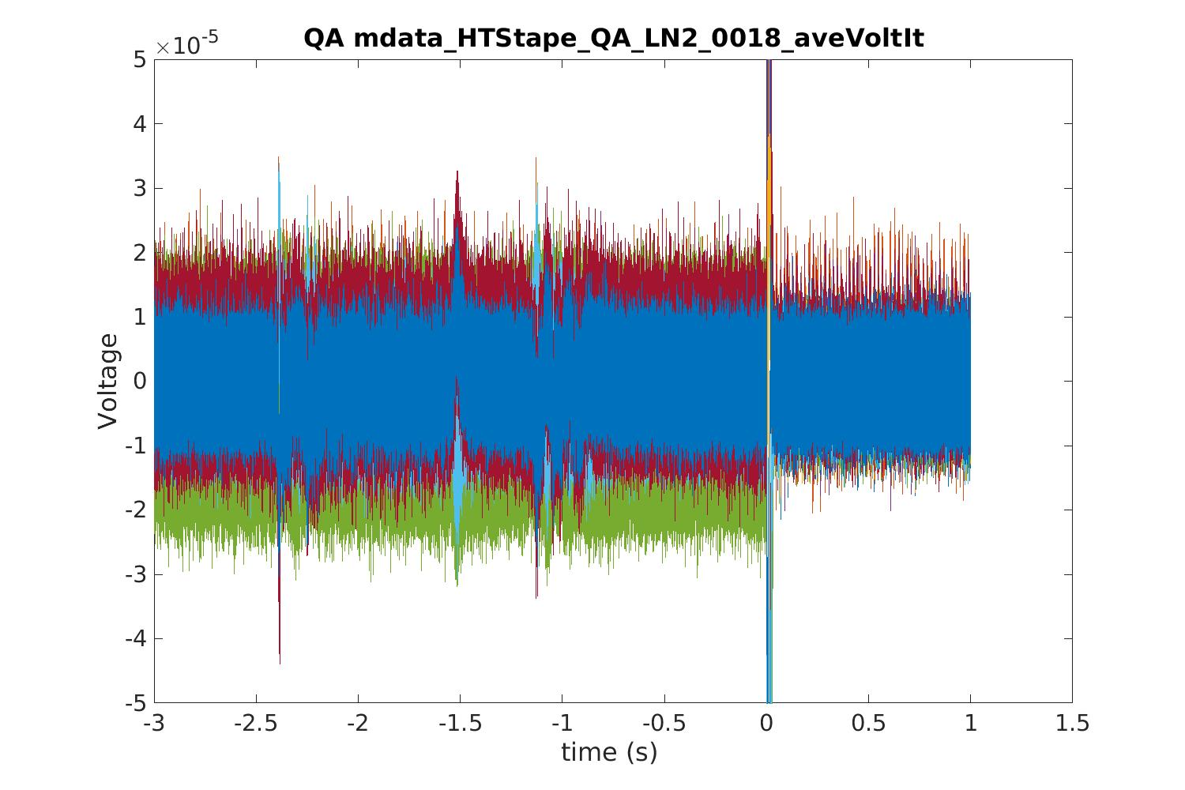

Slide 12
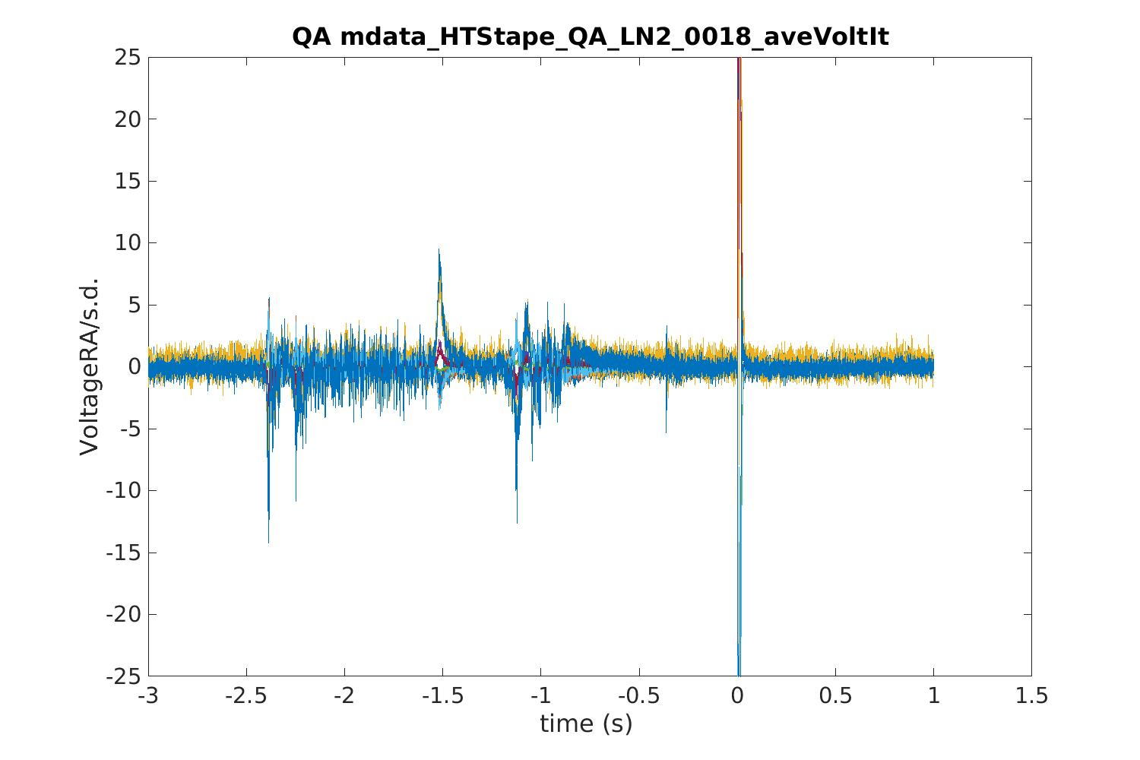
Using running average and normalizing by the standard deviation
Some sort of signal – presumably from current redistribution in the tape - is clearly visible about 1-2 s before threshold exceeded

Slide 13
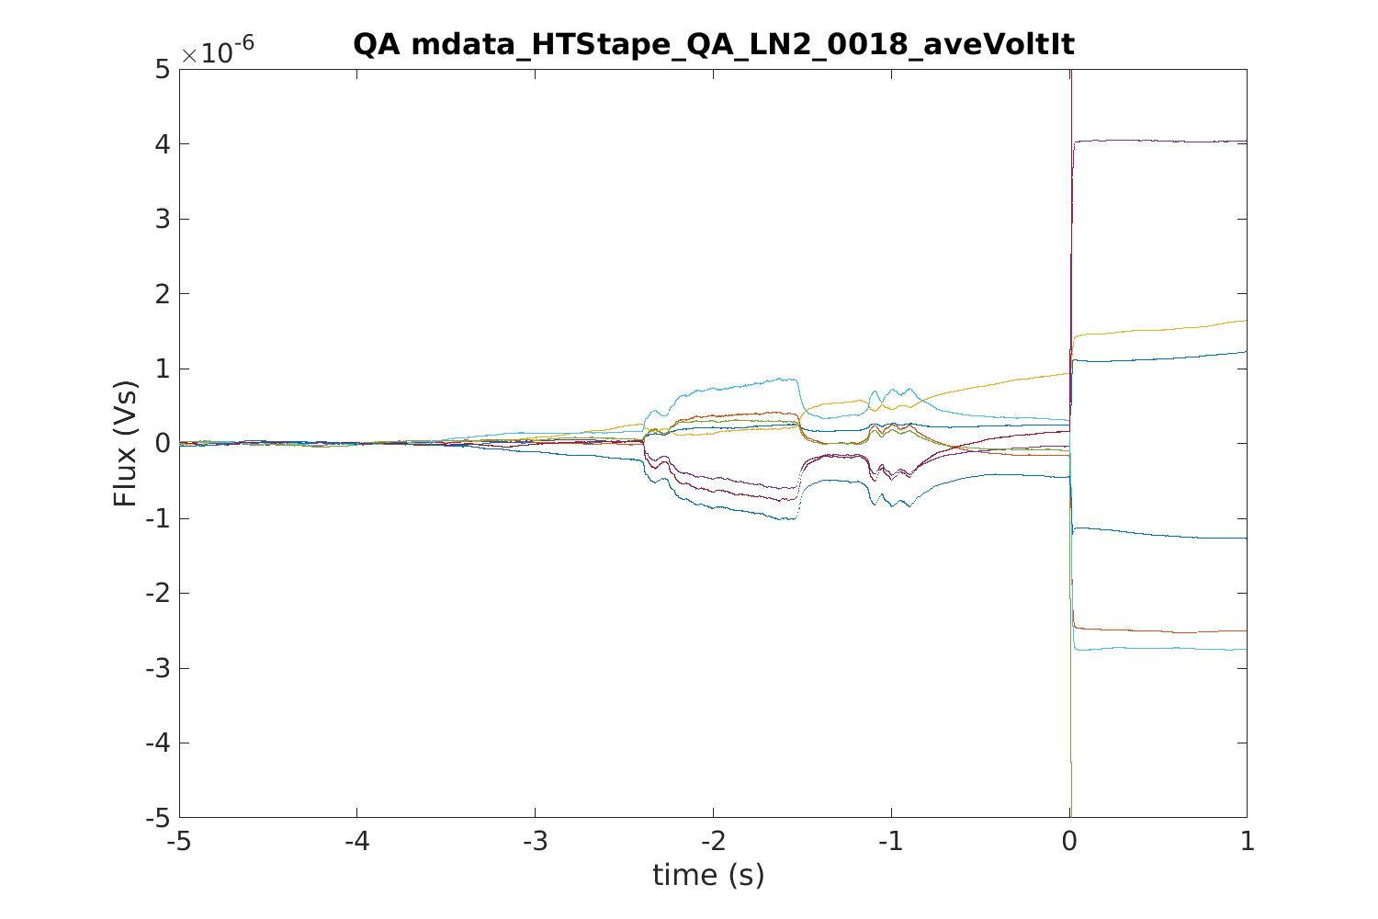
Can integrate to see signal in terms of flux change

