Slide 1
General Purpose Low Temperature Pressure Prob
S. Krave
General thoughts and notes…
3 December 2025

Slide 2
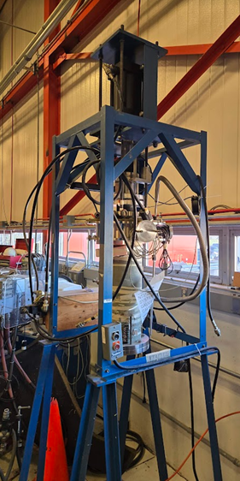
Motivation
Quality Models require validation and good reference data.
Much can be simulated via multilevel modeling with good results, perhaps better than can be measured but properties assumptions in models should be correct.
Our Universal Test Machines are less than universal
And/or out of service
Lots of questions on mechanical performance of different conductors
Delamination performance of REBCO
REBCO cable properties and limits
Under-characterized materials
Telene, 2212, etc

Slide 3
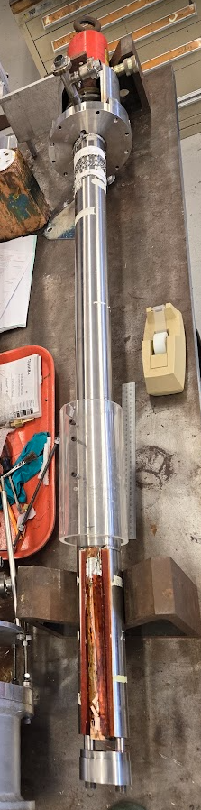
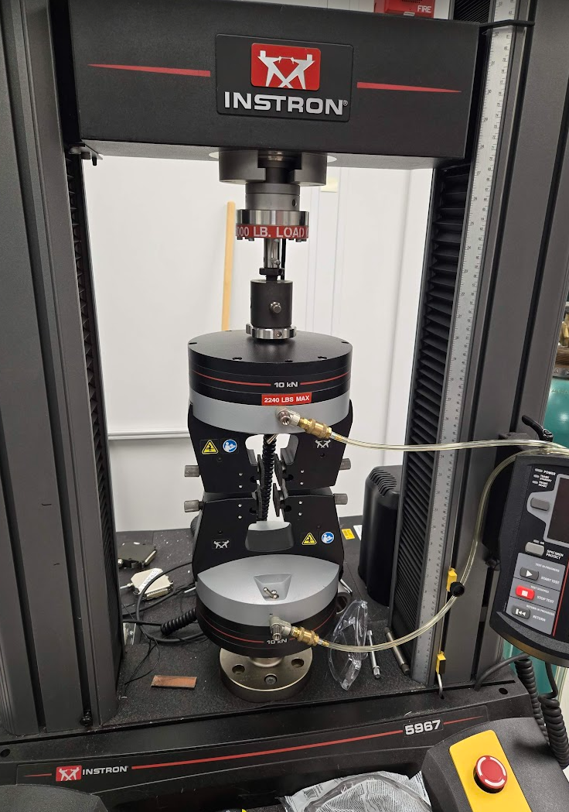
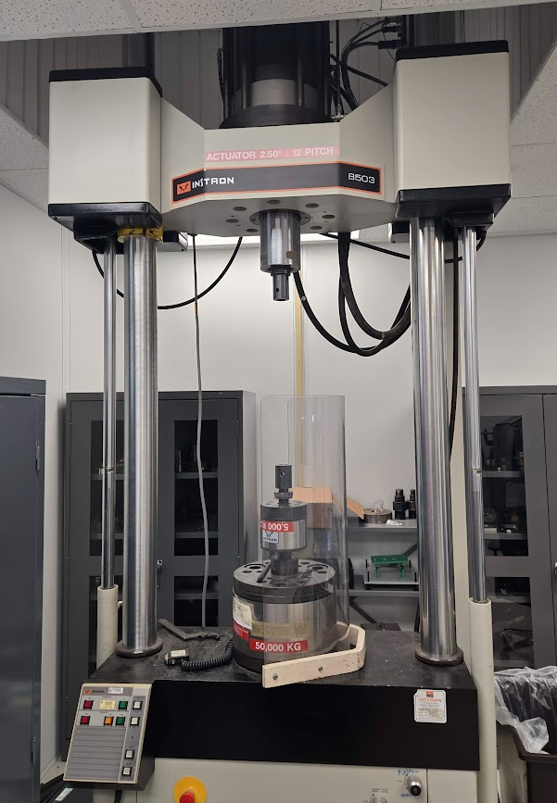

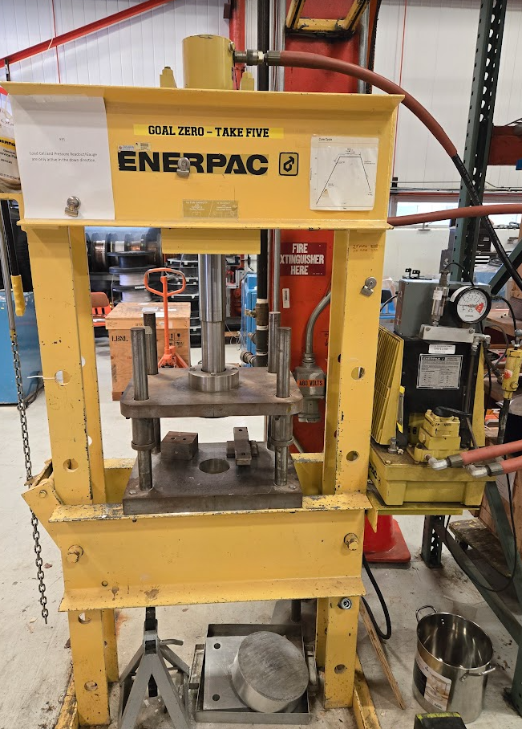
Infrastructure (FNAL)
At FNAL, for measuring material properties (squishing things) we have the following:
Low Temperature Loader (90 kN?) (Needs recommissioning)
Large Instron (500 kN) – out of service (Needs new controller)
Transverse pressure probe (20 tons)
Unique specific purpose device
Small Instron (30 kN)
Generic 20 ton shop press
No load cell

Slide 4
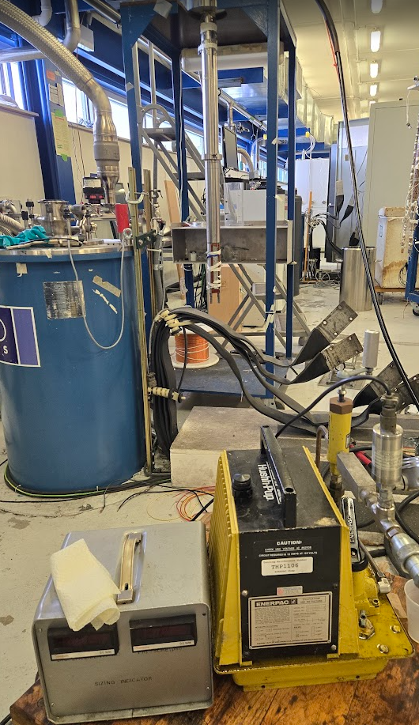
Transverse Pressure Probe
Our existing load probe
Works(ish) down to 4.2K
Low current leads
Not modular
Low precision at low forces
Force readout is only from non-calibrated hydraulic pressure transducer
My guess is ~500 lbs hysteresis over 20 tons
Large errors under 1000 pump psi
Plus spring return forces
Right now current is being supplied independent of probe (Nitrogen only)

Slide 5
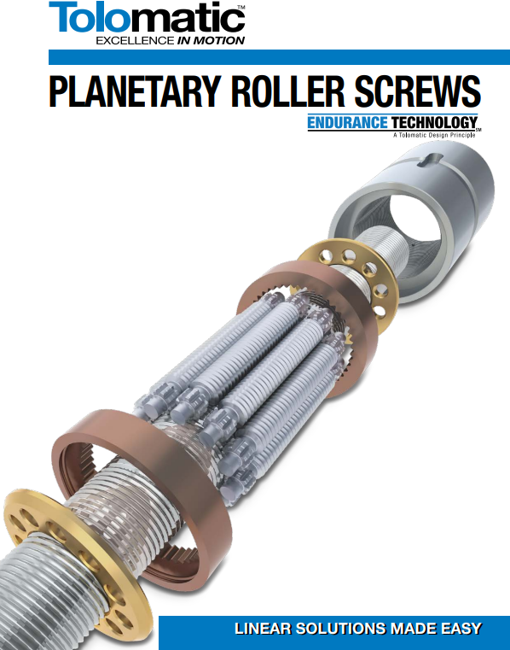
Proposal: Build a cryogenic capable load system
Load frame to react forces
Double acting cylinder Roller Screw? to apply ~200 MPa to 20mm x 50 mm (20 ton)
Teslatron or generic mount flange
140 mm outer diameter (or VTI OD)
ID Pushrod sized to optimize loads and minimize total heat leak/mass
Instrument thin wall with strain gages and calibrate for force sensing
Interchangeable load head using Instron Style coupling
Some displacement sensing
Possibly Fiber-optic interferometry for displacement and dilatometry (S. Holl, https://cds.cern.ch/record/2845427/files/CERN-THESIS-2022-274.pdf)
That happens to have current leads
That happens to fit in a magnet
System is a large pushrod
Prevents buckling
Use roller screw or hydraulics to apply either tension or compression to sample
Use inner and outer supports as current leads
Wrap in HTS to reduce He Consumption
Where applicable, insert G-10 electrical and thermal brakes
~20 Ton
Load Cell

Slide 6
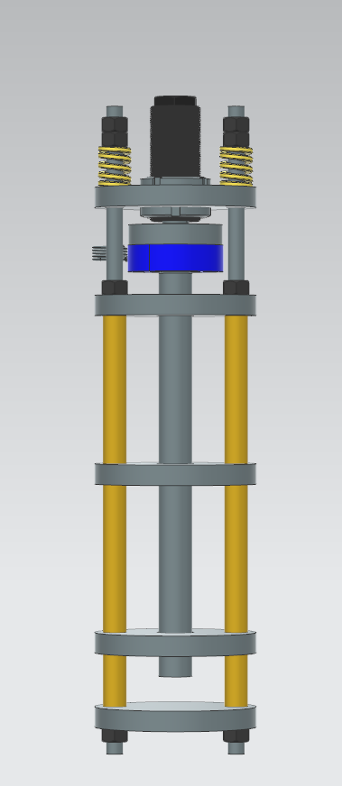
Mini Transverse Sample Holder : A small step
A smaller low cost holder is desired for testing of larger bend radius ~25mm with straight section samples. It is to work in LN2 without background field. External actuation is desired (~24”-36”)
Max load 5000 lbf
Limited by load cell
External actuation
Sample width up to 1.5”
Sample Length up to 4”
2 kA (800 stated)
@10A/mm² requires 200 mm² of conductor
1” x 0.5” copper is 322 mm² or 6.2 A/mm^2
External Diameter 5.5 inches (fits in 14.7 cm 8.5T magnet)
This would be a little larger in size than the TPI probe.
Actuated by hand pump? – Compression only
In process of lead analysis…
To have in hand:
$15k M&S
.05 FTE
A couple months for simple machining

Slide 7
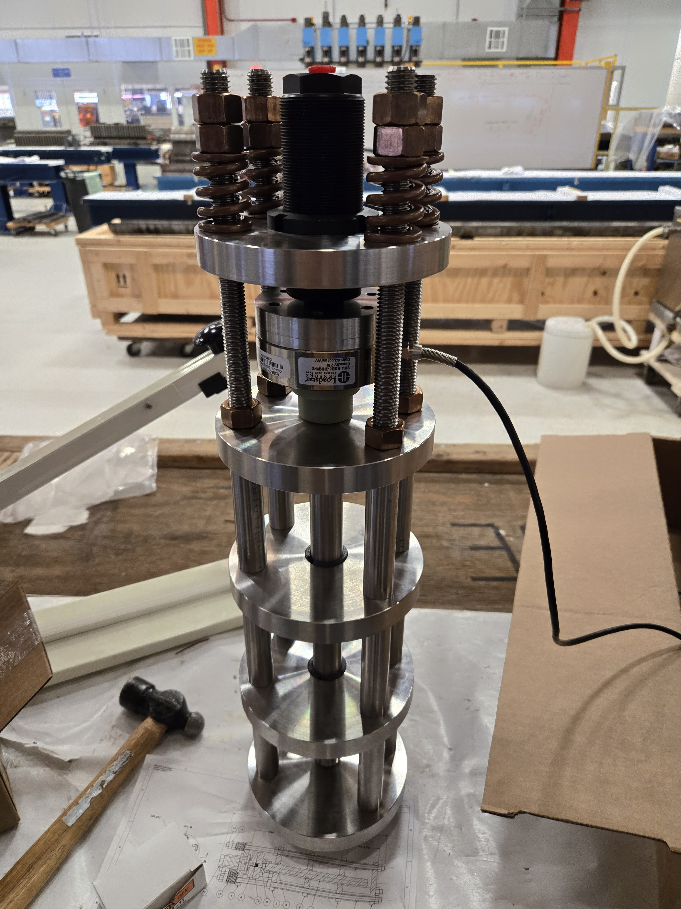
Mini Probe Assembled
Right now we can*:
Cool down in nitrogen tub
Control to precise set force manually
Read load
*Hydraulic fittings have not been installed but it may be directly connected to manual system

Slide 8
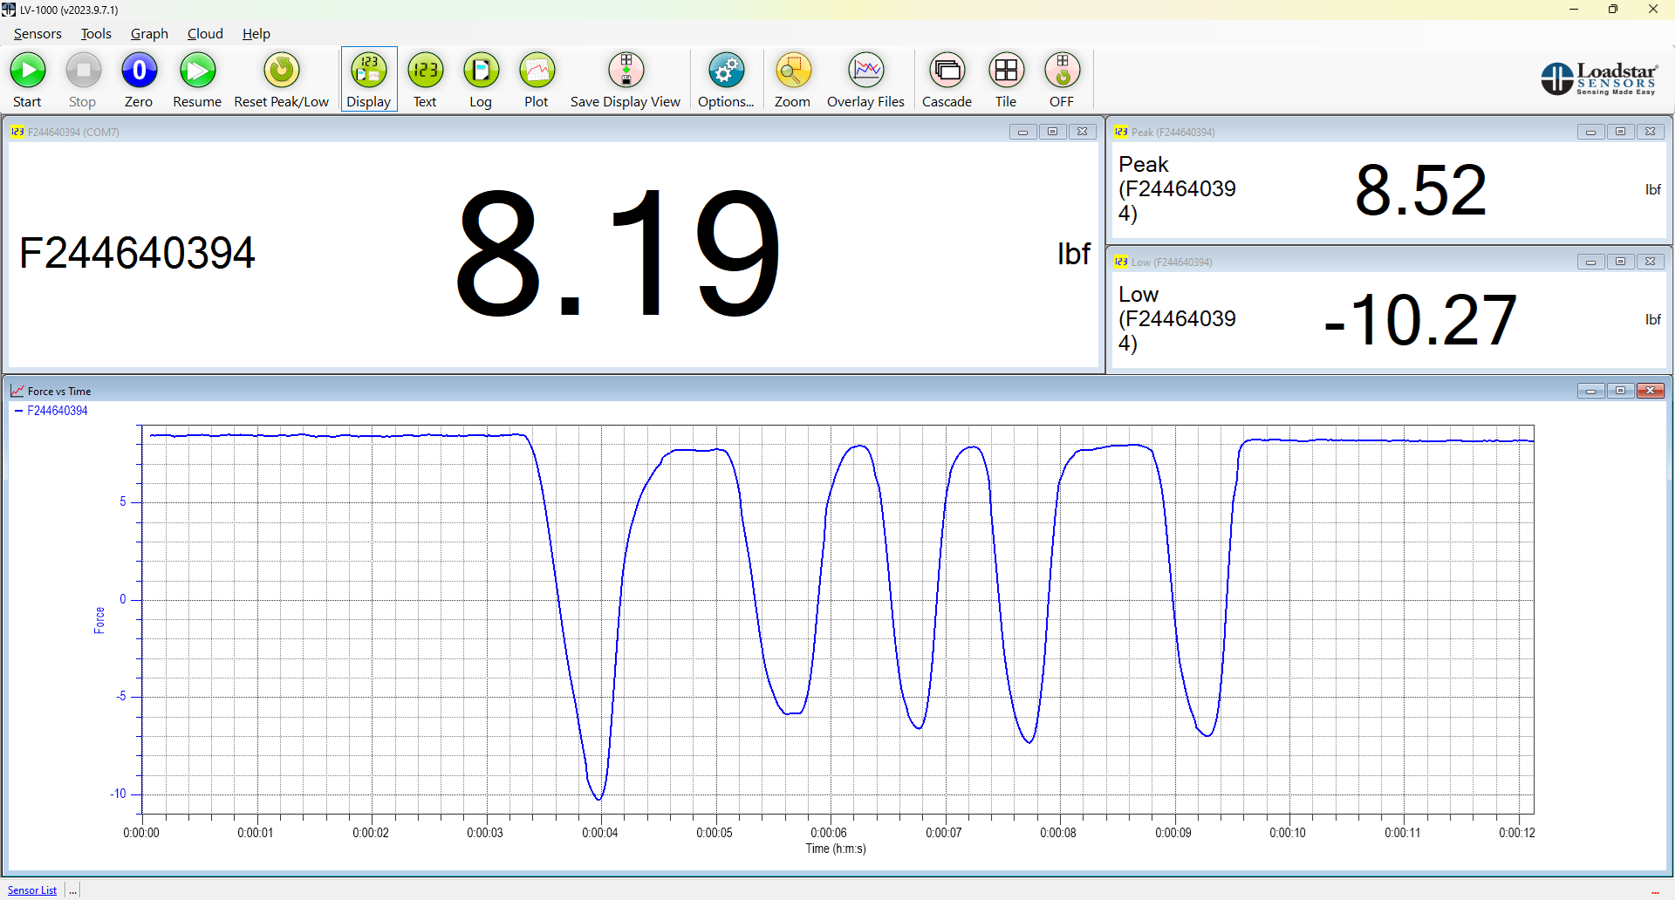
Loadcell Test
Loadcell on device is working well. Set to log to file. Can use for postprocessing.
High precision calibrated loadcell (<0.05% full scale error)
Can interface with Labview via serial (USB)

Slide 9
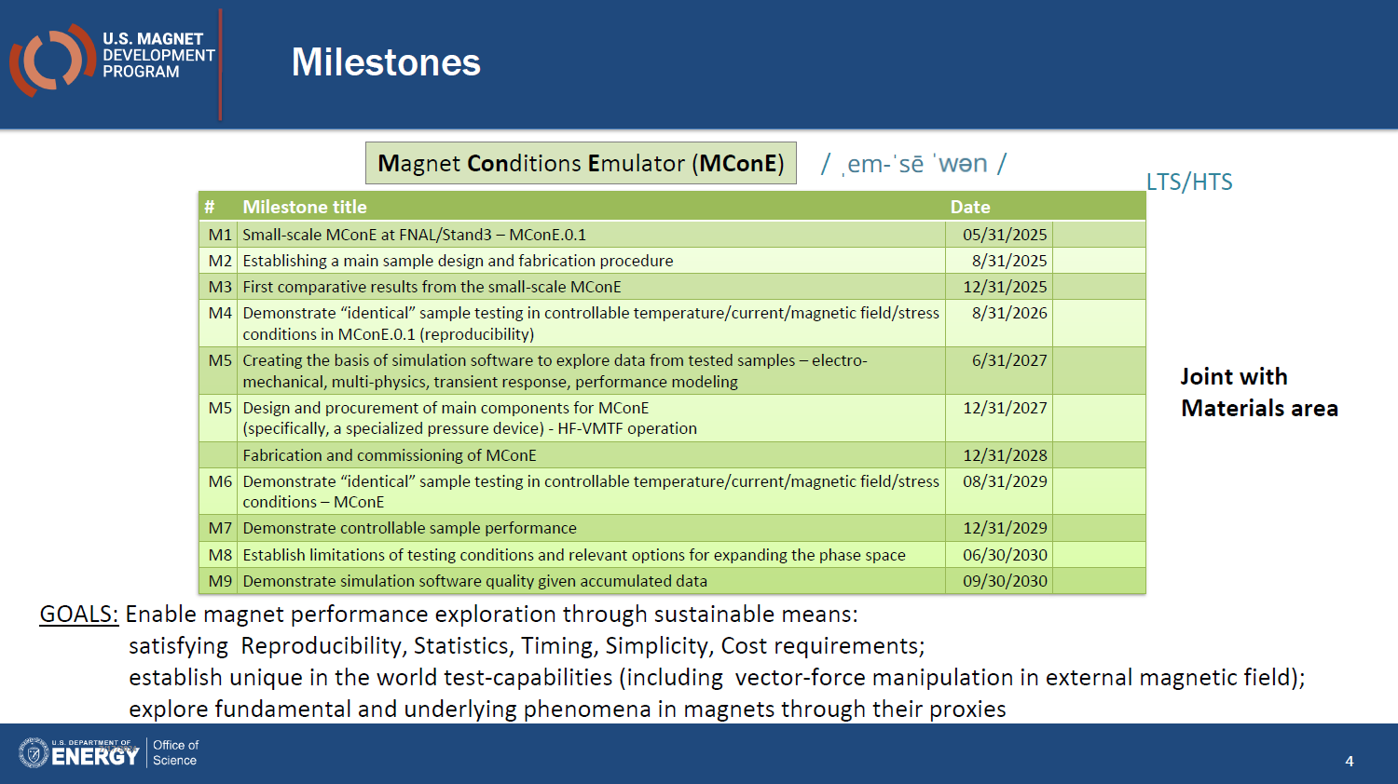
Should Update to IB3

Slide 10
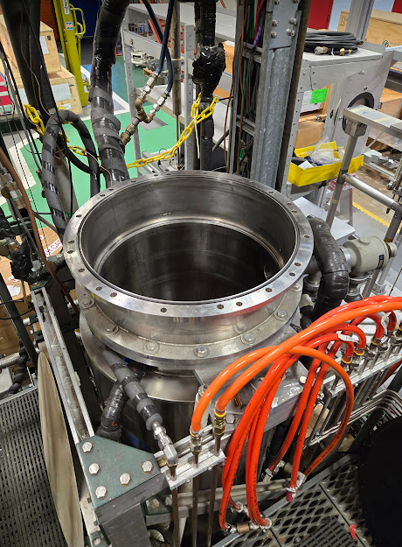
TS3 Version Extensions
The system will allow loading of a sample in LHe at Test Stand 3 / elsewhere
The mini-version (small Scale MConE) is extendable to fit into the 8.5T solenoid.
Extend support rods
Modify for smaller current leads
The system is planned to allow some substantial current down to 4.2 K (~10 kA) in the 14cm size
It is being configured to be small enough to fit in a background field, to be determined
8.5T solenoid.
SMCT?
HFVMTF

Slide 11

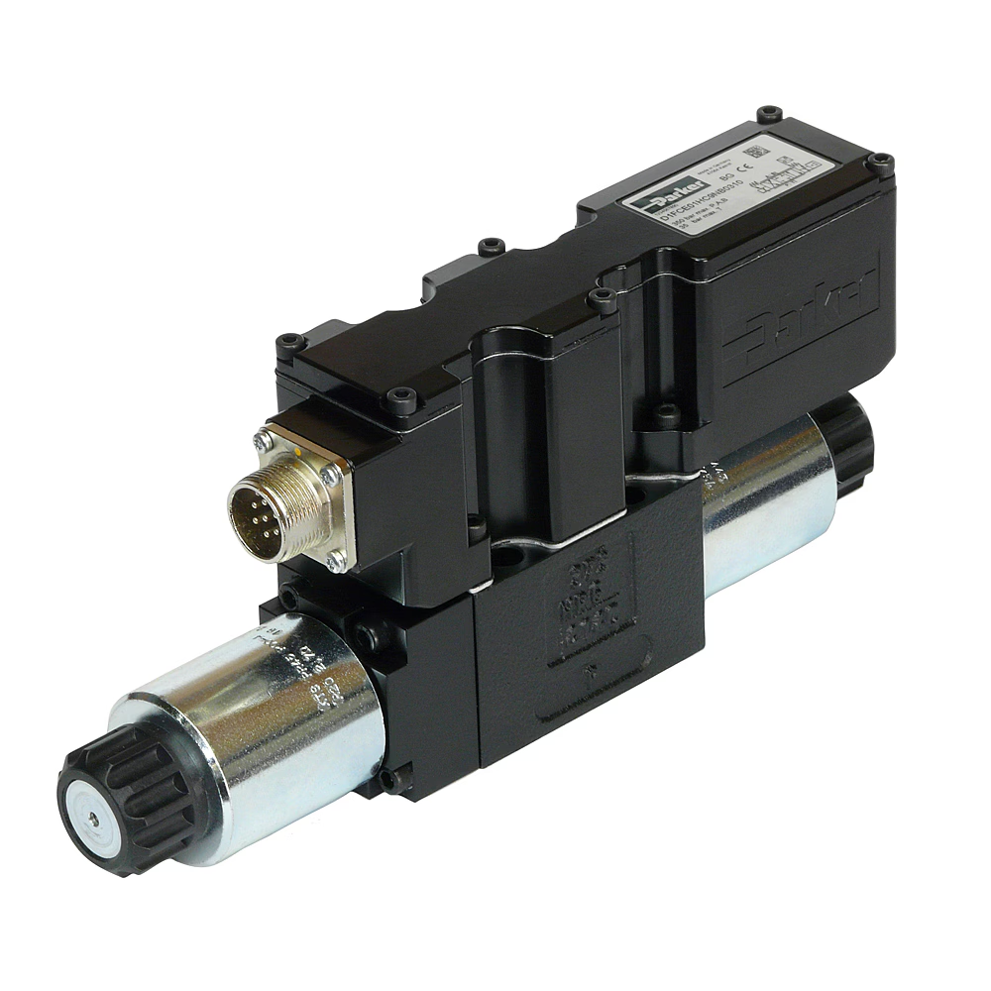
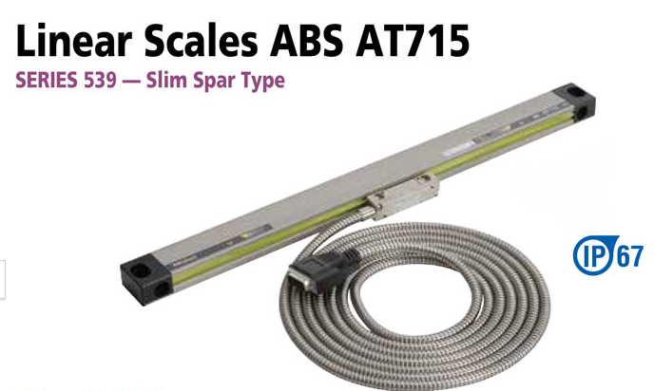
Controls for Such a system
Initial version can
Apply load to cold sample, which can be cooled if desired, maybe controlled by hand
A simple mechanical system like this can give simple measurements, but with several adjustable parameters, and generic end implements, it can become incredibly powerful for learning about magnet behavior given some automation
We can add variables to fully realize as MConE
Parametric load control
Parametric Current Control
Parametric field control
With a VTI… Parametric Temperature control
I will be looking for some help here as things progress

Slide 12
Conclusions (ish)
A small scale MConE is ready to test, and may be extended for background field testing
(LN2 only)
In a ‘Full Size’ version, it appears that up to 20 tons and up to 10 kA can be delivered to a sample with a 140 mm diameter probe
Subject to psu limits
With optimization, it should be reasonable to deliver substantially higher forces and currents.
The system will be compatible with the 8.5T 147mm bore solenoid. This system should be useful for others as well.
Next Steps: Start more detailed design of full size model with plans to scale/adapt for different background fields as they become available. Iterations on detailed thermal analysis before design detailing note:
Questions: Is there anything else to investigate integrating?

Slide 13
Extra Stuff

Slide 14
Quick Analysis for ballparking…
Check system resistivity vs diameters
Using RT properties
Check loads and stresses
And buckling, note that coaxial configuration eliminates buckling, but probe may move a little
Heat loss assuming a large bar of material with 1 end at 4k and one at room temperature
Poor assumptions lead to very high heat loads
Assume 140 mm OD, and vary Inner member
Since buckling is eliminated, equal area should be optimum.
Targets:
200 MPa in 1 in^2 sample (29000 lbf)
2+ kA
Fits in magnet

Slide 15
Unsupported buckling limit of ~20 kN
Again coaxial arrangement eliminates failure by buckling
Column stress of a low value.

Slide 16
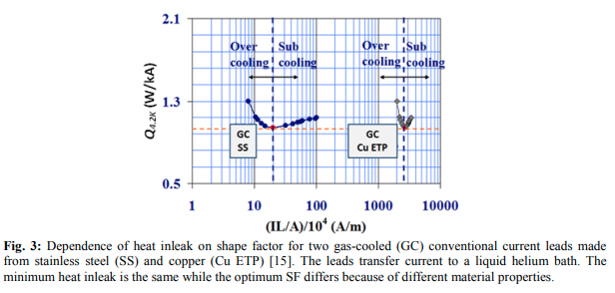
Approximate Sizing for TS3
Heat loads to helium can be calculated as a function of current and shape factor. As a result of the Wiedemann–Franz law, the minimum heat load tends to match across materials, with a varying cross-sectional area
L = 1.5 m
Dia = 140 mm (147 nominal)
Fill factor = .8
Maximum lead area = .0062 m^2
10 kA
IL/A = 2.4E6 (24/10^4 per chart)
~ 1W/kA@4.2
~ 10 watts to 4.2K at 10 kA
Optimum for SS is 1700 A
Stainless will work with a large aperture at large currents, but maybe we want to use something more conductive (but less than copper) –need optimization. (6061 Aluminum looks promising)
From A. Ballarino, “Current Leads, Links and Buses

Slide 17
Clearly…
Detailed analysis is required after some settling
Include non-linears.
Heat loads from lead power dissipation is substantial and washes out thermal contributions
High conductivity is better than the alternative
Thermally insulate device as practical

Slide 18
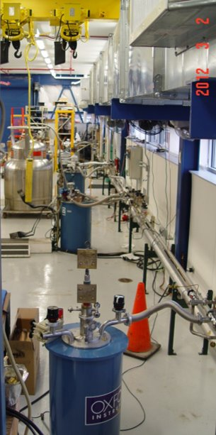
Available Facilities: Do we have a preferred initial target?
64 mm bore 15 T
49 with VTI
2400 A for insert
77 mm bore 14 T
1850 A for insert
147 mm bore 8.5 T
2400 A for insert
Various cryostats

Slide 19
Mini Probe Plans
Add electronic proportional valve to programmatically set pressure
Control via labview
Integrate with test stand
Automate for multifunction testing

Slide 20

Superconductor Equipment List at FNAL, IB3A
Teslatron 1 (T1) Cryostat with 15T/17T 64 mm cold aperture solenoid, 2000 A Power Supply w/ 49 mm Variable Temperature Insert (VTI) for testing between 1.5 K to 300 K
Teslatron 2 (T2) Cryostat with 14T/16T and 77 mm cold aperture solenoid, 1850 A PS w/VTI
Teslatron 4 (T4) Cryostat with 8.5T/10T and 147 mm cold aperture solenoid, 2400 A PS
Telslatron 3 (T3) Cryostat with 253 mm neck, 2400 A PS
Physical Property Measurement System Quantum Design PPMS®
4 tube furnaces 6’’ diameter for heat treatment in Argon and Oxygen to 1500°C
I 1100°C Three Zone High Pressure Tube Furnace with Gas Flow System
2 m long furnace up to 1250°C for heat treatment in air and in argon
Metrology well calibrator for thermocouples calibration up to 700°C
Motorized flat-rolling system for wires
Probes and sample holders for SC strand critical current tests up to 2000 A in T1 and T2
Devoted probes to test RRR of up to 6 wire samples in T1,T2 and T3
Sample holders to measure angular dependence of current with field for HTS wires in T1 and T2
Balanced coil magnetometer to measure magnetization in T1 and T2
Device to test critical current sensitivity of impregnated cables to uniaxial transverse pressure in T2
Walters’ spring-type device for tensile/compressive strain sensitivity studies of critical current density in T1
SC transformer for Rutherford cable tests and splice studies up to 28 kA in self-field in T1 and T2
14T/16T Rutherford cable test facility for cable tests up to 30 kA in T2
Modular Insert Test fixture for testing HTS YBCO pancake coils in T2
Hall probe system for magnetic measurements in T4, eg shielding capabilities of bulk MgB₂ tubes
Instrons for mechanical properties
Optical and electron microscopes
Respooler and 42-spool cabling machine with turkheads for 1-step and 2-step cables

Slide 21
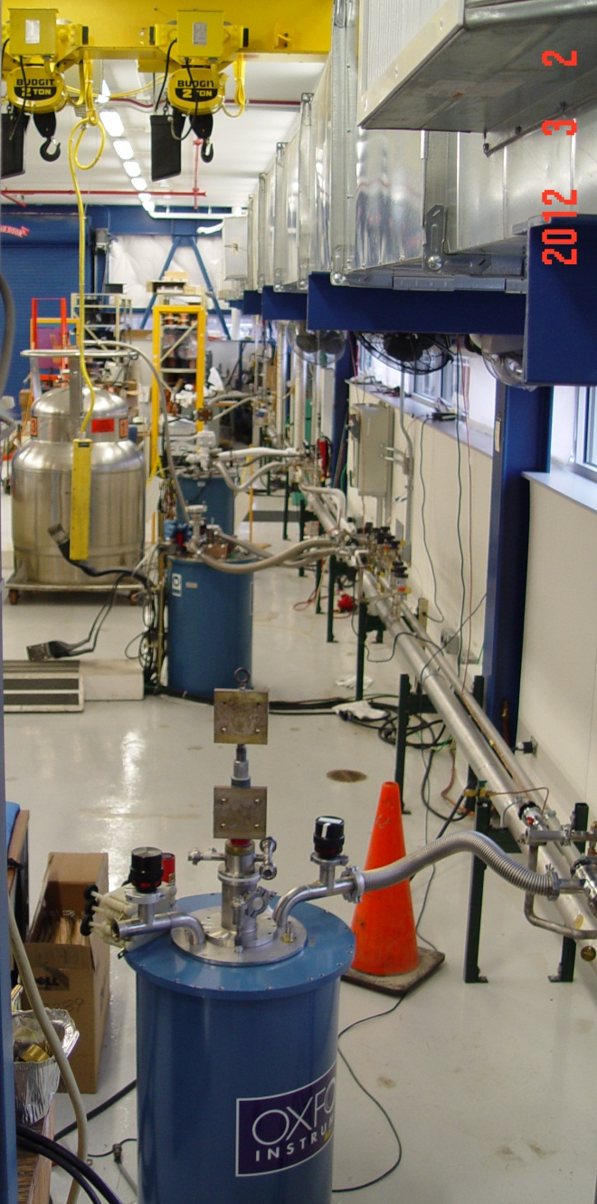
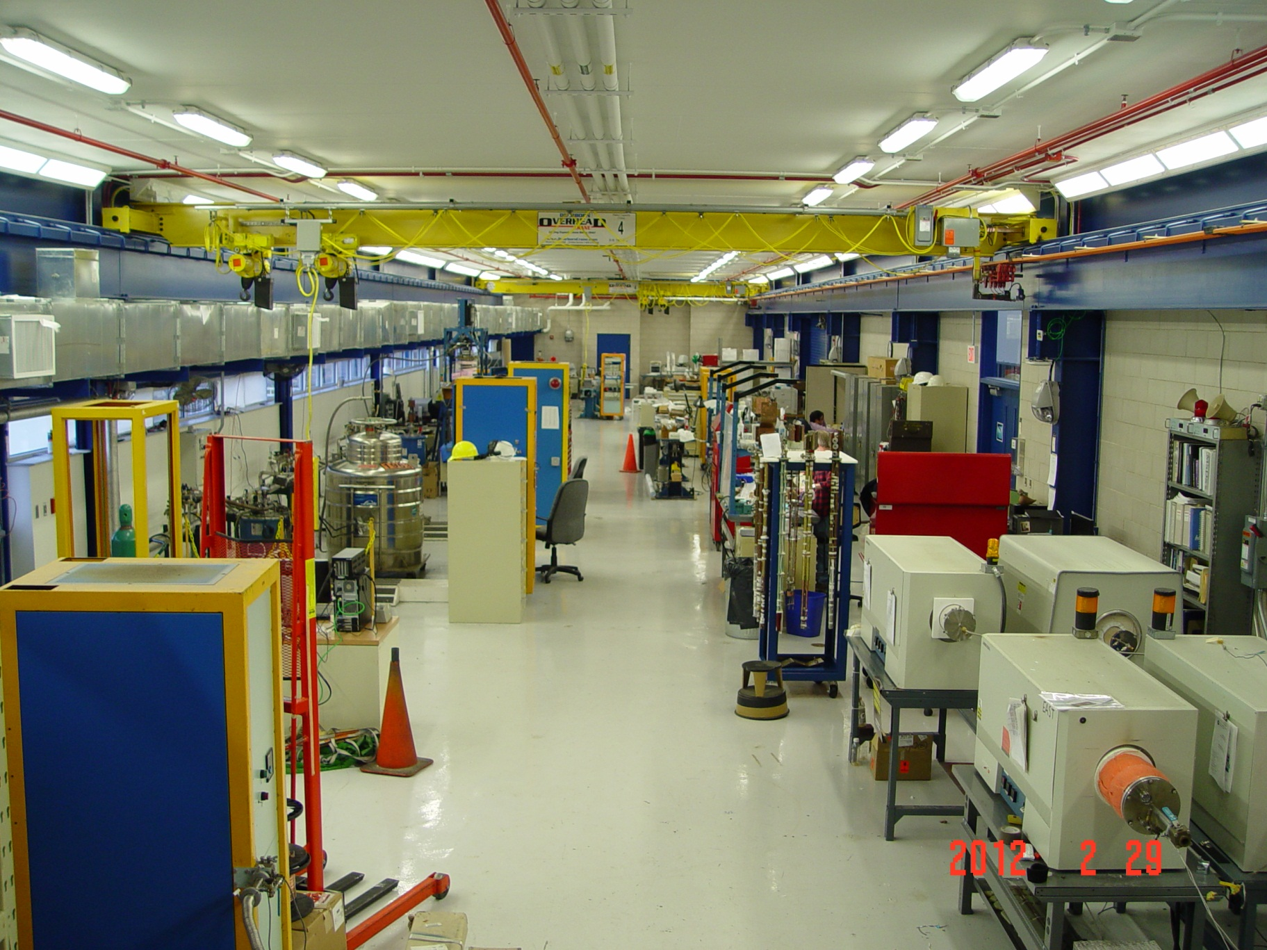
IB3A Superconducting R&D Lab
Four magnetic cryostats with up to 15T/17 T background field, and with cold apertures between 64 mm and 147 mm are connected to new vent and vacuum systems.
Is located in IB3-A, a ~6000 square feet addition to Technical Division’s IB3 that was built in 2010 with ARRA funds.
Each system has its own DAQ crate and power supplies up to 2400 A. Variable Temperature Inserts allow measurements between 1.5 K and 60 K.
Five ovens up to 1250◦C for heat treatment in Argon and in Oxygen.

Slide 22
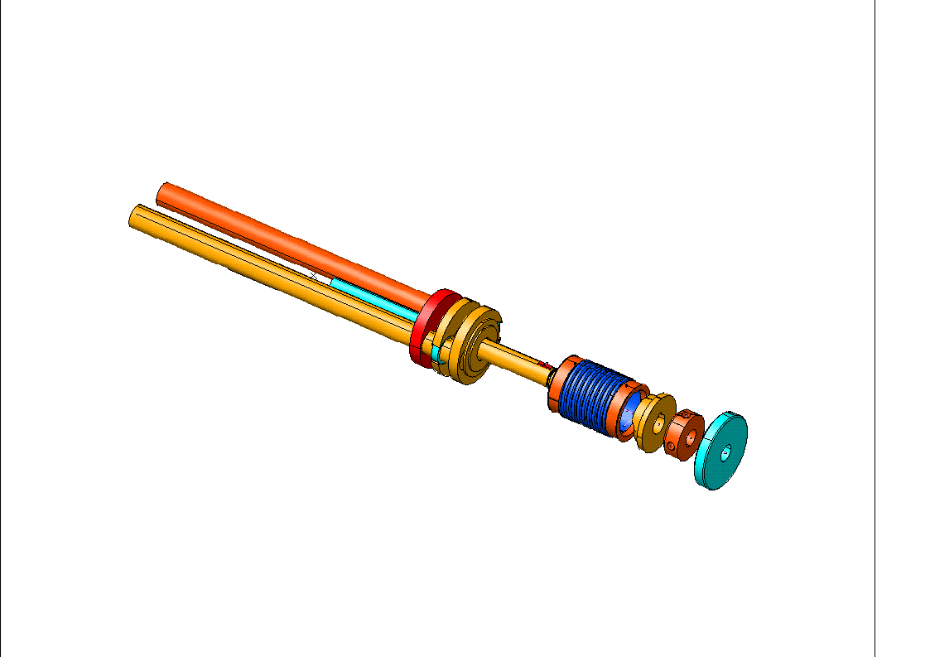
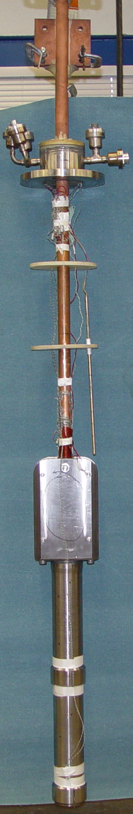
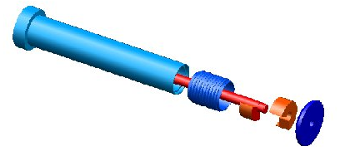
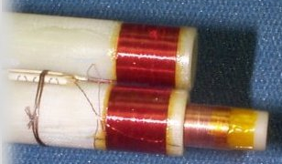
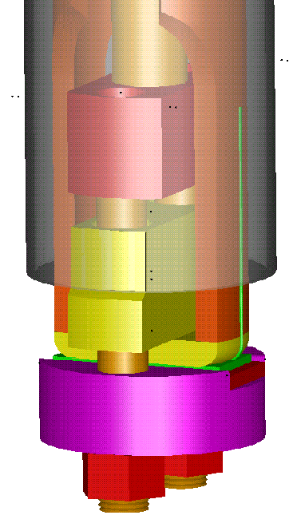
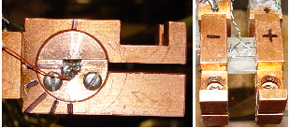
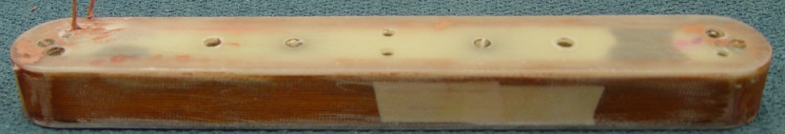
Experimental Setups
1998: Pressure contact probe for I_{c} measurements up to 1400 A
2003-2009: Five low resistance probes for stable current measurements up to 2000 A between 1.9 K and 4.5 K
2001: Device to test I_{c} sensitivity to uniaxial transverse pressure up to 200 MPa
1999: Balanced coil magnetometer for magnetization measurements
2009-13: SC transformer for cable tests in fields up to 14T/16T and ~30 kA
2001-03: ~28 kA SC transformer for SC splice resistance measurements
B
2007: Probe to measure I_{c} dependence on field orientation for anisotropic HTS wires.

Slide 23
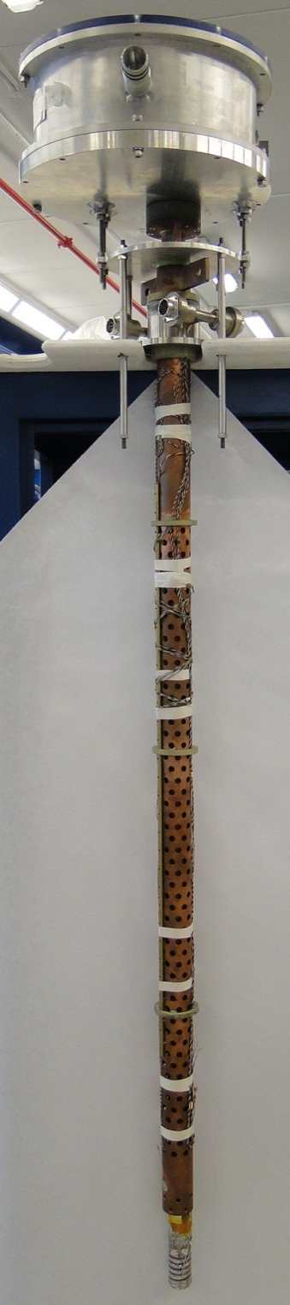
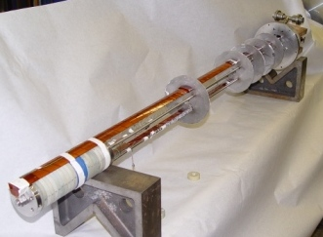
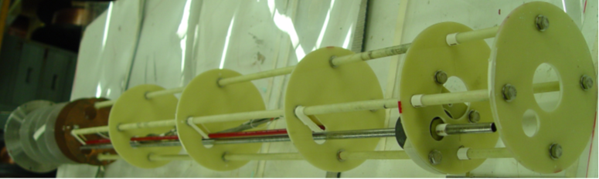
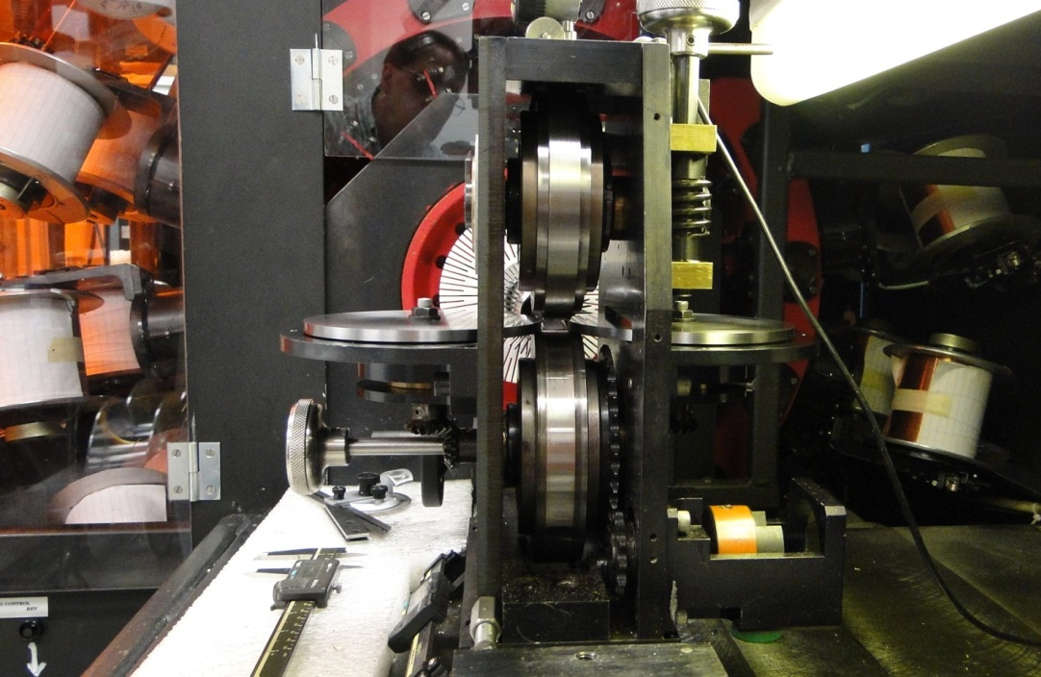
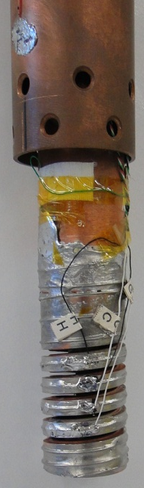
Experimental Setups (cont.)
Modular Insert Test Fixture (ITF) designed to test YBCO double pancake coils and Bi-2212 wire coils
New RRR probe for wire and bulk samples
Walters’ Spring probe for strain sensitivity studies of I_{c} in SC wires
New Hall probe system to measure shielding of bulk MgB₂ tubes
New keystoned turkhead for Rutherford cable fabrication in 1 step

Slide 24
Mini probe BOM
Center Pushrod: 1.25” Stainless Steel
Threaded side rods 5/8-11 18-8
https://www.mcmaster.com/94400A530/
~16.9 kip each
Nuts: Silicon bronze:
https://www.mcmaster.com/93439A665/
Or Black Oxide: https://www.mcmaster.com/97149A300/
Springs, 5/8 ID die spring 836 LB max each (1600 lbf):
https://www.mcmaster.com/9588K21/
Load Cell (with USB Computer Logging), to 5000 lbs
https://www.mcmaster.com/3487N24/
Cylinder: https://www.mcmaster.com/6297K17/
8830 lbf
Some other parts not yet listed
Top Cylinder Plate
Bottom plate
Mid-braces

Slide 25
1kW lead power at 685 A for equal areas
~1.7 V

Slide 26
Bronze
1 kW power at 1635 A for equal cross section
1V

Slide 27
Copper
1st pass
Did not use nonlinear data
Did not use vapor cooling
At equal areas, roughly 50 µΩ
Add HTS because we can.
Will be lower from RRR affects as well.
For 1 kW of lead power, this is 4400 A
.22 V

