Slide 1
15 T magnet – instrumentation performance
MDP meeting
August, 2019
Stoyan Stoynev
US Magnet Development Program
Fermi National Accelerator Laboratory

Slide 2
Instrumentation in 15 T
Voltage taps
Strain gauges on coils, poles, bullets/rods and shell – strain monitoring during cool down, warm up and quenches to build the full stress picture vs conditions
Protection heaters – for quench protection of the superconducting magnet
In addition to heaters the magnet is protected by an energy extraction system
Quench antenna – for independent quench characterization
Acoustic sensors - for independent quench characterization
Temperature sensors – outside magnet/coil temperature
In collaboration between FNAL and LBNL

Slide 3
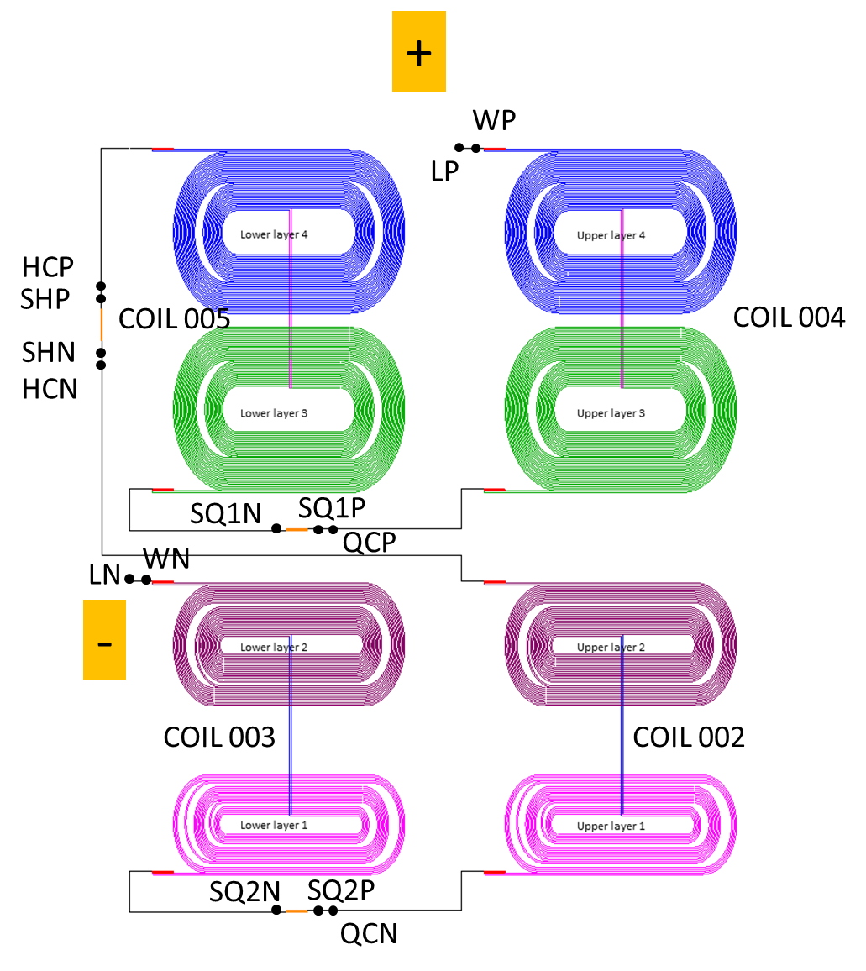
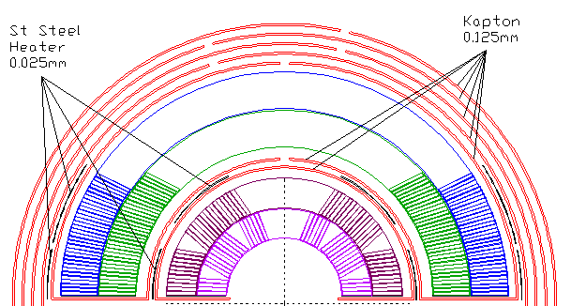
Voltage tap schematics
insulation
( )
Coil connection and
VT for NbTi-NbTi
splices between coils
Shown together with quench
protection VTs
Splices performed well in the test with measured resistances well below 1 nΩ.

Slide 4
Voltage taps
Coil instrumentation (seen from “above”)
D7
D1
D2
B1
B2
B8
D4
B5
Layer 2
D3
Layer 4
B3
D6
D5
B4
B7
B6
C3
C7
A5
A9
A8
A3
C4
C6
Layer 1
Layer 3
A4
A7
C5
A6
A1
A2
C1
C2
All VTs but one (coil 5 D03 : VT05D03) were operational in the beginning of testing.
After cool-down VTs C03, C04, C05 and C07 in both coils 4 and 5 were OPEN.
After ramp 5 (or 6) VT04D05 and VT05D06 were also OPEN.
We need to see the coils themselves to make assessments
but the losses may be correlated with SG losses (trace issues?) – see later

Slide 5
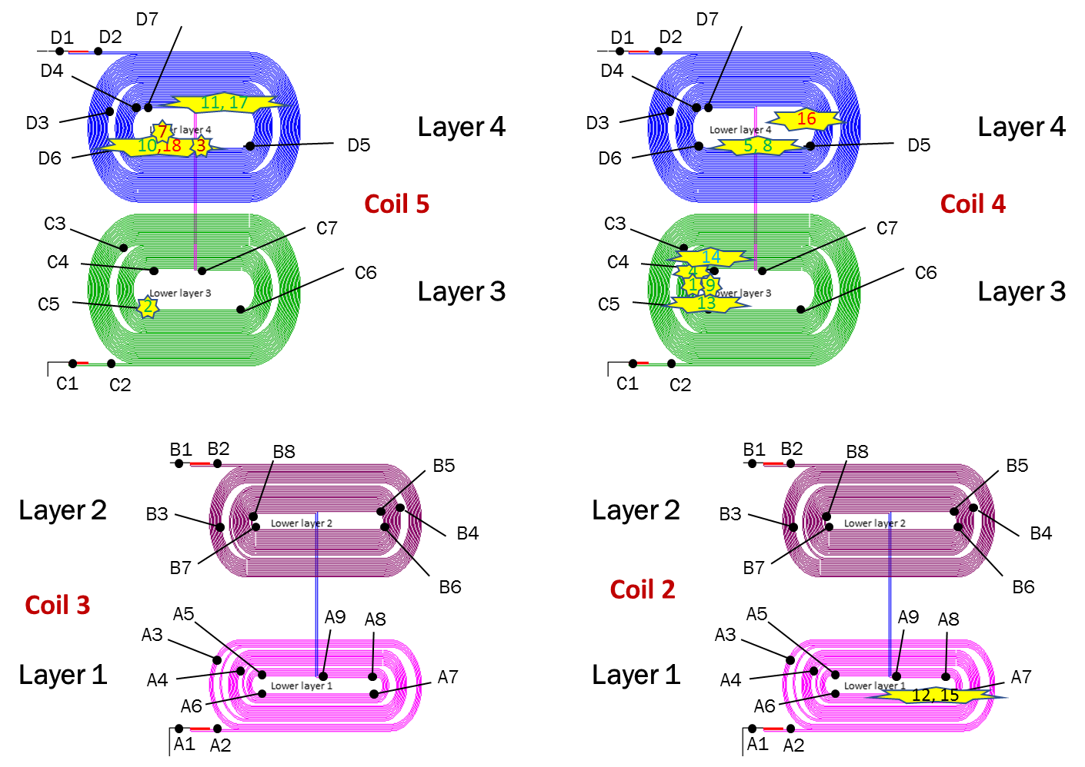
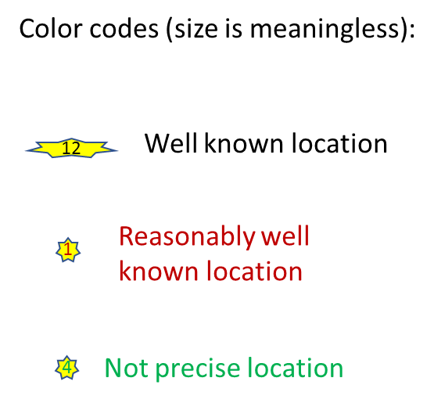
Quench locations from VT data
Open:
c3,4,5,7 (coils 4 and 5) – after cool-down
d5 (coil 4) – after ramp 5/6
d6 (coil 5) – after ramp 5/6
d3 (coil 5) – from coil fabrication
Because of open VTs many quench
locations are not well known

Slide 6
Quench antenna
warm
LBNL: seven axially
placed elements
cold
FNAL: two sets of six
axially placed elements
(each set faces a coil)
Only two quenches were in the innermost layer (layer 1).
In both we saw QA signal from the FNAL sensors although in only one sensor.
LBNL antenna did show signal in the second quench, in the first
the battery ran out (at the time we didn’t find a proper connector for powering).
We are setting a power supply connection for the future test.

Slide 7
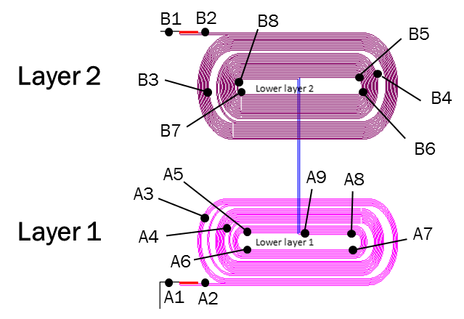
Inner layer quenches
Ramp 12 (similar for ramp 15)
Quench in coil 2/layer 1,
Iq = 9678 A
Coil 2/ Layer 1
*
Quench location
Assuming constant quench propagation velocity,
the quench happened at ~ 3 cm from VT A7
(toward the straight section or LE). The FNAL
QA active element is ~ 6-7 cm from A7 in
longitudinal direction toward LE.
The quench also propagated through a7_a8 which is
11 cm in length in 18.5 ms / t(a9_a8 = -7.6 ms)/.
This gives a propagation velocity of 0.6 cm/ms.
Turn-to-turn propagation /t(a5_a4 = -4.0 ms)/ is 23.5 ms.
Layer-to-layer propagation /t(b4_b5) = -8.0 ms/ seems to
be 19.5 ms, but this is not confirmed in a similar
quench later (or in any other quench).
Quench propagated through a6_a7 with an
average velocity of 2.3 cm/ms
/t(a6_a7 = 27.5 ms), t(a8_a7) = -26.1 ms ,
t(a6_a5) = - 3.8 ms, length of the a6_a7 segment is 57.5 cm /

Slide 8
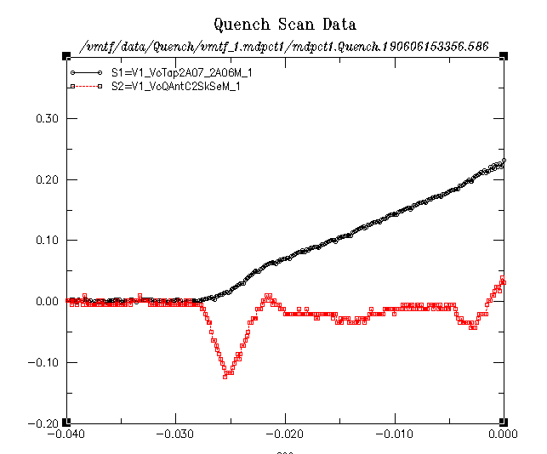
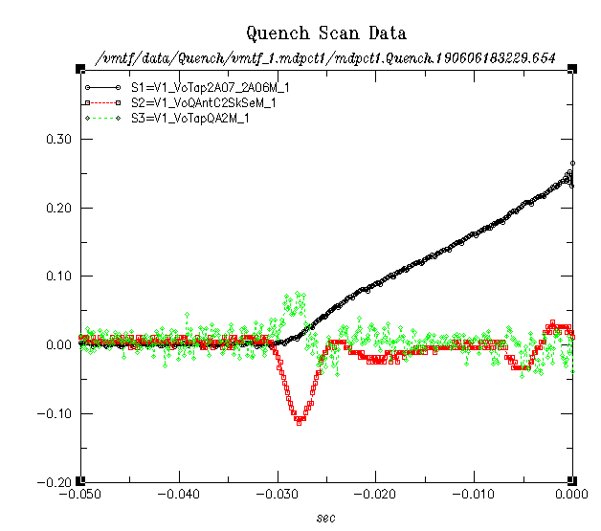
Inner layer quenches (2)
Ramp 12
Ramp 15
- VT
- FNAL QA (not to scale)
- VT
FNAL QA (not to scale)
LBNL QA
LBNL QA was not powered

Slide 9
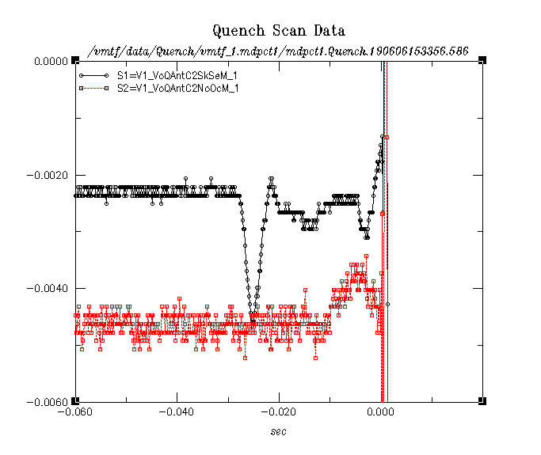
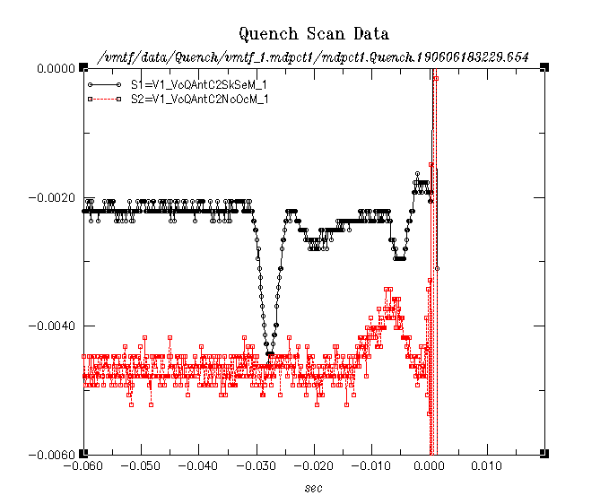
Inner layer quenches - QA
Ramp 12
FNAL QA
Ramp 15
Distance between the two
FNAL QAs is 12.7 cm
QA indicates somewhat slower propagation velocity than VTs in the straight section (factor of three).

Slide 10
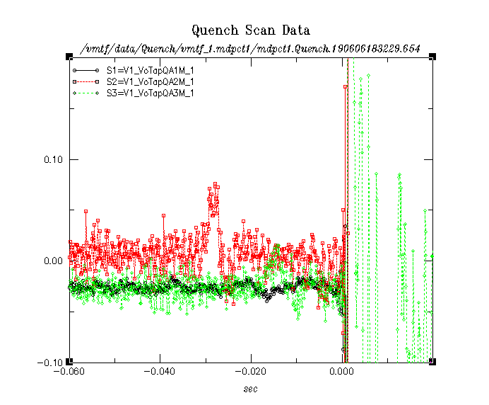
Inner layer quenches – QA (2)
LBNL QA
Ramp 15
Distance between two
LBNL QAs is 14.5 cm
The first LBNL QA active element is
~ 1-2 cm from VT A7 in longitudinal
direction toward RE .
LBNL QA also indicates slower propagation velocity than VTs in the straight section (factor of two).

Slide 11
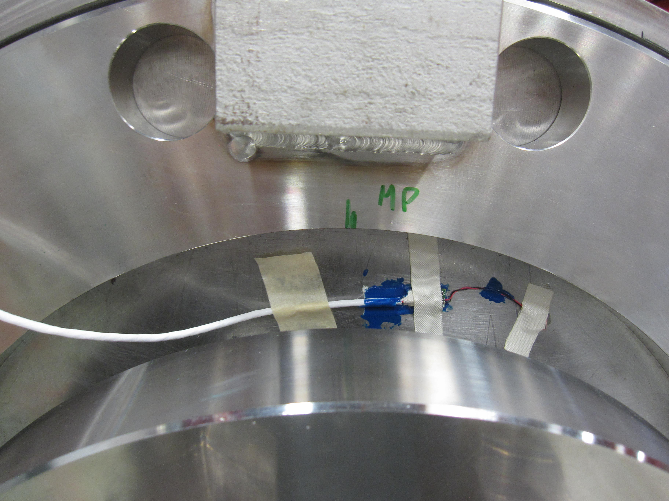
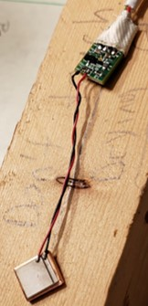
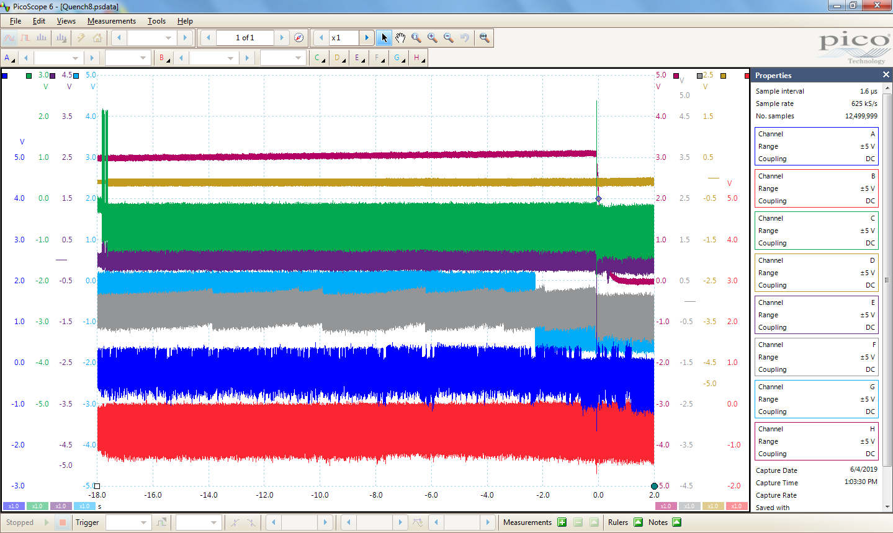
Acoustics
Two sensors on each end and three on the shell.
We couldn’t get signal for any of them during quenches
(they were tested fine before cool-down, on the magnet
when the magnet was outside the cryostat)
On the right is an example from one
of the ramps (last ~20 s of it).
The top curve is proportional to the
current (it drops to zero toward the
end). The rest are acoustic sensor
signals, shifted in the Y-axis for
clarity.
We plan to use the old-style sensors
for the next test (ends only),
they performed reliably in past.

Slide 12
Acoustics (2)
Investigations by Steve
Some potential loop areas in the wires were eliminated (reconfigured harness) – to quiet down the system and for easier troubleshooting individual sensors. This didn't do much, but it did enable us to view individual sensors current draw. We had a substantial current draw when all sensors were connected to power in parallel, ~several hundred milliamps.
We did try and individually troubleshoot a couple of the sensors, including running at a slightly increased voltage. There was some oscillatory behavior, and a little something looking like switching between states but it was not responsive to external input. They never ended up kicking over from the unusually high current draw to something more reasonable, expecting something along the lines of a couple milliamps or less per sensor. The old style sensors last a couple days on a single battery, so we are probably looking at microamps.

Slide 13
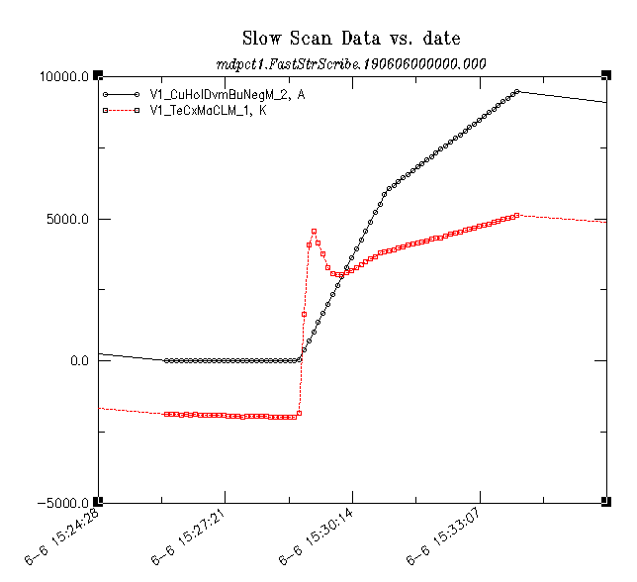
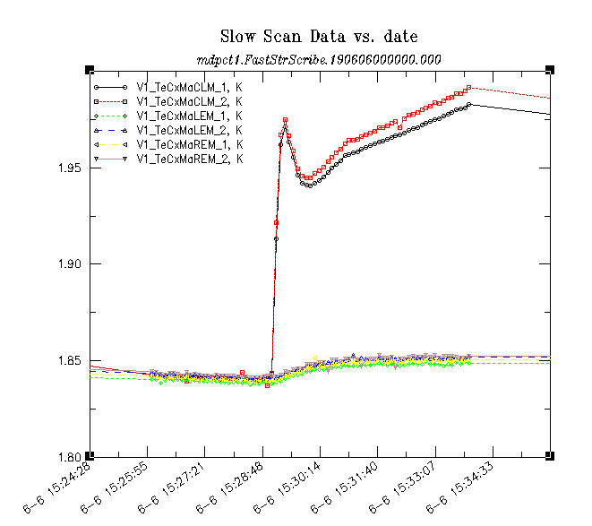
Temperature sensors
Unusually we placed two temperature sensors in the bore (facing each other in the LE bore).
One of them died (got disconnected) in the last half of the test.
[A]
Ramp 12
The bore sensors showed that the bore
temperature rises sharply during a ramp.
The slope of the rise changes with the
ramp rate.
Quenches in inner layers were at temperatures around 2 K.
The insert shows a rescaled version of a temperature graph compared with
the current ramp graph (black).
[K]
Bore
Shell (top/bottom)

Slide 14
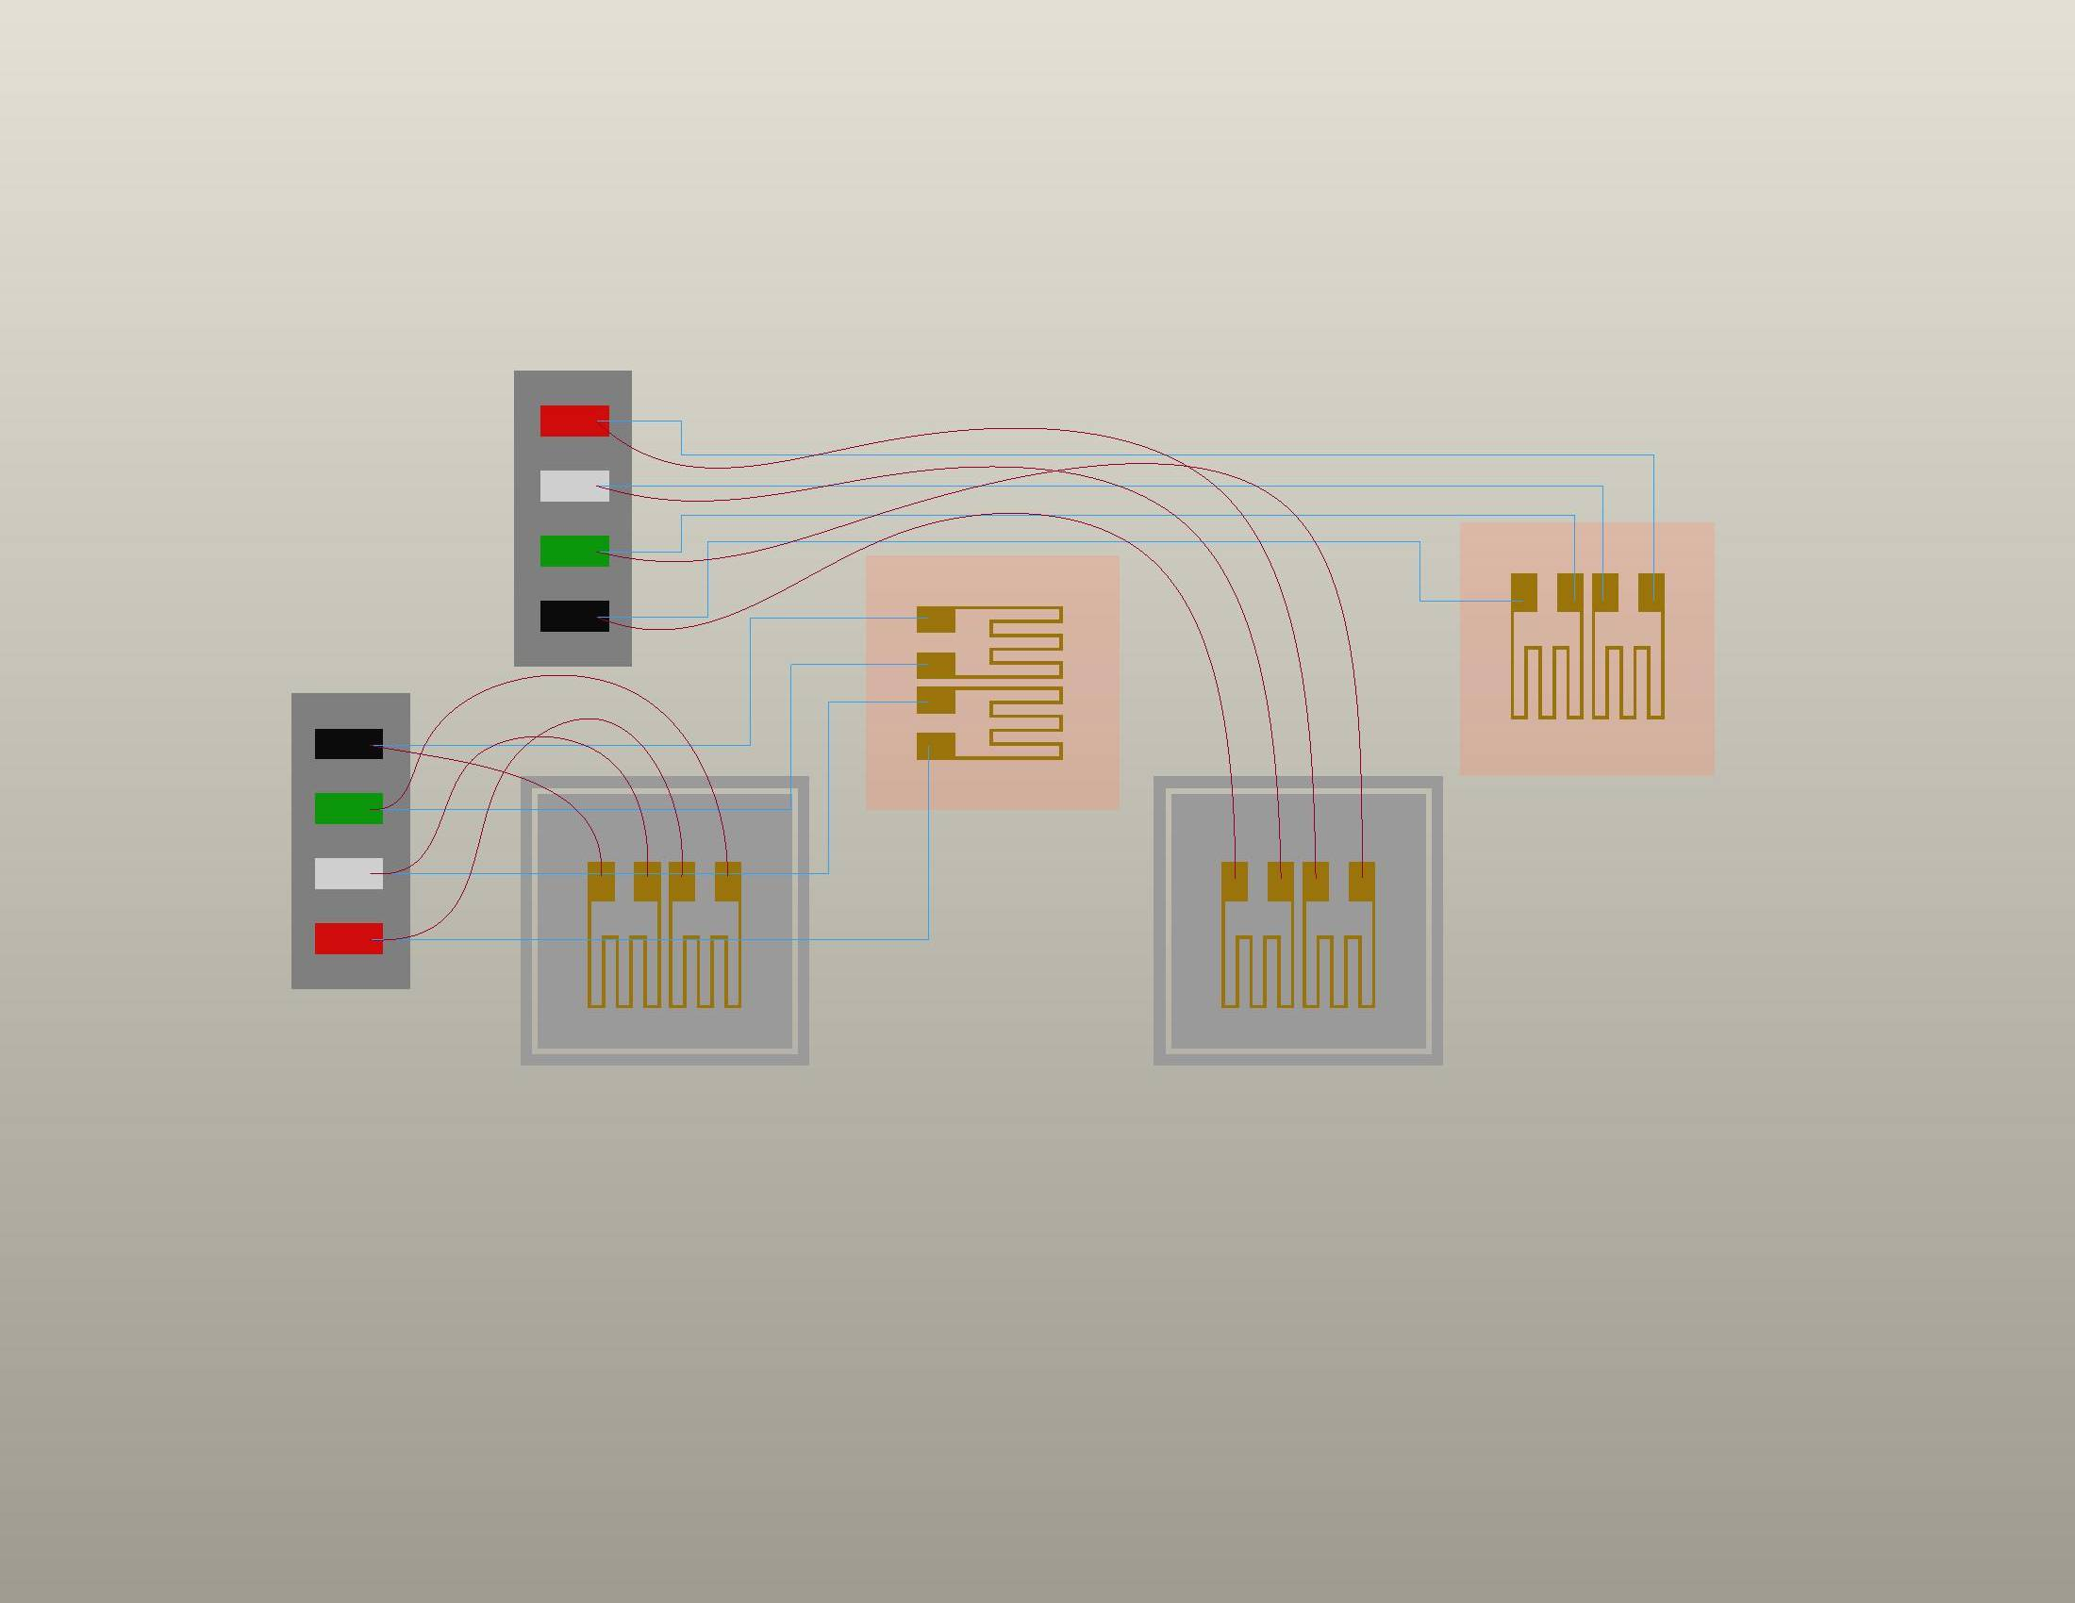
Strain gauges – half bridges where possible
ACTIVE GAGE
Bonded in Axial Direction
ACTIVE GAGE
Bonded in Transverse Direction
P+ (red)
S- (wht)
S+ (grn)
P- (blk)
We are using the
typical LBNL SG
configuration where
possible
(coil and bullet gauges
are exceptions)
TEMP-COMPENSATING GAGES
“Floating”
LBNL COIL INSTRUMENTATION
from LBNL 23N928 SPEC DWG

Slide 15
Strain gauges – half bridges where possible
64 strain gauge channels in total
Shell gauges – worked fine
Bullet gauges – worked fine (two “died” but each gauge come as one in a pair)
Clamp gauges – worked fine
Coil gauges (layer 1) – worked fine (one “died”)
Pole gauges (layer 1) – worked fine (two “died”)
Pole gauges (layer 3 and 4) – problems with hipot and shorts, disconnected after cool down
“worked fine” : it means we had read them through all stages,
it doesn’t mean we understand the data fully (it is not “noise”)
The data were in the hands of me, Igor, Shlomo and in part they are confusing (and there is a lot of data).
Often we can make trivial conclusions (the structure twists).
And probably more dedicated time on those studies is needed.

Slide 16
SG - cool-down and warm up
All normalized to ZERO just before cool-down, in microStrain

Slide 17
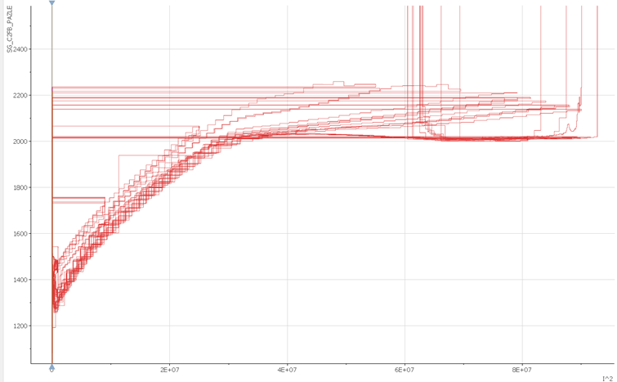
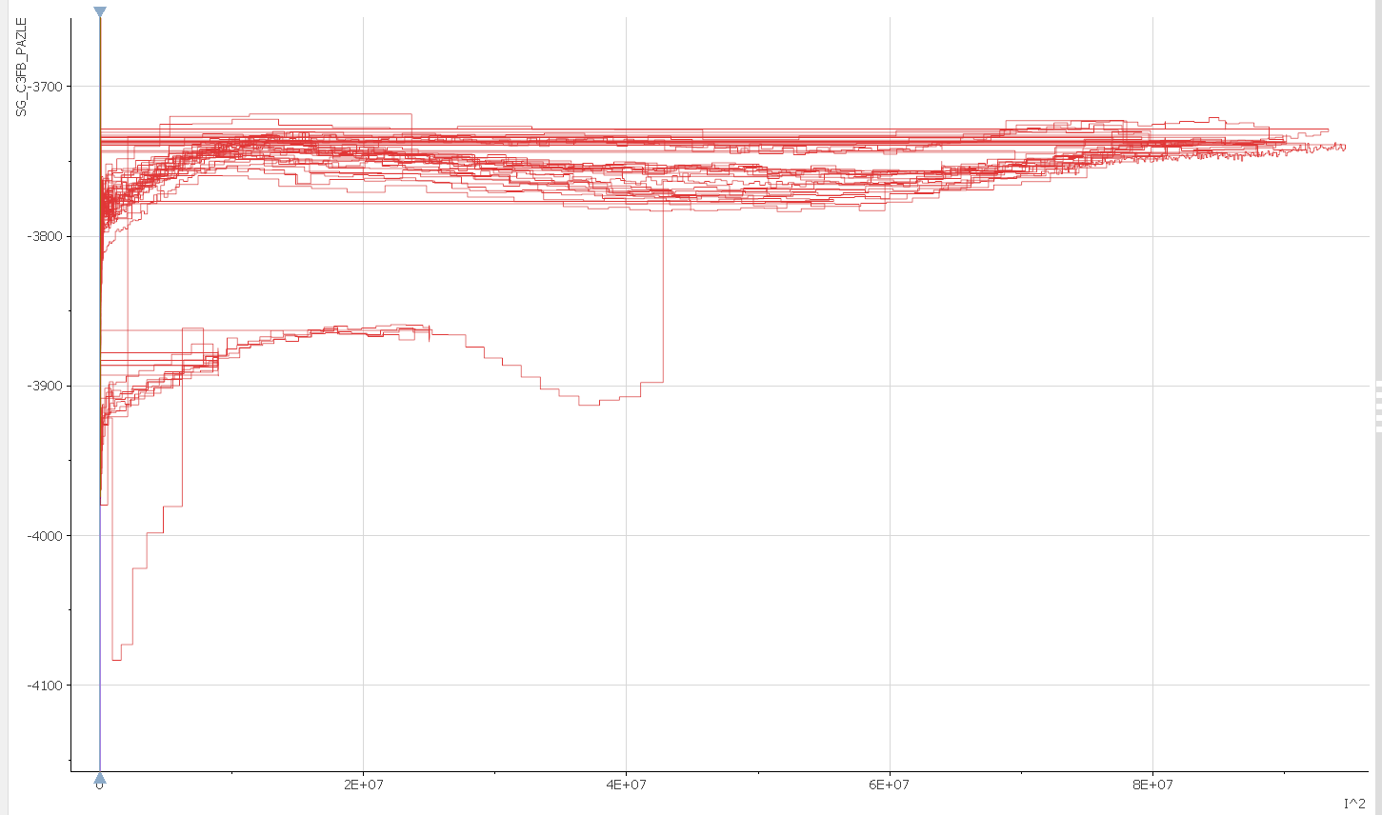
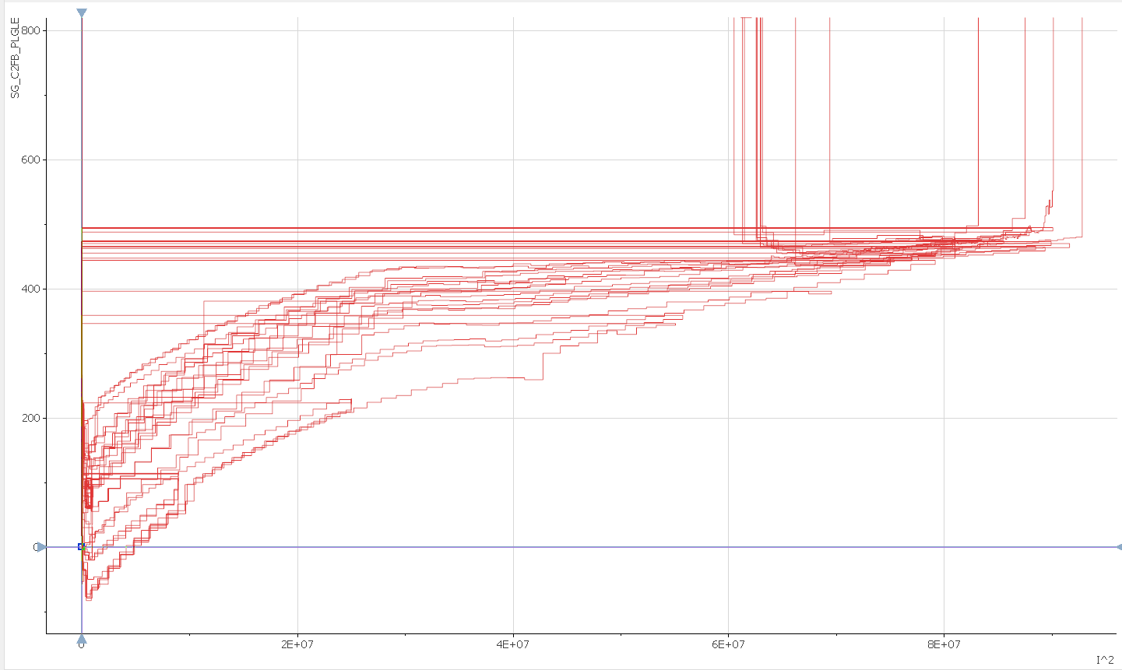
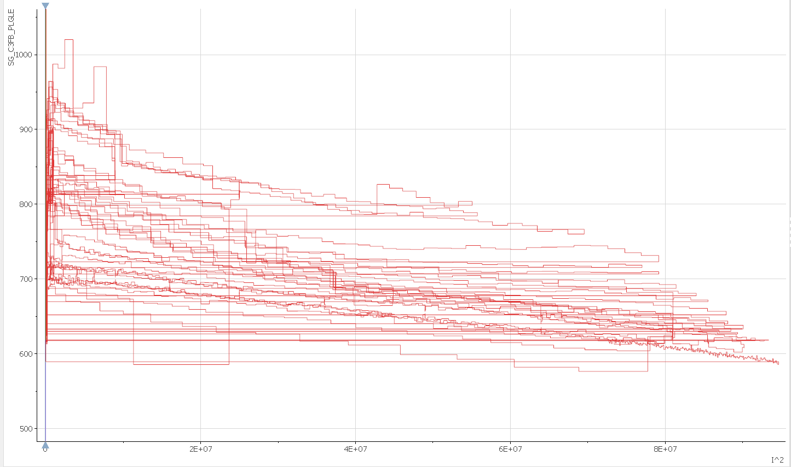
Ramps – strain vs I² (pole, layer 1)
Not seen in RE
2000
-3800
1500
C2_PAZLE
-4000
C3_PAZLE
9² [kA²]
C3:
different
behavior
Not seen in RE
1000
C3_PLGLE
500
C2_PLGLE
0
500

Slide 18
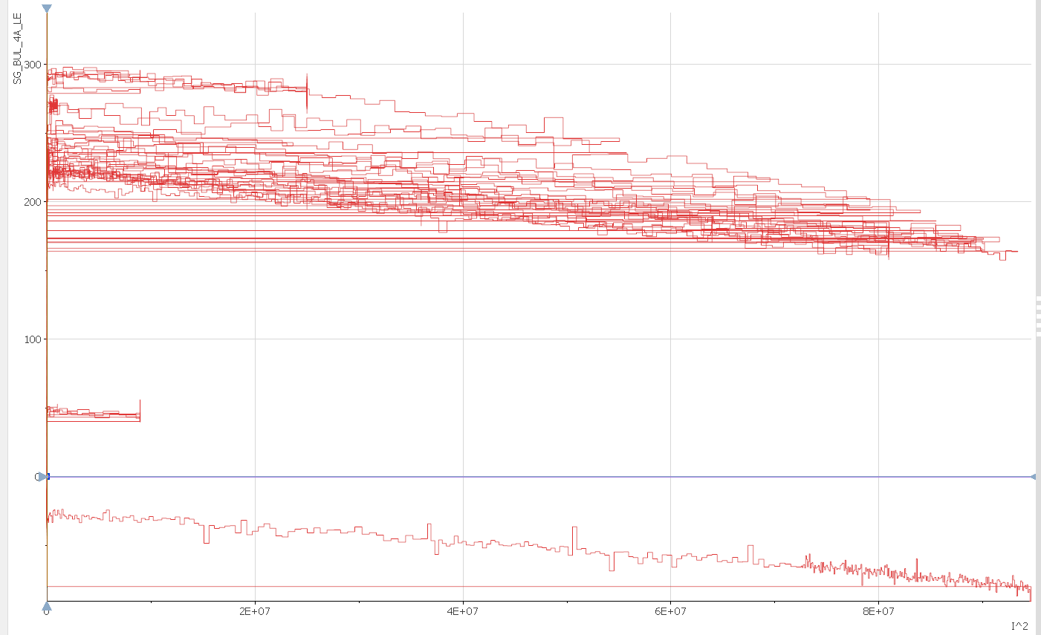
Ramps – strain vs I²
4_LE
Bullet SG
Bullet gauges were more consistent
shape-wise.
The relative changes during ramps
(poles, bullets) were about the same within a gauge type within a factor of two
The initial strain after each ramp kept increasing/decreasing (a bit)
200
0
This is the only ramp at 4.5 K
(not ideal compensation).
The RE showed consistently reverse behavior
(higher readable strain at 4.5 K).

Slide 19
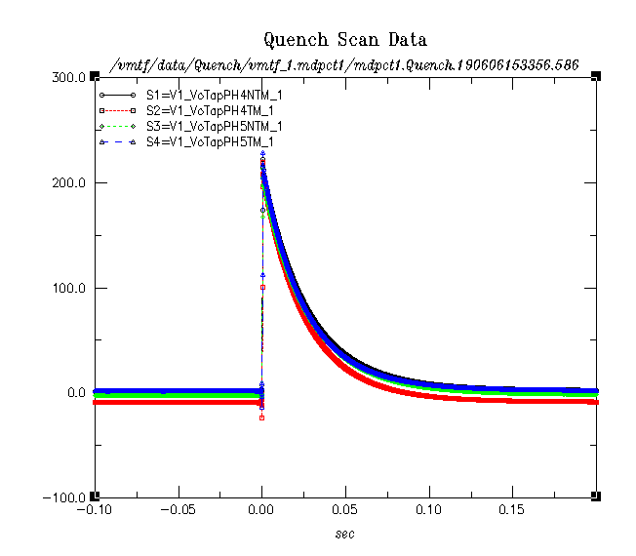
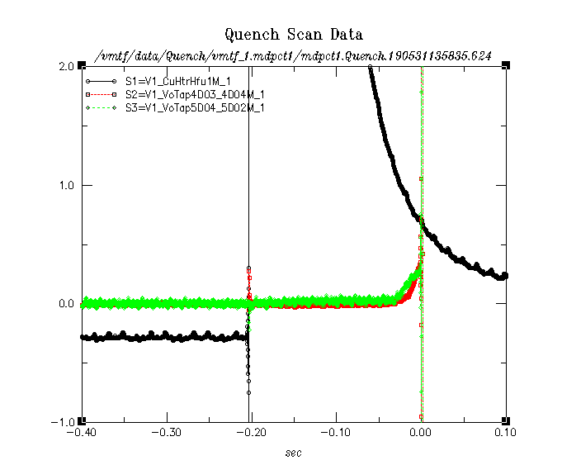
Heaters
Four external heaters (8 strips), as in 11 T – operated well
Voltages on the four heaters during a
typical protection discharge (ramp 12)
Heater discharge (current, black) and
coil segment responses in a dedicated
test at 3 kA
Here heater delay (response)
is measured to be 172 ms
At maxim allocated 15 MIITs (~320 K hotspot T) the highest reached was 11.2 MIITs (~200 K)

Slide 20
“Spike” data
We also took voltage “spike” data (bucked coil signals with “minimal” noise) for many
ramps but it was only partially analyzed to the extend to show there are usable data there.
No relevant results to show yet.

Slide 21
Summary
Characterization voltage taps in the outer layers were lost and this compromised the quench characterization in many quenches
The two inner layer quenches were well measured
We plan to fix issues as much as we can for the next test
Splices were measured fine
Quench antennas worked well
Reliable and fast signal, helps to pin point the quench origin too (layer 1)
We plan to use a power supply for the LBNL antenna instead of batteries
Acoustics did not work
We plan to use the “old” type sensors which we used at FNAL in past
Protection heaters and temperature sensors worked fine
We lost one temperature sensor during testing but that is why we have “back ups”
Most of the strain gauges worked fine but we lost all pole gauges in layers 3 and 4
May be related to the loss of VTs in the same layers
We plan to fix issues as much as we can for the next test
Data analysis is puzzling as usual

Slide 22
Back up

Slide 23
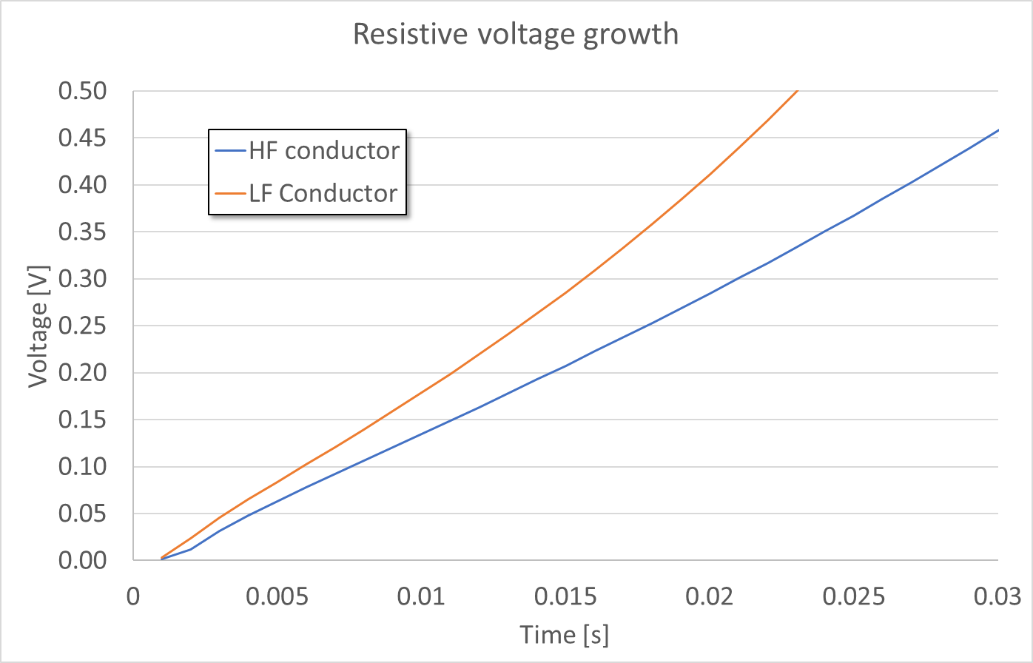
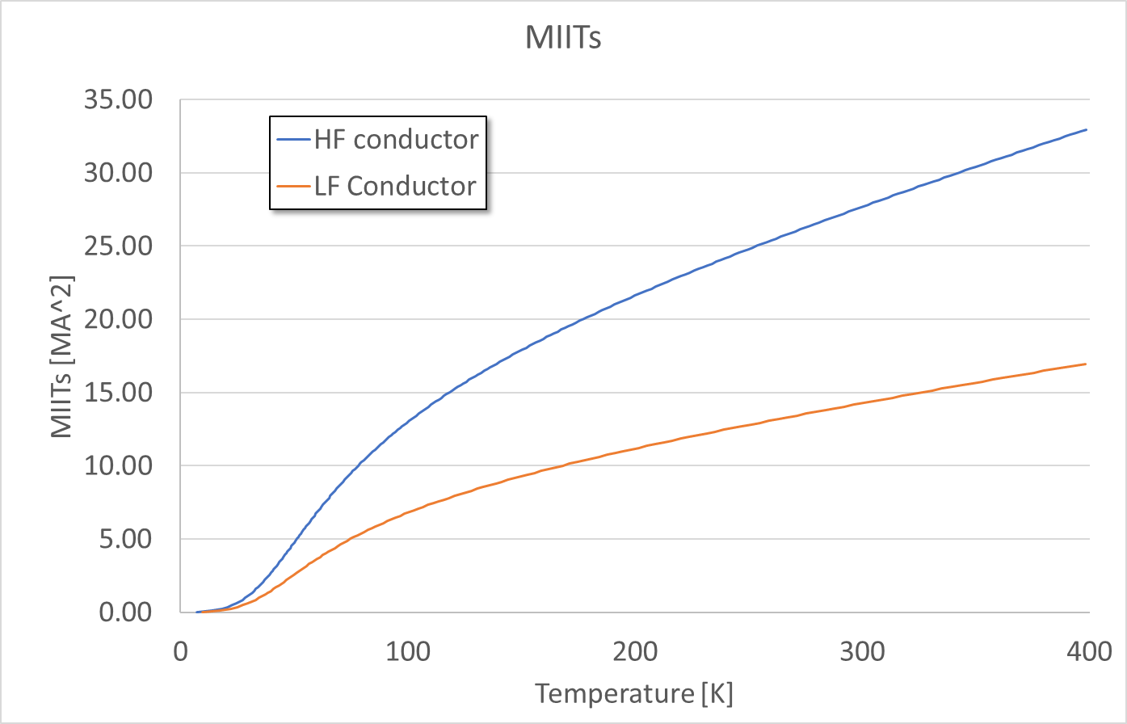
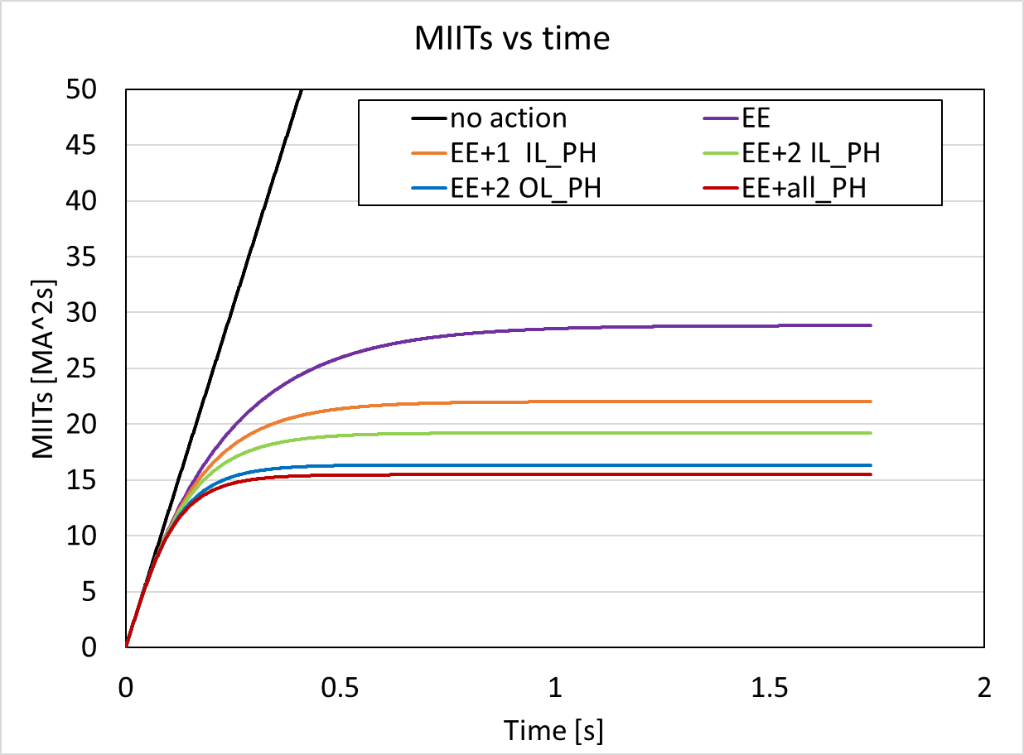
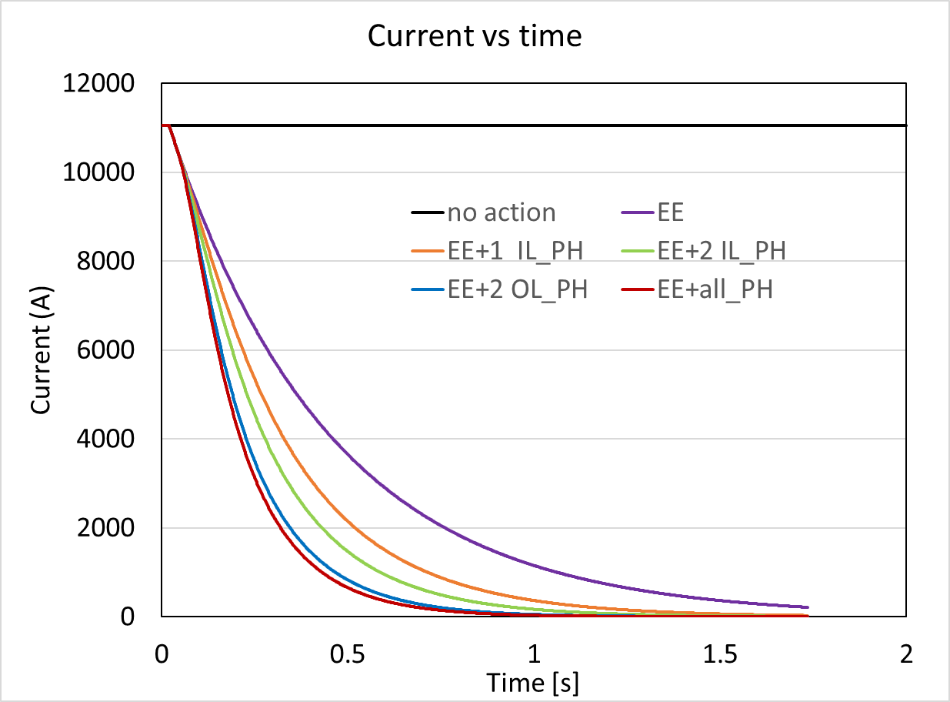
Magnet safety
MIITs budget:
conservative
estimates for various
failure scenarios
Vittorio M.
and Stoyan S.

Slide 24
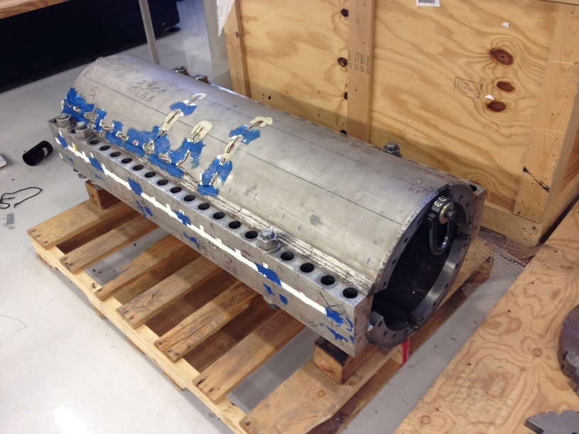
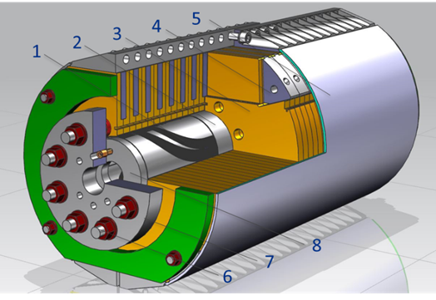
Skin and bullet strain gauges
Example from 11 T models
Instrumented
skin gages
Two positions (~ 70 cm apart longitudinally) around the magnet center to be instrumented
- At 75º and 45º
- Azimuthal and axial gages
- Two opposite sides of the magnet circumference
16 skin SG (“half bridge”).
Bullet
with
SG
15 T model
There are 8 bullet holes on the LE and 10 bullet holes on the RE
- A bullet is instrumented with 2 SG
- One TC on each side of the magnet
- Only part to be instrumented
18 bullet SG (including TC).
bullet
Those are all “standard” positions

Slide 25
DAQ channels
Voltage Taps: 50 coil channels to use
Splices will take about 10 more channels
102 channels available (the “spare” ones can be used for other type of data –
a back up option)
Strain gauges – all 64 channels to use
All gauges as discussed except: 10 skin SG (“half bridge”) instead of 16
One half of the skin will be fully read, and the other will have a single station (azimuthal, longitudinal readings) read out – 10 channels in total
Protection heaters: 12 channels to use
Includes the additional (non-trace) heaters – see later
There are still four spare channels
Quench antenna – 12 dedicated channels to use
There are 13 available
Several additional independent channels will be read by the independent LBNL DAQ
(high rate)
Acoustics – between 4 and 6 channels
The whole measurement system will be provided by LBNL
High read-out rate (1 MHz)

