Slide 1
Flexible Quench Antenna for CCT
MDP meeting
August, 2019
Stoyan Stoynev, Joe diMarco
US Magnet Development Program
Fermi National Accelerator Laboratory

Slide 2
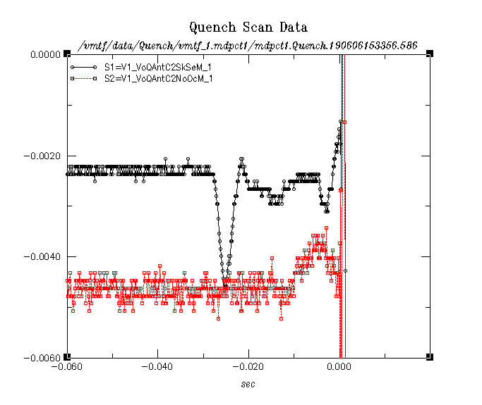
Flexible quench antenna boards
Small flexible QA boards were tested
earlier in LARP and now the 15 T magnet
They performed very well.
Few months ago we initiated a discussion
with Diego and Maxim about the
benefits of using the technology with CCT
(seems perfect match for the small models).
After some time with technical problems at FNAL
we are now committed to finalize the task.
Distance between the two
FNAL QAs is 12.7 cm

Slide 3
QA array (2D grid)
We want to cover the whole surface of a CCT coil with QA channels to form a 2D grid.
For the first test we don’t need optimizations, we’ll use the channels as they are in the small
boards and just re-scale.
We got preliminary parameters for the inner layer of a short CCT

Slide 4
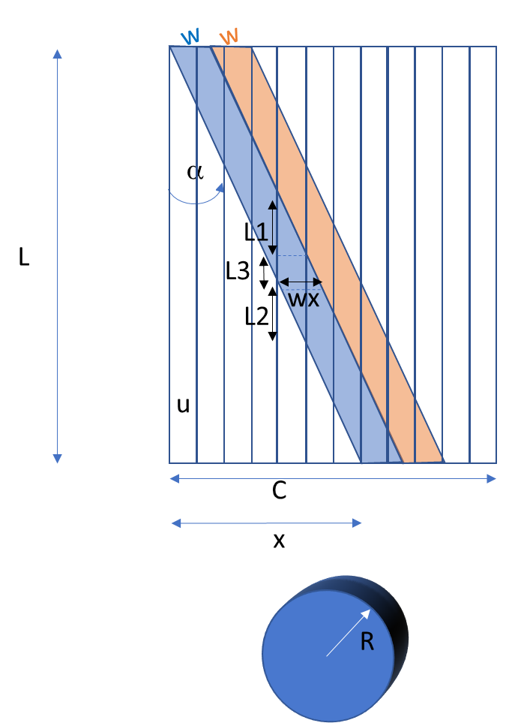
QA array dimensions
R: radius of cylinder to be covered with QA
C=2*pi*R : circumference of cylinder
L : length of QA
Tan(α) < C/L
Tan(α) = x/L
w: width of angled QA loop
u: width of straight loops
wx: width of angled loops in the x direction
L_angLoop: length of angled loops
Nch_angLoop: number of angled loops needed
R=
L=
Nch_x=
C=2*pi*R
u=C/Nch_x
w=u*1.5
%% slopeFraction must be <=1
slopeFraction=0.75
x=slopeFraction*C
alpha=atan2(x,L)
L_angLoop=L/cos(alpha)
wx=w/cos(alpha)
Nch_angLoop=C/wx
L1=w/sin(alpha)
L2=L1
L3=(u-wx)/tan(alpha)
Z_resolution=L1+L2+L3
We need only six
channels per
dimension
in the current
configuration

Slide 5
QA array
0.585m long QA for CCT
(z resolution 200mm, 12 channels)
Toy-model
h
L=585mm
R=32mm
C=201mm
Nch_x=6
U=33.5mm
W=33.5mm
wx=35.4mm
x=201
Alpha=0.33rad (18.9 deg.)
L_angLoop=L/cos(alpha) =618.6mm
Nch_angLoop=5.7
h=200mm
Equal to the circumference of the cylinder (coil)

Slide 6
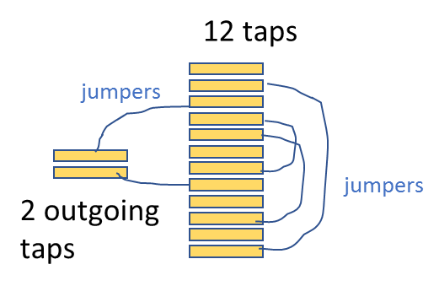
Wrapping up
There will be six independent “strips” (on a single sheet) and three sheets – only two on two sheet shown below
18 channels in total
Third layer with strips in this direction to address some R&D issues
Each strip will look like this at the end:
However those could be rerouted
(to grooves) and then the question is what
is the right geometry that will fit
your coils. In other words how do you want
to take the signals out.
~150 microns thickness per sheet
Although there are 12 taps on the trace, there will be only two active (there are proper jumpers to be applied on the trace to choose the configuration; we want to be able to choose for possible retesting), so only two (twisted) wires are needed to take the signal out. It could look like this on the trace (except the jumpers) :

