Slide 1
Welcome back to Berkeley!
Barbara Jacak
Nuclear Science Division
Lawrence Berkeley National Laboratory
and
Department of Physics, UC Berkeley
September 18, 2019

Slide 2
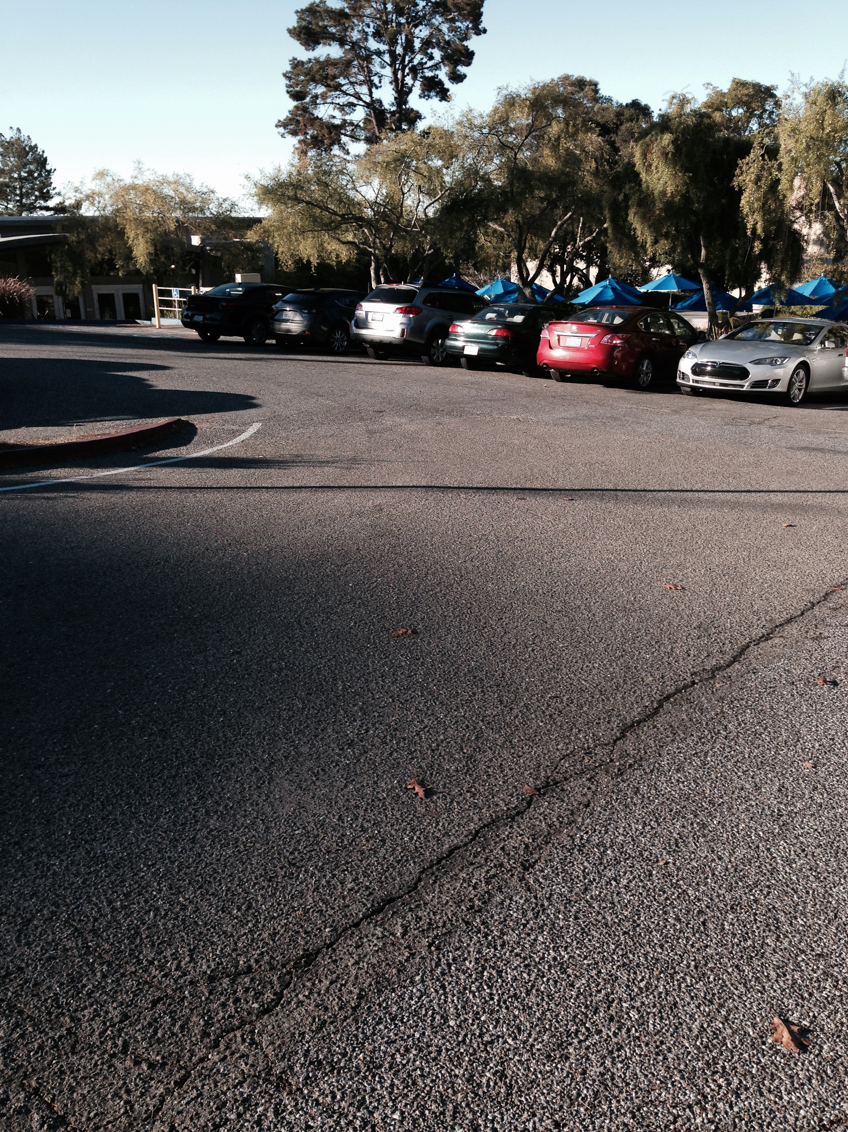
You are in earthquake country!
Drop down on the floor.
Cover under a sturdy desk, table or other furniture. In an auditorium, cover your head with your arms and get between rows of chairs.
Hold on and be prepared to move with the furniture
Evacuate to the assembly area (in the front parking lot).
Follow Directions from the building emergency team.

Slide 3
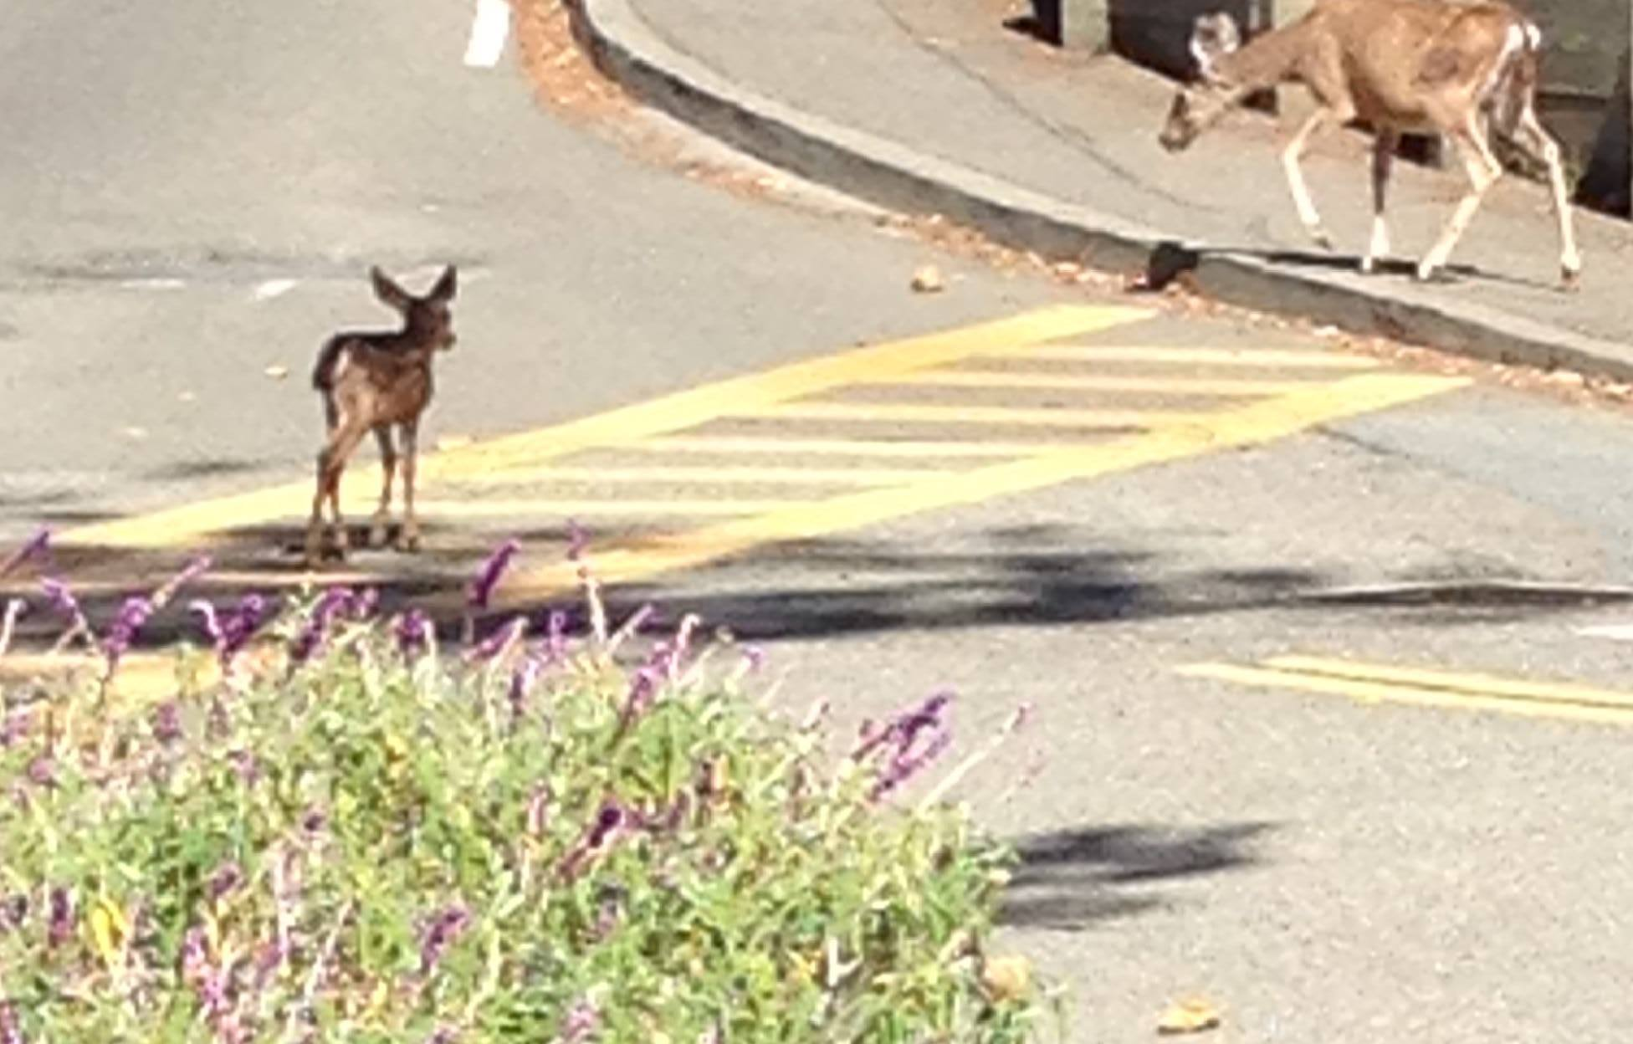
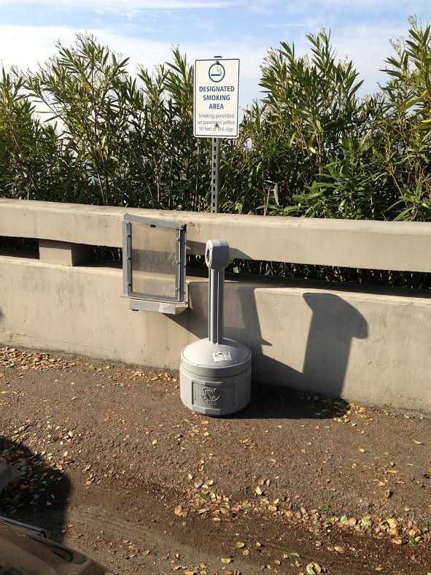
Things to know about LBNL
Traffic Safety
Speed limit is 15 mph
Follow traffic and parking signs
Pedestrian Safety
Stay on the sidewalk
Cross at crosswalks
Smoking Policy
The Lab provides ash cans in a few outdoor designated smoking areas
Traffic Safety
Speed limit is 15 mph
Follow traffic and parking signs
Obey all traffic control personnel and security officers
Bicyclists must wear helmets and obey traffic rules and signs
Pedestrian Safety
Stay on the sidewalk
Cross at crosswalks

Slide 4
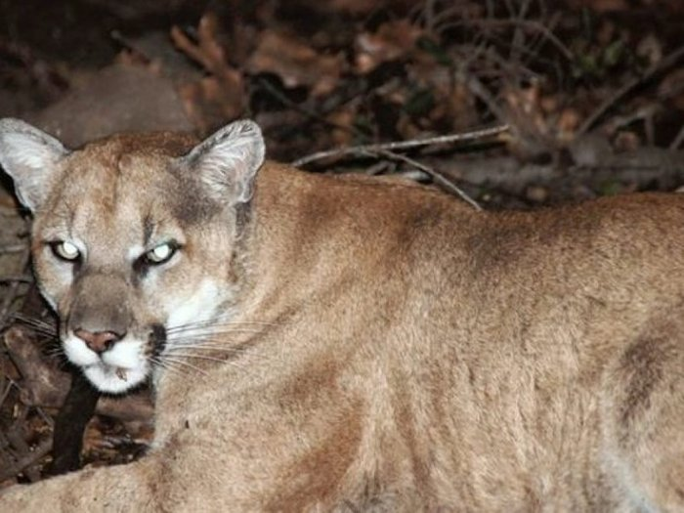
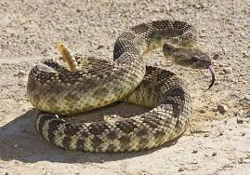
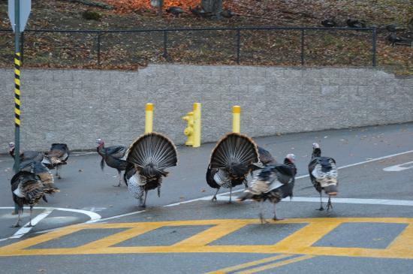
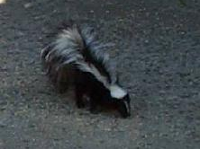
We also have other critters
But you are unlikely to see any of them
(except for turkeys)

Slide 5
Logistics for this meeting
Indico page with the talks:
https://conferences.lbl.gov/event/239/
please upload your slides, or ask Miguel to help
Video and audio connection using zoom
Coffee breaks and lunch will be provided
Thank you, UC!
No dinner arranged for tonight
Many POETIC participants are already here

Slide 6
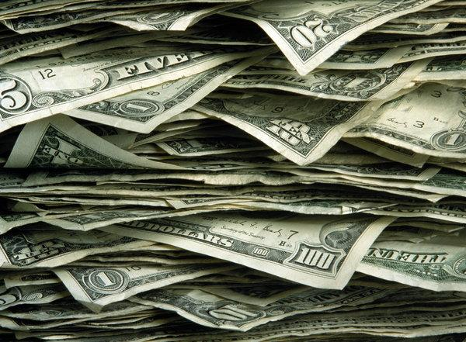
Financial logistics for the Consortium
All campuses should have our money
any problems?
Does everyone have students on board?
I was able to swap some grad $ for undergrad
UCB Research Administrator is Ms. Ying Zhang
Start date was retroactive to January 1, 2019
Meeting support
each campus received travel funds
we received meeting support funds
will labs be able to participate in SoCal meeting?

Slide 7
Finances for the National Lab groups
Successful competition to seed the consortium is considered an achievement at the labs
Possible strategy: use MRPI success to support request for LDRD while we are in “seed” period (2019 and 2020)
LANL was successful, right?
LBNL has a plan, to begin in FY20 (early, I hope)
LLNL participation secured?

Slide 8
MRPI Reporting requirements
Lead PI is responsible for coordinating with Co-PI’s
Need coordinated submission of annual progress and final reports
Annual progress and financial reports must be submitted to UC Research Initiatives at RGPOGGrants@ucop.edu
On or before Nov. 30 of each year, unless otherwise instructed
Instructions for completing and submitting reporting forms will be provided at a future date
“If you don’t receive instructions, it is your responsibility to contact our office and request guidance”
I have heard nothing so far!
I propose to request guidance at the beginning of November. OK?

Slide 9
Last time we said:
Set simulation goals for each campus
How do each unit’s goals fit into the whole?
Articulate how the whole is > sum of the parts
How the work benefits from the consortium
How the studies we start now bring us into the detector development business
How we come into the broader community as a big group (instead of a loose confederation of small groups)
Define success for the consortium over the next 2 years
What metrics will use to measure progress toward that
Report to UCOP, as required
Presentations at workshops, conferences; publications?

Slide 10
Advertising our consortium & output
Time to seek speaking opportunities as a consortium?
Become visible as a consortium
Reports on pooled results more impactful
Help to get us “on the EIC map”
Let’s plan at the end of today
Venues of interest
Conferences: POETIC, DIS, Moriond, APS GHP, Lepton-Photon, PANIC, etc.
Users group: EICUG, others: RHIC, Jlab Users’ Groups, where else?
Workshops...

Slide 11
UC Berkeley

Slide 12
Group members active on EIC
Miguel Arratia
Ezra Lesser, possibly Dhruv Dixit
Jose Soria
Youqi Song
Barbara Jacak
New undergrad students…
Will recruit new postdoc & new grad student this year
Expand close collaboration with
Ernst Sichtermann, Yue Shi Lai from LBNL

Slide 13
UCB Goals for MRPI
Simulate jet production and reconstruction
Aim to specify
tracking requirements
Jet reconstruction also implies requirements on calorimetry performance and design
Required statistics (will affect run time and triggering requirements)
What it takes to make 1% precision measurements?
Use physics-driven performance specs and connect with detector technology R&D
Collaborate with LBNL on tracker design

Slide 14
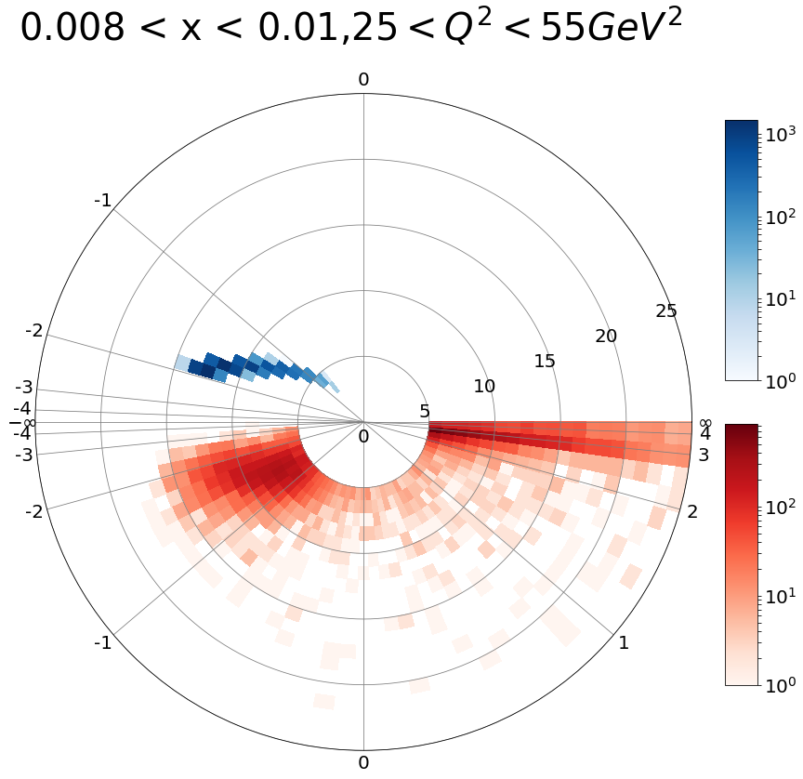
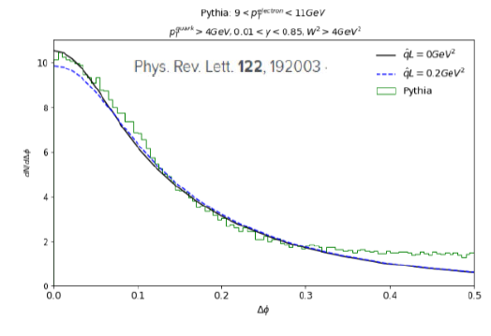
Approach
Focus on jet probes of cold, dense matter
Begin with kinematics studies
Identify struck quark in DIS as our probe
Characterize jets from the struck quark
Interesting Measurements:
Jet yields & spectra in e+p & e+A
Energy balance, opening angle to get q-hat
Jet fragmentation functions & modification
Jet substructure & modifications in cold QCD matter
Begin with particle level from PYTHIA
Next add effects of detector response

Slide 15
Results
In February, we had first results on particle multiplicities and where the jets go
Now
How to connect jet with struck quark & separate the beam remnant; where the jets go (Youqi Song)
x range accessible & Q² required (Youqi Song)
Nature of the jets & jets vs. single hadrons (Youqi Song)
Physics accessible, statistics & systematics needed (Miguel Arratia)
Jet correlations with scattered electron (tag the photon); what reference frame to use (Miguel Arratia)

Slide 16
Next steps
Simulate effects of tracking detector response
Reconstruction precision of scattered electron
How well we tag the struck quark
Effects of tracking efficiency & resolution on jet reconstruction & jet energy scale
Optimize tracker barrel/endcap arrangement based on where the jets go
Calorimetry requirements for jet trigger & reconstruction
+ measurement of scattered electron energy

Slide 17
Next steps, continued
How well can we measure substructure variables?
What detector hardware R&D is needed?
What to copy & what to develop for silicon pixels?
How to utilize timing information.
Address these in collaboration with LBNL.
Figure out how best to use the technical infrastructure of the 3 labs for tracker development (detector hardware development & computing)

