Slide 1
UCR Group Updates
Medium Energy:
Faculty: Ken Barish, (+ Miguel 1/1/2020)
Postdocs: Chong Kim, Latif Kabir, +1 PD (Miguel’s)
Grad students: William Baker, Malia Chevalier, David Kapukchyan, Xilin Liang, + 1-2 students (Miguel’s).
Heavy-Ion:
Faculty: Rich Seto
Postdocs: Yang Wu
Grad students: Erik Loyd, Camron Racz, Liankun Zou, Ding Chen
UG student: Riley Gleason

Slide 2
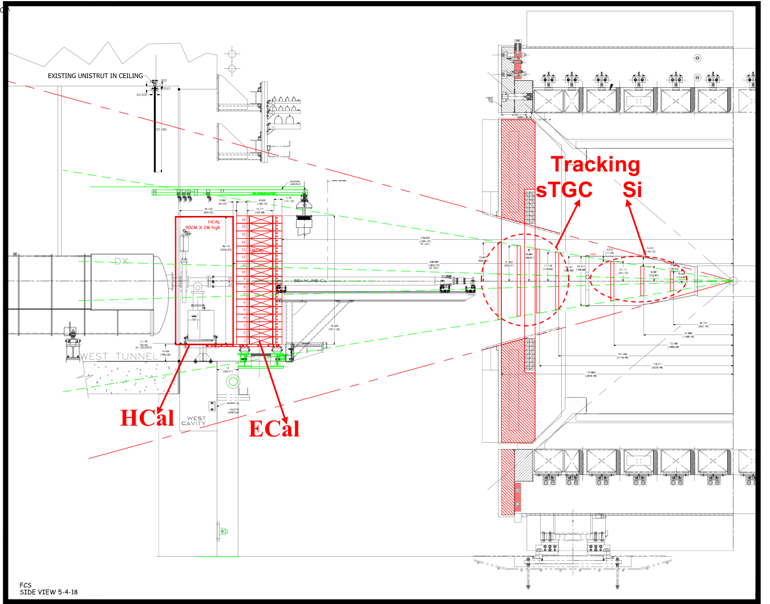
STAR Forward Upgrade
Calorimeter System
Intensive R&D work on both ECal and HCal as part of STAR and EIC Detector R&D
Beam tests and STAR in situ tests
System optimized for cost and performance
Same readout for both calorimeters → cost
ECal Reuse PHENIX PbSC calorimeter with new readout instead of W/ScFi SPACAL
Significant cost reduction ☺
Non-compensating calorimeter system ☹
HCal: Sandwich iron-scintillator plate sampling calorimeter.
NSF MRI for FCAL funded!!
Path to EIC.
Side View
Ding Chen, David Kapukchyan, Xilin Liang.
2

Slide 3
TMDs at STAR
Pushing forward => higher x:
0.05 ≲ x ≲ 0.5, 10 ≲ Q² ≲ 100 GeV²
STAR unique kinematics: from high to low x at high Q²
500 GeV
1<η<4
Notes:
The x-Q² plane for data from the future EIC and Jlab-12 GeV as well as the current SIDIS data and the W-boson data from RHIC. All data are sensitive to the Sivers function and transversity times the Collins FF in the TMD formalism.
We note that this is a fundamental advantage of p+p collisions, as any SIDIS measurement of the d-quark transversity has to be on a bound system, i.e. He-3, which leads to nuclear corrections. The high scale we can reach in 500 GeV collisions at RHIC will also allow for the verification that previous SIDIS measurements at low scales are, in fact, accessing the nucleon at leading twist. Figure 2‑6 shows the x-Q² coverage spanned by the RHIC measurements compared to a future EIC, JLab-12, and the current SIDIS world data.

Slide 4
Initial State of Nuclei
Current knowledge including
first LHC pA data
Understanding the initial state of heavy nuclei is critical to RHIC and LHC programs
Knowledge currently limited when compared to our knowledge of free protons
EPJ C77, 163 (2017)
Opportunities with pA@RHIC:
Can measure nuclear PDFs (nPDFs) in a x-Q² region where nuclear effects are large
Q² > Q_{s}² over a wide range in x
Access to observables free of final state effects
Gluons: R_{pA} for direct photons
Sea-quarks: R_{pA} for DY
Access to saturation region at forward rapidities
Capability to scan A-dependence prediction by saturation models
pA@RHIC: unique kinematics
RHIC pA y≤4
direct photon
2.8 < η < 3.8
Saturation
Notes:
Figure 2‑15: Summary of the most recent sets of nPDFs. The central values and their uncertainty estimates are given for the up valence quark, up sea quark, and the gluon. The yellow bands indicate regions in x where the fits are not constrained by any data (taken from Ref. []). [] H. Paukkunen, DIS-2014, http://indico.cern.ch/event/258017/session/1/contribution/222/material/slides/0.pdf
Figure 2‑16: The nuclear modifications at Q²=10GeV² from the EPPS-16 fit (black central line and light-blue bands) compared with the Baseline fit (green curves with hatching) which uses only the data included in the EPS09 fit.
Figure 2‑20: The kinematic coverage in x–Q² of past, present and future experiments constraining nPDFs with access to the exact parton kinematics event-by-event and no fragmentation in the final state.
Figure 2‑20 shows the kinematic coverage in x–Q² of past, present, and future experiments capable of constraining nuclear parton distribution functions. The experiments shown provide measurements that access the initial state parton kinematics on an event-by event basis (in a leading order approximation) while remaining insensitive to any nuclear effects in the final state. Some of the LHC experiments cover the same x-range as DY at forward pseudo-rapidities at RHIC but at a much higher scale Q², where nuclear modifications are already significantly reduced [67,]. At intermediate Q², DY at RHIC will extend the low-x reach by nearly one decade compared to EIC.
[] H. Paukkunen, K. J. Eskola, and C. A. Salgado, Nucl. Phys. A931 (2014) 331;
K. J. Eskola, H. Paukkunen, and C. A. Salgado, JHEP 1310, 213 (2013).
does essential Day 1 Physics
In the following we propose a measurement program unique to RHIC to constrain the initial state effects in strong interactions in the nuclear environment. We also highlight the complementarity to the LHC p+Pb program and stress why RHIC data are essential and unique in the quest to further our understanding of nuclei. The uniqueness of the RHIC program is based on the flexibility of the RHIC accelerator to run collisions of different particle species at very different center-of-mass energies. This in combination with the existing and planned STAR detector capabilities allows to disentangle nuclear effects in the initial and final state as well as leading twist shadowing from saturation effects in a kinematic regime where all these effects are predicted to be large. The discussed measurements critically rely on the forward upgrade described in section 3.
Our current understanding of nuclear parton distribution functions (nPDFs) is still very limited, in particular when compared with the rather precise knowledge of PDFs for free protons collected over the past 30 years. Figure 2‑15 shows an extraction of nPDFs from available data, along with estimates of uncertainties. All results are shown in terms of the nuclear modification ratios, i.e., scaled by the respective PDF of the free proton. The yellow bands indicate regions in x where the fits are not constrained by data [] and merely reflect the freedom in the functional form assumed in the different fits. Clearly, high precision data at small x and for various different values of Q² are needed to better constrain the magnitude of suppression in the x region where non-linear effects in the scale evolution are expected. In addition, such data are needed for several different nuclei, as the A-dependence of nPDFs cannot be predicted from first principles in pQCD and, again, currently relies on assumptions. Note that the difference between DSSZ [] and EPS09 for the gluon modification arise from the different treatment of the PHENIX midrapidity p⁰ R_{dAu} data [], which in the EPS09 [] fit are included with an extra weight of 20. The p⁰ R_{dAu} data are the only data, which can probe the gluon in the nucleus directly, but these data also suffer from unknown nuclear effects in the final state (see Ref. []). Therefore, it is absolutely critical to have high precision data only sensitive to nuclear modification in the initial state over a wide range in x and intermediate values of Q², away from the saturation regime but where nuclear effects are still large, to establish the nuclear modification of gluons in this kinematic range.
[] H. Paukkunen, DIS-2014,
http://indico.cern.ch/event/258017/session/1/contribution/222/material/slides/0.pdf
[] D. de Florian, R. Sassot, M. Stratmann, and P. Zurita, Phys.Rev. D85 (2012) 074028.
[] PHENIX Collaboration, Phys.Rev.Lett. 98 (2007) 172302.
[] K. J. Eskola, H. Paukkunen, and C. A. Salgado, JHEP 0904, 065 (2009).
[] R. Sassot, M. Stratmann, and P. Zurita, Phys. Rev. D81 (2010) 054001.
It is important to realize that the measurements from RHIC are compelling and essential even when compared to what can be achieved in p+Pb collisions at the LHC. Due to the higher center-of-mass system energy, most of the LHC data have very high Q², where the nuclear effects are already reduced significantly by evolution and are therefore very difficult to constrain. A recent article [] assessed the impact of the available LHC Run-I p+Pb data on determinations of nPDFs. The rather moderate impact of these data is illustrated in Figure 2‑16. Note that the extra weight factor of 20 for the PHENIX midrapidity p⁰ R_{dAu} data [] in the original EPS09 [] fit was removed in all of the new fits, leading to a much smaller nuclear modification factor for gluons, especially at medium to high x.
RHIC has the unique capability to provide data in a kinematic regime (moderate Q² and medium-to-low x) where the nuclear modification of the sea quark and the gluon is expected to be sizable and currently completely unconstrained. In addition, and unlike the LHC, RHIC can vary the nucleus in p+A collisions and as such also constrain the A-dependence of nPDFs.
[] K.J. Eskola, P. Paakkinen, H. Paukkunen, C.A. Salgado, Eur.Phys.J. C77 (2017) no.3, 163,
N. Armesto, et al., Eur.Phys.J. C76 (2016) no.4, 218.
[] PHENIX Collaboration, Phys.Rev.Lett. 98 (2007) 172302.
[] K. J. Eskola, H. Paukkunen, and C. A. Salgado, JHEP 0904, 065 (2009).

