Slide 1
MDP general meeting - 2/11/2026
Area IV: IR & Combined Function Magnets
MDP Work for Interaction Region magnets
G. Ambrosio
US Magnet Development Program
Fermilab

Slide 2
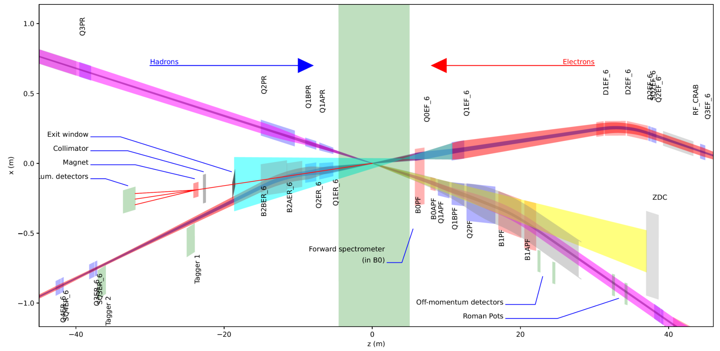
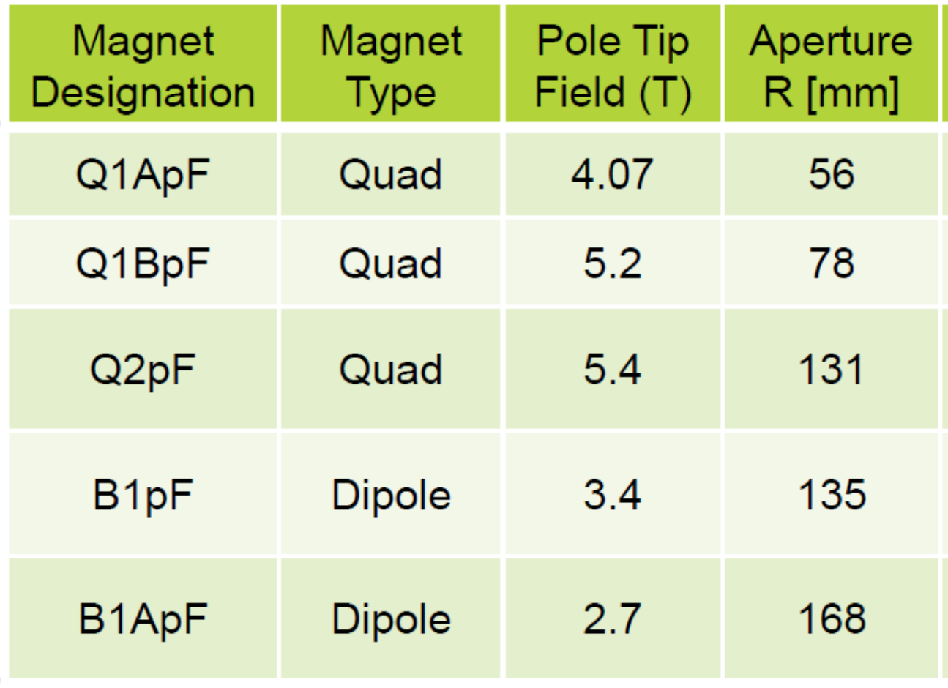
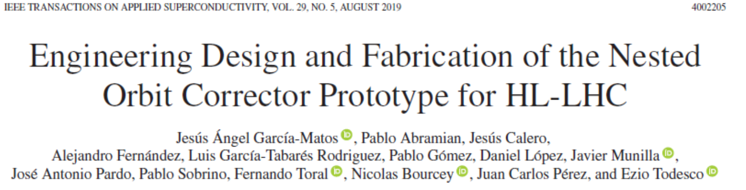
MDP work in support of the Electron Ion Collider (EIC) and epoxy-impregnated NbTi magnets
In synergy with MPD Area III: Materials & Conductors
EIC IR magnets challenges:
  Very large apertures
    No quad collaring press available for Q2pF
  Single magnets most of them w/o prototype
Possible solution for Q2pF: B&K with epoxy impregnated coils
We are developing technology for epoxy-impregnated NbTi magnets
  starting from the one used for the HL-LHC nested dipole correctors:
Table under revision
See S. Krave talk

Slide 3
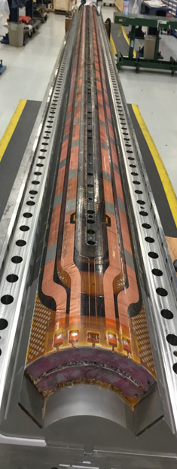
MDP work in support of FCC-hh and future Nb₃Sn magnets using MQXFA coils
A lot can be learned using rejected/on-hold MQXFA coils:
HL-LHC AUP has donated to MDP the coil that limited MQXFA16. MDP has shipped that coil to CERN for tomography and metallurgical inspection (in progress).
FCC-hh and future accelerators using Nb₃Sn magnets are going to face this challenge: “what to do with non-conforming coils that may be OK”?
  MQXFA coils may be used to address this question by MQXFA vertical testing
  ➔ CERN is interested in testing some MQXFA non-conforming coils.
  AUP is planning to donate ~4 MQXFA coils to MDP that will ship them to CERN, follow the test, and do analysis as needed to learn from this test.

Slide 4
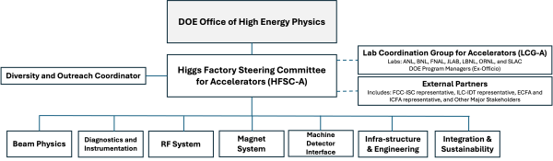
Possible MDP work in support of FCC-ee and future lepton colliders
DOE and NSF have started the Higgs Factory Circular Collider (HFCC) to advance the program for a future Higgs Factory
  HFCC-A is the sub-program for accelerator components
Funds in FY26 and FY27 are very limited. Nonetheless, it’s possible to build synergies with other programs. MDP is very welcome!
Contact GianLuca Sabbi or Giorgio Ambrosio for details
Higgs Factory Consortium Collaboration – Accelerator

