Slide 1
Talks for 2026 MDP Collaboration Meeting
S. Krave

Slide 2
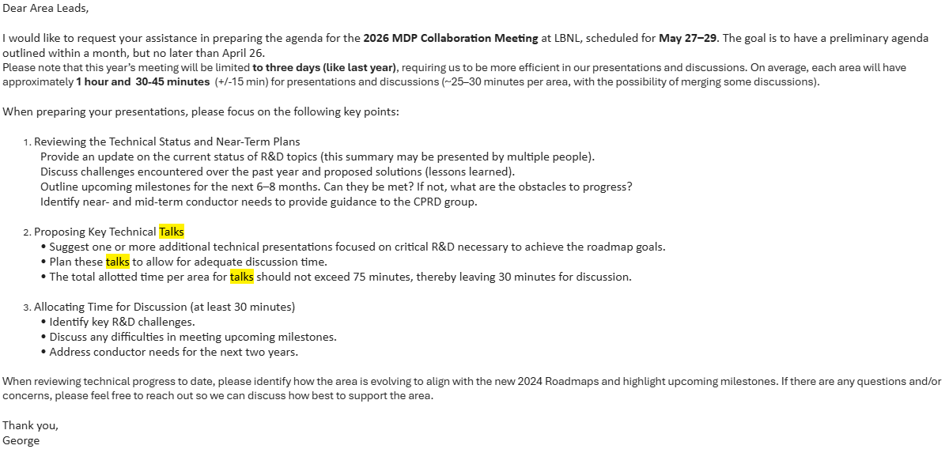

Slide 3
Suggested Topics
Generic Group overview and Milestones
Technical Talks
  Results on Bi2212 stiffness measurements
  Results on EIC Style stacks with CTD 1.1 binder
  ReBCO Impregnation at LBNL

