Slide 1
Stack Fabrication
S. Krave
30 March 2026

Slide 2
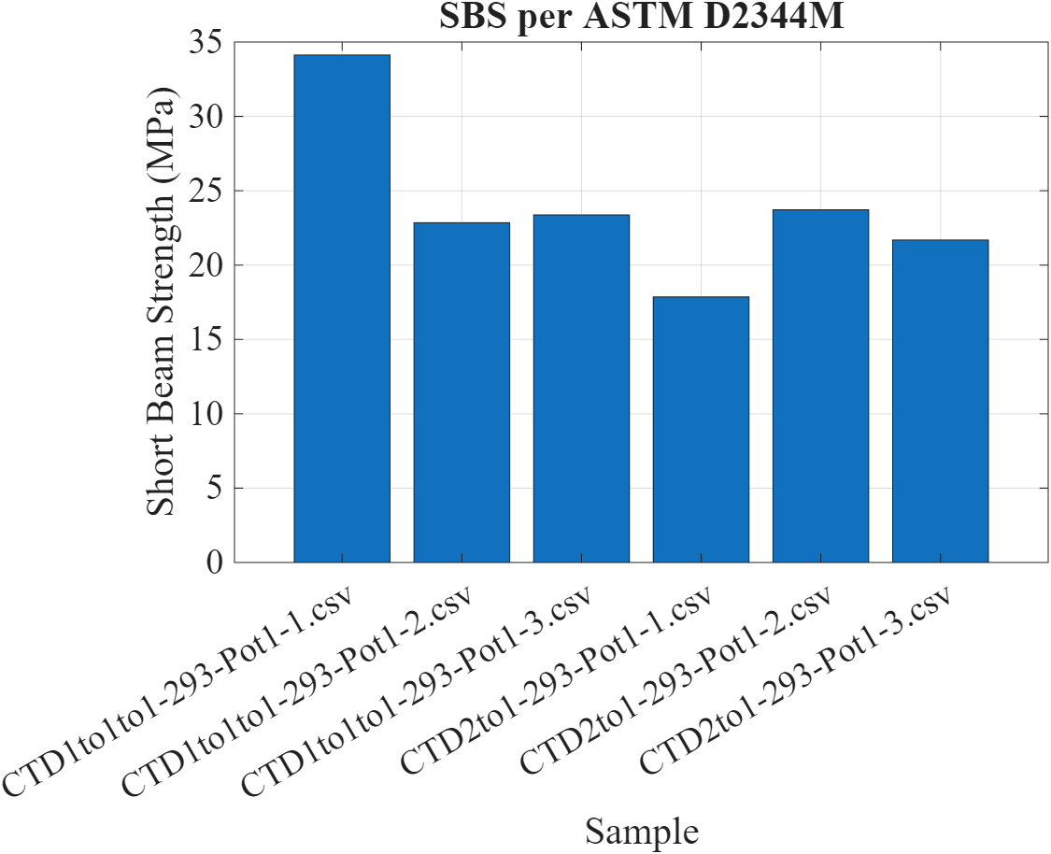
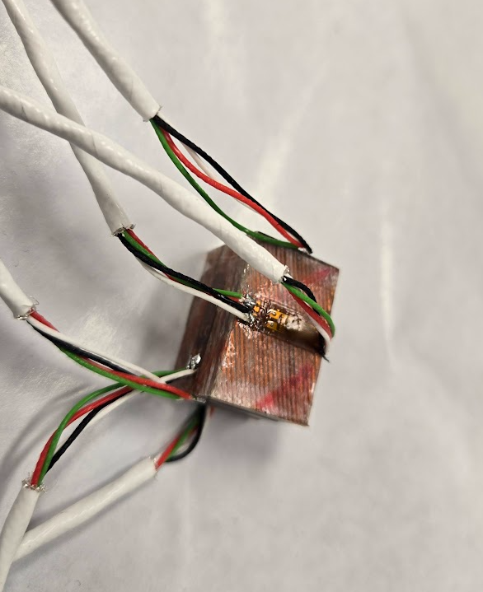
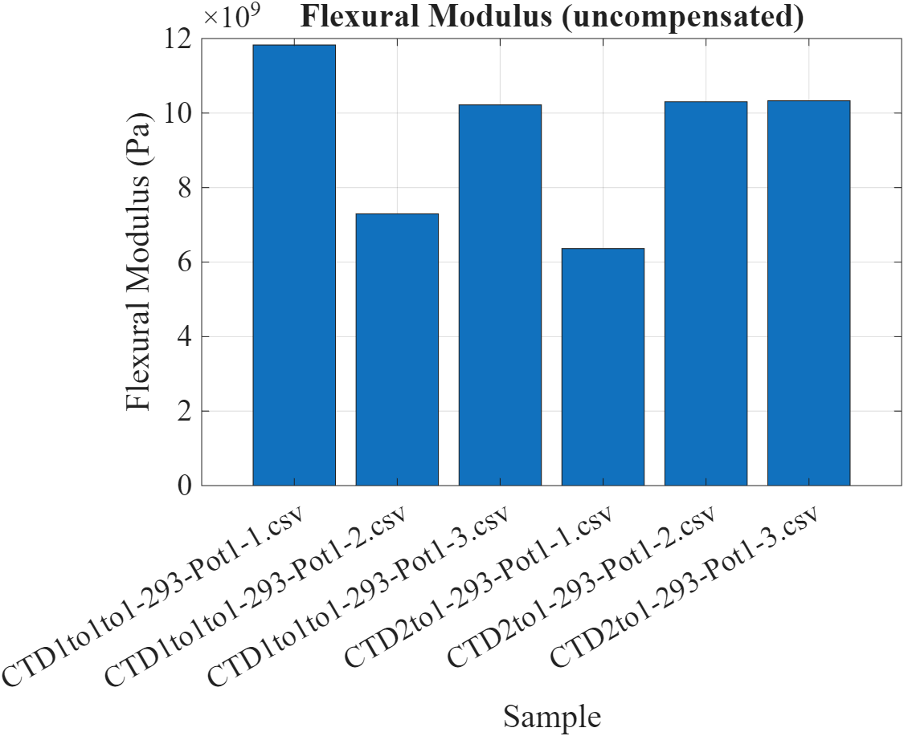
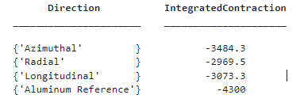
Status
1st set of stacks has been measured in Shear (at room temp)
  ~22 MPa Shear Strength
  ~10 Gpa Flex Modulus
1st set of Compression CTE samples have been prepared
  Technician was not available to take measurements
  CTE Has been measured
  Planning Compression RT Tuesday on Instron to 60 MPa
µm/m

Slide 3
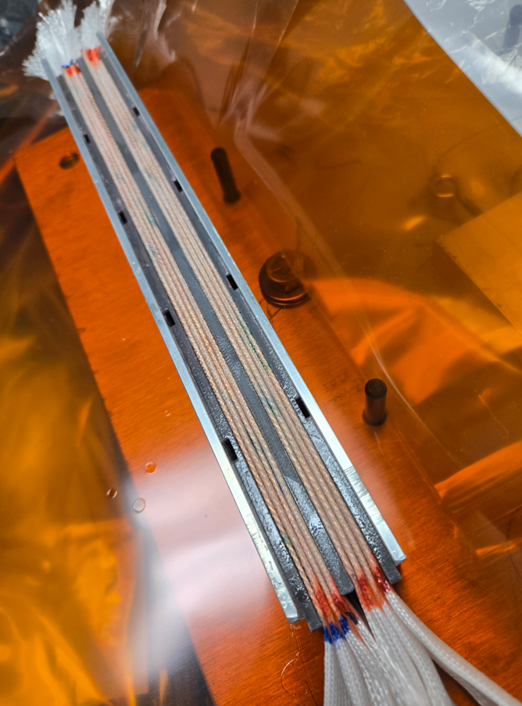
Recap
Using an epoxy binder (CTD 1.1BDR) dissolved in a 1:1:1 ration Binder to Acetone to MEK
Other recipes showed poor adhesion and flow and resulted in a large solids content in the stack
Stacks were fabricated with unreacted QXF Cable

Slide 4
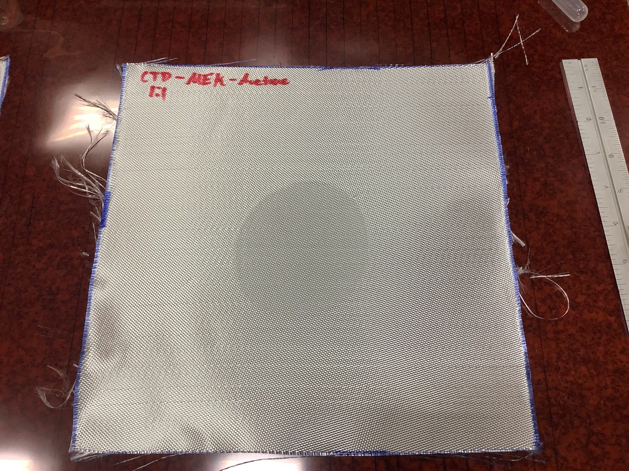
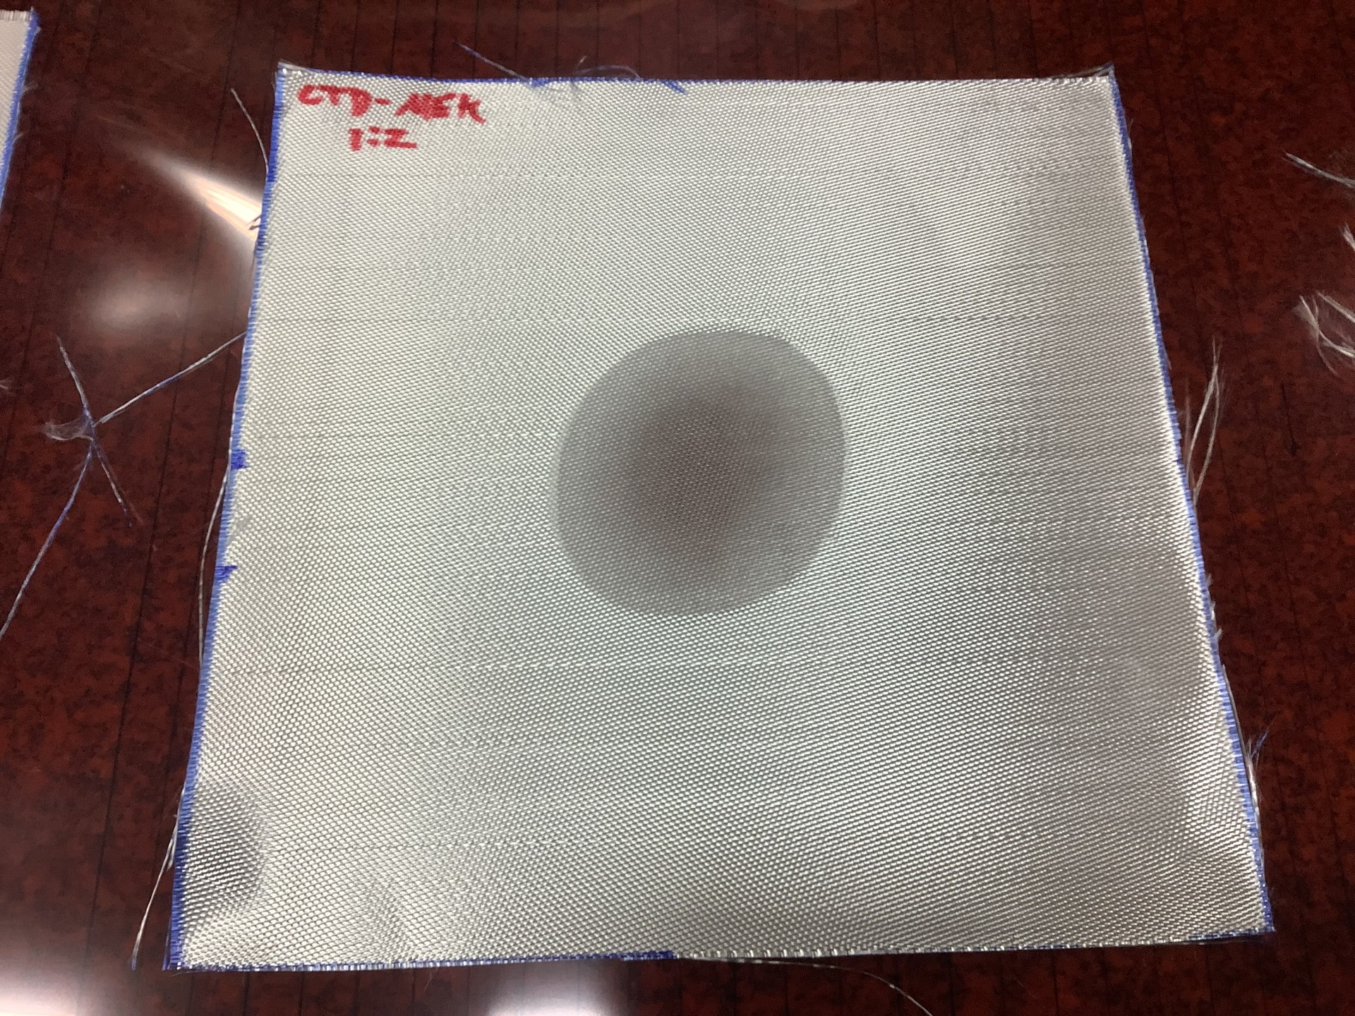
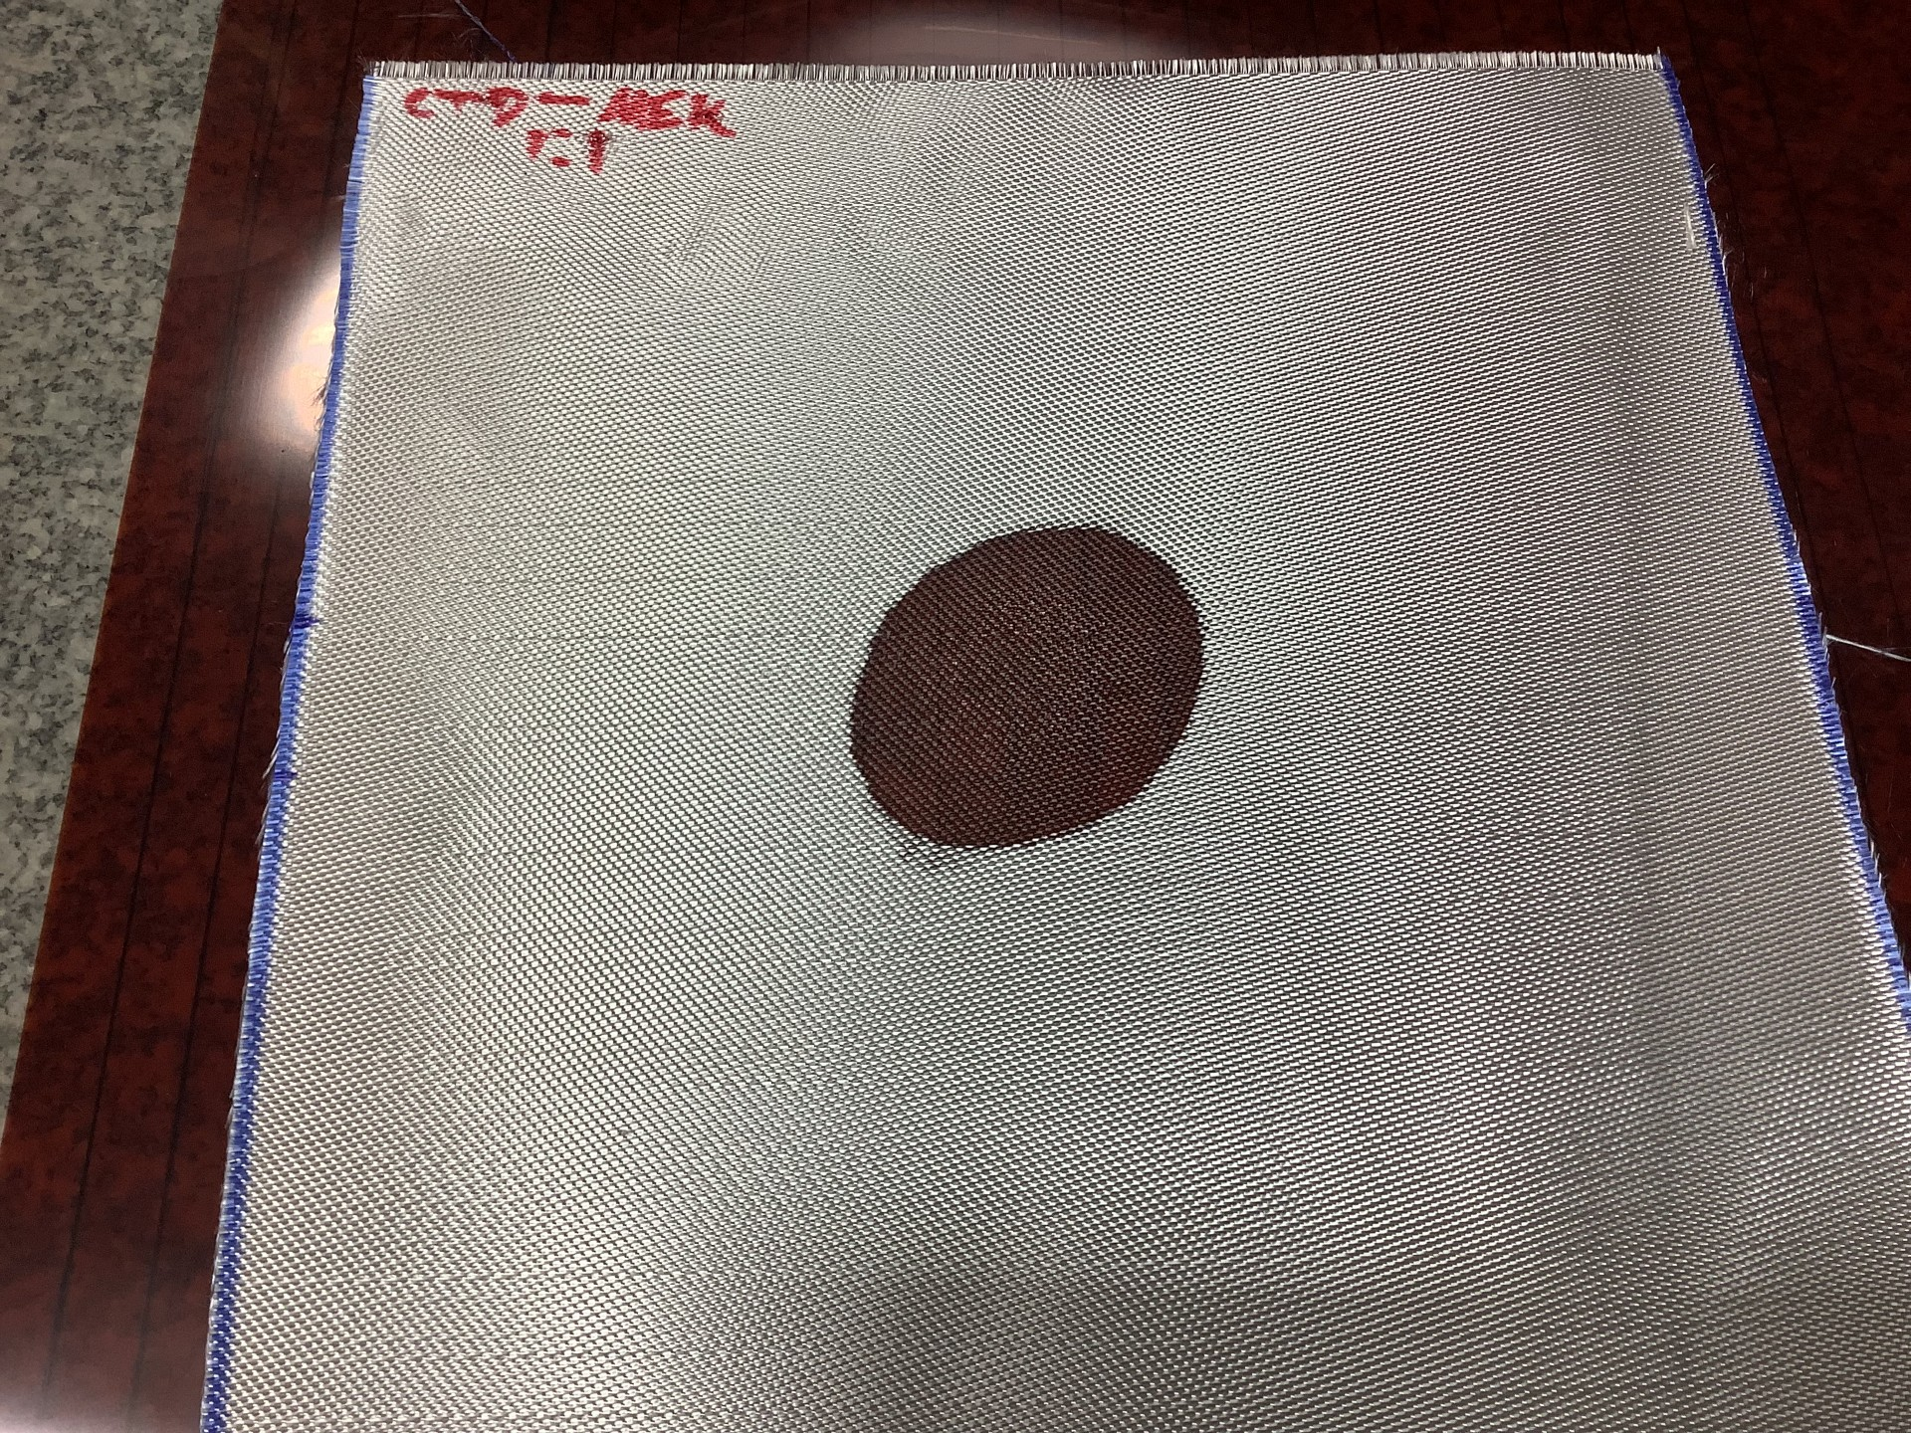
Added some Acetone to assist in resin take-up
Trying to be more quantitative, we made a simple wicking test: Apply 1ml of solution and track spot size vs time
3 recipes:
  Standard
  Diluted with extra MEK (1 part solids to 2 parts MEK)
  Diluted with Acetone (1:1:1 Solids to Acetone to MEK)
CTD:MEK:Acetone
1:1:1
Fast wet out, low overall solids density
CTD:MEK
1:2
Intermediate wet out, uneven solids distribution
CTD:MEK
1:1
Spanish Recipe
Low wet out, high solids.

Slide 5
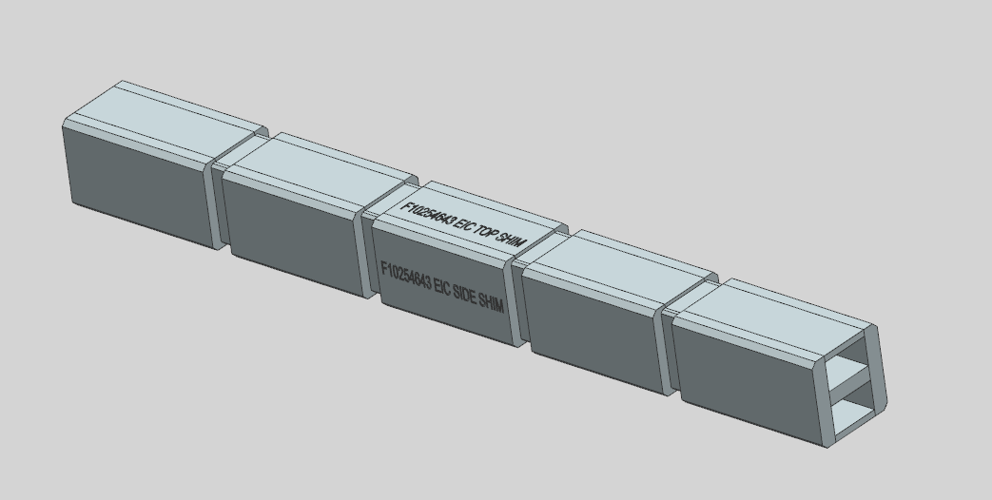
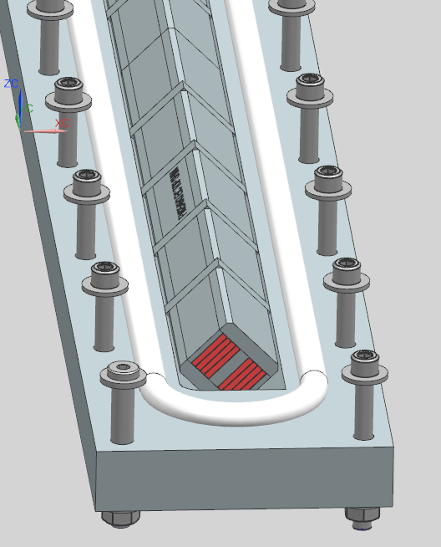
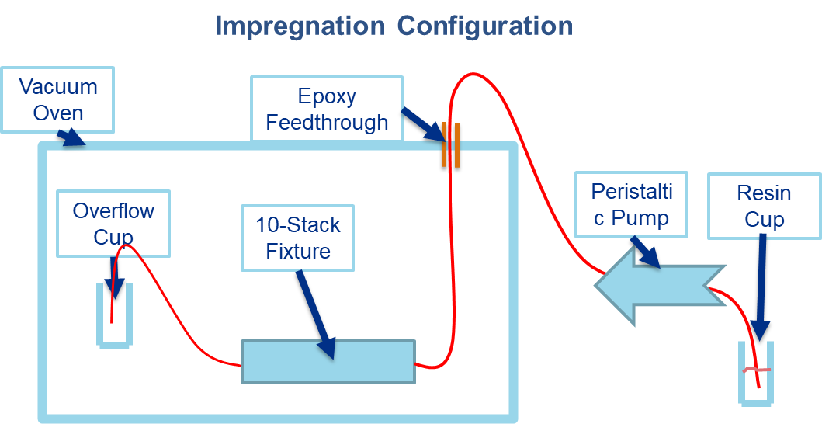
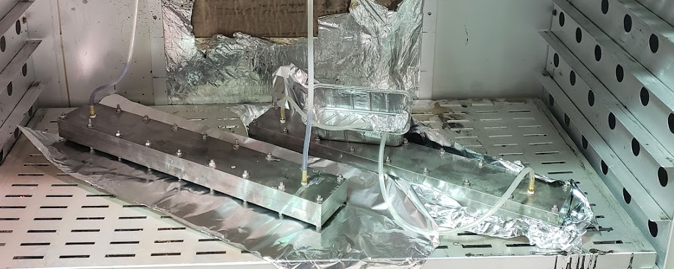
Stack Impregnation
Remove stacks form Curing fixture
Transfer to standard 10-stack impregnation fixture
Pot with selected resin
  101K first

Slide 6
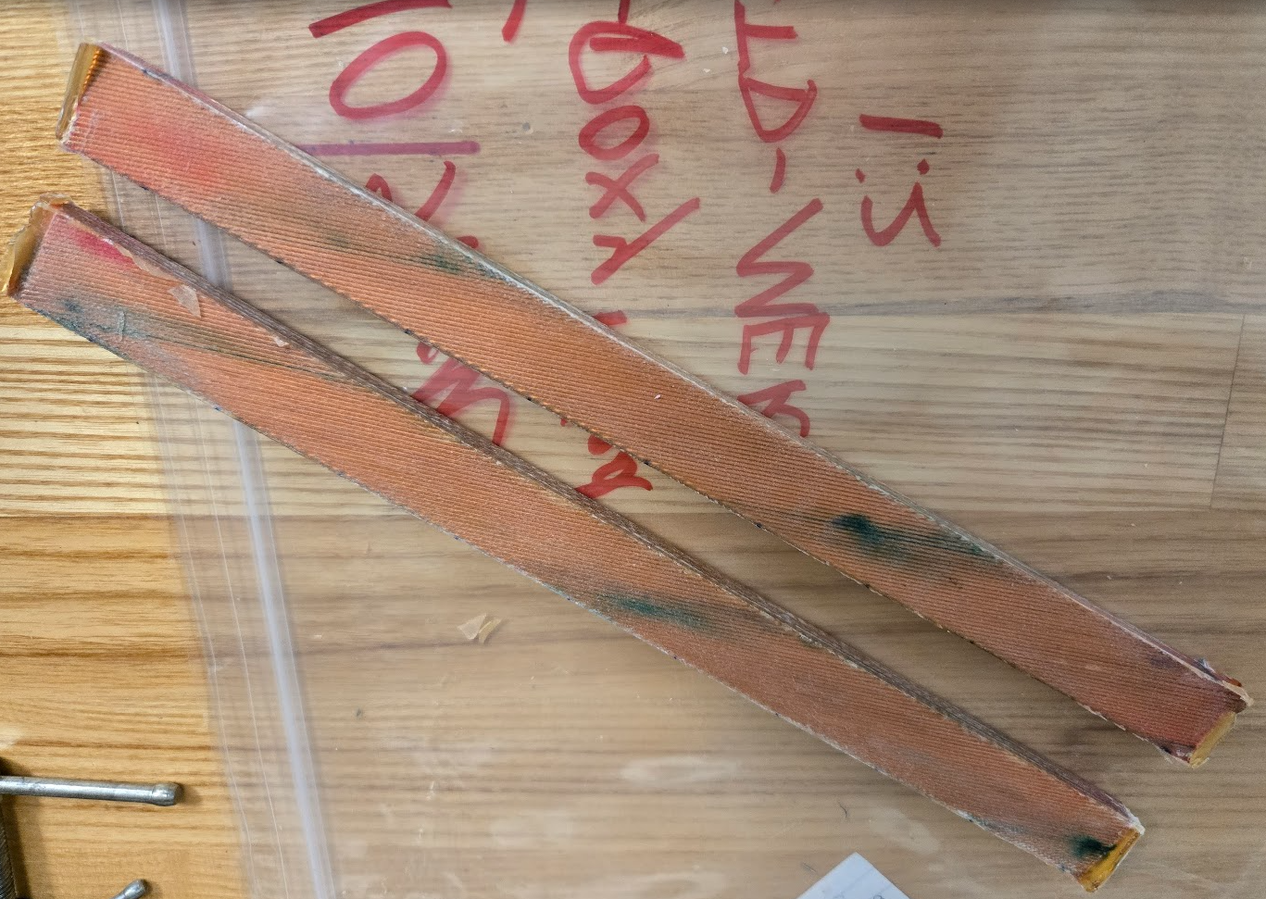
1st set of samples have been potted with CTD-101K and look very good
  Glass is fully transparent
    Fully wetted
    Good adhesion to cable
      Clear glass with white spots would indicate debonding between insulation and cable, but we do not see this
  Samples with Acetone and Without look nearly identical
Will measure shear strength, flexural modulus and possibly CTE next week.

Slide 7
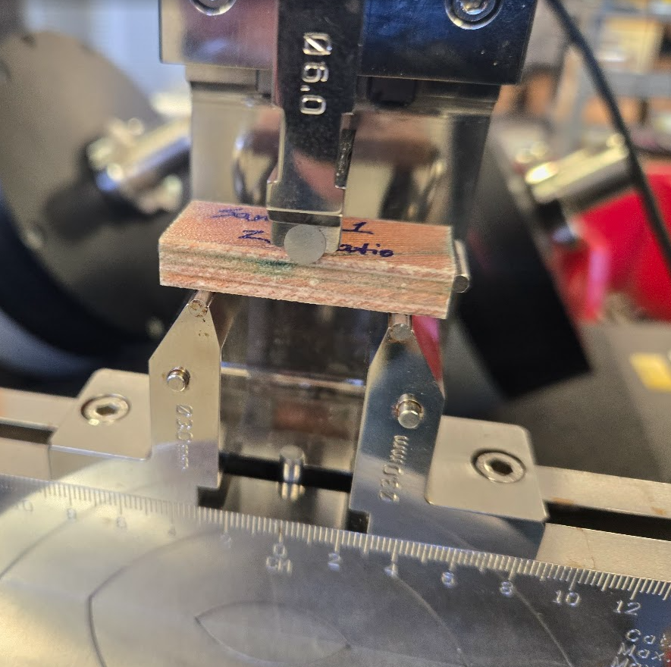
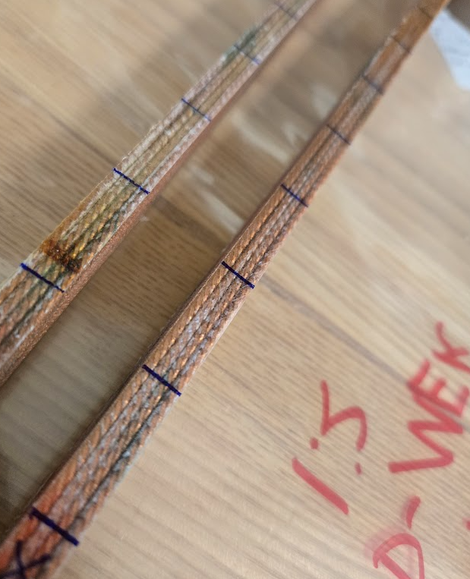
Samples Sectioned and measured using SBS fixture in IB3A
  No LN2 yet…

Slide 8
Add procedure details
Curing press/profiles
  Arup’s Cartoon
  Modification for what we can accomplish
How much oxidation can we obtain?

Slide 9
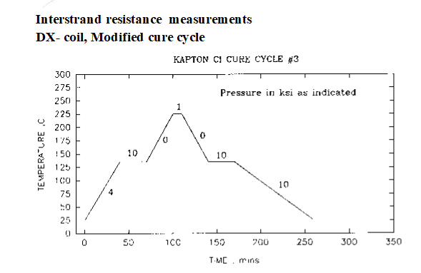
Suggested Stack Temp Profile from Arup
Unable to do this with out curing press
  Expect dwell of several hours at high temperature

Slide 10
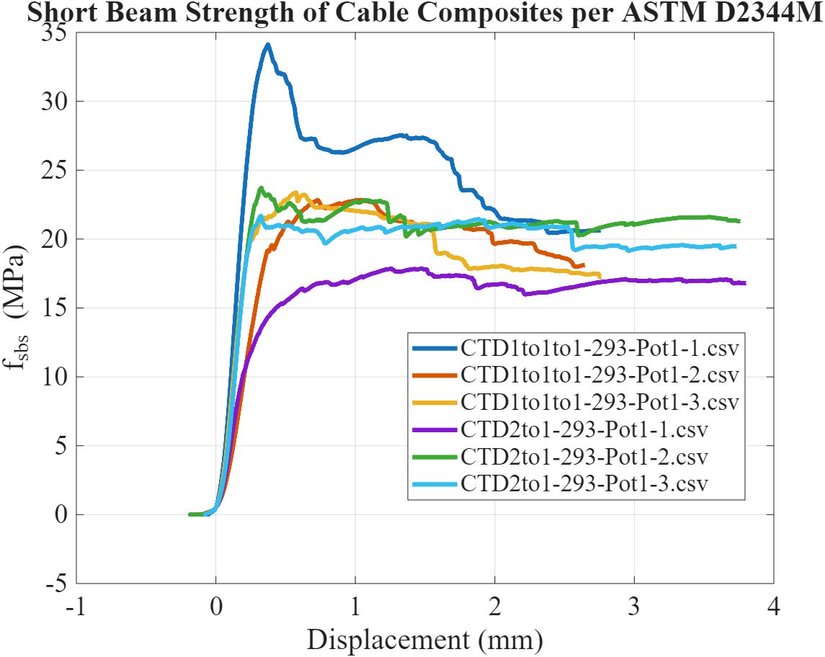
Overview of SBS plots
We extract the max load (F_SBS)
and derive the stiffness
  From initial slope
1st observation: Sample quality is good with high shear strengths compared to reacted cable
  And large ductility

Slide 11
Sample Results
All samples fail in shear, the low value one looked slightly less clear
Flexural modulus calculated between 10 and 90% of load

Slide 12
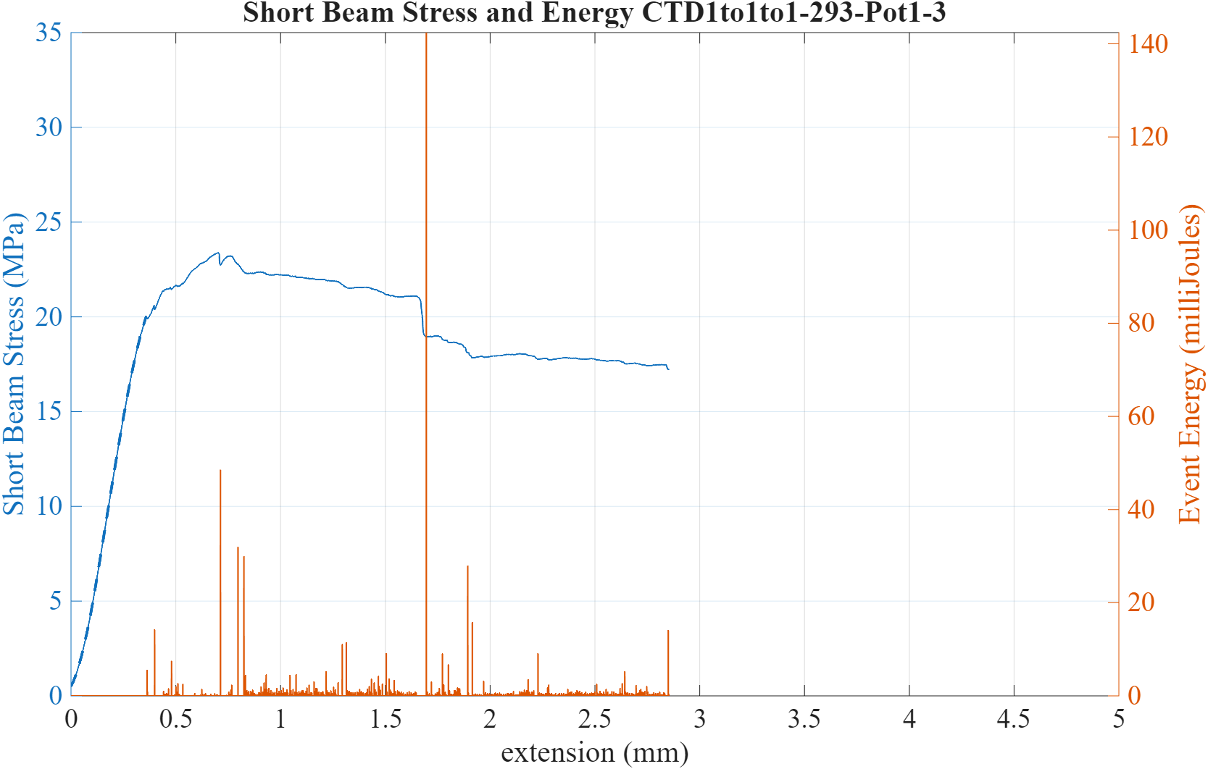
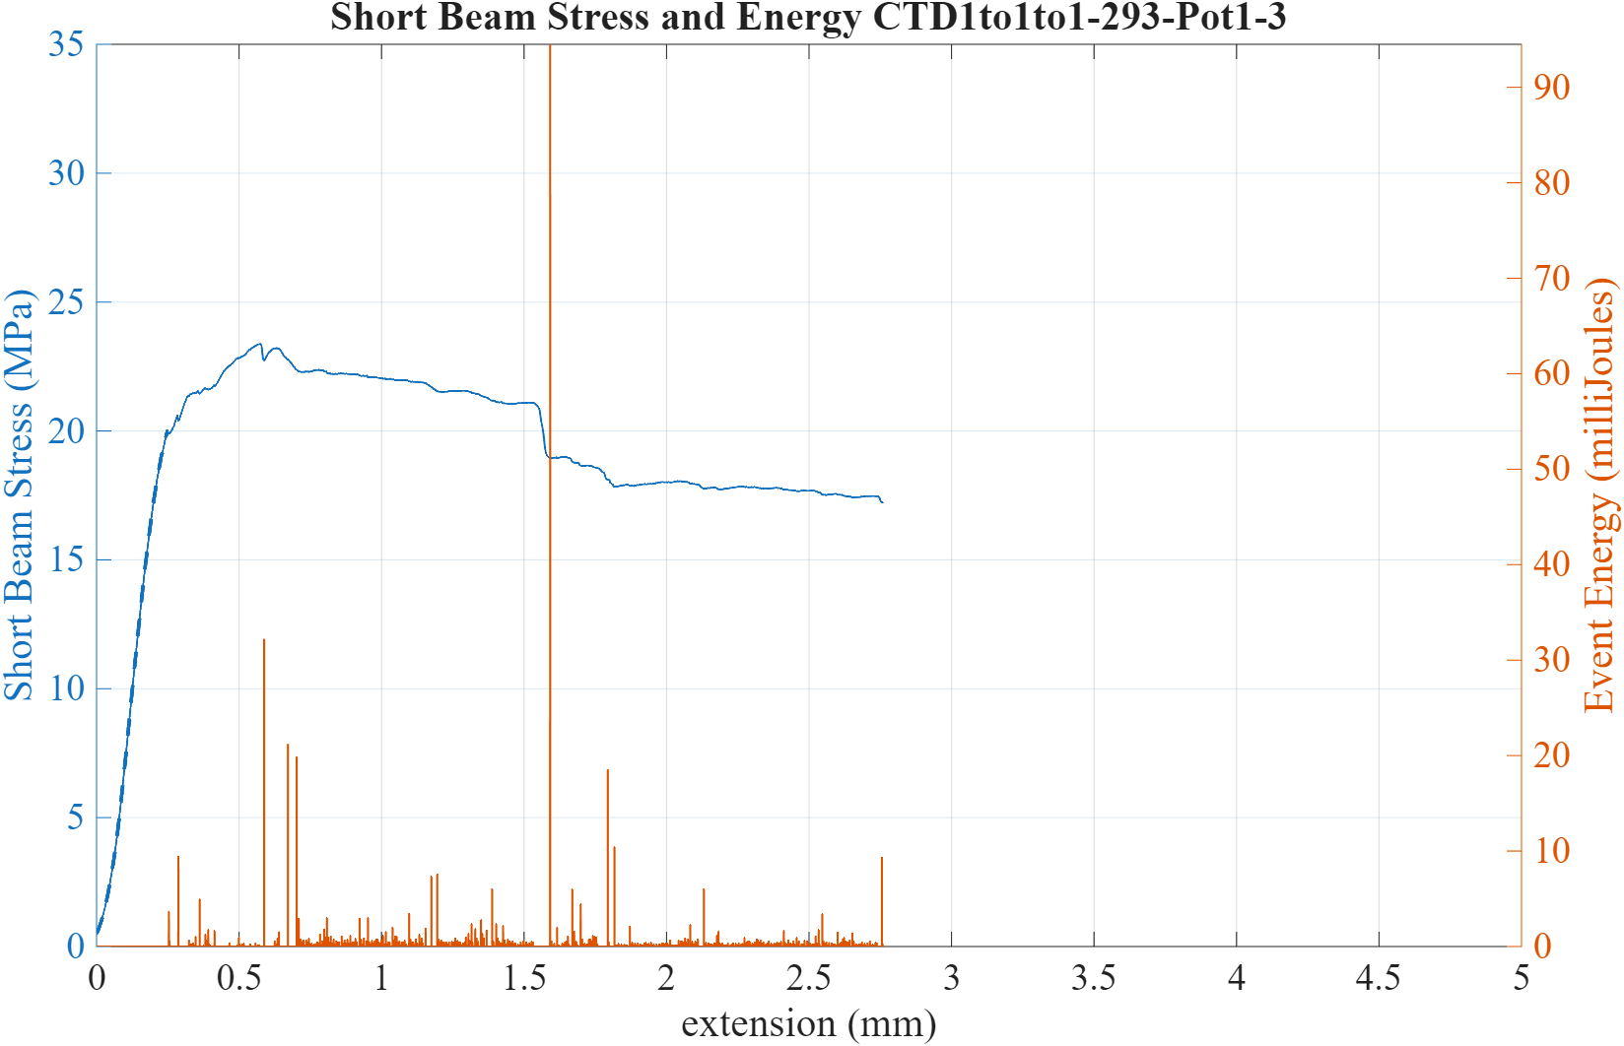
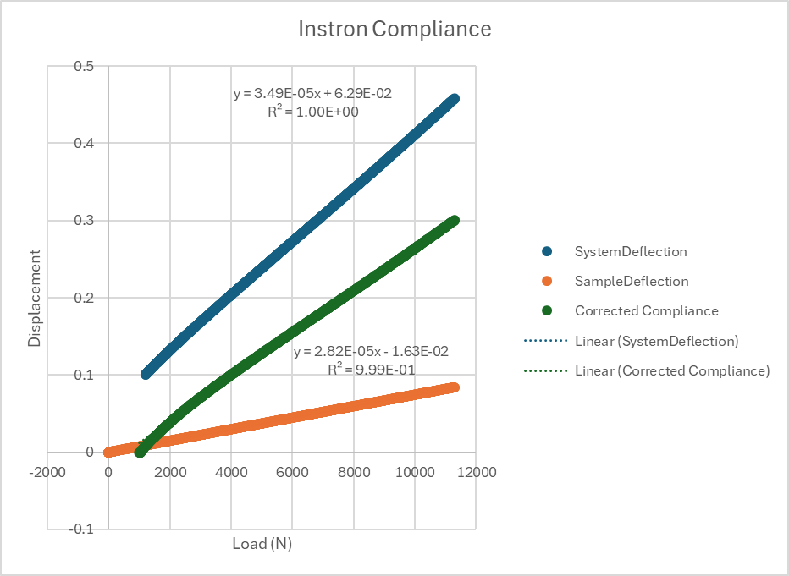
Example SBS plot.
  Top no compliance correction
Dashed line shows region used for modulus calculation
Bottom with compliance correction

Slide 13
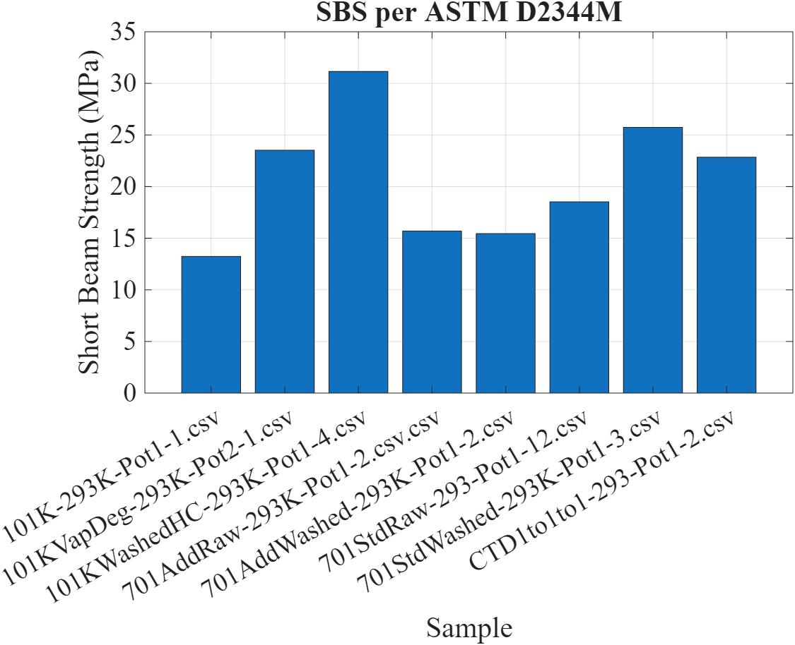
Comparing unreacted with BDR to other samples (reacted)
Performance looks good, I choose an intermediate sample some have outperformed this one.
Reacted samples are without binder
  QXF with 1202 tends to land in the 12-15 MPa Range
  15T (E-Glass) is ~8 MPa

Slide 14
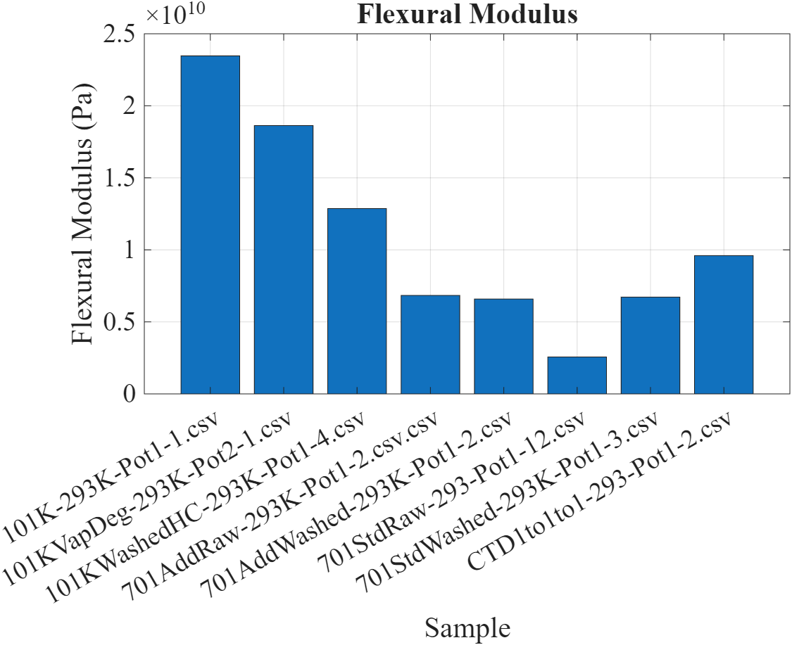
Modulus of Unreacted Nb3Sn vs reacted using different systems

Slide 15
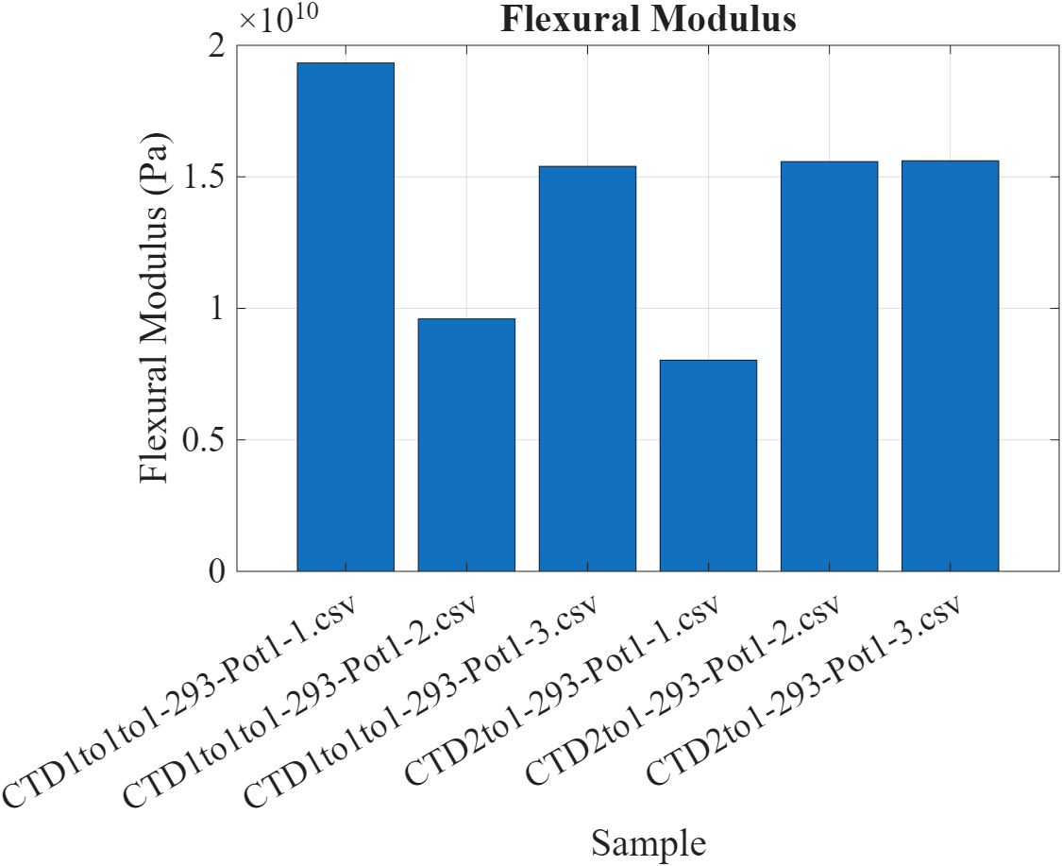
Flex modulus of measured BDR Samples
Low modulus of unreacted and high relative volume fraction of epoxy may be lowering measured value
Technically the sample span to thickness is not high enough for a flexure modulus measurement.

Slide 16
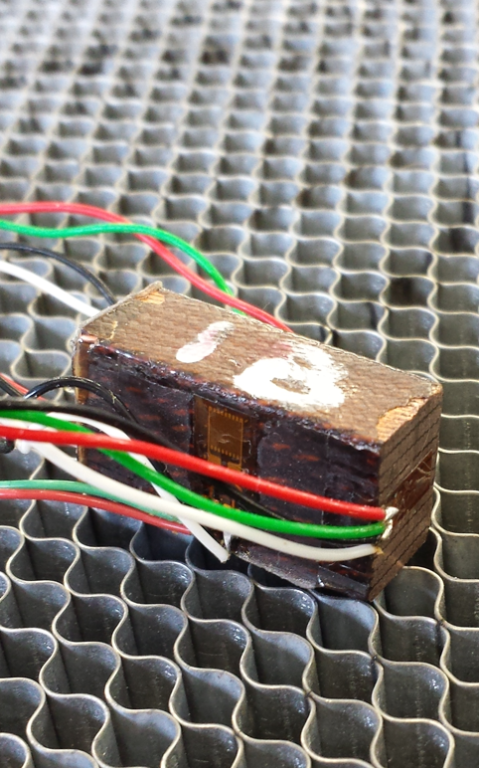
Moving forward
Preliminary Conclusion: 1:1:1 recipe provides good handling and impregnation. No reason to suspect issues mechanically.
  Any objection to abandoning MEK and 1:1 mixture?
Re-make 4-stacks to compensate for slightly different unreacted cable conditions
  1st samples used the reacted QXF cable equivalent
Make 10 stacks using the same recipe for compression modulus and Integrated thermal contraction to 77K using the strain gage technique
  Micro-Measurements TN-513-1 (~1 month)
  Ten stacks are being inserted in fixture today, potted tomorrow?
Repeat 4/10 stacks with EIC Cable (4 weeks after cable)
  Likely 1:1:1 recipe
Benchmark against 101 K without binder
Repeat tests using Telene instead of 101 K

Slide 17
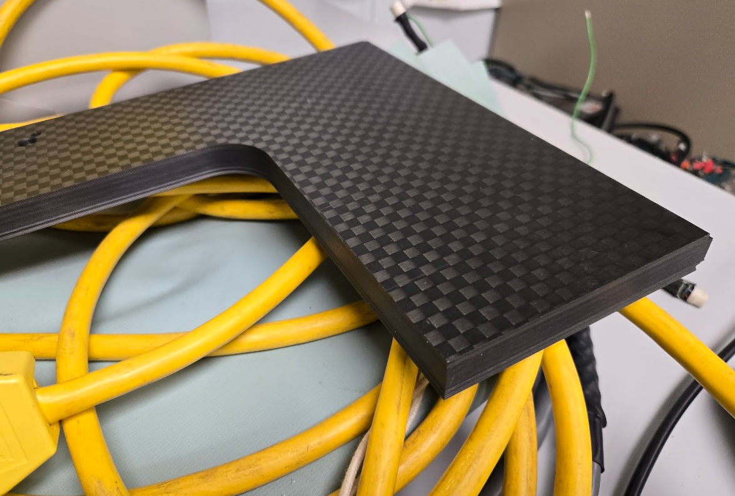
Additional Topics
Validate CTE and modulus of G-10
Validate CTE and modulus of Carbon Board

Slide 18
Old Stuff

Slide 19
Old Stuff

Slide 20
EIC Stack Layout
4.29 mm shim
21.45 mm Outer
25.27 mm
2 x 8.58 mm 4-stack
3.82 mm shim
2x 250 mm

Slide 21
EIC
4.93 mm
4.93 mm
25.27 mm
EIC
4.29 mm shim
21.45 mm Outer
2 x 8.58 mm 4-stack
15.4 mm
25.27 mm

Slide 22
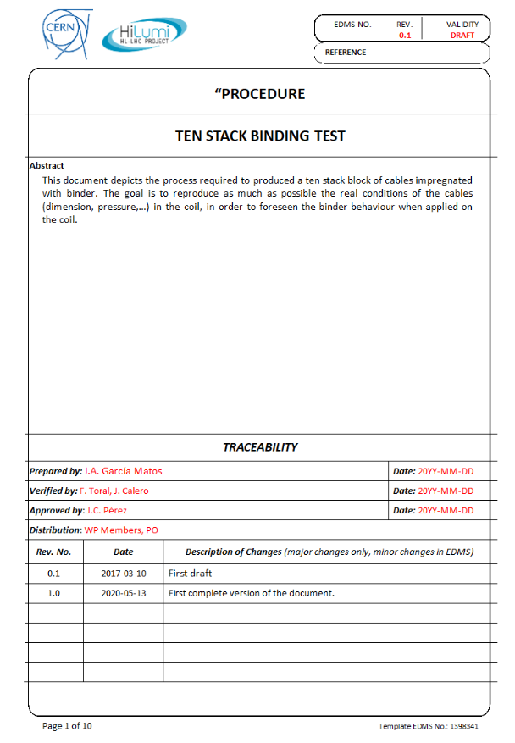
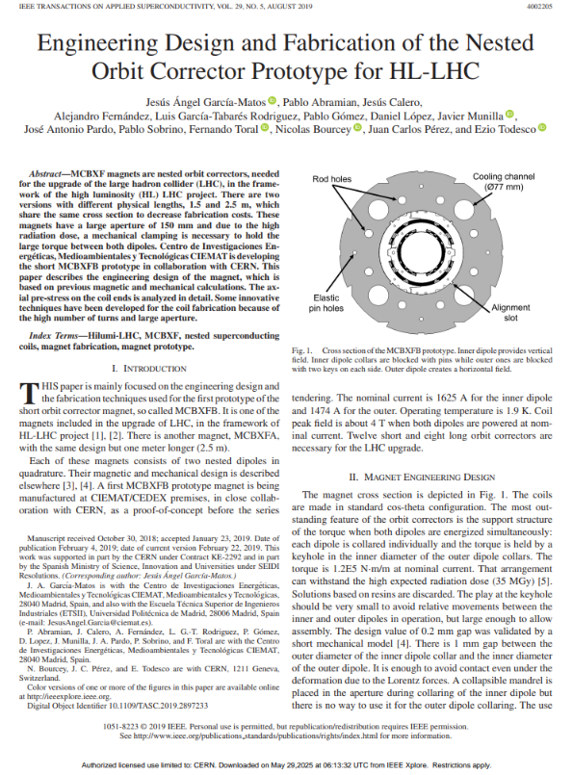
Exploration of NbTi cable stacks with intermediate binding
Fermilab is fabricating a large NbTi IR quad (Q2PF) for EIC of the key and bladder design and required a rigid cable composite
  This leads to the requirement of epoxy impregnation
  To minimize risk we wish to have a similar process to MQXF
    Intermediate curing stage between layers with a binder
      CTD 1.1 BDR

Slide 23
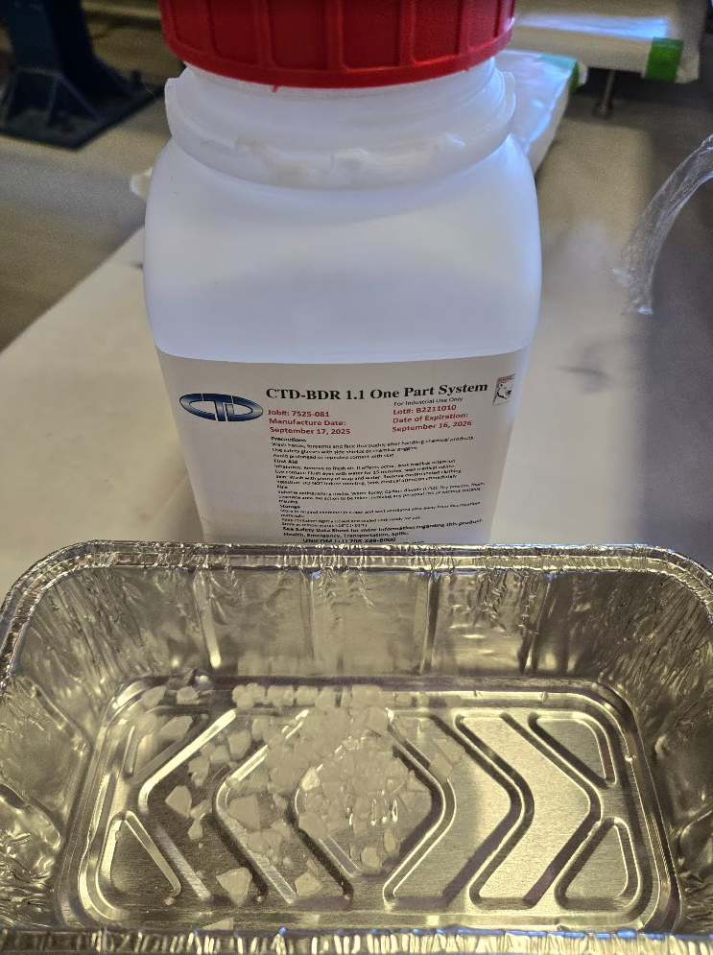
Why Binder
Pre- impregnation binder process to set coil layer geometry after winding
The process has been proven in the MCBXF
CTD 1.1 is an epoxy compatible binding system dissolved in a solvent (Acetone or MEK)
  The system appears to be raw B-staged epoxy resin. (Guessing the same system as 101K)
  Cured with heat similar to other binder systems
    Allows drop in replacement to allow same curing process as the Ceramic binder in QXF

Slide 24
Goal and Steps
Determine mechanical properties of potential insulation systems for EIC
  At FNAL: Handling, Modulus (1-3 directions), CTE, dielectric strength
  Externally: AC Loss
Intermediate steps:
  Cable-stacks to demonstrate good quality impregnation, and make samples for measurements of mechanical and electrical properties;
  1-m coils to demonstrate good quality impregnation, and make samples for measurements of mechanical and electrical properties:
Results to be compared with similar samples impregnated with CTD-101K to be used as benchmark

Slide 25
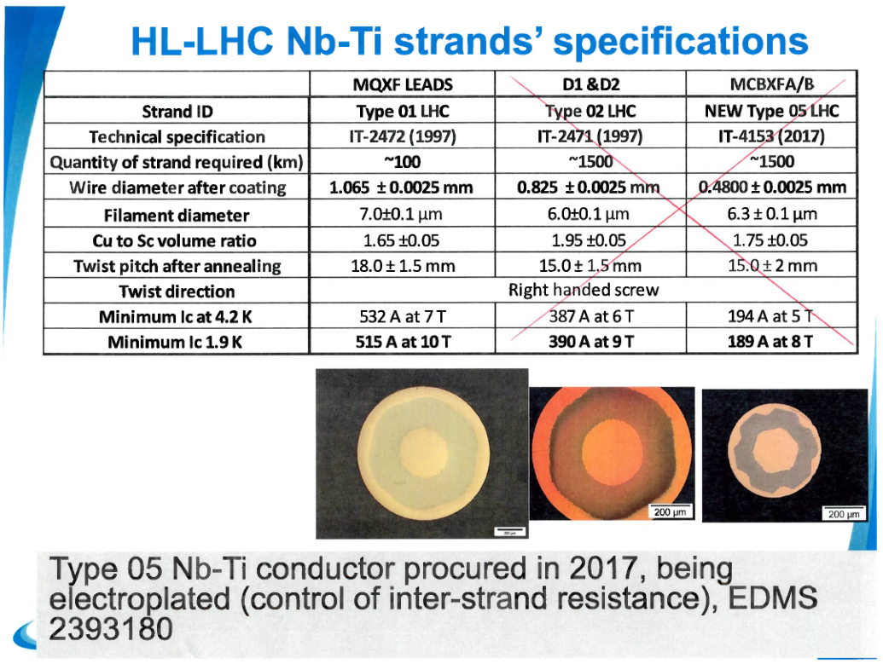
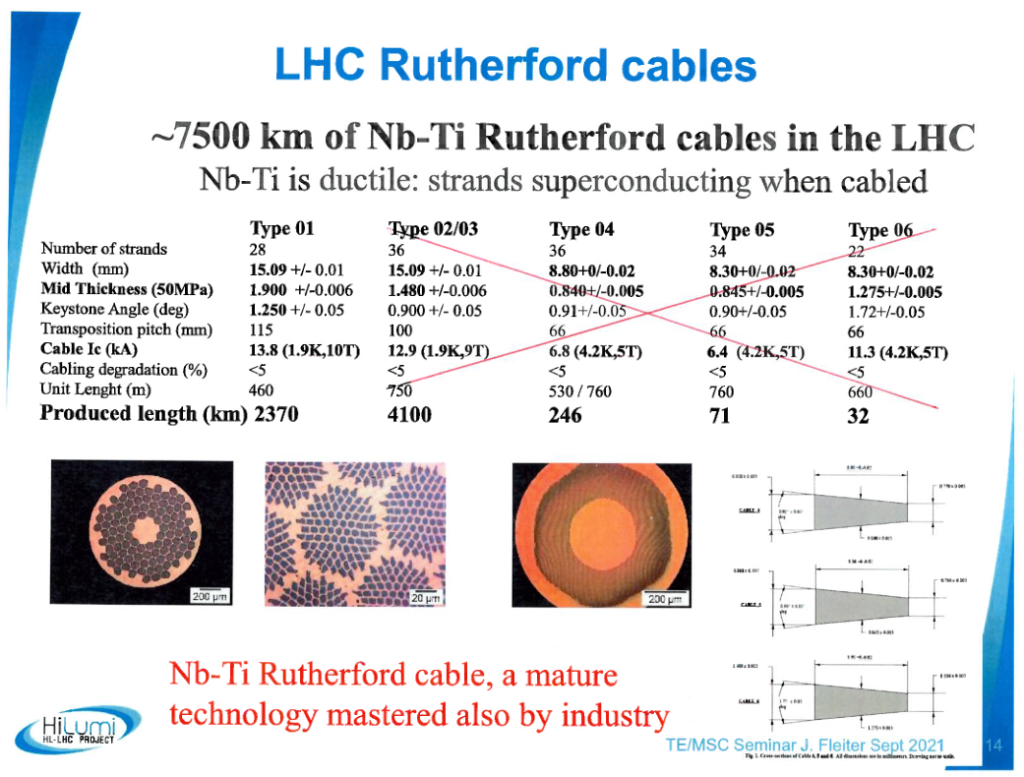
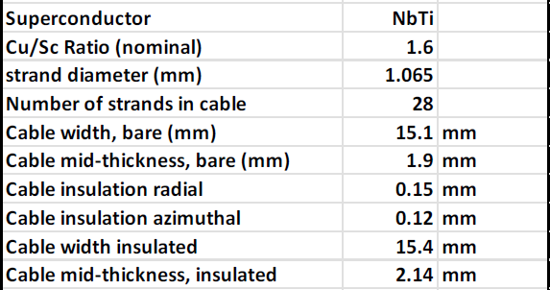
Cable dimensions
EIC IR quadrupole cable dimensions

Slide 26
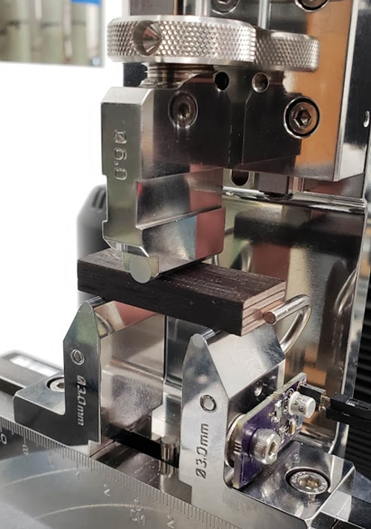
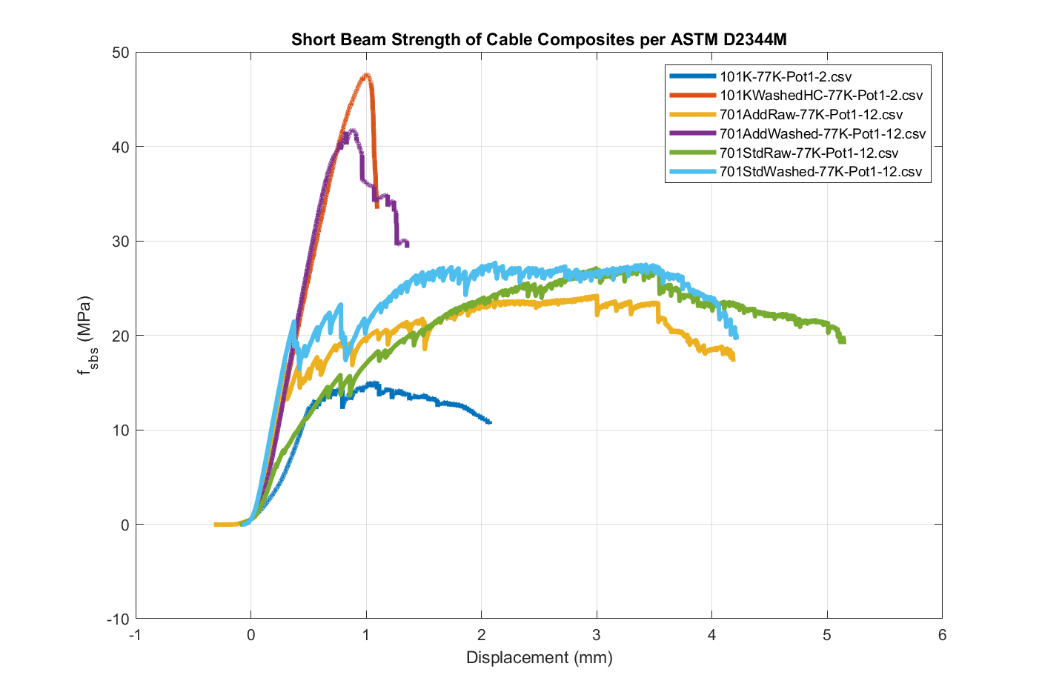
Plans for cable stacks
Make cable stacks exploring insulation and impregnation options:
  Benchmark: S2-glass sleeve (used for HQ) impregnated with CTD-101k
  Using CTD 1.1 BDR
  Prototype using unreacted QXF cable
    Once process is established, use EIC-Like Cable (LHC Inner)
    Value Engineering -Telene
Measure structural properties at RT and 77K:
  Elastic modulus at RT to 75MPa (can be measured at Fermilab)
  Elastic modulus at 77 K (can be measured at Fermilab)
  Thermal contraction RT-77K
  Shear strength at RT and 77K (ASTM D2344) (can be measured at Fermilab with SBS test )

Slide 27
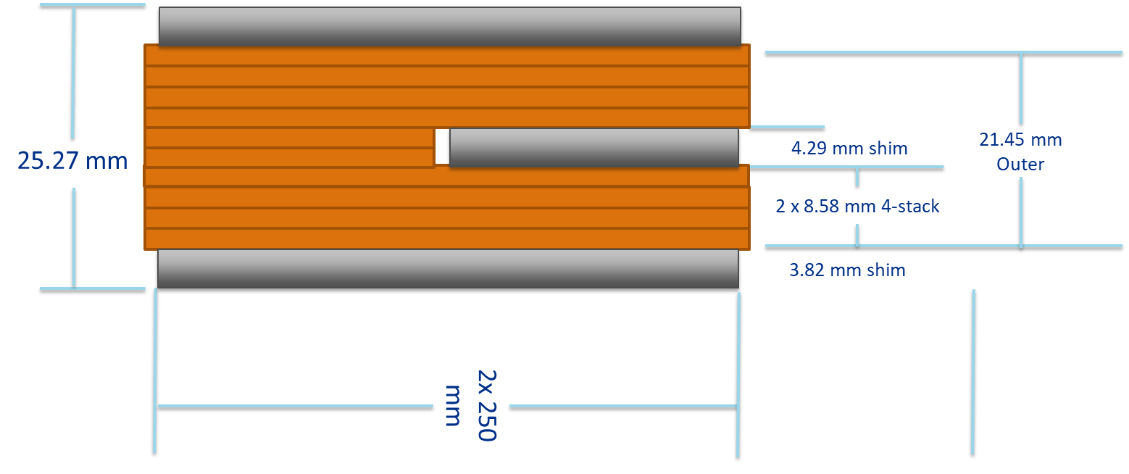
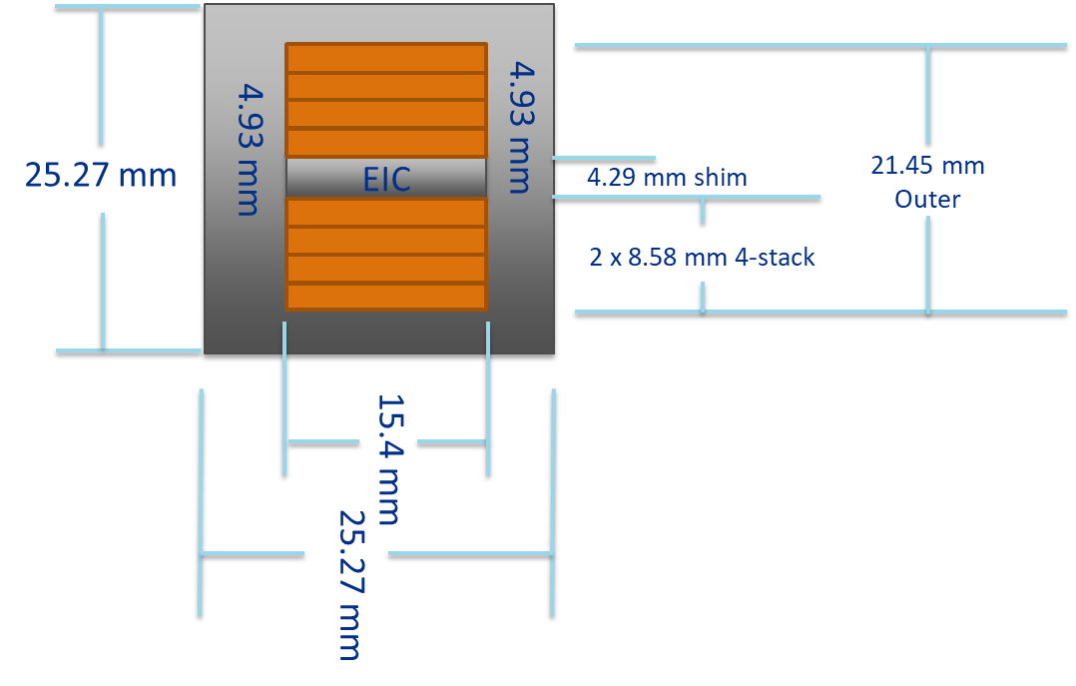
Stack Configuration
The stacks are shimmed to nominal size (cable plus insulation)
  Fixed cavity not fixed Pressure
  Same constraint as QXF
Prototype stacks of QXF are being fabricated with equivalent constraints

Slide 28
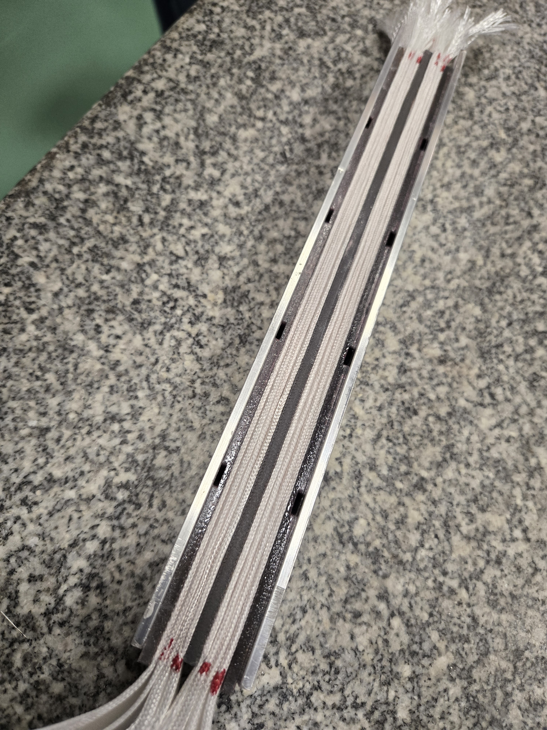
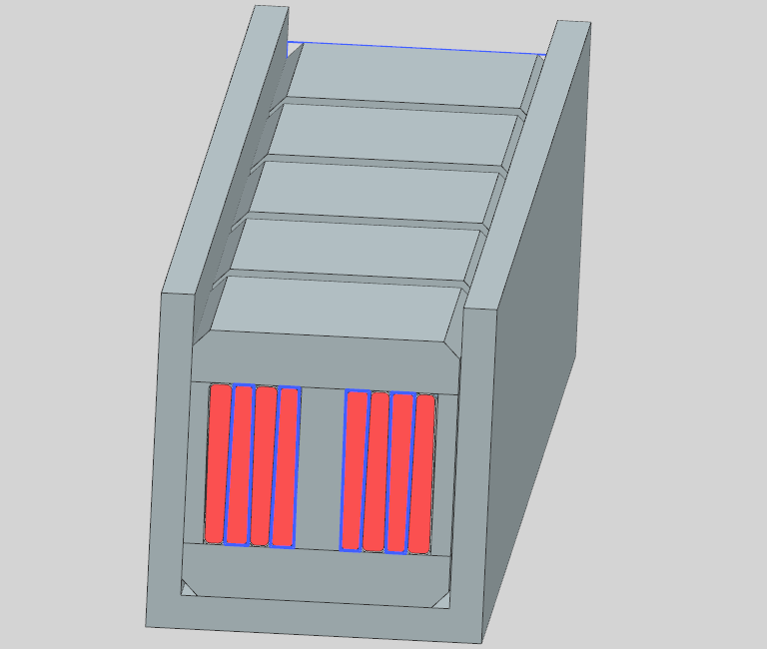
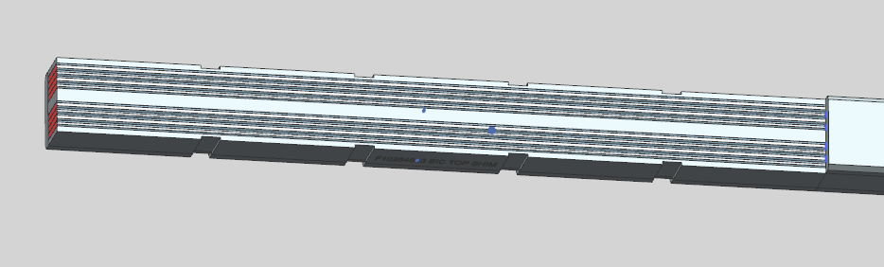
Sample Prep
Cable is sectioned and insulated
  Then placed in fixed cavity in AL channel
  Shims are made from 3D printed PPS-GF, good to ~200°C
    Super handy, I recommend getting a machine that can use this material
Binder is applied at desired rate. We found that the tooling allows easy distribution applied by disposable pipette
Apply unit volume per square
Dry

Slide 29
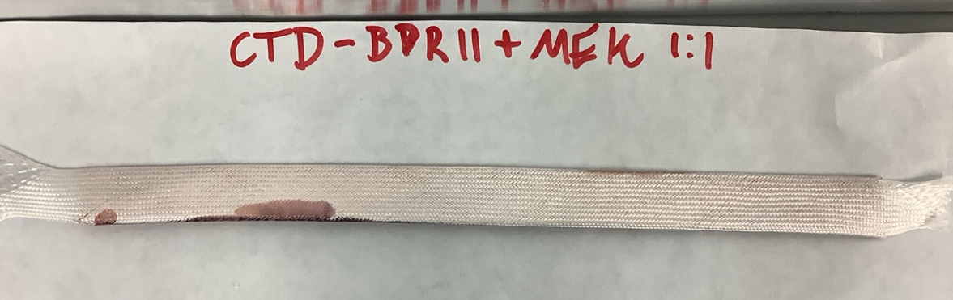
1st set used 6 grams binder per total sample (3g solution, 1.5g solid/meter of cable)
  Missing photo but only ~3mm penetration into stack
Time to update the binder recipe

Slide 30
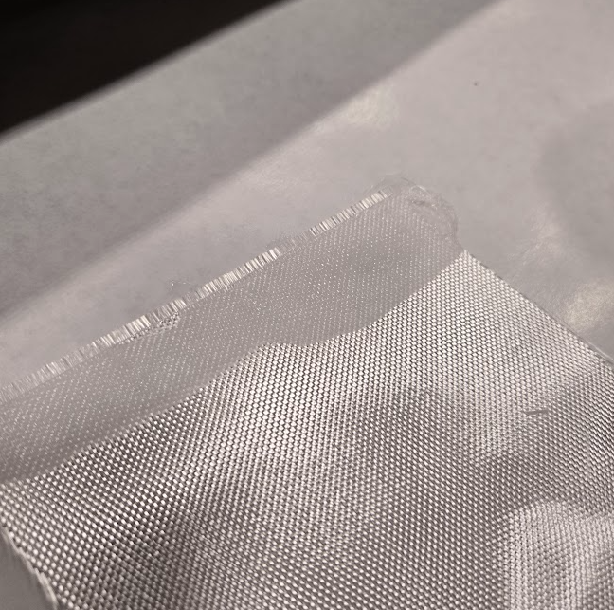
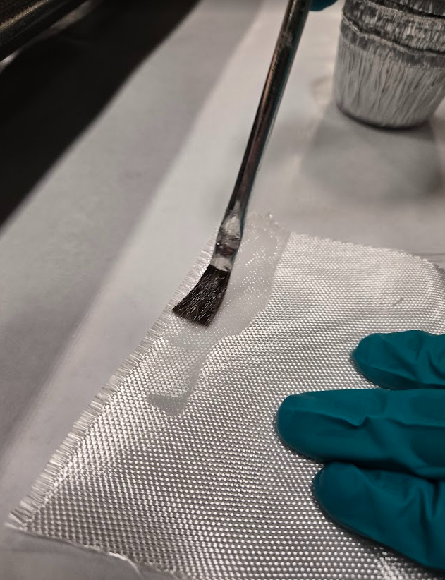
Quick wetting test
Just to see behavior…
Glass did not pull mix aggressively from brush
Stayed wet under brush with no additional wicking (6781 S2/ 933HTS)

Slide 31
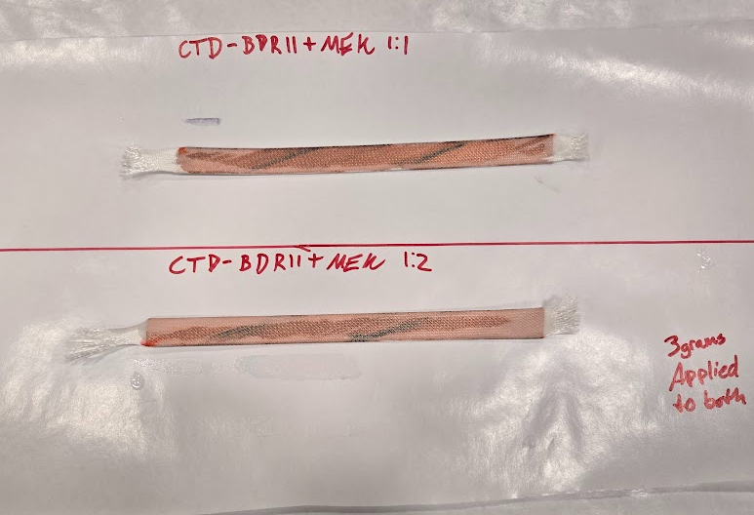
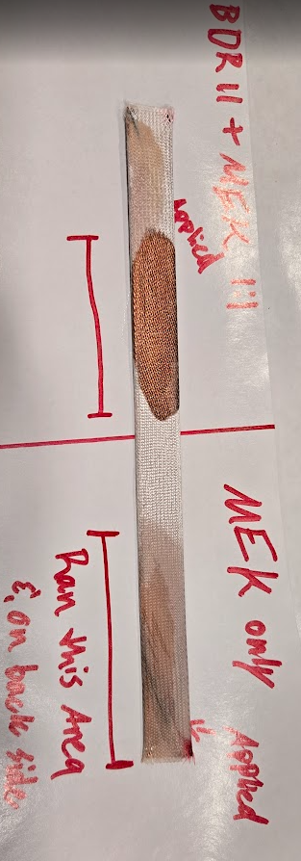
Looking at wicking
  1:1 Binder to MEK did not wick substantially away from the brush
  Adding additional Solvent improved wicking to a point
    But did not pull aggressively away from brush.

Slide 32
Summary of test
 | Diametral Distance traveled (to 1/8")
Time (seconds) | 1:1 Binder to MEK | 1:2 Binder to MEK | Acetone Blend
0.50 | 1.5 | 2 | 3
1.00 | 2.5 | 2.5 | 3.9
1.50 | 2.5 | 3 | 3.9
2.00 | 2.5 | 3.5 | 3.9
2.50 | 2.5 | 3.75 | 3.9
1:1 MEK system had small spot size and did not flow aggressively
1:2 system wicked substantially better
Aceton system drastically improved resin take-up
Normalized resin application rate to grams per square meter

Slide 33
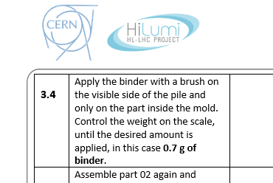
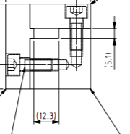
For reference:
Comparison to MCBXF system
From what I can gather the effective solids application rate in MCBXF per stack procedure was 23 g/m^2 of insulation
solids rate for QXF stack seems to bottom out at 40 g/m^2
  Not unlike MQXF ceramic binder
  Samples with same rate did not wet out MEK only

Slide 34
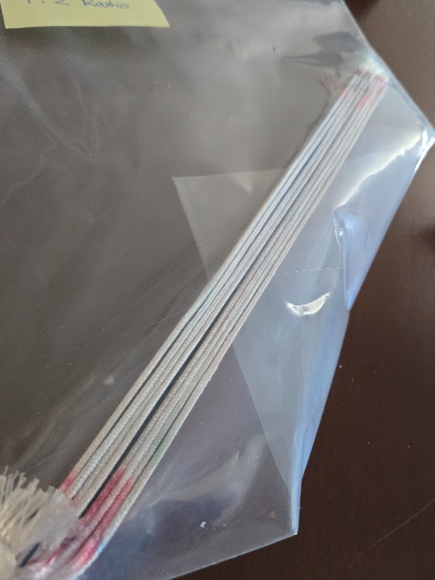
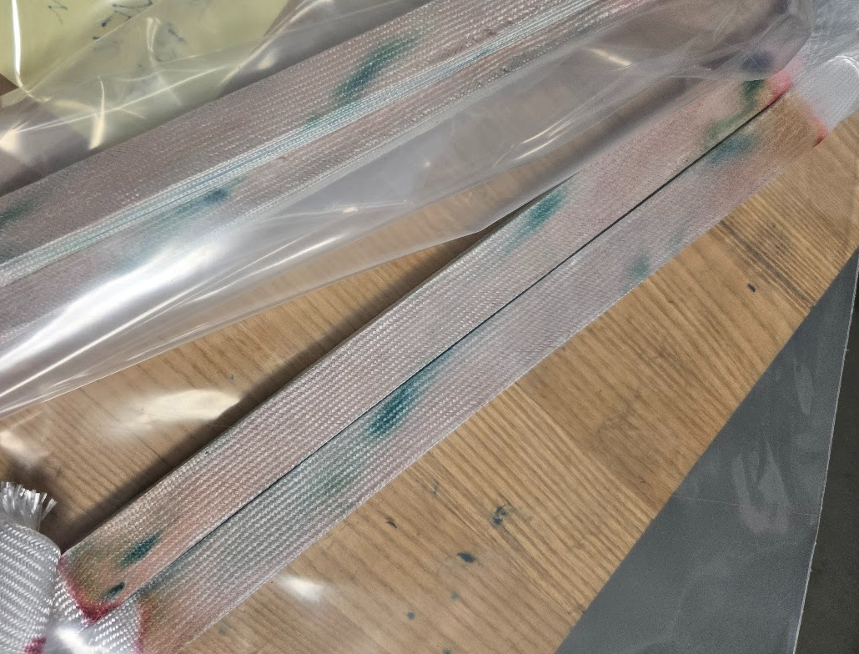
Back to stacks:
Same procedure, 2 more dilute Recipes.
No Acetone
With Acetone
Samples without acetone exhibited poor adhesion for the same geometry. Added acetone substantially improved adhesion

