Slide 1

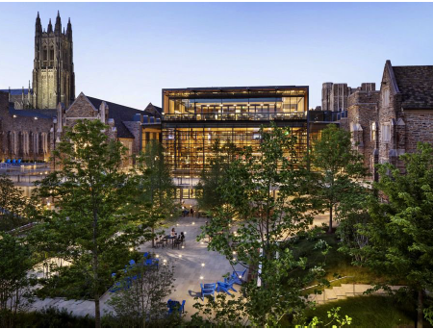
Local transfer learning for cost-efficient surrogate modeling of expensive simulators
Simon Mak
Department of Statistical Science
Duke University

Slide 2
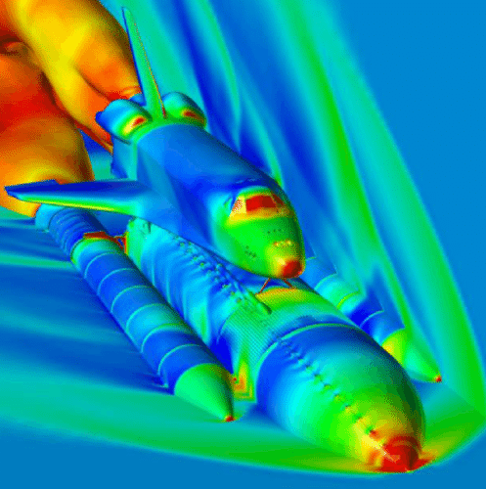
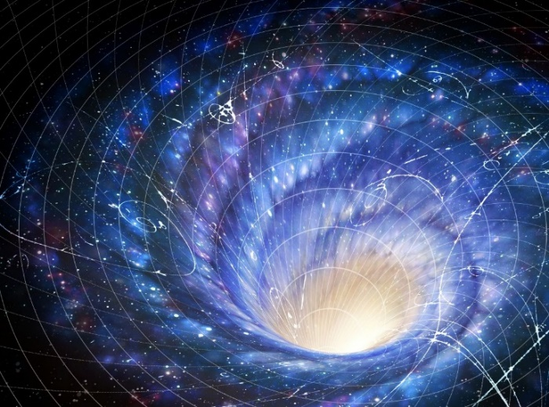
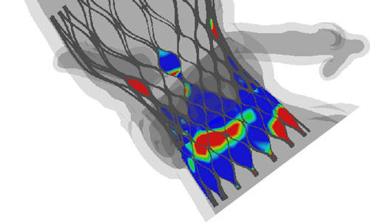
Computer experiments
Complex phenomena can be virtually simulated via computer code
Rocket propulsion
Mak et al. 2018, Yeh et al. 2018, Chang et al. 2019, 2021, Zhang et al. 2022
High-energy physics
Everett et al. 2021, Liyanage et al. 2022, Ji et al. 2023 (a,b), Li et al. 2023+ (a,b)
Aortic valves
Chen et al., 2020, 2021
Computer experiments widely used as proxies for physical experiments (expensive, unethical, or impossible)
However, the more complex the phenomena, the more time-consuming the simulations!

Slide 3
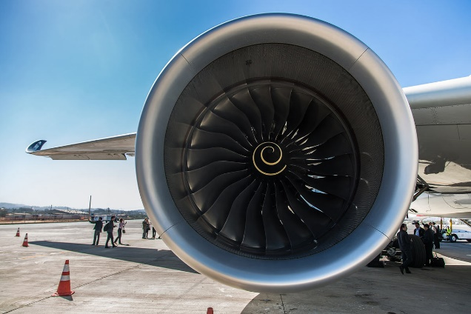


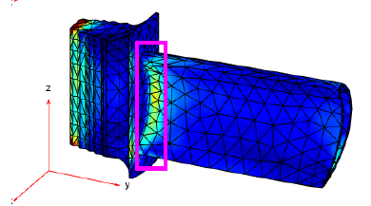
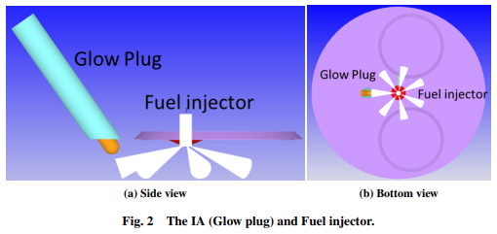

Jet engine design
Jet engine design for sustainable aviation (Duke, UMinn, ARO):
Jet turbine
Maximum stress $f\left(x\right)$
Virtual CFD engine
Operating conditions $x$, simulated QoI $f\left(x\right)$
Stress analysis of engine blade

Slide 4
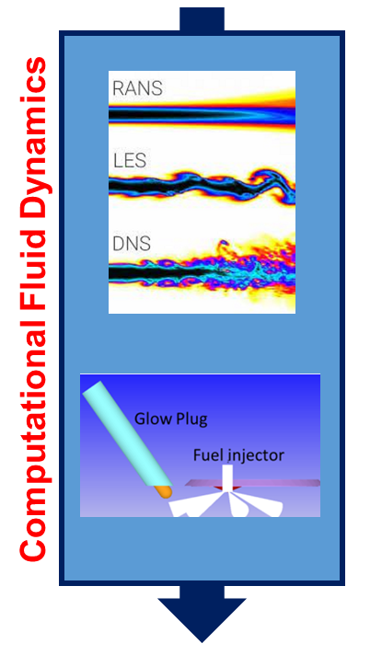
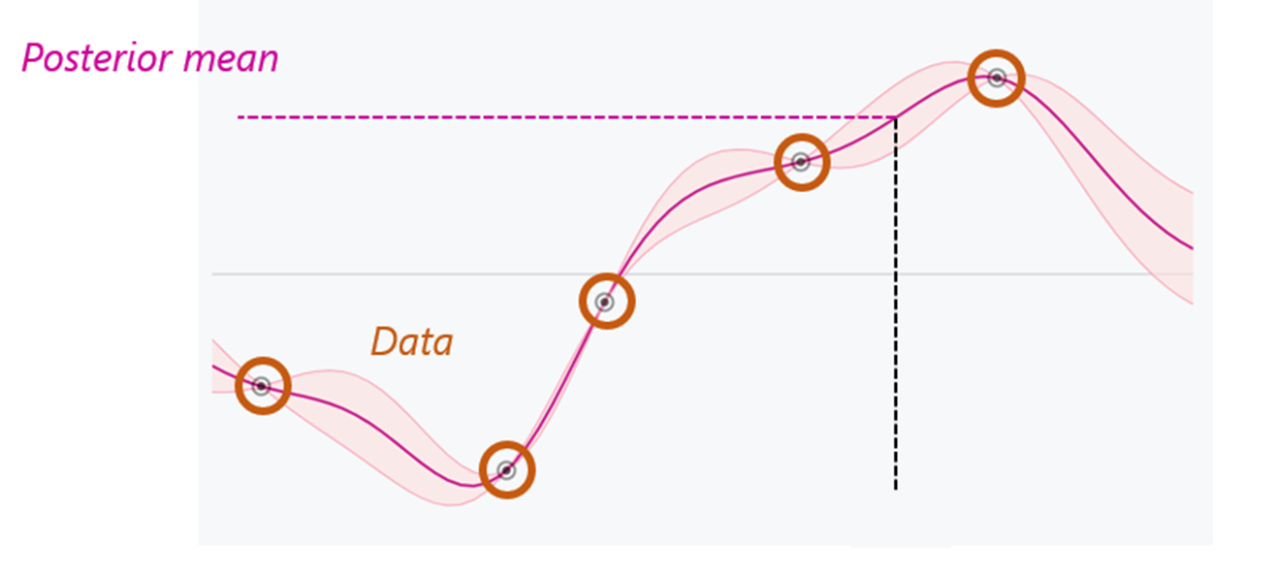


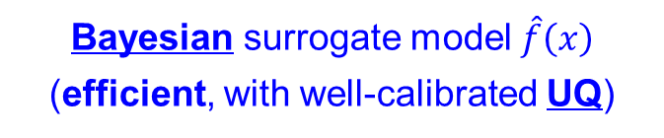
Jet engine design
Challenge: Simulation runs are highly expensive – ${𝒪(10}^{4})$ CPU hours / parameter
Operating conditions $x∈ℝ^{d}$
(expensive)
Bayesian surrogate model $\hat{f}\left(x\right)$
(efficient, with well-calibrated UQ)
Maximum stress $f\left(x\right)$

Slide 5
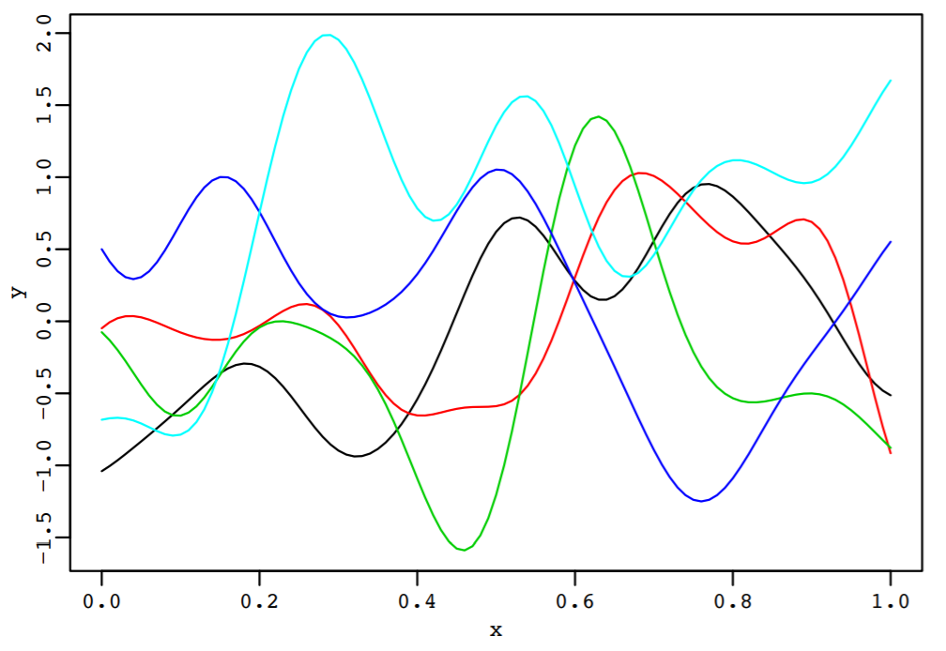
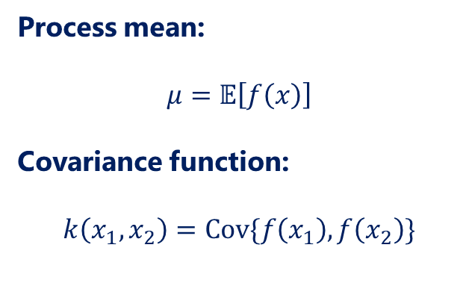
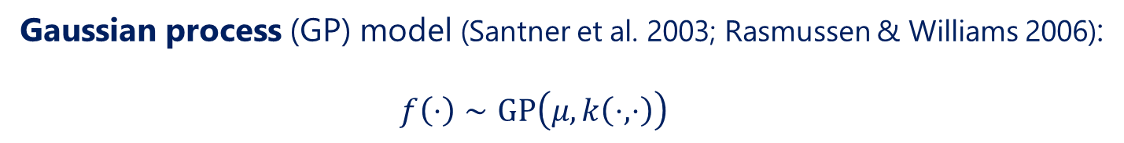
Gaussian processes
Gaussian process (GP) model (Santner et al. 2003; Rasmussen & Williams 2006):
  $$f\left(⋅\right)∼GP\left(μ,k\left(⋅,⋅\right)\right)$$
Process mean:
$$μ=𝔼\left[f\left(x\right)\right]$$
Covariance function:
$$k\left(x_{1},x_{2}\right)=Cov\{f\left(x_{1}\right),f\left(x_{2}\right)\}$$
Flexible Bayesian nonparametric model for predictive modeling

Slide 6
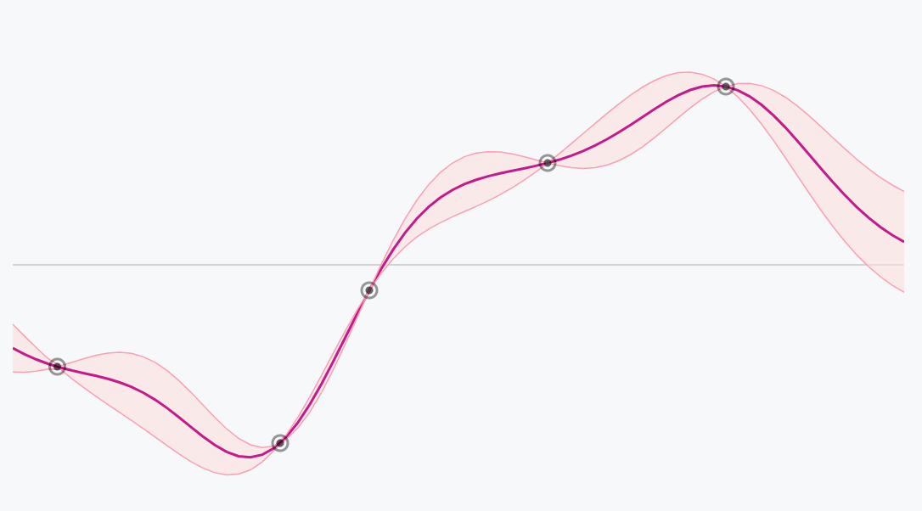

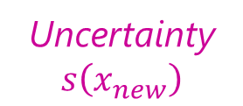


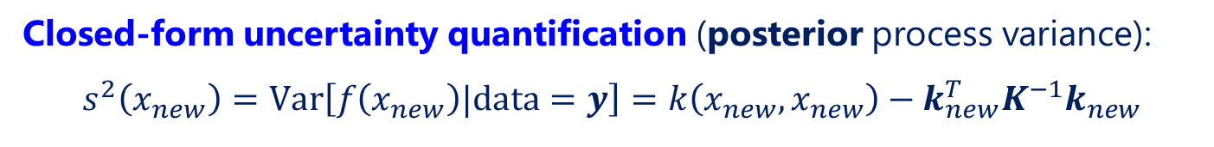
Gaussian processes
Prediction
$$\hat{f}(x_{new})$$
Data
Uncertainty
$$s\left(x_{new}\right)$$
$$x_{new}$$
Closed-form uncertainty quantification (posterior process variance):
$$s^{2}\left(x_{new}\right)=Var\left[f\left(x_{new}\right)|data=y\right]=k\left(x_{new},x_{new}\right)−k_{new}^{T}K^{−1}k_{new}$$
Closed-form predictor (posterior process mean):
$$\hat{f}\left(x_{new}\right)=𝔼\left[f\left(x_{new}\right)|data=y\right]=μ+k_{new}^{T}K^{−1}(y−μ1)$$

Slide 7
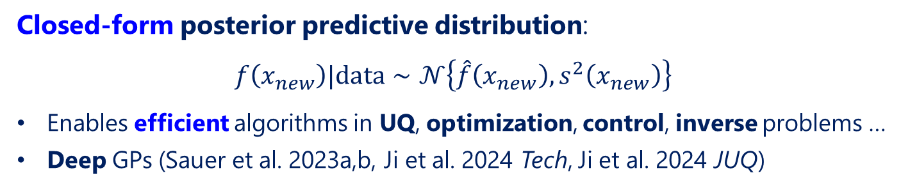
Gaussian processes
Prediction
$$\hat{f}(x_{new})$$
Data
Uncertainty
$$s\left(x_{new}\right)$$
$$x_{new}$$
Closed-form posterior predictive distribution:
$$f\left(x_{new}\right)|data∼𝒩\left\{\hat{f}\left(x_{new}\right),s^{2}\left(x_{new}\right)\right\}$$
Enables efficient algorithms in UQ, optimization, control, inverse problems …
Deep GPs (Sauer et al. 2023a,b, Ji et al. 2024 Tech, Ji et al. 2024 JUQ)

Slide 8
Gaussian processes
Why GPs (and their deep variants) over other probabilistic ML models?
Flexible framework for probabilistic transfer learning
GPs (& their deep variants):
More robust in black-box scientific applications (Yan et al. 2018)
Alternate probabilistic models:
Polynomial chaos (Xiu 2010): prior knowledge for basis specification
Bayesian NNs: excellent point predictions but UQ can be erratic (Adlam et al. 2020, Yao et al. 2019)
B-PINNs (Yang et al. 2020): integrates known governing physics within a Bayesian NN
Well-calibrated UQ via Bayesian non-parametrics theory (Stein 1999)
Useful in complex problems where governing physics are unknown or unclear

Slide 9
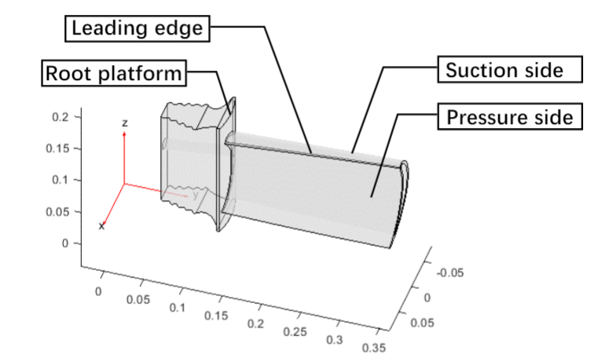
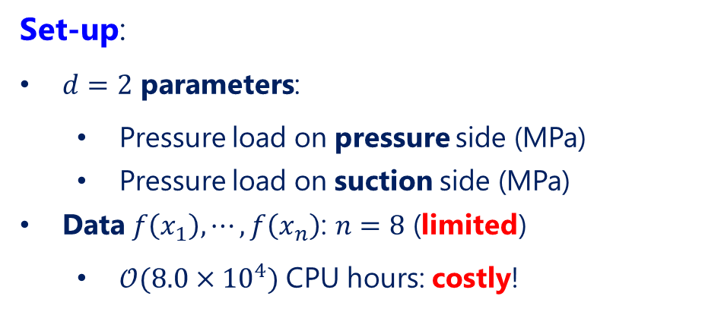
A motivating case study
Let’s see how well standard GP surrogates perform:
Operating conditions $x∈ℝ^{d}$
Set-up:
$d=2$ parameters:
  Pressure load on pressure side (MPa)
  Pressure load on suction side (MPa)
Data $f\left(x_{1}\right), ⋯, f\left(x_{n}\right)$: $n=8$ (limited)
  $𝒪(8.0×{10}^{4})$ CPU hours: costly!
(expensive)
Maximum stress $f\left(x\right)$

Slide 10
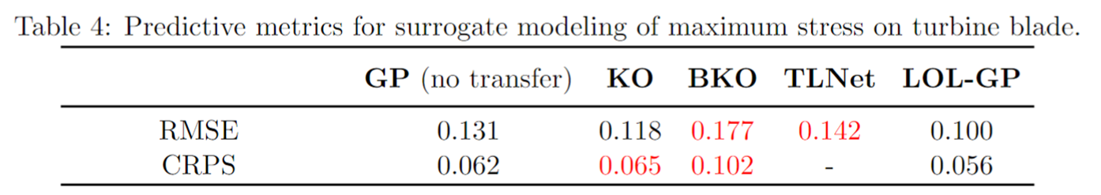
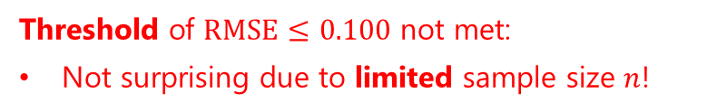
A motivating case study
Let’s see how well standard GP surrogates perform:
Threshold of $RMSE≤0.100$ not met:
Not surprising due to limited sample size $n$!
Automatic relevance determination (ARD) with sq.-exp. kernel
Prediction metrics:
  Root mean-squared error (RMSE)
  Continuous ranked probability score (CRPS; Gneiting & Raftery 2007)

Slide 11
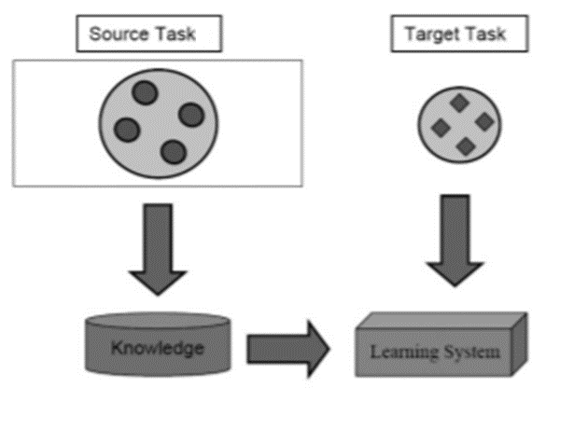
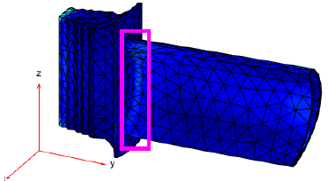


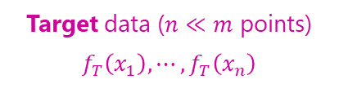
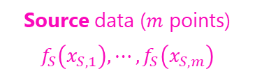
Transfer learning surrogates
Transfer learning (Pan & Yang 2010):
Source data ($m$ points)
$$f_{S}\left(x_{S,1}\right),⋯,f_{S}\left(x_{S,m}\right)$$
Target data ($n≪m$ points)
$$f_{T}\left(x_{1}\right),⋯,f_{T}\left(x_{n}\right)$$
Ceramic matrix composites
Nickel-based alloys
Transfer of knowledge from related source tasks to more efficiently solve a target task with limited data
Can we use simulated data on related source systems (e.g., from existing studies) to improve probabilistic surrogates on the target system?

Slide 12
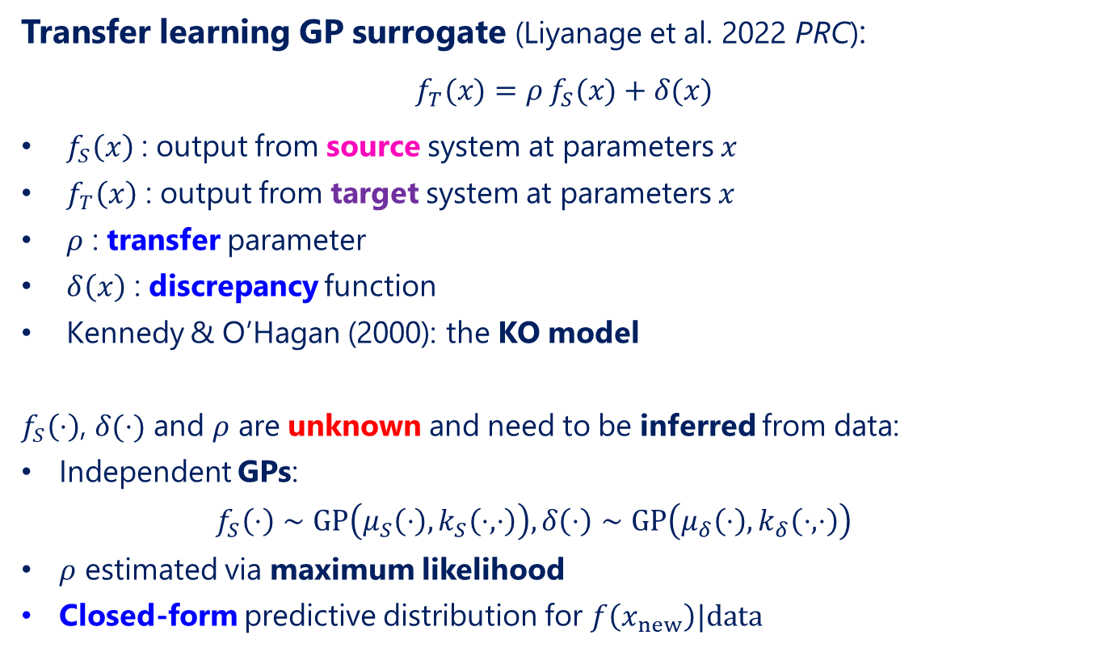
Transfer learning surrogates
Transfer learning GP surrogate (Liyanage et al. 2022 PRC):
$$f_{T}(x)=ρ{ f}_{S}(x)+δ(x)$$
$f_{S}\left(x\right)$ : output from source system at parameters $x$
$f_{T}\left(x\right)$ : output from target system at parameters $x$
$ρ$ : transfer parameter
$δ\left(x\right)$ : discrepancy function
Kennedy & O’Hagan (2000): the KO model
$f_{S}\left(⋅\right)$, $δ(⋅)$ and $ρ$ are unknown and need to be inferred from data:
Independent GPs:
  $$f_{S}\left(⋅\right)∼GP\left(μ_{S}\left(⋅\right),k_{S}\left(⋅,⋅\right)\right), δ\left(⋅\right)∼GP\left(μ_{δ}\left(⋅\right),k_{δ}\left(⋅,⋅\right)\right)$$
$ρ$ estimated via maximum likelihood
Closed-form predictive distribution for $f\left(x_{new}\right)|data$

Slide 13
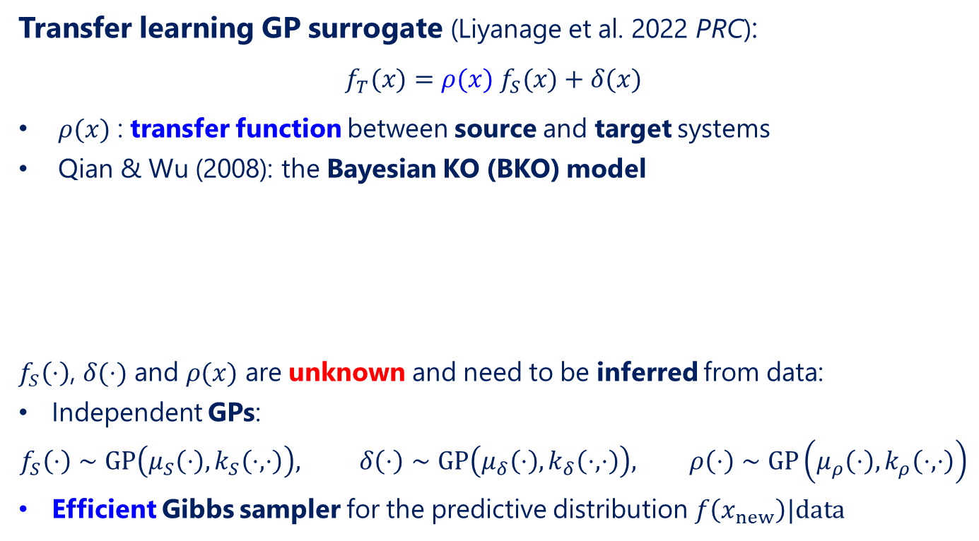
Transfer learning surrogates
Transfer learning GP surrogate (Liyanage et al. 2022 PRC):
$$f_{T}(x)=ρ(x){ f}_{S}(x)+δ(x)$$
$ρ(x)$ : transfer function between source and target systems
Qian & Wu (2008): the Bayesian KO (BKO) model
$f_{S}\left(⋅\right)$, $δ(⋅)$ and $ρ(x)$ are unknown and need to be inferred from data:
Independent GPs:
$$f_{S}\left(⋅\right)∼GP\left(μ_{S}\left(⋅\right),k_{S}\left(⋅,⋅\right)\right), δ\left(⋅\right)∼GP\left(μ_{δ}\left(⋅\right),k_{δ}\left(⋅,⋅\right)\right), ρ\left(⋅\right)∼GP\left(μ_{ρ}\left(⋅\right),k_{ρ}\left(⋅,⋅\right)\right)$$
Efficient Gibbs sampler for the predictive distribution $f\left(x_{new}\right)|data$

Slide 14
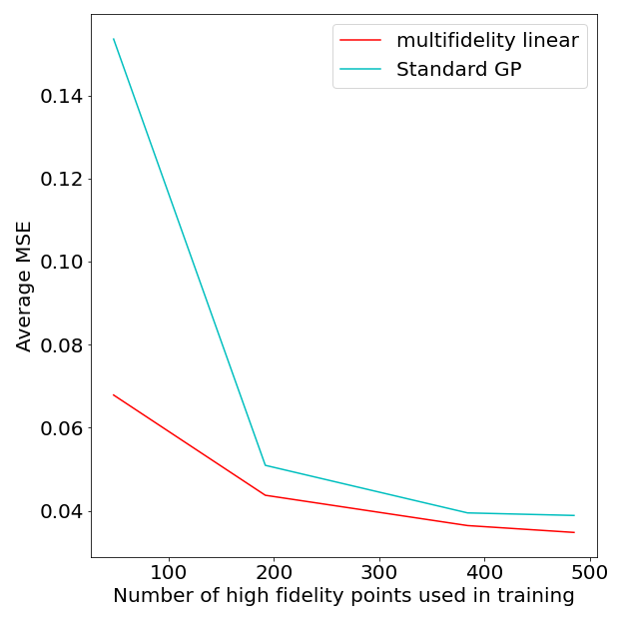
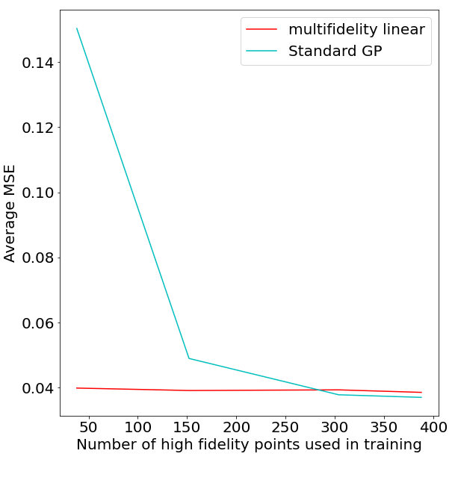

Transfer learning surrogates
Source: p+p collisions at 2.76 TeV with Grad viscous correction
Target: Au+Au (Grad)
Target: Pb+Pb (CE)
TL-GP
TL-GP
GP (no transfer)
GP (no transfer)
Liyanage et al. (2022, PRC)
Great - more accurate surrogates at reduced computational cost!

Slide 15

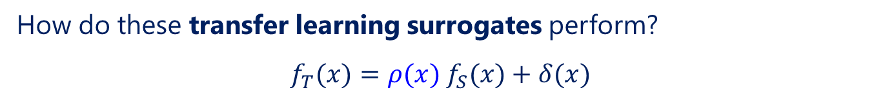


A motivating case study
How do these transfer learning surrogates perform?
$$f_{T}(x)=ρ(x){ f}_{S}(x)+δ(x)$$
$$ρ\left(x\right)=ρ$$
$$ρ\left(x\right)∼GP$$
$ρ\left(f_{S},x\right)$ : modeled as fully-connected NN
TLNet:
NN-based benchmark for point (not probabilistic) prediction
Perdikaris et al. (2017)
Negative transfer (Zhang et al. 2020):
Both transfer models yield worse predictive performance than the GP
Highly undesirable! Robustness of transfer model needs to be carefully considered.
Cause of this negative transfer?

Slide 16
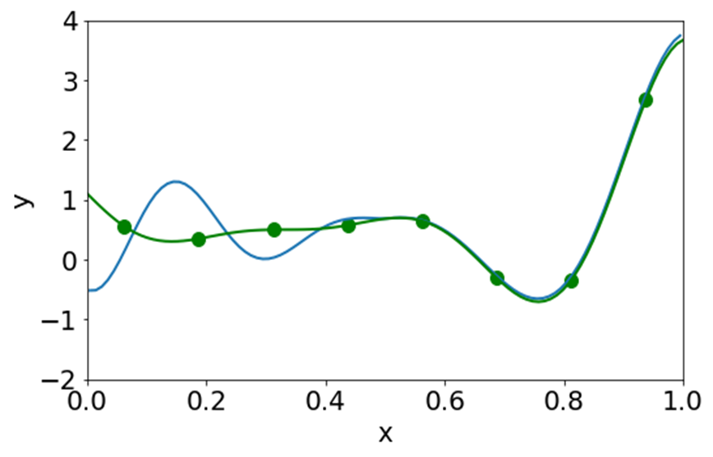
Negative transfer
Transfer learning appropriate here
… but not here!
Source system, target system
Source and target systems similar at certain parametrizations, but considerably different for others
  This local transfer property often arises in physical systems

Slide 17
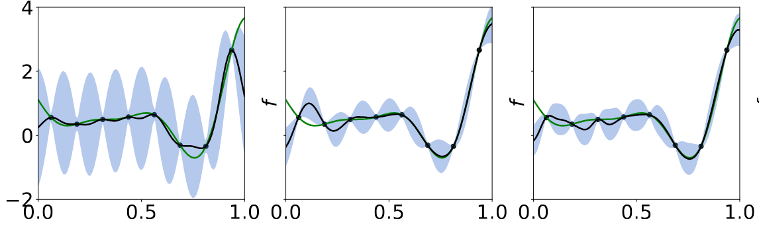
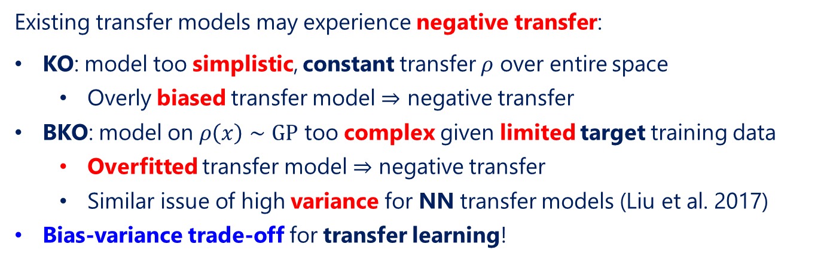
Negative transfer
GP (no transfer)
KO (Kennedy & O’Hagan 2000)
BKO (Qian & Wu 2008)
negative transfer
negative transfer
Existing transfer models may experience negative transfer:
KO: model too simplistic, constant transfer $ρ$ over entire space
  Overly biased transfer model $⇒$ negative transfer
BKO: model on $ρ\left(x\right)∼GP$ too complex given limited target training data
  Overfitted transfer model $⇒$ negative transfer
  Similar issue of high variance for NN transfer models (Liu et al. 2017)
Bias-variance trade-off for transfer learning!

Slide 18
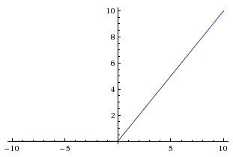
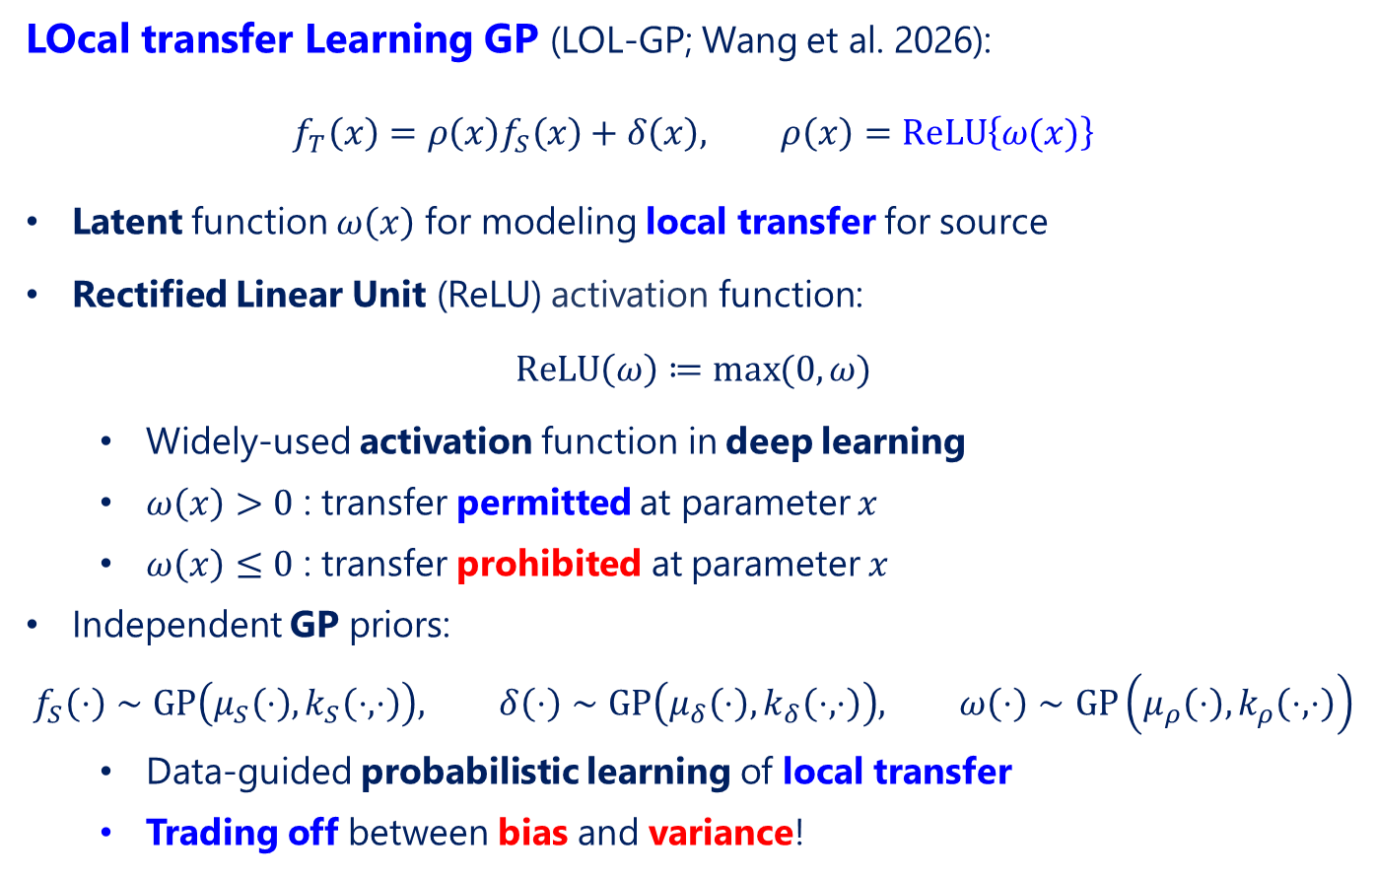
LOL-GP
LOcal transfer Learning GP (LOL-GP; Wang et al. 2026):
$$f_{T}\left(x\right)=ρ\left(x\right)f_{S}\left(x\right)+δ\left(x\right), ρ\left(x\right)=ReLU\left\{ω(x)\right\}$$
Latent function $ω\left(x\right)$ for modeling local transfer for source
Rectified Linear Unit (ReLU) activation function:
$$ReLU\left(ω\right)≔\max{(0,ω)}$$
  Widely-used activation function in deep learning
  $ω\left(x\right)>0$ : transfer permitted at parameter $x$
  $ω\left(x\right)≤0$ : transfer prohibited at parameter $x$
Independent GP priors:
$$f_{S}\left(⋅\right)∼GP\left(μ_{S}\left(⋅\right),k_{S}\left(⋅,⋅\right)\right), δ\left(⋅\right)∼GP\left(μ_{δ}\left(⋅\right),k_{δ}\left(⋅,⋅\right)\right), ω\left(⋅\right)∼GP\left(μ_{ρ}\left(⋅\right),k_{ρ}\left(⋅,⋅\right)\right)$$
  Data-guided probabilistic learning of local transfer
  Trading off between bias and variance!

Slide 19
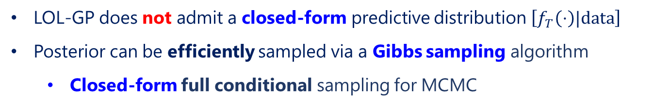

LOL-GP
LOcal transfer Learning GP (LOL-GP; Wang et al. 2026):
$$f_{T}\left(x\right)=ρ\left(x\right)f_{S}\left(x\right)+δ\left(x\right), ρ\left(x\right)=ReLU\left\{ω(x)\right\}$$
LOL-GP does not admit a closed-form predictive distribution $\left[f_{T}\left(⋅\right)|data\right]$
Posterior can be efficiently sampled via a Gibbs sampling algorithm
  Closed-form full conditional sampling for MCMC

Slide 20
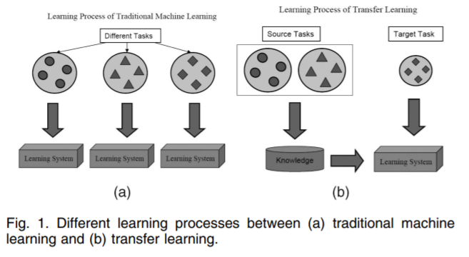


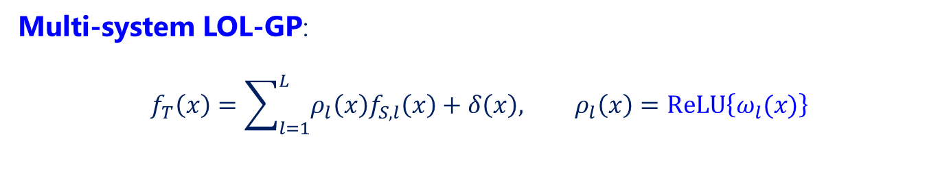

Multi-system LOL-GP
Multi-system LOL-GP:
$$f_{T}\left(x\right)=\sum_{l=1}^{L}{ρ_{l}\left(x\right)f_{S,l}\left(x\right)}+δ\left(x\right), ρ_{l}\left(x\right)=ReLU\left\{ω_{l}(x)\right\}$$
Generalizable for multiple source systems
Source 1 ($m_{1}$ points)
Target ($n≪min⁡(m_{1},m_{2})$ points)
Ceramic matrix composites
Source 2 ($m_{2}$ points)
Nickel-based alloys
Ceramic matrix composites

Slide 21
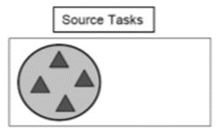
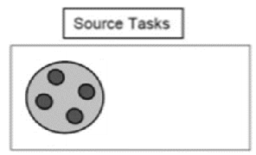
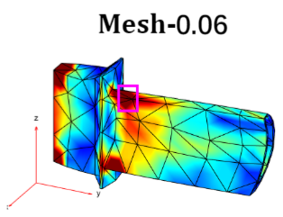
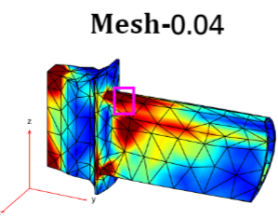
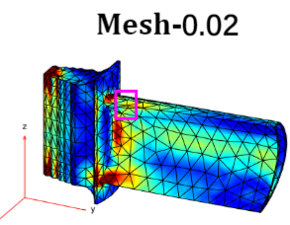
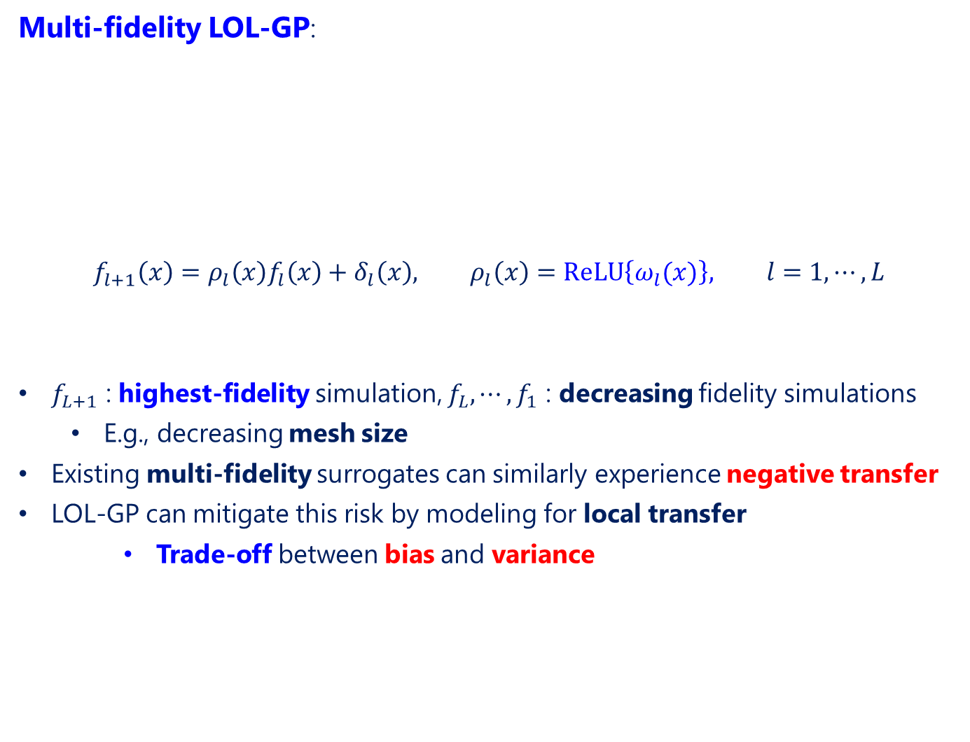
Multi-fidelity LOL-GP
Multi-fidelity LOL-GP:
$$f_{l+1}\left(x\right)=ρ_{l}\left(x\right)f_{l}\left(x\right)+δ_{l}\left(x\right), ρ_{l}\left(x\right)=ReLU\left\{ω_{l}(x)\right\}, l=1, ⋯, L$$
$f_{L+1}$ : highest-fidelity simulation, $f_{L}, ⋯, f_{1}$ : decreasing fidelity simulations
  E.g., decreasing mesh size
Existing multi-fidelity surrogates can similarly experience negative transfer
LOL-GP can mitigate this risk by modeling for local transfer
    Trade-off between bias and variance
Low fidelity
Mid fidelity
High fidelity

Slide 22
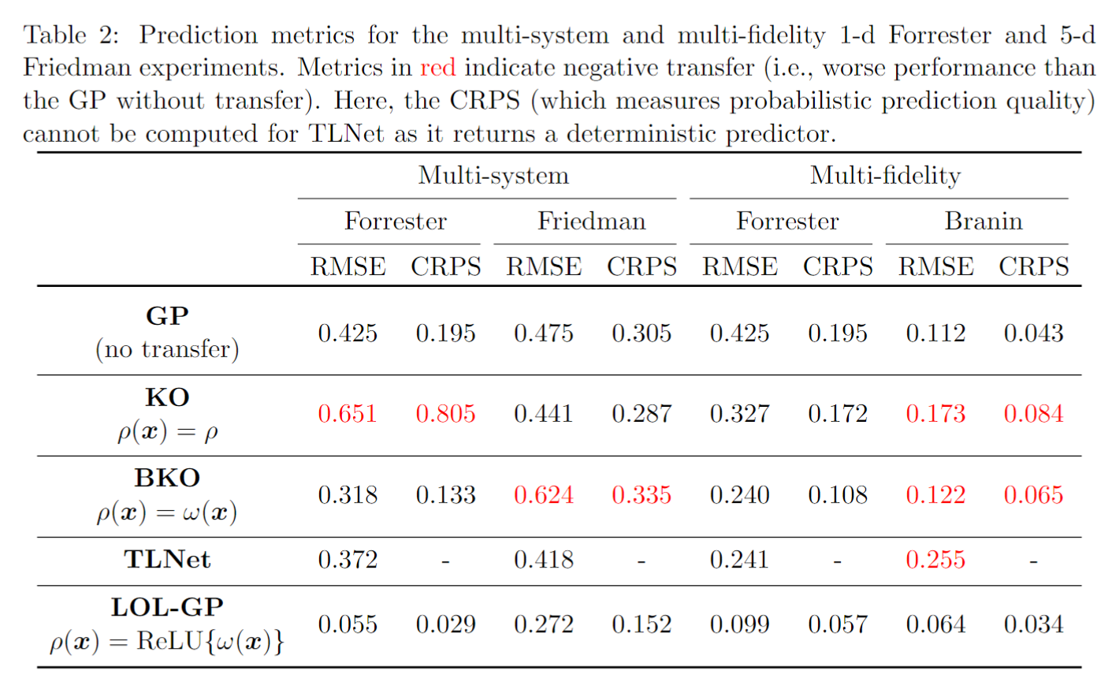
Numerical experiments
5-d test function
1-d test function
Negative transfer!
Trade-off between bias & variance $⇒$ Robust transfer learning

Slide 23
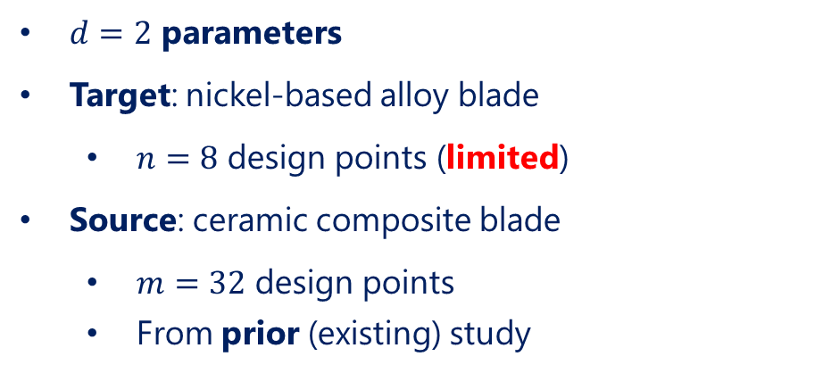
Jet turbine stress analysis
Multi-system application:
Operating conditions $x∈ℝ^{d}$
$d=2$ parameters
Target: nickel-based alloy blade
  $n=8$ design points (limited)
Source: ceramic composite blade
  $m=32$ design points
  From prior (existing) study
(expensive)
Maximum stress $f\left(x\right)$
Ceramic matrix composites
Nickel-based alloys

Slide 24

Jet turbine stress analysis
Multi-fidelity application:
$d=2$ parameters:
  Pressure load on pressure side (MPa)
  Pressure load on suction side (MPa)
High-fidelity: maximum mesh size 0.02
  Data: $n_{T}=10$ (limited)
Two lower fidelities:
  Low: maximum mesh size 0.06, $m_{1}=40$
  Medium: maximum mesh size 0.04, $m_{1}=20$
Operating conditions $x∈ℝ^{d}$
(expensive)
Maximum stress $f\left(x\right)$

Slide 25
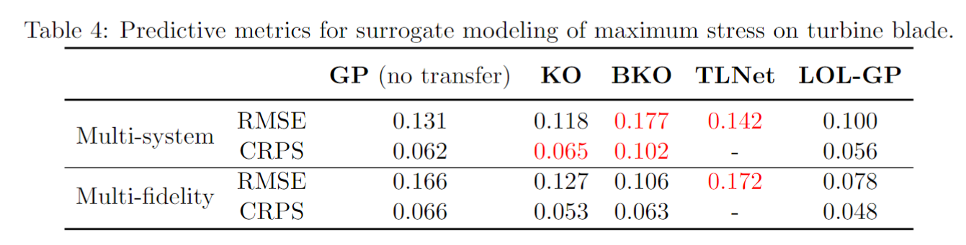
Jet turbine stress analysis
Negative transfer!
Existing models can experience considerable negative transfer
By modeling for local transfer, the LOL-GP allows for robust transfer learning that mitigates the risk for negative transfer

Slide 26
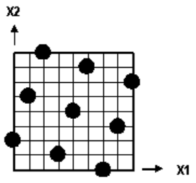
Ongoing directions
Transfer learning for surrogate modeling of QGP observables:
  Multi-task learning for different collision systems (e.g., Au+Au, Pb+Pb)
  Multivariate observables
  Experimental design
Au+Au
p+p
Pb+Pb

Slide 27
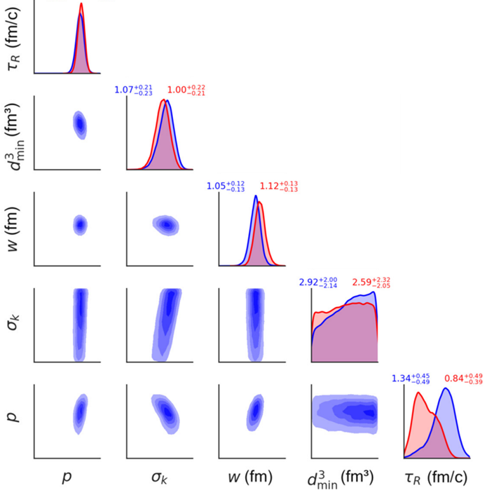

Ongoing directions
Transfer learning for Bayesian optimization:
  One application: MAP calculation for QGP Bayesian analysis
Bayesian analysis:
$$\left[θ | data\right]∝[data|θ][θ]$$
MAP parameters:
$$\hat{θ}={argmax}_{θ} [θ|data]$$
Bayesian optimization can be used to pinpoint the MAP parameters with considerably fewer design points
MAP parameters
Everett et al. (2021, PRC)

Slide 28

Ongoing directions
Transfer learning for Bayesian optimization:
  Efficient MAP calculation via transfer learning between collision systems
  Applications for detector optimization?
  Au+Au
  Pb+Pb
  Transfer

Slide 29

DSiS special issue

Slide 30

Questions

