Slide 1
A proposal to validate conductors for C4 magnet
With feedback from the REBCO WGM on 18 June 2026

Slide 2
Making C4 is a worthwhile process with many challenges
Can conductor vendors deliver?
  Double the total conductor length from C3
Can we make the magnet?
  Introduce new features in magnet fabrication
Can the conductor sustain a higher Lorentz force? [see X. Xu’s talk]
  Double the Lorentz force from 42 kN/m in C3 to 100 kN/m in C4
Can we protect the magnet without thermal runaway?
  Stored energy increased from 56 kJ in C3 to ~ 300 kJ in C4
How reproducible are the main field and field errors?

Slide 3
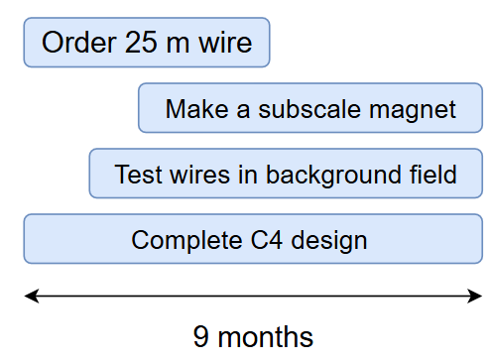
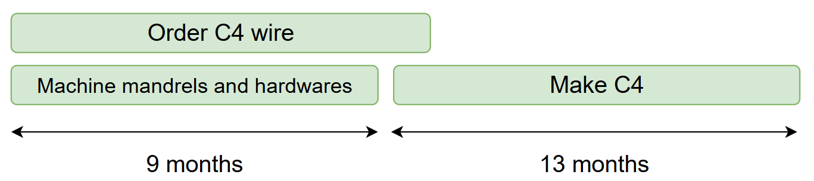
Approach C4 in two steps to manage risk
1. Evaluate conductor and practice with a subscale magnet
2. If Step 1 succeeds, make and test C4
Notes:
Wind subscale C4 coils to validate conductor behavior and debug magnet winding process.
Verify the resilience of the wire to IxB force in a configuration relevant for C4.
17 m for a 4-layer, 4-turn subscale coils. 8 m to make three samples for in-field test at NHMFL. One practice and at least two good samples for test
Conductor cost ~ $54 k, lead time ~ 2 months.

Slide 4
We propose two methods to validate the conductor first
Wind subscale C4 coils to validate conductor behavior and debug magnet winding process
Verify the resilience of the wire to IxB force in a configuration relevant for C4
Pursue both in parallel, ideally

Slide 5
Driving questions for subscale coils
Wire
  What’s the bending performance of the new CORC® wires using Fujikura tapes?
  What’s the wire performance at 4.2 K?
Winding
  Does the new groove diameter work for the winding and instrumentation?
  Does the continuous groove cause any issue for winding and Stycast painting?
  Can we apply an overband on top of the wire?
Assembly
  Does the shim between the layers work?
  Can we reverse the process and extract the coil?
  Does the shim cause any issues on coil performance?
How does the electrical termination work with the new CORC® wires using Fujikura tapes?

Slide 6
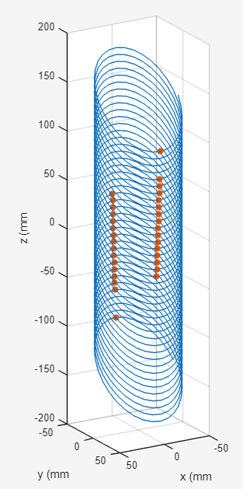
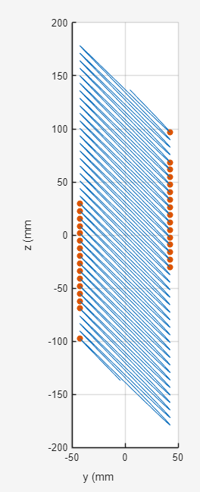
Peak transverse IxB load occurs at the pole region in C4
Pole S
Dipole field from N to S
Pole S
Pole N
C4 innermost layer
Pole N
IxB force push the wire against the groove

Slide 7
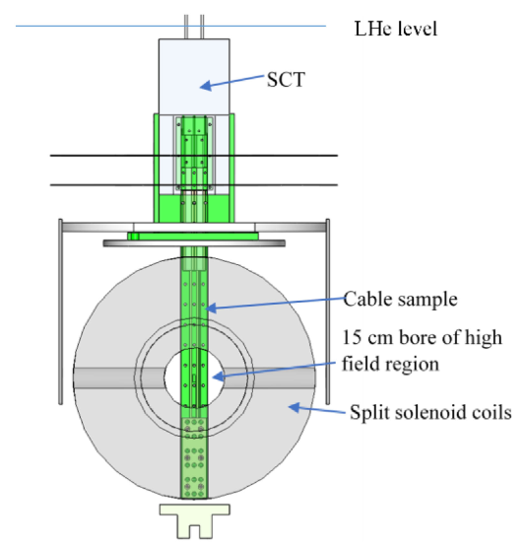
Test in a background dipole field to check the resilience of the new CORC® wire to the IxB force
NHMFL 12-T split-pair magnet
Superconducting transformer up to 45 kA
Possible to reproduce the peak IxB force in a CCT magnet
Cost ~ $50 k for a one-week test campaign
  Possible to test up to three samples
Sample
Current
B field
IxB force
H. Yu et al., 2022, TAS

Slide 8
Stress-validation test
Multiple test campaigns possible
Campaign 1
  test the setup, instrumentation, measurement protocol
  Two samples: one without Stycast, one with Stycast painting
Campaign 2 to be designed based on the feedback from Campaign 1
  Check the reproducibility from Campaign 1
  VPI sample and compare with painted Stycast

Slide 9
What can be considered as success for Step 1?
Machine the mandrels without significant issues
Wind the coils without significant issues
I_{c} degradation < 15% at 77 K, 30 mm bend radius
  C3a wires, 5% - 10% degradation at 77 K at 30 mm bend radius
Reach 115 kN/m IxB force at 4.2 K without showing degradation after 100 cycles
  10 T at 10 kA gives 100 kN/m. 115 kN/m provides some margin
  I_{c} criterion?
  No change in n value? Dan: 20% drop in n value observed at 77 K from ASC test.
  Increase IxB forces in steps, cycle x times at each step, increase force again, until degradation
Inter-layer joint sustains 12 kA with a stable voltage rise < 150 microV across the joint at 4.2 K
  Can be better but good enough for C4
Notes:
Matt:
should we include the Ic retention after bending in the specs in the order. Also useful to specify the targets with a timeline.
How far can CORC go in terms of IxB force? 100 kN/m is insufficient for future high-field insert.
Shaon:
Why do we measure at 77 K?
Matt: we don’t have many mechanical property data at 4.2 K?
Ian's suggestion: evolve the specification towards KPP, threshold value and objective value. From internet: Key Performance Parameters (KPPs) in defense acquisition define critical system capabilities required for operational success, structured into mandatory threshold (minimum acceptable) and objective (desired) values. Thresholds are non-negotiable; failing them can terminate a program, while objectives represent high-performance goals at higher risks

Slide 10
We propose a total of 25 m long CORC® wires for Step 1
17 m for a 4-layer, 4-turn subscale coils
8 m to make three samples for in-field test at NHMFL
  One practice and at least two good samples for test
Conductor cost ~ $55 k, lead time ~ 2 months
Any other experiments that we can carry out?
  FNAL interested in transverse compression test, 5 m ?
  ASC can also test in solenoid background field but may need to anchor the sample holder at the lower end?

Slide 11
Feedback from 6/18 REBCO WG meeting
Ian: What if we must reduce the scope or limited by man power?
  Focus on the stress test first, then work on subscale coil
  Reduce the scope of subscale
    Pursue two layers of subscale coil, not four, “in parallel”
    Subscale test is useful:
      to verify the bending performance of the wire by measuring the conductor Ic before and after winding and comparing to the expected coil performance
  There could be order afterwards

Slide 12
Backup

Slide 13
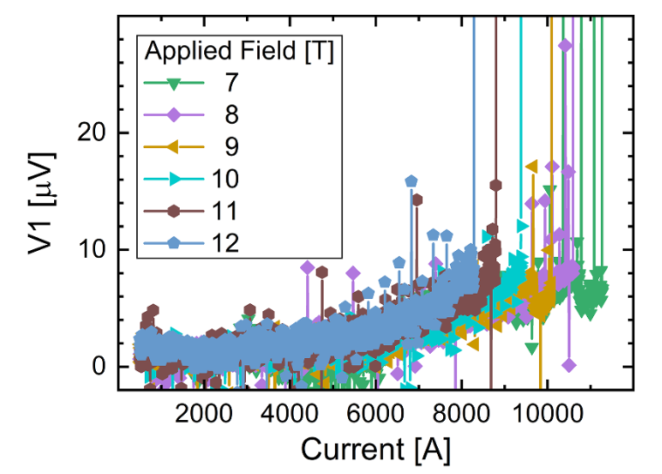
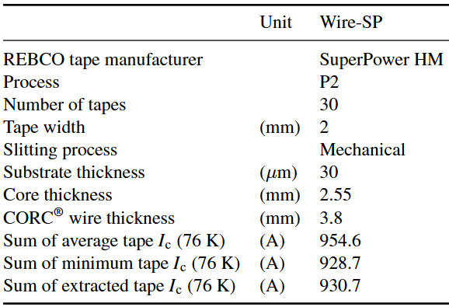
C3-type CORC® wire showed no degradation up to 102 kN/m IxB force
Danko ver der Laan et al. 2024, SuST

Slide 14
Specific questions that drive the REBCO effort
What performances should the conductor have? How to collaborate with vendors to meet the performance targets?
How to make magnets using these conductors?
What is the maximum dipole field one can get?
What is the magnet performance? How does it transition? What is the field quality?
How does a magnet fail? How to avoid it?

Slide 15
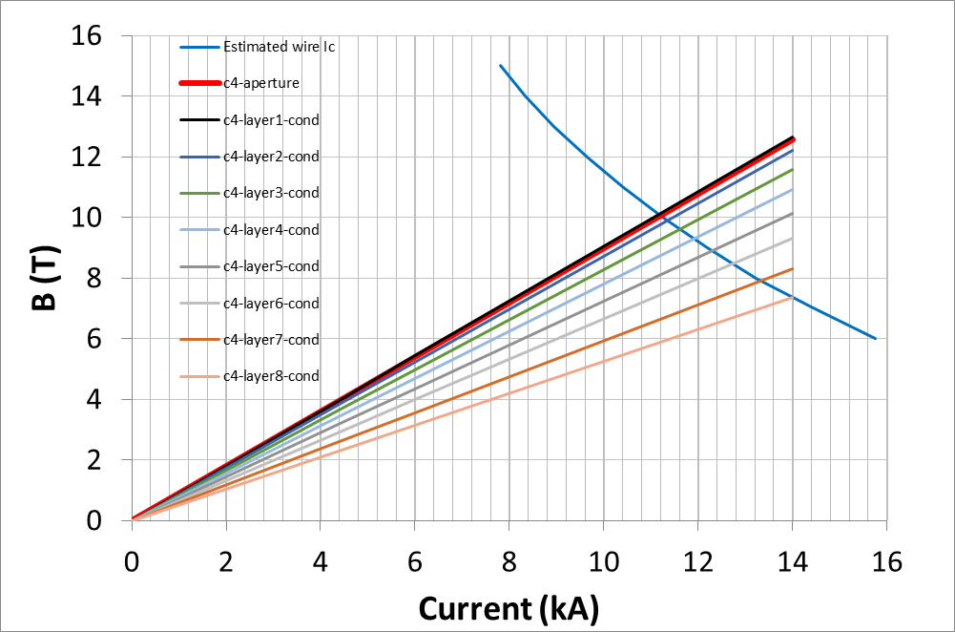
We propose a CCT dipole magnet to generate 9 T at 4.2 K using CORC® wires
8 layers using a new CORC® wire design
Short-sample prediction 10 T at 11.2 kA, 4.2 K, without iron
  TF ~ 0.9 T/kA
113 kN/m peak force on the wire
  ~ 100 kN/m at 10 T with iron
~ 320 m long conductors
  Ballpark number. To be updated after completing the mechanical design
Proposed at the recent MDP collaboration meeting

Slide 16
C4 will differ from C3 in several aspects that require careful evaluation
 | C3 | C4
Manufacturer | SuperPower | Fujikura
Substrate thickness | 30 µm | 35 µm
Number of tapes | 30 | 24
Core diameter | 2.5 mm | 3.0 mm
Wire diameter | 3.8 mm | 4.2 mm
Groove diameter | 4.1 mm | 4.5 mm
Ribs | Discontinued | Continued
Layer coupling | Stycast | Shim

Slide 17
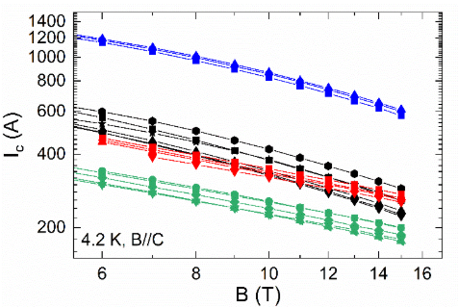
Fujikura tapes will allow MDP to continue develop and evaluate the REBCO technology towards higher fields
Courtesy of D. van der Laan of ACT and D. Abraimov of ASC/FSU
Fujikura vs. SuperPower HM
Higher I_{c}
Readily available, ~ 2 months lead time for 1 km long tape
Lower cost, ~ 65% of HM tape
Fujikura
SuperPower HM
SST

Slide 18
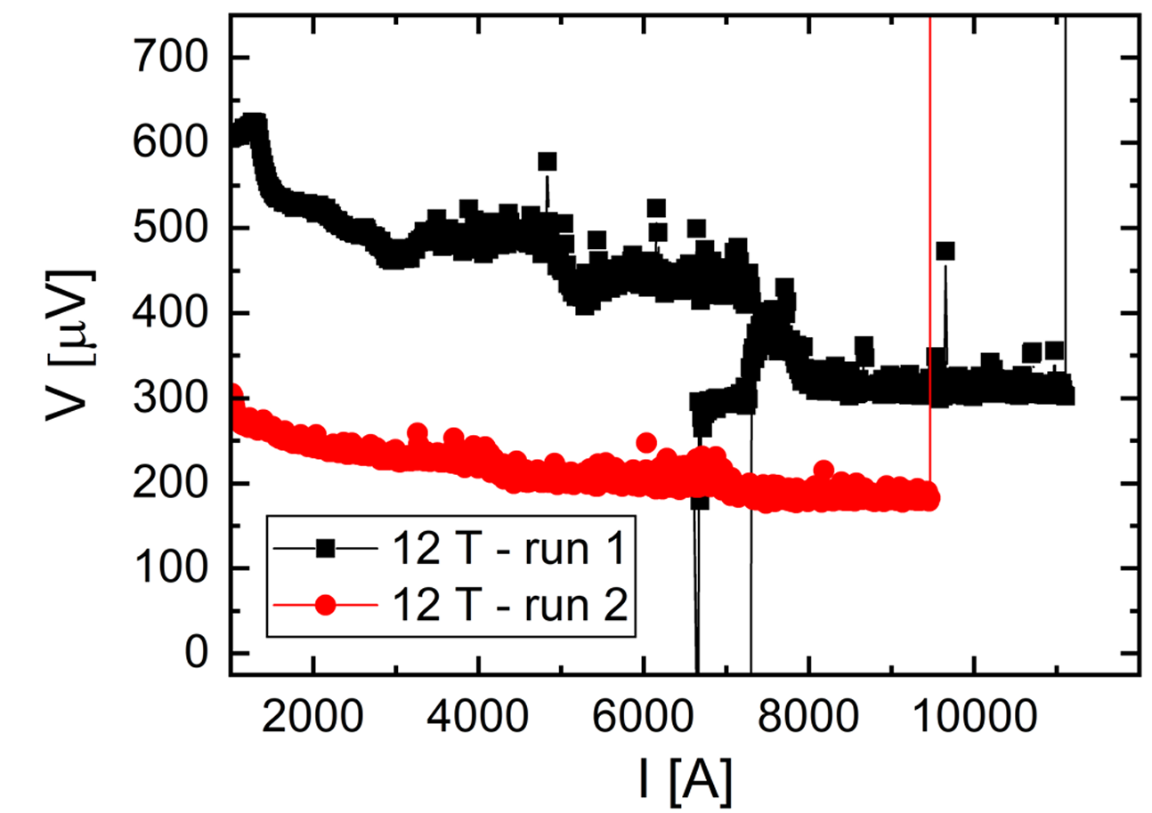
Sustaining a high Lorentz force, > 100 kN/m, becomes challenging
Recent Fujikura CORC® samples quenched after reaching 132 kN/m at 4.2 K and apparently degraded
  Could it be something else other than degradation due to Lorentz forces?
ACT test setup: “U”-shaped sample in a solenoid field
132 kN/m
Degradation?

