Slide 1
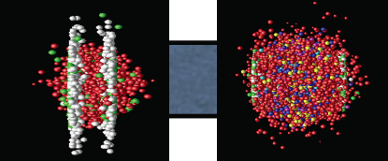
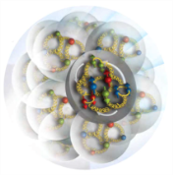
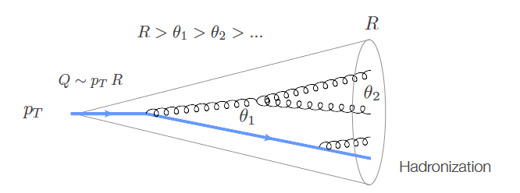

Probing QCD Matter, hot and cold
Symposium for Wick Haxton
Barbara Jacak, UC Berkeley & LBNL
January 7, 2020

Slide 2


In honor of Wick Haxton
Chair of the UCB Physics Department
Senior Staff Member at LBNL Nuclear Science Division
Cheerful skeptic who keeps us on our toes…

Slide 3
Quark Gluon Plasma: strongly coupled hot QCD matter
η/s *2π
QGP flows as a nearly perfect liquid
QGP is very opaque to color-charged particles
What are its transport properties?
J/Ψ Alice 0-90%
J/Ψ Atlas 0-80%

Slide 4

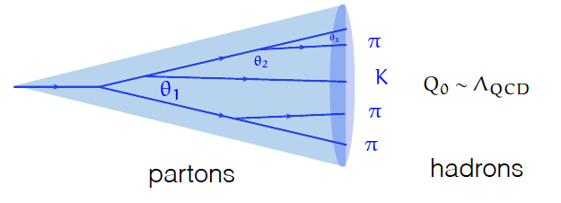
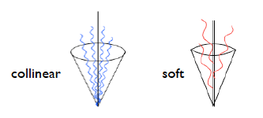
Probe of coice: jet (a coherent “object”)
  q,g undergo probabilistic cascade of g emissions
  Total color charge & flavor are conserved
  Successive branchings are ordered in angle
  Color coherence suppresses large angle soft radiation
Modified by color exchange
with dense medium

Slide 5
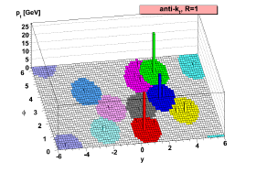
What’s in a jet?
Which hadrons belong to the same jet?
  In ion collisions: underlying event of particles from other sources than this parton
Jet algorithm of choice: “anti-k_{T}”
  Seed is hardest hadron or calorimeter tower
  Calculate distance to other particles:
  Clusters softer particles with harder ones, until no more remain within distance of 2R
arXiv:1802.1189
and
Typically, use R ~ 0.4 to allow statistical subtraction of the underlying event. But this misses some of the parton’s energy.
R = 1.0 is better. Feasible in e+A

Slide 6
Some Mysteries in hot QCD
Where does the energy lost by fast particles go?
  How does strongly coupled QCD plasma transport energy?
Why does hydrodynamics work so well?
  Hydrodynamic flow sets in very fast
  Even very small systems exhibit flow
  How does (cold ) QCD matter transport energy?

Slide 7
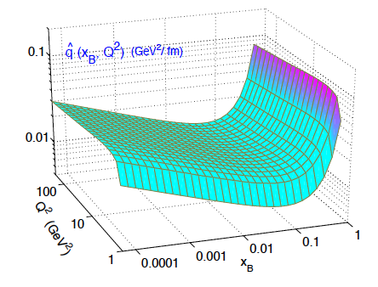
Parton energy loss
Quantify using q-hat
For a 10 GeV parton
  q = 1.9 +/- 0.7 GeV²/fm @ T=470 MeV
  1.2 +/-0.3 GeV²/fm @ T=370 MeV
    JET Collaboration PRC90, 014909 (2014)
  0.38 GeV²/fm @ 150 MeV(hot hadron gas)
  arXiv:1910.07027: Dorau, Rose, Pablos & Elfner
Many body q,g interactions!
In cold nuclear matter
  q ~ 0.02 GeV²/fm
  arXiv:1907.11808:
  Ru, Kang, Wang,
  Xing & Zhang
<
  q= √μ²/λ λ=mean free path; μ=typical p_{T} transfer per scatter
  ~ k_{T}²/l
⌃
⌃

Slide 8
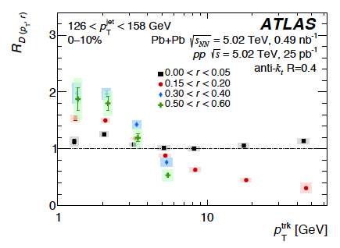
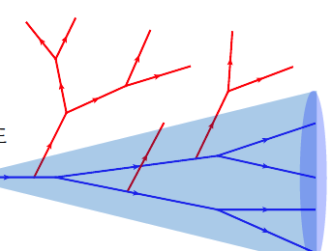
Looking differentially inside jets
arXiv: 1908.05264
See also: CMS
arXiv: 1803.00042
Pb+Pb/ p+p
r
Excess soft particles at large jet radius
Narrowing of higher p_{T} particle density
Energy loss vs. medium response?
  quantify: compare theory to the differential data
  CoLBT-hydro, Hybrid, SCET_{G}

Slide 9
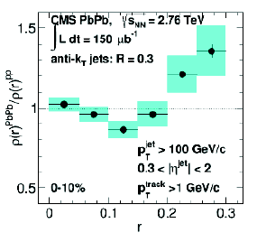
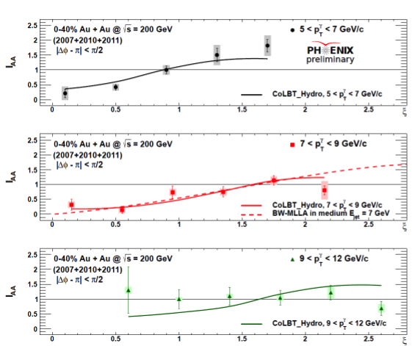
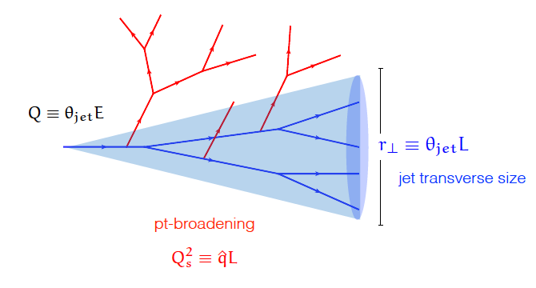
Jets get wider & “softer” in QGP
Pb+Pb/p+p:
Extra low momentum
particles; high momenta
suppressed
Pb+Pb/
p+p:
Jets are wider in
Pb+Pb
p_{T}
Medium induced radiation!
+ medium response

Slide 10
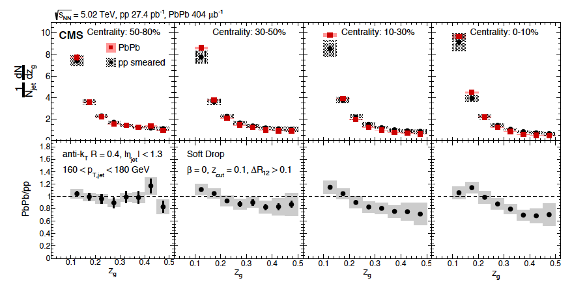
  Medium induced gluon splitting?
Groom away soft stuff, look for the 2 highest p_{T} objects
PRL 120, 142302 (2018)
Modification observed!
Experiment + Theory: constrain E, p transport.

Slide 11
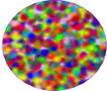
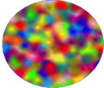

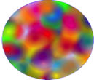
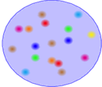
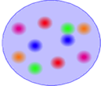


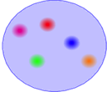
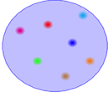
Gluon density increases at small x
Saturation
Smaller gluon momentum➔
BFKL
DGLAP
Increasing probe energy ➔
Probe with jet & di-jet production
Energy loss will affect lepton-jet opening angle

Slide 12
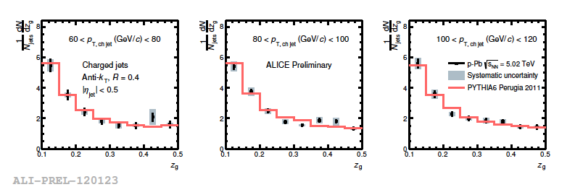
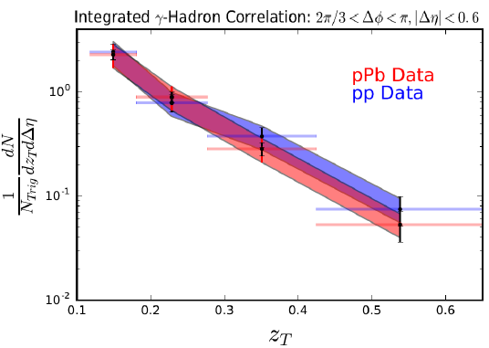
Jets in cold nuclear matter: p+Pb
p+Pb ~p+p, at ~20% level
Need precision for q ~ 0.02
Both on measurement and on the kinematics to understand hydro onset
⌃

Slide 13
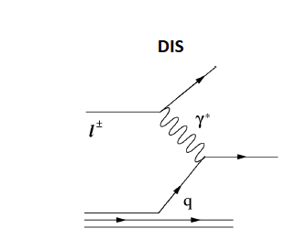
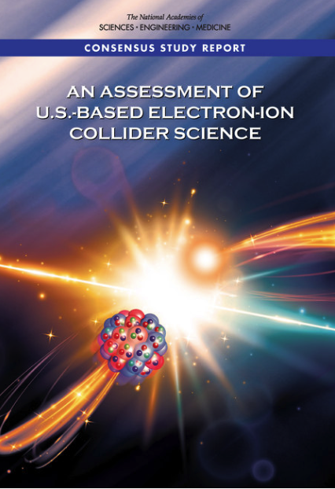
Parton - cold matter interaction: use DIS instead of γ – jet
Scattered electron: energy & angle ➔ x, Q²
jets!
Can do this at the EIC!

Slide 14
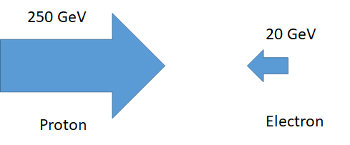
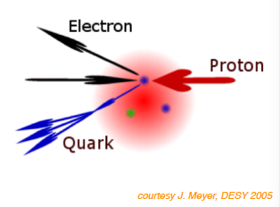
Studying the low-x region with DIS jets
Semi-Inclusive Deep Inelastic Scattering
100
Y. Song, M. Arratia
For struck quark at x ~ 10⁻³ - 10⁻²
P_{quark} ~ 100 MeV – 1 GeV
Lowest x is like fixed target!
Jet goes into electron direction

Slide 15
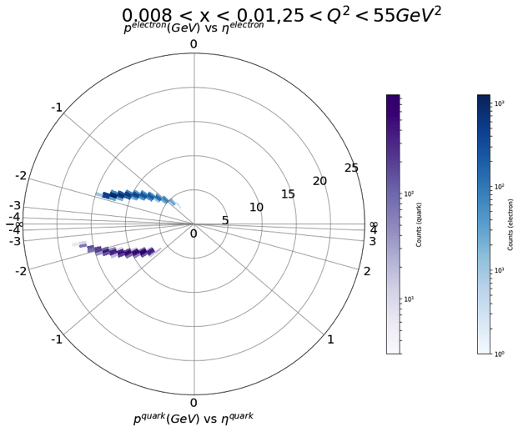
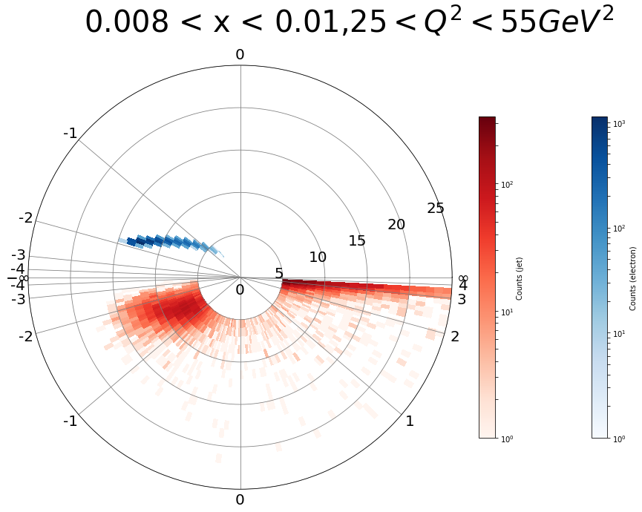
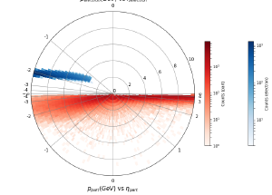
Using tagged jet probe
e+p, DIS; Pythia 8. Require W² > 4 GeV², Q² = 25 – 55 GeV²
electron
p
η
struck parton
reconstructed jet
Youqi Song, M. Arratia
Smearing is larger for single hadrons; more so for low Q²

Slide 16
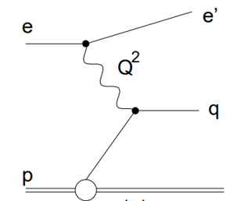
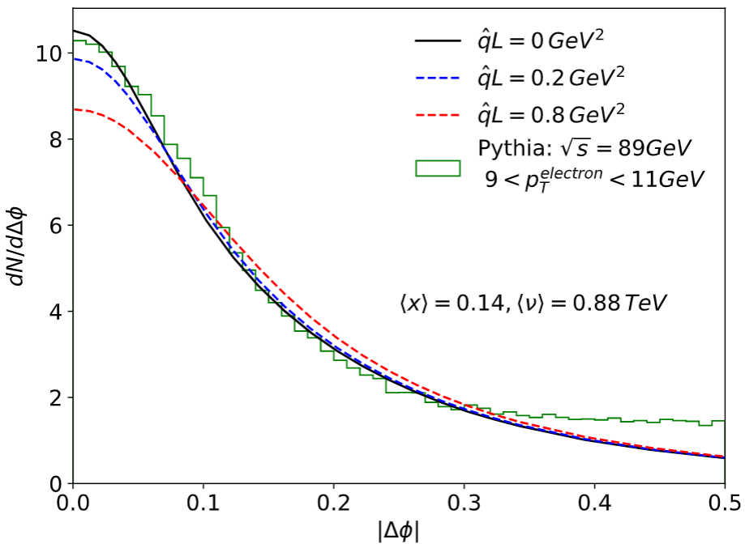
Lepton-jet azimuthal correlation
tag
probe
PRL 122 192003
Imbalance due to intrinsic quark k_{T} and soft radiation.
Channel to measure jet transport parameter qhat
in e-p also quark TMD PDF, quark Sivers function
Liu et al. PRL 122 192003

Slide 17
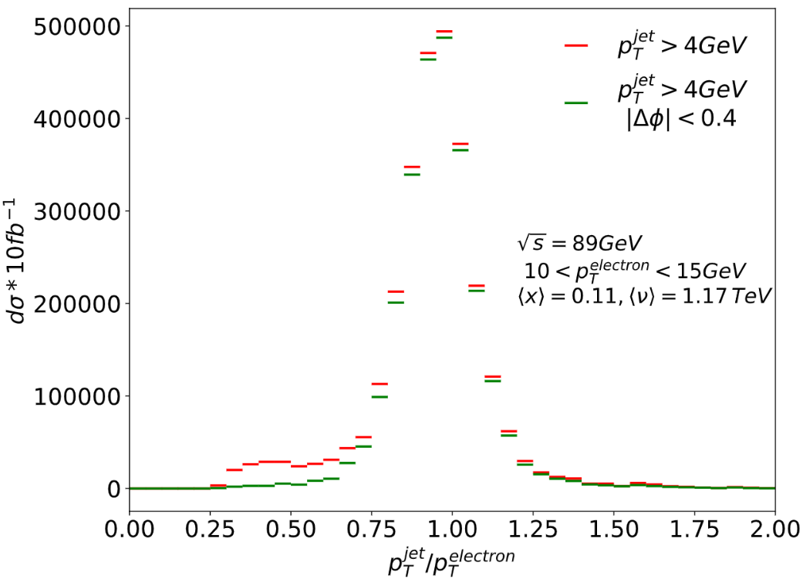
Lepton-jet p_{T} balance
eA/ep comparison for E-loss studies:
- event-by-event tagging
~ static medium.
~ pure quark fraction.
~ background free.
- Ultra-precise data!
“How does the nucleus react to a fast color charge?”
Lab frame

Slide 18
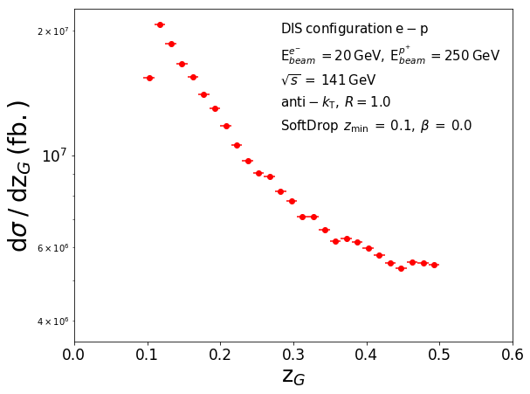
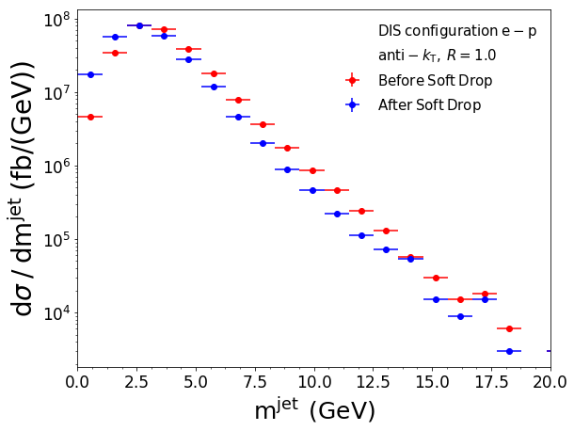
Jet substructure in e + p
Miguel Arratia
Sensitive to interactions with matter; hadronization…
Next steps: simulate e+A, detector response effects

Slide 19

Conclusions
Jets offer precision probe of QCD matter!
  quantify parton - matter interactions
  Groomed substructure observables <-> QCD
Jets at the EIC will open a new window
  Precise nucleon & nuclear pdf’s
  Gluon contribution to proton spin
  Possible saturation effects
  Sensitive to hadronization process?
Congratulations Wick!
  You’ve had tremendous
  influence in many areas!

Slide 20
Backup

Slide 21
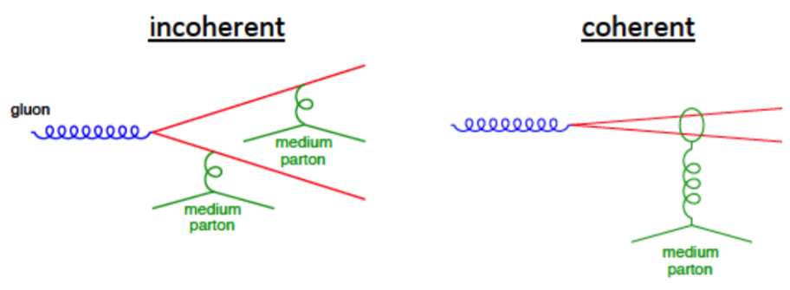
Fast QCD matter isotropization*
Very hard to measure directly!
  Depends on transport in (cold) QCD matter
Is coherent scattering the reason?
  Parton interactions in hot, dense QCD and cold, dense QCD should be similar
Or, might the system already have many-body interactions that change the distributions from a sum of pp collisions?
  g+g ➔ g large if approaching saturation…
* Full thermalization not required for hydrodynamics
maybe not even isotropization… but why is not known!
Y. Mehtar Tani: JHEP04, 125 (2017) 2017
picture: M. Arratia

Slide 22
How to make progress?
What are the pre-equilibrium dynamics?
Need to better understand parton transport!
  In matter at small x in nucleon/nucleus
  In hot, dense quark gluon plasma
Need QCD transport in medium(s) & medium response
  Have a nice tool to use!
Jets:
Parton energy loss
Quark mass
Dependence
Jet structure modifications from parton-plasma interactions
Y. Mehtar-Tani

Slide 23
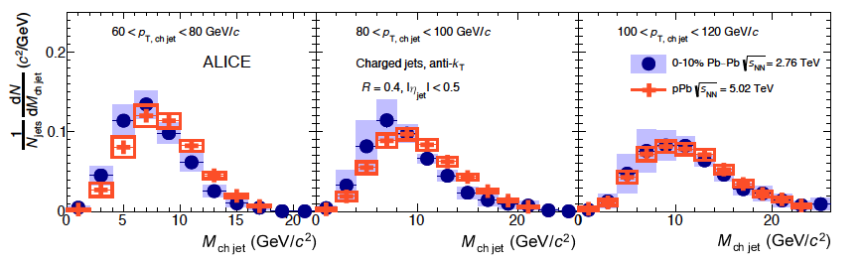
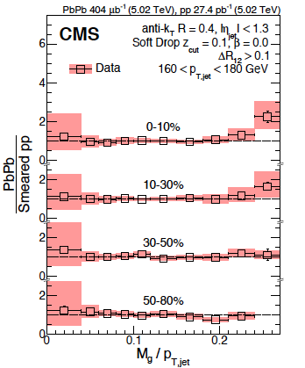
Groomed jet mass
M_{Jet} ~ zθ²
PLB 776 ,249 (2018)
Grooming allows comparison to QCD calculations (< hadronization effects)
So, is the mass modified?
Perhaps a bit for lower p_{T} jets?
But, the mass is controlled by the groomer!
arXiv: 1805.05145

Slide 24
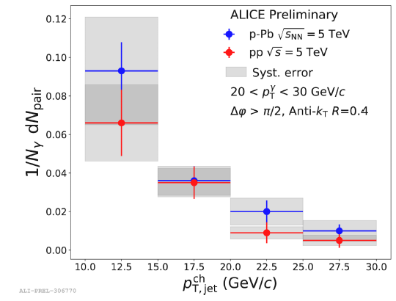
How about in cold matter?
Look at cold matter using p + nucleus collisions
  Low x is where the gluon density is high
Use γ-jet correlations from QCD Compton scattering
  γ energy tags the energy of the scattered parton
Jet spectra in p+Pb same as that in p+p, within ~20%

Slide 25
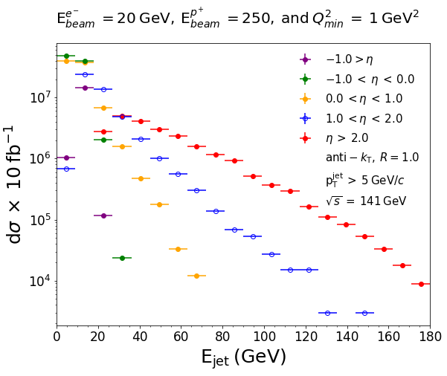
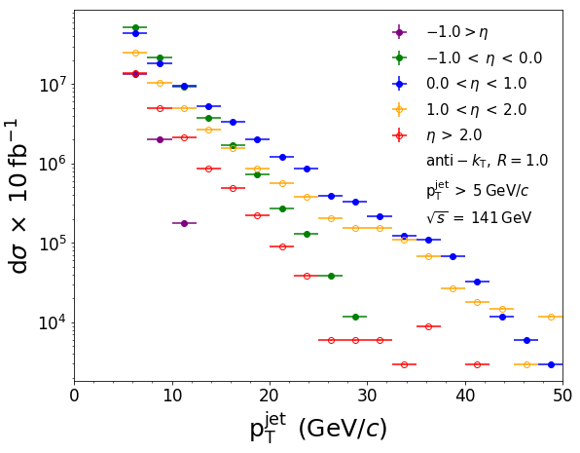
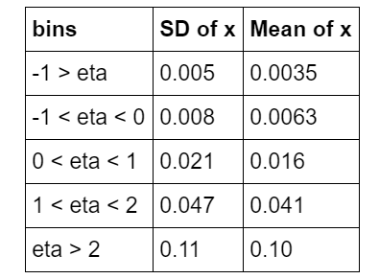
Kinematic reach for DIS jets
Jose Soria
Low-x reach is limited by kinematics
Reasonable jet p_{T} at -1< η <0 Scatter off q at x ~ 8 x 10⁻³
(for √s = 89 GeV)
  These jets go thru lower x matter

Slide 26
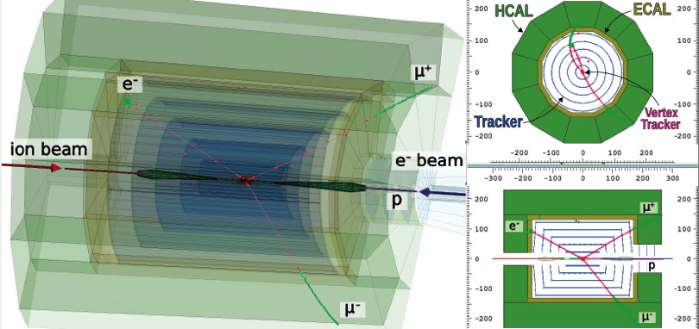
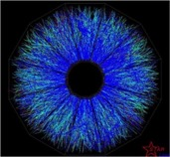
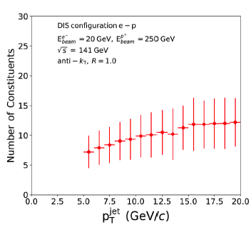
Cleaner events -> easier reconstruction
Can reconstruct with R=1.0
  No underlying event!
Can study substructure
  Jet grooming effects should
  be less important

Slide 27
Other QCD topics with jets at the EIC
pdf’s
  In nucleons (evolution in x and Q²)
  In nuclei
  modification from that in protons
  especially at low x, where nucleons overlap
Photon pdf
Spin in the gluons
  Δg via scaling violations in g₁(x,Q²)

Slide 28
How about hadronization?

Slide 29
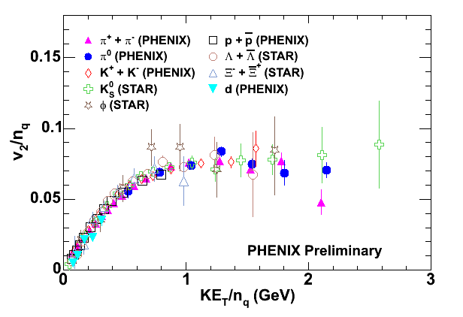
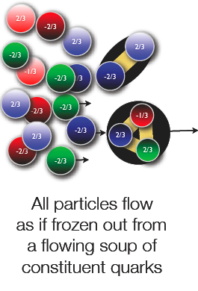
Hadronization of quark gluon plasma
transverse KE
implication: valence quarks, not hadrons, are relevant
pressure builds early, dressed quarks are born of flowing field
hadronize by (simple) coalescence of co-moving quarks
Is coalescence the right picture?

Slide 30
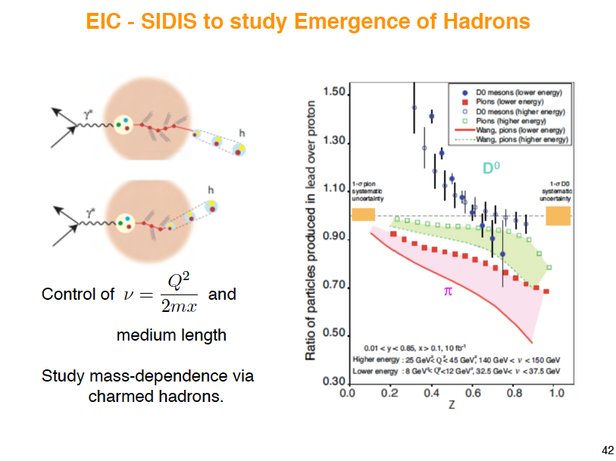
E. Sichtermann
+ nucleus-filtered jet constituents & substructure

Slide 31
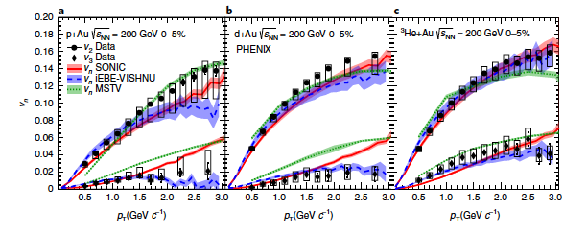
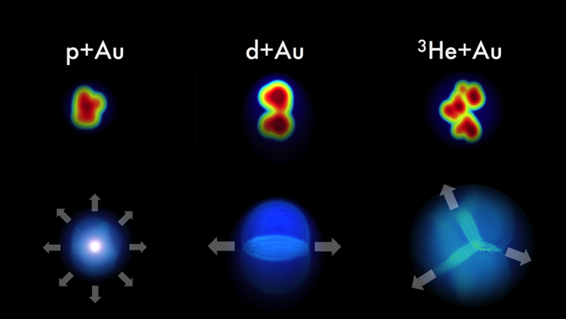
Hydrodynamics works in small systems!
PHENIX Collaboration
Nature Physics
15, 214 (2019)
Collective flow! Seeded by initial geometry
Why/how can the pressure build up before this tiny system evaporates??

Slide 32
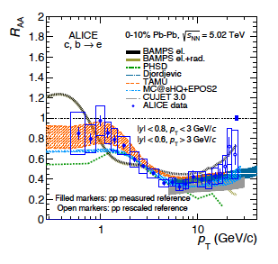


Heavy quarks
arXiv: 1910.09110
Lose energy too!
Dominated by collisions at low p_{T}
Radiation at high p_{T}
<
  q= √μ²/λ
Phys. Rev. C 90, 014909 (2014)
S. Cao, et al. arXiv:1809.07894
Light quark R_{AA} fits: JET collaboration
Heavy quark R_{AA} fits

Slide 33

Range in x

Slide 34




Measuring collective flow in QGP
Almond shape overlap region in coordinate space
z
momentum space
y
x
dN/dφ ~ 1 + 2 v₂(p_{T}) cos (2φ) + …
“elliptic flow”

Slide 35


At η < -1: p_{T} ≠ p
x = 1 - 4 x 10⁻³
Youqi Song
Look at jet p > 5 GeV/c
Kinematic cut-off visible
For η < -2, dihadrons rather than jets

Slide 36

Backup

Slide 37



Jet mass
M_{Jet} ~ zθ²

Slide 38

T. Ullrich

Slide 39

E. Sichtermann

Slide 40
We tickled the nucleus with a proton
In p+A probe cold nuclear matter with a parton, not a photon.
Partons can lose energy before the hard scattering
  Photons do not
Parton can lose energy after the hard scattering
Parton experiences multiple scattering
These may be not be independent!
Many-body QCD suggests coherent interactions!
same as in parton-plasma interactions…
Goal: turn off the interactions before the hard scattering!

Slide 41




Collective flow causes particle correlations
p+Pb
p+p
The “ridge”
See Fourier components v_{N} (n=2 to 5) as in Au+Au and Pb+Pb
Multi-particle correlations
(v2{4}≈v2{6}≈v2{8}≈v2{LYZ})
Collective system once there are > 100 particles?
Early time particle correlations mock up flow signal?
Artefact of particle freeze-out surface?
NB: no significant energy loss seen in pp and pA
  But hot spot is pretty small here…

Slide 42


Jet R_{AA}
Consistent picture with single hadrons: jets are suppressed in Pb+Pb
Nuclear effects are small in p+Pb

