Slide 1
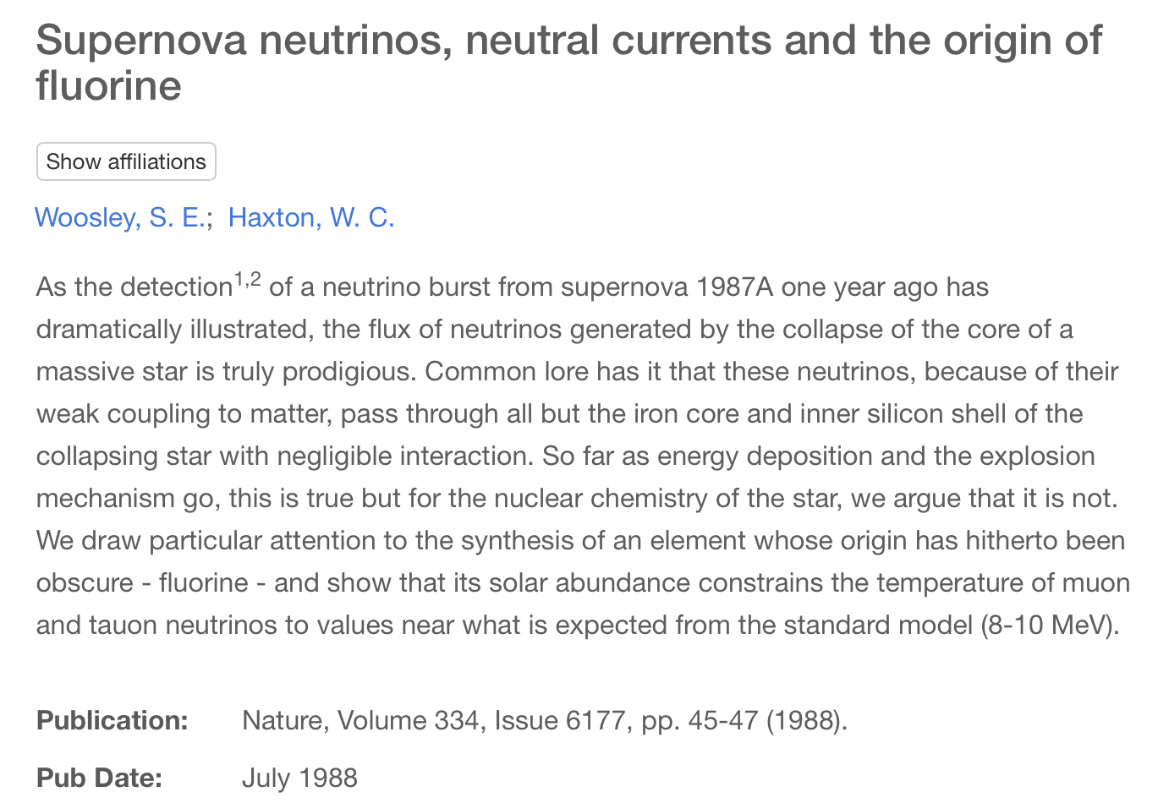
Following - Epstein, Colgate and Haxton, “Neutrino-induced r-process nucleosynthesis”
PRL, 61, 2038 (1988)
Also numerous earlier papers on neutrino nucleosynthesis in supernovae by Dimitrij
Nadyozhin in the late 70’s and early 80’s of which we were unaware. Also those
were by charged current reactions.

Slide 2
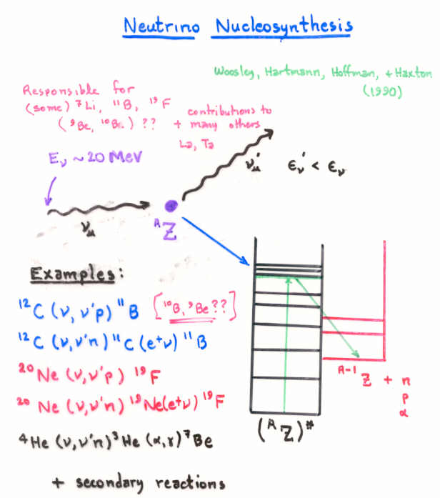

Slide 3
Production factor relative to solar normalized to ¹⁶O production
as a function of μ and τ neutrino temperature (neutral current)
and using 4 MeV for the electron (anti-)neutrinos (for charged current only).
6 MeV is now considered a more likely value for T_{mt}
Product
 | 6 MeV |  | 8 MeV |  | 6 MeV |  | 8 MeV
 | WW95 | This work | WW95 | This work | WW95 | This work | WW95 | This work
¹¹B | 1.65 | 1.88 | 3.26 | 3.99 | 0.95 | 1.18 | 1.36 | 1.85
¹⁹F | 0.83 | 0.60 | 1.28 | 0.80 | 0.56 | 0.32 | 1.03 | 0.53
¹⁵N | 0.46 | 0.49 | 0.54 | 0.58 | 0.09 | 0.12 | 0.15 | 0.19
¹³⁸La |  | 0.97 |  | 1.10 |  | 0.90 |  | 1.03
¹⁸⁰Ta |  | 2.75 |  | 3.07 |  | 4.24 |  | 5.25
Heger et al,, 2005, Phys Lettr B, 606, 258

Slide 4
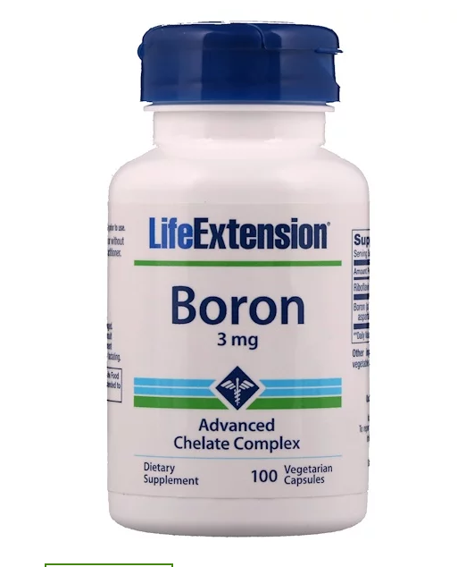
Sieverding et al ApJ, 865, 143, (2018)
13 – 30 solar masses, 1.2 x 10⁵¹ erg piston induced explosions
Much cooler, also cross sections smaller especially F.

Slide 5
Sieverding et al (including spectrum from Janka) 27 solar mass model only.
Sieverding et al (2019) - time dependent neutrino flux histories from models including
break out slightly increase yields, especially of boron. This is the low temperature
case from the previous slide.
So should multiply B yield on previous slide by 2.5. B probably mostly
due to neutrino process (my view). Can be used to constrain n-spectrum

Slide 6
THE DEATHS OF MASSIVE
STARS AND THE
BIRTH OF BLACK HOLES
Stan Woosley (UCSC)
with Tuguldur Sukhbold (Ohio)
Thomas Ertl (MPI), and
Thomas Janka (MPI)

Slide 7
Surveys For the Impatient
For over 50 years (Colgate and White 1966) theorists have
struggled to produce supernovae powered by neutrino
transport that agree with observations. A lot of progress has
been made. Really.
Several groups now routinely get low energy explosions
of low mass progenitors, roughly 8 to 11 solar masses. These
may account for the Crab, in particular, and maybe half of all
supernovae. Heavier stars occasionally explode on the computer,
but with low energy – few x 10⁵⁰ erg
Heavier stars are needed for nucleosynthesis, light curves,
explosion energies above ~10⁵¹ erg, and remnant mass
distributions, but it may be that most stars over 20 solar
masses (helium cores about 6 solar masses) usually fail to explode.
This is (maybe barely) consistent with observations
Missing pieces may involve presupernova turbulence, mild
rotation, modifications to the EOS, and/or new physics
(flavor mixing?).

Slide 8
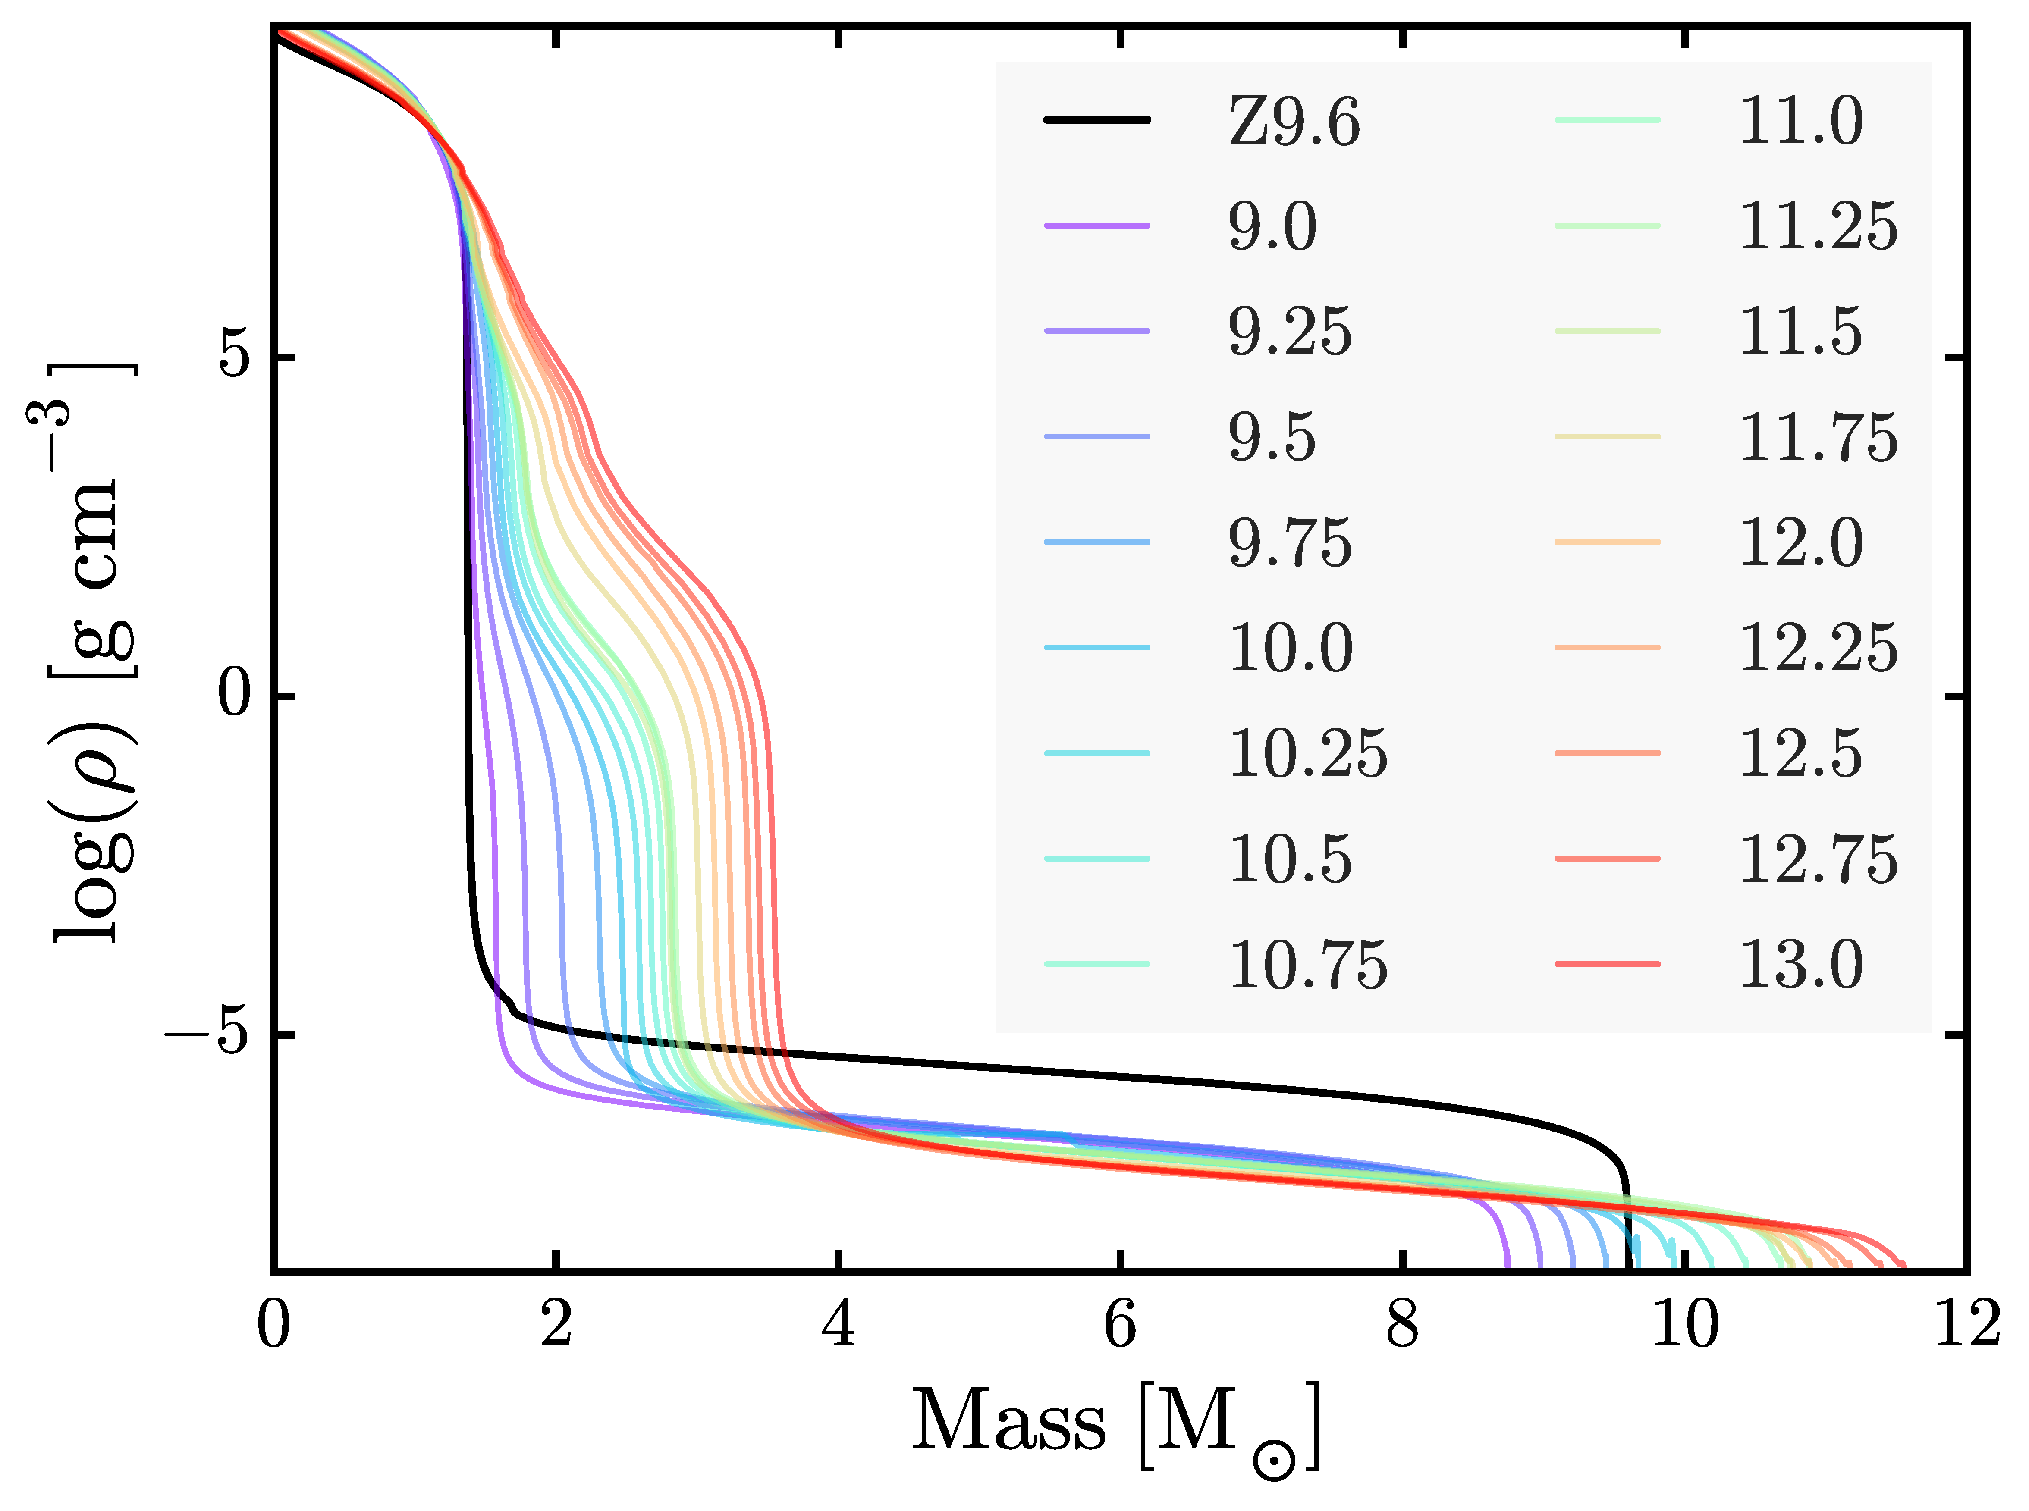
Presupernova Density Distributions
Maximum
neutron
star
Stars below 12 M_{O} (He core 3.5 M_{O}) are comparatively easy to explode with
neutrino transport and account for about half of observed supernovae. It is
very likely that they all make neutron stars.

Slide 9
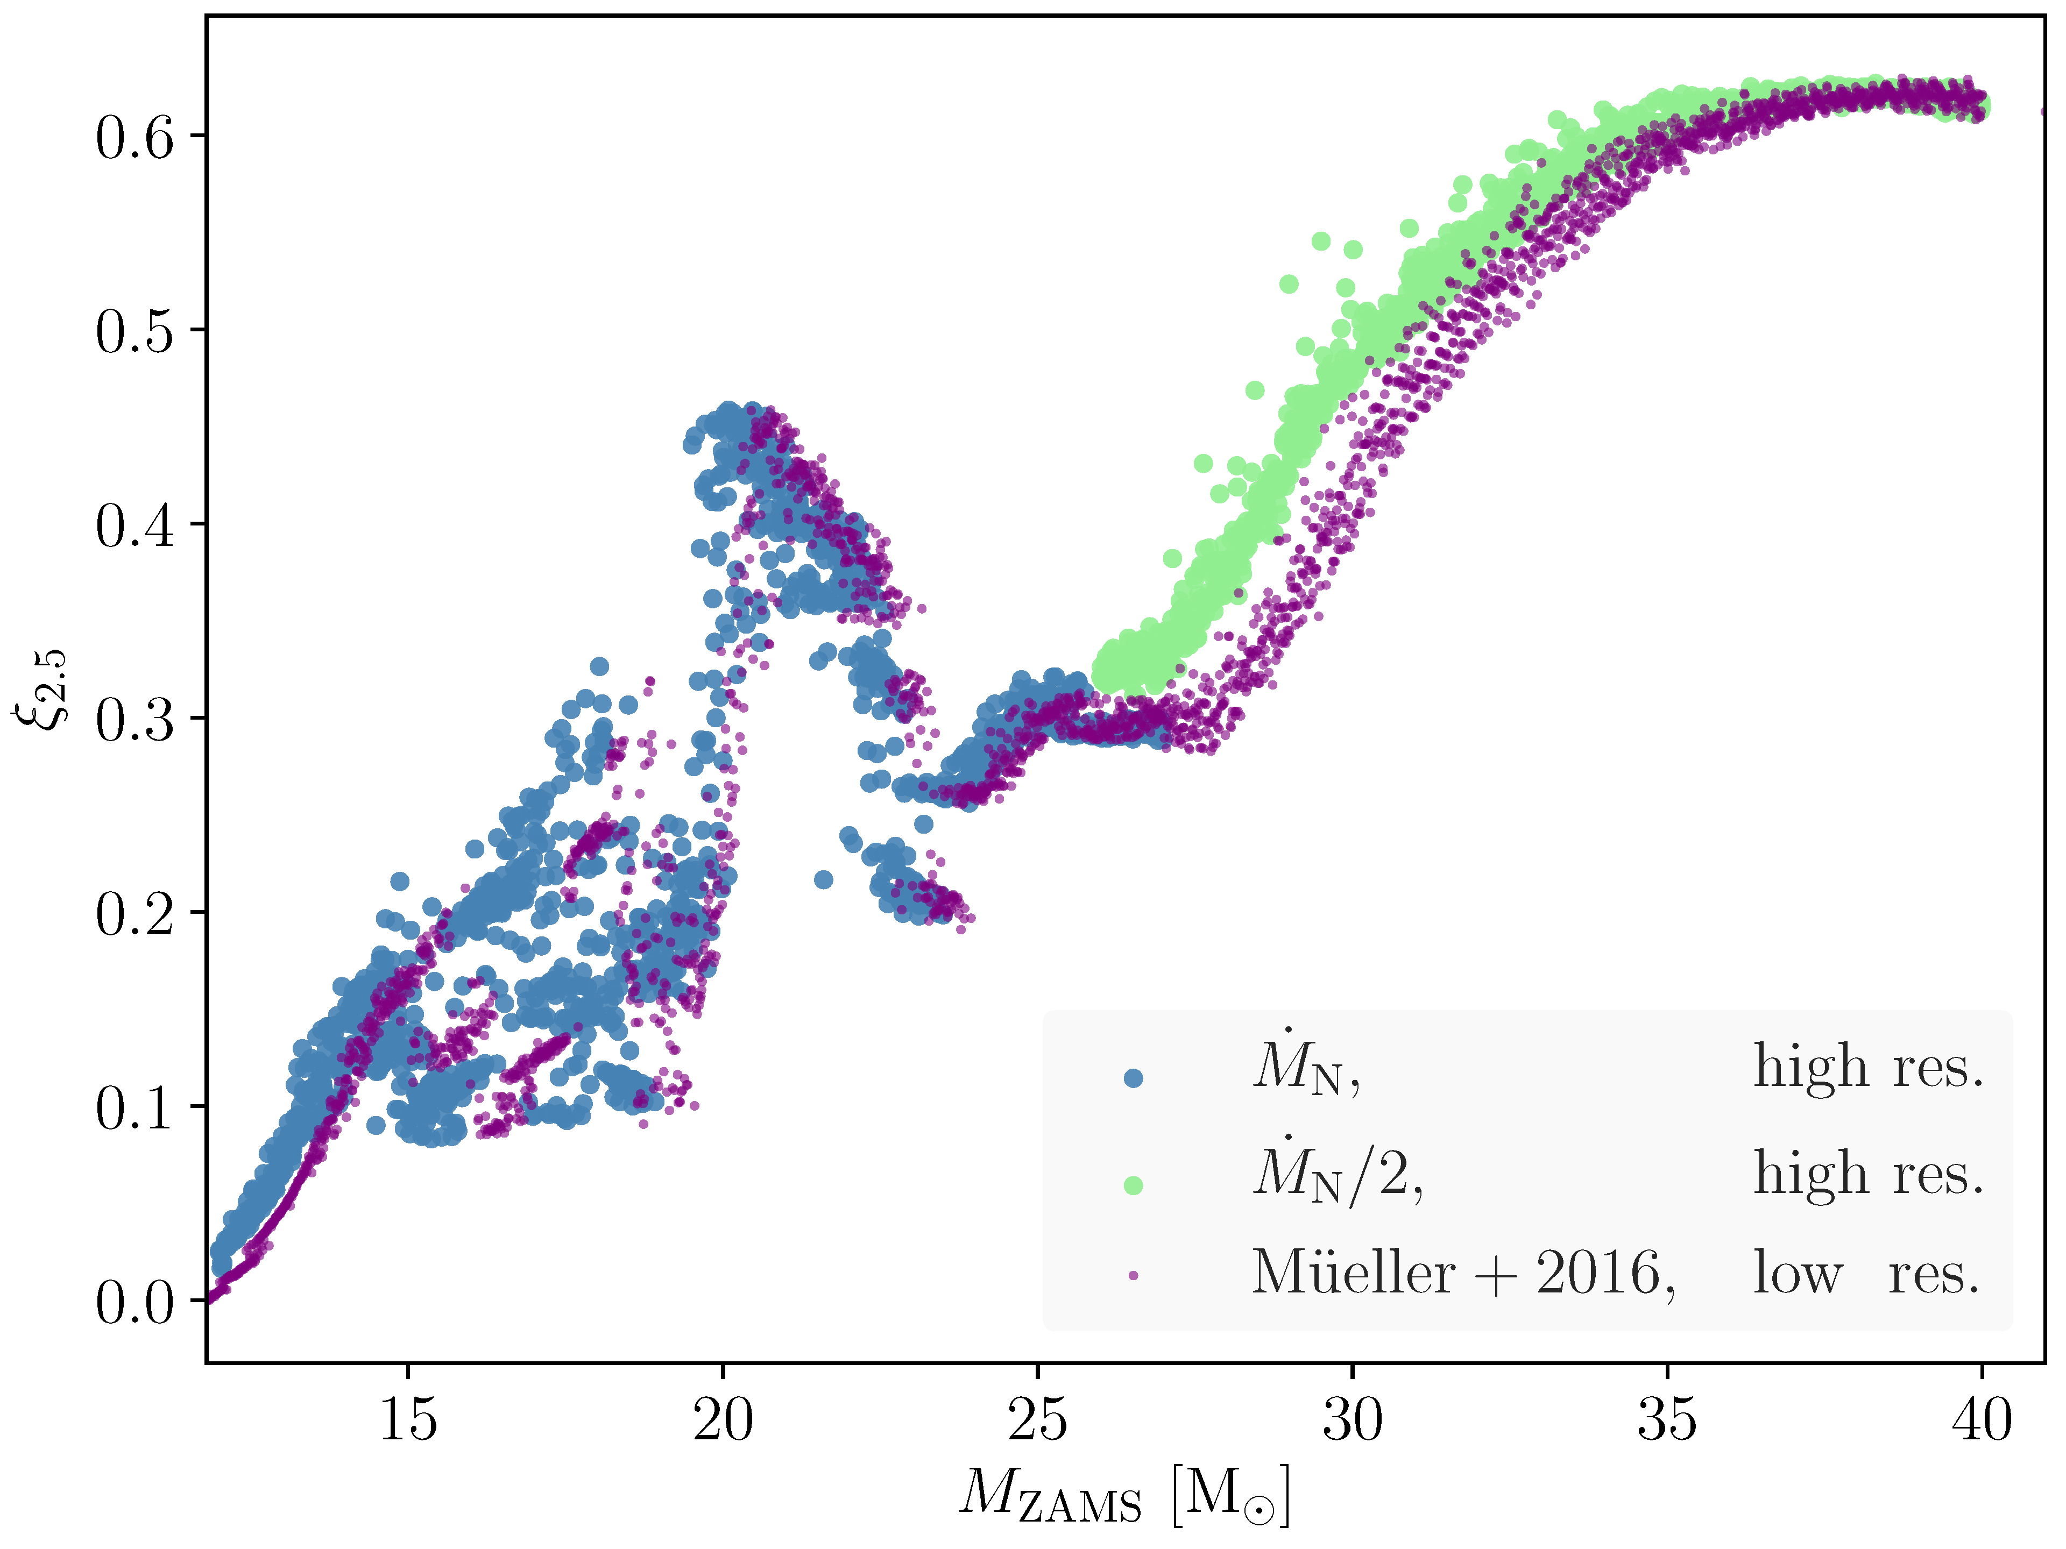
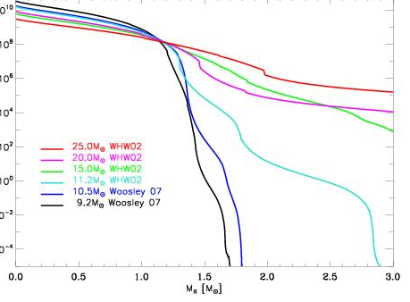
The “supernova problem” has three pieces: preSN models,
explosion models, and observation. Presently in terms of quality of data:
Observations >> PreSN models >> Explosion models
The preSN models show a great deal of systematics that will
certainly affect the outcome. We’d like to explore those systematics
now, especially in an era of GW observations
Hard to
Explode
Easy

Slide 10

Beyond Pistons
1D Neutrino-Transport Calculation
with a standard central 1.1 M_{O} core
center
“PNS”
Full (1D) neutrino transport
on a model by model basis
Standard
Progenitor dependent
Radiates BE
as neutrinos
shrinks in t
Sukhbold, Ertl, Woosley, Brown, and Janka (2016)
see Ugliano, Janka, Marek, and Arcones (2012)
[ApJ, 757, 60]
Central engine varied – 5 models for 87A; 1 for the Crab
Star not forced to explode

Slide 11
M_{c} = 1.1 solar masses
R_{c,i} from preSN model
EOS Lattimer Swesty 220 MeV
Neutrinos launched
from edge of core
with thermal distributions
and the local temperature.
1D transport after that.
Crab
standard
*
87A
Central engine varied – 5 models for 87A; 1 for the Crab
Star not forced to explode

Slide 12
Explosion highly correlated with compactness
(about 200 preSN models explored; 5 explosions each)
explode
to 9 M_{O}
Sukhbold et al (ApJ, 821, 38, 2016) 12 – 70 M_{O}
WR mass loss from Welstein and Langer (1999)
[large
Single stars
Average explosion energy 6 - 8 x 10⁵⁰ erg
Average ⁵⁶Ni mass 0.04 – 0.06 M_{O}
Supernovae > 20 M_{O} 5%
Fraction SN that make BH 26 – 45%

Slide 13
50% of SN below 12 M_{O} ; Very few above 20 M_{O}
12
Sukhbold et al (2016)

Slide 14
9 – 12 M_{O}

Slide 15
p-proc deficient
s-proc
deficient
IMF averaged nucleosynthesis is
reasonably good but a deficiency
of s- and p-process. Need larger
^{22N}e(a,n)²⁵Mg rate or more massive
stars to explode. B and F are
mostly n-process here but used a
large T_{mt}

Slide 16
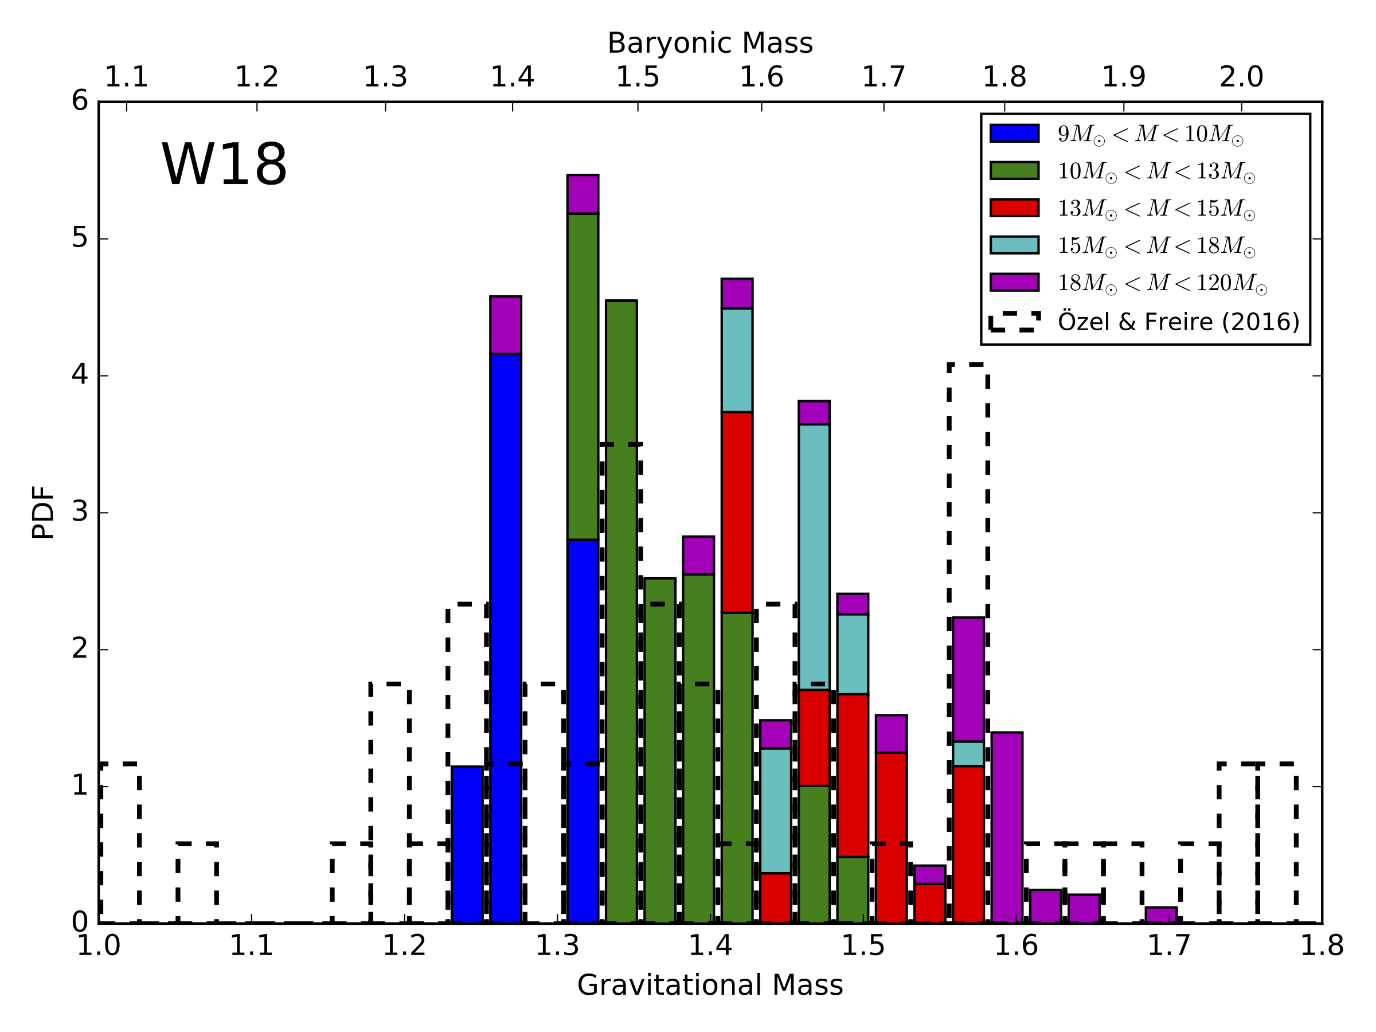
Neutron Star Masses
IMF
weighted

Slide 17
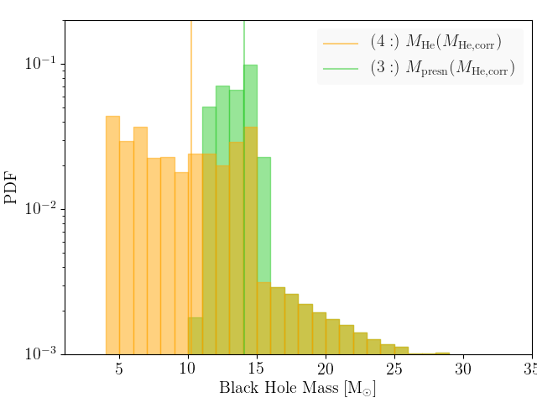
Black hole mass distribution
Solar Metallicity; “Normal” Mass Loss, Single stars
He core implodes for
single preSN
Whole Pre-SN star
implodes
Pile up from
stars 33 - 70 M_{O}
ZAMS stars
Tail sensitive
to WR mass loss.
No PPISN in
this study
Stars lose entire envelope
before dying

Slide 18
Survey - Binaries
Woosley (2019, ApJ)
Half or more of massive stars are found in binaries with
such close separations that the stars will interact when
one of them becomes a supergiant (Sana & Evans 2011;
Sana et al. 2012).
Most measurements of stellar remnant masses come from close binaries that will have interacted during their evolution.
Most often mass transfer occurs during or near the onset of core helium burning (Case B mass transfer),

Slide 19
25 M_{O} Radius History
Case C
He-depletion
Case
B
He = 0.5
He ignition
Case A

Slide 20
The outcome of presupernova evolution is
different in binaries
The size of the helium core in a massive
star grows during He burning if the
star retains an envelope. But suppose
the envelope is lost to a companion
at the beginning of helium burning
(Case B). Its initial mass would be
the green points.
*
*
+ WR mass loss
Had the star kept its envelope until the
end, its mass would be the red points.
A 25 M_{O} star in a bianry ends up as a
5 M_{O} progenitor instead of a RSG with
an 8.4 M_{O} core.
The exposed helium core then loses mass as a WR-star. It’s mass
shrinks further.
Yoon (2018)

Slide 21
Use same approach to modeling the explosion as before. –
central 1.1 M_{O} of proto-neutron star evolves as before in
models calibrated to SN 1987A; 1D neutrino transport
outside.
Again study hundreds of models, but this time start
with bare helium stars and allow them to lose mass
according to several current mass loss prescriptions.
Essentially we assume that the effect of binary membership
is to remove the hydrogen envelope at helium ignition.
Explode using P-HOTB, postprocess with KEPLER.
Check for consistent energy, remnant mass, and
especially ⁵⁶Ni production.
Ertl, Woosley. Sukhbold and Janka (2019)

Slide 23
Ni_{max} = 0.75*(Ni+Tr+a) starts to violate fundamental constraints

Slide 24
These explosions produce Type Ib and Ic supernovae
Ertl et al (2019)

Slide 25
The rise times, widths, velocities, and temperatures of the
models are consistent with observations. However, it only
proves possible to produce the peak luminosity of about half
the observations.
The models predict a maximum bolometric luminosity of 10^{42.5} erg s⁻¹
and a maximum ⁵⁶Ni mass near 0.15 M_{O}. Median luminosities and Ni
masses were between 10^{41.15} and 10^{42.23} erg s⁻¹ and 0.05 to 0.07 M_{O}
Possibilities
We have underestimated ⁵⁶Ni production in our models
(unlikely based on physics arguments, neutron star masses,
and the need to make most of iron in SN Ia not SN II or Ib)
The observers have overestimated the bolometric luminosities
of Type Ib and Ic supernovae, especially the brightest 1/3
“Normal” Type Ib and Ic supernovae are not all powered by
radioactive decay like the text books say. Magnetar? Relation to
SN Ic BL, SLSN, GRB ?

Slide 26
To get the remnant mass distribution 4 choices of mass loss
rate were explored and two metalliciies
Yoon = Yoon (2018) Vink = Vink (2018) Sander et al = Sander et al (2019)
2 x Yoon is regarded as “high” and Vink (2018) as “low” especially for large L.

Slide 27
Neutron Star Initial Mass Function
(in binaries)
Main
peak
Masses above 1.6 M_{O} are
produced by fall back. Note that
their fraction is sensitive to mass
loss

Slide 28
The median is robustly between 1.32 and 1.37 M_{O}
This is consistent with observations
Very similar results for Z = 0.1 solar.
Lightest neutron star 1.24 M_{O}

Slide 29
structure
sensitive
all
stars
collapse
PPISN
pileup

Slide 30
No BH mass gap at 5 M_{O} Can produce a continuous
distribution from max neutron star mass on up. But there
is a relative deficiency below 5 – 6 M_{O}
BH mass gap at 46 to 133 (55 to 144) M_{O} depending
on ¹²C(a,g)¹⁶O in binaries. (PPISN). Smaller ¹²C(a,g)¹⁶O
raises the gap and also weakens the PPI
Pile up around 38 - 40 M_{O} (PPISN)
BHs up to 70 M_{O} can be made in single stars or detached
binaries (H envelope implodes)
Hint of a gap at 11 M_{O,} sensitive to reaction rates and
convection physics
Remnant mass distribution is determined by preSN mass
distribution for stripped stars (and helium core mass
distribution in preSN for single stars)

Slide 31
Assuming a Salpeter like
(power law) distribution of
initial stellar masses up to
130 M_{O}
And a mass loss rate that is
not very non-linear in the
luminosity
Between 12 and 33 M_{O} the
distribution of black hole masses
follows the IMF. This is because
the preSN mass, all of which
collapses is nearly a constant
fraction of the initial star’s mass
Measurements of the BH IMF
in this mass range would
constrain the stellar IMF for
ZAMS stars in the range 50
to 130 M_{O}

Slide 33
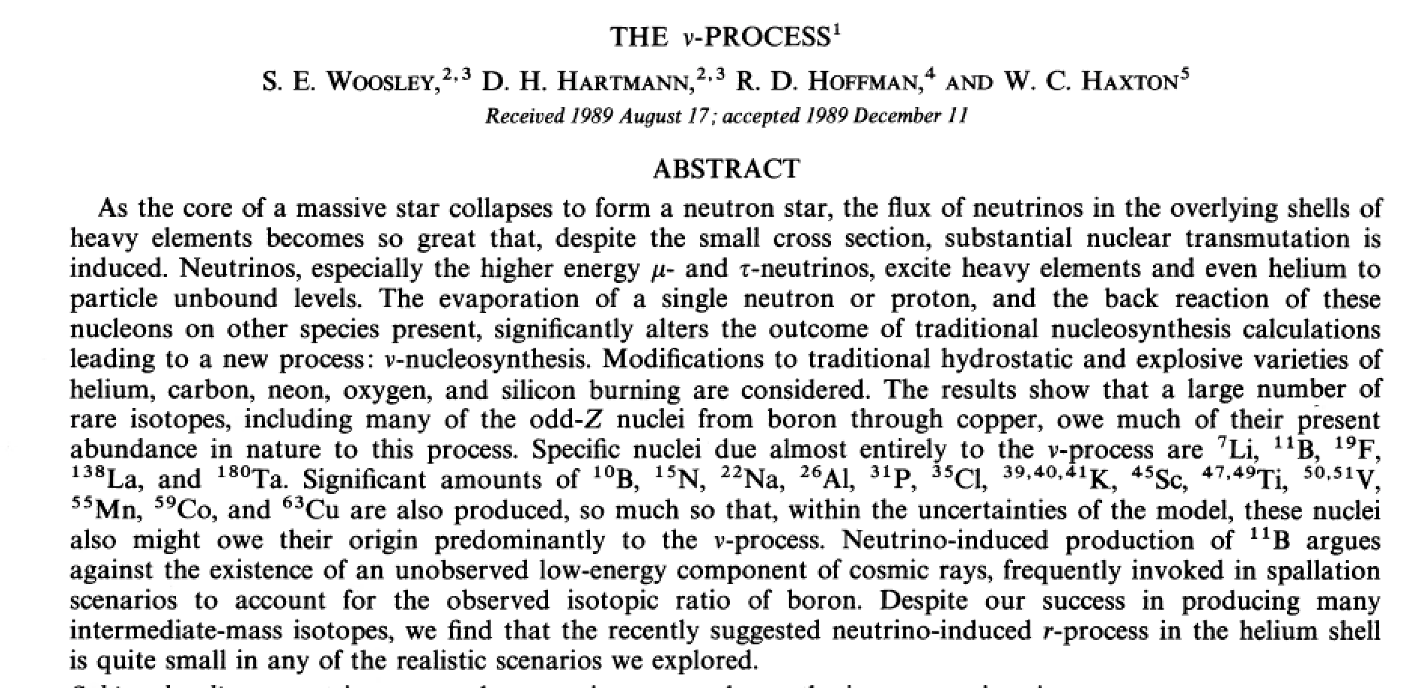

Slide 34
Basics
If degeneracy is negligible and mass is constant, the Virial Theorem
implies that the central temperature, central density and mass of a
star follow a simple scaling. (This scaling is strictly true for any polytrope
of single index n, uniform composition, and constant ratio of ideal gas
pressure to total pressure, b, where degeneracy does not dominate)
More massive stars have higher
entropy, less degeneracy, and
burn their fuels at lower density

Slide 35
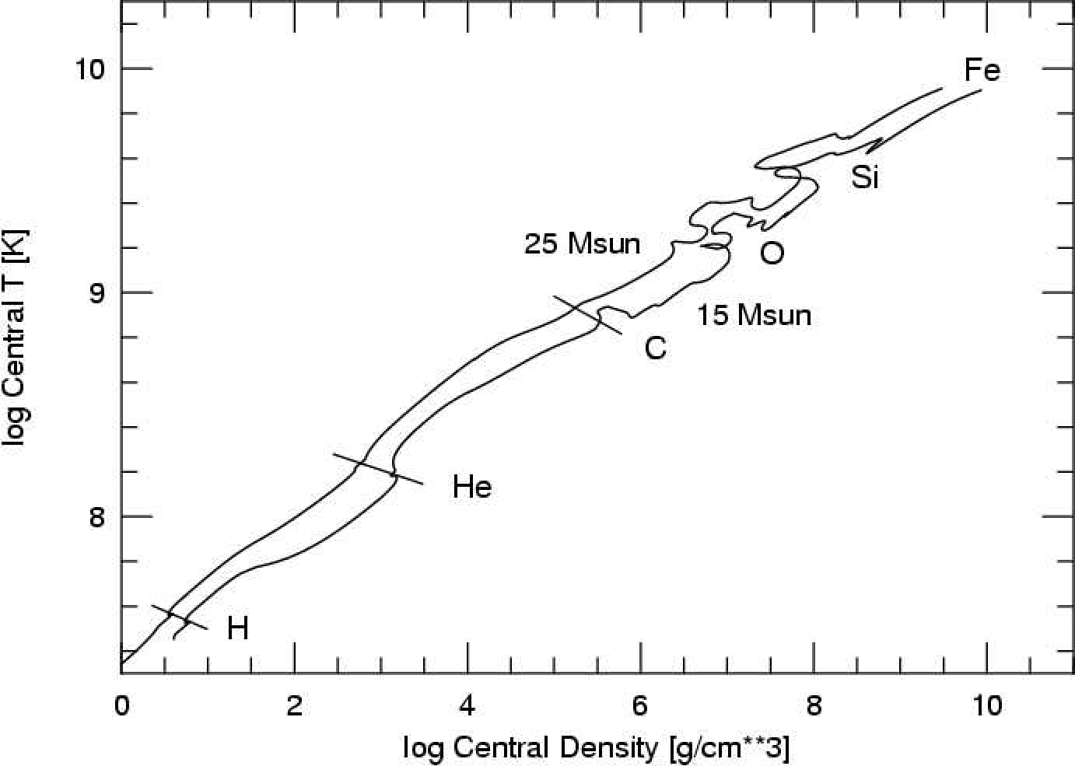
Central Conditions
at death the
iron cores of
massive stars
are somewhat
degenerate

Slide 36
More generally for helium cores of constant
mass, 2.2, 2.8, 3.0, 3.3, 6 and 8 M_{O} (Nomoto and Hashimoto 1988)
Presupernova
high mass
Degeneracy
low mass
It turns out that M_{He} =35 M_{O} will just brush the e+e- pair instability

Slide 37
Single Star Death Chart
Mass (solar masses) | End point | Remnant
< ~8 | planetary nebula | CO white dwarf
~8 to ~11 | degenerate core neutrino-powered low energy SN | Ne-O WD below 9? neutron star above 9
~11 - ~20 | neutrino-powered normal supernova; Islands of collapse at higher mass | neutron stars and black holes
20 - 70 | without mass loss very few SN unless rotationally powered; SLSN?, GRB? | black hole occasional neutron star
70 – 150 | pulsational pair SN if low mass loss | black hole
150 - 260 | pair instability SN if low mass loss | none
> 260 | pair induced collapse if low mass loss | black hole
n-powered
explosions?
Pair Instability Photodisintegration Degeneracy
Electron Capture Electron Capture

