Slide 1
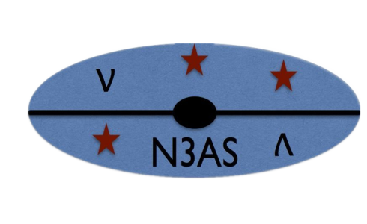


On a theme of neutrinos
A.B. Balantekin, University of Wisconsin
Looking for ν Physics on Earth and in the Cosmos
January 7-8, 2020

Slide 2
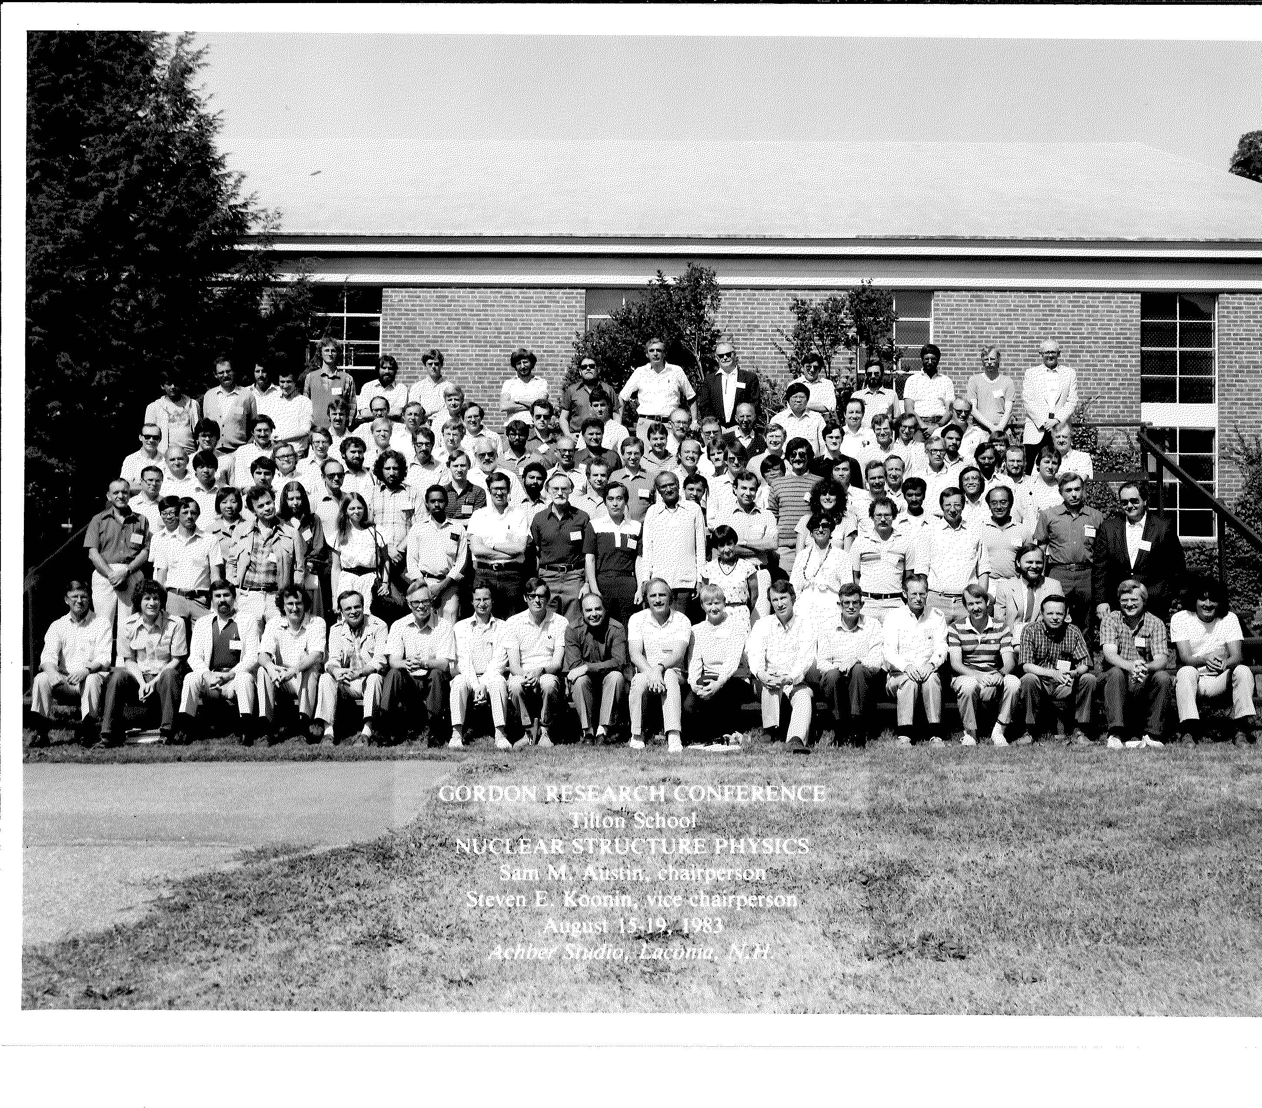

Slide 3



Slide 5
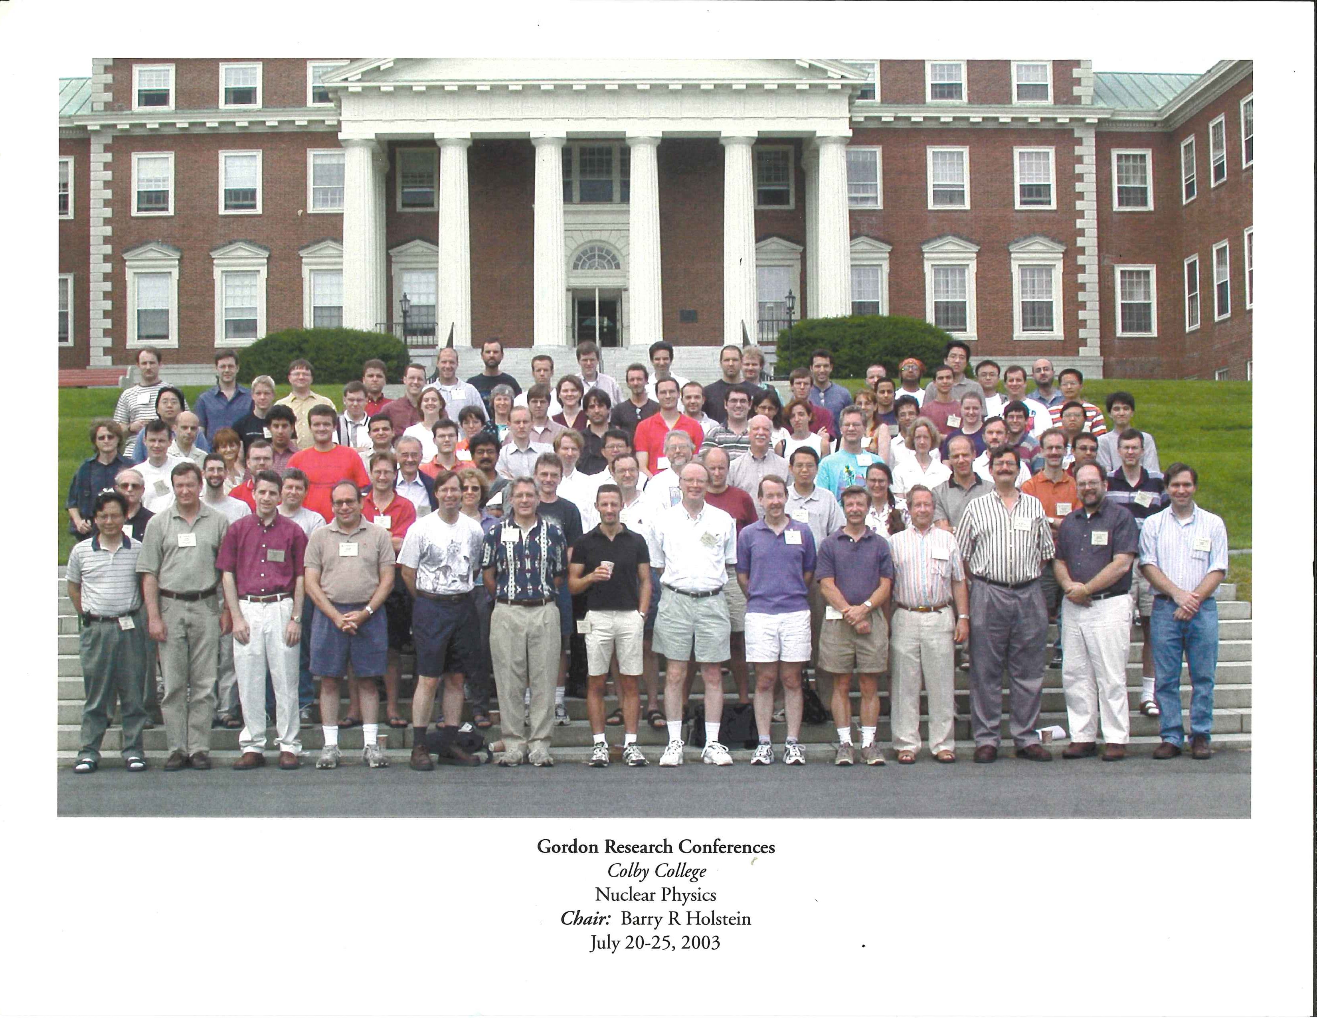

Slide 6
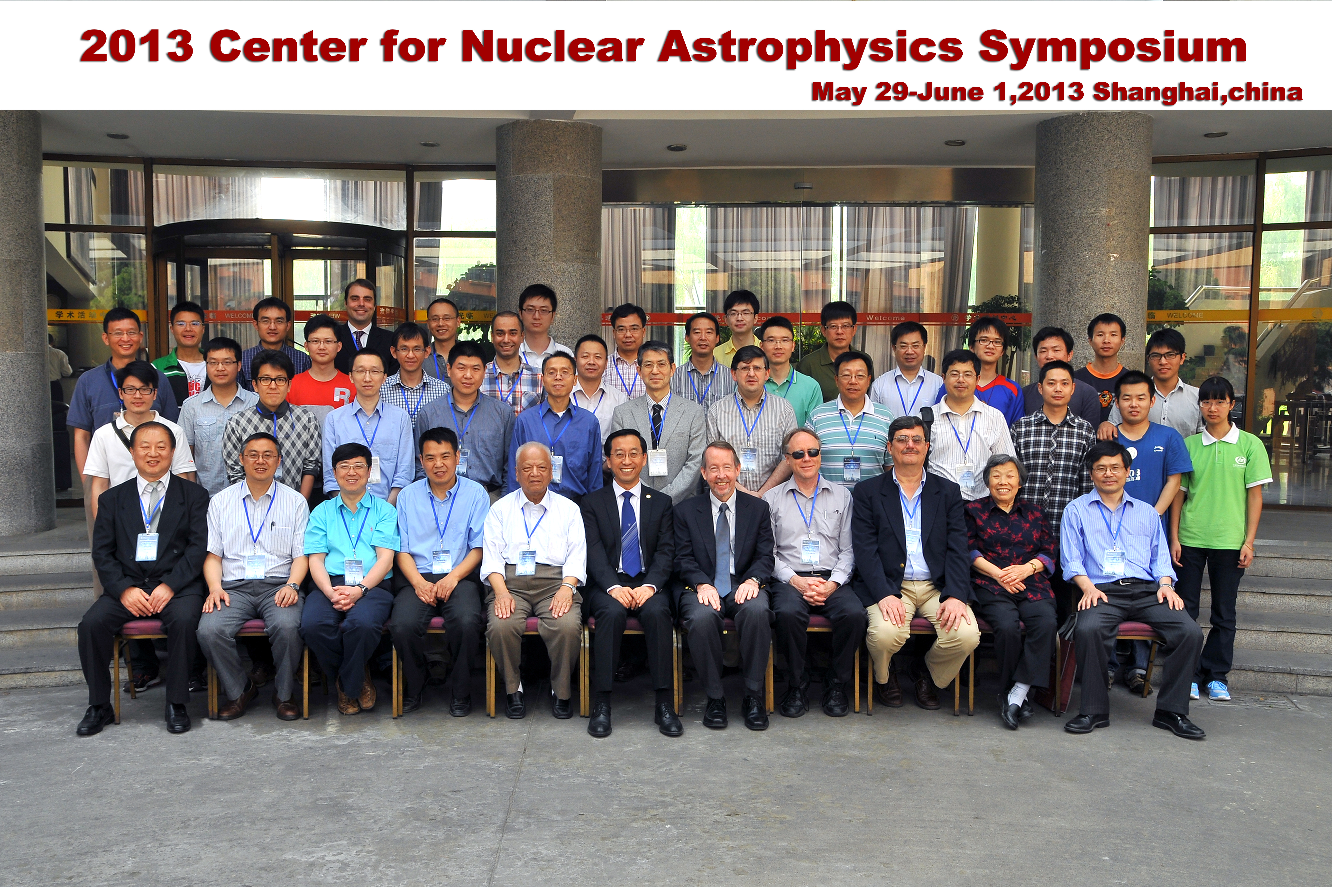

Slide 7



Slide 10
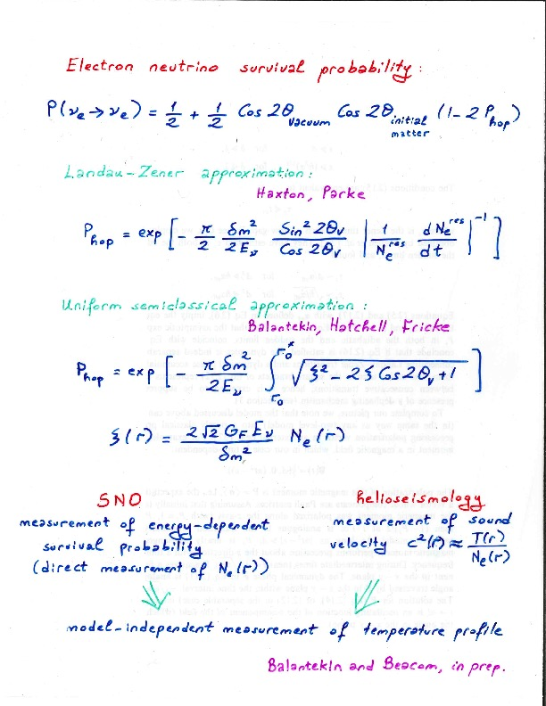
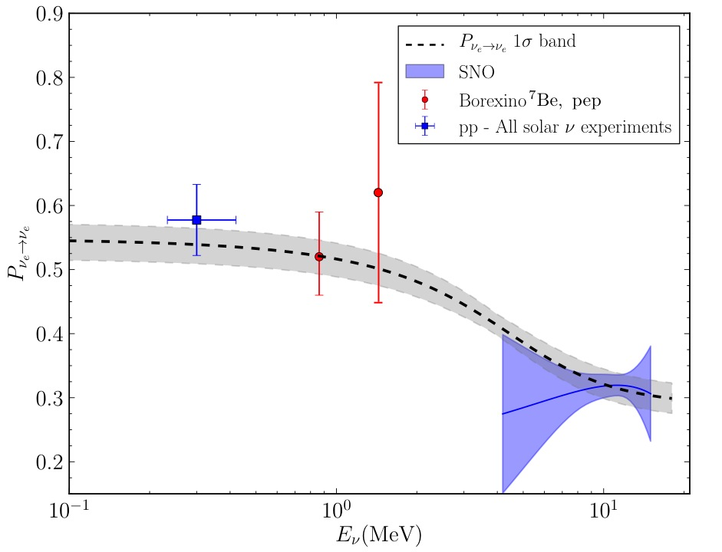

Slide 11
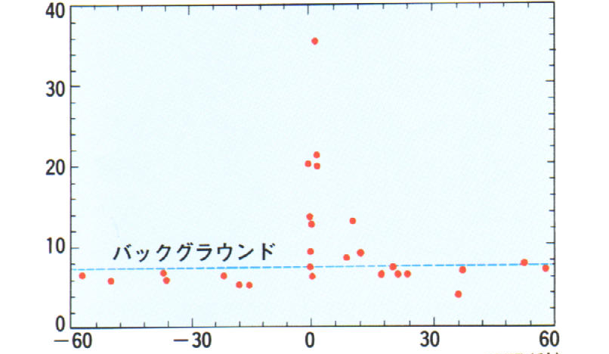
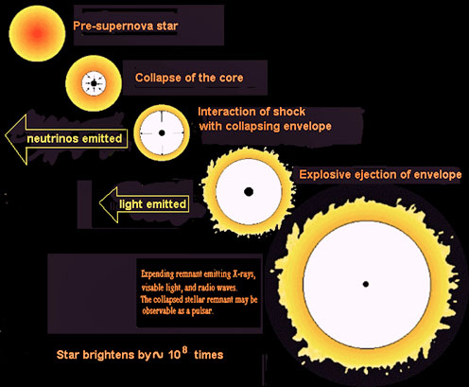
Neutrinos from core-collapse supernovae

Slide 12
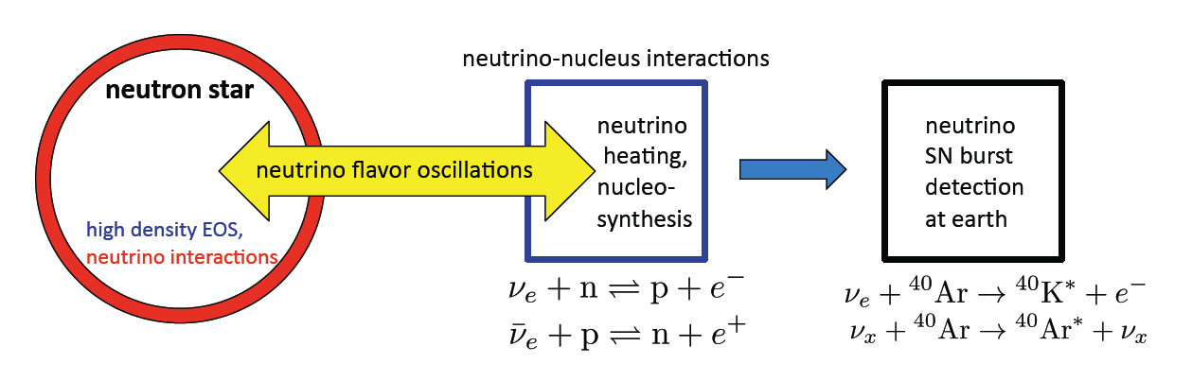
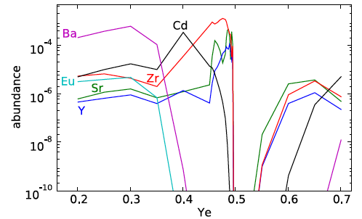
Understanding a core-collapse supernova requires answers to a variety of questions some of which need to be answered, both theoretically and experimentally.
Balantekin and Fuller, Prog. Part. Nucl. Phys. 71 162 (2013)
Arcones and Montes

Slide 13
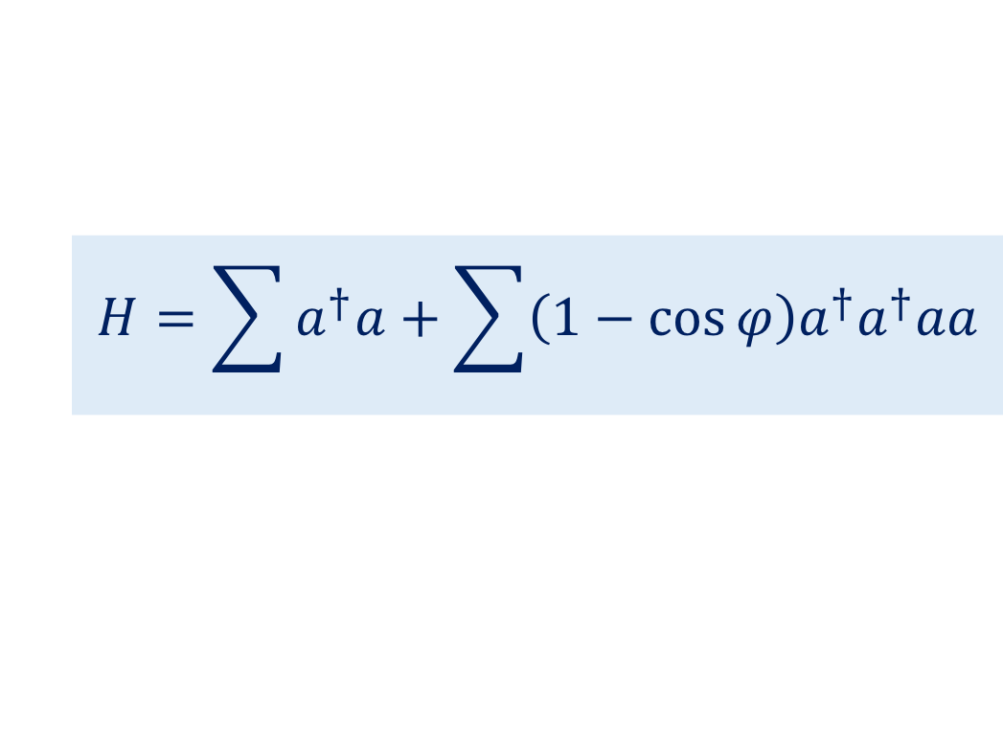
ν
Energy released in a core-collapse SN: ΔE ≈ 10⁵³ ergs ≈ 10⁵⁹ MeV
99% of this energy is carried away by neutrinos and antineutrinos!
~ 10⁵⁸ Neutrinos!
This necessitates including the effects of νν interactions!
ν
ν
Proto neutron star
ν
ν
$$H=\sum{a^{†}a+\sum{\left(1−\cos{φ}\right)a^{†}a^{†}aa}}$$
oscillations
MSW effect
neutrino-neutrino interactions
The second term makes the physics of a neutrino gas in a core-collapse supernova a very interesting many-body problem, driven by weak interactions.
Neutrino-neutrino interactions lead to novel collective and emergent effects, such as conserved quantities and interesting features in the neutrino energy spectra (spectral “swaps” or “splits”).

Slide 14
Neutrino flavor isospin
Linear combinations of the mass eigenstates interact with weak interactions
ν_{e}
ν_{μ}
Free neutrinos (only mixing)
Interacting with background electrons

Slide 15
Neutrino flavor isospin
ν_{e}
ν_{μ}
These operators can be written in either mass or flavor basis
Free neutrinos (only mixing)
Interacting with background electrons

Slide 16
Smirnov, Fuller and Qian, Pantaleone, McKellar, Friedland, Lunardini, Raffelt, Duan Balantekin, Kajino, Pehlivan …
Neutrino-Neutrino Interactions
p
θ
q
This term makes the physics of a neutrino gas in a core-collapse supernova a genuine many-body problem
Neutrino-neutrino interactions lead to novel collective and emergent effects, such as conserved quantities and interesting features in the neutrino energy spectra (spectral “swaps” or “splits”).

Slide 17
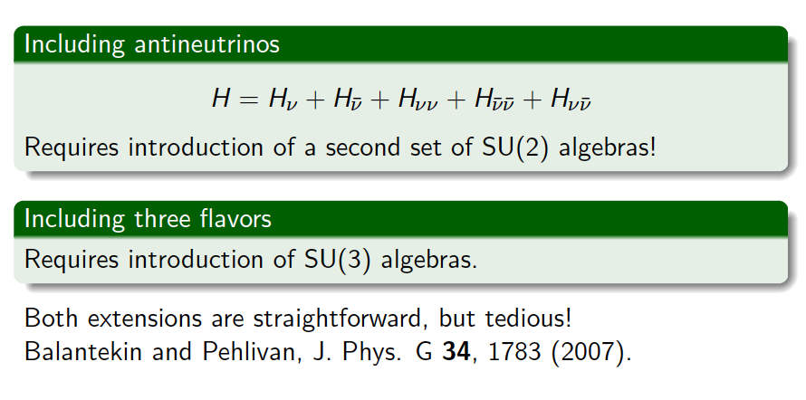

Slide 18
Collective Neutrino Oscillations

Slide 19
This problem is “exactly solvable” in the single-angle approximation

Slide 20
Two of the adiabatic eigenstates of this equation are easy to find in the single-angle approximation:
To find the others will take a lot more work

Slide 21
This problem is “exactly solvable” in the single-angle approximation
Pehlivan, Balantekin, Kajino, Yoshida, PRD84 (2011) 065008
Bethe ansatz

Slide 22
Bethe ansatz equations
Pehlivan, ABB, Kajino, & Yoshida
Phys. Rev. D 84, 065008 (2011)

Slide 23
Conserved quantities of the collective motion
(Gaudin magnets)
There is a second set of conserved quantities for antineutrinos.
Note the presence of volume. In fact h_{p}/V are the conserved quantities for the neutrino densities.
For three flavors a similar expression is written in terms of SU(3) operators.

Slide 24
Recall that two of the adiabatic eigenstates of this equation are easy to find:

Slide 25
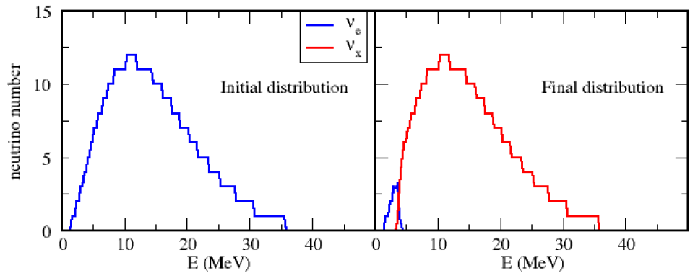
Away from the mean-field: First adiabatic solution of the exact many-body Hamiltonian
Solutions of the Bethe ansatz equations for 250 neutrinos. Same behavior as the mean-field.
Two flavors only
Inverted hierarchy, no matter effect
2015

Slide 26
initial
Adiabatic evolution of an initial thermal distribution (T = 10 MeV) of electron neutrinos. 10⁸ neutrinos distributed over 1200 energy bins with solar neutrino parameters and normal hierarchy.
final
Birol, Pehlivan, Balantekin, Kajino
arXiv:1805.11767
PRD98 (2018) 083002

Slide 27
A more practical approach
Patwardhan, Cervia, Balantekin, Phys.Rev. D99, 123013 (2019)

Slide 28
These Λ(ω_{p}) = Λ_{p} are eigenvalues of the invariants, h_{p}:
 | Cervia, Patwardhan, Balantekin, arXiv:1905.00082

Slide 29
Adiabatic Eigenstates
Patwardhan, Cervia, Balantekin, Phys.Rev. D99, 123013 (2019)

Slide 30
Energy eigenvalues for a system with 10 neutrinos in 10 bins with ω_{p} = pω₀ for κ = 4
Patwardhan, Cervia, Balantekin, Phys.Rev. D99, 123013 (2019)

Slide 31
A system of N particles each of which can occupy k states (k = number of flavors)
Exact Solution
Mean-field approximation
Entangled and unentangled states
Only unentangled states
Dimension of Hilbert Space: k^{N}
Dimension of Hilbert Space: kN

Slide 32
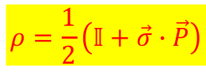
von Neumann entropy
S = - Tr (ρ log ρ)
 | Pure State | Mixed State
Density matrix | ρ² = ρ | ρ² ≠ ρ
Entropy | S = 0 | S ≠ 0
Polarization vector for a two-level system
$$ρ=\frac{1}{2}\left(𝕀+\vec{σ}∙\vec{P}\right)$$

Slide 33
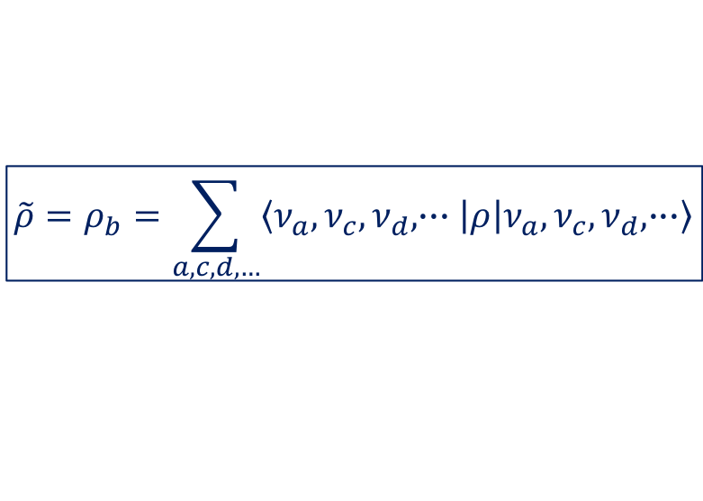
Pick one of the neutrinos and introduce the reduced density matrix for this neutrino (with label “b”)
$$\tilde{ρ}=ρ_{b}=\sum_{a,c,d,…}{\left\langle ν_{a},ν_{c},ν_{d},∙∙∙ | ρ | ν_{a},ν_{c},ν_{d},∙∙∙\right\rangle }$$

Slide 34
Pick one of the neutrinos and introduce the reduced density matrix for this neutrino (with label “b”)
$$\tilde{ρ}=ρ_{b}=\sum_{a,c,d,…}{\left\langle ν_{a},ν_{c},ν_{d},∙∙∙ | ρ | ν_{a},ν_{c},ν_{d},∙∙∙\right\rangle }$$
Entanglement entropy

Slide 35
ω_{Ν} = Νω₀
Initial state:
all electron neutrinos
Note: S = 0 for mean-field approximation
Cervia, Patwardhan, Balantekin, Coppersmith, Johnson,
arXiv:1908.03511

Slide 36

N=4
All possible initial states
Correlation between entanglement entropy and deviation from the mean-field
$$ΔP_{z}\left(ω_{p}\right)=\left|P_{z}^{MF}\left(ω_{p}\right)−P_{z}^{MB}\left(ω_{p}\right)\right|$$
~
N=8
A sampling of initial states
Cervia, Patwardhan, Balantekin, Coppersmith, Johnson,
arXiv:1908.03511

Slide 37
Example: analytically solvable N=2 case

Slide 38
Example: analytically solvable N=2 case
Initial state: two electron neutrinos

Slide 39
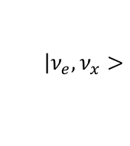
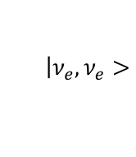
Initial state
$$\left|ν_{e},ν_{e}>\right.$$
Initial state
$$\left|ν_{e},ν_{x}>\right.$$

Slide 40


Slide 41
