Slide 1
Neutrinos, Dark matter, and Effective Theories
Xiangdong Ji
Jan. 7-8, 2020, Berkeley
Wick Symposium on Looking for ν physics on Earth and in the Cosmos

Slide 2
Outline
Neutrinoless double-beta decay
  PandaX-II: a 580-kg liquid nat-Xe dual TPC
  A possible 100-ton nat-Xe dual TPC
Dark matter
  PandaX-II result
  Effective WIMP-nucleon interactions
Effective theories
  EIC and nuclear physics
  Lattice QCD and large-momentum effective theory
Outlook

Slide 3
Double beta decay
W.C.Haxton and G. J. Stephenson Jr,
Prog. Part. Nucl. Phys. 12 (1984) 409-479

Slide 6
Searching for ¹³⁶Xe DBD with a 580kg liquid xenon detector

Slide 7
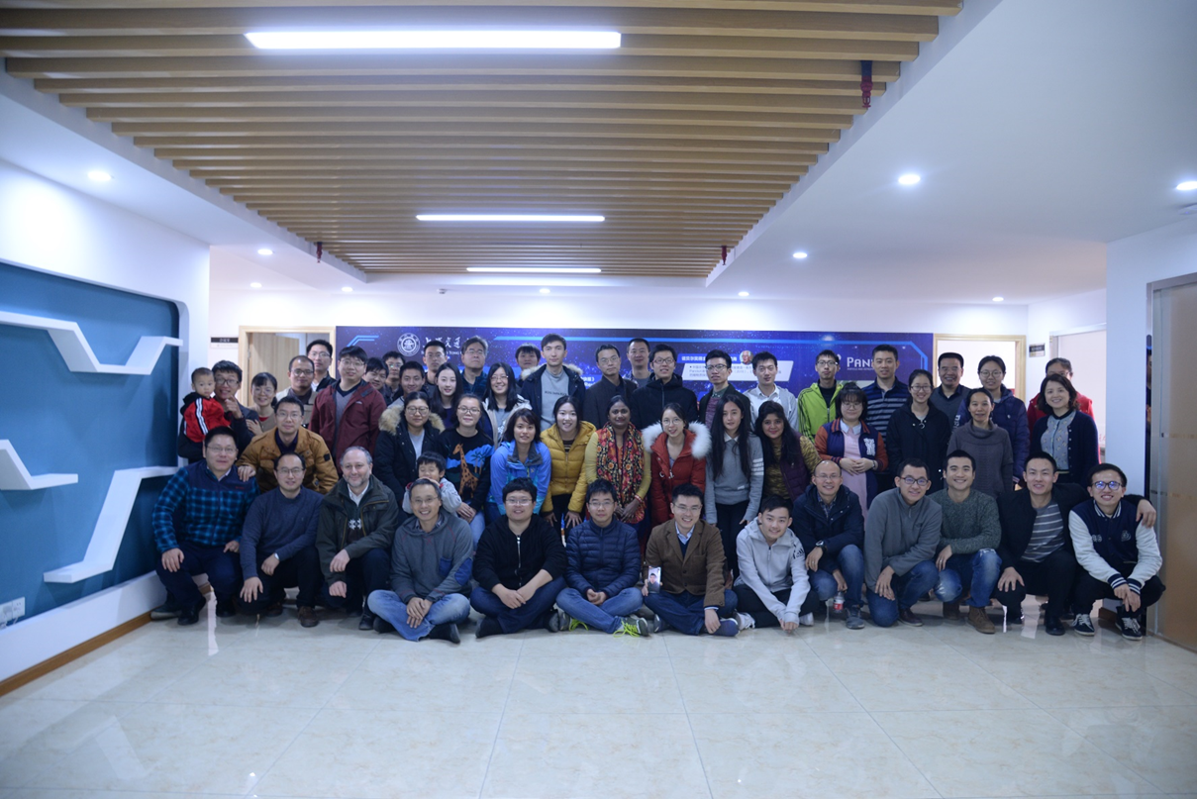


PandaX collaboration
Started in 2009
Shanghai Jiao Tong University (2009-)
Peking University (2009-)
Shandong University (2009-)
Shanghai Institute of Applied Physics, CAS (2009-)
University of Science & Technology of China (2015-)
China Institute of Atomic Energy (2015-)
Sun Yat-Sen University (2015-）
Yalong Hydropower Company (2009-)
University of Maryland (2009-)

Slide 8
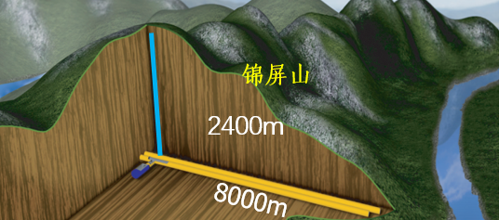

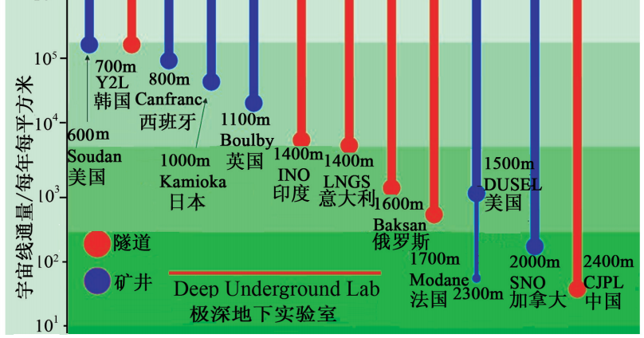
China Jinping Underground Laboratory (CJPL)
Deepest in the world ( 1µ/week/m²)
and Horizontal access!

Slide 9
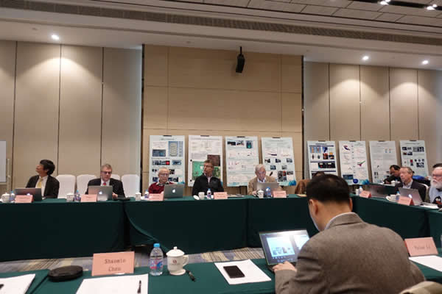
CJPL IAC meeting, 2019

Slide 10
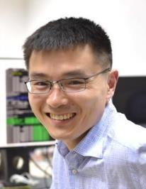
Data

Slide 13
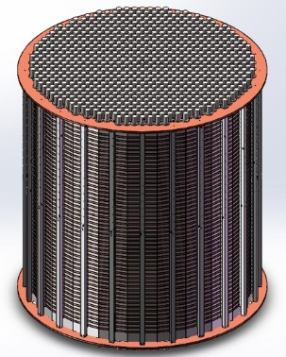
A 100ton ^{nat}Xe detector
Imagine a 100 ton scale ^{nat}Xe detector.
Volume：30m³
Fiducial volume: 14m³
With 0.5m Xe shielding!
Total ¹³⁹Xe mass 4 ton!
Energy resolution: 3%
Radioactive background: Ra

Slide 14
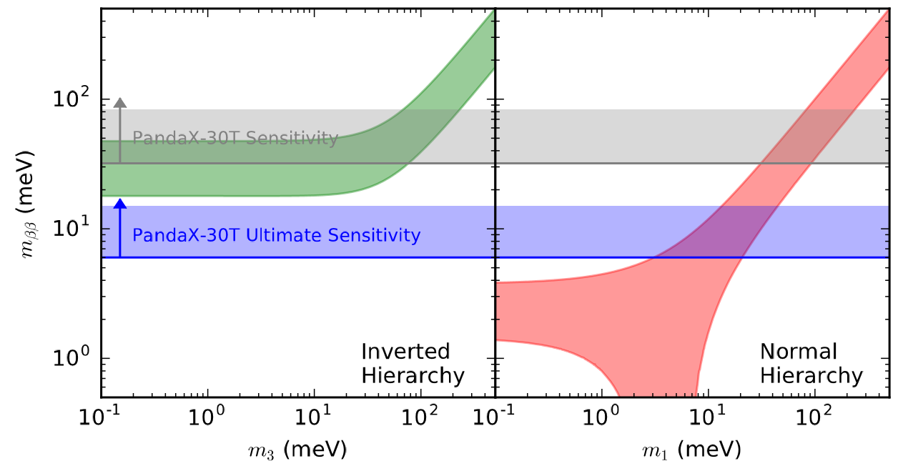
Potential for 100ton detector
Detection threshold 1keV.
30-ton-year
200-ton-year

Slide 15
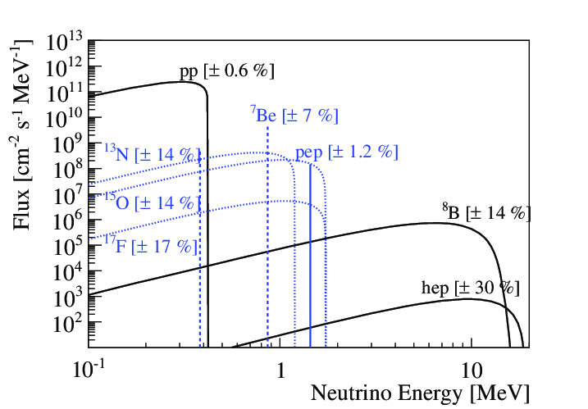
A low-energy solar neutrino detector!
Threshold about 1 keV, hundreds time smaller than other large neutrino detectors.
Great for pp neutrinos as well as CNO neutrinos.
Can measure neutrino magnetic moment very precisely

Slide 16
MSW effects

Slide 17
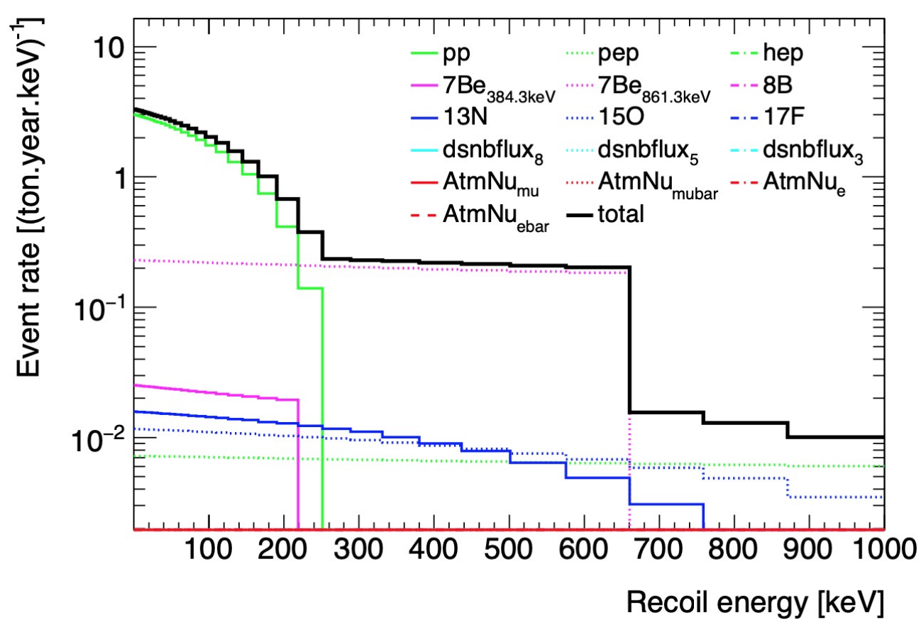
Neutrino rate

Slide 18
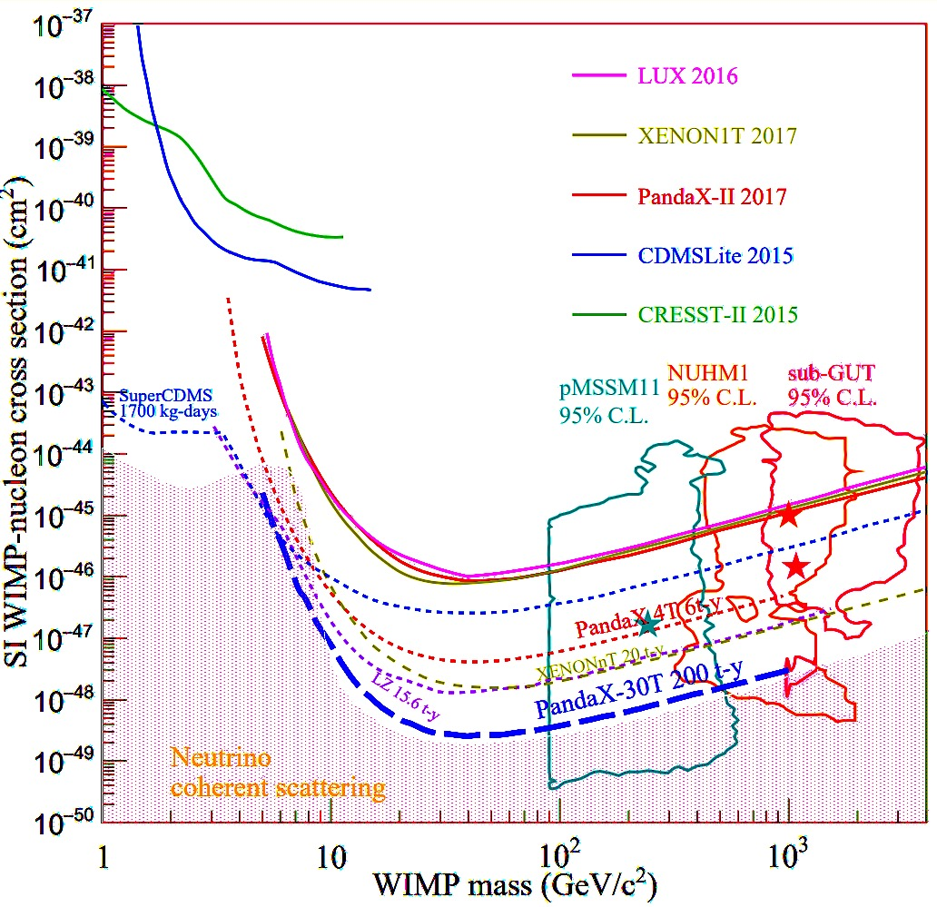
An ultimate DM detector

Slide 19
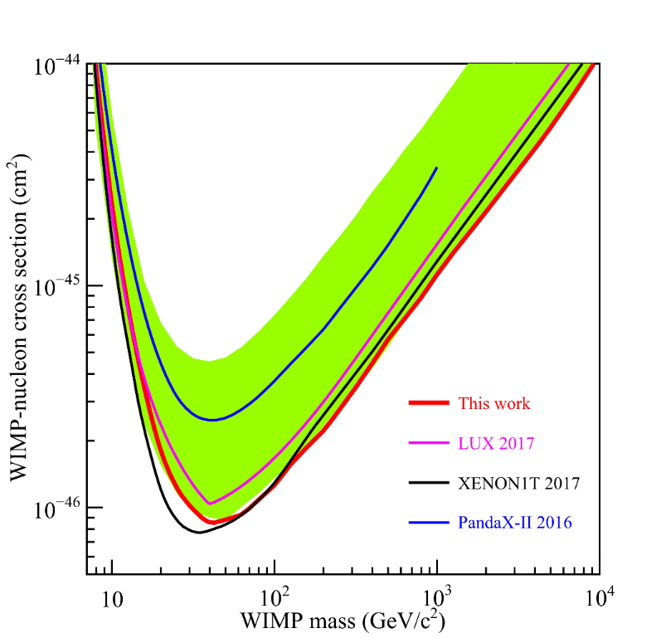
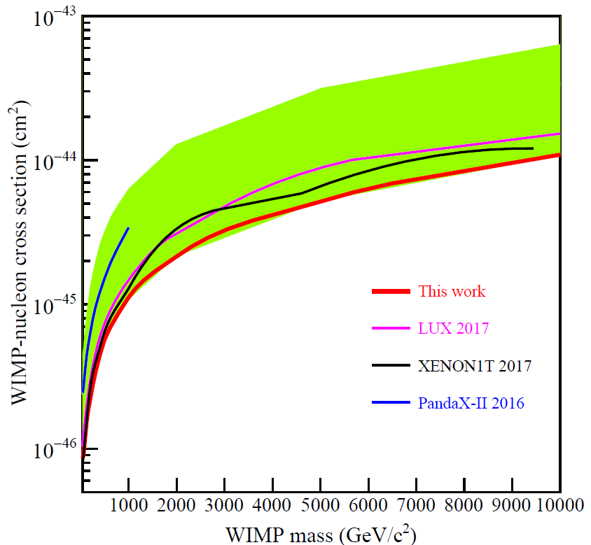
Results on elastic SI DM-nucleon scattering (2017)
Profile likelihood fits made to the data
Yield a most stringent limit for WIMP-nucleon cross section for mass >100GeV
Improved from PandaX-II 2016 limit about 2.5 time for mass>30 GeV
Lowest exclusion at 8.6×10⁻⁴⁷cm² at 40GeV/c²

Slide 20
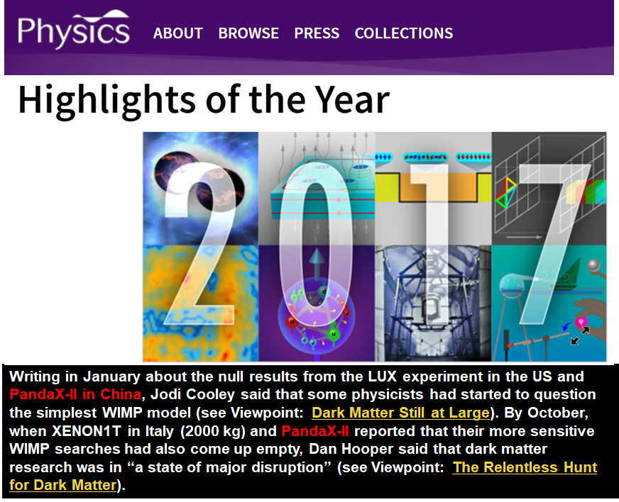

Slide 21
The DM-nucleon interactions are unknown

Slide 22
Effective Interactions
Without knowing the microscopic theory of interactions, how to make progress in a model-independent way.

Slide 23
Wick’s PandaX paper

Slide 26
Effective Theories
With/without knowing the microscopic theory of interactions, how to make progress in a model-independent way with relevant degrees of freedom, consistent with all symmetries.

Slide 27
Effective nuclear structure theory: Wick’s ambitious program

Slide 28
Latest accomplishment

Slide 30
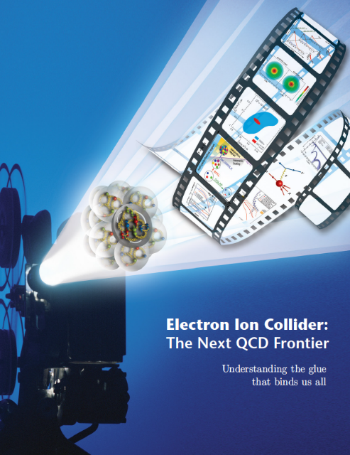
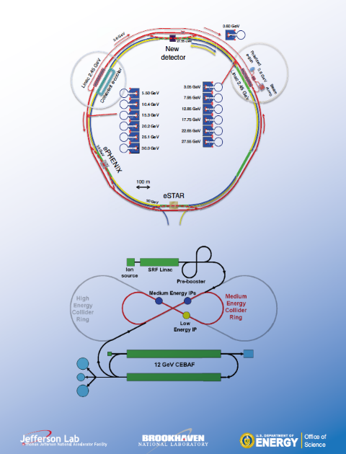
Structure of the nucleon and EIC
The protons and neutrons have been discovered for 100 years.
The structure of the nucleon in terms of QCD is till unsolved.
EIC will probe partonic landscape of the nucleon and nuclei.

Slide 31
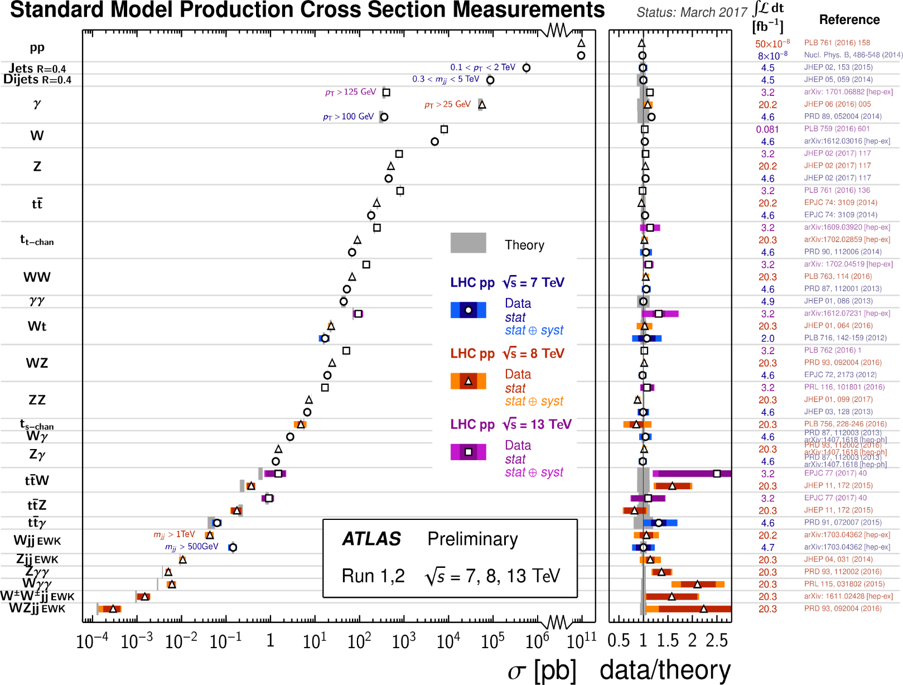
Parton model as an effective theory for high-energy physics
Proton’s structure depends on the center-of-mass motion P.
The idealized limit, P→∞, as suggested Feynman provides a simple picture of the protons, and PDFs are effective low-energy “constants” in high-energy scattering.

Slide 32
Partons are hard to calculate
However, the PDFs cannot be computed on lattice because it involves time-like correlations in lagrangian formulation.
In Hamiltonian approach, one faces the renormalization and non-perturbative problems.
Therefore, over the years, partons cannot be calculated from QCD directly!
⁻
^{t}
⁺
^{z}

Slide 33
Effective Theory for partons
Partons are similar to critical phenomena.
P=∞, UV fixed point, same as T=Tc
One can use an effective theory NEAR the critical point to study the physics AT the critical point.
This effective theory is a proton travelling at a few GeV on lattice.
Large-momentum effective theory.
One expects all parton physics at EIC can be computed this way.

Slide 34
Approaching the light-cone from boosting

Slide 35
Initial Tests of LaMET

Slide 36
Prospect for the future
EIC will produce large amount of data on parton properties of the nucleons and nuclei
PDFs, GPDs, TMD-PDFs, LCWFs,
They are all light-cone correlations
We must learn how to calculate them.
LaMET seems to provide a unique way forward.

Slide 37
Happy Birthday, Wick!

