Slide 1






Update on FCC Status and Strategy
M. Benedikt
gratefully acknowledging input from FCC coordination group,
global FCC design study team and all other contributors
LHC
PS
SPS
FCC
http://cern.ch/fcc
Work supported by the European Commission under the HORIZON 2020 projects EuroCirCol, grant agreement 654305; EASITrain, grant agreement no. 764879; ARIES, grant agreement 730871; and E-JADE, contract no. 645479
photo: J. Wenninger
photo: J. Wenninger

Slide 3
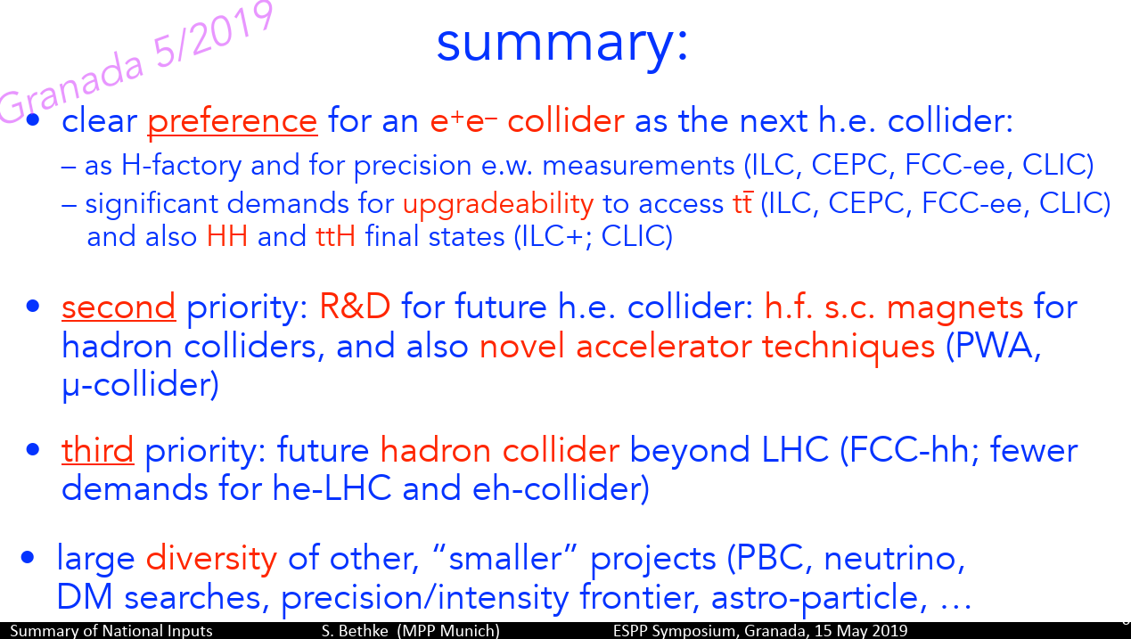
Update from ESG, slides from S. Bethke, German KET meeting 15th Nov. 2019 (i)

Slide 4
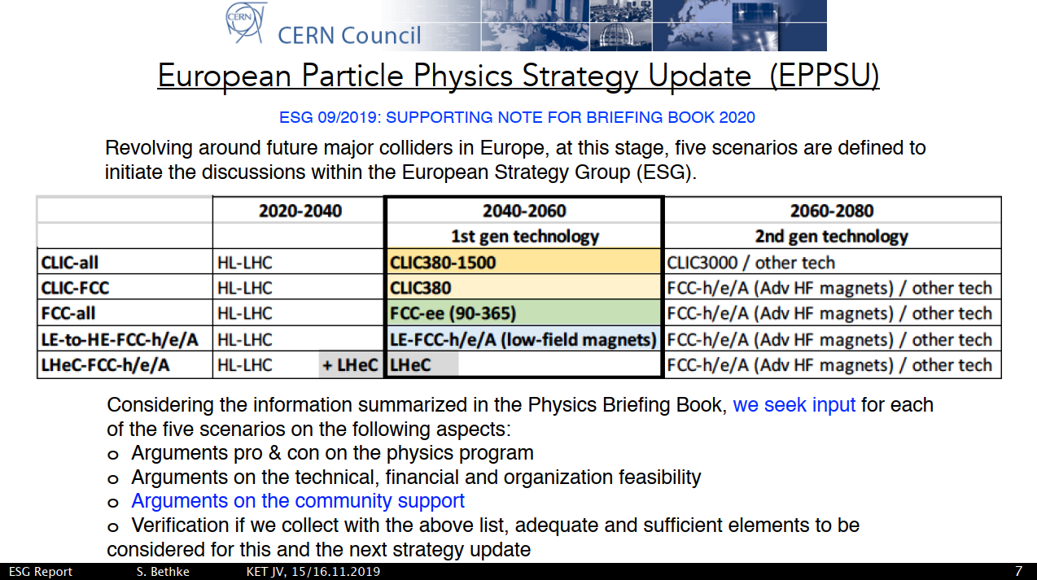
Update from ESG, slides from S. Bethke, German KET meeting 15th Nov. 2019 (ii)

Slide 5
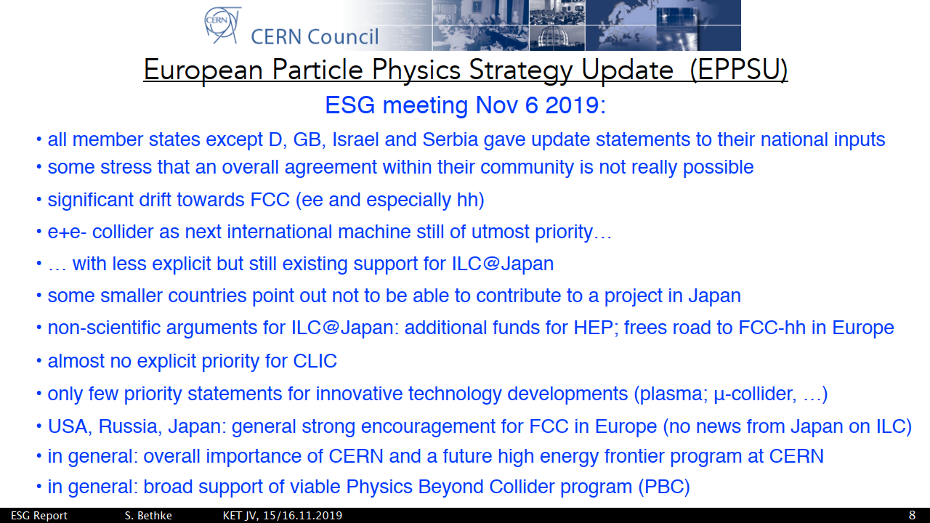
Update from ESG, slides from S. Bethke, German KET meeting 15th Nov. 2019 (iii)

Slide 6

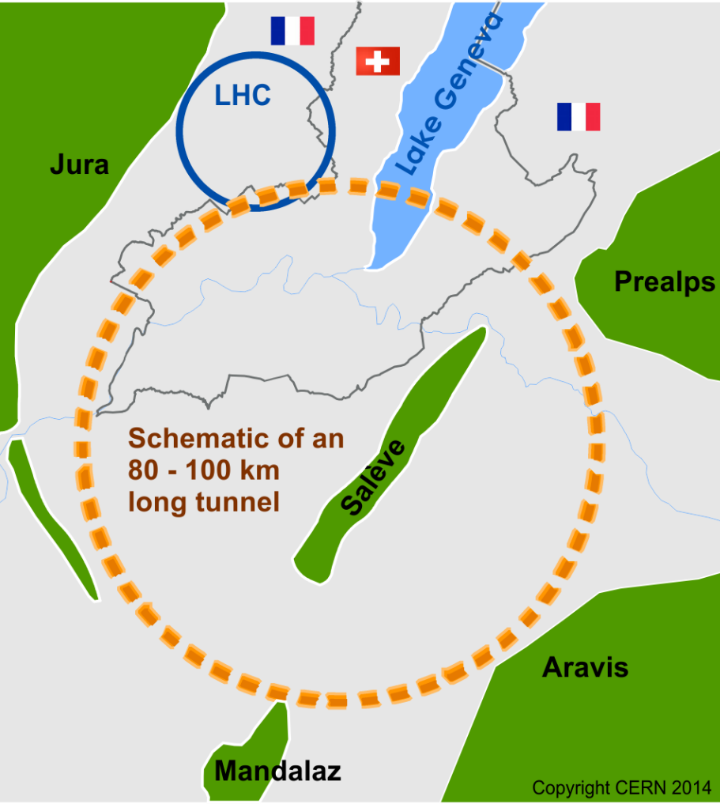
FCC overall strategy and status
CERN management fully supports the FCC Integrated Programme that was submitted to the ESG in December 2018.
Peparations for all activities as identified in the FCC integrated project plan.
Technical areas:
Increase efforts on FCC-ee design including injector optimisation.
FCC-ee 4 IP study with potential for energy saving, larger user community, shorter running time.
Key technology programs SCRF and high-efficiency RF production for FCC-ee and HF SC magnets for FCC-hh.

Slide 7
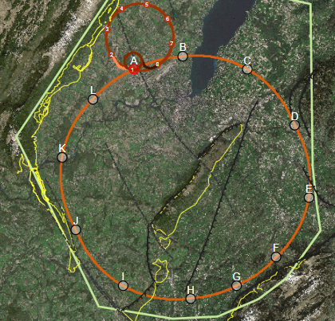
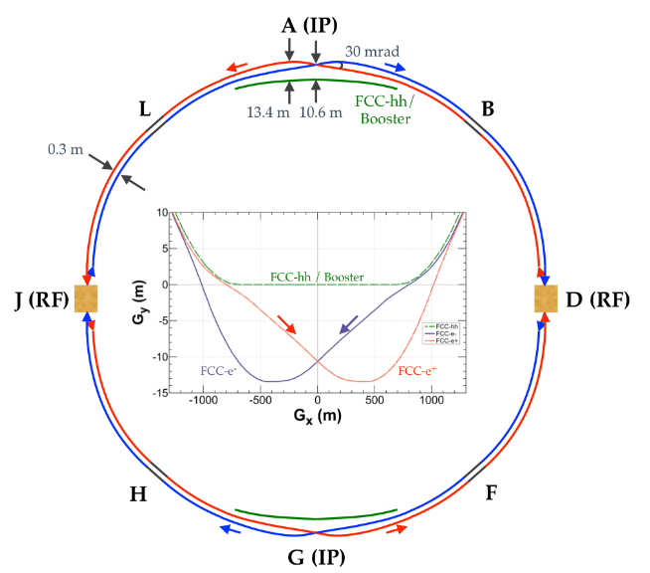
The FCC integrated program
inspired by successful LEP – LHC programs at CERN
Comprehensive cost-effective program maximizing physics opportunities
Stage 1: FCC-ee (Z, W, H, tt) as first generation Higgs factory, EW and top factory at highest luminosities.
Stage 2: FCC-hh (~100 TeV) as natural continuation at energy frontier, with ion and eh options.
Complementary physics
Integrating an ambitious high-field magnet R&D program
Common civil engineering and technical infrastructures
Building on and reusing CERN’s existing infrastructure.
FCC integrated project plan is fully integrated with HL-LHC exploitation and provides for seamless continuation of HEP.
FCC-ee
FCC-hh

Slide 8
FCC-integrated cost estimate
Total construction cost FCC-ee (Z, W, H) amounts to 10,500 MCHF & 1,100 MCHF (tt).
Associated to a total project duration of ~20 years (2025 – 2045)
Total construction cost for subsequent FCC-hh amounts to 17,000 MCHF.
Associated to a total project duration of ~25 years (2035 – 2060) (FCC-hh stand alone 25 BCHF)

Slide 9
FCC integral project technical schedule
1
2
3
4
5
6
7
8
9
10
11
12
13
14
15
16
17
18
15 years operation
34
35
36
37
38
39
40
41
42
43
~ 25 years operation
70
Project preparation &
administrative processes
Permis-sions
Update
Permissions
Funding strategy
Funding and
in-kind contribution agreements
Funding and
in-kind contribution agreements
Geological investigations, infrastructure detailed design and tendering preparation
Tunnel, site and technical infrastructure construction
FCC-ee dismantling, CE & infrastructure adaptations FCC-hh
FCC-ee accelerator R&D and technical design
FCC-ee accelerator construction, installation, commissioning
FCC-hh accelerator R&D and technical design
FCC-hh accelerator construction, installation, commissioning
Set up of international experiment collaborations, detector R&D and concept development
FCC-ee detector technical design
FCC-ee detector
construction, installation, commissioning
FCC-hh detector R&D,
technical design
FCC-hh detector
construction, installation, commissioning
Superconducting wire and magnet R&D
SC wire and 16 T magnet R&D, model magnets, prototypes, preseries
16 T dipole magnet
series production
Superconducting wire and magnet R&D
Consider accelerated magnet schedule with total duration ~30 years, including full production
SC wire and 16 T magnet R&D, model magnets, prototypes, preseries
16 T magnet industrialization &
series production

Slide 10
FCC main goals for 2020 - 2026
Overall goal:
Perform all necessary steps and studies to enable a definitive project decision by 2025/26, at the anticipated date for the next ESU, and a subsequent start of civil engineering construction by 2028/29.
This requires successful completion of the following four main activities:
Develop and establish a governance model for project construction and operation
Develop and establish a financing strategy, including in-kind contributions
Prepare and successfully complete all required project preparatory and administrative processes with the host states (debat public, EIA, etc.)
Perform site investigations to enable CE planning and to prepare CE tendering..
In parallel development preparation of TDRs and physics/experiment studies:
Machine designs and main technology R&D lines
Establish user communities, work towards proto experiment collaboration by 2025/26.

Slide 11
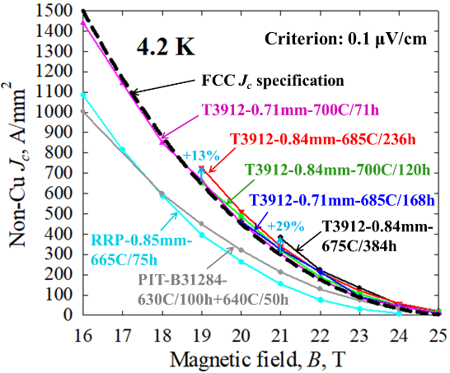
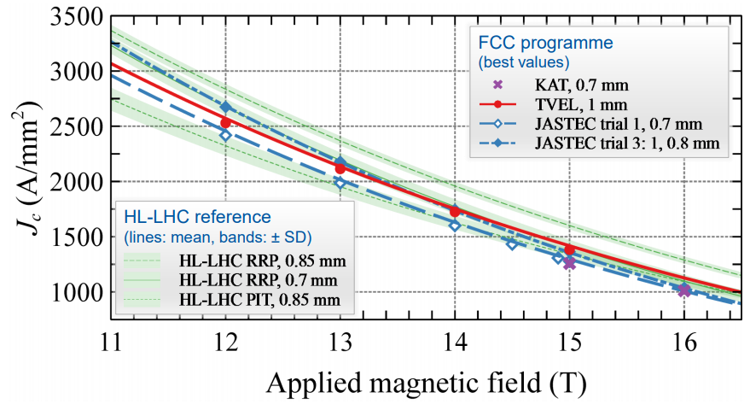
Status superconductor for 16 T
recent US wires with Artificial Pinning Centres “APCs” have reached FCC target J_{c} (50% above HL-LHC wire, →size & cost) …
… and after only few years, new suppliers from Japan, Korea and Russia already achieve HL-LHC J_{c} specification.
high B_{c2} (28.8 T at 4.2 K)
X. Xu et al.
FNAL, Hyper Tech Research Inc., and Ohio State, X. Xu et. al., https://arxiv.org/abs/1903.08121 ;
NHMFL, FAMU/FSU: S. Balachandran et al. https://arxiv.org/ftp/arxiv/papers/1811/1811.08867.pdf

Slide 12
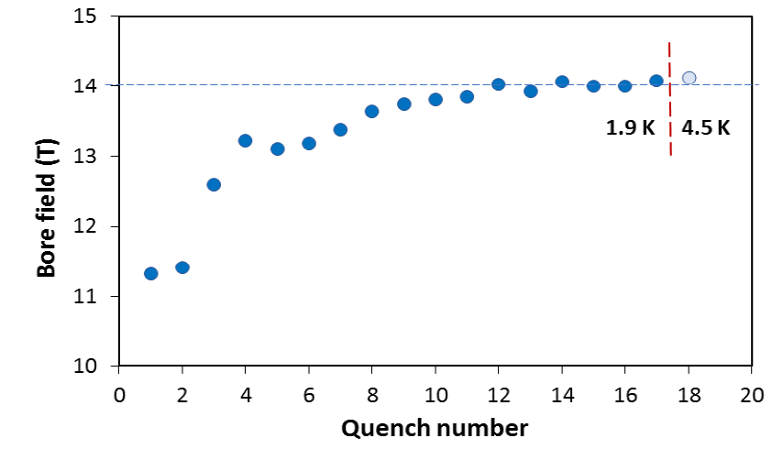
US – MDP: 14 T magnet tested at FNAL
→ A. Zlobin et al., NAPAC2019, MOPL020
84% on the laodline at 1.9 K
92% on the loadline at 4.2 K
60-mm aperture
4-layer graded coil
15 T cosϑ 4-layer dipole demonstrator
Staged approach: In first step pre-stressed for 14 T
Tests at higher field foreseen with additional pre-stress for 14.5 or 15 T

Slide 13




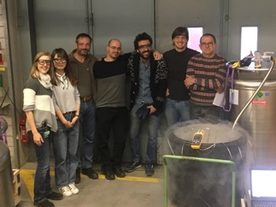
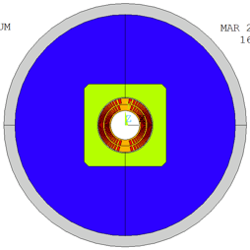
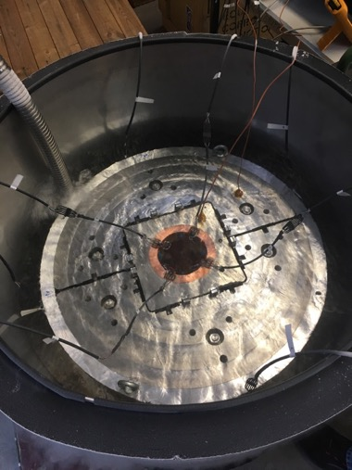
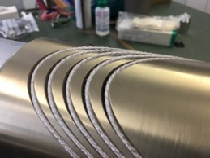
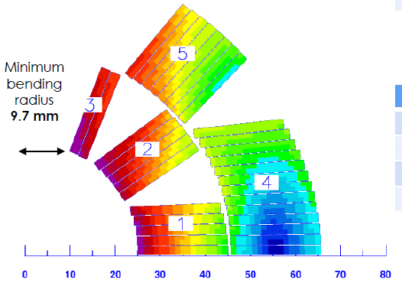
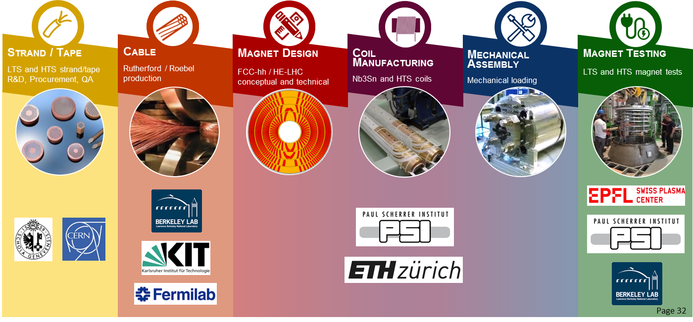
Magnet development: magnet models production
CHART2 – Swiss Accelerator Research and Technology
F2D2 or
CEA: 15.5 T 4-layer magnet with 14% load line with current wire spec
INFN: 14 T 2-layer magnet with 14 % margin (FCC spec), 9.5% with current wire spec
First model coil: 11 T will be tested in LBNL soon

Slide 14
FCC high-field magnet R&D strategy
Remain focused on FCC 16 T program and increase resources, this is THE baseline for FCC-hh
Understand technology and performance limits of Nb3Sn
Understand potential systematic advantages/disadvantages of all coil design/magnet options
Basis for final optimization of the FCC-hh magnet in 10-15 years.
Continuation of Nb3Sn wire program
  Consolidation of Jc increase via artificial pinning centres and subsequent “industrialization”
  Increase focus on other conductor targets (RRR, filament size, stability, etc) and work towards cost target
Continuation of associated wound conductor and other R&D programs
  Reinforcement of international R&D collaboration, strengthening the network by systematically involving external partners in their specific areas.
  Coupled, with industry, a process technology optimization program (wiring, curing, impregnation, etc.)
Continue 16 T model program with partners (CEA, INFN, CIEMAT, PSI, US MDP, BINP):
  Attractive and challenging goals range 14 – 16 T, double vs. four-layer designs, EuroCirCol designs
  Permanently feed R&D results and industrialization aspects back into magnet design.

Slide 15
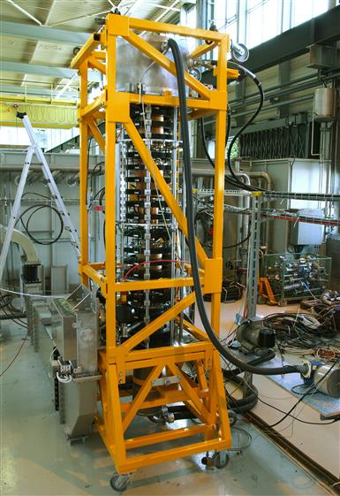
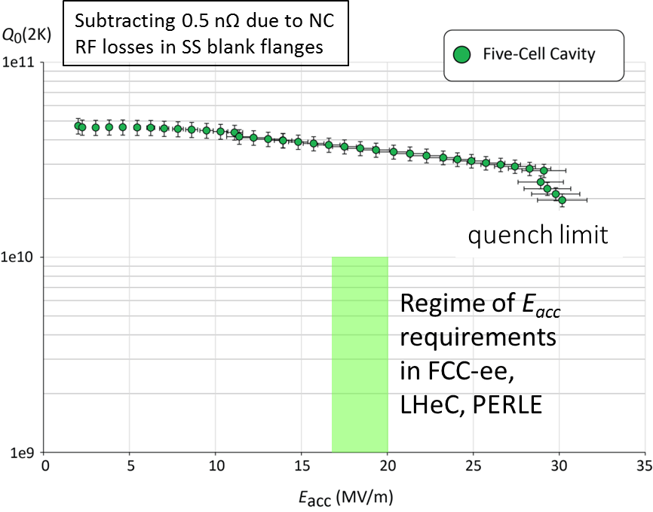
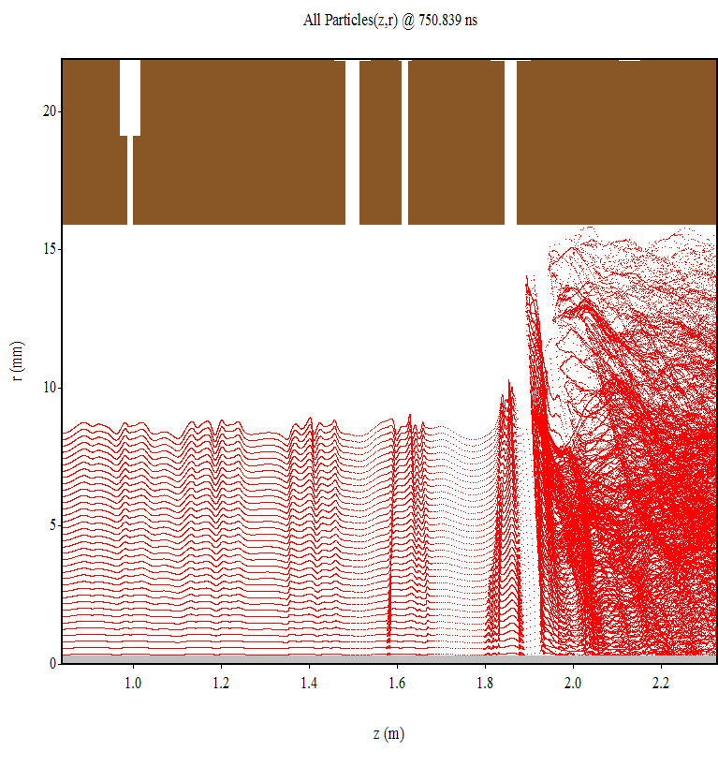
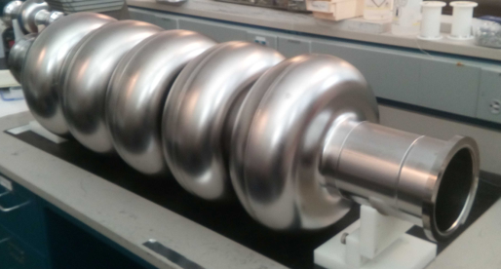
SRF , cryo-modules, RF power sources R&D
Several R&D lines aim at improving performance & efficiency and reducing cost:
  Improved Nb/Cu coating/sputtering (e.g. ECR fibre growth, HiPIMS)
  New cavity fabrication techniques (e.g. EHF, improved polishing, seamless…)
  Coating of A15 superconductors (e.g. Nb₃Sn)
  Bulk Nb cavity R&D at FNAL, JLAB, Cornell, also KEK and CEPC/IHEP
  High efficiency klystrons – synergy with HL-LHC and CLIC
  MW-class fundamental power couplers for 400 MHz
  Cryo-module design optimisation
cryo-modules for FCC-ee:
30 CM with four single cell 400 MHz cavities
100 CM with four 4-cell 400 MHz cavities
200 CM with four 5-cell 800 MHz cavities
80%
Klystron R&D
800 MHz 5-cell Nb
prototype / JLAB

Slide 16
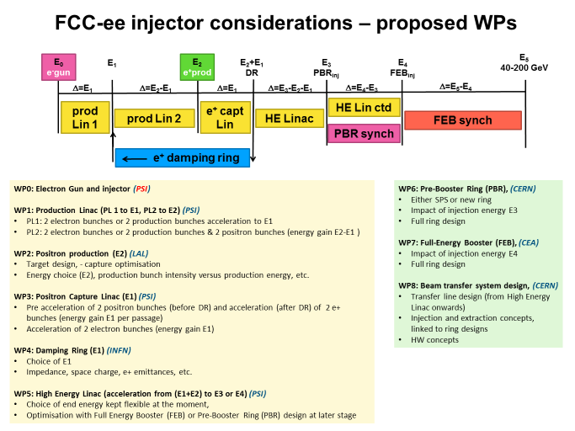
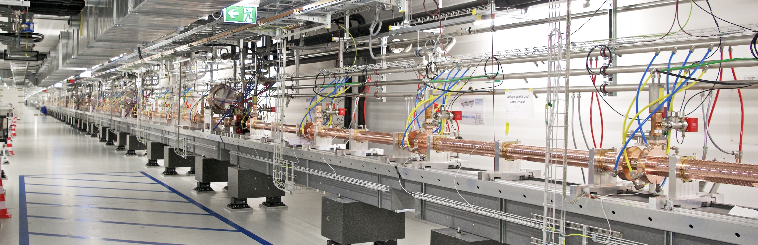
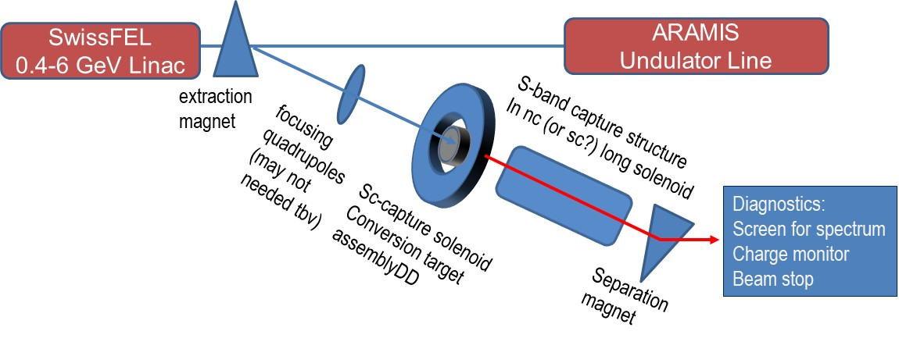
FCC-ee injector collaboration
Design optimization of FCC-ee injector and prototype positron source at PSI
BINP, CEA-Saclay (Booster design), CNRS-LAL (e+ source), INFN-LNF, PSI, CERN.
Design and construction of positron target & capture linac.
Experimental set-up at SwissFEL, beam 400 MeV – 6 GeV
Demonstration of efficiency by 2024.
Study of alternative injector based on ~6 / 20 GeV ERL.

Slide 17
Beneficiaries
New H2020 DS FCC Innovation Study
Goal: Carry out the technical design study for a 100 km long luminosity frontier circular collider infrastructure at CERN that will extend Europe’s leadership in the domain of fundamental physics research until the end of the 21st century.
The study focuses on the high priority topics to prepare the ground for a construction project by 2026:
optimisation of the particle collider design, which leads to the invariants of the infrastructure project,
planning and necessary investigations for a sustainable civil engineering construction project including the requirements of a circular economy,
implementation and public participation processes in France and Switzerland (CERN host states) including transnational topics such as environmental impact assessment, management of excavation materials and access to shared resources (electricity, water, communication, transport),
definition and implementation of a project exploitation plan considering the need to create a committed user community that exploits the RI from the beginning onwards and to engage every member of the society,
Socio-economic impact assessment with a plan to design the facility for impact creation, including the regional impacts and potential synergies for all participating stakeholders in Europe.

Slide 18
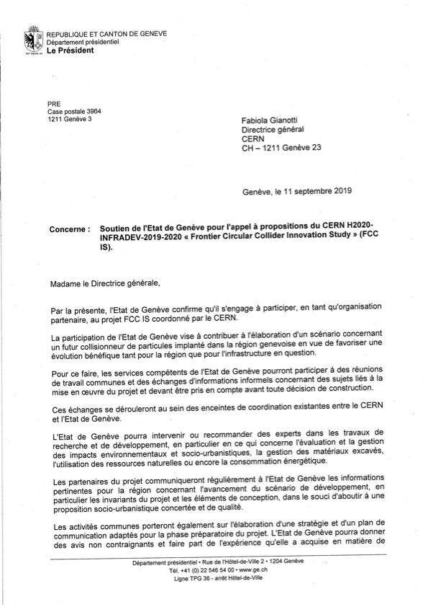
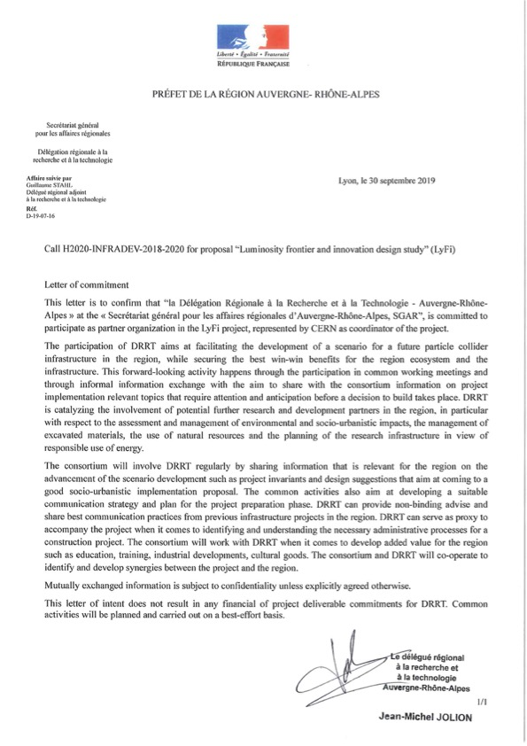
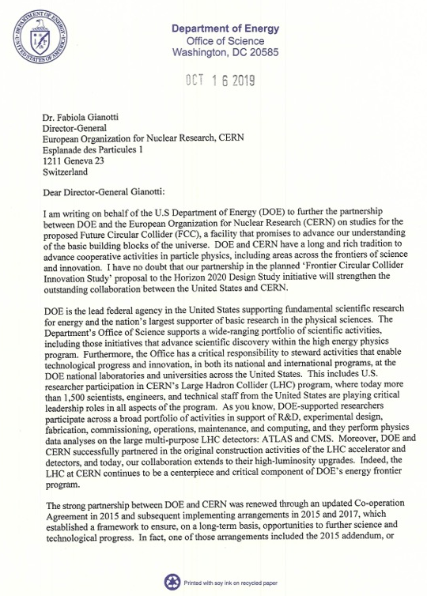
Beneficiaries
H2020 DS FCC Innovation Study - participants
Partners
DOE (US) covering participation of DOE laboratories
D.R.R.T. (F)
Etat de Geneve (US)
BINP (Ru)
U Oxford (UK)
Beneficiaries

Slide 19
Conclusions
In the course of ESU evolution, the integrated FCC programme, featuring FCC-ee as first step, followed by a ~100 TeV FCC-hh as long-term goal, is being confirmed as a highly interesting option for CERN’s future research infrastructure.
Lower energy hadron colliders such as HE-LHC and a low-energy FCC-hh, based on NbTi, are less favored due to limited physics potential and non-complementarity with FCC-hh, while being still “expensive” machines.
These developments confirm the FCC strategy and also the 16 T high field magnet program as central pillar for a future highest energy hadron collider.
It is hoped that the ESU will pave the way for preparatory activities towards FCC while recommending explicitly strong associated R&D programs with ambitious goals.
For high-field magnet R&D in the context of the FCC integrated program, this would mean to develop cost optimized and reliable designs, ready to industrialize and build by ~2040, so that from 2050, the magnets for a new machine could be installed.

Slide 20
Spare slides

Slide 21

Status of Global FCC Collaboration
136
Institutes
25
Companies
34
Countries
EC
H2020

Slide 22
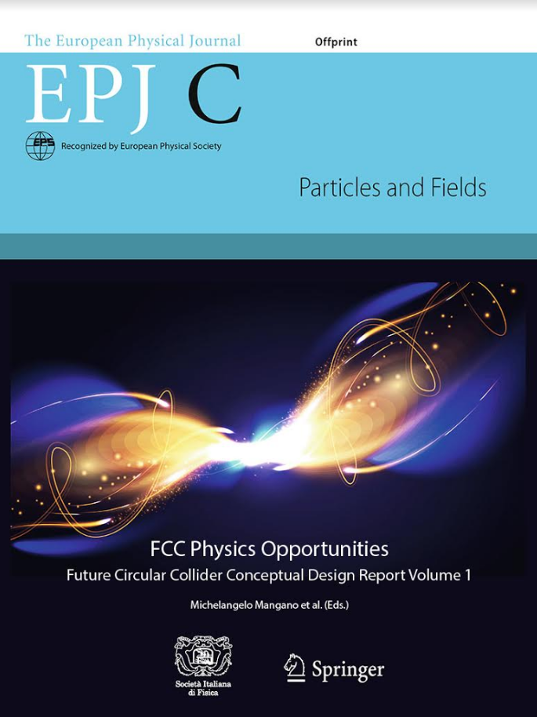
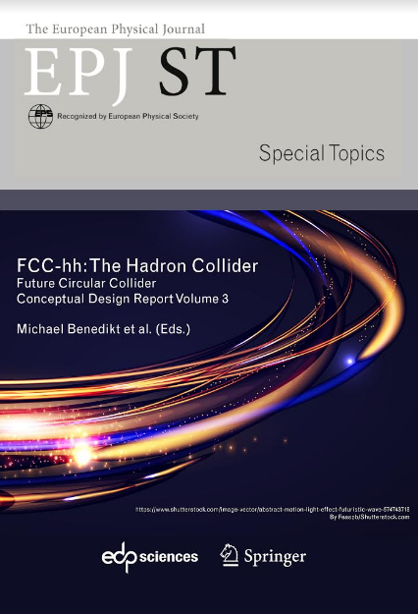
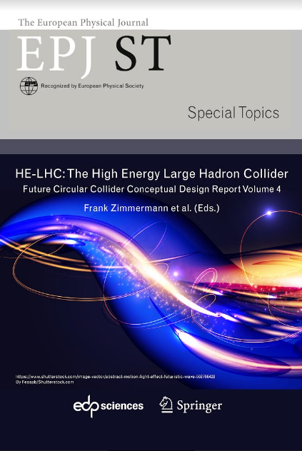
FCC CDR and Study Documentation
FCC-Conceptual Design Reports:
  Vol 1 Physics, Vol 2 FCC-ee, Vol 3 FCC-hh, Vol 4 HE-LHC
  Preprints available on http://fcc-cdr.web.cern.ch/
  CDRs accepted for publication in European Physical Journal C (Vol 1) and ST (Vol 2 – 4)
Summary documents provided to EPPSU SG
  FCC-integral, FCC-ee, FCC-hh, HE-LHC
  Accessible on http://fcc-cdr.web.cern.ch/
more than 1350 contributors from 350 institutes, a truly global collaboration and effort as suggested by the EPPSU 2013

Slide 23
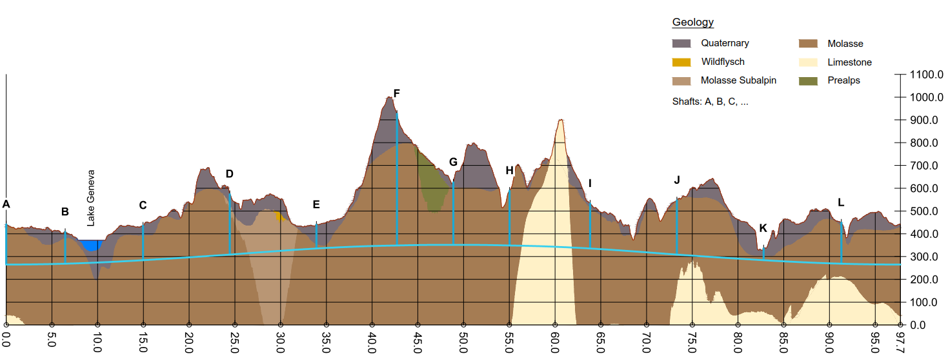
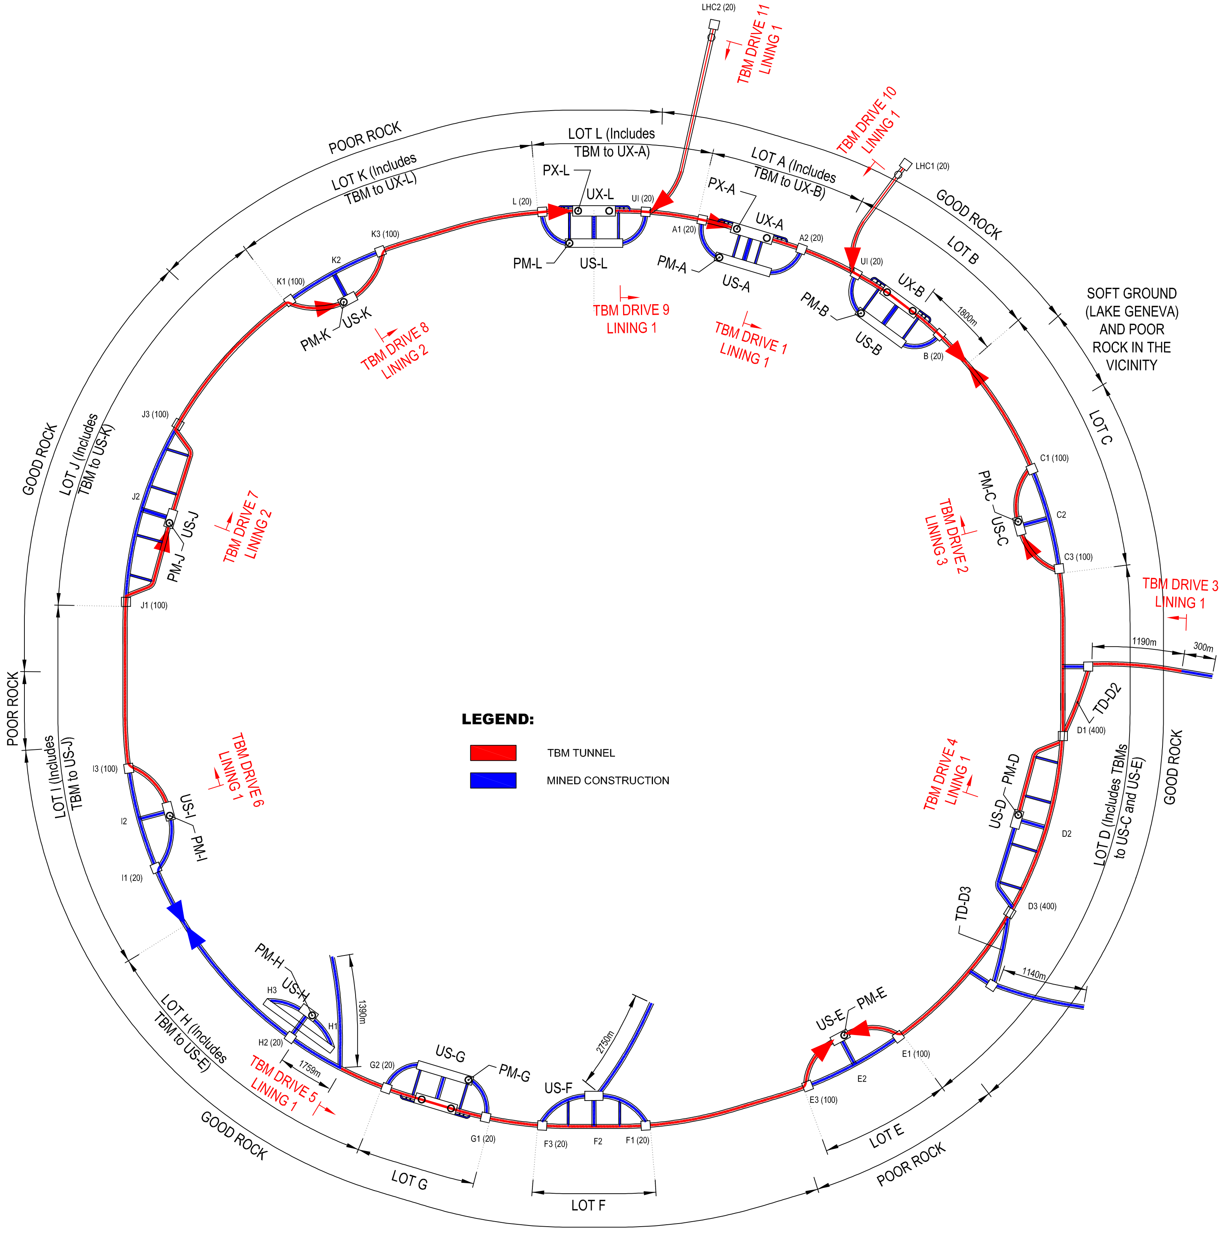
FCC implementation - footprint baseline
Present baseline position was established considering:
lowest risk for construction, fastest and cheapest construction
feasible positions for large span caverns (most challenging structures)
More than 75% tunnel in France, 8 (9) / 12 access points in France.
next step: review of surface site locations and machine layout

Slide 24
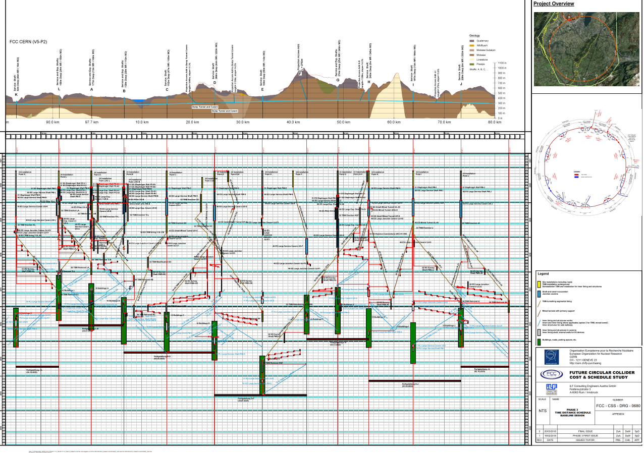
Civil Engineering studies
4.5yrs
6.5yrs
Total construction duration 7 years
First sectors ready after 4.5 years

Slide 25
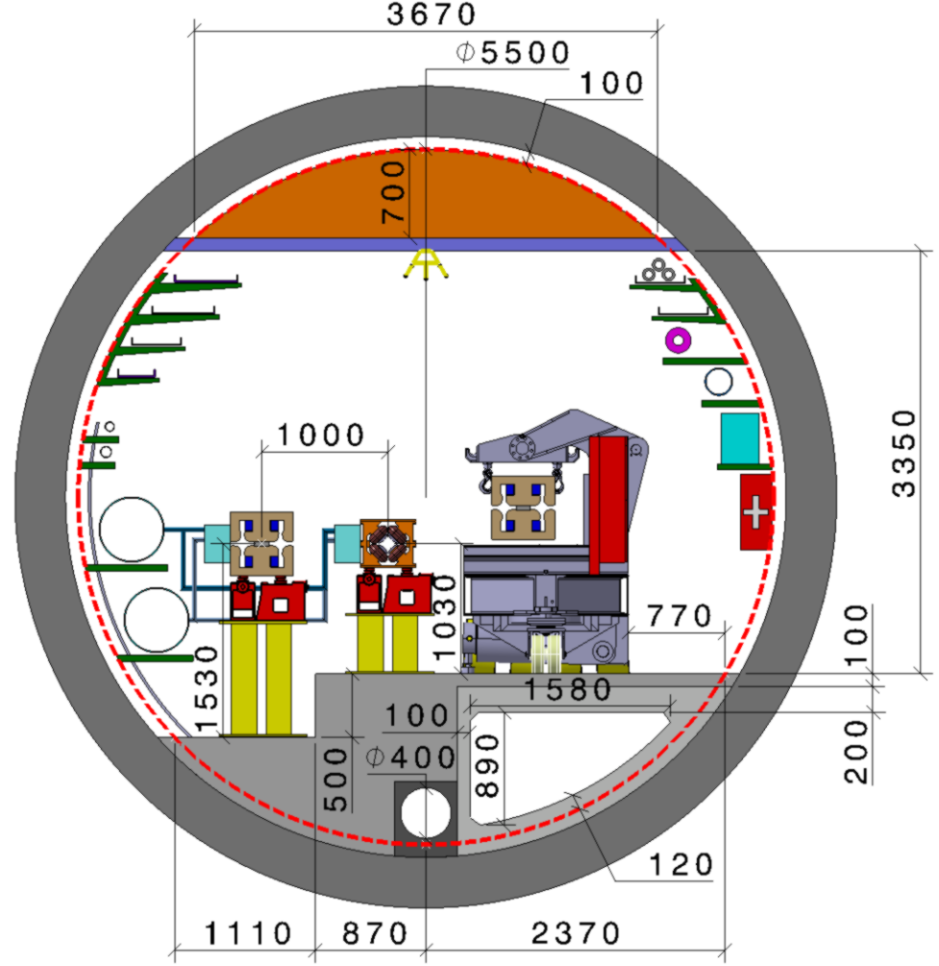
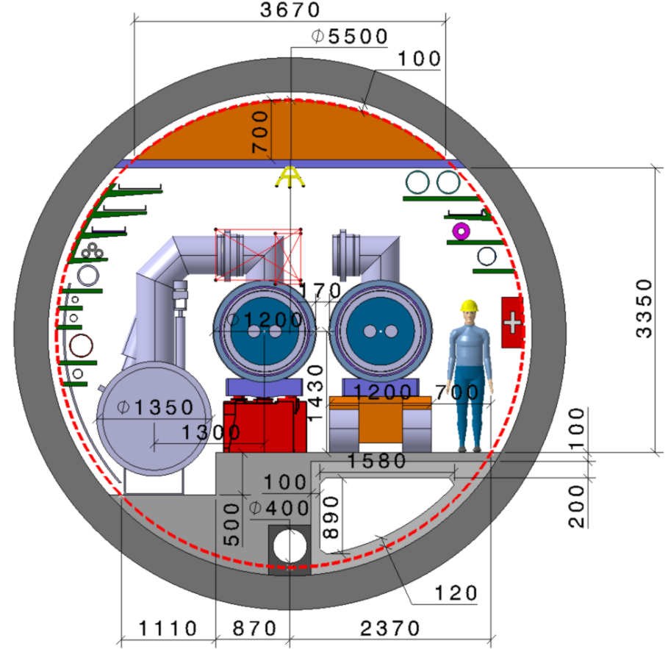
FCC-tunnel integration in arcs
  FCC-ee FCC-hh
  5.5 m inner diameter

Slide 26
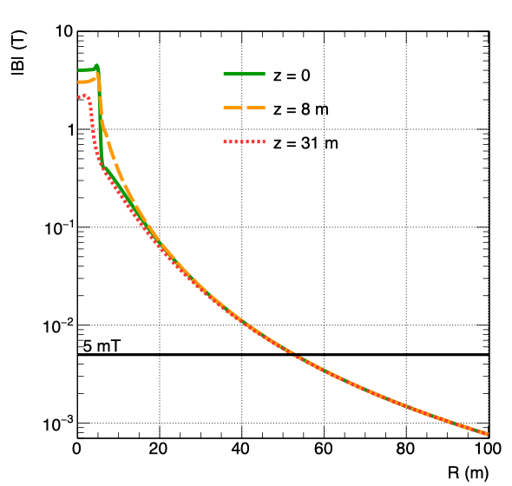
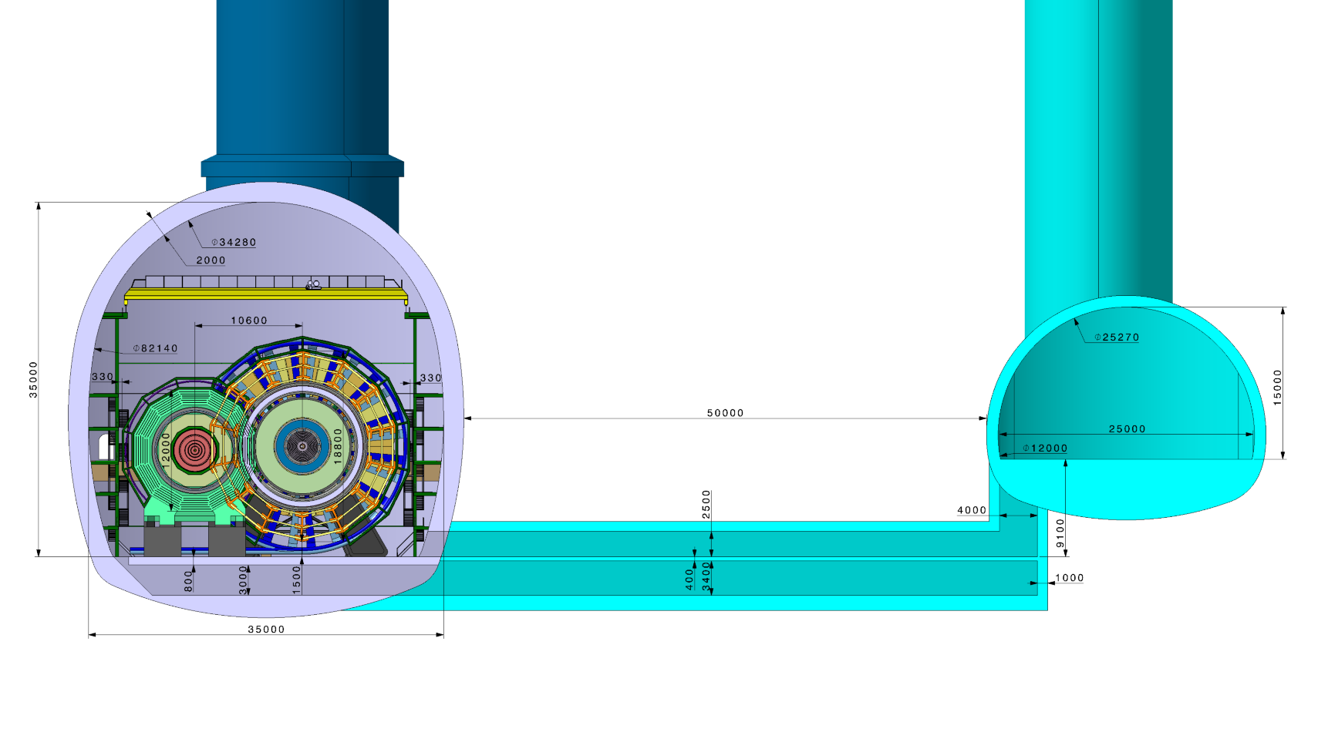
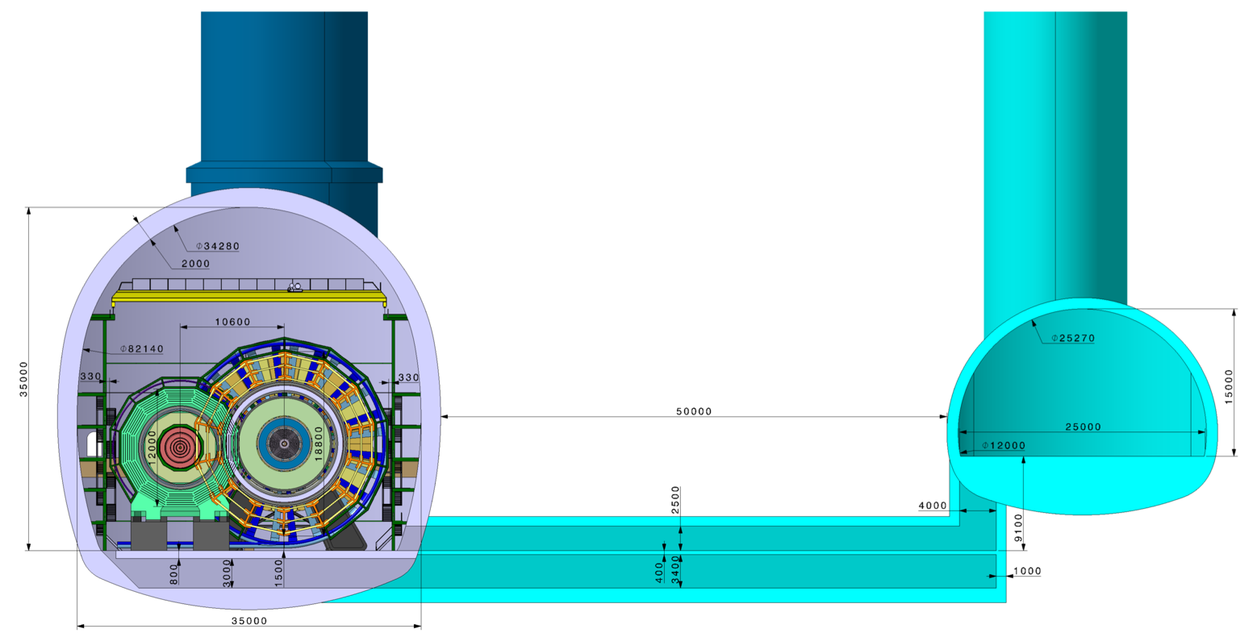
Common experimental points (A, G)
Distance between detector cavern and service cavern 50 m.
Strayfield of unshielded detector solenoid < 5mT.
FCC-ee
detector
FCC-hh
detector
Service cavern
Less than 5mT in the Service Cavern,
200-300mT outside the detector.
Preliminary design of access and cable paths

Slide 27
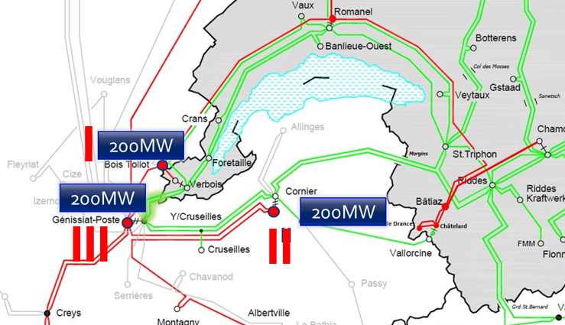
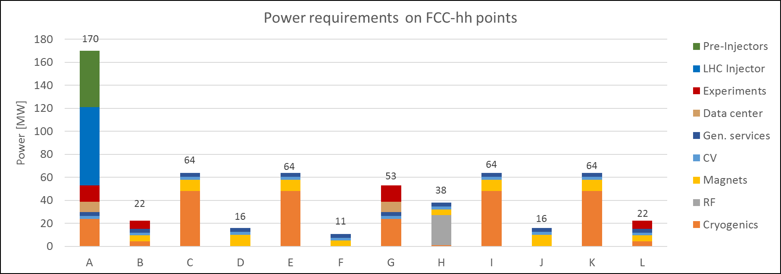
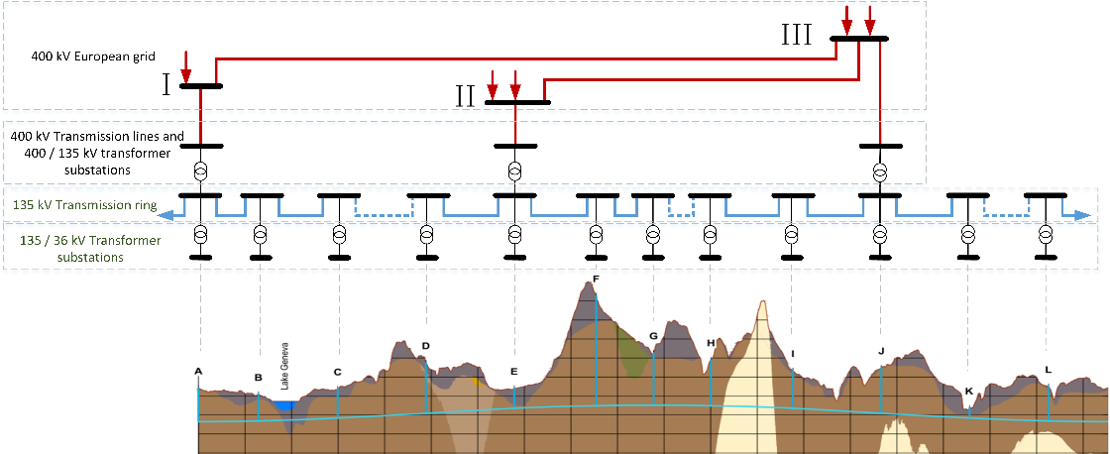
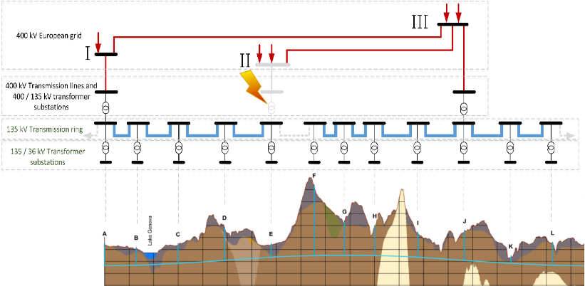
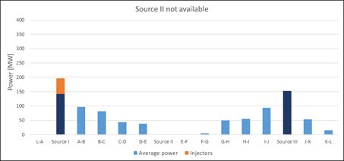
Electrical energy supply – French – European grid
Additional 200 MW available for FCC
at each of the three 400 kV sources.
Per-point power requirements as input for infrastructure-optimized conceptual design. (Peak FCC-ee 260 - 340 MW, total FCC-hh 550 MW)
---- 400 kV ---- 230 kV
Excellent location wrt electrical energy supply at node point of European Grid.
Supply redundancy from two separate 400 kV sources
3 x 400 kV connections
+ 135 kV underground power distribution (NC)

Slide 28
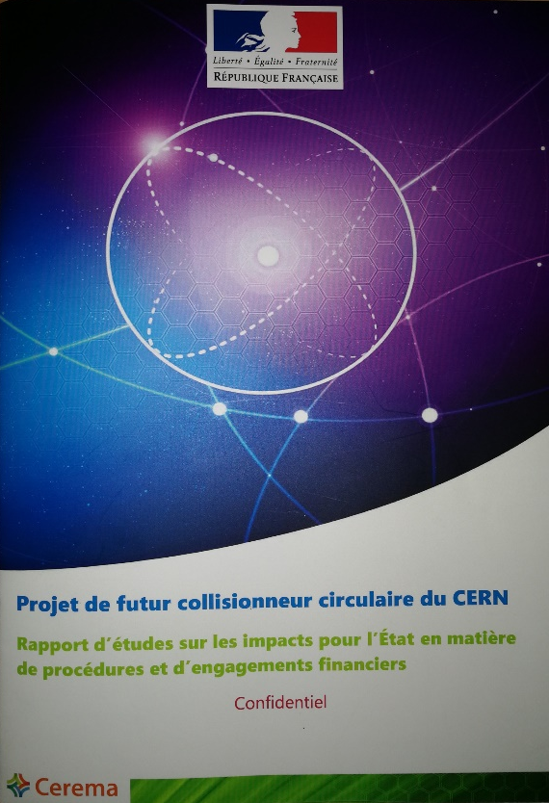


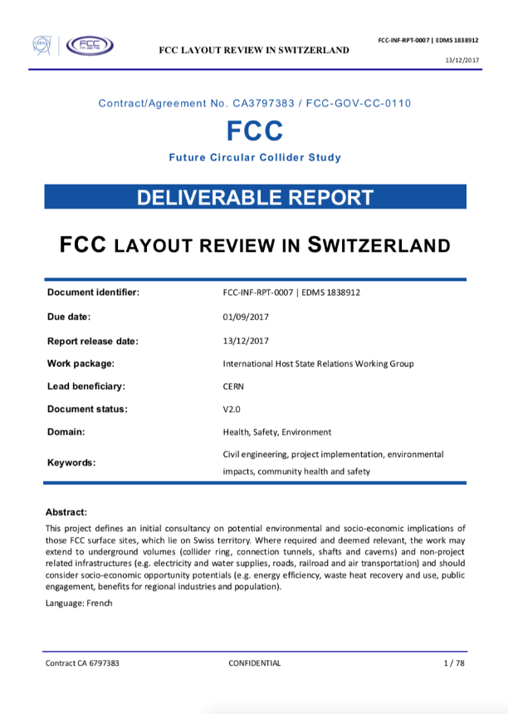
FCC work with Host States
General secretariat of the region Auvergne-Rhône-Alpes and notified body “Centre d'études et d'expertise sur les risques, l'environnement, la mobilité et l'aménagement” CEREMA
Working group with representatives of federation, canton and state of Geneva and representation of Switzerland at the international organisations and consultancy companies
Administrative processes for project preparatory phase developed.
First review of tunnel placement performed.
Requirements for urbanistic, environmental, economic impact, land acquisition and construction permit related processes defined.
For 2019-20, common optimization of collider tunnel and surface site infrastructure implementation.

Slide 29

EU H2020 Design Study EuroCirCol
European Union Horizon 2020 program
3 MEURO co-funding
Started June 2015, ends in May 2019
15 European beneficiaries & KEK & associated FNAL, BNL, LBL, NHFML
Scope:
FCC-hh collider key work packages
Optics Design Cryogenic beam vacuum system design including beam tests at ANKA
16 T dipole design, construction folder demonstrator (US MDP)
Notes:
New slide from Davide.
Showing that conductor development is launched at international level, Russia, Japan, (Korea and Europe in preparation)
Underline importance of that development as main cost driver for the hadron collider machine.

Slide 30

EASITrain Marie Curie Training Network
European Advanced Superconductivity Innovation and Training Network
selected for funding by EC in May 2017, started 1 October 2017
SC wires at low temperatures for magnets (Nb₃Sn, MgB₂, HTS)
Superconducting thin films for RF and beam screen (Nb₃Sn, Tl)
Electrohydraulic forming for RF structures
Optimisation cryogenic infrastructure systems (CEA Grenoble)
Magnet cooling architectures
Horizon 2020 program
Funding for 15 Early Stage Researchers over 3 years & training
13 Beneficiaries
I-CUBE
12 Partners

