Slide 1
CERN Conductor R&D
Amalia Ballarino, CERN
International HFM Meeting 2019
Washington, 4-5 December 2019
A. Ballarino, M. Benedikt, L. Bottura, A. Devred, D. Tommasini

Slide 2
CERN Conductor R&D Program
Nb₃Sn
HTS
Other Superconductors
A. Ballarino

Slide 3
Nb₃Sn
A. Ballarino

Slide 4
CERN Conductor Development Program – Nb₃Sn
Scope: develop, qualify and procure superconductors with performance meeting requirements of the CERN - magnet - programs
Present reference performance: conductor for 11 T - 12 T magnets (HL-LHC conductor) →
Explore and qualify different wire layouts; ensure availability and continuity of industrial production; sustain requirements of the CERN magnet development program via dedicated studies and conductor procurement
Final target performance: conductor for 16 T magnets (FCC conductor) → Explore, via R&D, possibilities for achieving the FCC conductor challenging targets; bring wire R&D to a level of development that enables starting technological optimization of Rutherford cables. Qualify Rutherford cables first in conductors’ test stations and then in short model coil dedicated programs
A. Ballarino

Slide 5
CERN Conductor Development Program – Nb₃Sn
Timeline: 2017 – 2024
Present reference performance: conductor for 11 T - 12 T magnets (HL-LHC conductor)
Final performance: conductor for 16 T magnets (FCC conductor)
Series HL-LHC
HL-LHC Performance
2020
Qualified long lengths of industrial wire
Lower cost
Long lengths
FCC R&D
2017
Dec 2021
Dec 2024
R&D Implemented in industrial processes
A. Ballarino
Notes:
Focus of FCC program on Nb₃Sn - need to provide input to the physics community in a relatively short time (when series procurement of HL-LHC conductor started)

Slide 6
CERN Conductor Development Program – Nb₃Sn
Conductor procurement: 2017 – 2024
∼ 1.4 tons (Φ = 1.1 mm, 1 mm, 0.7 mm) of HL-LHC wire procured in 2019
500 kg per year as from 2020 (∼ 2.5 tons total) of the most promising wires developed in the framework of the program
R&D Wire (20 km – 50 km per R&D contract)
A. Ballarino

Slide 7
CERN Conductor Development Program – Nb₃Sn
Program implementation
Started in 2017 - collaboration agreements initiated in 2017 and 2018
Launched an international effort aiming at providing feedback on the possibility of reaching beyond state-of-the-art HL-LHC Nb₃Sn high-field performance (Jc @ 16 T). Defined an intermediate milestone: achievement of HL-LHC performance;
Fostered Nb₃Sn conductor development in industry. Investigated potentials and interest of future suppliers;
Promoted advanced activities (material science, studies and characterization) in laboratories and institutes world-wide
A. Ballarino

Slide 8


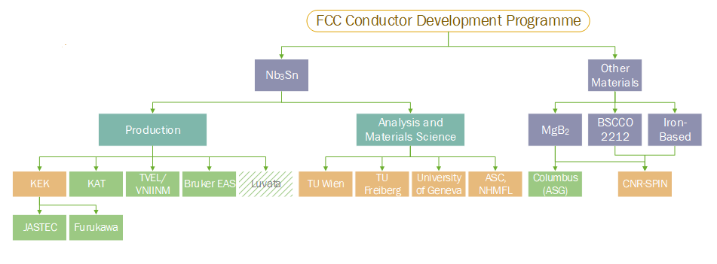
CERN Conductor Development Program
Japan
Korea
Russia
Europe
USA
Europe
Europe
Switzerland
USA
Europe
Europe
Fermilab
INFN
Participants: industry, supported by national laboratories, laboratories, institutes and universities worldwide
A. Ballarino

Slide 9
Nb₃Sn wires – Targets
FCC
HL-LHC
*
Production of about 20 km of wire by each of the industrial partners
*Processes shall enable scalability and show potentials for low cost large scale production
A. Ballarino

Slide 10
To-date results from industrial partners
A. Ballarino

Slide 11
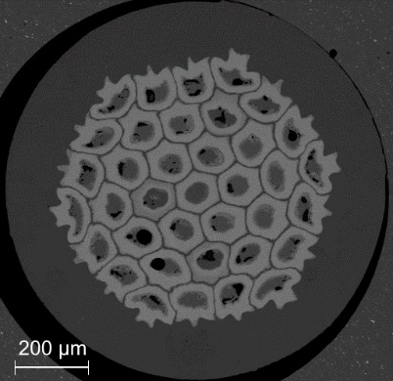

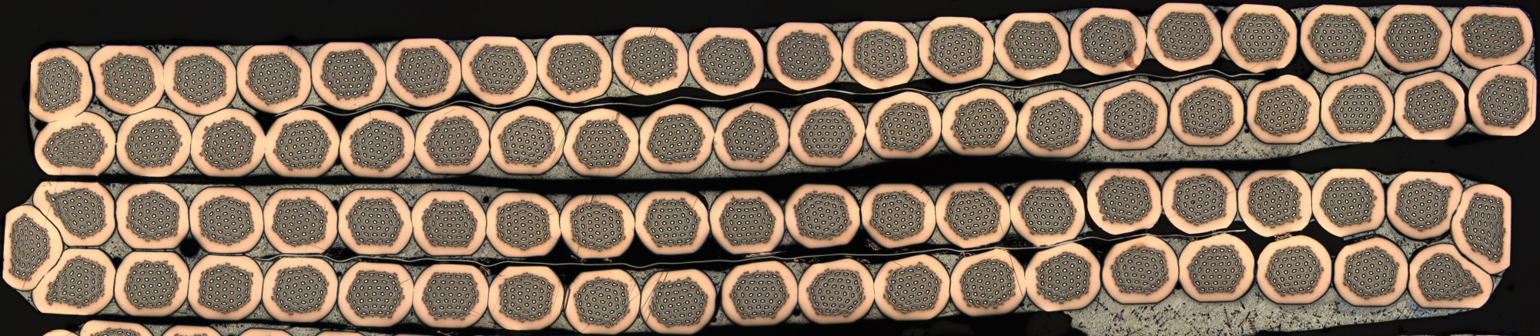
Nb₃Sn development in Russia - Achievements
Distributed barrier wire developed during a 2-year programme with TVEL
12 km of 1 mm diameter wire supplied, with > 1 km average piece length
  Non-Cu J_{c} > 1100 A/mm² (16 T, 4.2 K)
New wire design under development in a further 2-year programme
Wire cabled at CERN (trial Rutherford cable, 50 m long, 40-strand). Wire from two billets
RRR > 180, Ic degradation < 2 %
TVEL Wire - Φ = 1 mm
Rutherford cable – 40 strands
A. Ballarino

Slide 12
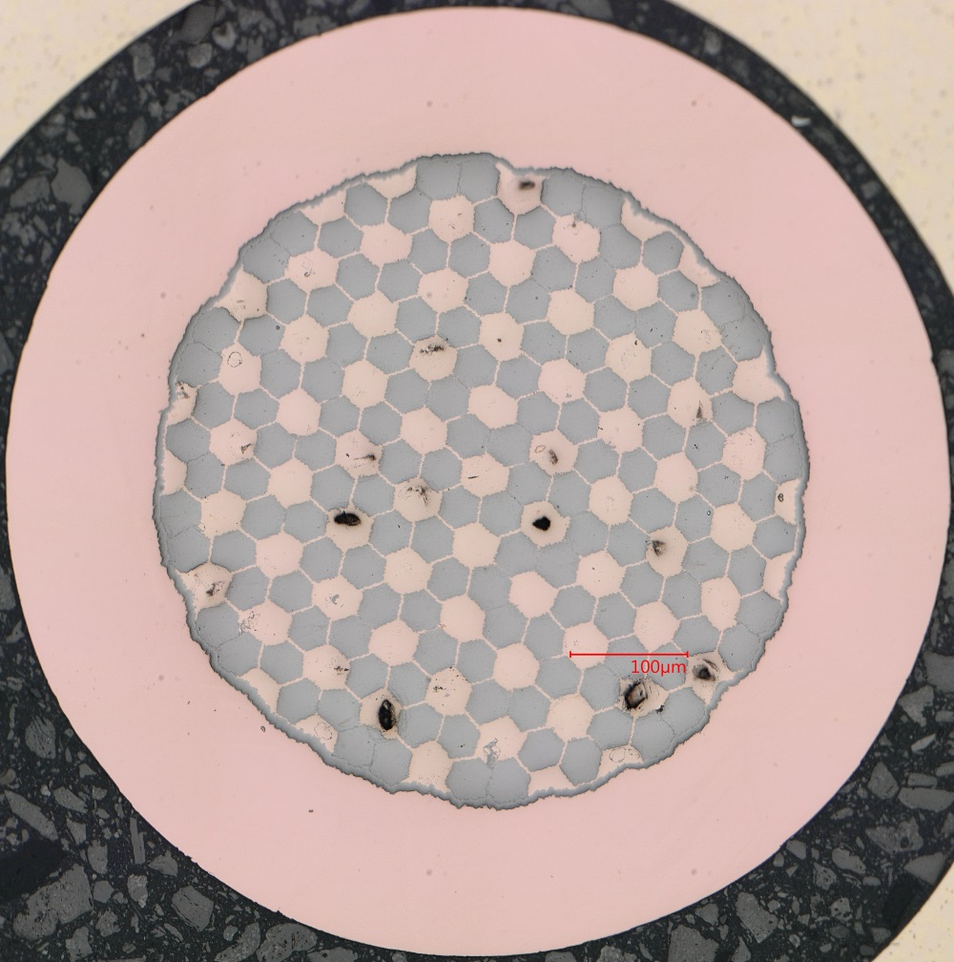
Nb₃Sn development in Japan - Achievements
Joint CERN-KEK programme developing:
  Distributed tin wires with JASTEC
  Tube type wires with Furukawa
JASTEC: achieved Non-Cu Jc of 1000–1100 A/mm² in piece lengths > 100 m with a final d_{eff} of ∼ 55 μm (reduction of d_{eff} from 267 µm, in 2018, to 65 µm)
  Rolling tests to assess suitability for cabling:
    RRR > 150, no I_{c} degradation after 15% rolling →
    Wire suitable for cabling
0.8 mm
Wire round and 15 % rolled
Wire from Jastec
A. Ballarino

Slide 13

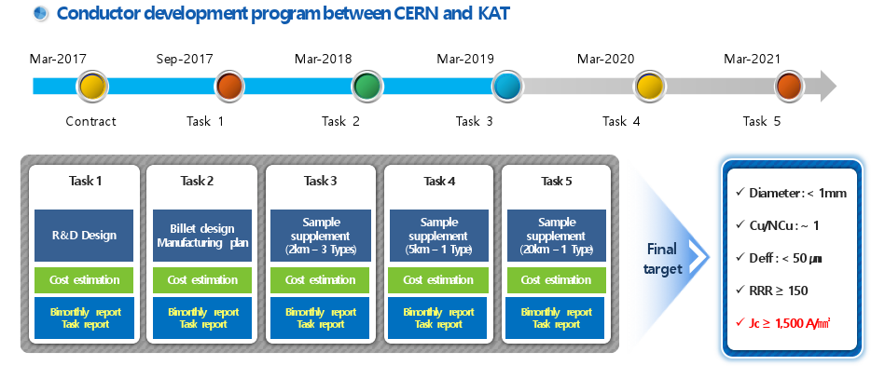
Nb₃Sn development in Korea - Achievements
J. Kim, FCC Week 2019

Slide 14

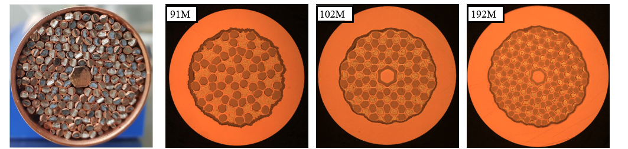
Nb₃Sn development in Korea - Achievements
Four-year programme started with KAT in 2017
Developing common barrier wires
with distributed Sn-Ti
  Achieved Non-Cu J_{c} ∼ 1000 A/mm² (16 T, 4.2 K)
  for first trials tested
  6 km of latest trial wire (192 M) recently supplied (unit lengths from 100 m to 750 m)
Optical micrograph of 1mm diameter KAT wire from 6 km delivery
KAT, wire design evolution
A. Ballarino

Slide 15
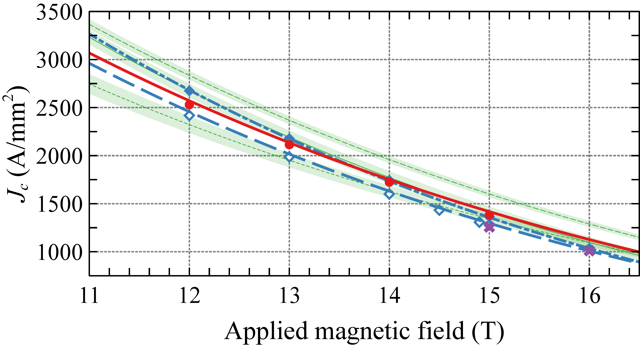
Nb₃Sn Wire Industrial Development - Summary
S. Hopkins
A. Ballarino

Slide 16
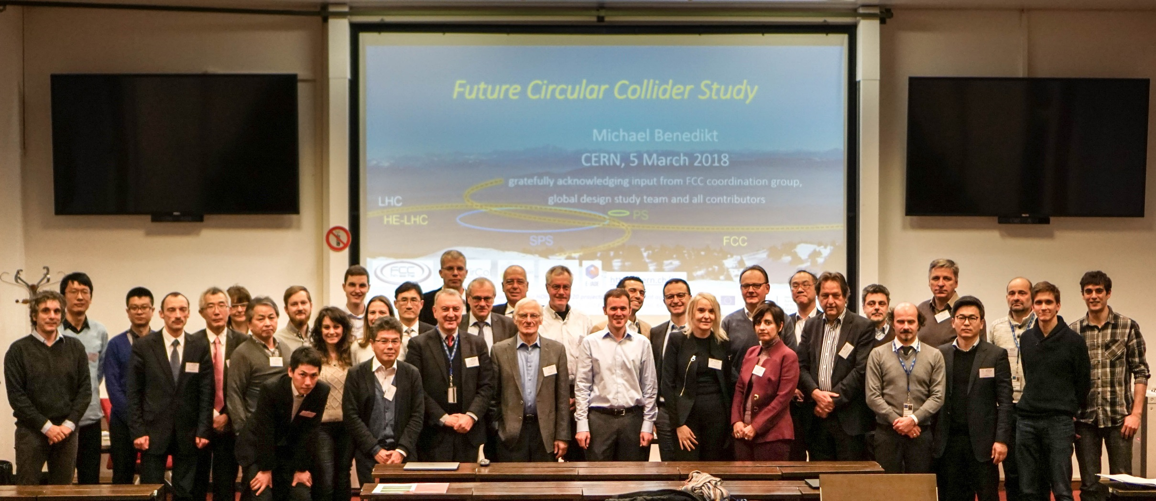
FCC Conductor Workshop – 5-6 March 2018, CERN
7 companies, two universities and two national research institutes
A. Ballarino

Slide 17
FCC Conductor Workshop – 5-6 March 2018, CERN
“After a short project time, industrial Nb₃Sn wires with J_{c} values between 850 and 1’100 A/mm² at 4.2K/16T have been reached, i.e. approaching the level specified for HL-LHC”
“It is recommended that the short model coil programme should be extended to run in parallel with the period foreseen for the production of long model magnets, to allow the validation of results achieved by the conductor development programme”
“The cost target is ambitious: from the present review it seems difficult, but realistic, as was considered by more than one participant in a reasonable timescale”
A. Ballarino

Slide 18
FCC Conductor Workshop – 5-6 March 2018, CERN
“The project is structured logically, with a staged approach and clearly defined intermediate steps (J_{c}, RRR, D_{eff}, robustness and cost). We support a procurement of wires satisfying HL-LHC performance for use as well for cable qualification as in magnet R&D, also to demonstrate a solid interest in the result”
“Wire diameter and effective filament diameter specifications have been defined in combination with magnet design. It is acceptable to retain 60 microns as an intermediate specification, but it is urgent to conduct a study to define requirements. An integrated conductor programme considering cabling degradation, stability and margin issues should be established”
“The panel supports to test the Internal Oxidation approach and to consider processes compatible with this technique”
A. Ballarino

Slide 19
Beyond state-of-the -art performance
A. Ballarino

Slide 20
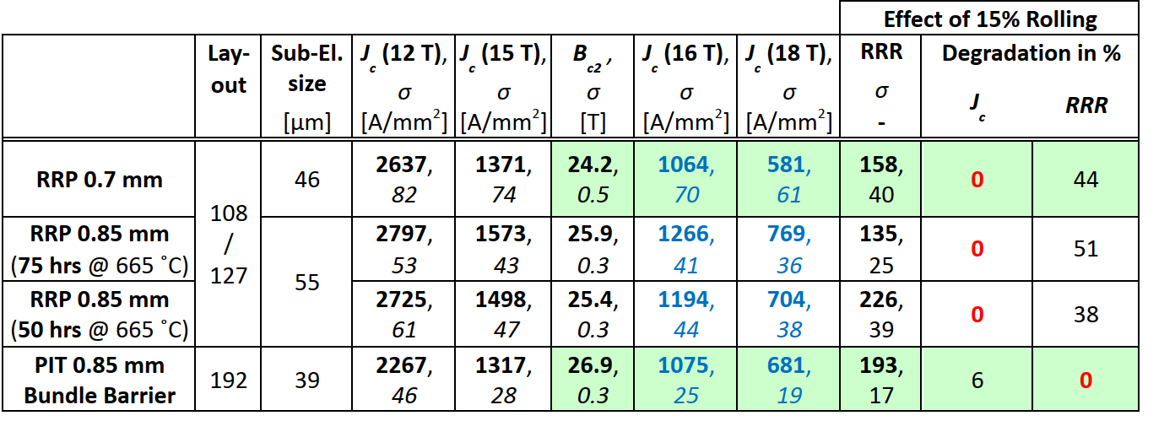
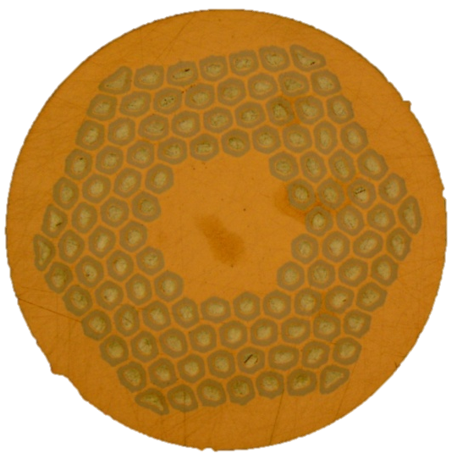
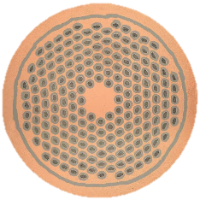

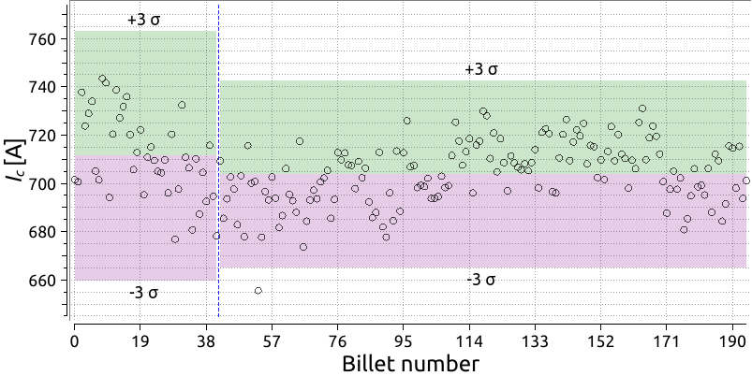
HL-LHC
Total procurement ∼ 30 tons
B. Bordini
RRP 108/127
PIT 192 Bundle Barrier
B. Bordini
L. Cooley
Ispec= 632 A (12 T)
Ispec= 632 A (12 T)
A. Ballarino

Slide 21
FCC Jc Target
FCC Jc target vs HL-LHC performance
Needed: 7000 tons - 9000 tons superconductors
A. Ballarino

Slide 22
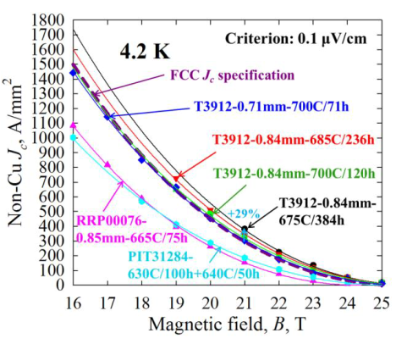
Internal Oxidation Process at Fermilab
Record Jc in multi-filamentary ternary APC wires: Jc (16 T, 4.2 K) > 1500 A/mm²
X. Xu et al, arXiv:1903.08121, 2019
FCC Target
Internal Oxidation
Multi-filamentary wires
Nb-1wt%Zr -7.5 wt% Ta
HL-LHC
Birr = 27 T
Bc2 = 27.8 T
Fermilab, Hypertech, Ohio State University
A. Ballarino

Slide 23
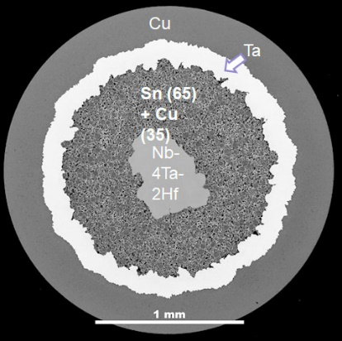
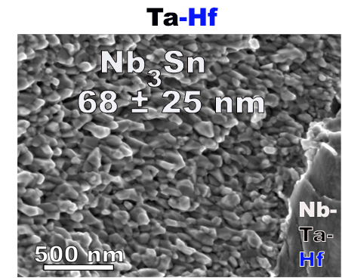
Nb-Ta-Hf at Florida State University
5.8 T
Balachandran et al., FCC Week 2019
Ta-Hf at FSU
Mono-filamentary wires
Ta-Hf at Hypertech
Multi-filamentary wires
S. Balachandran et al., Supercond. Sci. Technol. 32 (2019) 044006
A. Ballarino
Notes:
Here we show that addition of Hf to Nb4Ta can significantly improve the high field performance

Slide 24

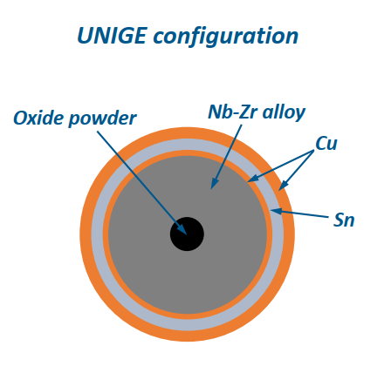
Internal Oxidation at University of Geneva
2019 Data
CERN-UNIGE Collaboration Agreement
A. Ballarino

Slide 25
Beyond state-of-the-art performance
Collaboration Agreement with Florida State University
Meeting organized by KEK, in Japan, in spring 2019 (KEK, CERN, ASC)
Jastec and Furukawa studying implementation of Nb-Ta-Hf in industrial R&D billets (as part of the on-going FCC collaboration agreement)
Collaboration Agreement with Fermilab – to be finalized in early 2020
R&D on APC billets produced with the internal oxidation process, study of process industrialization, electro-mechanical studies and characterization of APC wires
Collaboration Agreement with the University of Geneva – CHART 2 (with contribution from Suisse National Foundation for Science)
    Production of R&D billets (monocore and multi-filamentary) with the internal oxidation process
    Collaboration Agreement with Bruker
        Internal oxidation process in PIT conductor
A. Ballarino

Slide 26
Challenges to be addressed
Mechanical properties
  Optimization of wire layout
  Optimization of cable layout/impregnation
  Stability
    Wire
    Cable
    Field quality
      Wire’s filaments size
    Qualification in high-current and high-field test stations
      Wire
      Cable
A. Ballarino

Slide 27
High-field test stations
CERN, Superconductors Laboratory
  15 T and 16 T solenoids for wires/tapes’s characterization (1.9 K and 4.5 K);
  Fresca (9.6 T, 50 kA, 1.9 K and 4.5 K) and Fresca 2 as from 2021 (13 T, 50 kA, 1.9 K, 4.5 K and Tvariable) for LTS and HTS cables’ characterization
  University of Geneva
  21 T, Tvariable, 2 kA
  University of Twente
    15 T, 2 kA for wires’s characterization (4.5 K)
    11 T, 50 kA, 4.5 K for cables’ characterization (electro-magnetic press)
    LNCMI, Grenoble
    10 T, 3 kA (Φ = 298 mm), 4.5 K and Tvariable
    20 T, 1.5 kA (Φ = 128 mm), 4.5 K and Tvariable
    30 T, 1.5 kA (Φ = 38 mm), 4.5 K and T variable
A. Ballarino

Slide 28
HTS
A. Ballarino

Slide 29
REBCO
Very high in-field electric performance (Je(4.2 K, 20 T) > 1000 A/mm²)
We do not need more Jc !
Questions to be addressed for use in accelerator magnets:
  Use of large tapes in accelerator magnets;
  Development of cables for accelerator magnets (stacks, CORC, Roebel,…);
  Quench detection and quench protection aspects (in tapes, cables and coils);
  Technological aspects, e.g. impregnation and electrical joints
  Questions to be addressed at the level of tape production:
    Achievement of controlled, homogeneous and reproducible electro-mechanical properties along the full length, e.g. internal resistance and copper stabilizer electrical resistivity. Needed feedback to tape manufacturer
  Feasibility of long lengths and cost reduction
A. Ballarino

Slide 30
EuCARD2/ARIES have triggered a international collaboration also beyond EU laboratories
L. Rossi

Slide 31
REBCO
Develop technical specification for procurement of tape. Interface with tape manufacturers to understand potential difficulties and limitations
Qualify tapes from different manufacturers
Develop, study qualify cable layouts suitable for accelerator magnets. CERN experience: stacks of tapes (developed dedicated cabling machine), round cables (CORC type), and Robel cables (produced at KIT and characterized at CERN)
Develop and qualify cables for demonstration coils (undulators, wigglers, high-field magnets)
A. Ballarino

Slide 32
Other materials
A. Ballarino

Slide 33
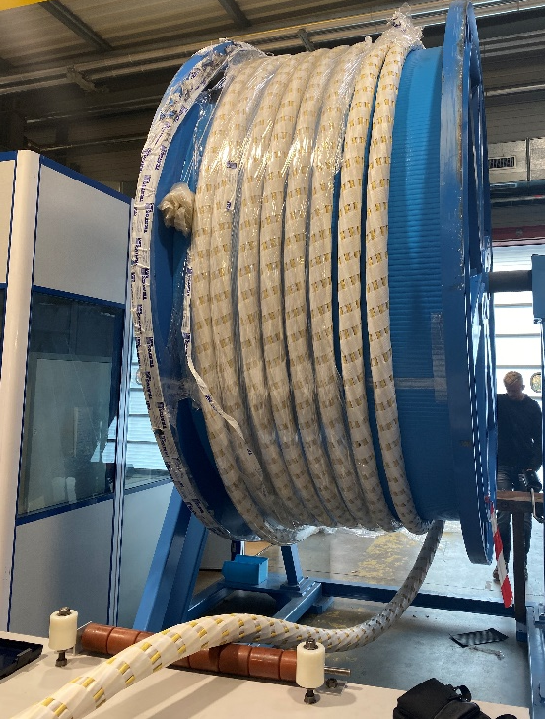
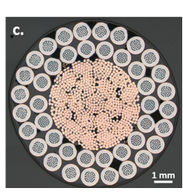
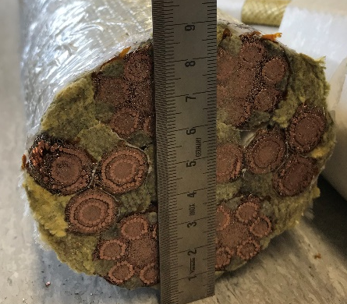
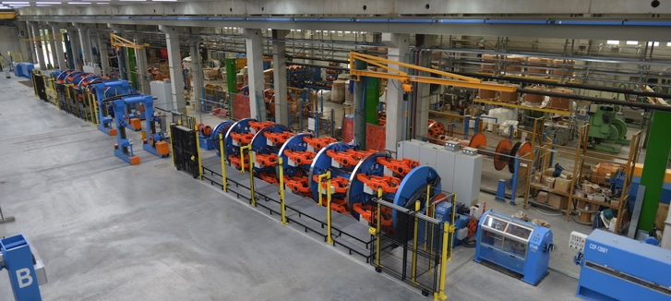
MgB₂ for Power Transmission Lines
120 kA @ 25 K
18 kA @ 25 K
7 kA
@ 25 K
120 kA @ 25 K
Received 480 km of wire (ULs up to ∼ 3 km)
Additional 650 km for HL-LHC series production
Low-field applications (developed wire with ASG)
Medium-field applications (Collaboration Agreement with SPIN and ASG)
A. Ballarino

Slide 34
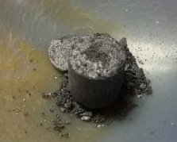
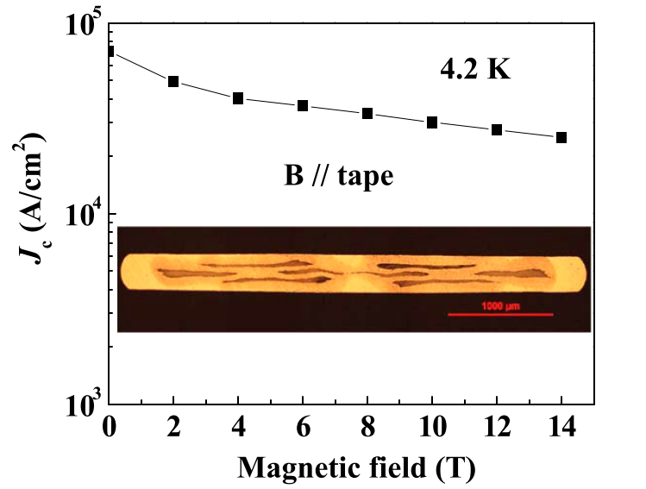

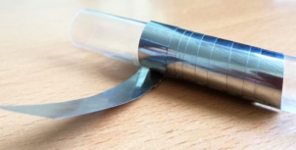
Iron Based Superconductors
SPPC: 100 km circumference, 12 T
Baseline: iron based Superconductor
Collaboration Agreement with SPIN
Conceptual design with expected J_{e} of IBS in 2025
Target Jc: ∼ 1000 A/mm² (16 T, 4.2 K)
Strand | diam. | cu/sc | RRR | Tref | Bref | Jc@ BrTr | dJc/dB
IBS | 0.802 | 1 | 200 | 4.2 | 12 | 3800 | 111
BaFe₂As₂ (122) PIT
Y. Ma, D. Wang et al
Focus on powder synthesis
122 Pellet
FeSe_{x}Te_{1-x} (11) Coated Conductor
Focus on substrates development
Invar 36 substrate
A. Ballarino

Slide 35
Conclusions
Focus of the CERN conductor development program is on Nb₃Sn. Program, targets and timeline are in line the with the magnet program. They will provide feedback to the HEP community on the feasibility of the FCC targets. To-date, effort, results and response from the world-wide community are extremely encouraging
HTS is explored via a small coils magnet program. Conductor study and development (REBCO tape and cables) are re-launched for better understanding potentials and limitations for future use in accelerator magnets
MgB₂ wire/cables for power transmission lines is now an established technology. This wire technology is applicable also to low-field magnets
Potentials of MgB₂ and iron-based superconductors for higher fields are investigated via dedicated R&D conductor programs
A. Ballarino

Slide 36
Thanks for your attention !

