Slide 1

CIEMAT perspectives
L. García-Tabarés, J. M. Pérez, F. Toral - CIEMAT
Washington, Dec 4th, 2020

Slide 2
Outline
Introduction
New magnet laboratory at CIEMAT
Plans for next years
Conclusions
2

Slide 3
Introduction
There is a strong commitment from the Spanish Ministry of Science and the Centre for Technological and Industrial development to foster the activities on high field magnets. They consider CIEMAT as the ideal research center to lead this effort.
An Agreeement has been signed to collaborate with CERN to this end.
Accelerator Technology Unit at CIEMAT is a small group but with a long tradition, started in 1989. Two main lines of activity:
  Collaboration with CERN projects.
  Development of small accelerators for medical applications.
About superconducting magnets, we have been moving forward assuming more difficult challenges at each stage:
  Last step was the nested orbit correctors for HL-LHC: our first collared magnet, our first coils with Rutherford cable.
  Next step is high field magnets based on Nb₃Sn coils.
We want to keep and enhance the capability to produce magnet prototypes in house.
3

Slide 4
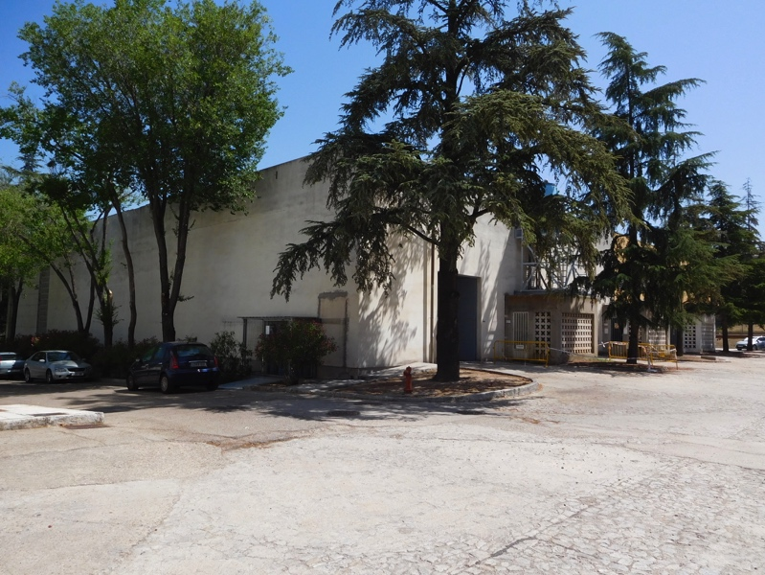
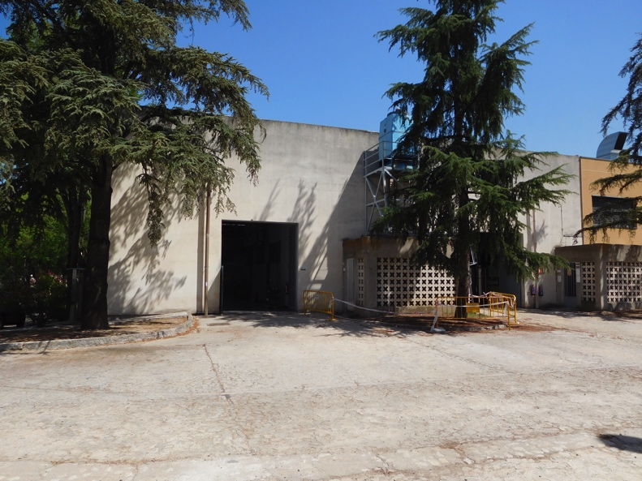
CIEMAT magnet laboratory
Building 31 has been assigned for the construction of the model magnet laboratory at CIEMAT.
The first project basic study has been completed. It is slow because of nuclear energy activities in the past.
Tendering for the execution of the detailed project study is ongoing.
Construction tender is foreseen in May 2020.
Construction work should start on February 2021 and end in October 2021.
No large magnet test facilities are foreseen.

Slide 5
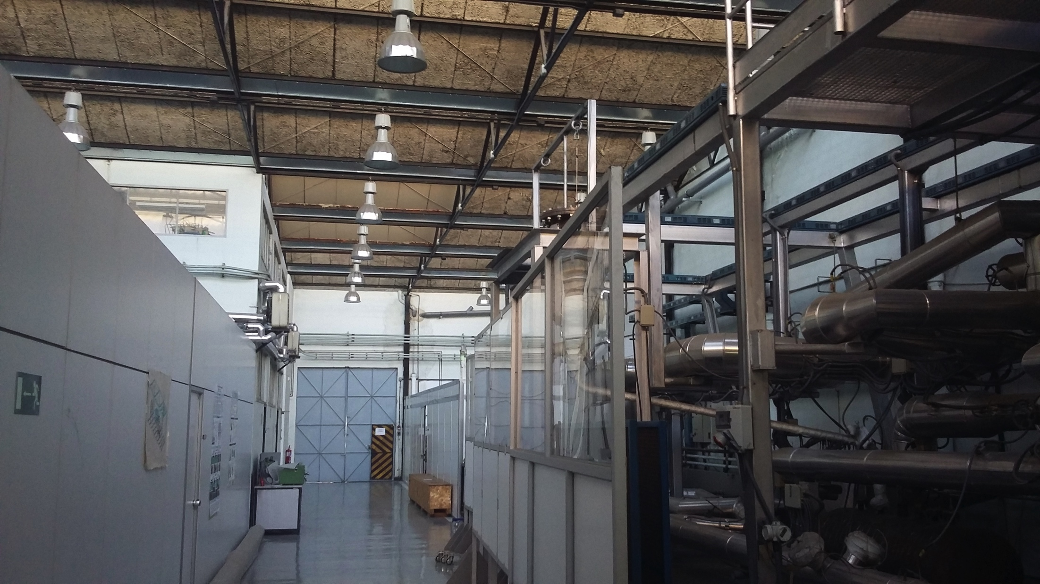
CIEMAT magnet laboratory

Slide 6
First step: learning on Nb₃Sn coils
Our first commitment is to develop a racetrack model magnet, known as RMM, in collaboration with CERN.
We will go to 927 laboratory at CERN to produce the coils, using existing tooling (Autumn 2020).
We will revisit the support structure to analyze if any modifications are necessary.
6

Slide 7
Second step: high field prototype magnet
CIEMAT has been working on the design of a 16 T common coil dipole magnet for FCC (EuroCirCol).
At this moment, it is worth to explore the advantages of a common coil magnet in the range of 12 to 14 Tesla.
It is not clear today when the reaction furnace will be operative at CIEMAT.
We will keep an eye on the optimization of fabrication techniques:
  Which resin?
  How to do an internal splice?
  Is it worth to explore react and wind techniques?
A prototype magnet about 1.5 m long will be built as deliverable.
No activities on HTS coils are foreseen by the time being.
7

Slide 8
Conclusions
CIEMAT supports the strategy of CERN for R&D on high field magnets, and its implications at European and World levels.
We want to be part of it.
We will contribute according to our resources and will be happy to provide inputs according to our scientific opinion and industrial aims.
8

