Slide 1
INFN perspectives in HFM developments
G. Bellomo, A. Bersani, B. Caiffi, P. Fabbricatore, S. Farinon,
F. Levi, S. Mariotto, R.Musenich, A. Pampaloni, M. Prioli,
M. Sorbi, M. Statera, A.Traverso, R. Valente

Slide 2
OUTLINE
INFN strategy
INFN activities on sc accelerator magnets
EuroCirCol activities and outcomes
Nb₃Sn R&D: the Falcon Dipole project
HTS R&D
Schedules and resources

Slide 3
OUTLINE
INFN strategy
INFN activities on sc accelerator magnets
EuroCirCol activities and outcomes
Nb₃Sn R&D: the Falcon Dipole project
HTS R&D
Schedules and resources

Slide 4
INFN position in framework of the European Strategy for Particle Physics
INFN thinks that the ESPP update should be based on significant jump in precision (e.g. in Higgs boson properties) and broad exploration (e.g. search of new physics at the energy frontier)
INFN believes that, out of the various proposed scenarios, the FCC-all option is the best one in this respect.
In particular the FCC-hh phase would guarantee in the best way direct broad exploration of new territories.
INFN believes that the ESPP conclusive document should include a strong statement in support of continuing the R&D of new technologies for accelerators. In particular, studies and experiments aimed at the development of a muon collider should be explicitly encouraged, as well as activities related to plasma-based accelerators and high-temperature superconducting magnets.

Slide 5
INFN strategy for future superconducting magnets
Following the guidelines of the general strategy, INFN is pursuing the objectives to :
Industrial development of Nb₃Sn magnets through the construction of a short model of a cos-theta dipole (FalconD project in the framework of a CERN-INFN specific agreement)
R&D on HTS magnets (studies and small models with INFN, regional and possibly EU funds)
Both activities are already started at Genova and Milano in parallel with the projects for High Luminosity.
HTS R&D is presently focused on sc CCT dipoles involving BiSCCO wires in cooperation with CNR-SPIN for low field applications (e.g. hadron therapy and to this aim MgB₂ is also studied). Other studies/models will starts in 2020 also involving ReBCO tapes or cables

Slide 6
OUTLINE
INFN strategy
INFN activities on sc accelerator magnets
EuroCirCol activities and outcomes
Nb₃Sn R&D: the Falcon Dipole project
HTS R&D
Schedules and resources

Slide 7
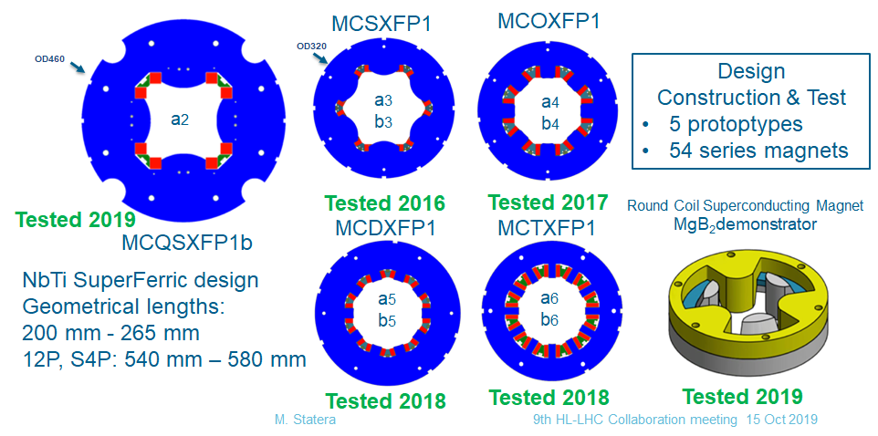
The INFN present projects in sc accelerator magnets (HL-LHC)
In the framework of the luminosity upgrade of LHC:
INFN-Milano (LASA) has developed and is now starting the series construction and cold test of the HO correctors
INFN Genova is developing with industry the separation/recombination dipole D2 (model, prototype and series)

Slide 8
OUTLINE
INFN strategy
INFN activities on sc accelerator magnets
EuroCirCol activities and outcomes
Nb₃Sn R&D: the Falcon Dipole project
HTS R&D
Schedules and resources

Slide 9
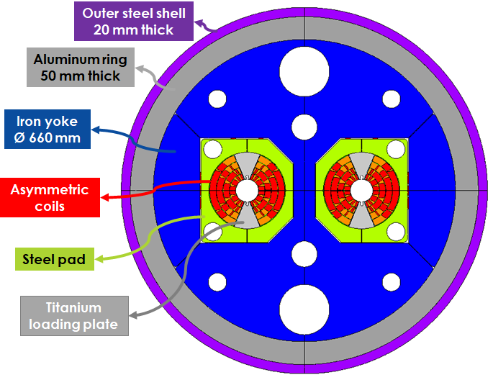
EuroCirCol
INFN developed a design of a 16T cos-theta twin dipole
Characteristics
Bore inner diameter | 50 mm
Beam distance | 250 mm
Material | Nb₃Sn
Bore nominal field | 16 T
Operating temperature | 1.9 K
Operating current | 11441 A
Operation on the load line | 86%
Strand number per cable | 22/38
Cu/Ncu | $$0.82/2.8$$
Field harmonics (geo/sat) | $≤$ 3/10 units
Yoke outer diameter | 660 mm

Slide 10
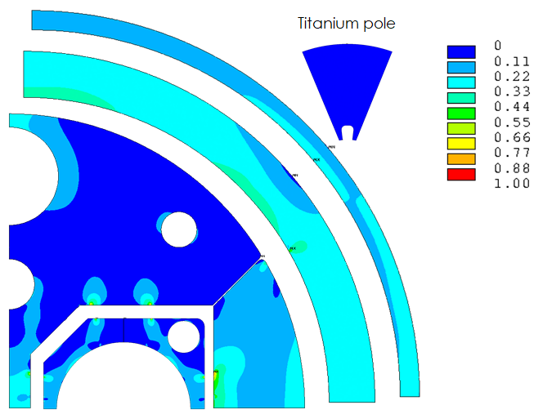
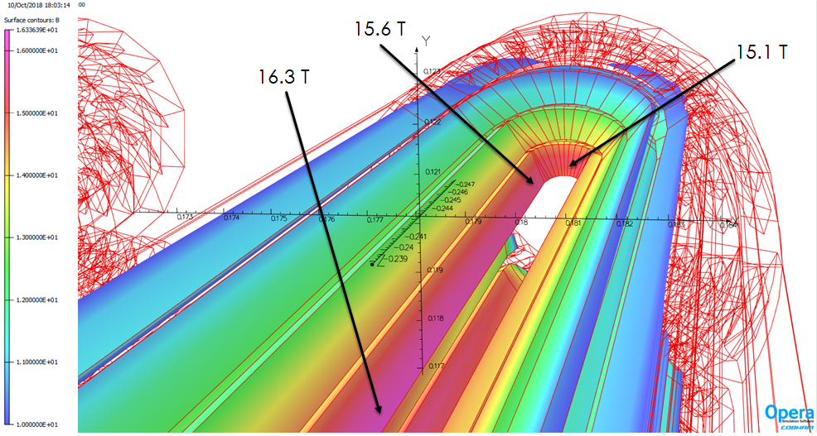
EuroCirCol
The design covered all main aspects: magnetic, mechanics, quench

Slide 11
OUTLINE
INFN strategy
INFN activities on sc accelerator magnets
EuroCirCol activities and outcomes
Nb₃Sn R&D: the Falcon Dipole project
HTS R&D
Schedules and resources

Slide 12
From EuroCirCol to short model development (FalconD project)
Development in four years of a significant model in collaboration with industry, simplifying as possible the structure
Basic choices: single aperture, comparable coil cross section with EuroCirCol design , length 1.5 m max
Magnetic field:
The minimum target is the first step beyond 11T (as this value is the consolidated state-of-art for accelerator dipoles): 12 T at 1.9K. This is also a reasonable target considering the limited experience of the team in Nb₃Sn technology and the involvement of the industry.
The ultimate field of about 14 T (short sample 15.8T)
Under these condition a two layers dipole is feasible
Start with existing wire (HL-LHC)
Plan the construction of a significant number of coils
Future Accelerator post-LHC
Cos-theta Optimised Nb₃Sn Dipole

Slide 13
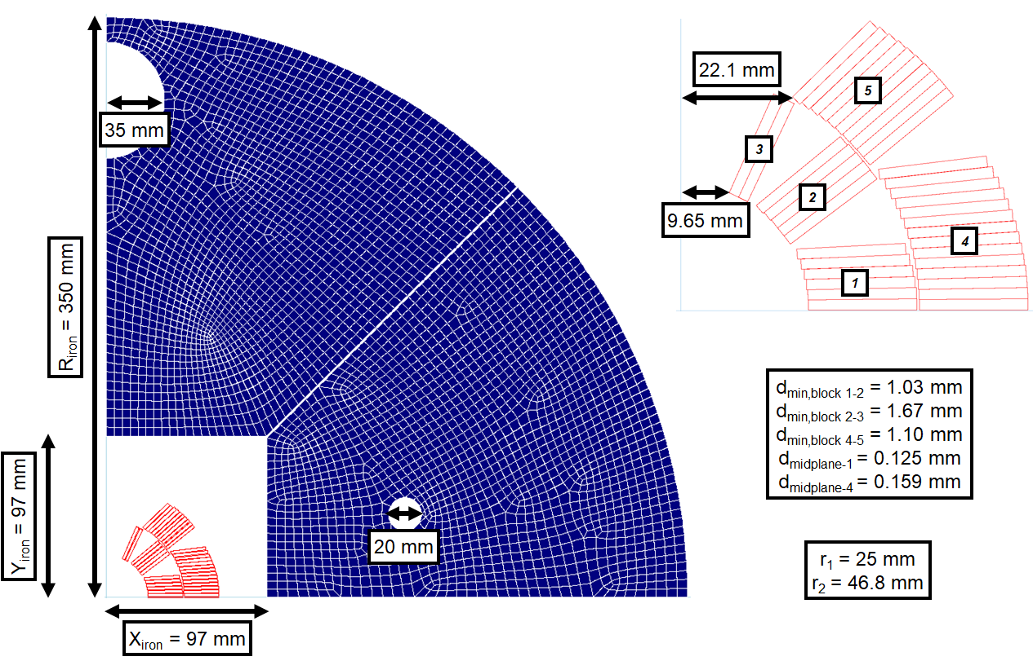
The magnet under design

Slide 14
The magnet under design:
Large margins at B=12T
Strand number | 40
Strand diameter [mm] | 1
Cable bare width [mm] | 21
Cable bare inner thickness [mm] | 1.72
Cable bare outer thickness [mm] | 1.90
Insulation [mm] | 0.15
Keystone angle | 0.5°
Cu/Ncu | 0.9
J_{c} (16 T, 4.2 K) [A/mm²] | 1200

Slide 15
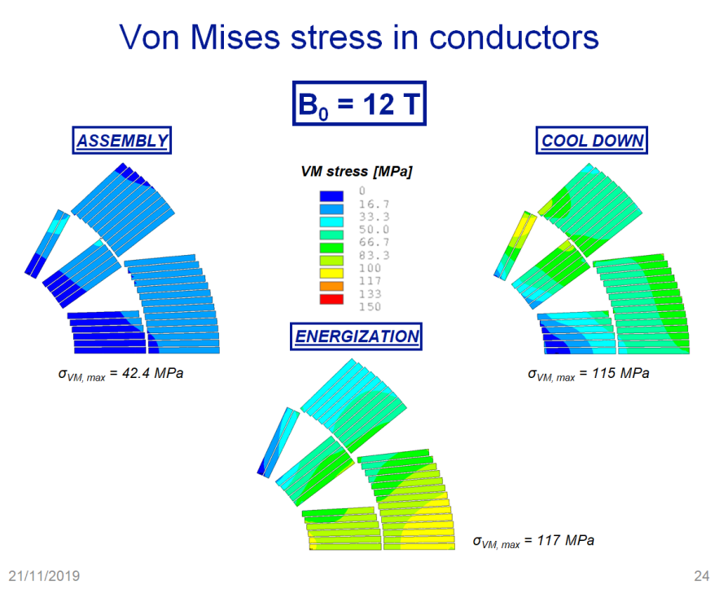
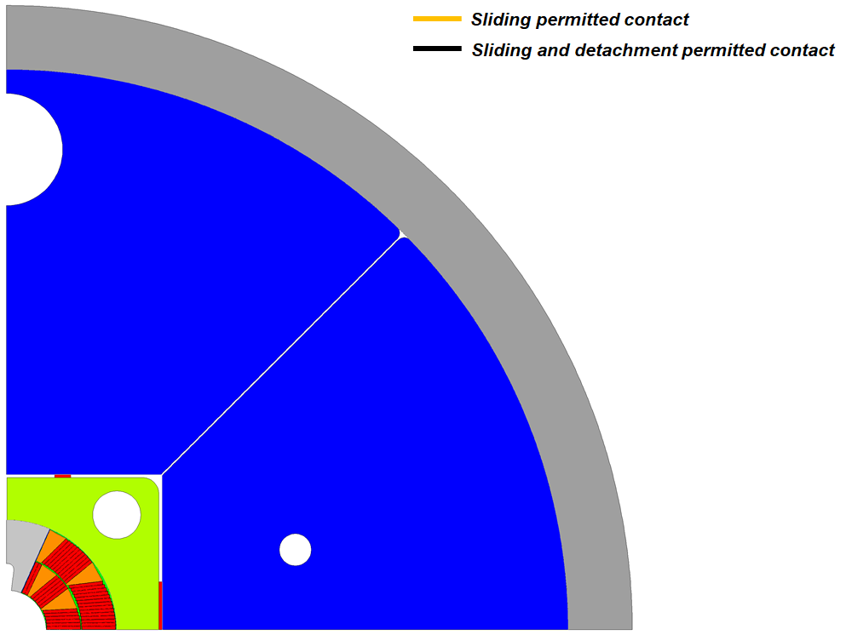
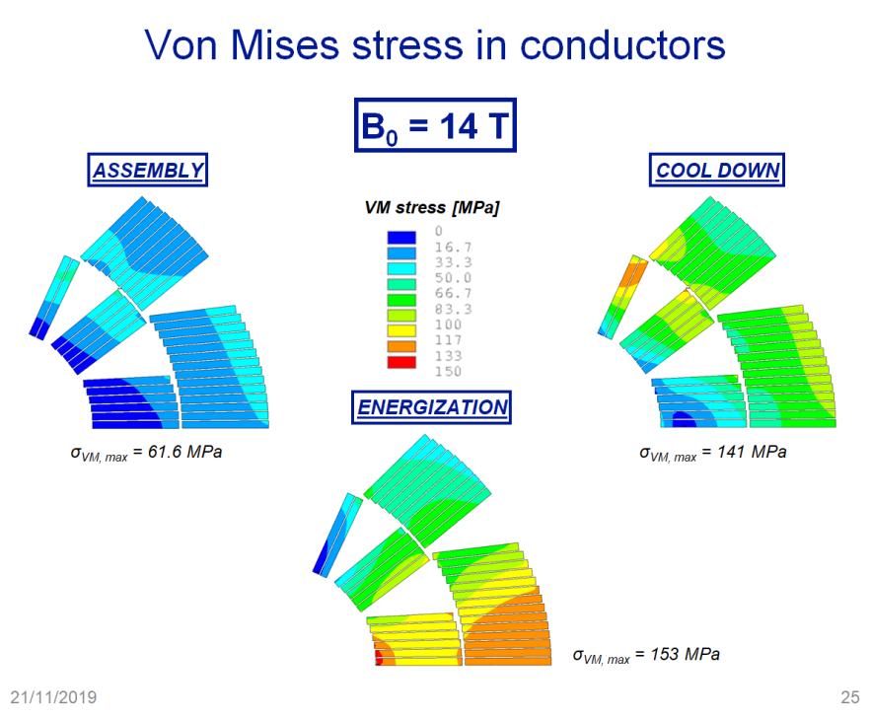
The magnet under design:
Mechanics
Also the mechanical analysis shows that the there are large margins at the minimum target of 12 T with possibilities to go up to 14T

Slide 16
OUTLINE
INFN strategy
INFN activities on sc accelerator magnets
EuroCirCol activities and outcomes
Nb₃Sn R&D: the Falcon Dipole project
HTS R&D
Schedules and resources

Slide 17
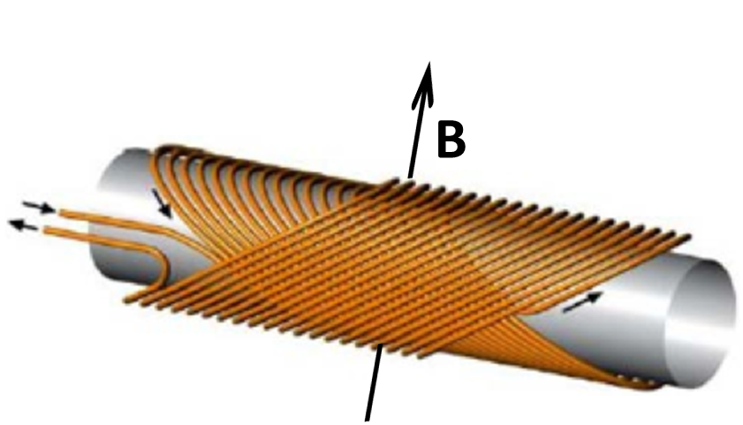
HTS R&D activities:
INFN internal R&D
INFN Genova
INFN Milano
CNR-SPIN Genova
Univ. Bologna
BISCOTTO
BiSCCO Cosine Theta Tilted Solenoids
Development of CCT in BiSCCO and MgB₂
Past experience with the construction and test of NbTi quadrupoles (50 Tm) for B-factory IR
Tilted Solenoid Dipole

Slide 18
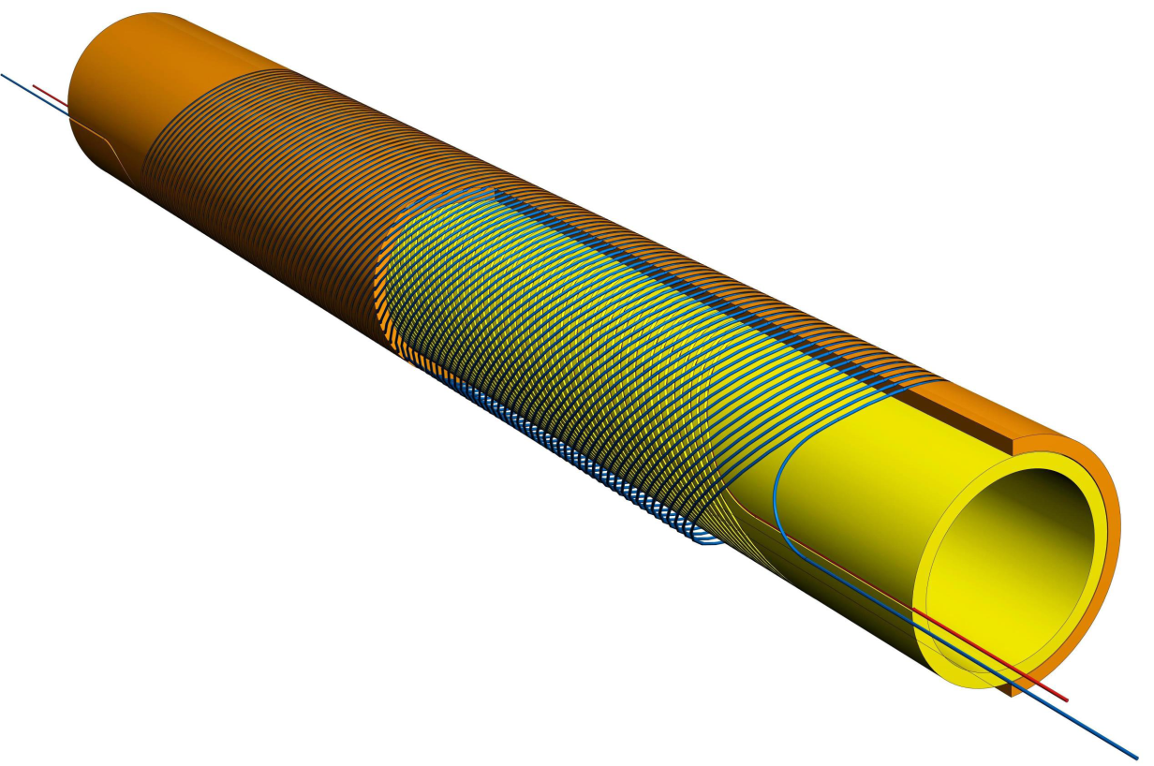
INFN design under coordination of R.Musenich
BiSCCO wire developed by CNR SPIN (A.Malagoli and A.Leveratto)
PhD A.Traverso (regional funds)
Test at LASA in a test facility for HTS magnets
BISCOTTO
Winding tests and 2-layer demonstrator ongoing

Slide 19
OUTLINE
INFN strategy
INFN activities on sc accelerator magnets
EuroCirCol activities and outcomes
Nb₃Sn R&D: the Falcon Dipole project
HTS R&D
Schedules and resources

Slide 20
Activities planned for next future and resource allocation
Scientists (15 FTE/year) Technicians (7 FTE/year)
2019 2020 2021 2022 2023 2024 2025 2026
}
HL-LHC*
70% Manpower
(average 2019-2022)
D2 prototype and series
HO correctors series
}
Nb3Sn *
20% Manpower
(average 2019-2022)
60% from 2023
FalconD
2nd model? **
}
HTS
10% Manpower
(average 2019-2022)
40% from 2023
HTS studies
Model developments**
* For HL-LHC and FalconD resources covered according CERN-INFN agreements ** Not funded yet

Slide 21
CONCLUSIONS
INFN is strongly committed to the developments of HFM for future hadronic colliders in the next years (5-7). Further developments will be depending on results and more updated perspectives
The most of efforts are devoted to the development of a 12T/14T Nb₃Sn magnet in collaboration with CERN and with involvement of industry
Smaller size (today) R&D activities started for CCT involving HTS

