Slide 1
Strategy and Plans: Magnet Technology PSI/CHART Perspective
B. Auchmann (CERN/PSI)
December 5, 2019, Washington DC, USA.
Work supported by the Swiss State Secretariat for Education, Research and Innovation SERI and the ETH Board.

Slide 2
Overview
CHART1 (2016-2019) Goals and Take-Aways
CHART2 (2019-2024) Goals and Proposals

Slide 3
Overview
CHART1 (2016-2019) Goals and Take-Aways
CHART2 (2019-2024) Goals and Proposals

Slide 4
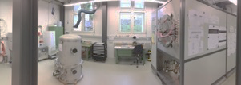
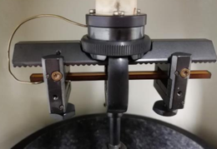
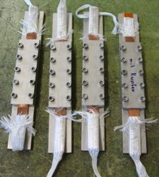
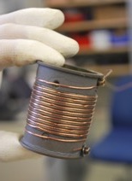
CHART1 (Swiss Accelerator Research and Technology, 2016-2019) – Magnet Activities
PSI
ETHZ
EPFL
UniGE

Slide 5
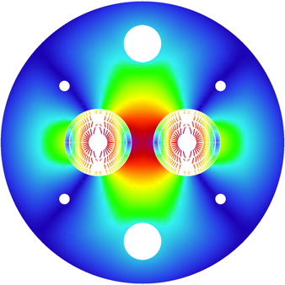
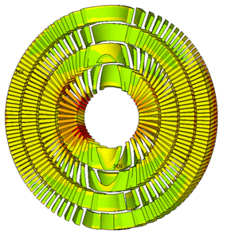
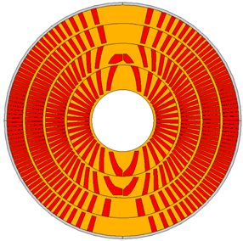
CHART1 Goals
CHART1 goals (mid-2016 to mid-2019) :
the design of an optimised 16 T Canted Cosine Theta (CCT) dipole magnet, as an option for the FCC hadron collider main magnet;
the development (design and prototype) of a high-field dipole magnet with CCT technology; and
the development of reaction-resistant splicing techniques for Nb₃Sn magnets for FCC.
[B. Auchmann et al., Electromechanical Design of a 16-T CCT Twin-Aperture Dipole for FCC, IEEE Trans. on Appl. SC 28 (April, 2018) no. 3.]

Slide 6
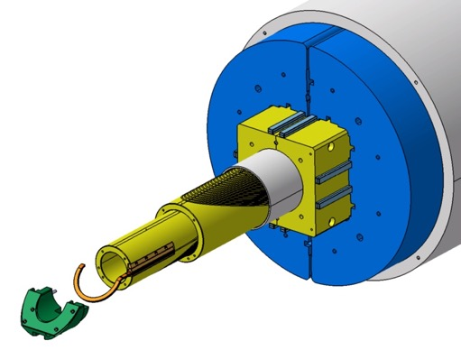
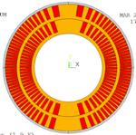
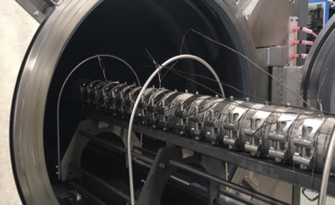
CHART1 Goals
CHART1 (mid-2016 to mid-2019) goals:
the design of an optimised 16 T Canted Cosine Theta (CCT) dipole magnet, as an option for the FCC hadron collider main magnet;
the development (design and prototype) of a high-field dipole magnet with CCT technology; and
the development of reaction-resistant splicing techniques for Nb₃Sn magnets for FCC.
[G. Montenero et al., Coil Manufacturing Process of the First 1-m-Long Canted-Cosine-Theta (CCT) Model Magnet at PSI, IEEE Trans. on App. SC., Vol 29(5), 2019. G. Montenero et al., Mechanical Structure for the PSI Canted-Cosine-Theta (CCT) Magnet Program, IEEE Trans. on Appl. SC., Vol 28(3), 2018.]

Slide 7
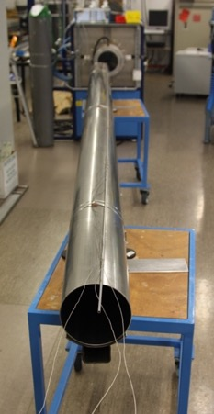
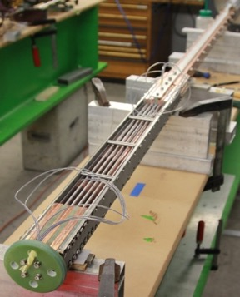
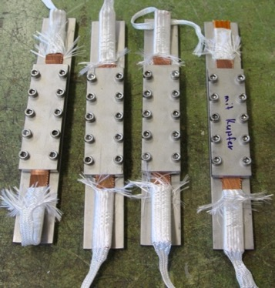
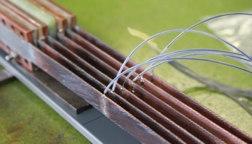
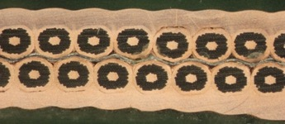
CHART1 Goals
CHART1 (mid-2016 to mid-2019) goals:
the design of an optimised 16 T Canted Cosine Theta (CCT) dipole magnet, as an option for the FCC hadron collider main magnet;
the development (design and prototype) of a high-field dipole magnet with CCT technology; and
the development of reaction-resistant splicing techniques for Nb₃Sn magnets for FCC.
[M. Kumar et al., Preliminary Tests of Soldered and Diffusion-Bonded Splices between Nb3Sn Rutherford Cables for Graded High-Field Accelerator Magnets, IEEE Trans. on Appl. SC., Vol 29(5), 2019.]

Slide 8
CHART1 Take-Aways
Nb₃Sn technology introduced at PSI.
90 m² laboratory refurbished, equipped, commissioned.
Production-readiness review (http://indico.psi.ch/event/cd1prr).
Portal crane
Storage
Winding table
4-m winding/instrum/assembly bench
Vacuum Impregnation
Coil reaction

Slide 9
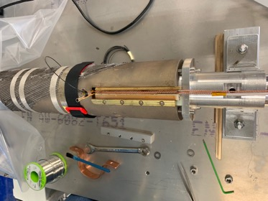
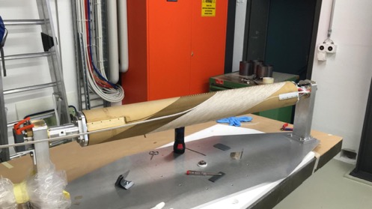
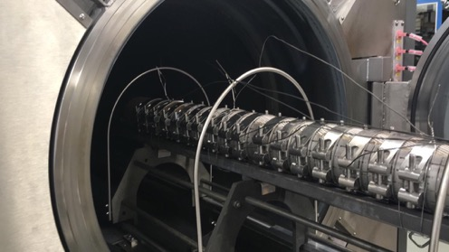
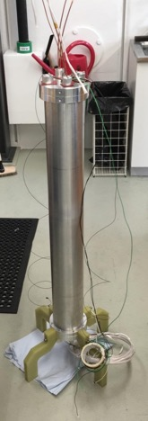
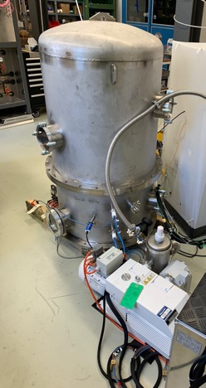
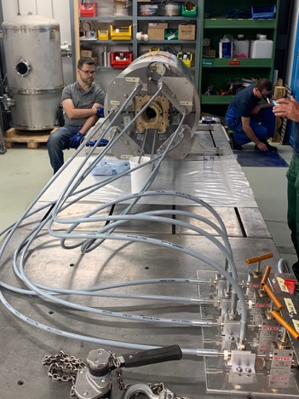
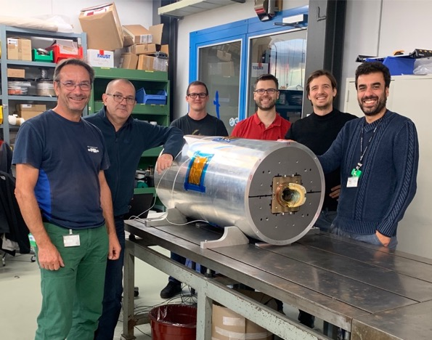
CHART1 Take-Aways
Nb₃Sn technology introduced at PSI.
CD1 magnet construction complete, magnet is shipped.

Slide 10
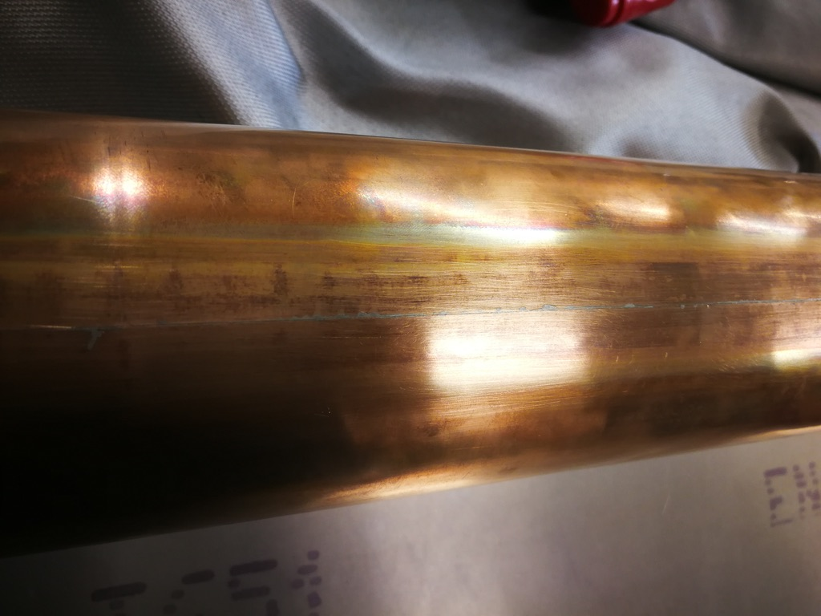
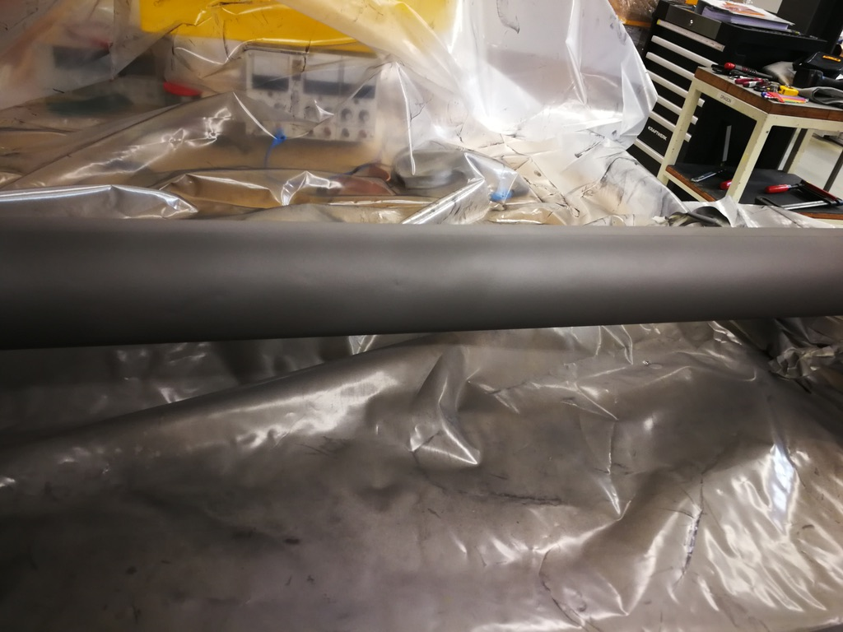
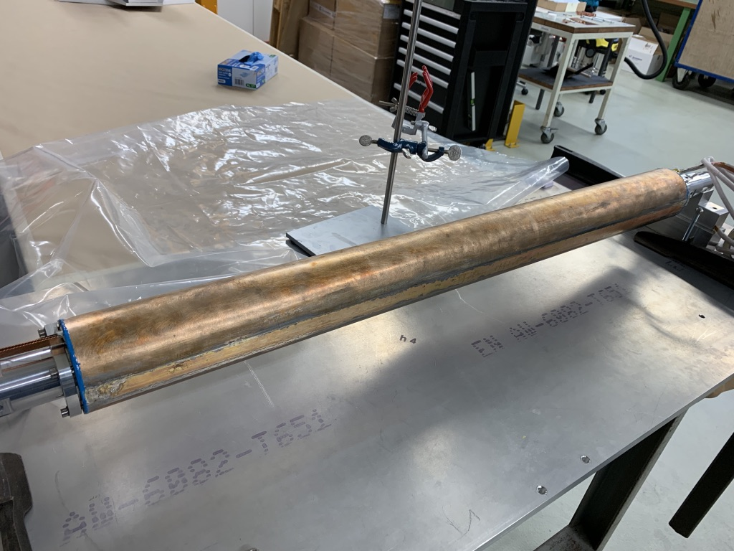
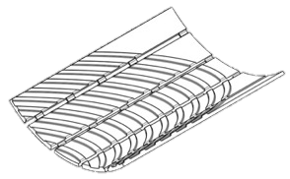
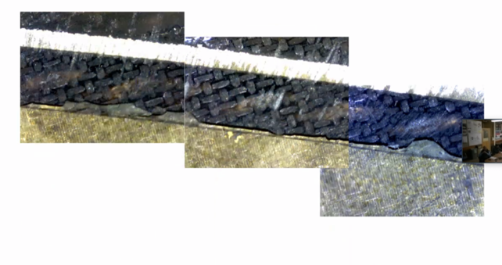
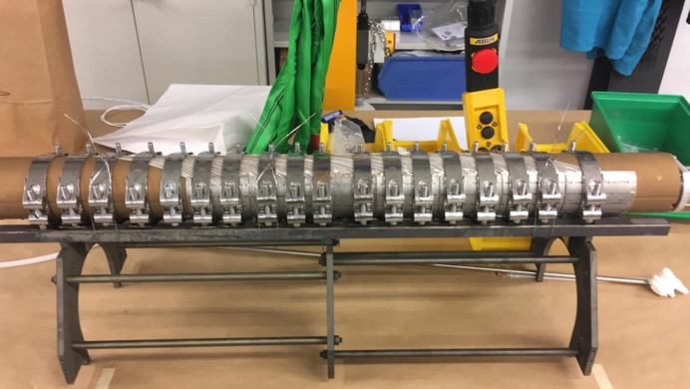
CHART1 Take-Aways
Nb₃Sn technology introduced at PSI.
CD1 magnet construction complete.
Challenges remain:
CCT inherent technological challenges:
bonding of cable in winding channels.
reliable insulation.
FCC-parameter specific challenges:
winding and annealing on small diameter.
plastic deformation of thin mandrel at 665ºC.
 | CD1 | CCT5
ID | 63.6 mm | 90 mm
Spar | 3/2 mm | 7.4/3 mm
Layer interface | Sliding plane | Bend & Shim
Mechanical structure | Bladder & Key | Al shell
Resin | FSU Mix 61 | FSU Mix 61
[Cable-channel delamination in CCT5 after testing. Photo courtesy of LBNL]

Slide 11
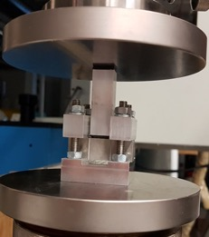
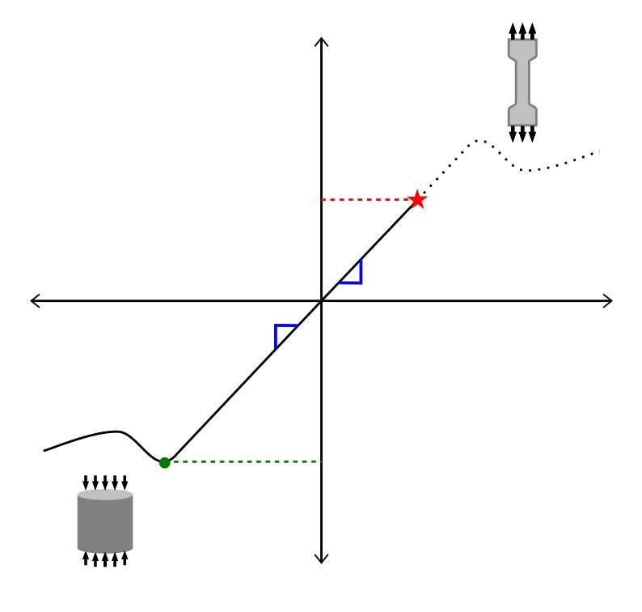
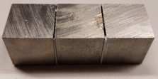
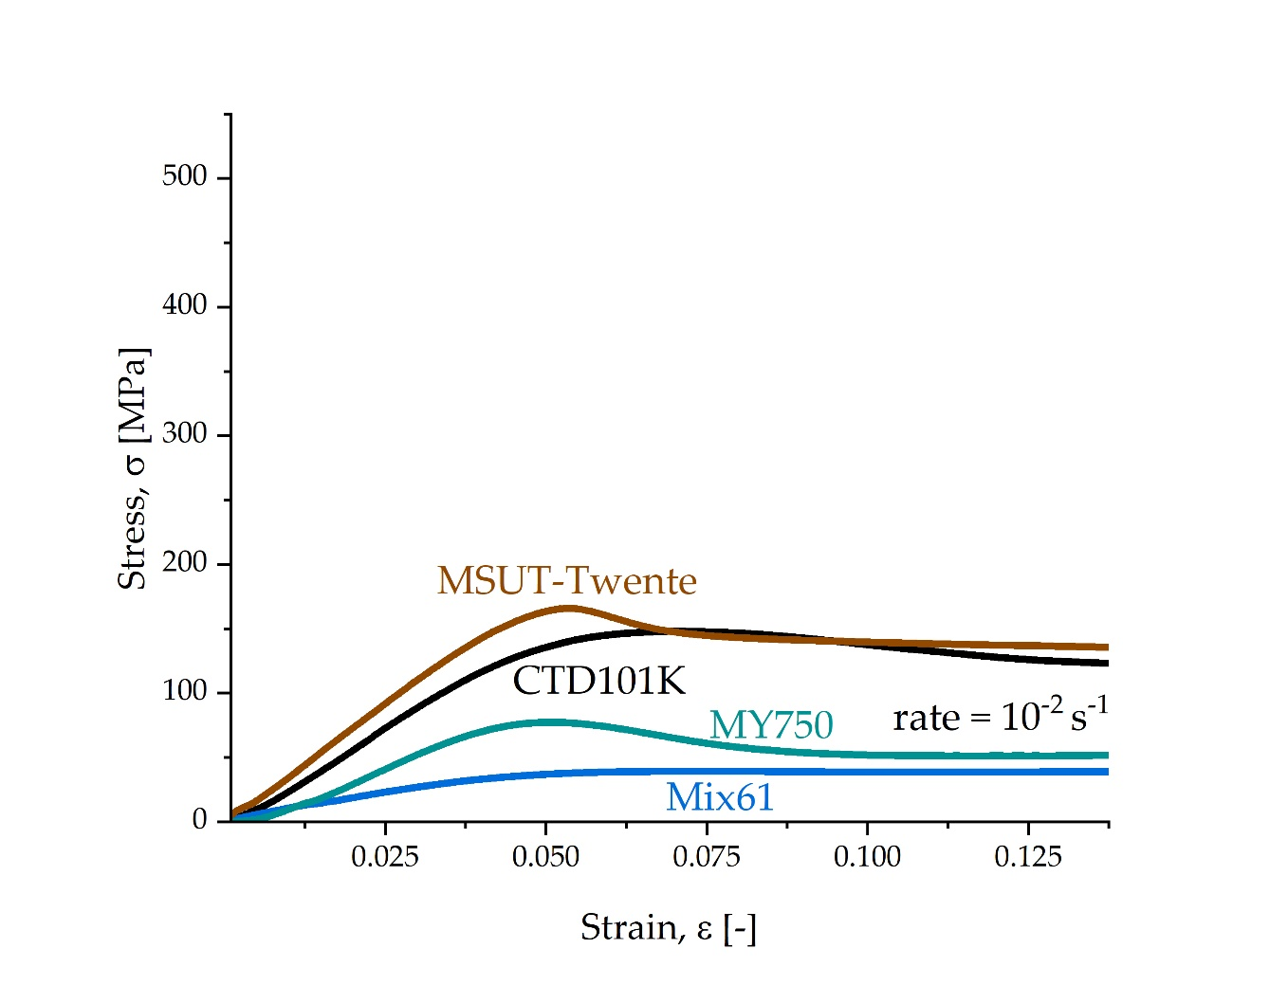
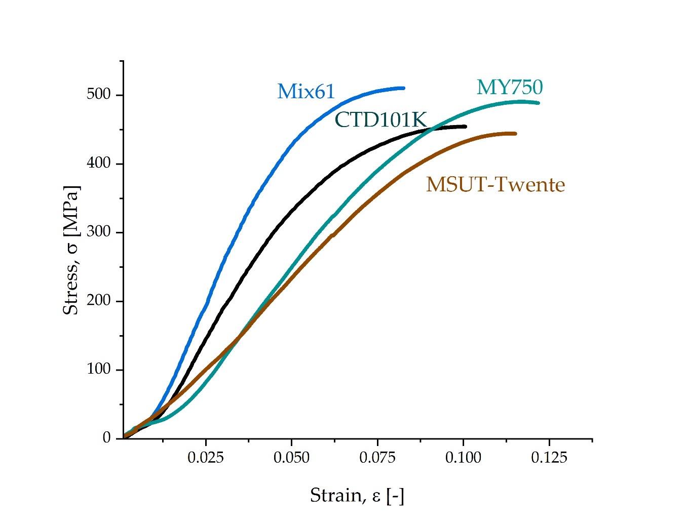
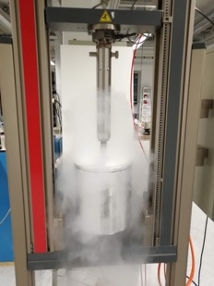
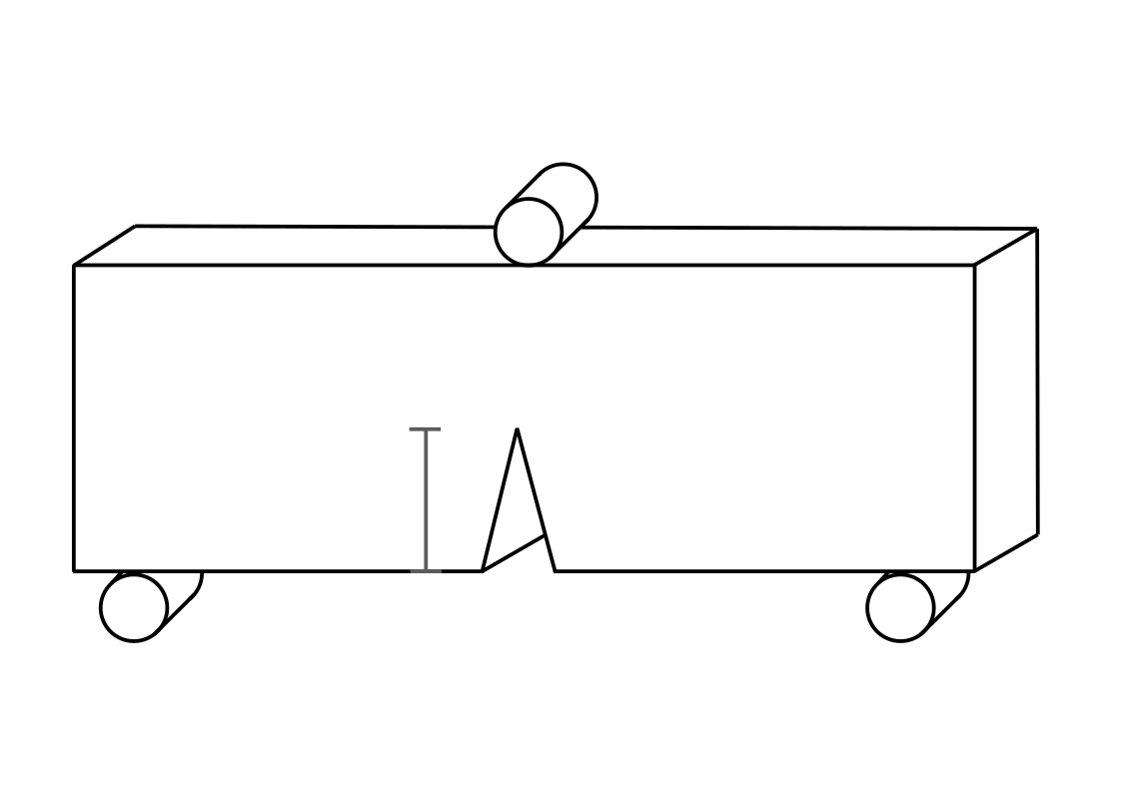
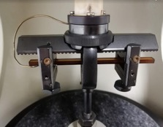
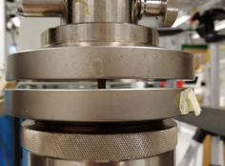
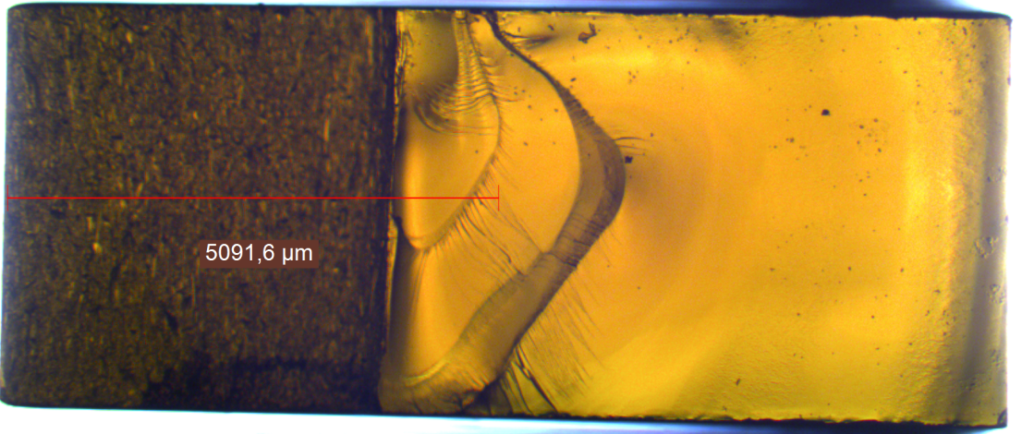
CHART1 Take-Aways
FCC-CHART collaboration
Polymer-system characterization, new systems, and adhesion testing with of ETHZ Soft-Mat Group (Prof. Theo Tervoort), CERN, and PSI.
Characterize existing resin systems for SC magnets (CTD 101-K, Mix 61, MSUT MY740, MY750).
Study h-BN fillers (0.5 vol%) for enhanced strength.
Study adhesion and influence of reaction residues.
tension
uniaxial state
of stress
$$stress, σ$$
$$σ_{c}$$
room temperature
LN₂
$$T<T_{g}$$
fracture
~450 MPa
$$strain, ε$$
$$σ_{c}(T)$$
yielding
modulus, $E$
$$σ_{y}$$
Poisson’s ratio, $ν$
$$K_{Ic}=σ_{c}\sqrt{π∗c}∗Y(B,W,c)$$
compression
$$W$$
System | RT $(MPa\sqrt{m})$ | LN₂ $(MPa\sqrt{m})$
CTD-101K | 0.6 | 1.4
Mix 61 | NA* | 2.4
MY750 | 4.6 | 4.7
MSUT-Twente | 0.9 | 1.4
$$c$$
$$E(T)$$
$$B$$
$$σ_{y}(T)$$
5.5 mm

Slide 12
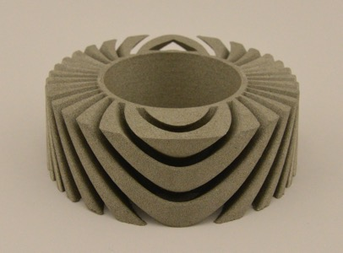
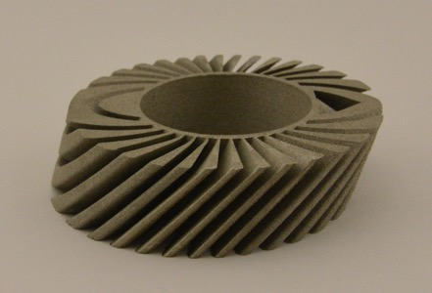
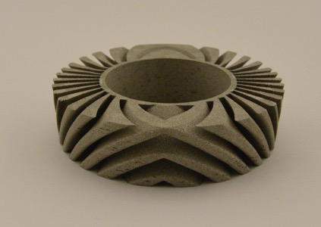
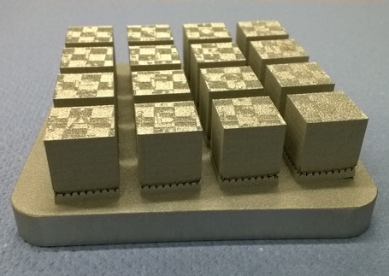
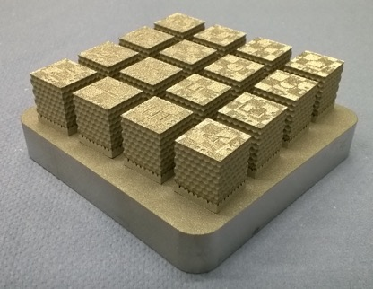
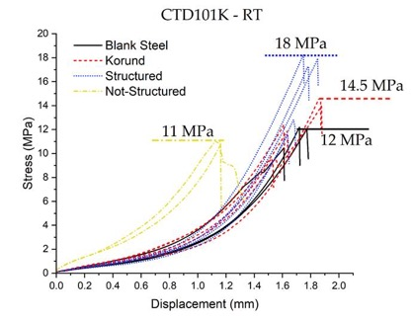
CHART1 Take-Aways
CHART subcontract
Additive manufacturing for CCT formers; proof-of-concept in Masters Thesis at ETHZ’s Inspire AG
Proof-of-concept printing of former slices with variable process parameters.
Engineered surface finishes for enhanced adhesion.

Slide 13
Overview
CHART1 (2016-2019) Goals and Take-Aways
CHART2 (2019-2024) Goals and Proposals

Slide 14
CHART2 – Swiss Accelerator Research and Technology
CHART2 (2019-2024)
Mission with regard to applied superconductivity:
Develop a sustainable and Swiss-based expertise in applied superconductivity and superconducting magnets for HEP, in view of a possible FCC-hh or HE-LHC. This shall be anchored in the existing institutes and universities, and further developed thanks to additional recruitment and hands-on training of applied scientists and technicians in the practical objectives described below (R&D, prototyping and testing). [L. Bottura]
High-field magnets:
evaluate CCT technology for Nb₃Sn 16-T dipoles,
develop an up to 2-m-long high-field demonstrator – possibly of different coil geometry.
contribute to the development of Nb₃Sn conductors that match the performance targets […] and of the cable optimization and test.
HTS magnets:
develop technologies for HTS based accelerator magnets,
design, build, and test an HTS variant of the SLS 2.0 superbend magnet.
design, build, and test several periods of an HTS undulator magnet.
Infrastructure:
To establish the infrastructure needed to build and test all aspects of FCC-hh, HE-LHC magnets and other SC accelerator magnets.
[Based on: Application for support of the Swiss Accelerator Research and Technology Initiative beyond the year 2019.
Deviations from original text marked in italic font.]
Infrastructure
Enabling Technologies
Wire and Tape R&D
LTS Magnet R&D
HTS Magnet R&D
HFM Demonstrator

Slide 15
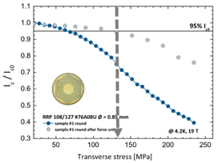
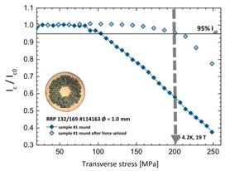
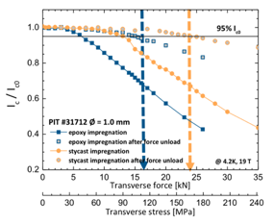
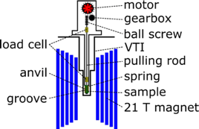
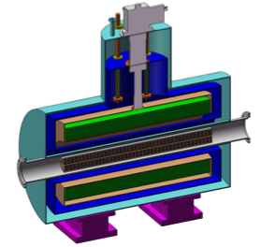
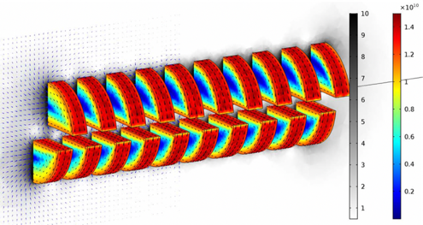
CHART2 Proposals under Approval
UniGE/CERN
Multiphysical characterization of Nb₃Sn wires and REBCO coated conductors
Advanced Niobium-Tin superconductors for next generation particle colliders
ETHZ-SMG/CERN/PSI
Resin and Adhesion R&D
PSI
REBCO Bulk SC Undulator

Slide 16
CHART2 Proposal under Preparation
Superconducting Accelerator Magnet R&D at PSI
Opportunities:
CCT experience brings to the forefront the need for enabling-technology R&D:
Tough resins with appropriate T_{g} and thermal contraction, radiation hard, processable.
Improved adhesion via chemistry.
Advanced manufacturing of SM structures for improved adhesion and windability (utopia point: interface strength = resin strength).
Temperature-resistant insulating former coating for good adhesion or as lubricant.
Minimized reaction residues from braided glass insulation.
Vacuum-pressure impregnation for flexibility in process parameters and reliability.
Cryogenic low-friction interfaces (temperature resistant?).
CCT winding tooling.
CCT stress-relief after winding, avoiding of former deformation.
Most of these enabling technologies are also important for other coil types, in particular SM-CT and, to variable extent, CT, BC, and CC and HTS coils.
ETHZ/EPFL partnerships can effectively provide appropriate expertise.
HTS accelerator magnets constitute a relatively younger field, where PSI can make a valid contributions, supported by the upgrade to PSI’s cryogen-free test station.
PSI applications may bring HTS magnets into beamlines or accelerators relatively soon.

Slide 17
CHART2 Proposal under Preparation
Superconducting Accelerator Magnet R&D at PSI
While awaiting the European Particle-Physics Strategy Update, as well as future magnet needs at PSI we can nonetheless address the most pressing needs encountered in CCT R&D, but relevant also to other coil types.
In a two-year program, we propose that CHART2 at PSI
establish a magnet laboratory (in terms of space, equipment, and skills) capable of the design and construction of super- conducting accelerator magnets in Nb₃Sn and HTS (REBCO tape) technologies.
provide generic enabling-technology R&D and apply the results to improve the performance of Nb₃Sn canted-cosine-theta (CCT) magnets, as demonstrated by the delivery of a CCT technology demonstrator.
integrate with CERN’s HTS technology-coil program, delivering a number of technology-coil assemblies that are to be tested in PSI’s upgraded cryogen-free test station, and thereby introducing HTS magnet design, construction and testing at PSI.
After two years and a technical review, the CHART Council will decide upon the parameters of a high-field magnet demonstrator, to be built at PSI or in collaboration with other labs, as well as on HTS magnets to be developed for accelerators.

Slide 18
CHART2 Proposal under Preparation
Getting infrastructure ready.
Enabling technology R&D on characterization samples.
CCT R&D on powered subscales and a CD2 demonstrator.
HTS technology coil R&D.

Slide 19
Summary
CHART is committed to continue to build a Swiss expertise in SC accelerator magnets and to contribute to the FCC roadmap.
CCT and collaboration with LBNL was ideal to get this started quickly.
A 2-year R&D proposal centered at PSI plans to
Leverage the emerging Swiss network of competencies to conduct enabling-technology R&D.
Push CCT HFM performance through subscale and technology demonstrator magnets.
Contribute to CERN’s HTS technology-coil program.
Following this initial phase, CHART shall design and build a high-field magnet demonstrator (16 T, subject to ESPP update), and an HTS magnet for a PSI accelerator.
Collaboration within and without Switzerland shall remain a pillar of the program.

Slide 20
CHART Applied SC Network
Strand / Tape
LTS and HTS strand/tape R&D, Procurement, QA
Cable
Rutherford / Roebel production
Magnet Design
FCC-hh / HE-LHC conceptual and technical
Coil Manufacturing
Nb3Sn and HTS coils
Mechanical Assembly
Mechanical loading
Magnet Testing
LTS and HTS magnet tests
INJECTION

Slide 21
CHART Applied SC Network
Polymer and Adhesion R&D
Heat-resistant surface coating
Insulation and composite R&D
Strand / Tape
LTS and HTS strand/tape R&D, Procurement, QA
Cable
Rutherford / Roebel production
Magnet Design
FCC-hh / HE-LHC conceptual and technical
Coil Manufacturing
Nb3Sn and HTS coils
Mechanical Assembly
Mechanical loading
Magnet Testing
LTS and HTS magnet tests
INJECTION

Slide 22
CHART Applied SC Network
CCT CNC former manufacturing
CCT former coating
Additive manufacturing
Winding automation
Coil interfaces
Strand / Tape
LTS and HTS strand/tape R&D, Procurement, QA
Cable
Rutherford / Roebel production
Magnet Design
FCC-hh / HE-LHC conceptual and technical
Coil Manufacturing
Nb3Sn and HTS coils
Mechanical Assembly
Mechanical loading
Magnet Testing
LTS and HTS magnet tests
INJECTION

