Slide 1
High Field Vertical Magnet Test Facility for Conductor, Cable and Magnet R&D
MDP Roadmap Workshop, December 4-5, 2019
G. Velev, G. Sabbi and S. Prestemon

Slide 2
Outline
  Overview
      Why a new Vertical Magnet Test Facility at Fermilab in the context of conductor, cable and high field accelerator magnet R&D?
      Synergy with FES
  Current status: schedule
15 T preliminary dipole magnet design: schedule
Summary
N.B. This facility is not part of MDP but will enable MDP capabilities to test hybrid magnets

Slide 3
Why new Vertical Magnet Test Facility?
One of the primary goals of the US Magnet Development Program is to pave the way for future high field accelerator magnets, e.g. 16-20 T dipoles
The x-section of magnet is increasing with the field - need a test facility with larger cryostat diameter; capable of testing hybrid magnets
Goal: to construct a vertical test facility (pit) with cryostat ID= 1.4-m (cold mass size 1.35 m) operating at 1.8-1.9K and max current for the magnet 24kA:
  For MDP: it will serve for testing HTS, Nb₃Sn samples, hybrid magnets (Nb₃Sn+HTS), utility structures to test magnet components in HF
  For FES: 15 T large aperture magnet will be built to serve as a vehicle for HTS cable testing (lead LBNL)
Fermilab is unique place to build such facility
  1.8K testing capabilities
  30 kA power supply system
  50-ton lifting capability for a single object in vertical direction
  New cryoplant is coming in operation at the end of 2021
This proposed setup has similar parameters, comparing to FRESCA2 at CERN or HEPdipo at PSI

Slide 4
Fermilab Site
For this project, we take advantage of relevant studies, designs and activities performed at Fermilab and LBNL in the past:
  Building and operating 4 vertical pits for SC magnet and SRF programs.
  Design and fabrication capability of block type SC magnets
  Experience with designing, assembling and commissioning of complex quench monitoring and quench protection systems for High Field magnet stands, the Mu2e experiment and the HL-LHC production stand.
  Experience in the design and commissioning of complex measurement system, including magnetic field measurement devices.

Slide 5
Current R&D US Test Facilities
R&D US Test Facilities*
Institution | V/H | T_{min} | L_{max} | ID _{max} | I_{max} | User | Availab.
BNL | V | 1.9 K | 5.2 m | 0.67 m | 22 kA | HL-LHC | After 2025
FNAL | V | 1.9 K | 3.7 m | 0.63 m | 30 kA | Open/MDP | Now
LBNL | V | 4.5 K | 2.2 m | 0.8 m | 25 kA | Open/MDP | Now
*There are other test stands, like stand 4 in Fermilab, which is used to test production series of magnets and can be used for R&D after HI-AUP project is concluded

Slide 6
Specifications - Test Facility
The test facility will be constructed in Industrial Building 1, APS-TD, Fermilab. To save money, the proposed place is selected based on the proximity to the needed base infrastructure for a such test stand, including cryogenic, power, water and crane(s).
Minimum operating temperature of the facility is 1.8K for the magnet providing the background field and 4.2-4.5 K *(under discussion) for the test samples.
The test pit cryostat should accommodate a dipole (cold mass) with maximum dimensions of ø=1.35 m and length of 2.5-3.0 m
The maximum energy in the test field dipole should be < 15MJ (under discussion)
The maximum weight of the dipole cold mass should not exceed 50 t with lifting tooling
The test facility should be efficient and safe, minimizing the time for experiment preparation and no helium losses after quenches.
• Operational lifetime of the facility at least 20 years.

Slide 7
Test Facility & FES requirements
The main magnet cryostat includes a Lambda plate and top plate assembly (appropriate number of current leads).
HTS test cryostat for the magnet well with possibility to control the sample temperature to 1K in the region of 4.3 to 55 K.
Design and assembly a reliable Quench Monitoring and Protection systems for the main dipole and testing samples.
Together with FES to design and manufacture appropriate SC transformer for test samples.

Slide 8

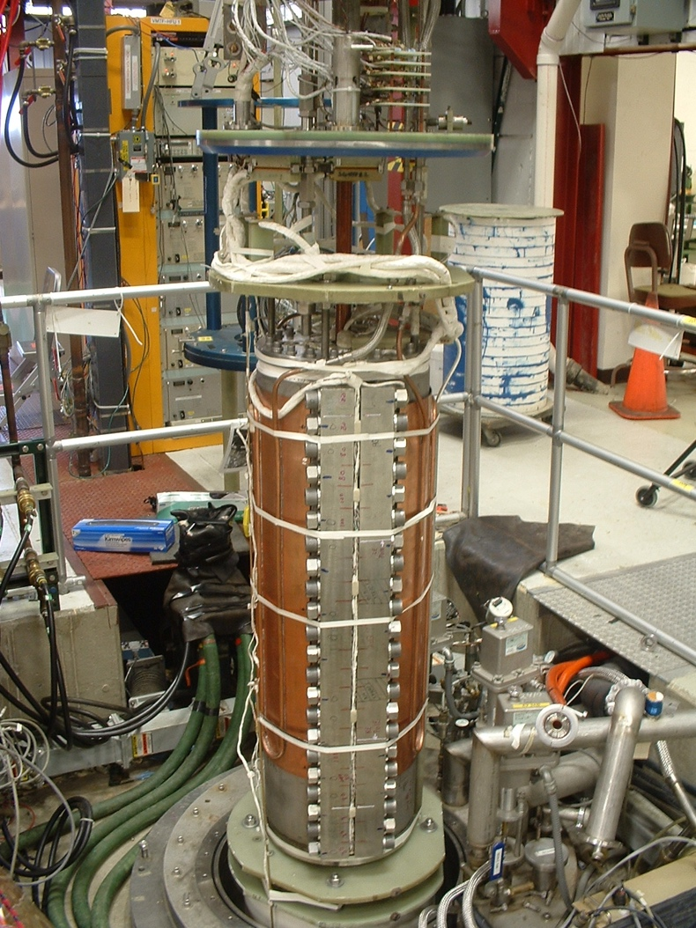
Fermilab: VMTF and HFVMTF
VMTF
HFVMTF
1.3 m
0.6 m

Slide 9
Current Status
The firsts tranche of money is received from the Offices of FES and HEP
This project includes only the civil (pit) and the cryostat and top/lambda plates
It was classified as GPP by Fermilab site DOE office
  Pit design is process of final review - Dec 2019
  Bidding process – Jan 2020
  Pit construction is expected late spring/early summer 2020
The cryostat design - just started
The plan for this phase is to finish in July 2021
Notes:
eneral Plant Projects

Slide 10
Civil Construction Drawings
Current VMTF
HFVMTF

Slide 11
HFVMTF pit and cryostat: Timeline and Milestones

Slide 12
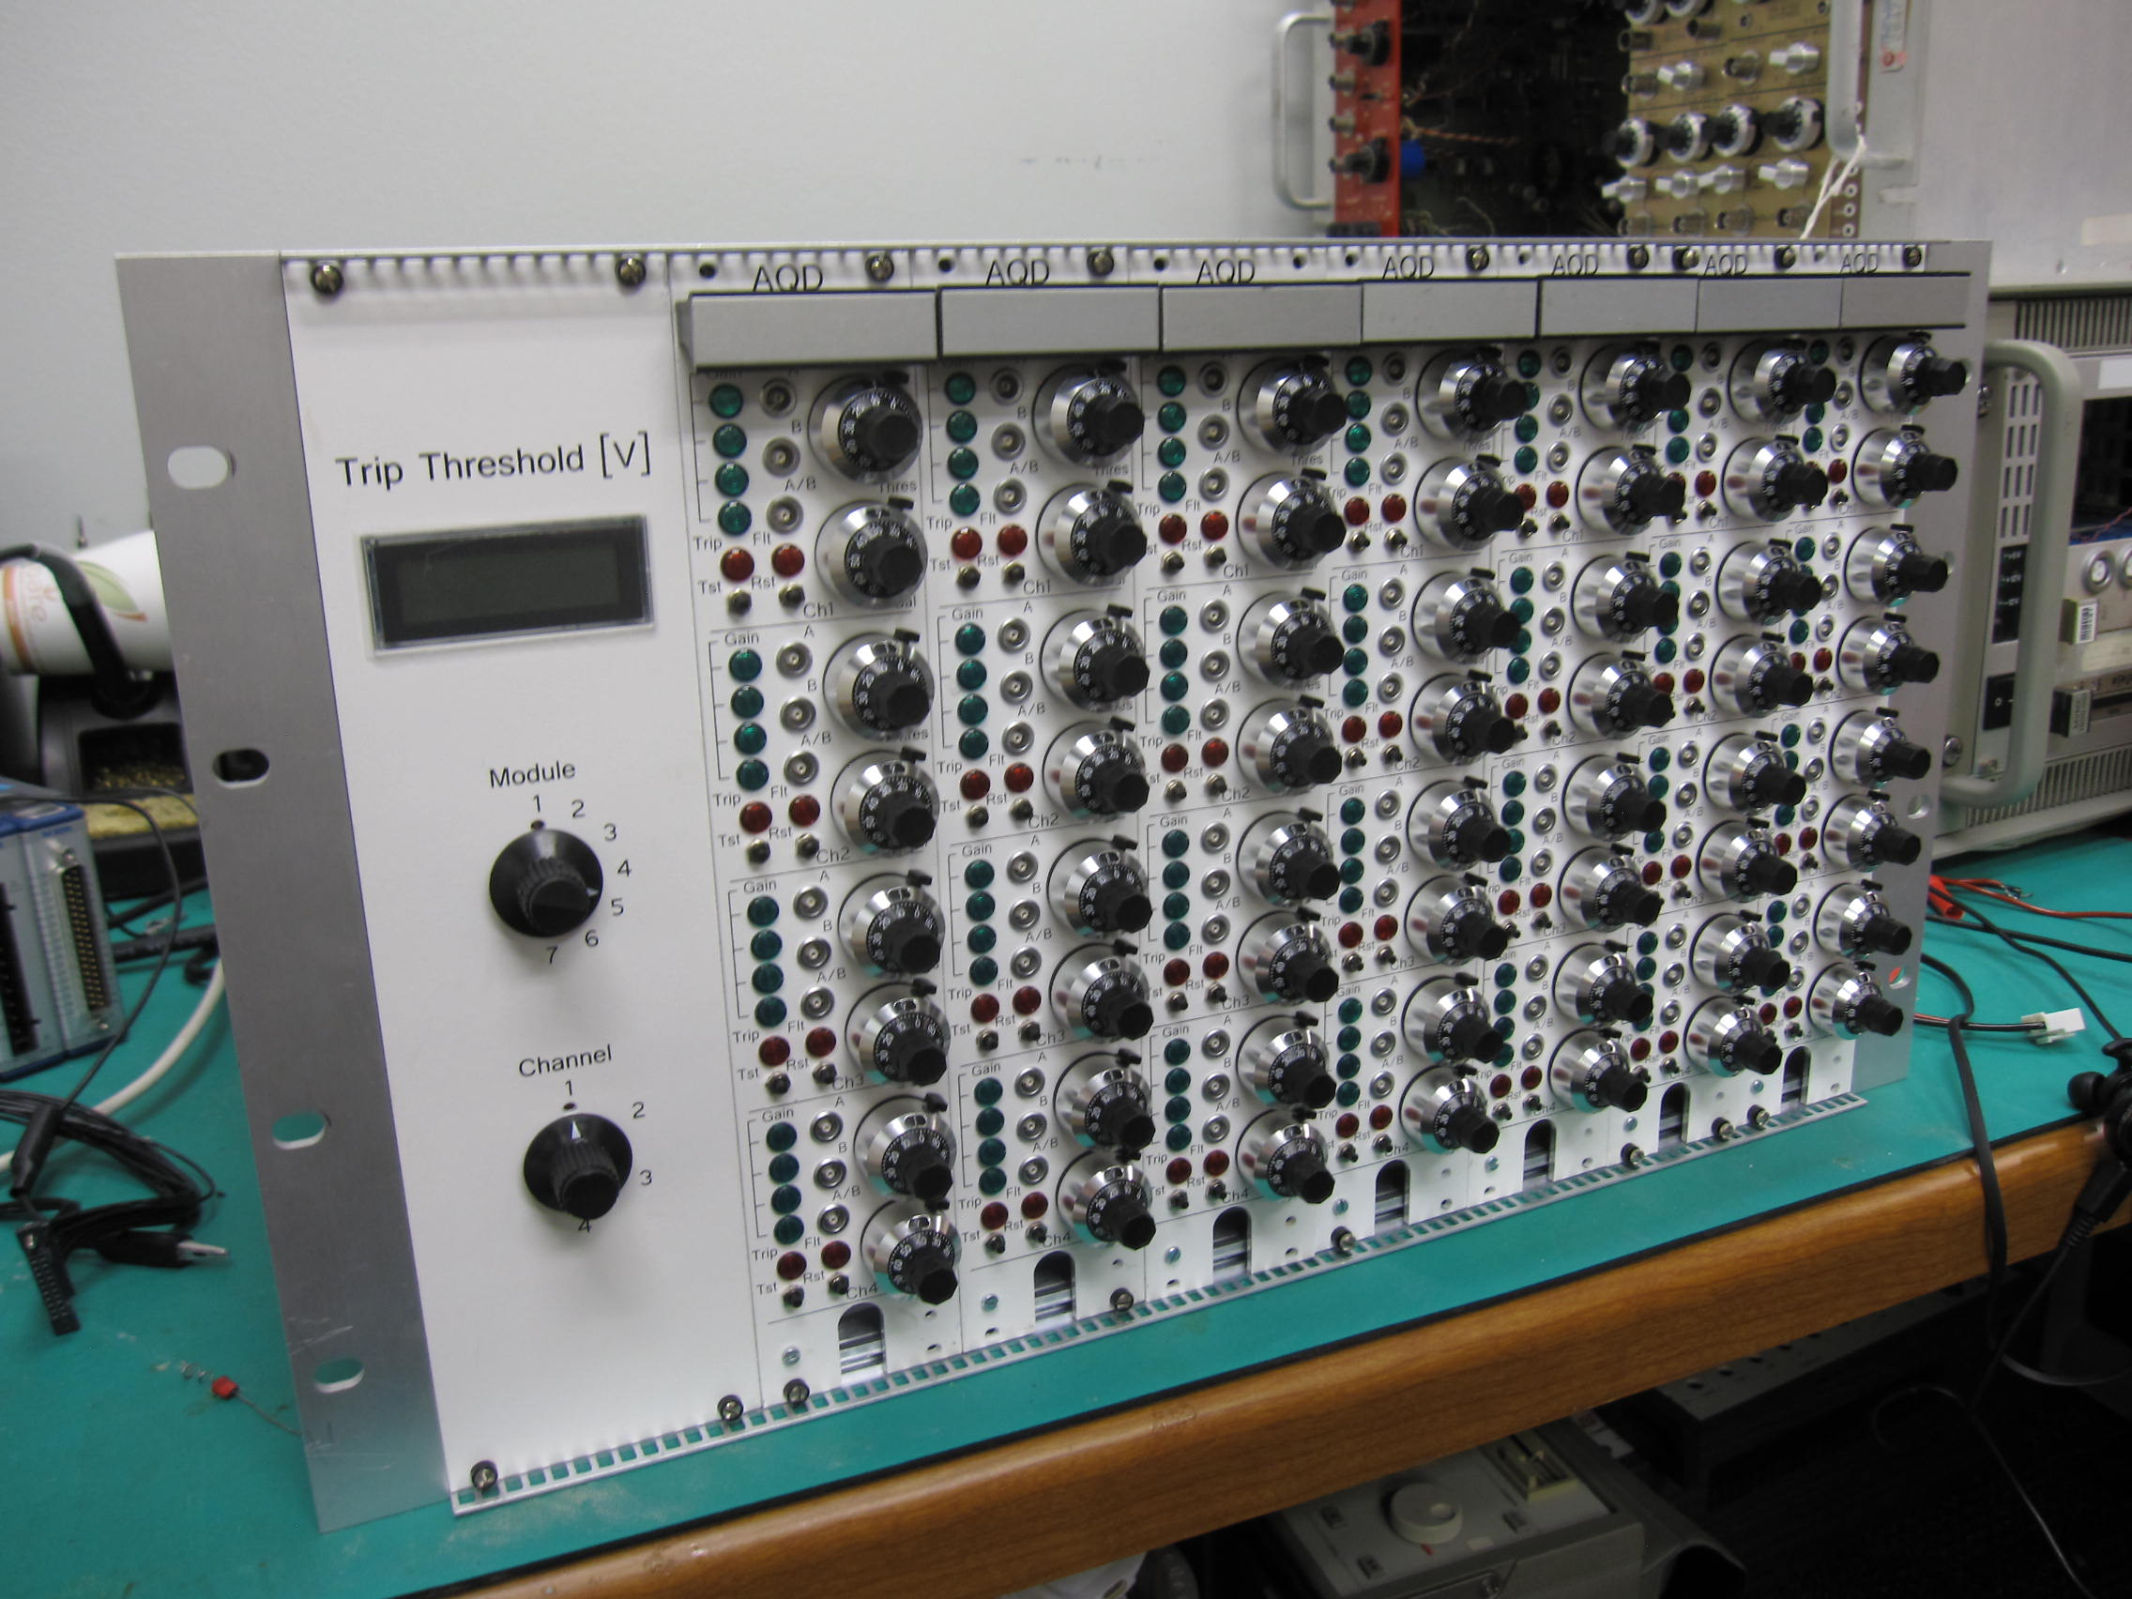
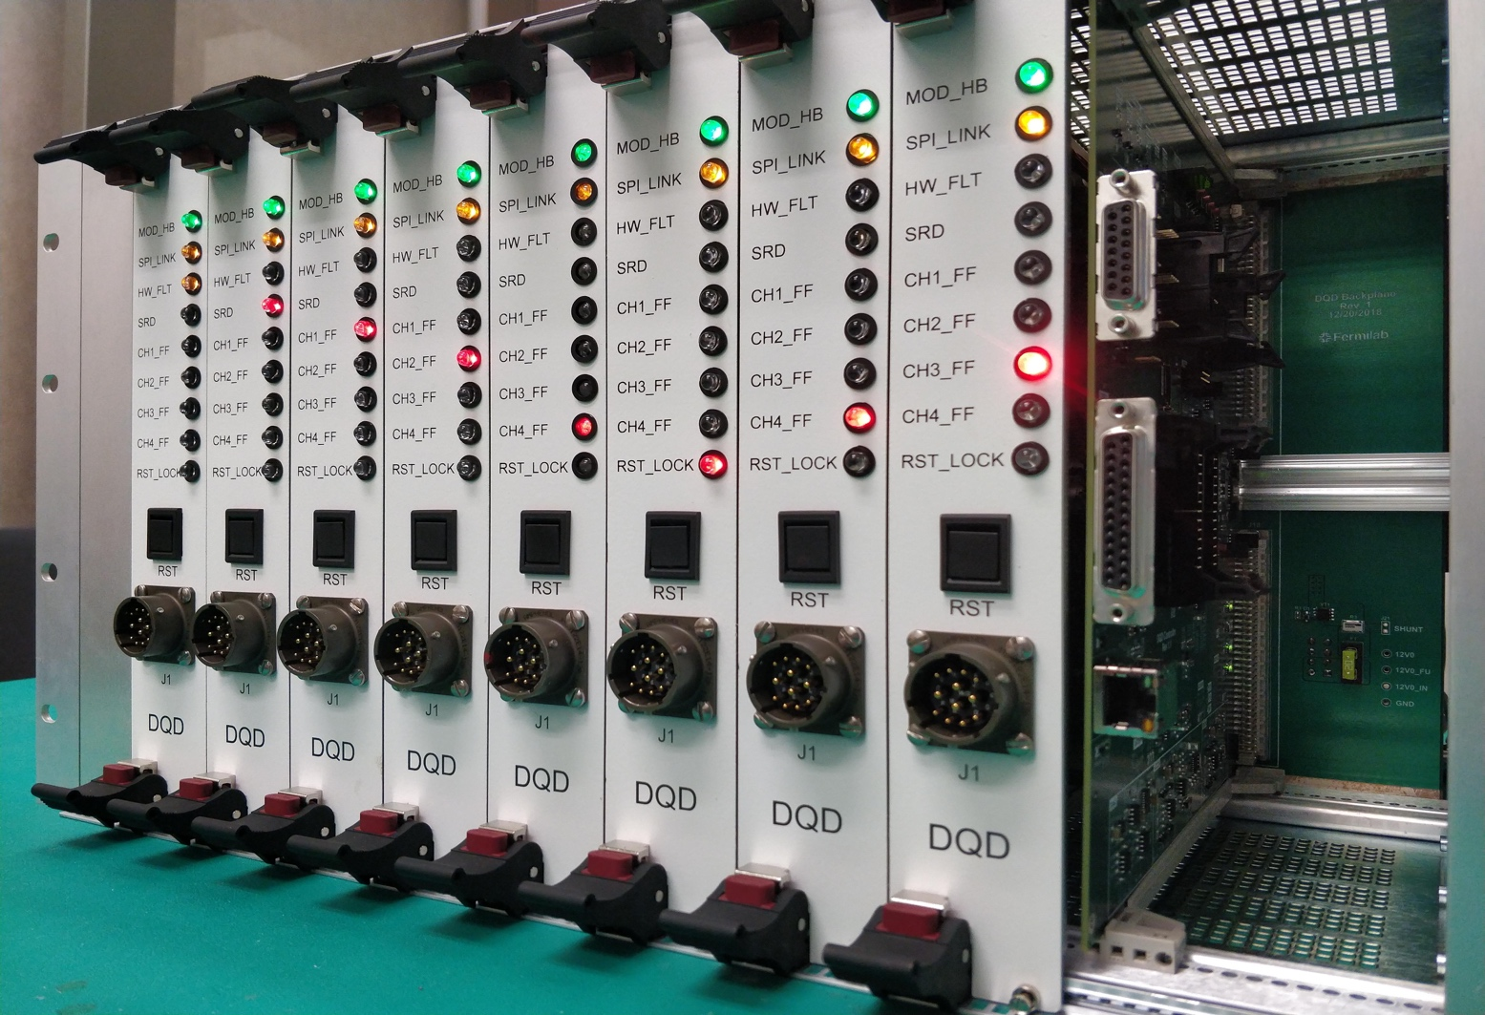
Next Steps
For the test facilities next step includes:
  Design, procure and build QP and QM system (for AUP - will be ready in Feb2020)
  Purchase two sets of PSs, for the main magnet and the test samples/coils
  Final integration of the test facility, receive Operation Reediness status
If we receive the second tranche of funds in FY20 the test pit can be operation at the end of 2021 (FY22).
Next Generation of Digital Quench Protection and Monitoring System.
Chassis with 32 Isolated Analog Channels and Digital Controller.

Slide 13
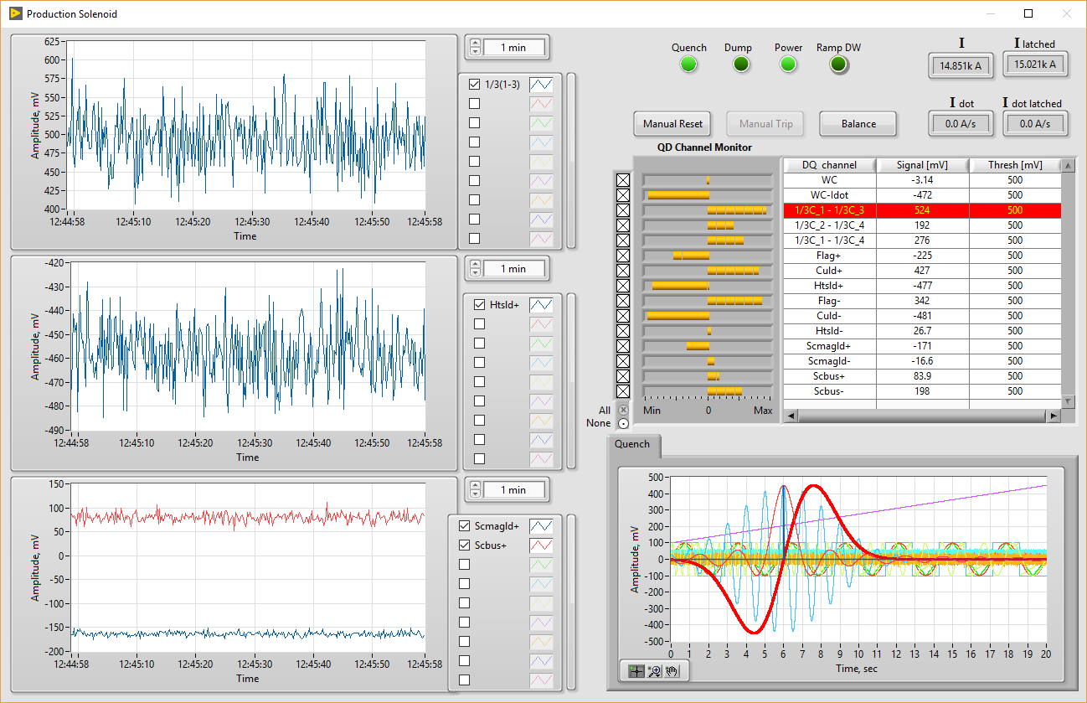
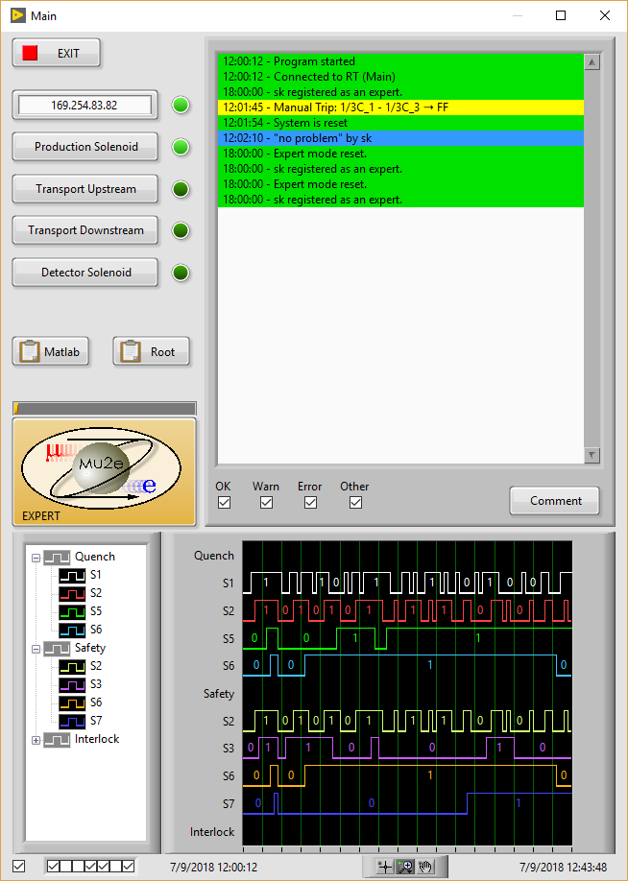
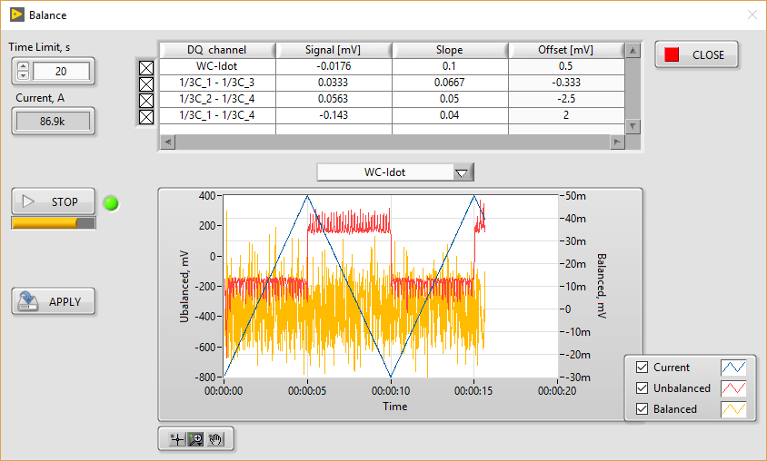
Quench Detection System GUI
Main Quench Control Window
1 of 4 Magnet Quench Signal Monitoring Windows
Expert Mode Configuration & Balancing

Slide 14
HFVMTF QP and QM: Timeline and Milestones

Slide 15
Specifications - Magnet
Background dipole field > 15T, at 1.9 K with graded coils. This goal is comparable with the previous facilities or other proposals ~ HEPdipo magnet.
Homogeneous field region > 0.5-0.6 m, preferably > 1 m. This requirement has a strong influence on the magnet cost.
Well dimension is 100x150 mm². It would be compatible with FRESCA2 and SULTAN/EDIPO samples
Sample cryostat to accommodate sufficient length to keep sample joint in low field.
Field quality in the transverse plane: for now not specified. Current assumption is <20 units for all harmonics at 35 mm radius

Slide 16
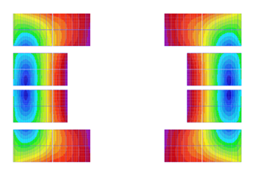
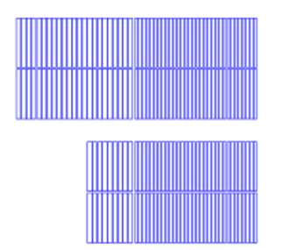
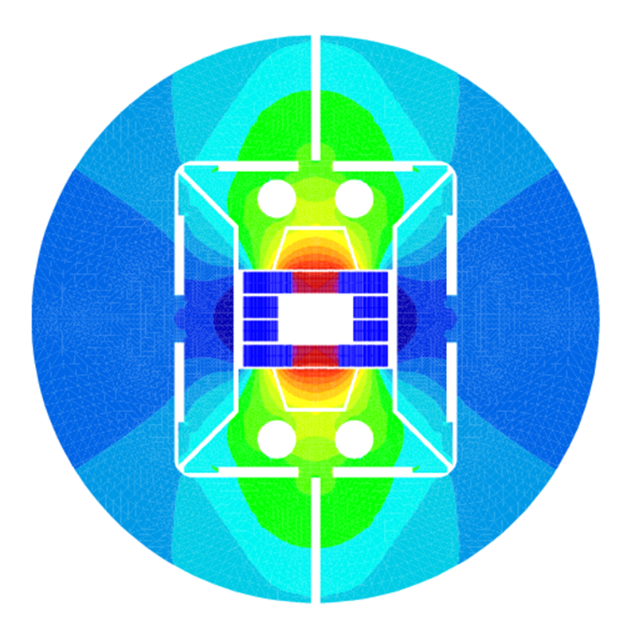
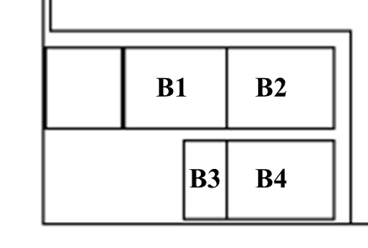
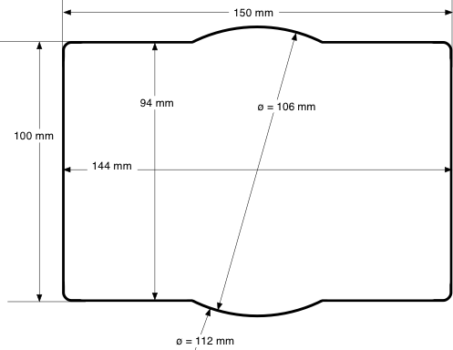
Preliminary Magnet Design (G. Sabbi et al.)
Cable Parameters
23 turns
32 turns
Parameter | Unit | Cable 1 | Cable 2
Strand diam. | mm | 1.1 | 0.8
No. strands |  | 37 | 51
Cable width | mm | 22.0 | 22.0
Cable thickness | mm | 1.95 | 1.4
23 turns
32 turns
9
32
9
32
Block type
Cable 1
Cable 2
Operational Conditions
At 15 T (~81% SSL @4.5K)
Parameter | Unit | Value
Operating current | kA | 11.8
Stray field at 1 m | T | 0.34
Stored energy | MJ/m | 6.4
B
Peak field and forces at 15 T
Parameter | Unit | B1 | B2 | B3 | B4
Peak field | T | 15.18 | 11.36 | 15.31 | 10.65
Horizontal force | MN/m | 6.1 | 1.1 | 2.6 | 2.3
Ave. horiz. stress | MPa | 160 |  | 109
Vertical force | MN/m | -1.8 | -3.8 | -0.2 | -1.1
Semi rectangular aperture of 100x150 mm²

Slide 17
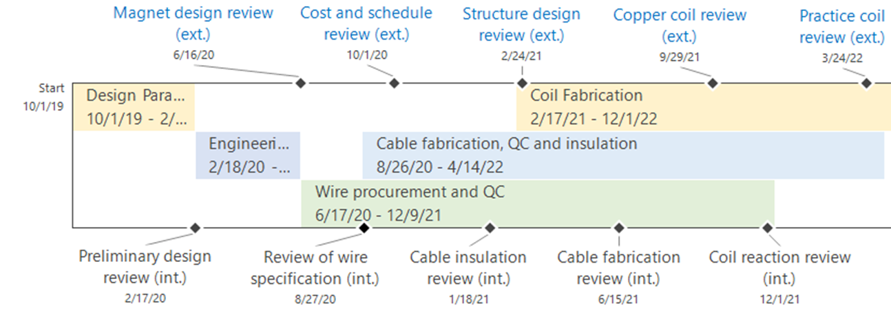
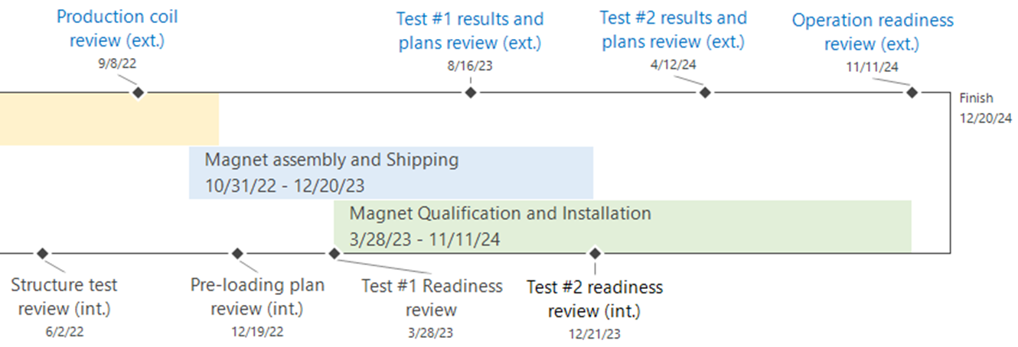
Project Timeline and Milestones

Slide 18
Summary
A project to build a new HFVMTF at Fermilab just started
The facility will support future MDP and FES R&Ds
Different level of the HFVMTF design and preliminary design of the 15 T dipole magnet exist
Schedules and cost estimations are in place
  First tranche of funds were received
  Depending on the future funding
    HVFMTV could be operational at the end of 2022
    15 T wide aperture magnet can be ready in 2023
    Test facility operational at the end of 2024
For now no conflicts with the current projects at Fermilab is expected

