Slide 1
The Berkeley Center for Magnet Technology
Soren Prestemon
Director, US Magnet Development Program
Director, Berkeley Center for Magnet Technology
Lawrence Berkeley National Laboratory

Slide 2

Mission statement
Serve as a Center of Expertise for Magnetic Systems Science and Engineering, through integration of design, fabrication and implementation of complex magnetic systems in support of the DOE Office of Science mission.

Slide 3
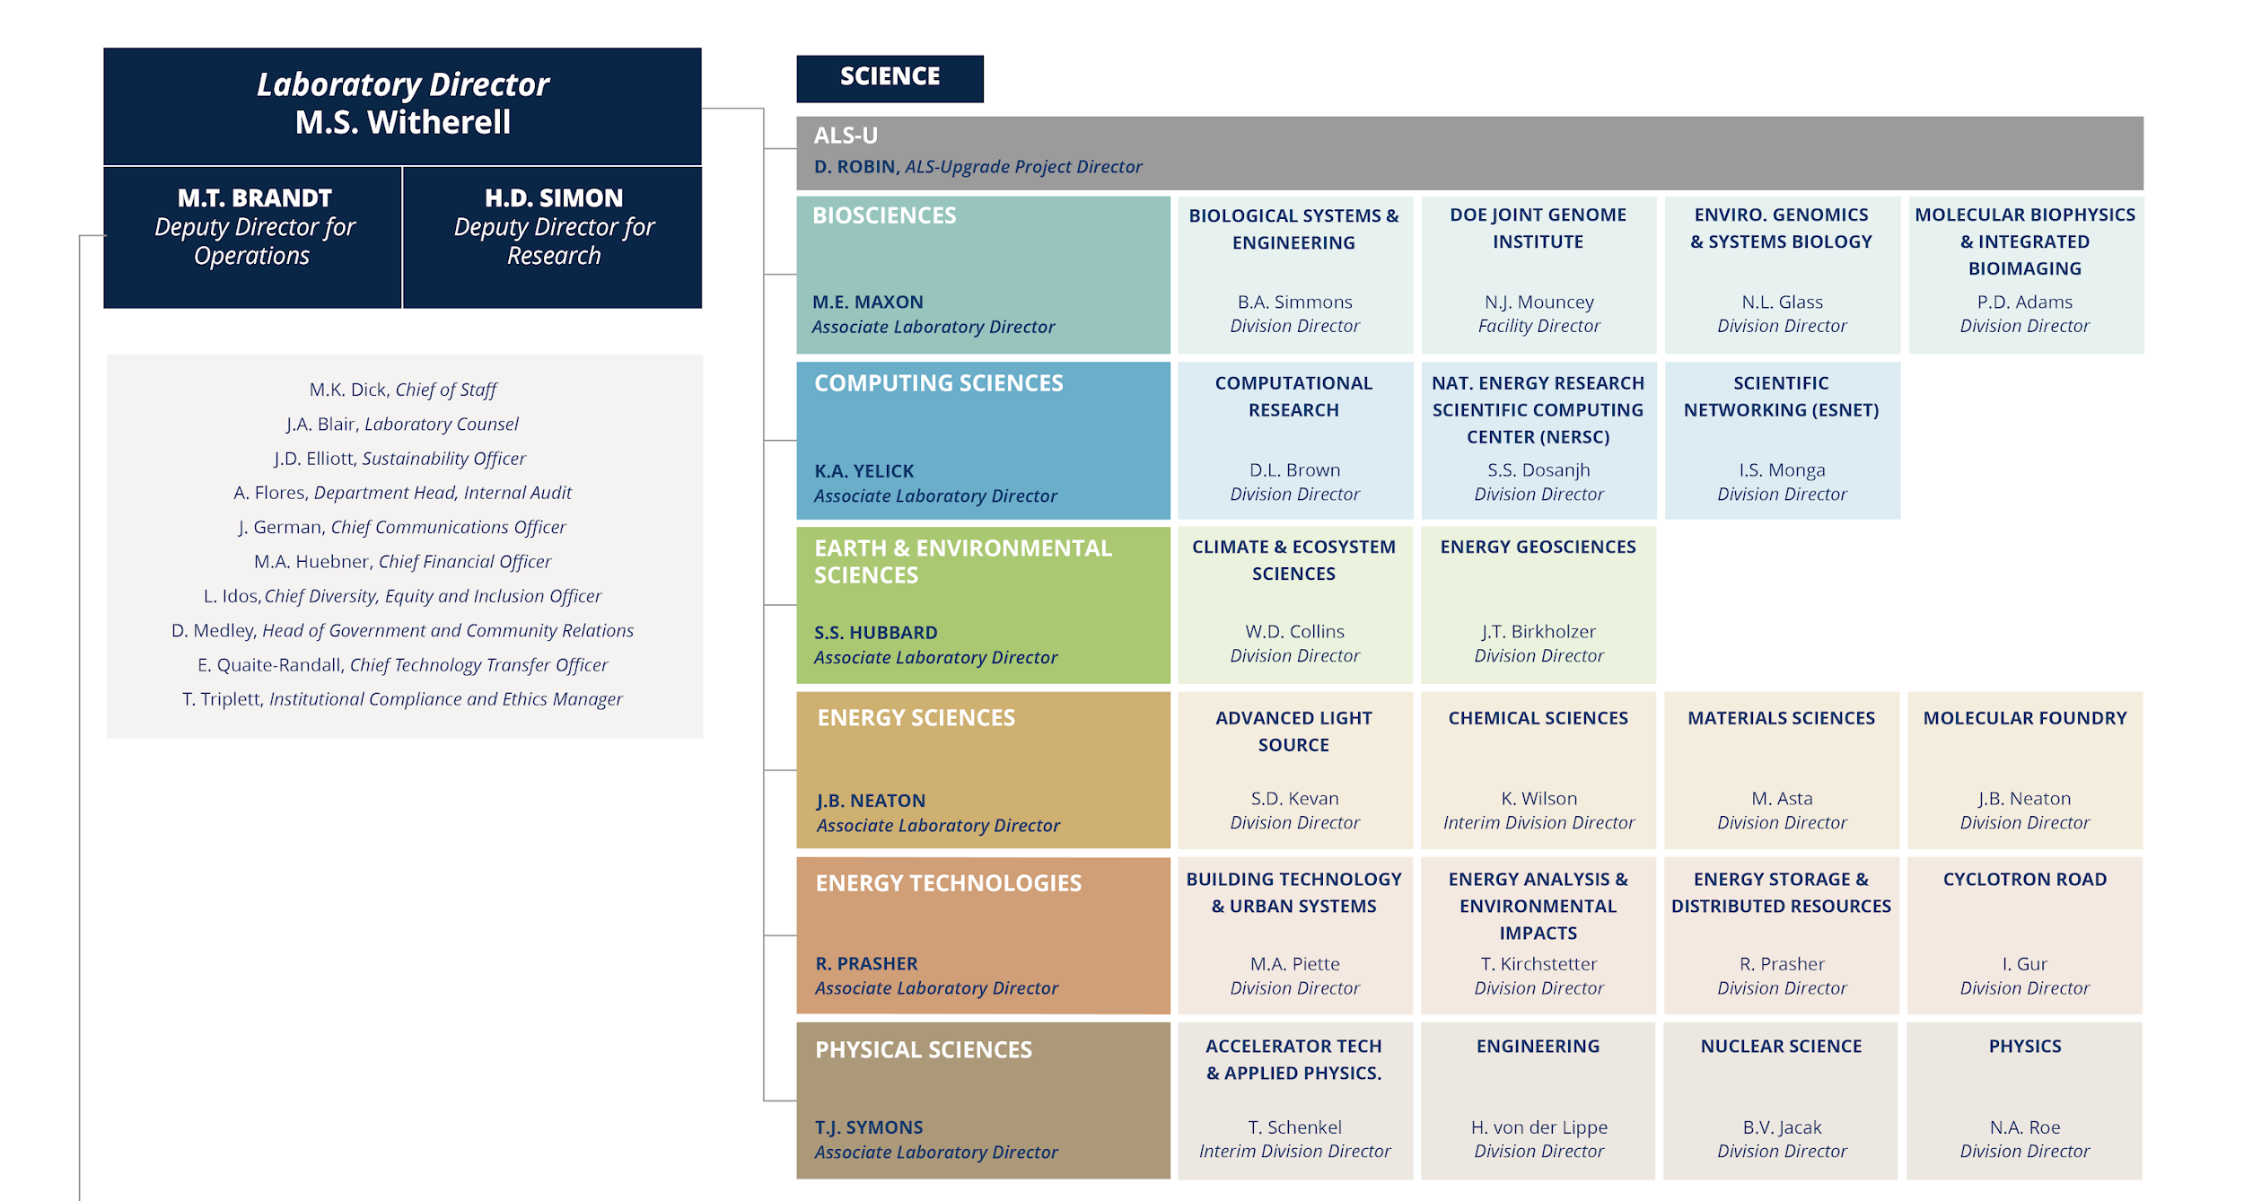
An overview of where we reside in the LBNL science landscape

Slide 4
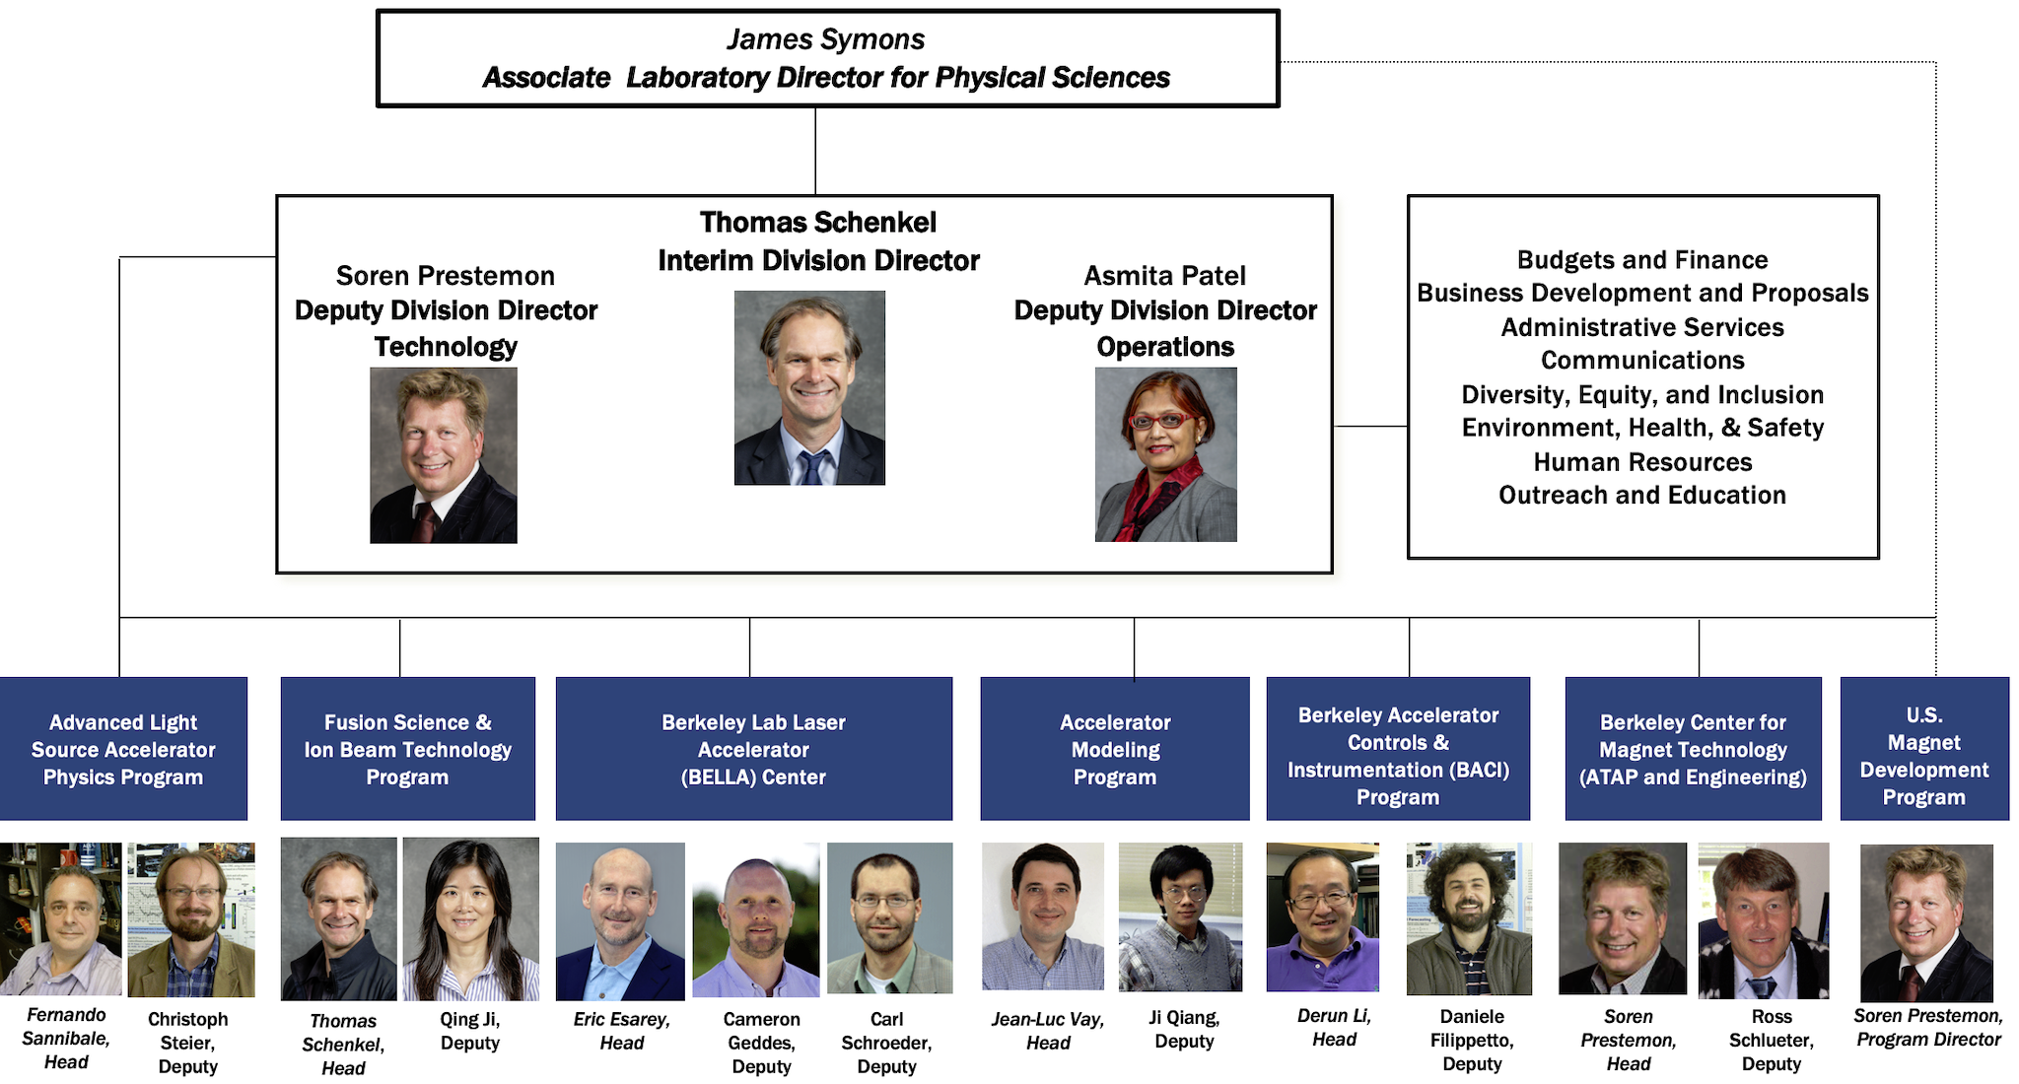
ATAP Organization Chart reflects the scientific programs within its purview

Slide 5
The Berkeley Center for Magnet Technology serves the DOE Office of Science needs for advanced magnet technologies
Led jointly by ATAP and Engineering Divisions to meet Science Program and Project Delivery needs

Slide 6
The major ongoing project in superconducting magnets is the Luminosity Upgrade of the LHC at CERN
The US is contributing ½ of the interaction region quadrupoles
  Project is led by FNAL, with major contributions from LBNL and BNL

Slide 7
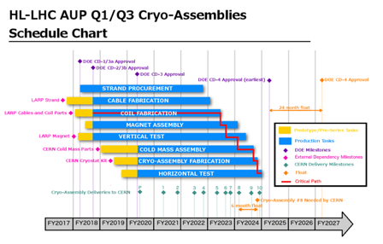
LBNL responsibilities are focused on cables and magnet structures
Produce 102 Rutherford cables (all cables for the US magnet deliverables)
    Conductor respool and prep for cabling
    Cabling operation, including in-situ QC
    Post-cabling QC using RRR measurements
    Manage production of cable insulation
  Fabricate 5 pre-series and 16+4 series production magnets
    Procurement of parts for 21 magnet assemblies
    QC of vendor-fabricated components
    CMM of coils received from FNAL and BNL
    Magnet assembly and application of azimuthal and longitudinal prestress
    Shipment to BNL for vertical testing

Slide 8

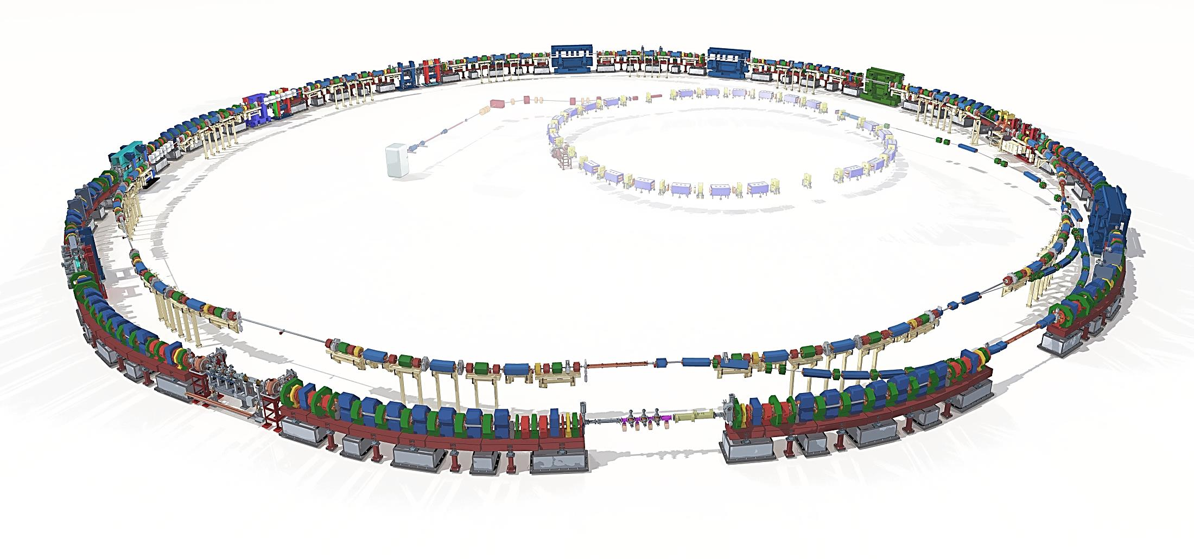
Advanced Light Source Upgrade project: novel 9BA lattice magnets for a diffraction-limited soft X-ray storage ring
ARC Sector 08
Superbend
BTA
Transfer
Line
ARC Sector 04
Superbend
Courtesy Christoph Steier and Chuck Swenson
Linac
(existing)
Booster
(existing)
Accumulator
Ring (AR)
ATS & STS
Transfer Lines
Magnets for ALS-U
Accumulator Ring WBS (A.B.02.04.02)
Storage Ring WBS (A.B.02.05.02)
Transfer Lines WBS (A.B.02.06.02)
Storage
Ring (SR)
ARC Sector 12
Superbend
Std. ARC Sector (9X)

Slide 9
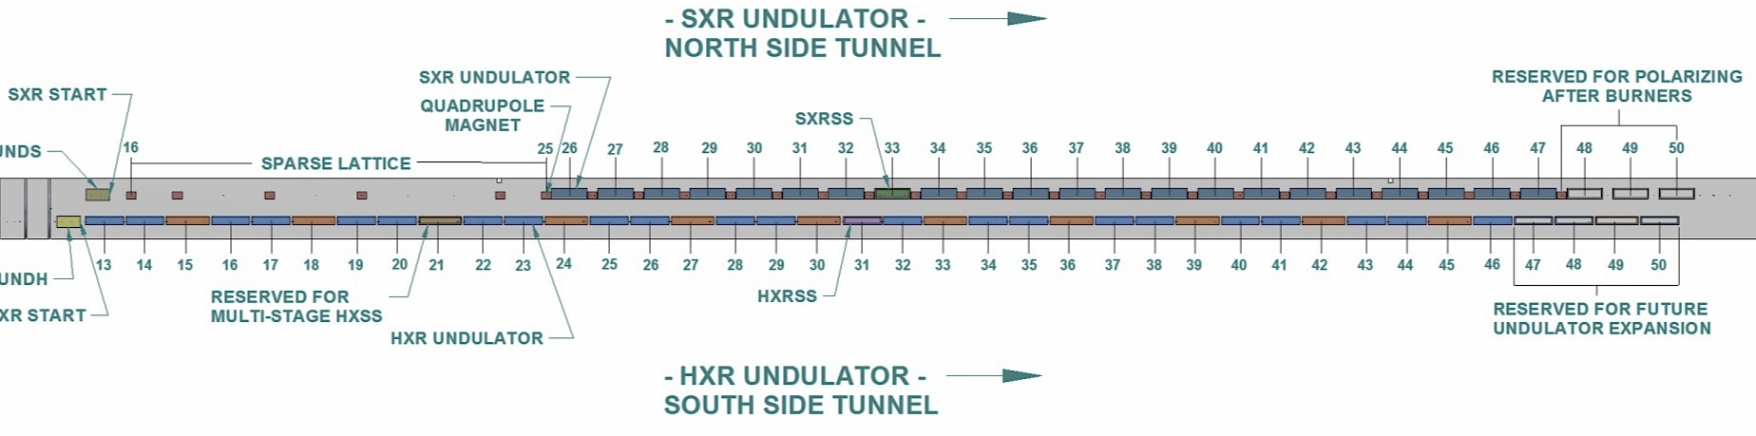
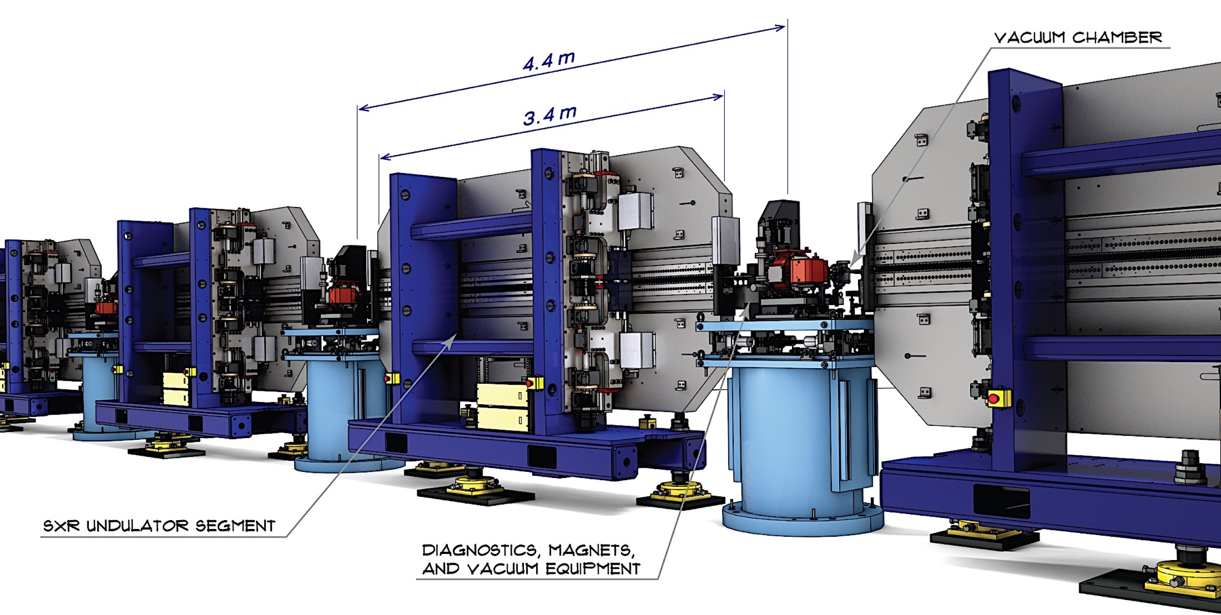

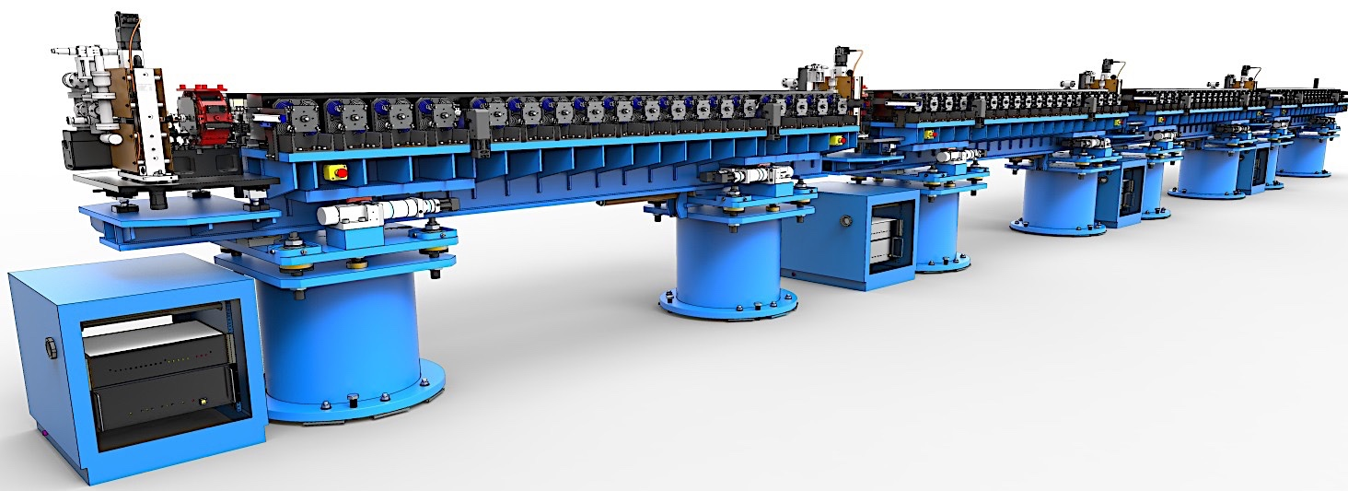
LBNL Provides Undulator Structures To LCLS-II – approach leverages industry for most fabrication and assembly work
Soft X-Ray Line
  21 Undulators + 2 spares
  Horizontally Polarizing
Hard X-Ray Line
  32 Undulators + 2 spares
  Vertically Polarizing
Matthaeus Leitner and Team

Slide 10
Another example of collaboration on a project for a facility: ECR source magnet for the Facility for Rare isotope Beams (FRIB)
Delivered a 28GHz ECR source magnet meeting magnet performance specifications
  Phase I: Design effort
  Phase II: coil prototype and final design
  Phase III: final magnet fabrication and test
Issues encountered, but addressed and delivered within budget and on schedule
Notes:
Add references

Slide 11
The major research pillar within the BCMT:
Lead and contribute to the US Magnet Development Program for DOE-OHEP
Maintain and strengthen US Leadership in high-field accelerator magnet technology for future colliders
Focus on the four primary goals identified in the the original MDP Plan
Further develop and integrate the teams across the partner laboratories and Universities for maximum value and effectiveness to the program
Identify and nurture cross-cutting / synergistic activities with other programs to more rapidly advance progress towards our goals
S. Prestemon, Workshop on Advanced Superconducting Materials and Magnets, KEK January 22 2019
S. Prestemon, Workshop on Advanced Superconducting Materials and Magnets, KEK January 22 2019

Slide 12
We have regular management oversight meetings to monitor progress and identify and address issues
Monthly meetings with Physical Sciences management to monitor main pillars:
  HL-LHC AUP – technical status updates, QC/QA issues, cost and EVMS, infrastructure issues, etc.
  US MDP – research progress and status updates, strategy and planning discussions, management issues, etc.
Weekly update meetings with ATAP Division Director and management team
Weekly update meetings with ATAP operations/finance team
  Regular cost updates on projects and programs – customized cost sheets tailored to project needs
  Support/oversight for procurements, EH&S, etc

Slide 13
Background on the HTS Cable Test Facility magnet planning

Slide 14
Background
SULTAN has been operating at PSI for decades as a major test facility for Fusion CICC cables
EDIPO was built to provide enhanced field in a dipole geometry – enables longer straight cable length
  Based on CICC technology; field of ~12.5T is limit of that technology
PSI and CERN have discussed the possibility to build a new dipole using HEP design approach - “HEPdipo” - to achieve higher field: Rutherford cable, high coil pack current density, full pre-load etc.
LBNL was asked to join the discussion, in particular because LD1 was considered as a starting point for the design
  The recently completed FRESCA2 magnet at CERN is the most relevant reference for fabrication, but a larger bore is required (~150x100 mm)
  FRESCA II: 14.6T, 100mm aperture

Slide 15
Background
FES and HEP began discussions on US options for an HTS Cable Test Facility
  Join with PSI and CERN for an EDIPO replacement, or
  Build a facility in the US
FES requested SP (aided by Joe Minervini) perform a stakeholder survey to develop specifications – completed July 2018
FES requested SP, GLS and GV provide a cost and schedule evaluation – completed Oct. 2018

Slide 16
Proposed Project Approach – minimize project risk while maximizing performance
Leverage DOE-OHEP-developed high field magnet technology
  Build off of HD-series magnets – HD1 (16T, no bore), HD2/3 (~13.8T)
  Leverage early design and development efforts for a large bore magnet – LD1
Leverage efforts of the HEPDipo team
  Build on the design and successful test of FRESCA-II (14.6T, 100mm bore)
  Leverage latest RRP conductors
Leverage facilities and expertise at the DOE-OHEP laboratories
  LBNL/FNAL/BNL have strong design and analysis teams
    LBNL with expertise and history in block-magnet designs
  US has only cabling machine capable of fabricating the requisite large cables (LBNL)
  Winding / reaction / potting tooling exists at LBNL that are not used by HL-LHC AUP
    BNL and FNAL have additional capabilities should the need arise
Define the project team so as to leverage expertise and facilities without impacting HL-LHC AUP and MDP progress towards goals

Slide 17
Define responsibilities / management for maximum efficiency and minimal risk
Proposal:
  LBNL serve as lead for the magnet design / fabrication and test
  FNAL serve as the host for the facility
LBNL Lead for magnet design/fab/test
FNAL serve as HTS Cable Test Facility Host
Interface / spec. coordination
FNAL lead for test facility prep

Slide 18
Assessment of Issues and Alternatives
Possible Risk Issues:
  Impact on HEP project and programs
  FES Stakeholder agreement on specifications
  Magnet performance
Possible Mitigation:
  Avoid use of same facilities
  Avoid key personnel with overlapping resp.
  Define a stakeholder advisory committee
  Minimize significant design changes from HD/LD/FRESCA-II magnets
Alternatives:
  Block magnet vs Cos(t)
  Magnet design with initially larger bore & lower field
    goal of enhancing field in future with HTS insert
Note: Investigating/pursuing alternatives will impact schedule and cost estimate (see GLS presentation)

Slide 19
Project management for a $10M-$15M project
Need a robust project management approach to control cost and schedule
413.3b approach may be excessive (costly management overhead), but EVMS concepts are very valuable
A possible approach tailored to the project scale:
  Set up a management approach with
    A full project WBS
    A resource loaded schedule
    Project contingency agreed-to with DOE in advance, and held by DOE
    Have the project plan reviewed by an external panel prior to baselining
  Perform monthly project updates yielding the usual performance metrics:
    Subtask % complete
    Subtask actual cost updates
    Resulting variances and performance evaluations
    Track discrepancies with variance reporting

Slide 20
Backup slides
Structure of Berkeley Center for Magnet Technology: designed to support DOE-SC mission needs
Example project with delivery of magnet to an SC project: FRIB ECR source

Slide 21
Specific FES questions:
1. Who will be responsible for the different work scopes of the facility, such as the magnet and pit, between LBNL and Fermi?
  See slide 6. Proposal is LBNL lead the magnet design/fab/test; FNAL lead test facility prep and development of sample test systems development
2. Following this, how do the two labs propose to manage the project? Either as one activity, or two different activities (depending on the answer to the first question)? While we are under the MIE threshold and this will not be a formal 413.3b project, the total cost is large enough that we believe some sort of rigorous project management is required for success, and we would like to understand the proposed path forward on this.
  We propose two activities linked via well-defined interface control documents
  The magnet in particular will require rigorous project management (see slide 8).
  In addition to a solid set of management tools and controls, we suggest an external oversight committee with a balance of technical expertise, stakeholder input, and management guidance.
3. What is the optimal schedule for producing the magnet in the shortest amount of time?
  See GLS presentation. The proposed schedule builds in schedule contingency (it is not a “success-oriented” schedule).
  Investigation of design alternatives would increase the schedule (time would be required to advance alternative designs, review, and downselect)
4. What are the most limiting factors which prevent shortening the schedule?
  Developing the design sufficiently to review and commit to long-lead procurement (wire)
5. Will more upfront funding facilitate shortening the schedule?
  Committing to the general design approach and providing immediate funding for design would enable us to advance quickly to the design review

Slide 22
Specific FES questions:
6. Can the schedule be shortened if you hire more technicians and/or set up another manufacturing station?
  It may be possible to leverage another lab for coil fabrication (BNL and/or FNAL), but schedule advantage is somewhat mitigated by setup/tooling development needs
7. Will you be building an identical magnet for EDIPO?
8. Will the design consist of known information or must some research be completed prior to finalizing the design?

