Slide 1
US MDP plans on HTS coil development and test in COMB structure
Vadim Kashikhin, Vito Lombardo
October 9, 2019

Slide 2
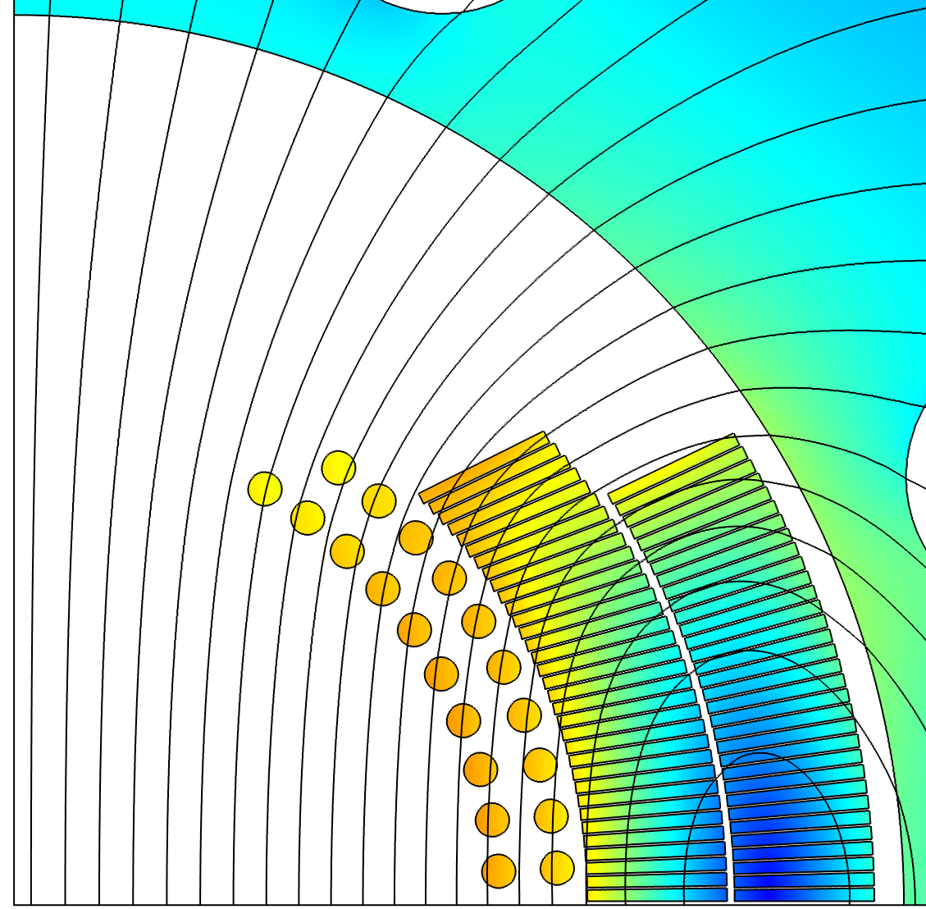
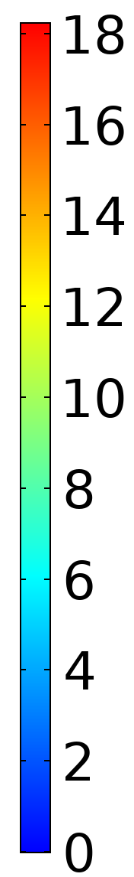
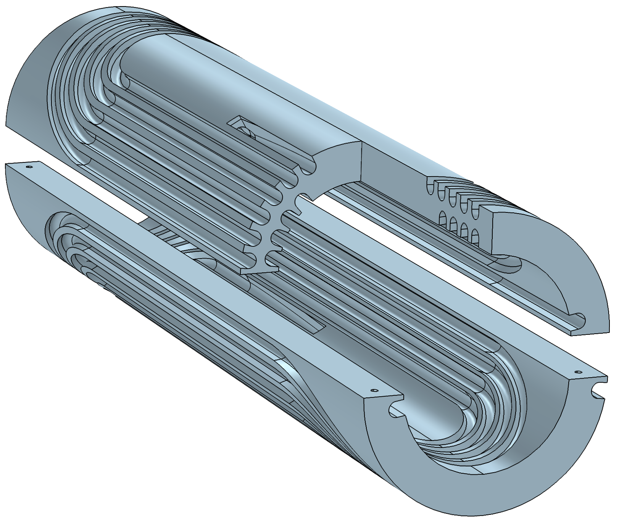
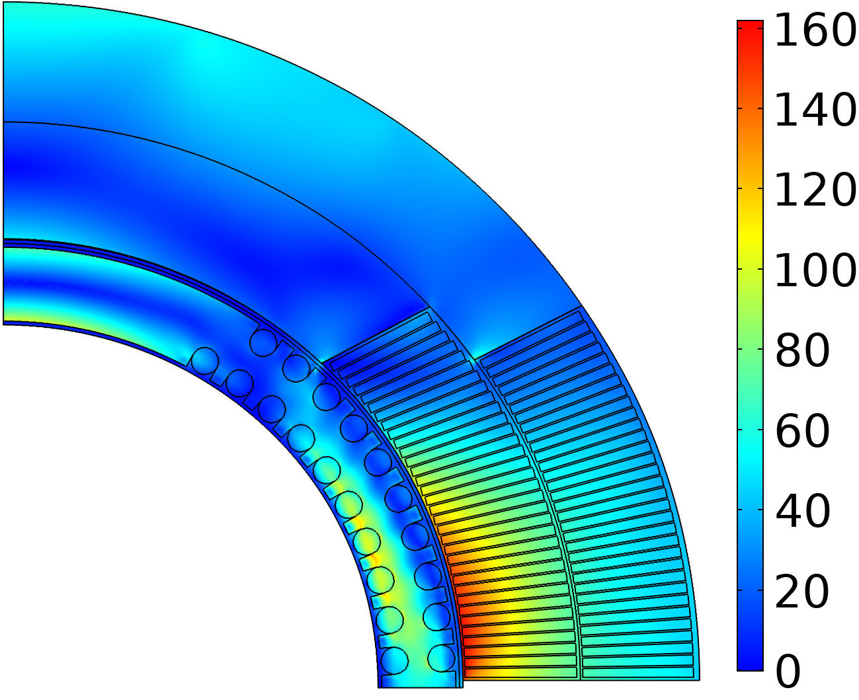
A novel magnet technology (proposed in 2019) -
Conductor On Molded Barrel (COMB)
Magnetic field (T)
Nb₃Sn coil
HTS coil
+1.25 T in Nb₃Sn 4.4 T standalone
Equivalent stress (MPa)
110 MPa
Mock-up coil built to demonstrate manufacturability
160 MPa
Double-COMB
support structure
Within safe limits

Slide 3
HTS/COMB development
Elegant solution for producing HTS inserts to boost magnetic field in superconducting accelerator magnets - well suited for round conductors including CORC® or Bi-2212 cables:
  An alternative to CCT, which has similar features, like an open bore with accelerator field quality and stress management of every turn;
  Benefits from the CCT experience and enhances the Magnet Development Program.
  The barrels can be fabricated as single solid pieces holding two layers of the cable, which permits winding both layers without a splice in high field – crucial for HTS!
  Handles like regular cosine-theta coil assemblies. Can be nested with any number of inner or outer coils using midplane and azimuthal shims – excellent scalability;
The COMB magnet development can be split into two paths:
  Technology demonstration. Procure CORC cable based on the presently available REBCO tapes with the I_{c} spec at 77 K and self-field (to have a quick turn-around). Fabricate two half-coils and test them in a standalone condition at 1.9 K – 77 K. Assemble the COMB coils with the outer Nb₃Sn coils from the 15 T dipole and test them in series at 1.9 K – 4.2 K.
  Performance demonstration. Procure CORC cable based on the next generation of REBCO tapes with a thinner substrate and an I_{c} spec at 6 T, 4.2 K. Fabricate two half-coils and test them in a standalone condition at 1.9 K – 77 K. Assemble the COMB coils with the outer Nb₃Sn coils from the 15 T dipole and test them powered separately (up to 12 T background field) at 1.9 K – 4.2 K.
The 3-year goal is to fabricate two complete COMB dipole coils with the HTS CORC conductors and test them in a standalone condition to demonstrate 4-5 T bore fields and in a background field of the 12 T magnet to demonstrate > 1 T bore field enhancement.

Slide 4
Roadmap (FY 2020-2023)
2020 Q1/2 | 2020 Q3/4 | 2021 Q1/2 | 2021 Q3/4 | 2022 | 2023
CORC cable procurement
Procurement of the next generation high-I_{c} thinner substrate CORC cable
Short-sample/joint fabrication/tests
COMB insert in 12T Nb₃Sn magnet assembly
COMB structure design
Insert test in Nb₃Sn magnet
Parts procurement
Fabrication of 2 COMB half-coils
Fabrication and tests of COMB insert standalone and in 12 T Nb₃Sn magnet
Standalone LN₂/LHe tests
Technology milestone -
Performance milestone -
COMB technology demonstration
HTS performance demonstration

