Slide 1
First discussion on an updated Technology Roadmap
U.S. Magnet Development Program
MDP weekly meeting, 10/31/2019

Slide 2
Technology areas
“POC” mean point of contact –role is for communication
Names are needed – and those identified can be modified
Start viewing these as “Working groups” that hold regular meetings
Technology Area | LBNL POC | FNAL POC | BNL POC | ASC POC
Modeling and Simulation | Lucas Brouwer | Vittorio Marinozzi | TBD | TBD
Training and Diagnostics | Maxim Marchevsky | Maria Baldini | TBD | TBD
Instrumentation and quench protection | Maxim Marchevsky | Stoyan Stoynev | TBD | Dan Davis
Materials studies – superconductors and structural materials properties | Tengming Shen | Steve Krave | TBD | TBD
Magnet design studies | TBD | Vadim Kashikhin | TBD | TBD

Slide 3
Presentation order
Stoyan – training and diagnostics
Joe and Maria - Instrumentation and Quench Protection
Emanuela et al. - high-Cp cables to improve magnet training
Steve and Tengming - Insulation Systems and Technology R&D
…

Slide 4
Training and Diagnostics
Stoyan Stoynev

Slide 5
Overview – improvements in diagnostics
  Fully integrated acoustics sensing capabilities
    With LBNL
    DAQ at >200 kHz (1 MHz)
    Specialized hardware (including data storage) and software
  Quench antenna development
    “3D” apparatus and analysis (Joe)
    “Traces”
      Functional 2D QA array
      “Permanent” (“warm finger”) VMTF QA instrumentation – cold and warm
      Developments for coils
        CCT (with LBNL)
        other magnets under testing at FNAL
  Fiber optics (Maria)
    Bringing the capability to FNAL
    New developments (distributed/non-distributed medium)
  Voltage measurements with multi-spot heaters
    “Point” vs “area” quench distributions (shape studies; comparisons with real data)
    Mirror magnet or another small model
Cold electronics is special
and relate to most subjects!

Slide 6
Overview – training
  Accelerating training
    Studies with the “QCD” (capacitor based device)
    Mirror magnets and later bigger ones (?)
  Sound related tests
    Ultrasonic pulsing
      Relates to quench protection too
    Vibrational test (developments)
  Cable training (in HFVMTF)
    Device to power-test cables (stacks) in magnetic field under pressure
    Determine the level of complexity needed for training
    Manipulate conditions to induce/control training
    Relate to more complex systems (coils)
  Continuous data analysis of tests
  Test bed
  (which small coil model is the base for training improvement studies)?

Slide 7
Timeline
2019 Q4 | 2020 Q1/Q2 | 2020 Q3/Q4 | 2021 | 2022 | 2023 | 2024
Cold electronics
acoustics
QA: 3D analysis
QA: small versions testing
QA: CCT coils
QA: “permanent” versions for VMTF
QA: dedicated for bigger coils
Fibers: capability at FNAL
Fibers: new developments and studies
Multi-spot heater studies
QCD development and tests on small models
QCD larger magnet tests
Ultrasound pulsing
Vibrational tests development
Cable training

Slide 8
Instrumentation and Quench Protection
Joe DiMArco and Maria Baldini

Slide 9
Overview – improvements in magnetic measurements
  Increase harmonic sensitivity and accuracy
    Fabricate measurement anti-cryostat (warm bore tube (WBT)) that is optimized to model magnet aperture (currently using WBT with 28mm diameter in 60mm bore)
    Build new probe(s) with larger radius for new WBT
  Develop high-speed rotating coil capabilities
  (harmonics while rotating 50Hz, stationary 1kHz+)
    Develop and test ‘multi-vertex’ probe technique/analysis with a dedicated probe assembly on bench
    Fabricate MV probe matching new WBT
    Develop analysis to understand magnetic transient / dynamic cable effects in terms of magnet parameters

Slide 10
Overview – magnet measurements
2020 Q1/2 | 2020 Q3/4 | 2021 Q1/2 | 2021 Q3/4 | 2022 | 2023
New WBT
New standard probes
Fabricate and test bench
version of multi-vertex
rotating coil
Fabricate and test multi-vertex probe matched to new WBT

Slide 11
Optical fiber sensors
Project Summary (goals, novelty, relation to mission)
Goal: Developing a novel instrumentation tools and analysis technique to enable a deep understanding of magnet training process and to design free of quench magnets in future accelerators.
Focus:
to use the fibers to characterize external disturbances in order to drive and give feedback for designing free of quench magnets. A novel approach to investigate the disturbance spectrum: energy and localization.
Develop quench protection in HTS magnets
Strategic relevance:
Match the Laboratory distinctive capability on accelerator magnets and bring enduring benefit in magnet diagnostic.
Significant impact on cost and schedule of future High Energy Hadron Colliders; possibly enabling them.

Slide 12
Optical fiber sensors
Project Summary
Goal: Developing a novel instrumentation tools and analysis technique to enable a deep understanding of magnet training process and improve magnet design.
Focus:
  Nb₃Sn: Develop a novel approach to investigate the disturbance spectrum (energy and localization) in order to drive and give feedback for designing free of quench magnets.
  HTS: Develop quench protection system in HTS magnets
Strategic relevance:
  Fit well in MDP distinctive capability and motivations
  Bring in enduring benefit in magnet diagnostic.
  Great synergy with most of the MDP ongoing projects

Slide 13
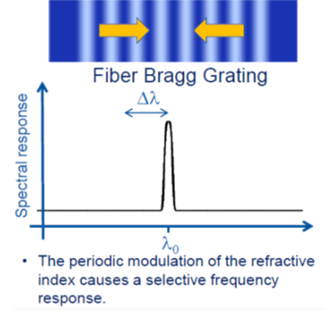
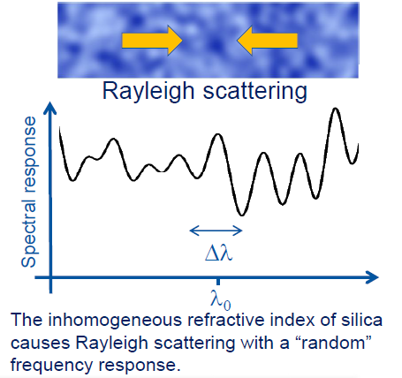
Fiber optics and future accelerator magnets
Discrete sensors
Goals
Monitor strain and temperature during magnet service life:
Coil fabrication: HT and impregnation
Assembly: Pre-stress effects
Cool down and training: Temperature and strain distribution
Continuous sensors
Quench detections for HTS magnets
Assessment of perturbation spectrum for High field superconducting magnets:
  Localization of quench in the pole turn: tip of the cable/distributed?
  Determination of energy releases
New coil design and novel diagnostic

Slide 14
Roadmap
FY20 | FY21 | FY22 | FY23
using FBG fiber sensors for magnet diagnostic to measure strain and temperature during magnet fabrication and training.
Rayleigh fibers: design a proof of principle experiment for energy spectrum analysis and HTS quench detection.
Embed and wind fibers with a coil
Fabricate a Nb₃sn coil and test fiber in a short mirror magnet
Not invasive:
can be easily installed and tested for shell and coil strain measurements in MDP magnet
Perform disturbance spectrum analysis and quench localization
Fiber calibration < 4K
Effectiveness: temperature rise detection at quench
Optimizing measurements
Data analysis and interpretation
Embed and wind fibers with HTS MDP coil
Develop a quench detection system for HTS magnets
  Handling and bonding
  Fiber coating
  Fiber calibration
  New diagnostic technology
Great synergy in within most of the ongoing MDP projects: fibers could be implemented in magnets under development

Slide 15
E. Barzi (PI), I. Novitski, D. Turrioni, and A.V. Zlobin (FNAL)
FY2020 - FY2022
Development and demonstration of high-C_{p} cable technology to improve magnet training

Slide 16
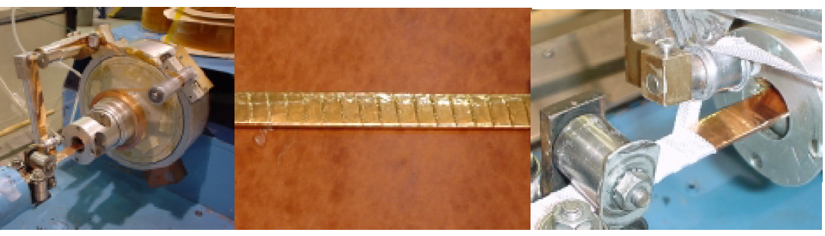
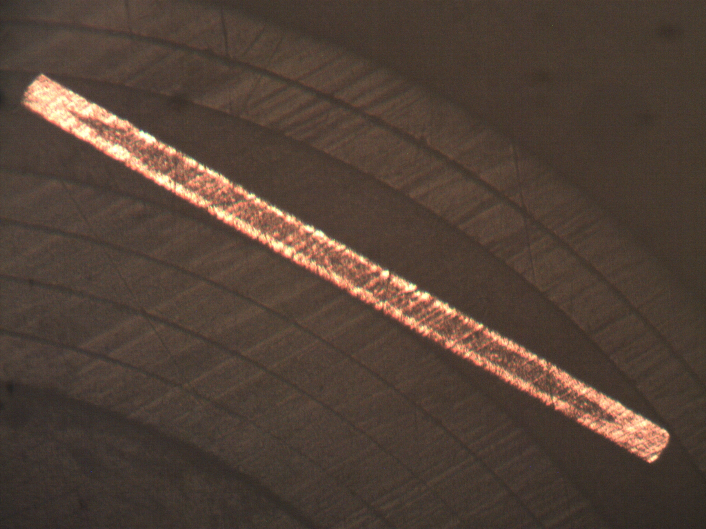
Introduction: ΔT ∝ ΔQ / C_{p}
  To reduce training, ΔT needs to be reduced. Epoxy studies aims at decreasing ΔQ. And what about increasing C_{p}?
  A few years ago an experiment was made to wrap Rutherford cables with Cu tape using FNAL cable insulating machine. See pictures. The idea was to intercept ΔQ from epoxy cracking and spread it over a larger area of cable surface. With a high-C_{p} tape it would be even more efficient.
  We had Hypertech roll down their high-C_{p} tubes to check whether tapes could be made. Below is an example of 2.2 mm x 100 micron tape. They have also shown that a 10 mm width and lower thicknesses are possible, and they have the capability to produce km lengths.
High-C_{p} tape
Cu tape

Slide 17
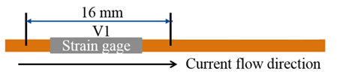
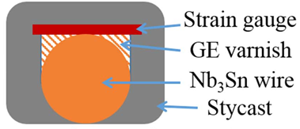
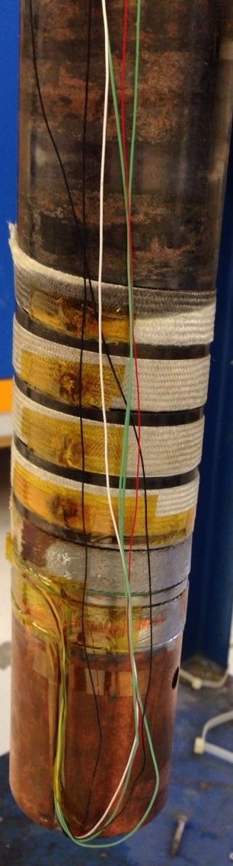
Proposed Tasks
Task 1. Optimize high-C_{p} tape geometry, measure tape mechanical and thermal properties (with Hypertech)
Task 2. Measure and compare MQE of bare Nb₃Sn wire and Nb₃Sn wire wrapped with high-C_{p} tape.
Task 3. Measure and compare stability of regular Rutherford cable and Rutherford cable wrapped with high-C_{p} tape using superconducting transformer:
Use heater setup to measure MQE and MQP.
Perform regular I_{c} cable tests at low fields in unstable regime.
Task 4. Fabricate high-C_{p} cable and test it in coils with long training (such as CCT).
17

Slide 18
Work Plan
2020 Q1/2 | 2020 Q3/4 | 2021 Q1/2 | 2021 Q3/4 | 2022 Q1/Q2 | 2022 Q3/Q4
Task 1. Optimize high-Cp tape parameters.
Task 2. Compare MQE for wrapped wire.
Task 3. Compare MQE for wrapped Rutherford cable.
Task 4. Fabricate high-C_{p} Rutherford cable and test it in coils with long training.

Slide 19
Insulation Systems and Technology R&D for coming Years
Steve Krave & Tengming Shen
FNAL

Slide 20
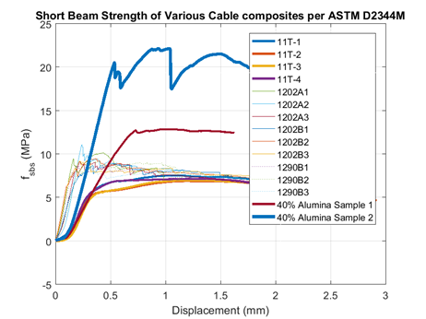
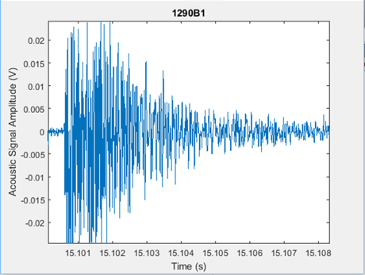
Overview
Insulation Systems, Epoxies and Resins
  Targeting the interfaces that lead to training and limit magnet performance
    Understand Behavior
    Understand Variables
    Develop controls
Tooling and Coatings
  High Temperature compatible process developments
  Co-developed with sample fabrication
Off Project Work
  CTD SBIR
  Current AUP Studies and QC

Slide 21
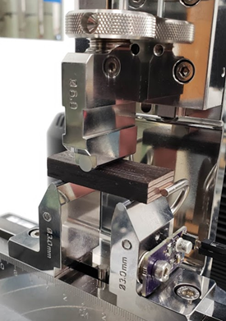
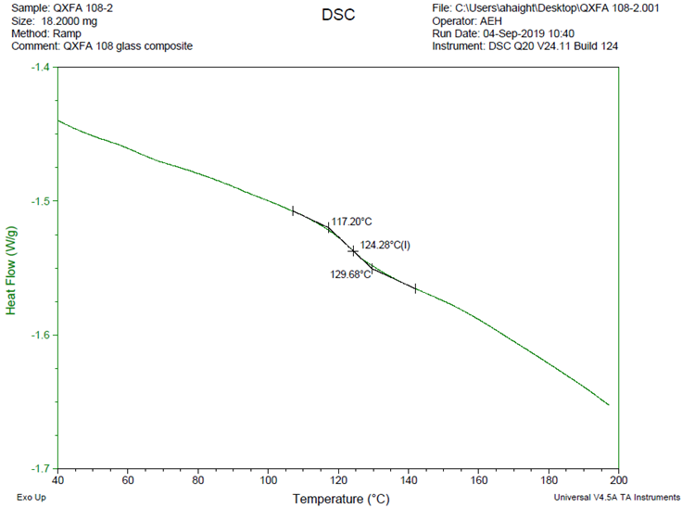
Resins
Continue development of thermoplastic resins
  Re-design system for 8” ten stack system
  Test ULTEM, PEEK, HDPE
Demonstrate Low CTE Resin on Nb3Sn
  Improve adhesion to conductor
  Define behavior relationships
  Cable washing and etching
  Oxidizing/reducing reaction environment
(Re)Develop Further testing, processing, and QA/QC capabilities
  Fracture Toughness
  Robust CTE
  DSC
  FTIR
  Epoxy Handling equipment at MDTL

Slide 22
Roadmap (FY 2020-2023)
2020 Q1/2 | 2020 Q3/4 | 2021 Q1/2 | 2021 Q3/4 | 2022 | 2023
Demonstrate Thermoplastic on Nb3Sn Cable
Materials Evaluations
Materials Evaluations
Demonstrate CTE Matched resin on Nb3Sn
Interface Modification: Surface Treatments
Interface Modification Process changes
Technology Subscale Fabrication-
Technology Subscale Fabrication-
Technology Subscale Fabrication-
Technology Subscale Fabrication-
Test
Test
Test
Test
Allow for continuous process improvement as understanding improves through magnet testing

Slide 23
Modeling and simulations
Lucas Brouwer, LBNL

Slide 24
Goal #1: advanced simulation tools for quench protection of LTS and HTS magnets
geometry and material independence allows for widespread use across all MDP labs (Nb-Ti, Nb₃Sn, Bi2212, REBCO)
open source allows for understanding and modifying code as desired (shared development)
enables
  design of advanced quench protection systems for HTS and LTS magnets (CLIQ, FLIQ, QCD, + new ideas)
  analysis of quench protection for planned hybrid testing (HTS + LTS)
2017 2018 2019 2020 2021 2022
2D Multiphysics FEM
Plan
Extension to HTS (E-J power law)
Extend to leverage DOE HPC resources
(clusters, NERSC, etc.)
Exploration of new methods for HTS simulation (xFEM, etc.)
Extension to 3D
Milestones
Simulation of CLIQ for Nb₃Sn and Bi2212 Magnets
HTS Bulk Benchmark
Fully Coupled HTS+LTS Hybrid Simulation
Fully Parallelized Multi-physics

Slide 25
Goal #2: advanced mechanical modelling for magnet design and understanding training
large forces and brittle conductor makes detailed mechanical design critical for LTS and HTS
growing emphasis on interface behavior motives new mechanical modeling approaches
enables
  study of interface behavior for CCT, SCT, and other magnets in MDP
  identification of potential sources of training (pinpoint for diagnostics in testing)
  design of sub-scale and epoxy experiments to probe desired behavior for large magnets
2017 2018 2019 2020 2021 2022
Develop 3D ANSYS Mechanical Modelling for CCT
Strong feedback from subscale and materials testing
Plan
Design of CCT and solenoid subscale magnets for training studies
Develop techniques for understanding interface behavior
Milestones
HPC w/Shared Memory for Large 3D Models (up to 50 cores)
Subscale Tests / Feedback
Cohesive Zone Elements, Model Delamination

Slide 26
Goal #3: improved modeling of HTS cable configurations
MDP is building magnets with HTS cables
current distribution between REBCO tables is already active area of research in MDP (networks models, initial experiments, etc.)
strong synergy with fusion efforts, key is to extend/apply for HEP, not replicate
A first list of driving questions (to be continued)
what is the strain distribution in REBCO tapes during cabling, magnet fabrication, operation
  how can we minimize strain induced degradation
  what is the impact of cycling Lorentz load and the mechanism of degradation
how do cable properties affect current distribution (contact resistance, defects, cable architecture)
  impacts field quality and quench behavior
how can we build a feedback loop to conductor/cable vendors
  leading to robust HTS cables for HEP/Fusion applications
4. ………
Strong input and coordination across labs will help to develop a plan to address these and other driving question (experiment + simulation)

Slide 27
Technology development roadmap
M. Marchevsky

Slide 28
Nb₃Sn magnet technology (I)
Quench and disturbance localization
We have established robust localization capabilities within MDP working on CCT magnets, and also gained unique expertize of disturbance localization on sponsored projects (FNAL/Mu2e, GE)
Complex magnet structures like multi-layer CCTs and cosine-theta magnets like FNAL 15 Tesla dipole are very heterogeneous and therefore require new approaches to disturbance location triangulation
Disturbance spectra and mechanical event type analysis for high-field magnets
We have collected very large continuous datasets of mechanical disturbance data on CCT4 / CCT5 for the first time, allowing for statistical and machine learning analysis. We have teamed up with NERSC on developing DL models for unsupervised classification of mechanical events in magnets. Some encouraging early results were presented at MT26.
Going forward we will develop a (magnet type-independent) capability to classify disturbances, identify precursors and predict quenches in real time.

Slide 29
Nb₃Sn magnet technology (II)
Training and degradation analysis: explore physical manifestation of training and repetitive stress at coil and conductor level
Systematic post-test analysis of trained coils vs untrained coils is needed to study training-specific changes in the conductor, impregnation material and structural interfaces. Identifying physical mechanisms responsible for magnet “memory”.
Understanding role of plastic deformation, low temperature serrations, and repetitive stress on conductor performance and degradation in high-field magnets. Getting increasingly relevant as we move to higher fields.
Real-time active acoustic monitoring of structural interfaces upon current ramping and training was demonstrated for CCT magnets (MT26 presentation). It is a simple and powerful tool for providing feedback on magnet structural integrity in real time during testing, and it will be further improved through use of multi-sensor arrays.

Slide 30
HTS magnet technology
Robust QD capability for HTS magnets
Recent explosive development of various non-voltage QD techniques for HTS has identified new opportunities but also new. New paradigm emerged: rather than detecting quench that is already happening, aim at detecting its early precursors. This will allow to safely turn off the current and avoid quenching altogether. (S. Gourlay - IDSM’01 Workshop, 2019)
We will develop an integrated portable “plug and play” acoustic QD solution (active sensors + cold FPGA)
Technique has already been demonstrated for ReBCO, CORC, Bi-2212 and fusion cables. Synergistic to our deliverables for FES and sponsored projects.
Long-term endurance of high-field HTS magnets
For now there is no diagnostics available to:
Identify and quantify damage along the REBCO tape edges caused by magnetization currents
Identify delamination's and crack formation in tapes due to excessive (repetitive) stress
Detect voids in REBCO layer responsible for local electric field anomalies / excessive flux creep
We will explore new ideas and solutions to address these important topics
Current sharing in tape stacks and cables, stability margins
Crucial for optimization and cost reduction of cables ands well as magnet design
We will develop flexible Hall sensor arrays for visualization and early detection of current redistribution in HTS conductor stacks and cables

Slide 31
Providing unique instrumentation capabilities and new diagnostic tools to the MDP
Local probing and control of superconductors using time-reversal acoustics
Focusing of acoustic waves on a specific location inside the coil can be very useful for local probing of mechanical interfaces and temperature variations. It can be also used to locally deposit mechanical energy into the coil aiming at modifying its training behavior. Room-temperature demonstration have been reported at MT26, small-scale cryogenic experiments are ongoing.
Demonstrating this technique on a CCT subscale is our next goal
Non-rotating magnetic measurement probes
A bulk stationary probe capable of measuring magnetic filed harmonics can be universally useful for the entire accelerator magnet community and benefit the ongoing magnet projects. We want to explore some new ideas in that area, aiming at close collaboration with FNAL for probe development and calibration.
Cryogenic FPGAs for readout and control of quantum sensors
Ongoing collaboration with a quantum computing company may bring unique opportunities to MDP in high-frequency cryogenic DAQs and quantum sensors (SQUIDs), helping us with future development of magnet diagnostics based on magnetic and optical probes.

Slide 32
Development timeline
2020 | 2021 | 2022 | 2023 | 2024 | 2025
Self-calibrating active acoustic system setup
Advanced localization
Interface monitoring
Mechanical memory mechanisms
FPGA-based acoustic QD
ML-based real-time disturbances classifiers / quench predictors
Flexible Hall arrays
Time-reversal acoustics experiments and demonstrations
HTS stress degradation / crack diagnostics
Non-rotating magnetic probe
Cryo FPGA and DAQ solutions
Quantum sensors

Slide 33
Backup slides

Slide 34
HTS coil development and test in COMB structure
Vadim Kashikhin, Vito Lombardo

Slide 35
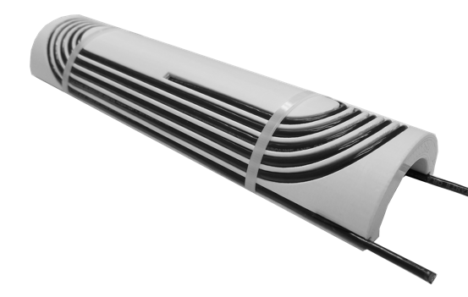
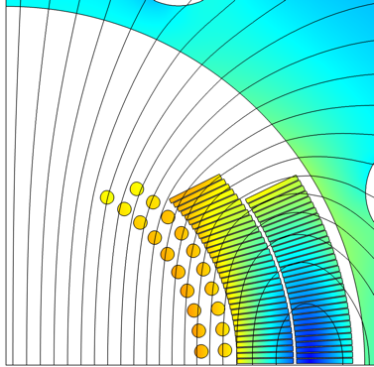

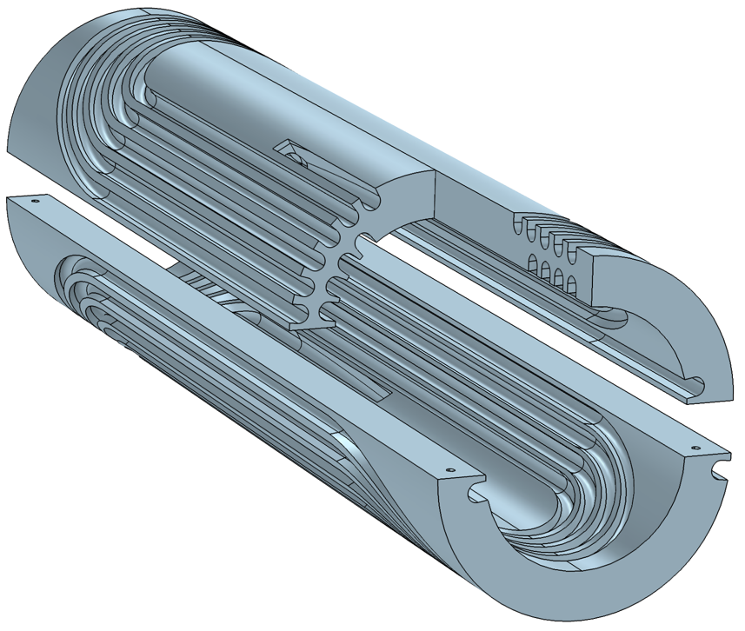
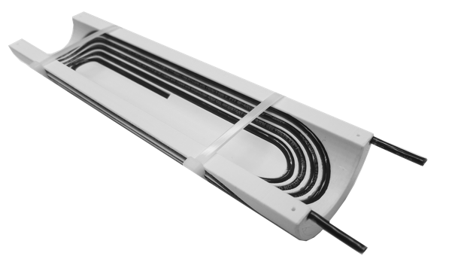
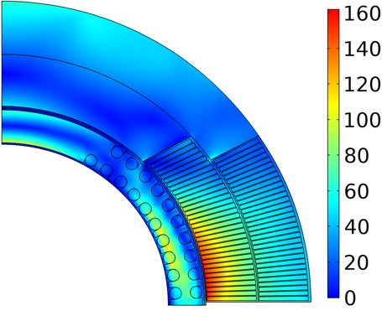
A novel magnet technology (proposed in 2019) -
Conductor On Molded Barrel (COMB)
Magnetic field (T)
Nb₃Sn coil
HTS coil
+1.25 T in Nb₃Sn 4.4 T standalone
Equivalent stress (MPa)
110 MPa
Mock-up coil built to demonstrate manufacturability
160 MPa
Double-COMB
support structure
Within safe limits

Slide 36
HTS/COMB development
Elegant solution for producing HTS inserts to boost magnetic field in superconducting accelerator magnets - well suited for round conductors including CORC® or Bi-2212 cables:
  An alternative to CCT, which has similar features, like an open bore with accelerator field quality and stress management of every turn;
  Benefits from the CCT experience and enhances the Magnet Development Program.
  The barrels can be fabricated as single solid pieces holding two layers of the cable, which permits winding both layers without a splice in high field – crucial for HTS!
  Handles like regular cosine-theta coil assemblies. Can be nested with any number of inner or outer coils using midplane and azimuthal shims – excellent scalability;
The COMB magnet development can be split into two paths:
  Technology demonstration. Procure CORC cable based on the presently available REBCO tapes with the I_{c} spec at 77 K and self-field (to have a quick turn-around). Fabricate two half-coils and test them in a standalone condition at 1.9 K – 77 K. Assemble the COMB coils with the outer Nb₃Sn coils from the 15 T dipole and test them in series at 1.9 K – 4.2 K.
  Performance demonstration. Procure CORC cable based on the next generation of REBCO tapes with a thinner substrate and an I_{c} spec at 6 T, 4.2 K. Fabricate two half-coils and test them in a standalone condition at 1.9 K – 77 K. Assemble the COMB coils with the outer Nb₃Sn coils from the 15 T dipole and test them powered separately (up to 12 T background field) at 1.9 K – 4.2 K.
The 3-year goal is to fabricate two complete COMB dipole coils with the HTS CORC conductors and test them in a standalone condition to demonstrate 4-5 T bore fields and in a background field of the 12 T magnet to demonstrate > 1 T bore field enhancement.

Slide 37
Roadmap (FY 2020-2023)
2020 Q1/2 | 2020 Q3/4 | 2021 Q1/2 | 2021 Q3/4 | 2022 | 2023
CORC cable procurement
Procurement of the next generation high-I_{c} thinner substrate CORC cable
Short-sample/joint fabrication/tests
COMB insert in 12T Nb₃Sn magnet assembly
COMB structure design
Insert test in Nb₃Sn magnet
Parts procurement
Fabrication of 2 COMB half-coils
Fabrication and tests of COMB insert standalone and in 12 T Nb₃Sn magnet
Standalone LN₂/LHe tests
Technology milestone -
Performance milestone -
COMB technology demonstration
HTS performance demonstration

