Slide 1
High Field Vertical Magnet Test Facility for Conductor, Cable and Magnet R&D
MDP Roadmap Workshop, December 4-5, 2019
G. Velev, G. Sabbi and S. Prestemon

Slide 2
Outline
  Overview
      Why a new Vertical Magnet Test Facility at Fermilab in the context for conductor, cable and high field accelerator magnet R&D?
      Synergy with FES
  Current status
15 T conceptual dipole magnet design
Schedule for HFVMTF
Summary
N.B. This facility is not part of MDP but will enable MDP capabilities to test hybrid magnets

Slide 3
Why new Vertical Magnet Test Facility?
One of the primary goals of the US Magnet Development Program is to pave the way for future high field accelerator magnets, e.g. 16-20 T dipoles
The x-section of magnet is increasing with the field - need a test facility with larger cryostat diameter
Goal: to construct a vertical test facility (pit) for ø= 1.4-m diameter magnets operating at 1.8-1.9K and max current for the main magnet 24kA:
  For MDP: it will serve for testing HTS, Nb₃Sn samples, hybrid magnets (Nb₃Sn+HTS), utility structures to test magnet components in HF
  For FES: 15 T large aperture magnet will be build to serve as a vehicle for HTS cable testing (lead LBNL)
Fermilab is unique place to build such facility
  1.8K testing capabilities
  30 kA power supply system, maybe reused, but better substituted
  2x 25-ton lifting capability for a single object in vertical direction
  New Cryo plant is coming in operation at the end of 2021
This proposed setup has similar or better parameters, comparing to FRESCA2 at CERN or HEPdipo at PSI

Slide 4
Fermilab Site
For this project, we take advantage of relevant studies, designs and activities performed at Fermilab in the past:
  Building and operating 4 vertical pits for SC magnet and SRF programs.
  Experience with designing, assembling and commissioning of complex quench monitoring and quench protection systems for High Field magnet stand, mu2e experiment and HL-LHC production stand.
  Experience in the design and commissioning of complex measurement system, including magnetic field measurement devices.

Slide 5
Current R&D US Test Facilities
R&D US Test Facilities*
Institution | V/H | T_{min} | L_{max} | ID _{max} | I_{max} | User | Availab.
BNL | V | 1.9 K | 5.2 m | 0.67 m | 22 kA | HL-LHC | After 2025
FNAL | V | 1.9 K | 3.7 m | 0.63 m | 30 kA | Open/MDP | Now
FNAL | V | 4.5 K | 0.7 m | 0.48 m | 10 kA | Open/MDP | Now
LBNL | V | 4.5 K | 2.2 m | 0.8 m | 25 kA | Open/MDP | Now
*There are other test stands, like stand 4 in Fermilab, which is used to test production series of magnets, which can be used for R&D after AUP is tests are concluded

Slide 6
Preliminary Specifications - Test Facility
The test facility will be constructed in Industrial Building 1, APS-TD, Fermilab. To save money, the proposed place is selected based on the proximity to the needed base infrastructure for a such test stand, including cryogenic, power, water and crane(s).
Minimum operating temperature of the facility is 1.8K for the magnet providing the background field and 4.2-4.5 K *(under discussion) for the test samples.
The test pit cryostat should accommodate a dipole (cold mass) with maximum dimensions of ø=1.35 m and length of 2.5-3.0 m
The maximum energy in the test field dipole should be < 15MJ (under discussion)
The maximum weight of the dipole cold mass should not exceed 25 t or 2x25 t with tooling
The test facility should be efficient and safe, minimizing the time for experiment preparation and no helium losses after quenches.
• Operational lifetime of the facility at least 20 years.

Slide 7
Design Assumptions - Test Facility & FES requirements
The main magnet cryostat includes a Lambda plate and top plate assembly.
HTS test sample cryostat for the magnet well with possibility to control the sample temperature to 1K in the region of 4.3 to 55 K. (under discussion)
Design and assembly a reliable Quench Monitoring and Protection systems for the main dipole and testing samples.
Together with FES to design and manufacture appropriate SC transformer for test samples. The alternative option is to use high current PS(s).

Slide 8

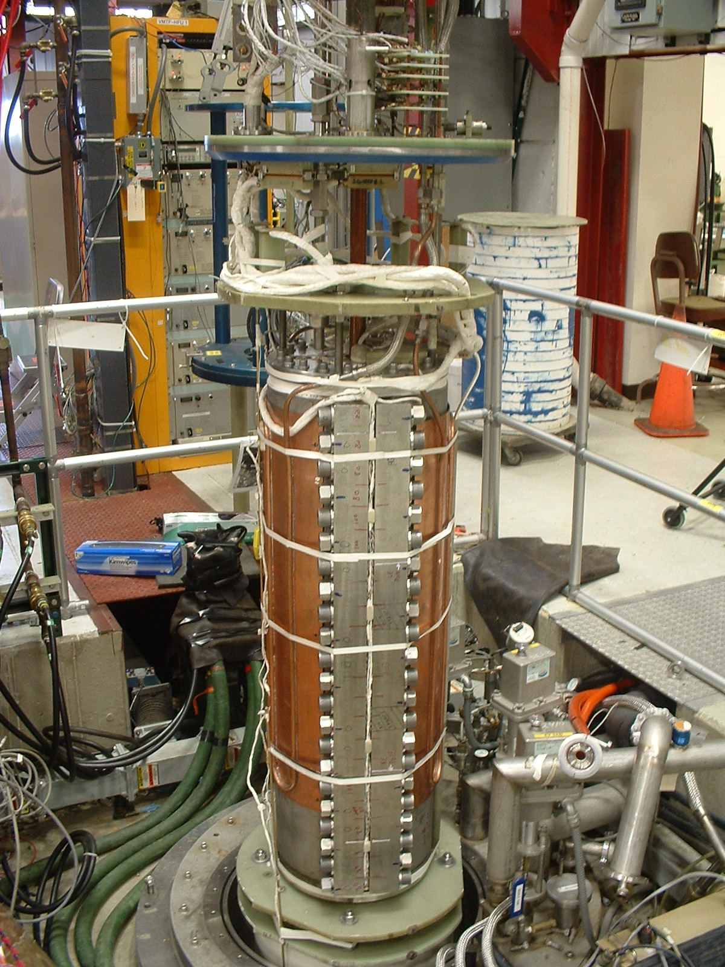
Fermilab: VMTF and HFVMTF
VMTF
HFVMTF
1.3 m
0.6 m

Slide 9
Current Status
The firsts tranche of money are received from the Offices of FES and HEP
This project includes only the civil (pit) and the cryostat and top/lambda plates
It was classified as GPP by Fermilab site DOE office
  Pit design is practically done
  Needs review
  Bidding process
  Pit construction is expected late spring/early summer 20202
The cryostat design is just starting
The plan for this phase is to finish in July 2021

Slide 10
Civil Construction Drawings
Current VMTF
HFVMTF

Slide 11
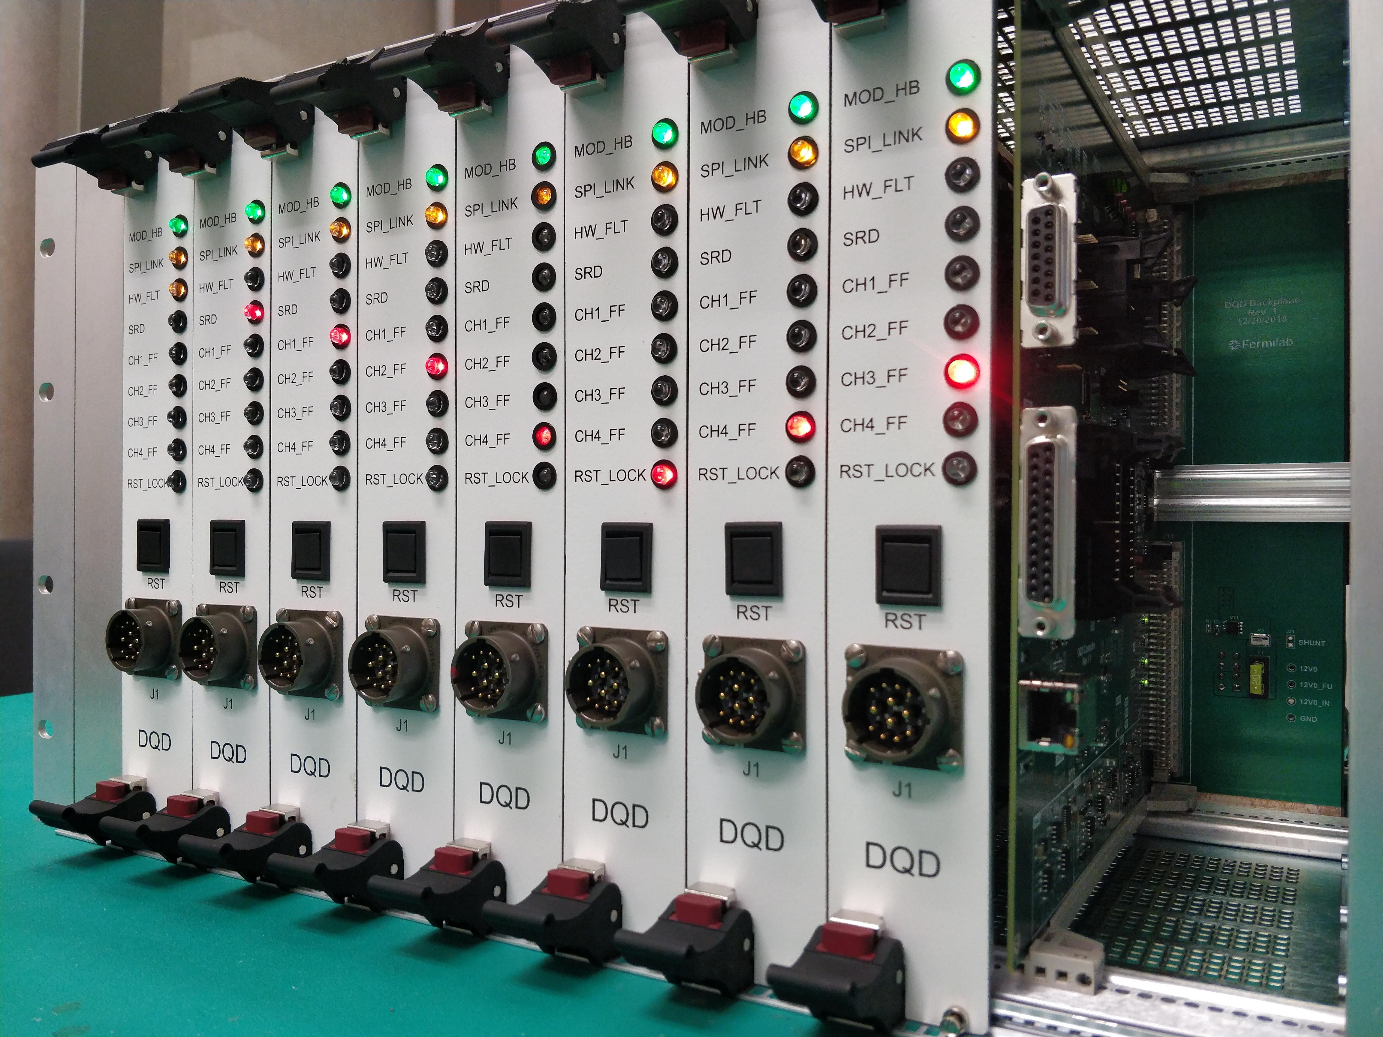
Next Steps
For the test facilities next step includes:
  Design, procure and build QD/QP and QM system
  Purchase two sets of PSs, for the main magnet and the test samples/coils
  Final integration of the test facility, receive Operation Reediness status
If we receive the second tranche of funds in FY20 the test pit can be operation at the end of 2022 (FY23).
Next Generation of Digital Quench Detection and Characterization System.
Chassis with 32 Isolated Analog Channels and Digital Controller.

Slide 12
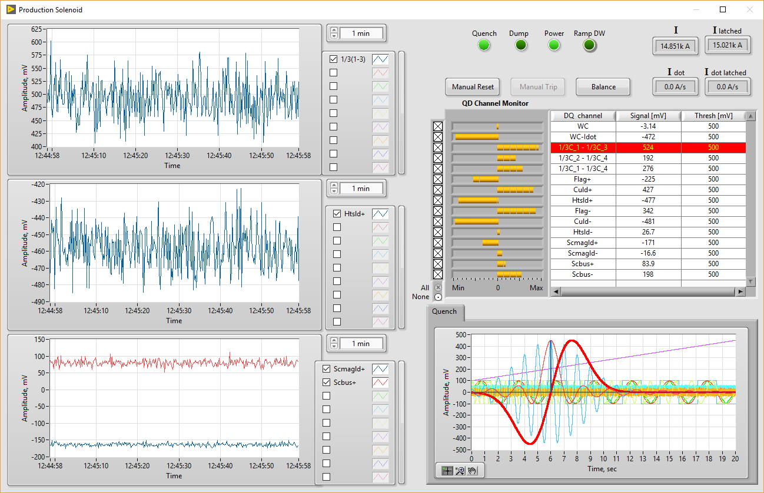
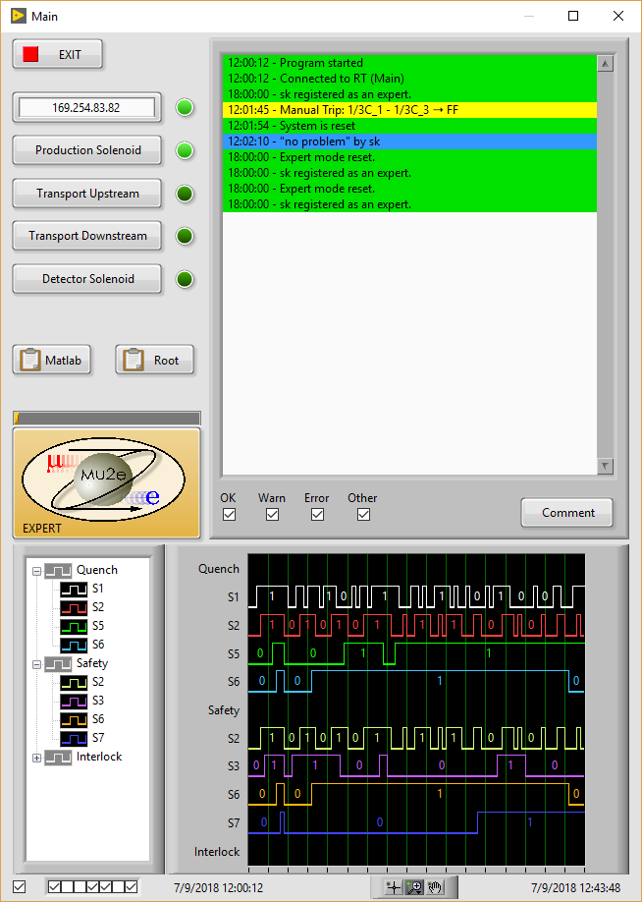
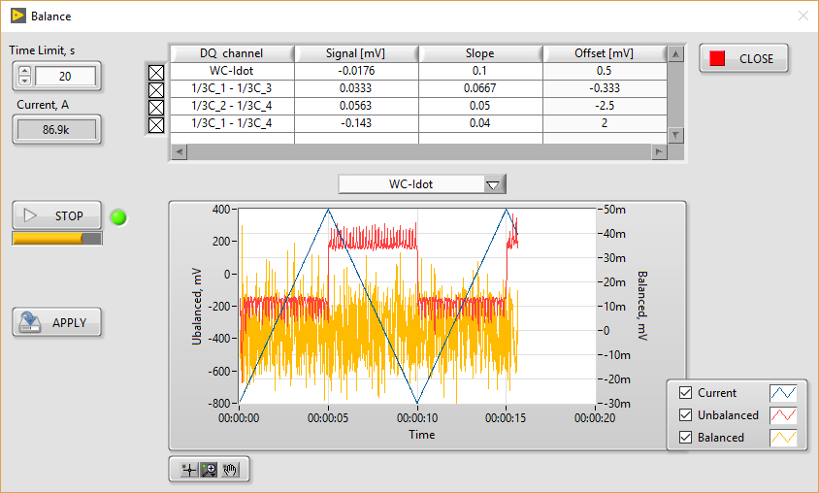
Quench Detection System GUI
Main Quench Control Window
1 of 4 Magnet Quench Signal Monitoring Windows
Expert Mode Configuration & Balancing

Slide 13
Specifications - Magnet
Background dipole field > 15T, at 1.9 K with graded coils. This goal is higher than in previous facilities or other proposals ~ HEPdipo magnet.
Homogeneous field region > 0.5-0.6 m, preferably > 1 m. This requirement has a strong influence on the magnet size and cost.
Cryostat to accommodate sufficient sample length to keep sample joint in low field.
Well dimension 90x140 mm², and preferably 100x150 mm². It would be preferable to make the well compatible with FRESCA2 and fusion SULTAN/EDIPO samples
Field quality in the transverse plane: for now not specified. Current assumption is <20 units for all harmonics at 35 mm radius

Slide 14
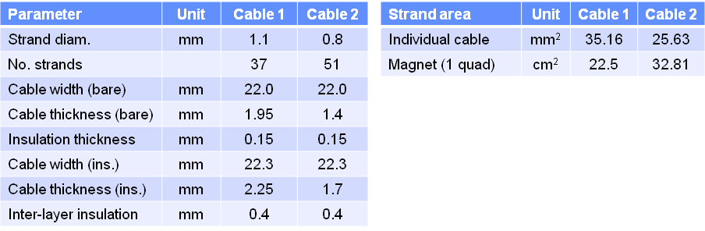
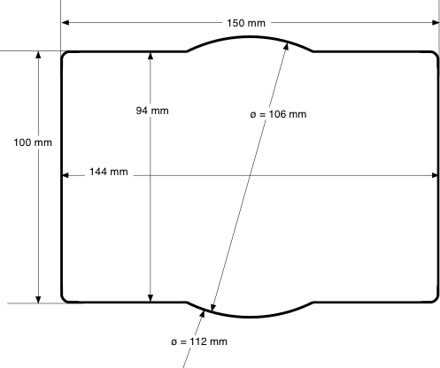
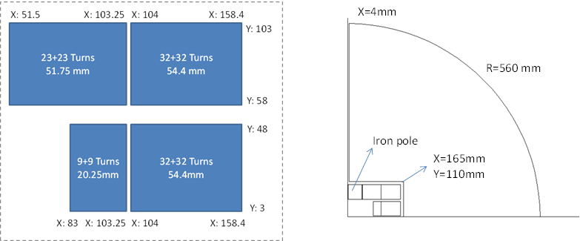
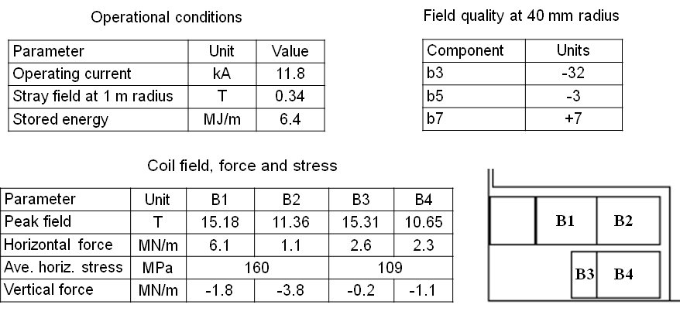
Conceptual Magnet Design
Conceptual magnet design by G. Sabbi at al. (PSI, CERN, LBNL, MIT)
EDIPO replacement spec: rectangular aperture of 94x144 mm²
Cable and Coil Parameters
Block type
B
High field wire based on MDP/FCC conductor development plans: large diameter (1.1mm) and 1.5<Jc<2.0 kA/mm² at 15T, 4.2K
Low field wire/cable based on LD1/HD2 parameters to take advantage of existing inventory
Operational Conditions

Slide 15
Summary
A project to build a new HFVMTF at Fermilab just started
The facility will support future MDP and FES R&Ds
Different level of the HFVMTF design and conceptual design of the 15 T dipole magnet exits
Schedule and cost estimations are in place
  First tranche of funds were received
  Depending on the future funding
    HVFMTV could be operational at the end of 2022
    15 T wide aperture magnet can be ready after that
For now no conflicts with the current projects at Fermilab is expected

Slide 16
EXTRAS

Slide 17
Fermilab VTF Summary
Parameter | Existing VMTF | Proposed HFVMTF
Operating Temperature | 1.8K | 1.8-1.9K
Maximum Current (1st PS) | 30 kA | 30 kA or new 24 kA
Maximum Current (2nd PS) | Not available | 15 kA (to test hybrid magnets) or 100 kA for FES
Helium Vessel Diameter | 0.66 m ( 25.8 inches) | < 1.4 m (55 inches)
Maximum Length of Test Object | 3.7 m | >2.5 m
Maximum Diameter of Test Object | 0.63 m (MQXFS1 with skin) | 1.35 m
Crane Capacity | 10 t | 25 t or 2x25 t & LF
Location | IB-1 VMTF Bay | IB-1 (IB1 High Bay)

Slide 18
New CERN High Field Test Facility Proposal
Slide from V. Benda et al. talk: ICEC25-ICMC2014 2014, The Netherlands
✓
✓
✓
✓
✓
✓
✓
✓
✓
✓
✓
✓

Slide 19
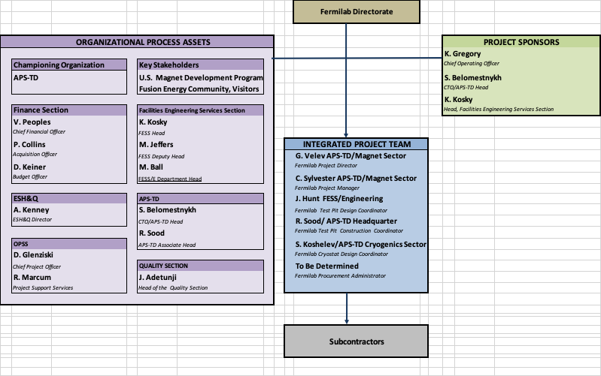
Project Structure

Slide 20
Project schedule - Magnet
  When funding is available the project can be executed for ~ 5 years.
  Note: schedule and cost assumes use of some existing inventory (shell and yoke) from LD1; conductor/cable cost assumes use of available cable from LD1

