Slide 1
Insulation Systems and Technology R&D for FY20-22
Steve Krave, FNAL
Tengming Shen, LBNL
10/31/2019

Slide 2
Charges from US MDP plan

Slide 3
Tasks and goals
Tasks | Rationales | FY20 Q1/Q2 | FY20 Q3/Q4 | FY21 | FY22
1. Thermoplastics | Pros: High toughness and high radiation toughness Cons: (1) High viscosity and high processing temperature | Materials properties assessment: (1) CTE; (2) Shrinkage during cure. | Materials properties assessment: (3) Compression modulus and strength. (4) Shear strength. | Decision point: Testing Thermoplastics on CCT Nb₃Sn subscale magnet (SM)?
2. High toughness resins with CTD | Investigate high toughness epoxy system besides NHMFL mix-61. Support small business to develop and verify new products. Supplement funding from SBIR. | Engage CTD materials testing |  |  | Decision point: Down selections and testing the best formulation on large size magnets. Radiation tests.
 |  | Cable and CCT mandrel fabrications | Testing CTD701x (not an epoxy) on CCT Nb₃Sn SM
 |  |  |  | Testing second formulation on CCT Nb₃Sn SM
 |  |  |  | Testing third formulation on CCT Nb₃Sn SM

Slide 4
Tasks and goals
Tasks | Rationales | FY20 Q1/Q2 | FY20 Q3/Q4 | FY21 | FY22
3. High specific heat, low CTE Gd₂O₃ nanoparticles filled epoxy | Stress management for epoxy, especially those neat resin areas between strands within Rutherford cables. | Ten turn 3D-printed CCT mandrel potting tests. | Decision point: Testing this approach on CCT Nb₃Sn subscale magnet (SM)?
4. Understand epoxy failure with advanced diagnostics | Understanding characteristic events, feeding into modeling and machine learning models | Four cable stack short beam shear. S-2/fiber epoxy short beam shear. | S-2/fiber epoxy compression/shear
5. Improve epoxy resin and Nb₃Sn QA/QC and processing controls | Understand impacts such as temperature gradient, shelf life, and moisture control etc. on properties of epoxy. | Effects of curing temperature on compression properties and T_{g} etc. | Effects of moisture control | Effects of shelf lives of epoxy components.
6. Nb₃Sn Rutherford cable Insulation materials | What are alternative insulation systems and how will they affect quench training?

Slide 5
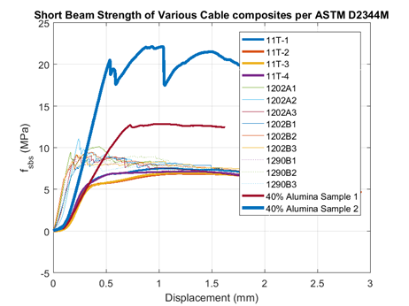
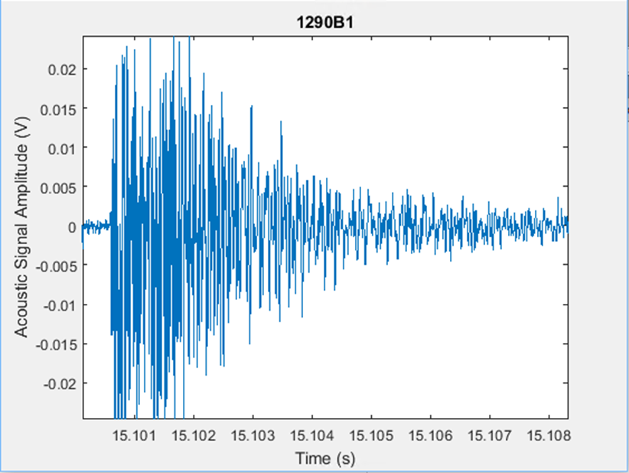
Overview
Insulation Systems, Epoxies and Resins
Targeting the interfaces that lead to training and limit magnet performance
Understand Behavior
Understand Variables
Develop controls
Tooling and Coatings
High Temperature compatible process developments
Co-developed with sample fabrication
Off Project Work
CTD SBIR
AUP Studies and QC?

Slide 6
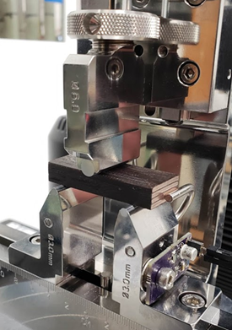
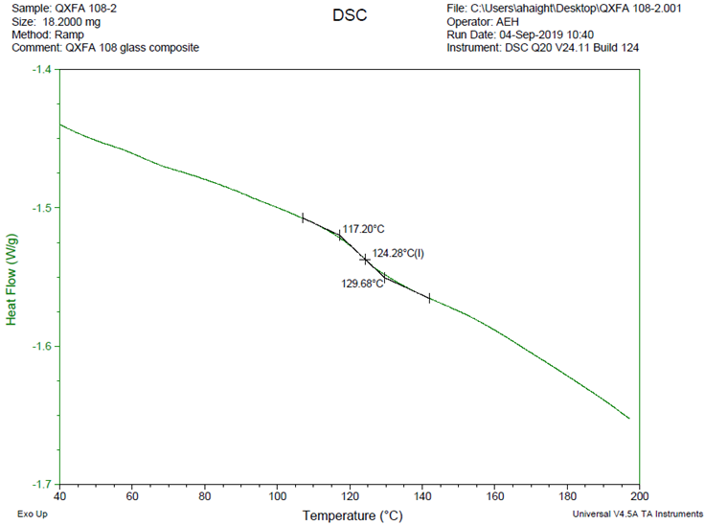
Resins
Continue development of thermoplastic resins
Re-design system for 8” ten stack system
Test ULTEM, PEEK, HDPE
Demonstrate Low CTE Resin on Nb3Sn
Improve adhesion to conductor
Define behavior relationships
Cable washing and etching
Oxidizing/reducing reaction environment
(Re)Develop Further testing, processing, and QA/QC capabilities
Fracture Toughness
Robust CTE
DSC
FTIR
Epoxy Handling equipment at MDTL

Slide 7
Roadmap (FY 2020-2023)
2020 Q1/2 | 2020 Q3/4 | 2021 Q1/2 | 2021 Q3/4 | 2022 | 2023
Demonstrate Thermoplastic on Nb3Sn Cable
Materials Evaluations
Materials Evaluations
Demonstrate CTE Matched resin on Nb3Sn
Interface Modification: Surface Treatments
Interface Modification Process changes
Technology Subscale Fabrication-
Technology Subscale Fabrication-
Technology Subscale Fabrication-
Technology Subscale Fabrication-
Test
Test
Test
Test
Allow for continuous process improvement as understanding improves through magnet testing

