Slide 1
Optical Stochastic Cooling
J. Jarvis
December 10, 2019

Slide 2
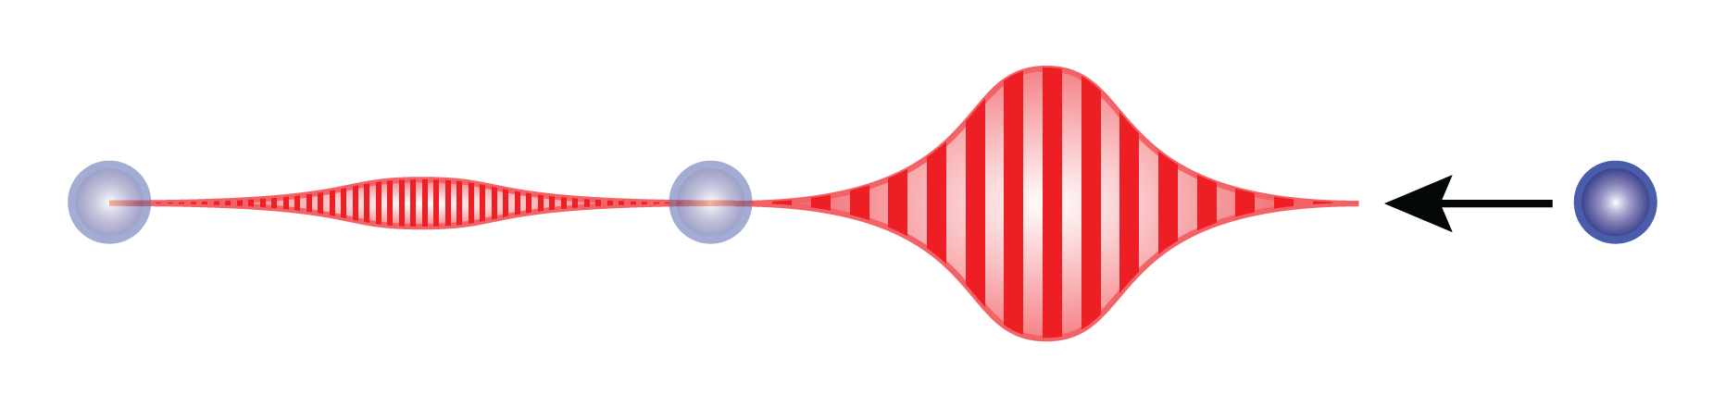
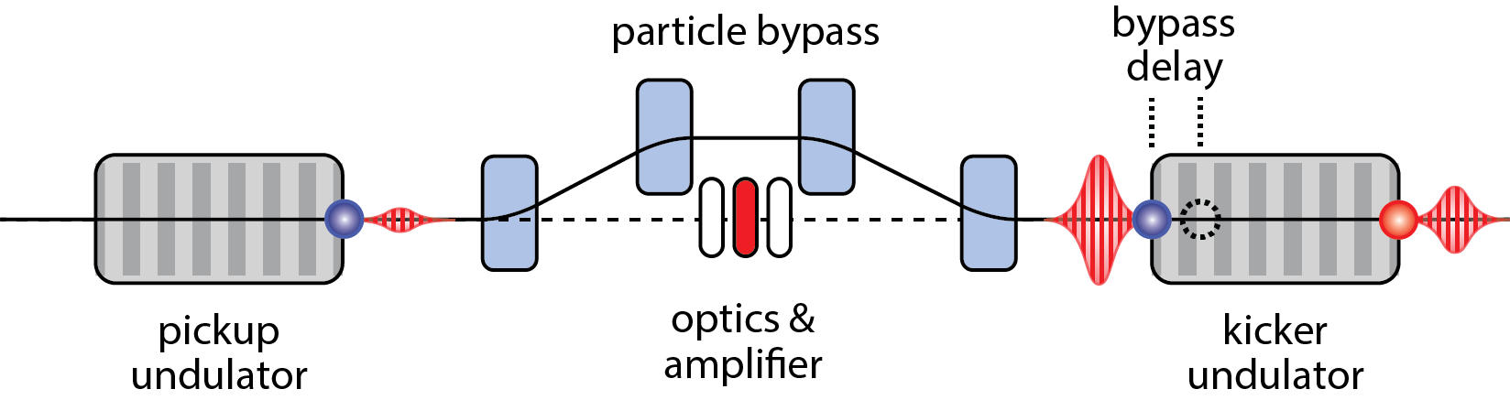
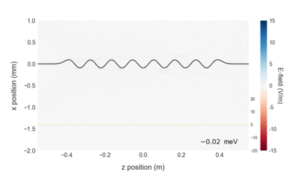
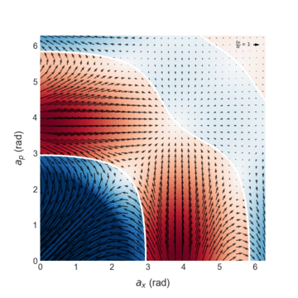
OSC extends the SC principle to optical bandwidth
2
1
4
Energy exchange in kicker
5
3
Wavepacket generated
Particle delayed in bypass
Wavepacket amplified and focused
Corrective kick applied
Cooling accumulates over many passes
Cooling vs. betatron and
synchrotron amplitudes
10³ – 10⁴ increase in cooling rate over microwave stochastic cooling
A. A. Mikhailichkenko, M. S. Zolotorev, Phys. Rev. Lett. 71 (25), p. 4146 (1993)
M. S. Zolotorev, A. A. Zholents, Phys. Rev. E 50 (4), p. 3087 (1994)

Slide 3
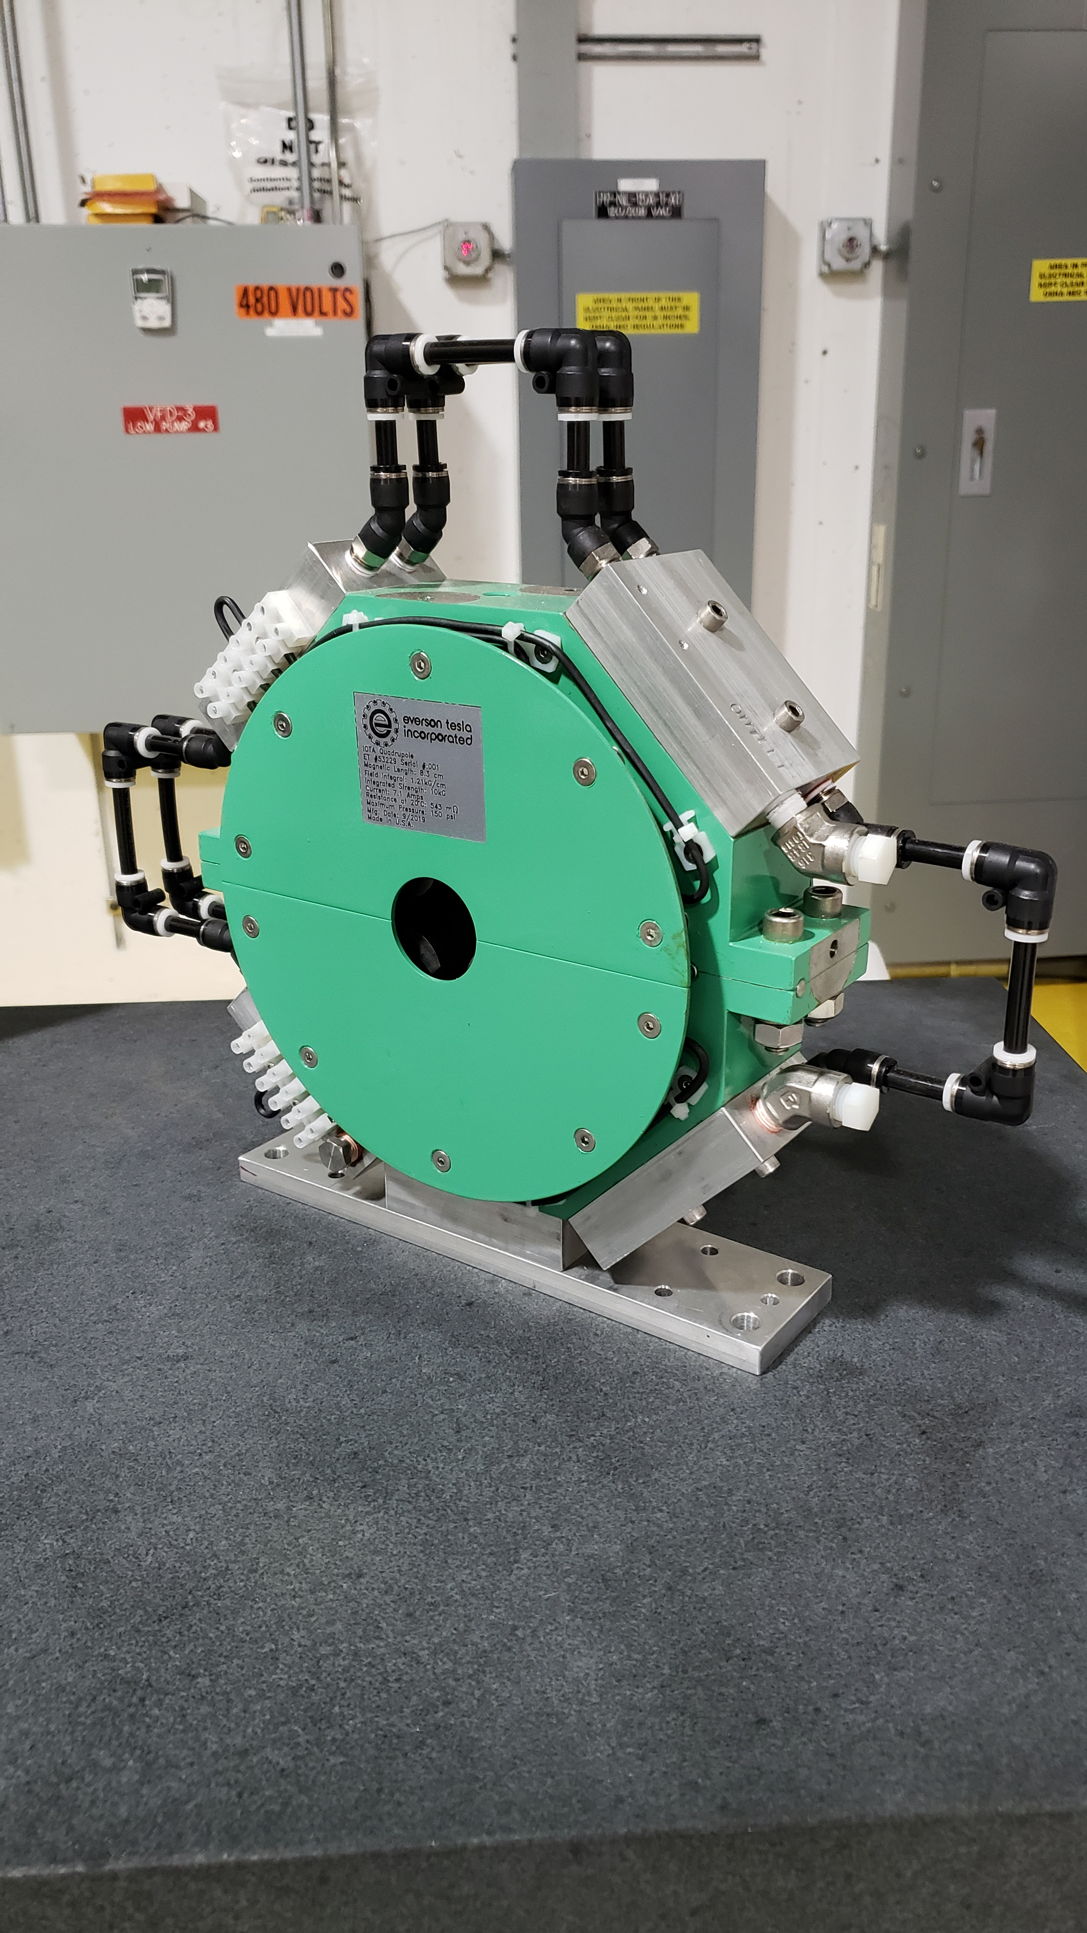
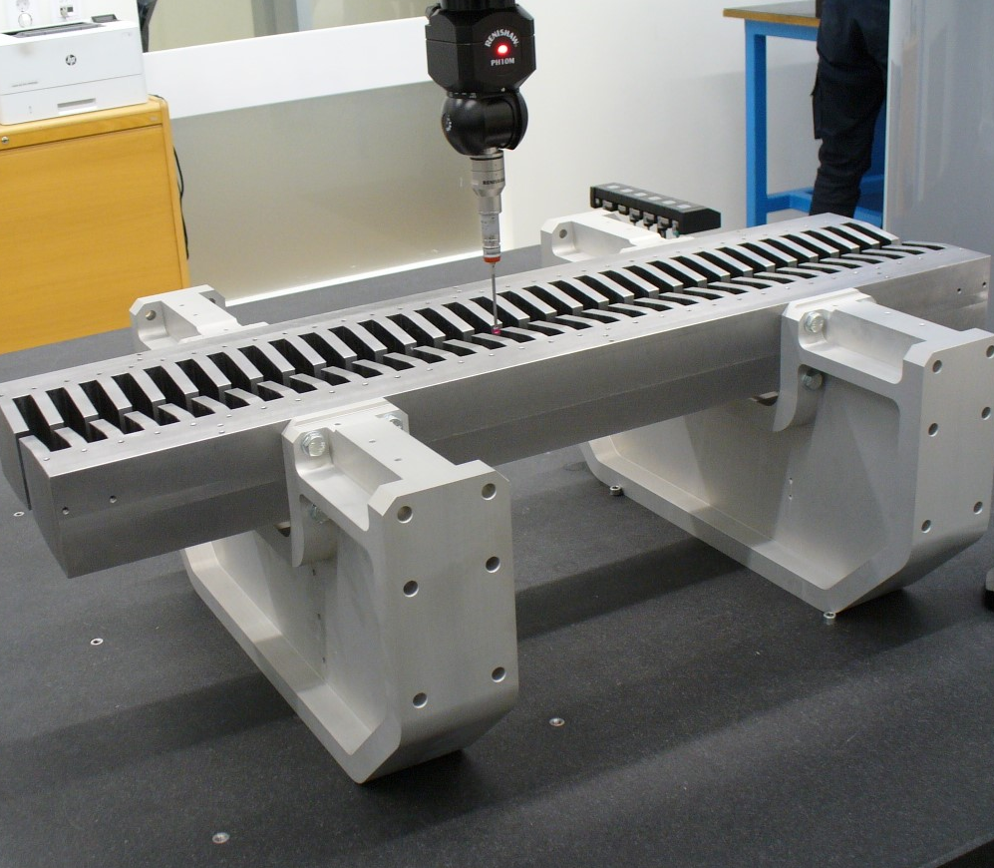
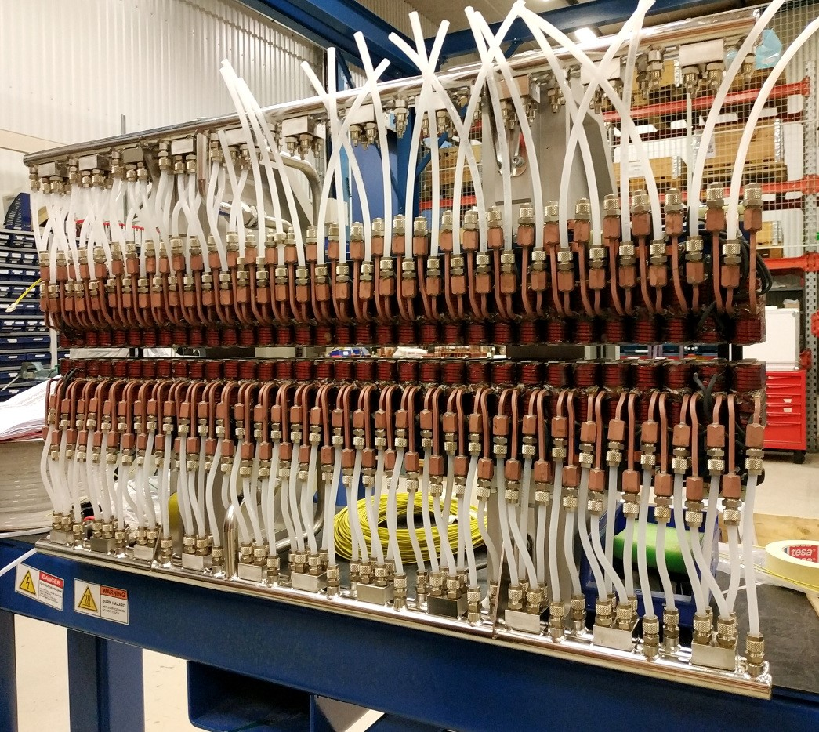
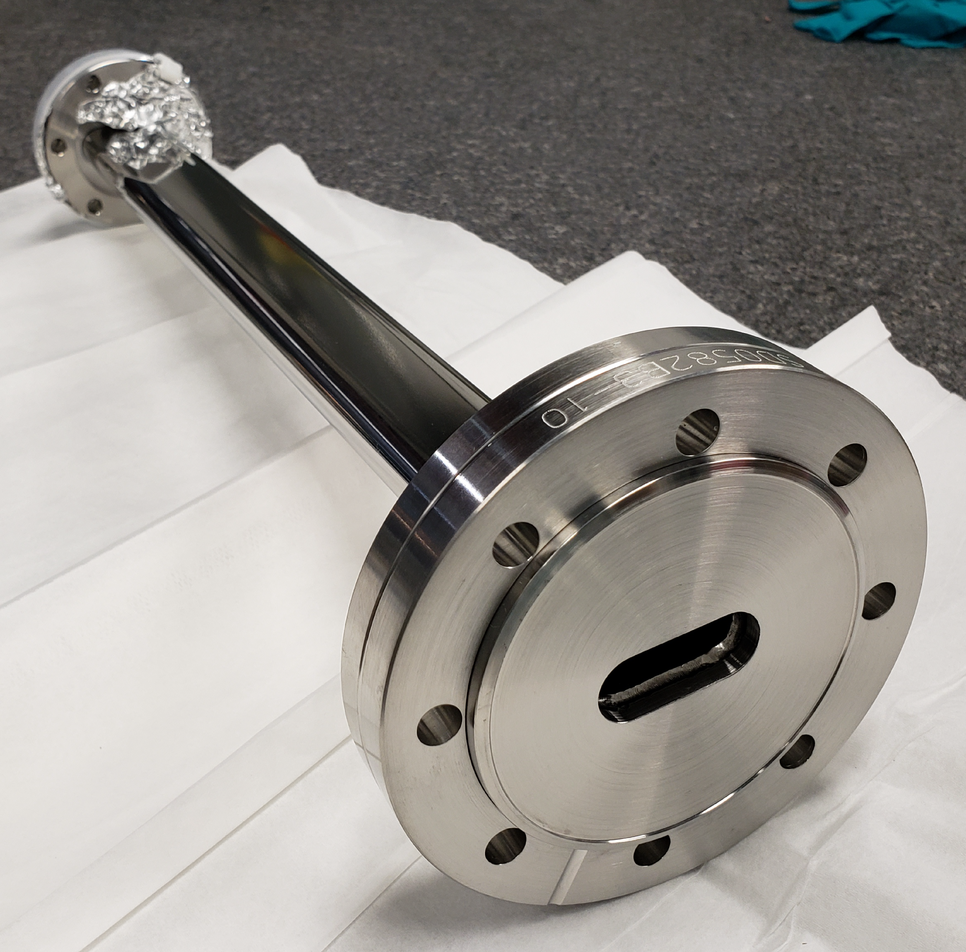
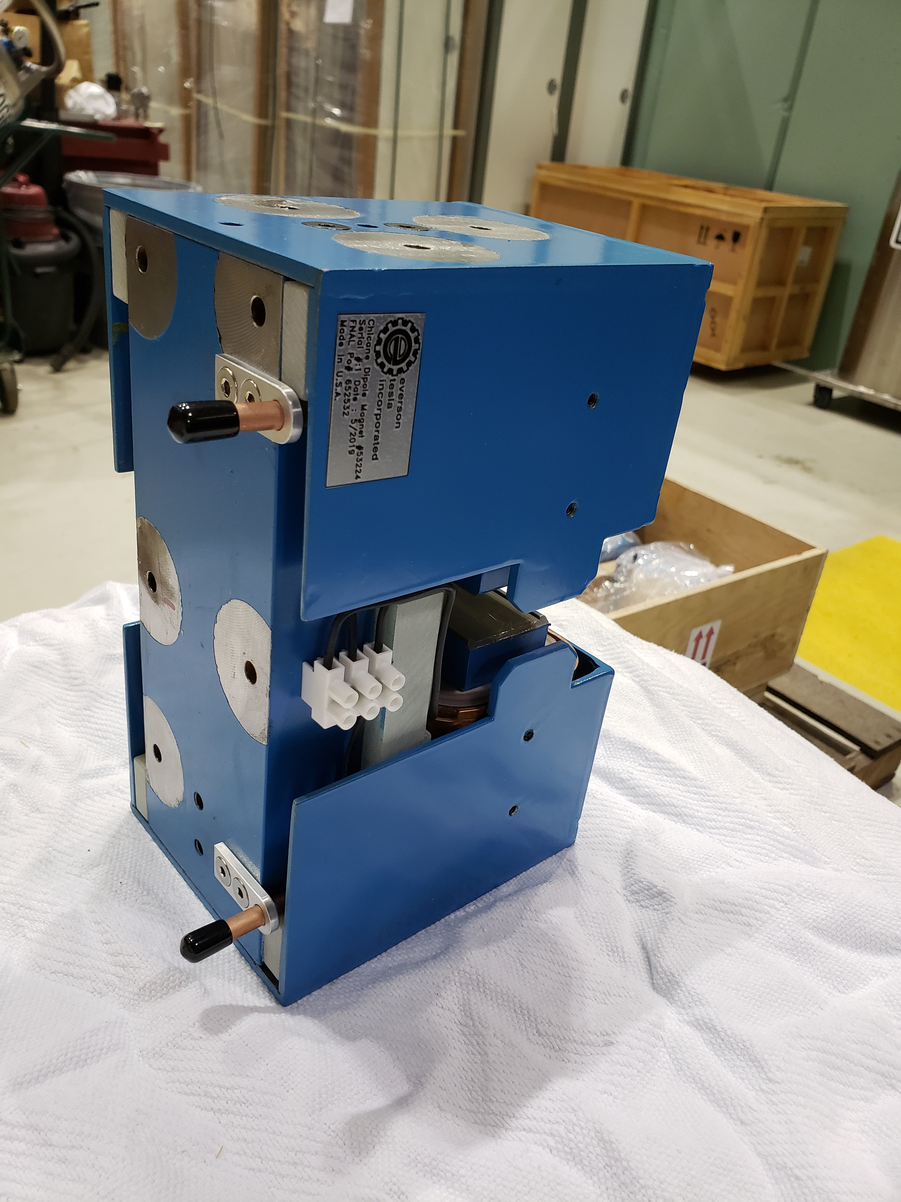
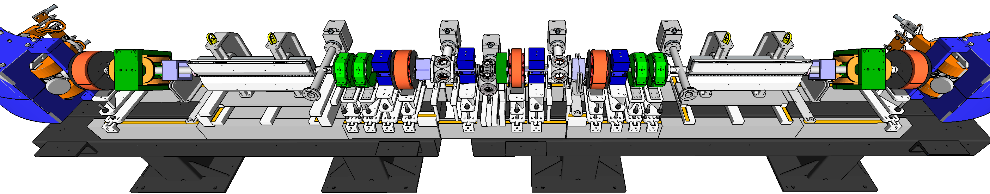
Proposing a broad experimental program based on OSC
Proposed at several facilities, but full experimental program/demonstration never materialized (RHIC, Bates, Tevatron, CESR)
R&D program is underway at IOTA; preparing for initial operations in ~04/2020
Envision a comprehensive OSC program with fundamental beam-physics studies and pathfinding for operational cooling and control systems

Slide 4
Desired outcomes and potential impacts:
First successful demonstration of OSC, both with and without optical amplification
A broad portfolio of concepts and techniques in high-bandwidth beam cooling and control
Strong conceptual and technological progress towards operational systems for future facilities
OSC could provide good coverage of the low-TeV range in the event that the need arises in future programs
  Feasibility look especially promising for 0.5-6 TeV protons (antiprotons); currently no beam-cooling solutions for this range
medium energy electrons (positrons): enhanced SR damping for specialized applications

Slide 5
OSC R&D fits nicely into GARD ABP missions
  Advance physics of accelerators and beams to enable future accelerators.
    OSC involves both fundamental and applied R&D and can lead to operational concepts for use at future facilities
  Guide and help to fully exploit science at the GARD beam facilities and operational accelerators.
    OSC is a high-impact topic that enhances the science program at IOTA/FAST
    There are good opportunities for follow-on activities in, and after, a full OSC R&D program
  Educate and train future accelerator physicists.
    Many opportunities for junior scientific staff, postdocs and doctoral students

Slide 6
IOTA/FAST is an excellent facility for a full OSC R&D program
Good beam properties for exploring OSC
Highly reconfigurable and can be dedicated to a particular experiment while still accommodating a wide range of parasitic activities
Compatible with amplifier development for next phases
Strong heritage in beam cooling at FNAL
Risks:
Principal risk is in the first demonstration; success in initial experiments is important for a broader R&D program
High amplifier gain (for some long-term applications)
Schedule pressure from IOTA’s other primary science goals (NL integrable optics with p⁺, E-lens, etc…); development must be coherent with needs of the overall sci. program

Slide 7
OSC R&D is well aligned with GARD ABP Grand Challenges
Which Grand Challenges (see above) is this proposal/idea addressing?
GC2: Beam Quality
  Aims to provide new high-bandwidth-cooling solutions for future accelerators and applications
GC3: Beam Control
  Potential for active beam control with unprecedented levels of granularity

Slide 8
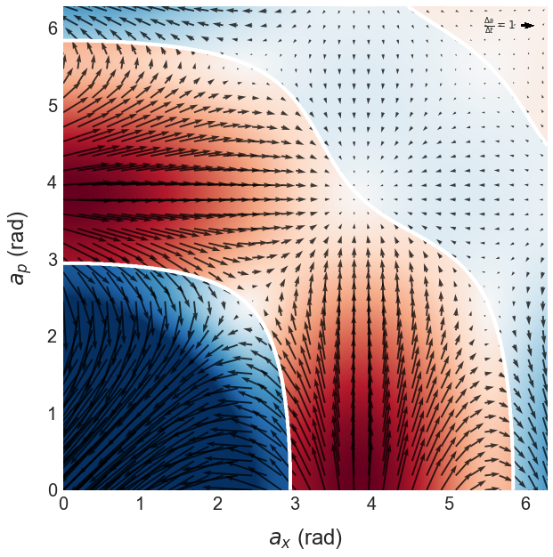
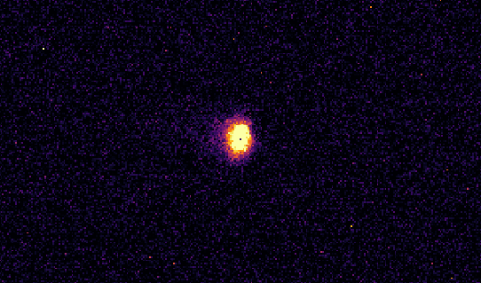
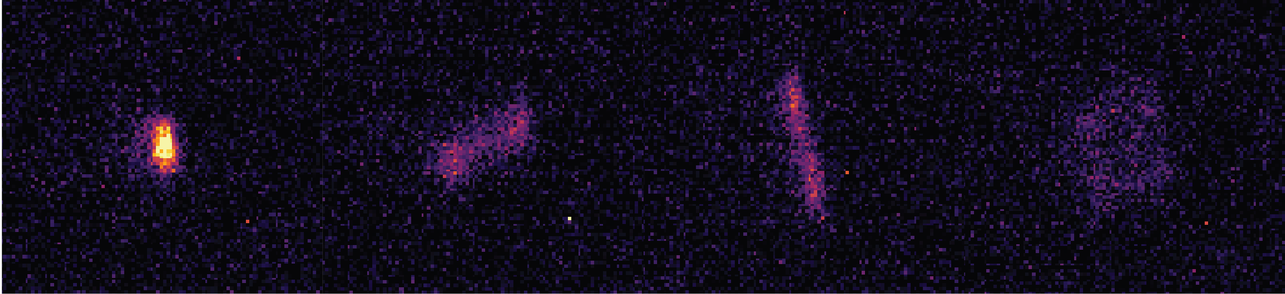
Cross-office synergies for OSC physics and technology
Describe potential synergies and connections to other GARD thrusts and other SC offices (BES, NP, QIS, FES, etc)
Performance enhancement of medium-energy ring coolers (EIC)
Active manipulation/shaping of particle distribution in phase space
Platform for QS experiments with relativistic single/few e⁻
Possible tool for steady-state microbunching systems
Performance enhancement of ring-based ICS sources
OSC hardware as a beam diagnostic
IOTA LE lattice: few/single e-

Slide 9
Near-term Roadmap:
Describe the proposed timeline and associated milestones
Initial non-amplified OSC experiments at IOTA: 04/2020
  Demonstrate and explore fundamental cooling dynamics over wide range of beam densities: few/single electrons to ~10⁷
Development for initial amplified OSC experiments: ’21/’22
  Develop and demonstrate a suitable amplifier; modify apparatus for amplified OSC experiments
  Explore techniques for advanced phase-space control
Amplified OSC experiments at IOTA: ’22/’23
  Demonstrate and explore fundamental dynamics of amplified OSC; study effects of quantum noise in amplification process
Development for operational and advanced OSC systems ’24+
  Higher-gain amplification (>20 dB)
  Advanced architectures for cooling

Slide 10
Current R&D Activities in OSC:
Who is working on this now? Collaborations?
  Experimental programs at FNAL (HEP) and Cornell (NSF)
  Fermilab collaboration with Wurtele/Charman (Berkeley) on single/few-electron “cooling” in IOTA (theory & experiment)
Are current facilities adequate? What’s available now?
  IOTA is well suited for demonstrating fundamental OSC physics
  Initial amplifier development can be performed at IOTA/FAST; first on the FAST linac then amplified OSC in IOTA
Facilities needed in the future?
  IOTA is space and schedule constrained; could limit the development of more advanced system configurations (long term)

Slide 11
On behalf of an excellent team:
OSC team: S. Chattopadhyay, V. Lebedev, H. Peikarz, P. Piot, A. Romanov, J. Ruan
Supported by: K. Carlson, D. Crawford, N. Eddy, D. Edstrom, R. Espinoza, D. Franck, W. Johnson, S. Nagaitsev, L. Nobrega, M. Obrycki, J. Santucci, L. Valerio, A. Valishev
11/22/2019

