Slide 1
Solenoid training test update
Sofia Jimenez Vinolo, Charlie Sanabria,
M. Marchevsky

Slide 2
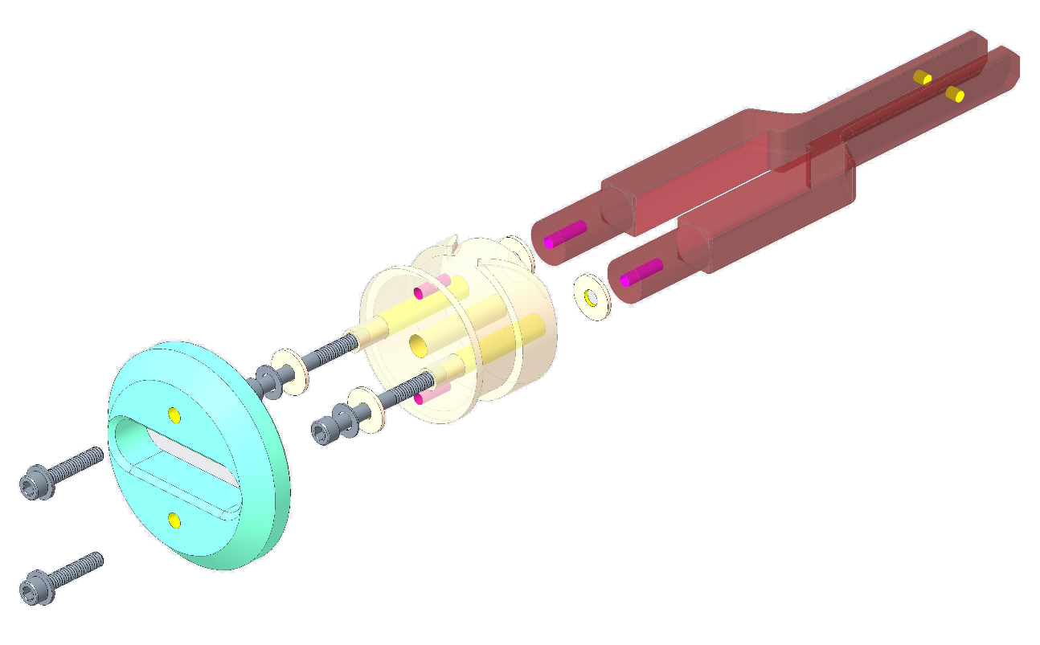
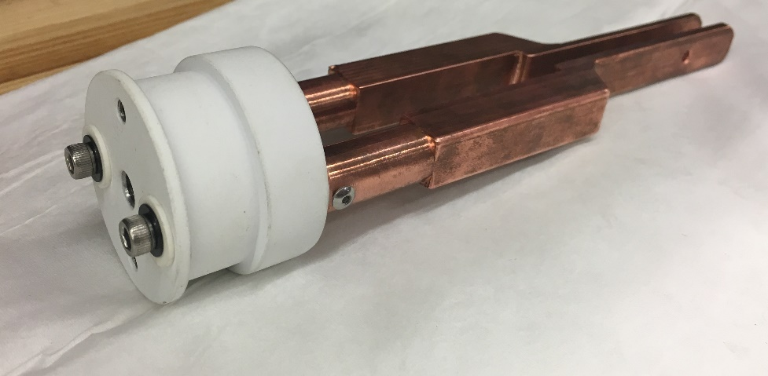
First Prototype
Drawing prepared by
Ray Hafalia
38.1 mm
Alumina-coated Stainless steel mandrel
OFHC Cu current leads
45.47 mm
Alumina washers
a₂ = 21.70 mm
a₁ = 19.05 mm
Centering cone (G-10) for testing
Wire + insulation Ø = 0.73 mm
2b = 14.65 mm
Expected number of turns = 20 x 4 = 80
Wire length ≈ 10.24 m
Notes:
Boron nitride sheets?

Slide 3
Wire properties and stress calculations
“Medium J_{c}” RRP wire critical current (bold values provided by vendor).
a₂ = 21.70 mm
a₁ = 19.05 mm
B (T) | I_{c} (A)
8* | 504
9* | 420
10* | 349
11* | 289
12 | 238
13 | 194
14 | 156
B (T) | Stress on OD (MPa) | Stress on ID (MPa)
8 | 177 | 155
9 | 166 | 146
10 | 153 | 134
11 | 140 | 122
12 | 126 | 110
13 | 111 | 97
14 | 96 | 84
2b = 14.65 mm
“Medium J_{c}” RRP wire properties
Diameter | 0.6 mm
Non-Cu% | 56.5%
Average RRR | 200
Extrapolated using the Pong-Ekin scaling spreadsheet
Wire purchased by ASC
*
Notes:
Boron nitride sheets?

Slide 4
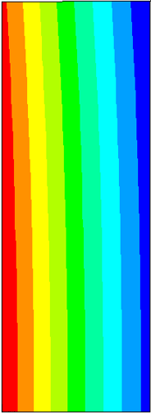
Stress calculations at 9 T
a₂ = 21.70 mm
B (T) | Stress on OD (MPa) | Stress on ID (MPa)
8 | 177 | 155
9 | 166 | 146
10 | 153 | 134
11 | 140 | 122
12 | 126 | 110
13 | 111 | 97
14 | 96 | 84
Hoop stress
Displacement
a₁ = 19.05 mm
ID
OD
2b = 14.65 mm
Sliding surface
T
α/2
|F|= IBRα
F = 2T sin (α/2) ~Tα
F
α
T = IBR
α/2
R
α/2
146 MPa
172 MPa
72.1 µm
T
Simulations by L. Brouwer

Slide 5
Winding
8 mm x 5 mm mica pieces
Winding speed: ~3.7 RPM
number of turns: 18, 17, 17, 17
No voltage taps between layers
One pair of voltage taps will be added after HT.

Slide 6
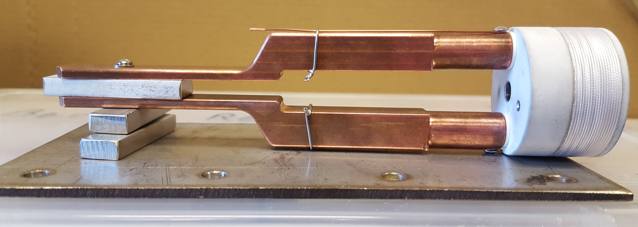
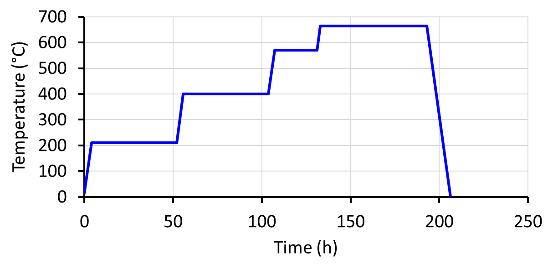
Heat treatment
Standard “Medium J_{c}” RRP heat treatment.
665°C
570°C
400°C
210°C
Wrapped with a fiberglass sheet.
Inside tube furnace with flowing argon.
Recipe:
210°C/48h + 400°C/48h + 570°C/24h + 660°C/50h
Starting date: Friday 8th, 2019

Slide 7
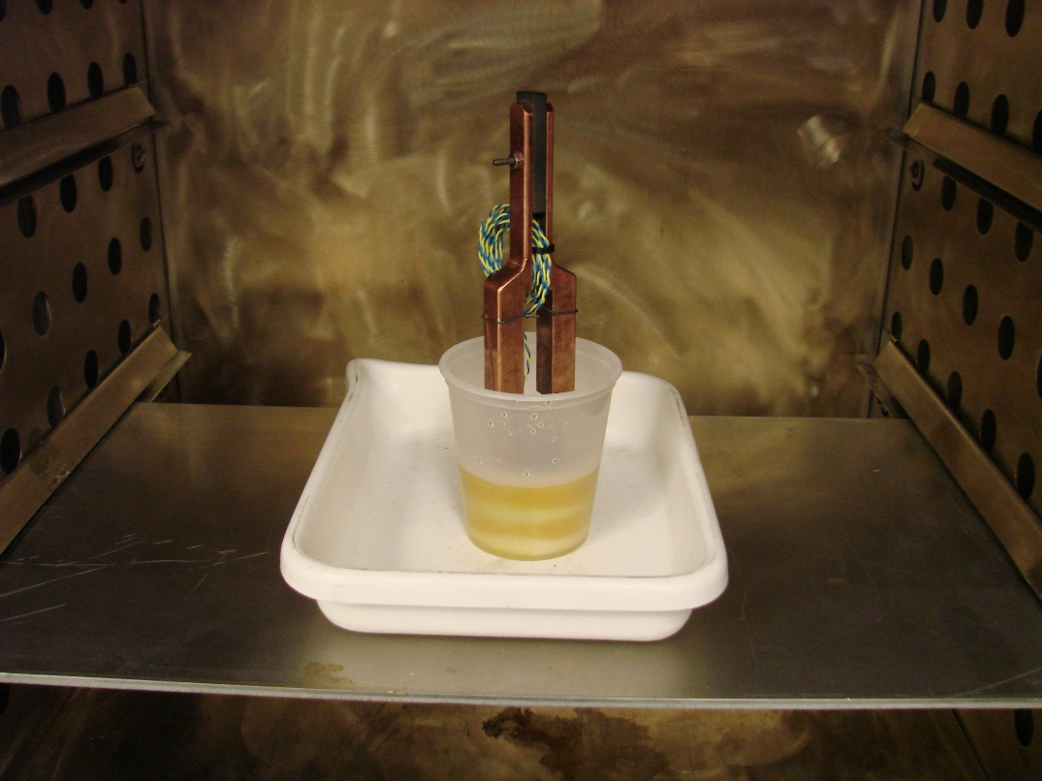
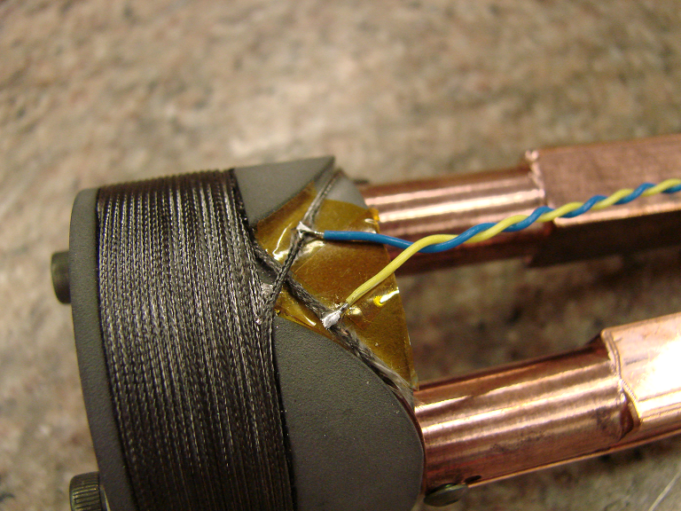
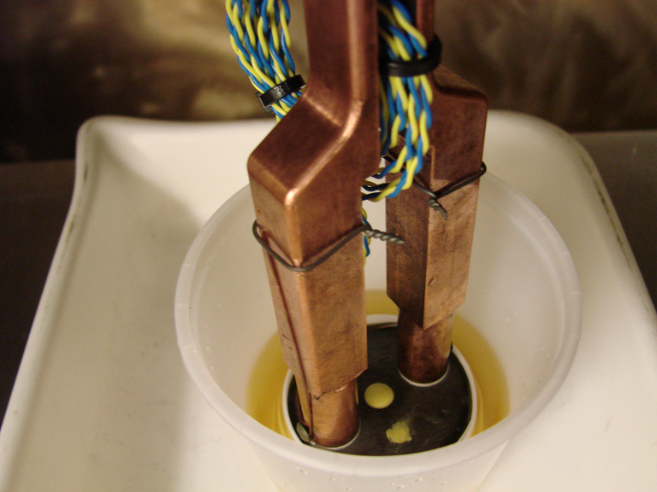
Coil potting

Slide 8
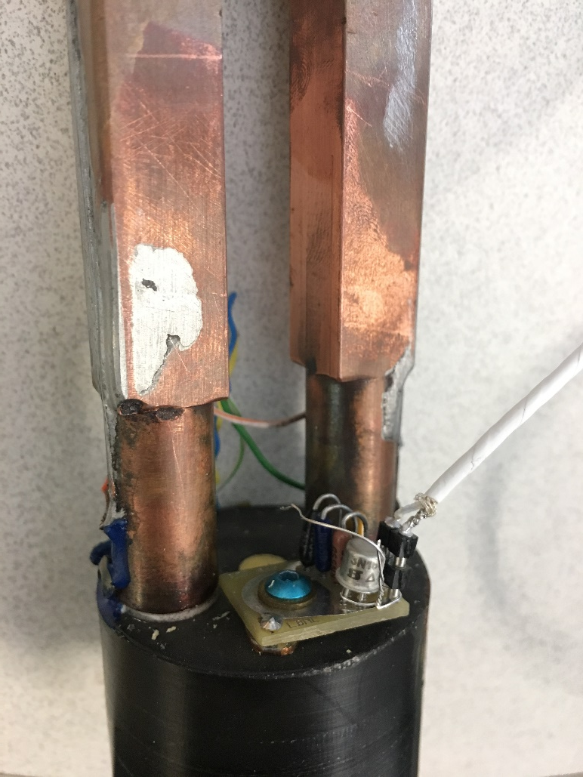
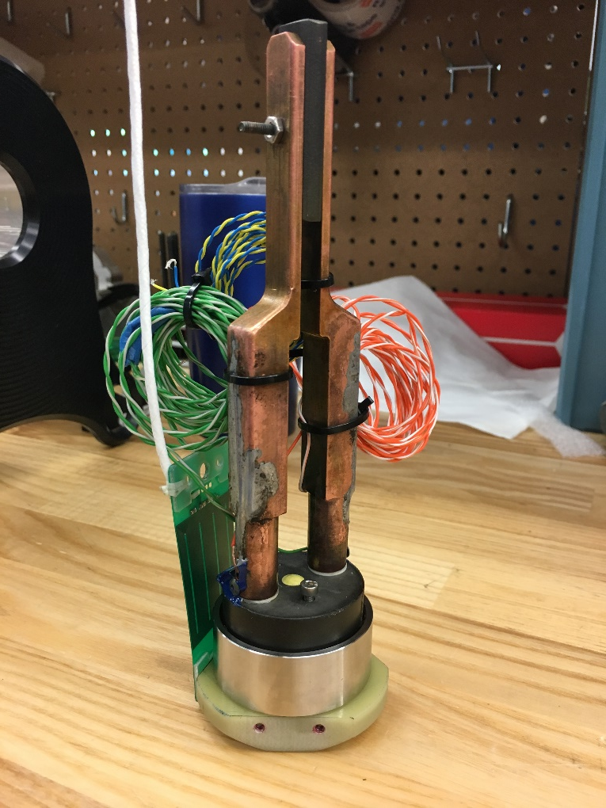
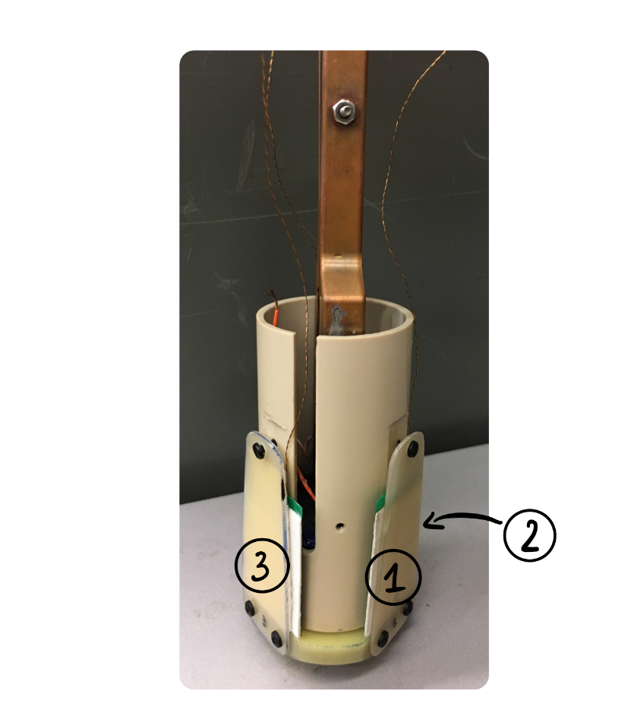
Instrumentation
Quench antennas
Acoustic sensor

Slide 9
Training
8.5 T
(81% I_{ss})
9 T
(81% I_{ss})

Slide 10
AE r.m.s. amplitude as function of current
The rest of the data to be analyzed…
Quench #3 (375 A, compression)

Slide 11
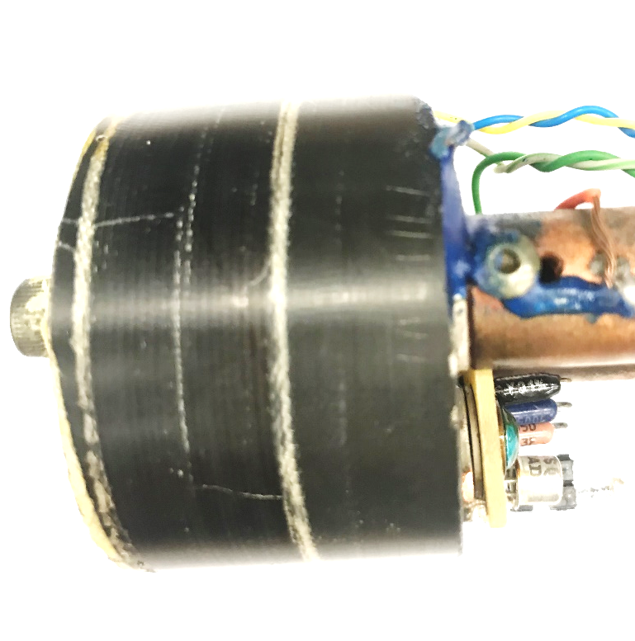
Epoxy cracks

Slide 12
Future steps
Analyze the acoustics
Analyze quench antenna data
Repeat test to see if quench memory is preserved
Build a new coil using and instrument it with multiple Vtaps, acoustic sensors and embedded thermometers

