Slide 1
Roadmap update process
November 5, 2019
Soren Prestemon
US Magnet Development Program
Lawrence Berkeley National Laboratory

Slide 2


Motivation
Motivation 1: We are on our 4th year as a program – healthy exercise to look back at what we promised, what we achieved, what we learned,… and how our vision has evolved
Motivation 2: We have made progress in working as a team – plenty more to do, but that trust allows us to integrate efforts more effectively and efficiently
Motivation 3: BNL has joined MDP, further strengthening our breadth and depth of expertise and facilities that can be brought to bear
Motivation 4: There are significant programs and projects that are synergistic with MDP – e.g. FES and private industry efforts in HTS for fusion, special high field magnets for EIC, 40+T all superconducting solenoids for NHMFL, etc., and our program should be structured to both benefit from, and add value to, those efforts
Motivation 5: DOE and our TAC have recommended that we update our roadmaps

Slide 3
Some general guidelines that we will follow
Stick to general program layout (unless strong reason to deviate; layout is designed to align with MDP goals)
Roadmaps for each area should have input/dialogue with staff from all laboratories; leads/coordinators are nominally defined, but updates can occur
Roadmaps should go out a few years and follow the “cartoon approach”
  A separate word/excel document should have correlated milestones with quantitative elements roughly every 6 months; more granularity near-term
All major elements should have involvement of staff from at least 2 labs
  this strengthens our ability to perform (shared expertise and facilities)
  stimulates a higher level of rigor
  …and introduces shared responsibility and ownership of results

Slide 4
Driving questions, from the original MDP plan (I)
Questions related to ultimate performance:
What is the nature of accelerator magnet training? Can we reduce or eliminate it?
What are the drivers and required operation margin for Nb3Sn and HTS accelerator magnets?
What are the mechanical limits and possible stress management approaches for Nb3Sn and 20 T LTS/HTS magnets?
What are the limitations on means to safely protect Nb3Sn and HTS magnets?
Notes:
HTS: Quench protection

Slide 5
Driving questions, from the original MDP plan (II)
Questions related to cost and operational considerations:
Can we provide accelerator quality Nb3Sn magnets in the range of 16 T?
Is operation at 16 T economically justified? What is the optimal operational field for Nb3Sn dipoles?
What is the optimal operating temperature for Nb3Sn and HTS magnets?
Can we build practical and affordable accelerator magnets with HTS conductor(s)?
Are there innovative approaches to magnet design that address the key cost drivers for Nb3Sn and HTS magnets that will shift the cost optimum to higher fields?
Question related to conductor development:
What are the near and long-term goals for Nb3Sn and HTS conductor development? What performance parameters in Nb3Sn and HTS conductors are most critical for high field accelerator magnets?

Slide 6
Process for consolidating roadmaps (I)
Take all input into consideration
  Everyone will be “heard”
  There will be “compromises” in the final roadmaps
    Not everyone will “get” what they want in the roadmaps, but they should expect a rationale for how compromises are arrived at
A major requirement of any roadmap element is that it have a well-articulated connection to one or more of the MDP goals;
  A good approach is to identify questions associated with the goals that the roadmap element will answer

Slide 7
Process for consolidating roadmaps (II)
We are a vertically integrated program.
Look for a means of showing the “flow” of research and the interconnectivity
(avoid disconnected “islands” or research)
Magnet design studies – concept evaluation; exploratory
Nb3Sn R&D
Nb3Sn magnets
Magnet-ready conductor
Magnet testing and feedback
Hybrid magnets
HTS R&D
HTS magnets
”Binning” of Technology elements
Notes:
Kathleen: Identify if there are any expertise gaps or potential issues
Feedback: clarify not a timeline (more a vertical integration line); hybrid is not the end goal,; etc.

Slide 8
Process for consolidating roadmaps (III)
For technology elements as a “sanity/consistency” check, approach the problem from two sides:
  A: bottoms-up, i.e. put all existing items on the table and consolidate where appropriate, then prioritize based on (imperfect) estimate of the value/impact
  B: Top-down: start from MDP goals and the magnet roadmaps:
    Identify “questions” that need to be answered/addressed
    Bin the proposed technology elements to the questions
Major differences would indicate an issue of relevance or a gap in need
Notes:
Steve: Do we want it, or do we need it
Lance: at some point be ready for prioritization based on funding scenario

Slide 9
Bottoms-up approach: pulling all proposed elements together
Approach:
  Try to capture all elements identified by the team
  Capture “flow” from one element to another – natural connection to milestones
  For magnets:
    Attempt to identify cross links / opportunities for lessons learned to be shared
    Identify potential points where “downselect” may occur based on progress/results/funding
  For technology:
    First look at “binning” proposals by general topic

Slide 10
1. “Stress-managed” cos-t (SMCT)
2. Continued CCT development
Themes:
Investigate stress management concepts
Develop background field for HTS
Example areas where lessons-learned/feedback is valuable

Slide 11
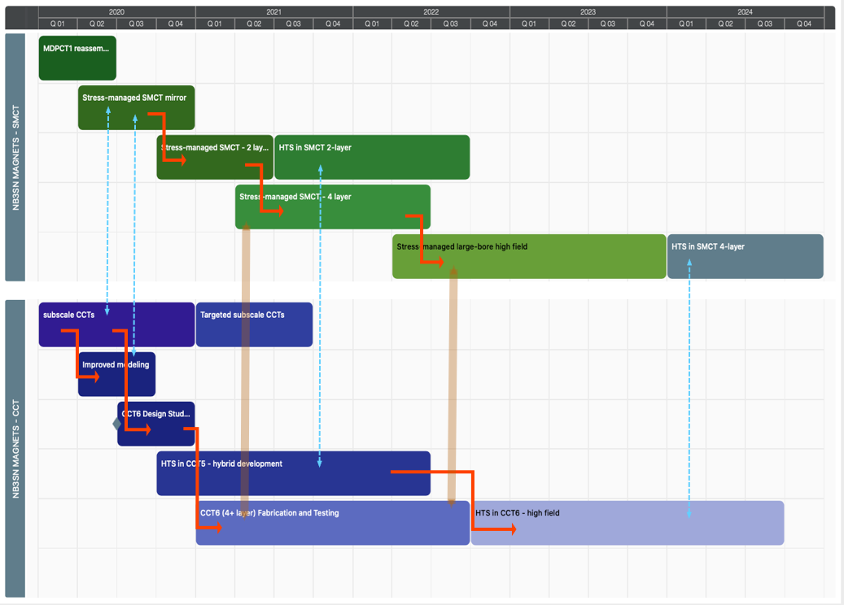
Example areas where down-select may be warranted

Slide 12
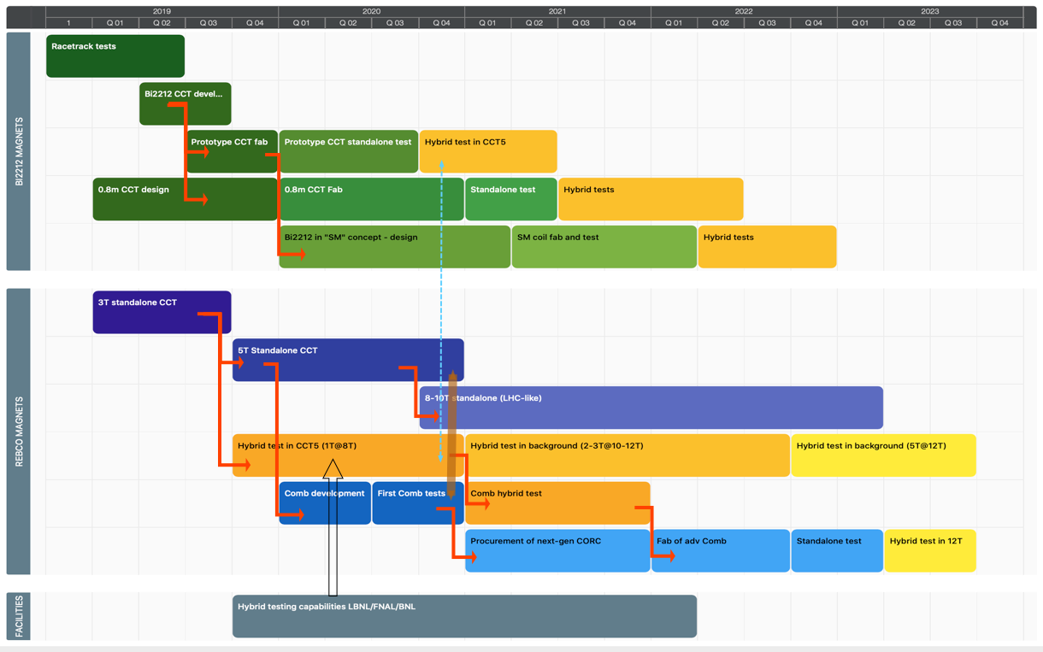
Themes:
Develop hybrid testing capabilities
Explore standalone vs hybrid performance
Explore magnet structure concepts

Slide 13
Technology areas support the magnet developments
Modeling focus:
Tailoring techniques for HTS
Leveraging high-performance computing
Impreg. Techniques and interfaces
Bi2212 cable optimization and limitations
High Cp evaluation
Dedicated in-field Corc experiments

Slide 14
Cryo-electronics: potential for many spin-offs
Advance acoustics and garner more physics
New probe developments
Enhance training rate

Slide 15
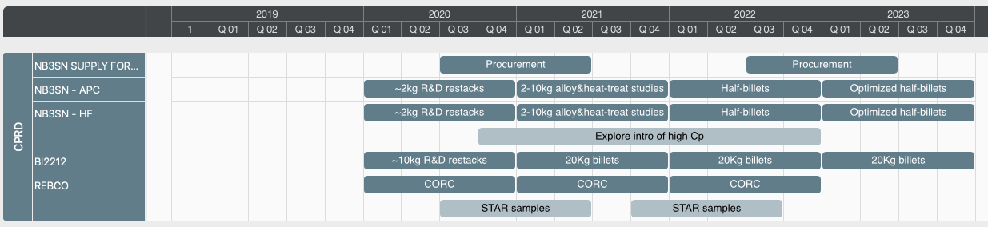
Conductor procurement and R&D – focused on bringing concepts to scale

Slide 16
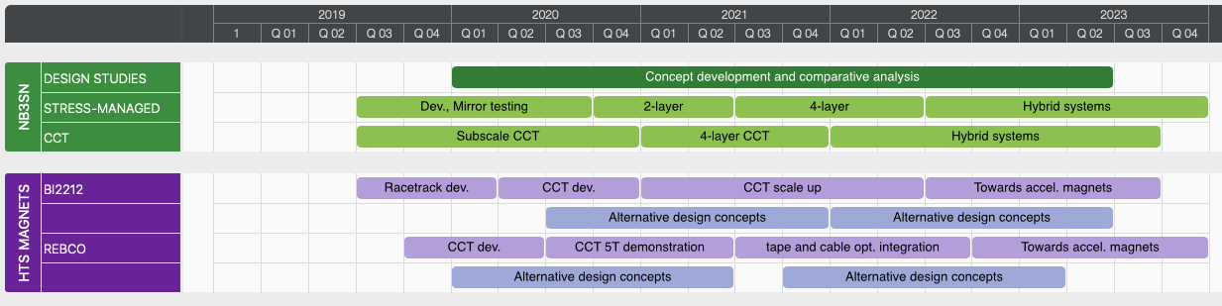
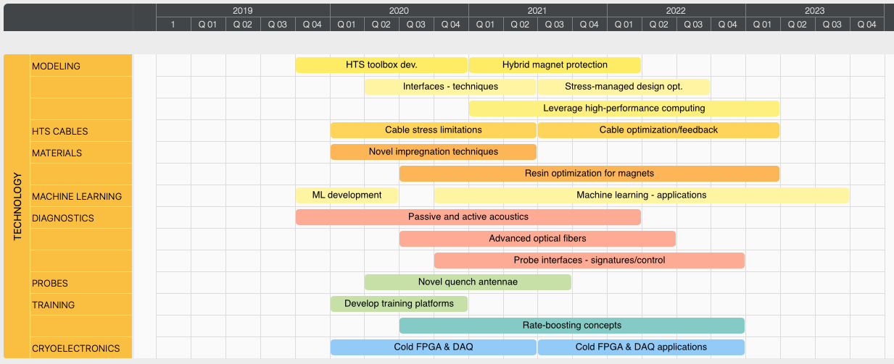
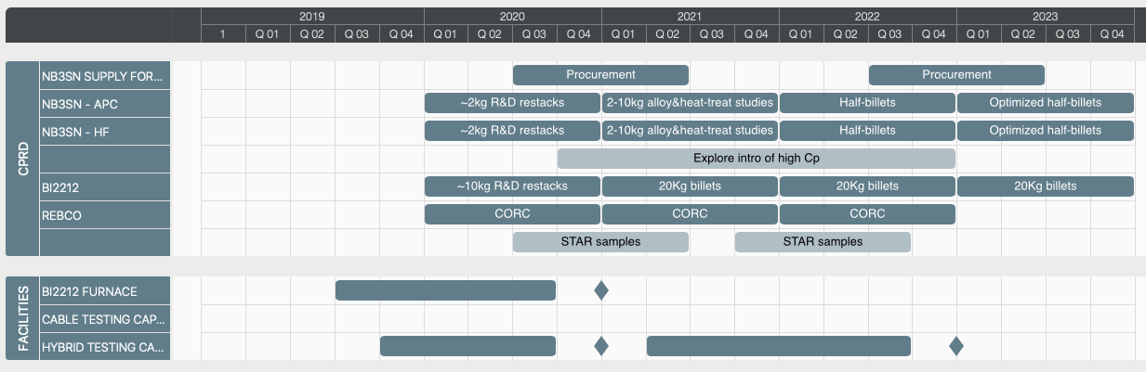
Top-down perspective

Slide 17
Some thoughts on our roadmaps so far – Nb3Sn magnets
Magnets are drivers for the program
  … but only as good as the conductors that go into them
Our focus / driving consideration is stress-management
  The program must deliver on question: “Can stress-managed structures really work?”
    Q: How do we define ”success” for a given structure?
    Q: What technical insights are most effective at addressing limitations?
    Q: What specific experiments are most useful to feed magnet design/fab/test?
  Design studies can document…
    To what degree SM structures deviate from “traditional” Cos-t, block, common coil,…
    How structures (in particular SM) are impacted by / leverage advanced Nb3Sn
    What additional limitations are encountered by advanced Nb3Sn (protection, stability,…)
    Try to quantify scalability & cost drivers for various structures

Slide 18
Some thoughts on our roadmaps so far – HTS magnets
We are still just developing basic magnet technology…
  But the path to high field is fairly clear
We should identify the key questions along the way and how we intend to answer them
  Q: Do HTS magnets need traditional protection, e.g. extraction, heaters, etc.?
  Q: Is hybrid operation effective, or do we inherit problems from both HTS and LTS?
We plan significant hybrid tests
  Approach:
    BNL has some hybrid testing capability; near term focus for MDP is on Corc cable tests
    LBNL is developing hybrid testing capability; near term idea is to use CCT5
    FNAL is developing hybrid testing capability as part of HTS cable test facility
  Strong arguments for each; need to make case that all are relevant and used timely and effectively

Slide 19
Some thoughts on our roadmaps so far – Technology
Lots of ideas and concepts to explore
  Need to keep focus on questions that drive magnet performance
  Need to strongly leverage “outside” sources – if they can benefit from a technology development, lets strive for “skin in the game”
  Lets not reinvent the wheel
    Always reach out to ”current” experts, give them credit, and get us up to speed as quickly as possible
    Then collaborate with the ”current” experts to move things along faster
      Our reputation should be one of an “excellent collaborator"
We need to identify the platforms being used for various studies
  Ex: what is the right test bed for the “QCD” experiments?
  Are the machine learning databases “generic”, or magnet-specific? How will we be able to tell?

Slide 20
Possible areas where we have a gap/weakness
Perhaps we need….
  More effort on understanding strain limits in modern conductors and cables
  More focus on understanding what material characteristics are most valuable for a given magnet structure (epoxy-interface bond? Epoxy modulus? Strength?)
Possible “gaps”:
  We have invested in some preliminary “test beds”; what is there status? Are they ready for applications? They do now show up clearly on the roadmaps

